Slide 1

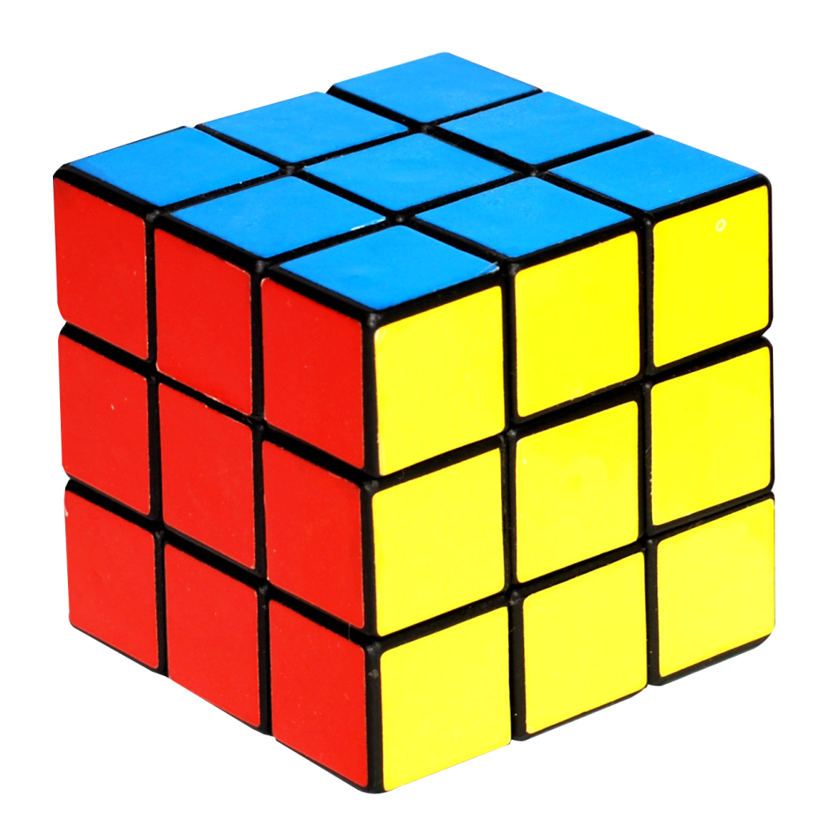
Rubik's Cube Solver

Slide 2
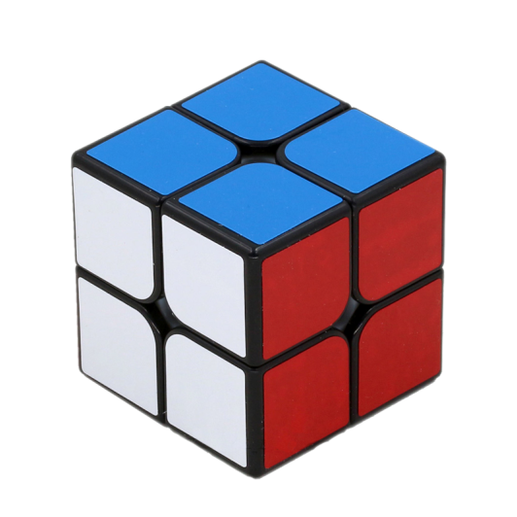

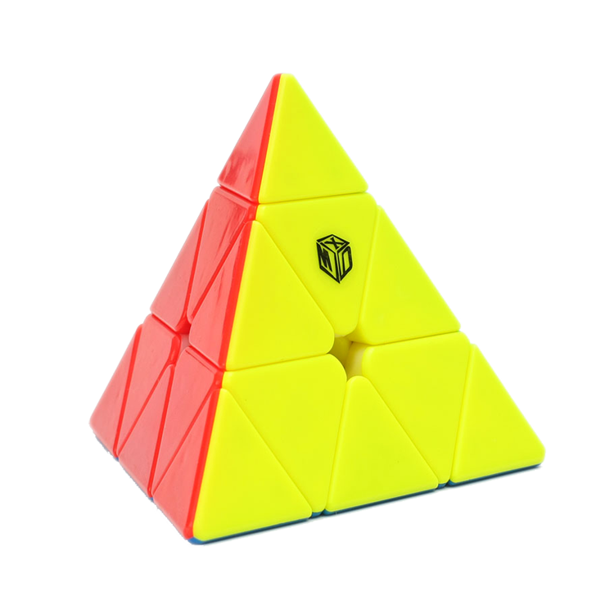
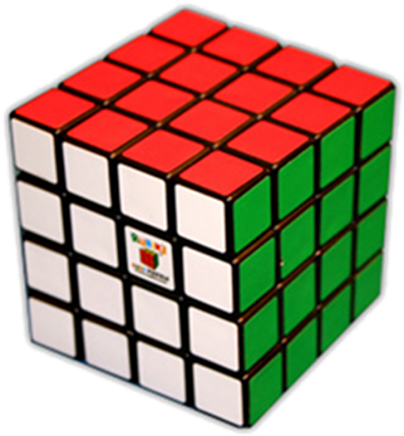
Types Of Cubes
1
2
3
4

Slide 3
Steps
1 . Create Daisy
2 . Make a WHITE Cross
3 . Solve WHITE Corners
4 . Place Edges in MIDDLE
5 . Make YELLOW Cross
6 . Orient Corners
Notes:
8

Slide 4

Rate Us

Slide 5
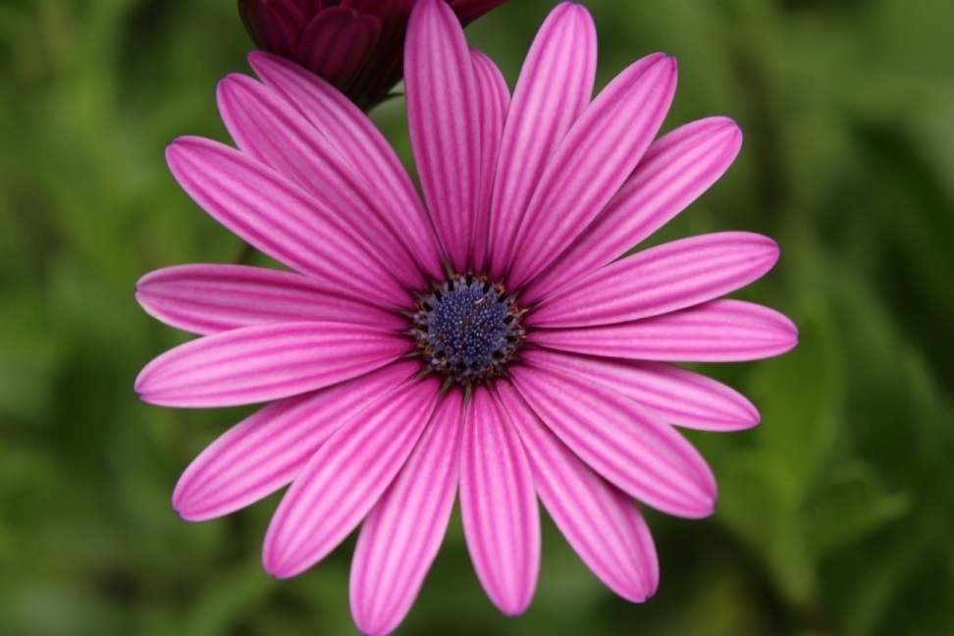
Thank You

