Slide 1

THE ENERGY STORY! -GROUP 04-
ZHIPENG ZHAO
KRUTI KOTADIA
MIHIR HOLMUKHE
NIDHI CHAUHAN
CHINMAY RANADE

Slide 2

LET’S EXPLORE
Sequence we have outlined is a typical data analysis workflow. Let's break down each step:
Obtaining Data
Scrubbing Data (Data Cleaning)
Exploring Data
Modeling Data
Interpreting Analysis

Slide 3

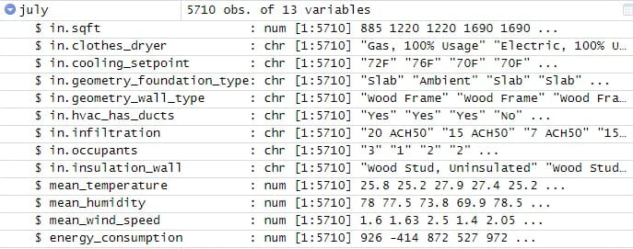
WHAT ARE THE MAIN FACTORS?

Slide 4

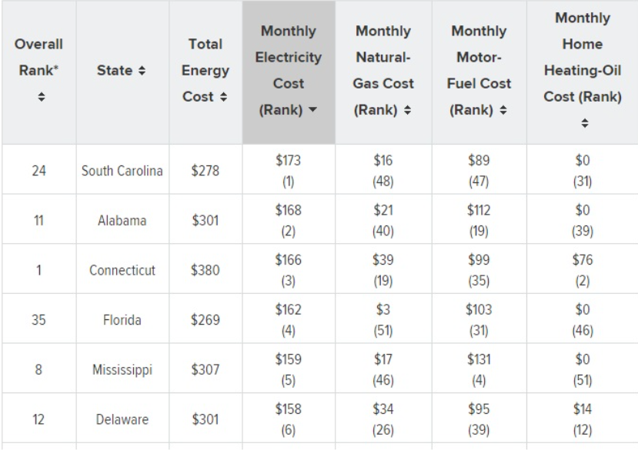
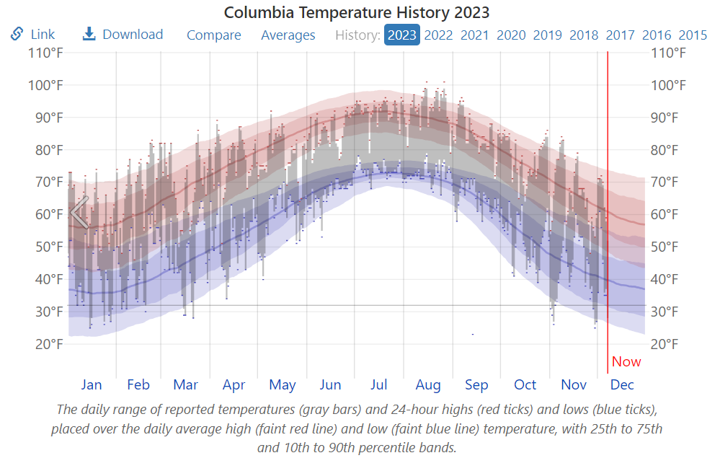
HOW ACCURATE ARE WE?
The Linear Regression model gives us an accuracy of 82.54%
The SVM model gives us an accuracy of 78.09%

Slide 5

LET’S SKIP TO THE GOOD PART!

Slide 6

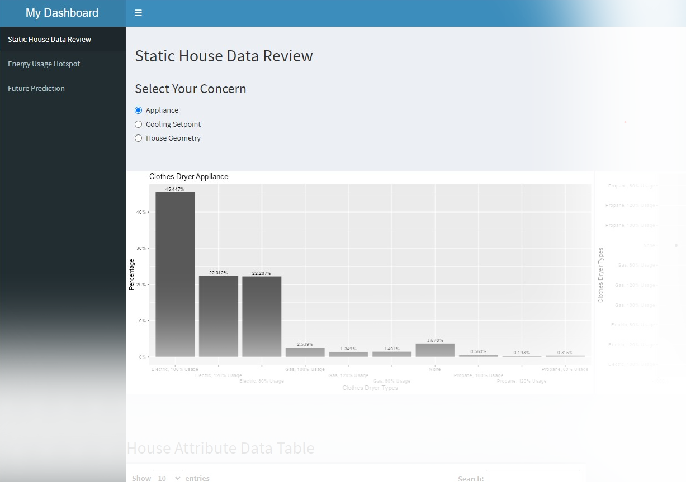
SHINY APP IT IS!
https://pisin.shinyapps.io/energyPredApp/

Slide 7
Dashboard
Static House Data Review
Energy Usage Hotspot Map
Future Prediction

Slide 8
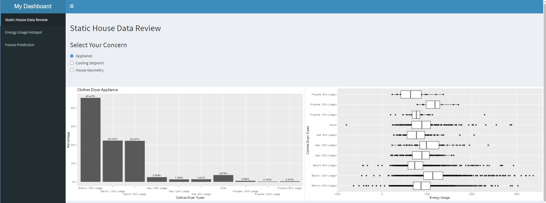
Static House Data Review
Radio Button
Histogram
Boxplot

Slide 9
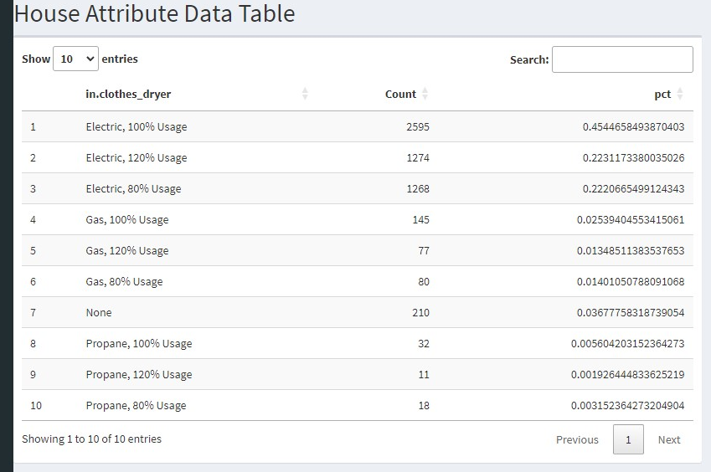
Static House Data Review

Slide 10
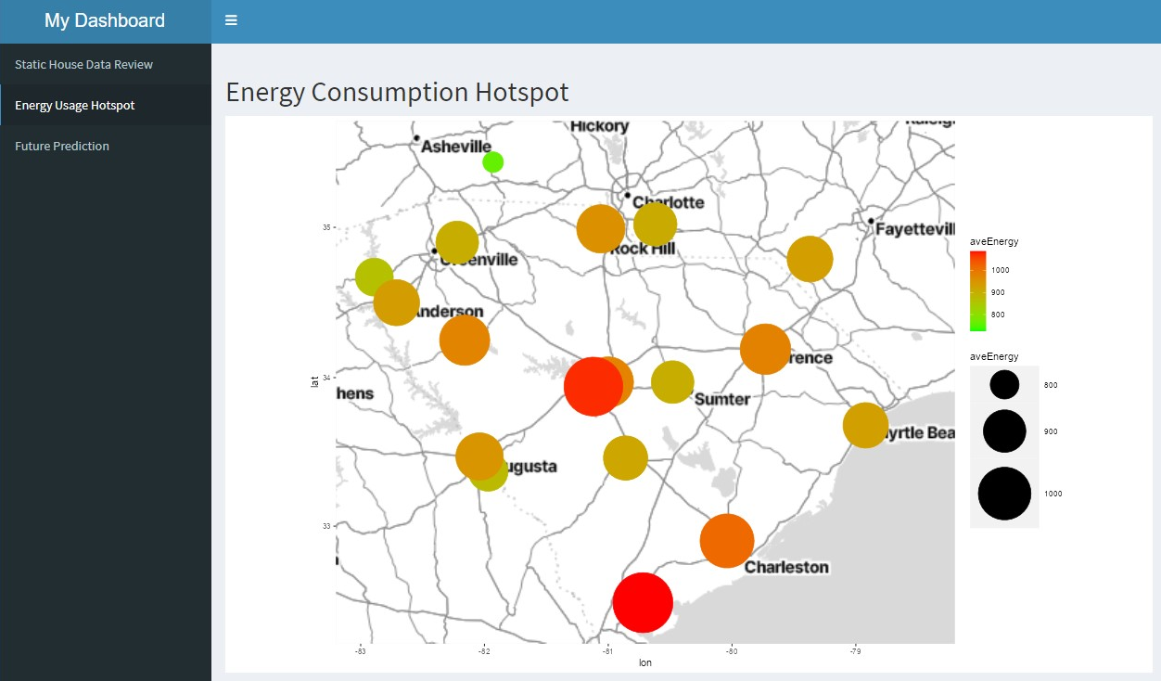
Energy Consumption Hotspot Mapping

Slide 11
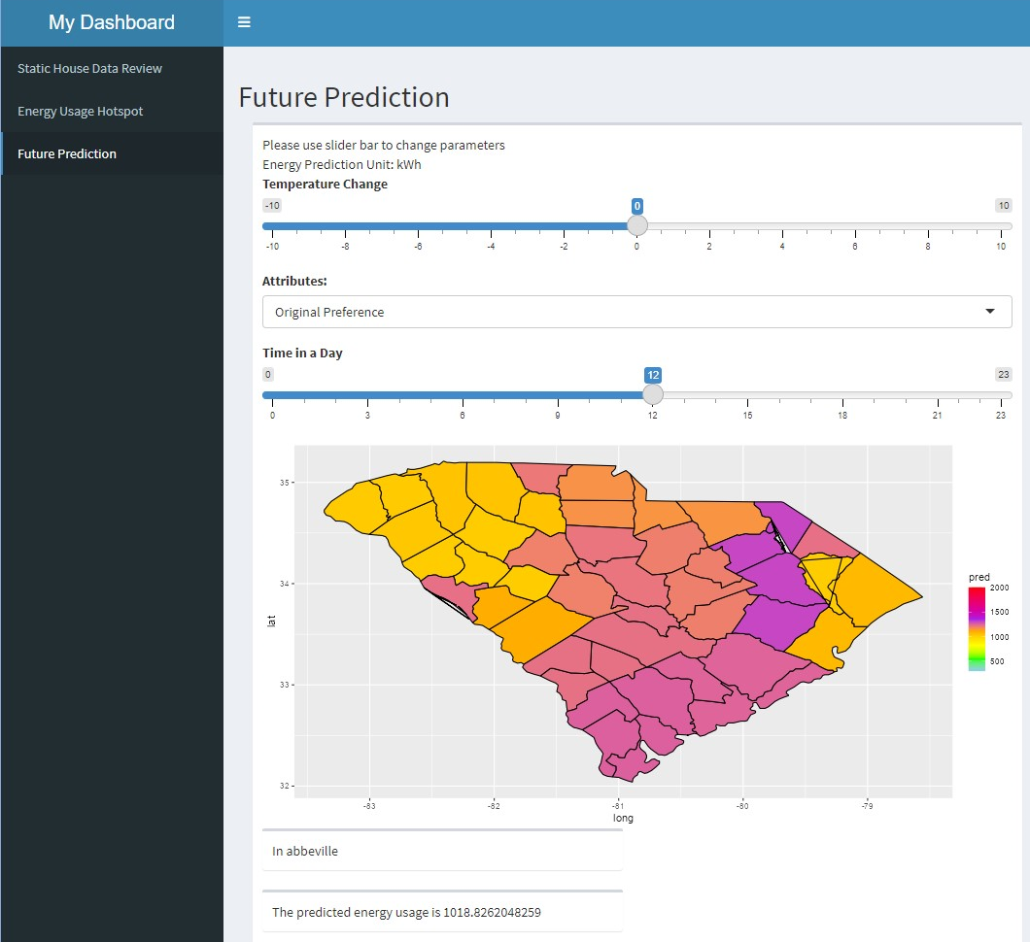
Future Prediction
SLIDER&MENU
Parameter Modification
Temperature
Energy Preference
Day Time
MAP
Interactive Visualization
TEXT OUTPUT

Slide 12
INTERPRETATIONS!
After studying and calculating all the possible ways for getting apt energy consumption, we have narrowed down to some points which can be used for saving energy.
1) Since south Carolina lies in southeastern coastal of the United States and by saying coastal, I mean humidity.
2) While optimizing the data, we found out that appliances play a very important role in energy consumption. Around 2595 houses prefer electric clothes dryer over propane and gas.
3) Apart from that the cooling setpoint of a house is vital when it comes to consuming energy. Till date there are 40% of houses having 60- 70 F set as their cooling setpoint which consumes more energy.
4) Since energy consumption is the most in Charleston which 1320 KW/hr we can come up with an idea or an awareness amongst the population for making some day-to-day life changes. Like switching to a propane clothes dryer as it consumes less energy compared to the electric .
5) Another adjustment can be setting the cool point in a range of 70-80F to provide large energy consumption.

Slide 13
THANKYOU!
OPEN FOR QUESTIONS..

