Slide 1
POLLUTION

Slide 2

There Are Four Types Of Pollution :
Air Pollution
Water Pollution
Land Pollution
Noise Pollution

Slide 3

Air Pollution
There are many disadvantages of air pollution, in fact there are no advantages only :
Children get into critical health due to Asthma. Adults can also get Asthma.
A/C’s & refrigerators leave harmful gases like CFC’s, etc. which are harmful to the world.
Chimneys and factories leave out gases which are not good. Factories leave out toxic gases and also pollute water.
AIR POLLUTION IS THREAT TO HUMAN & ANIMAL LIFE.

Slide 4

HOW TO PREVENT AIR POLLUTION?
People Must Use Public Transport For Long Distances And Not Take There Own Car Or Bikes.
We must use solar cars we do not need fuel, thus reducing air pollution.
A/C’s and refrigerators which leave CFC’s must not be used. It also destroys the ozone layer.
We must cook the required food only so that air pollution reduces.
Keep proper maintenance of vehicles.

Slide 5
Noise Pollution
Noise pollution is caused innumerable things :
Not keeping correct maintenance of vehicles.
Breaking cement roads.
Banging the drums loudly till late night.
Keeping high volume of loud speakers.

Slide 6
Ways To Prevent Noise Pollution :
Keeping correct maintenance of vehicles and machines.
To avoid honking.
Driving vehicle at right(economy)speed.
Keeping loud speakers volume in limit.

Slide 7
Water Pollution
There are uncountable ways that we pollute water :
Factories discharging chemical waste into creeks & rivers.
Use of soap and other cleaning chemicals.
Throwing plastic into rivers and creeks.
Used engine oils of vehicles mixing with water.
Human defecation in open

Slide 8
HOW TO PREVENT WATER POLLUTION ?
Factories must not give out toxic water into creeks and rivers.
We must not let water over flow from the buckets.
Plastic must be correctly handled and must be thrown into water bodies.

Slide 9

Land Pollution
Plastic is the main culprit for the pollution.
When we throw plastic into garbage, it takes thousands of years to decompose.
Animals like cows /dogs eat the plastic with the food. They die due to this reason.
If we throw plastic into the seas and oceans the fish eat them, thinking it as there food. That disturbs the marine life.
When such Sea-food is consumed by humans, it sticks in the digestive system and thus giving threat to the life.
If we burn plastic, it gives out toxic gases; which are not at all good for human and other living beings. It increases air pollution.

Slide 10
Known cases / Examples
A WHALE had eaten 100 kilograms of plastic and was found floating on the shore DEAD.
Calculating the current plastic wastage, it will start near Tropic of Cancer it will go up to Tropic of Capricorn.
Plastic has multiplied to such an extent that it even exists in the deepest place on the earth, more than ten thousand meters deep.

Slide 11
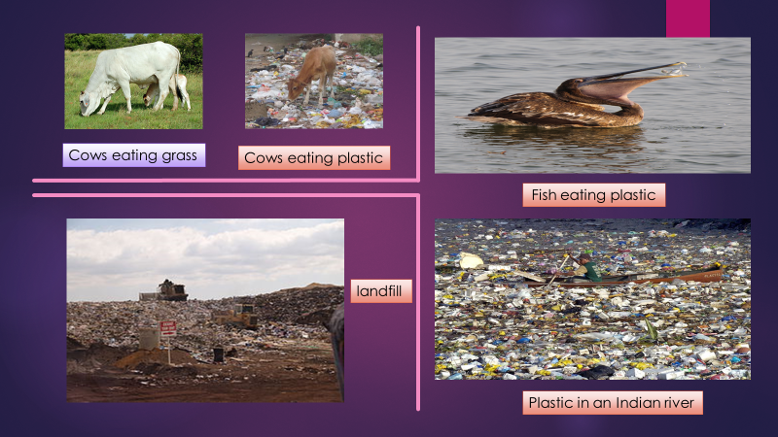

Slide 12
HOW TO GET RID OF PLASTIC ?
Plastic must be banned in every country.
Cold drink makers must not use plastic bottles, instead use glass bottles.
We must not throw plastic in rivers ,lakes, creeks, etc.
A person has made micro-organisms that eat plastic and decompose them in 15 days.
Plastic must be reused and recycled.
Use and throw plastic of less then 50 microns shall be avoided.

Slide 13
SUMMARY
Air Pollution | Noise Pollution | Water Pollution | Land Pollution
Use public transport. | Keep maintenance of vehicles. | Factories must not leave out toxic water. | Plastic must be banned
Use solar cars. | Use tar roads. | Not let buckets overflow of water | Cold drinks must not be in plastic bottles
CFC’s must not be used. | Drums must not be banged till late night. | Plastic must not be thrown in water bodies | Plastic must be re-used & re-cycled
Cook required food. | Do not keep loud noise of loud speakers. |  | Plastic must be above 50 microns.
Keep maintenance of vehicles.

Slide 14
SWACHH
BHARAT
ABHIAYANN
A great approach

Slide 15
7-E

