Slide 1



DEVINSTALL
Scribe-Android
A step-by-step guide to cloning, building, and running
Scribe-Android on your local development environment.
Blessings Mailos
DevInstall

Slide 2

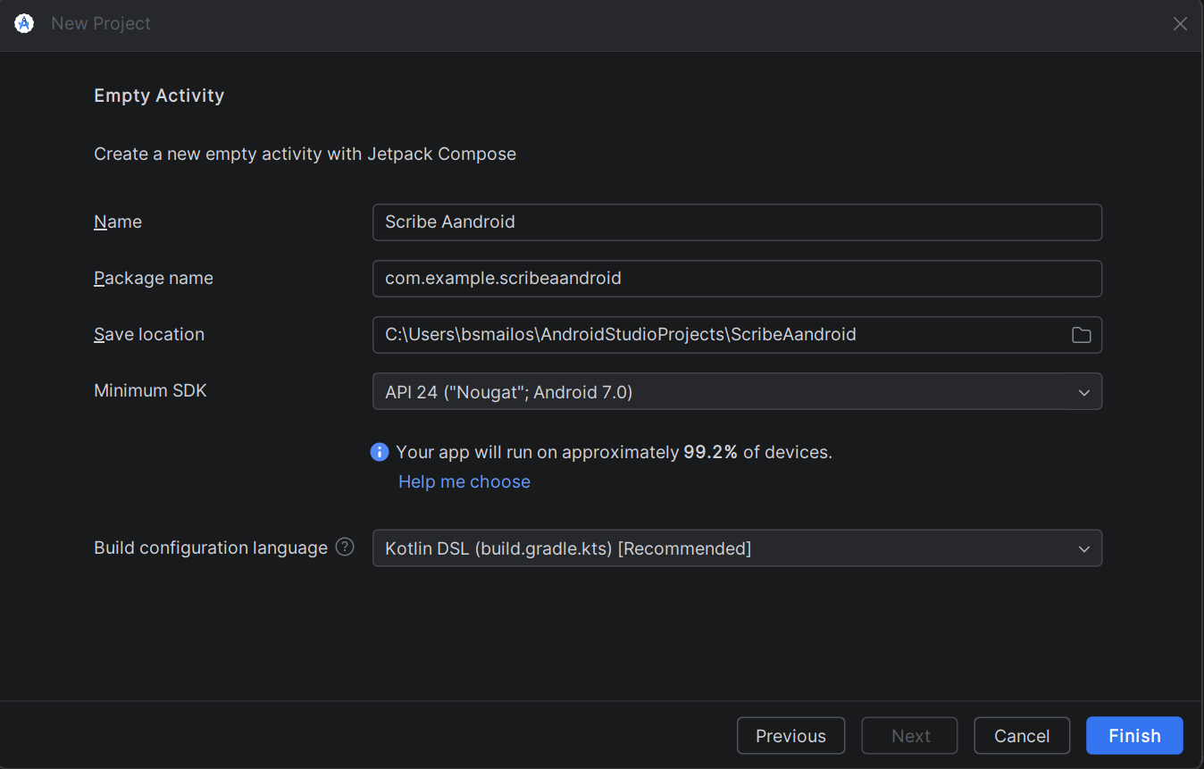
STEP 1
Create a New Project
Open Android Studio and create a new Empty Activity project. Set the save location to your preferred directory for Android projects.

Slide 3
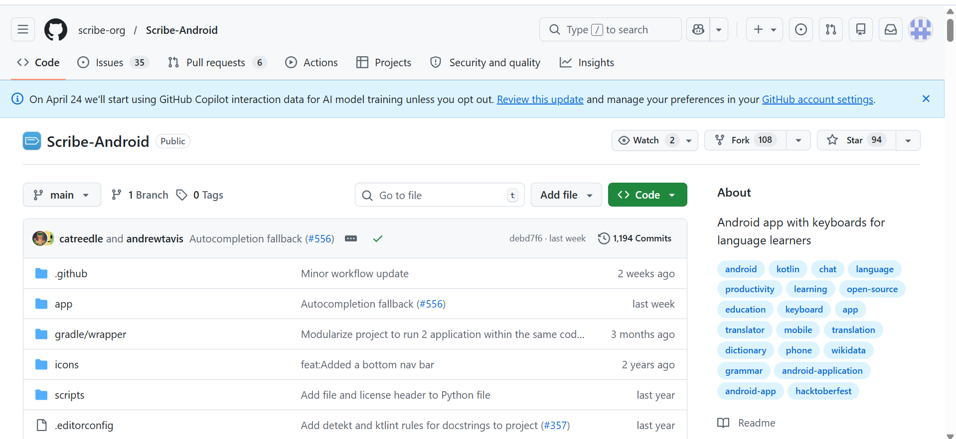
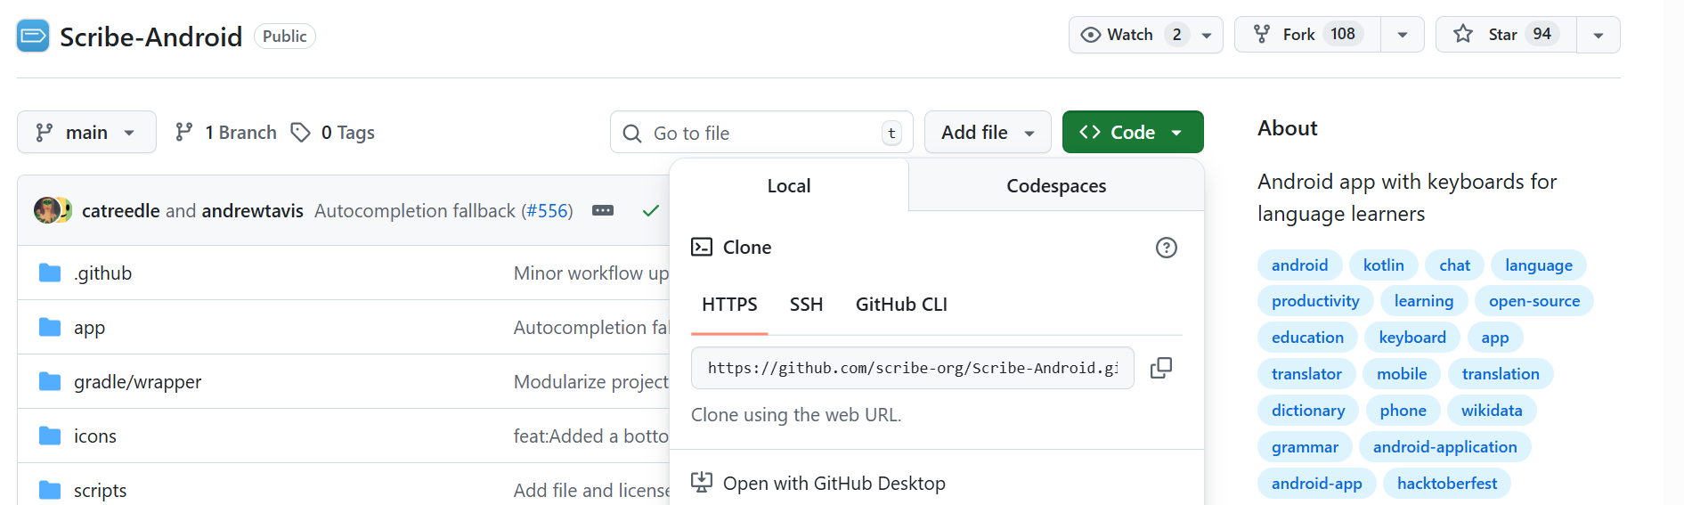
STEP 2
Find the Repository and Copy the Clone URL
Navigate to github.com/scribe-org/Scribe-Android. Click the green Code button and copy the HTTPS clone URL to your clipboard.

Slide 4

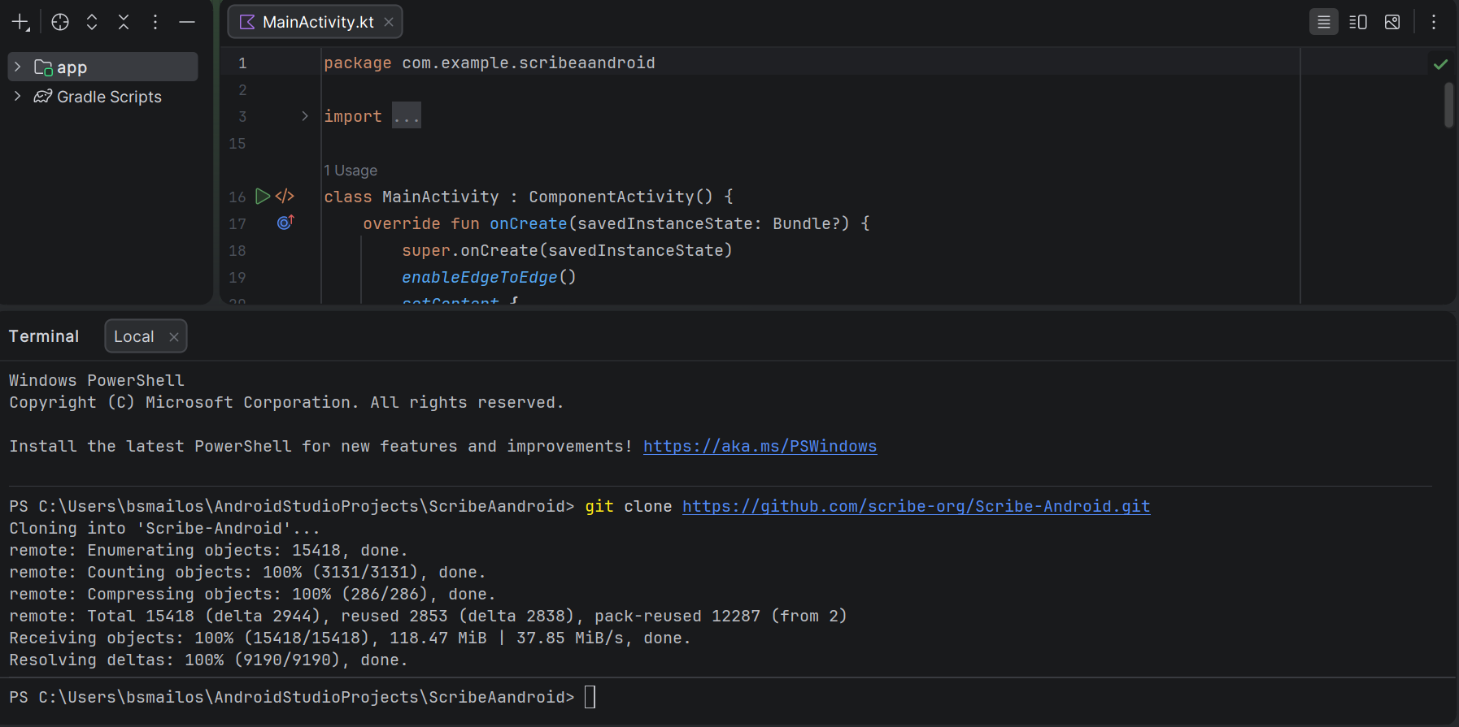
STEP 3
Clone the Repository to Your Machine
Open the terminal in Android Studio and run git clone with the copied URL. The repository will download into a Scribe-Android subfolder.

Slide 5
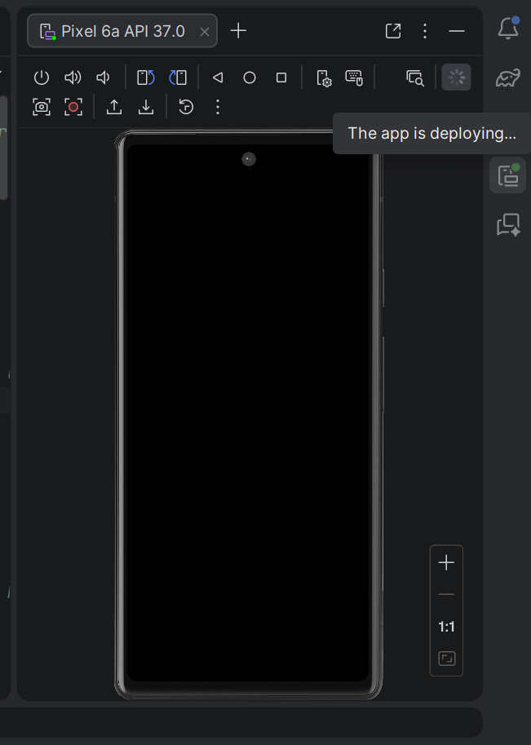
STEP 4
Deploy the Android Emulator
Wait for the Device Manager to deploy your virtual Android phone. The Pixel 6a emulator will boot up and display a black screen while loading.

Slide 6

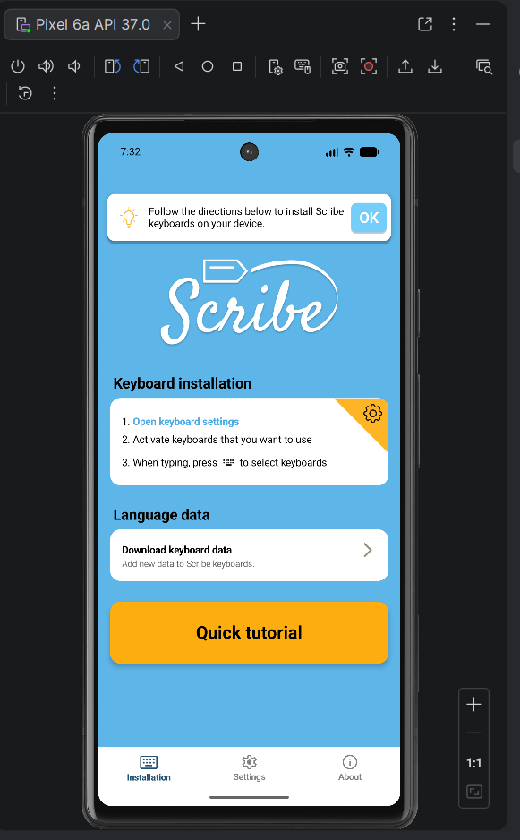
STEP 5
Open the Scribe App on the Emulator
Once deployed, the Scribe app opens showing the Installation screen. Follow the on-screen steps to configure your keyboards.

Slide 7

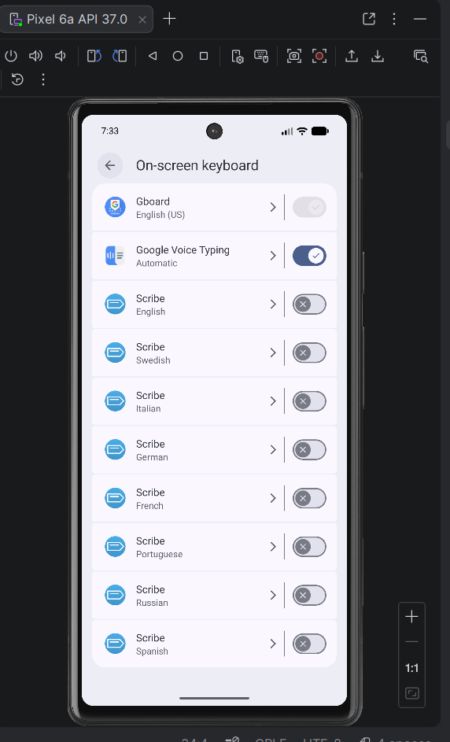
STEP 6
Navigate to Keyboard Settings
Go to the On-screen keyboard settings. You will see the Scribe keyboards listed for each supported language alongside Gboard.

Slide 8

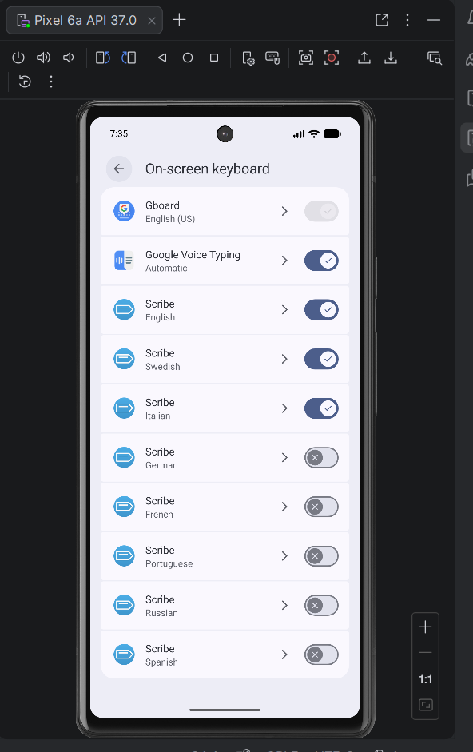
STEP 7
Toggle Your Desired Languages On
Enable the Scribe keyboards for the languages you want to use by toggling them on. Each language has its own keyboard with localized features.

Slide 9

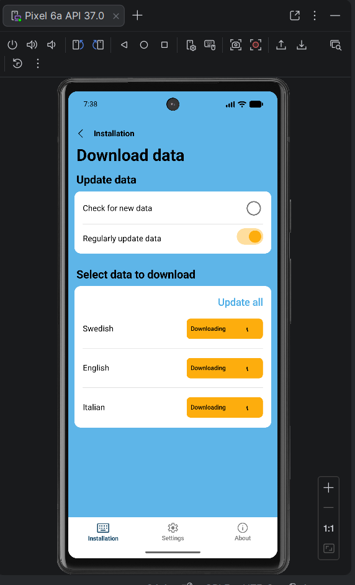
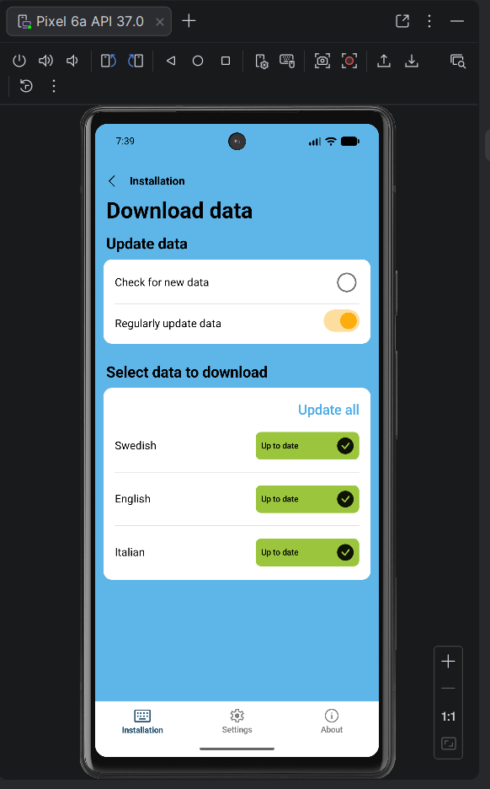
STEP 8
Download the Language Data
Download the language data packs for your enabled keyboards. Scribe works offline, so all data is stored locally on the device once downloaded.

Slide 10

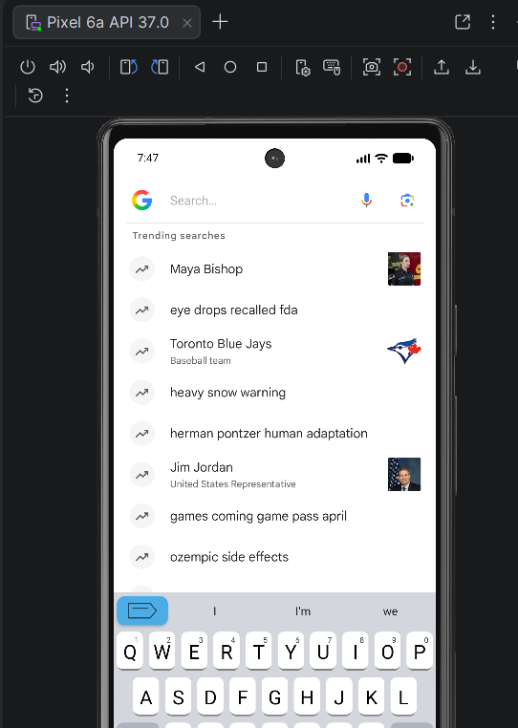
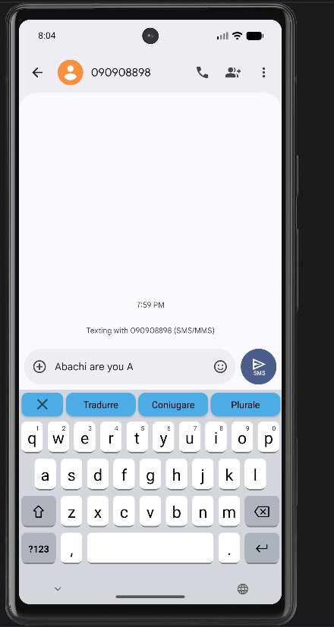
STEP 9
Switch to Scribe and Start Typing
Tap the globe icon to switch to a Scribe keyboard. Use the Scribe key (top-left) to access Translate, Conjugate, and Plural features.

Slide 11
You're all set!
Scribe-Android is now running on emulator.
Ready to start exploring the codebase and contribute to.
Repository github.com/scribe-org/Scribe-Android
Community
matrix.to/#/#scribe_community:matrix.org
Blessings Mailos | DevInstall

