Slide 1
Locate Missing Ones
Department Of Computer Engineering
Team ID:32785
Internal Guide:
Prof. Bhavika Tailor
Prepared By:
Parnasi R. Patel [120800107010]
Kruti P. Shah [120800107033]

Slide 2
CONTENT
INTRODUCTION
CURRENT SYSTEM
OBJECTIVE
SCOPE
TOOLS USED
DIAGRAMS
FLOW OF PROJECT
MODULES
USERS
LIMITATIONS
APPLICATIONS
FUTURE SCOPE
CONCLUSION

Slide 3
INTRODUCTION
Develop an application that allows any person to upload the information of any missing ones report with all their details.
Missing Ones details are easily accessible to anyone connected through internet around the globe so that anyone can easily publish the details and are able to access each other’s records.
This application provides the whole list of missing ones & also found ones.
The application will be available on mobile platforms so as to provide mobility, easy access as well as better connectivity.
It also gives you details of what you need to do, as a concerned citizen/organization you find a person who has lost his one’s and is in need of help.

Slide 4
Current system
User need to go to police station for missing ones report
Old ways use to found missing ones
Awareness message is not provided
Time consuming process
Notification message is not provided
Data are not centralized
Old ways use for advertisement
Time consuming process
Update data regularly

Slide 5
POSSIBLE SOLUTION
Online Report Generation
Online Report Viewing
E-Mail Alert
Update Data Regularly
Awareness Message/News

Slide 6
OBJECTIVE
We are still using the old conventional sources like posters and announcements to deal with such a heinous issue. Introducing a little bit of technology may prove to be a great innovation.
Generate online report for missing ones to provide mobility and allow centralized data with facility to submit report in police station.
PROVIDES
Security
Easy Access
Authentication
Verification

Slide 7
SCOPE
This application is basically for providing global environment where one user can find their special ones with interacting and get the help from the others.
It also gives the details about what action will be taken once find the person is missing.

Slide 8
TOOL USED
Front-end : MicrosoftAsp.net(with c#)
Back-end : SQL Server 2008 R2 Database
Environment : MicrosoftVisualStudio 2010
Documentation : MicrosoftOfficeWord 2013
Presentation : MicrosoftOfficePowerPoint 2013, Crystal Report
Diagram : Microsoft Visio 2013
Frame Work : 2 Tier Arch

Slide 9
DIAGRAMS
E-R Diagram
UML Diagram:
Class Diagram
Usecase Diagram
Sequence Diagram
Activity Diagram
State Diagram

Slide 10
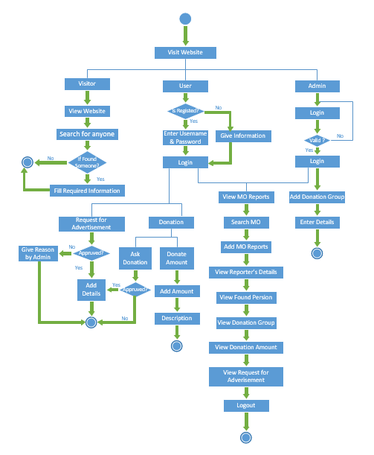
FLOW OF PROJECT

Slide 11
ACTORS
Police
Missing Ones Relative
NGO
Missing Ones
Visitors
Admin

Slide 12
MODULES
Access management Module
Police Station info Module
Lost ones info Module
E-mail Query Module
Search Results Module

Slide 13
APPLICATIONS
Report missing ones
View missing ones
View found ones
Notification for found ones
Search missing ones
Report missing details to related police station
Awareness Message

Slide 14
LIMITATIONS
Users which are not register, they cannot report for missing ones. They can only see the missing ones.
Major limitation of the system is that it doesn’t work properly in case of wrong entry.

Slide 15
FUTURE SCOPE
In Future possibly create android app for same system to get instant notification for any update on your missing ones.

Slide 16
CONCLUSION
We have observed that the project should be the user friendly and attractive.
The good interface always attracts the users. So the project, we have implemented, is our best effort for providing users whatever they want.

Slide 17
Implementation screenshot
Registration
Login

Slide 18
Thank You

