Slide 1
Stakeholder
Company Owner.
Plant head.
Developer.
Testing team head.

Slide 2
https://www.oee.com/calculating-oee.html

Slide 3
Req Analysis:
Company requirement.
Shift wise report.
Day wise, Month wise and Year wise report.
Production Count.
OEE calculation.

Slide 4
Costing
Hardware Costing :-
Node mc module -350.
PCB Costing -1500.
Power Supply -150.
N-Closure -1500.
PCB Components -2000.
Sensor -750.

Slide 5
System Architecture
Node MCU &
PCB
Proxy Sensor
Cloud
Owner/Admin
P.S

Slide 6
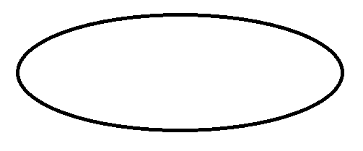
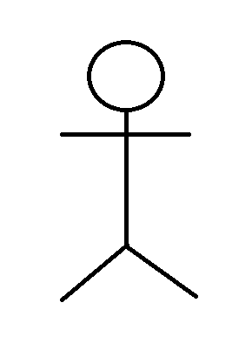
USE CASE Diagram
System
Setting up goal
Define Product
Product Manager
Owner
Define Features
Product Out
<<Include>>
<<Include>>
Notification
Product Manufacturing
Machine
Count
<<Include>>
Review Product
Controller
Reports
Fig: Use Case Diagram

