Slide 1
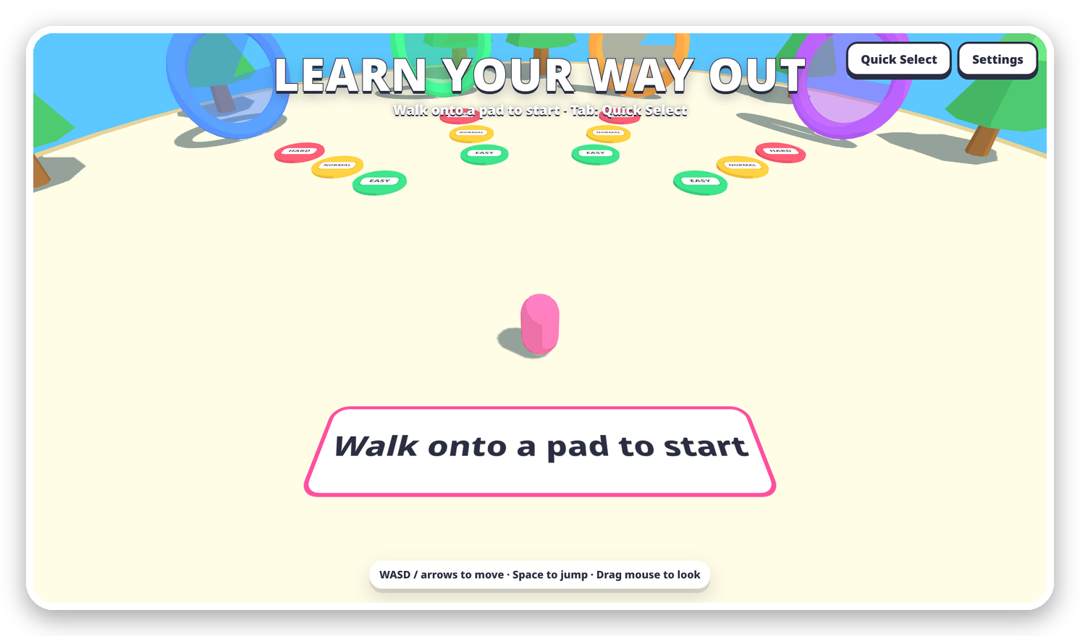

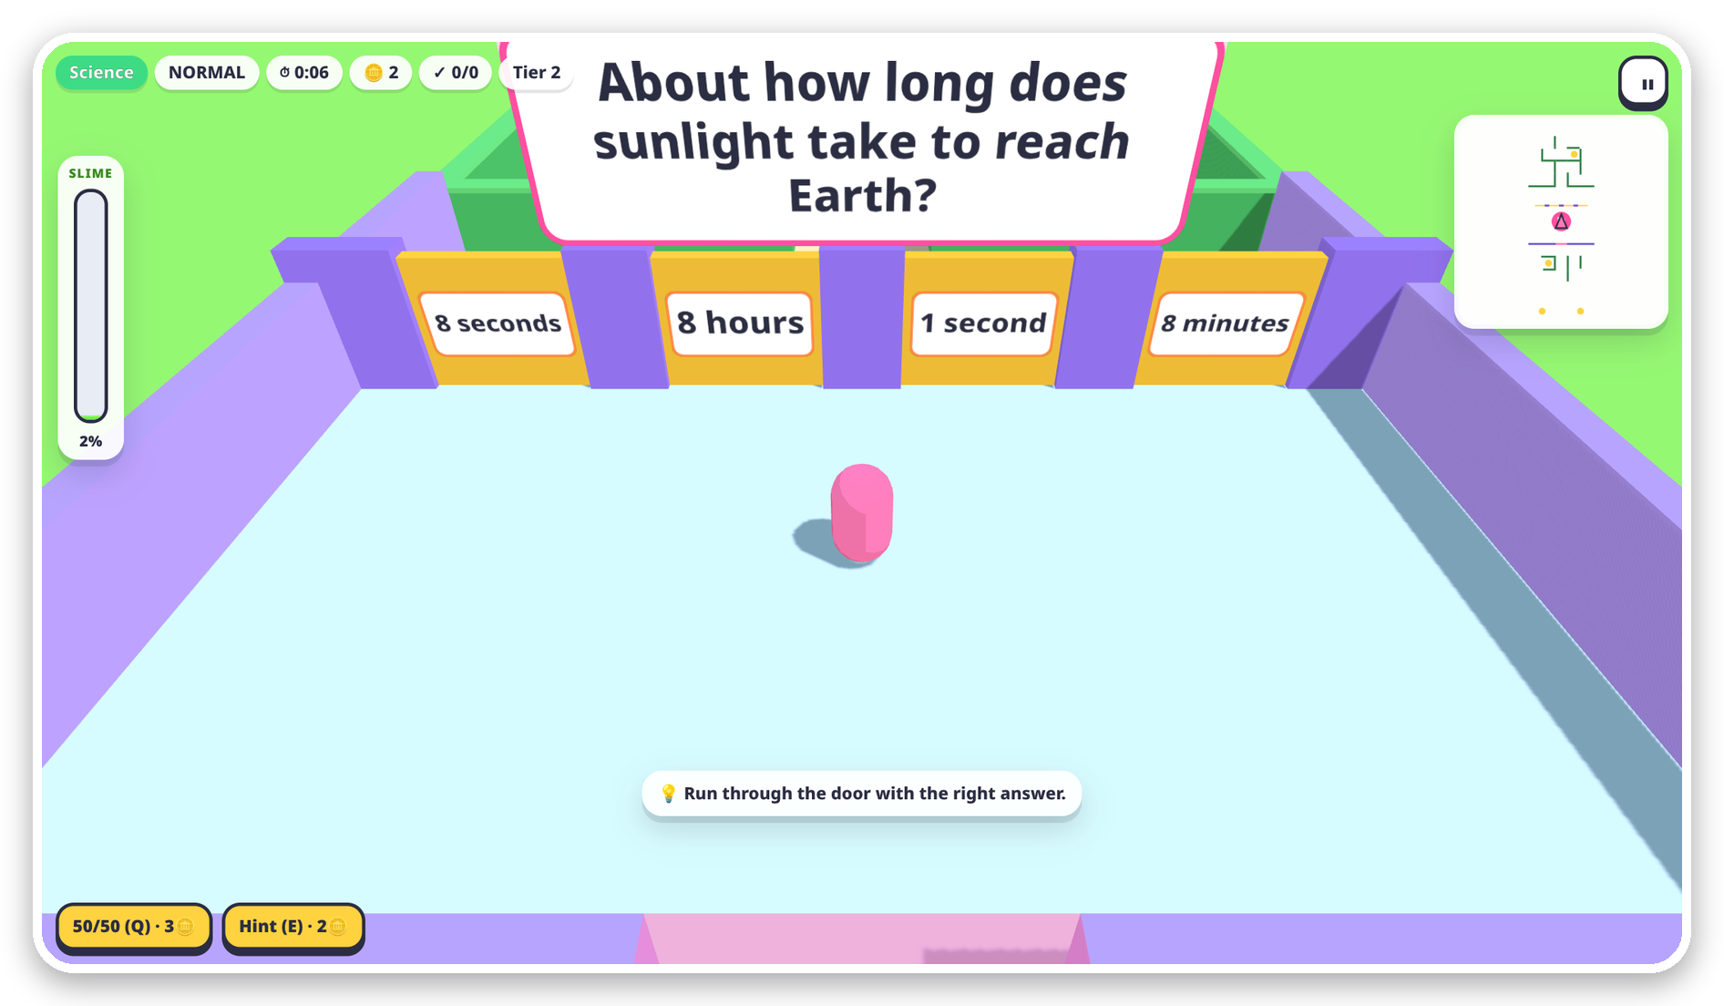
LEARN YOUR
WAY OUT
PL05 · PLAY LAB TRACK
IDEATION PHASE
Every learning game is a quiz in a costume.
In ours, the maze is the quiz.
TEAM
PROJECT
TRACK
Solo
PL05 – Learn Your Way Out
Play Lab
3D browser game
AI custom questions
Live multiplayer
Adaptive difficulty
EARLY CONCEPT PROTOTYPE
Notes:
Hi, I am Team Solo with PL05, Learn Your Way Out, for the Play Lab track. We are in the ideation phase. The idea is a 3D maze game in the browser where every answer is a place you run to: a door, a tile, a stepping stone. Players pick a subject and a difficulty, escape the maze, and learn on the way. We also plan AI-made questions on any topic and live races with friends.

Slide 2
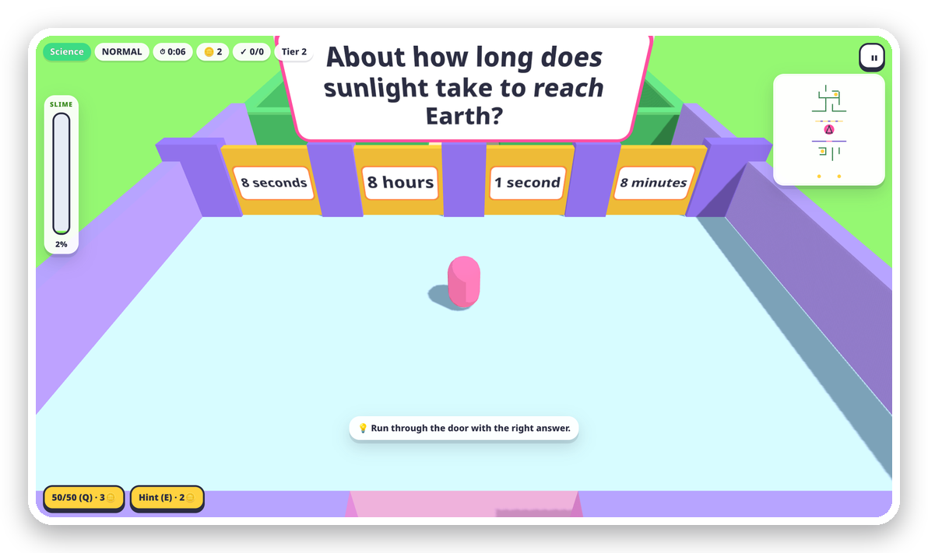
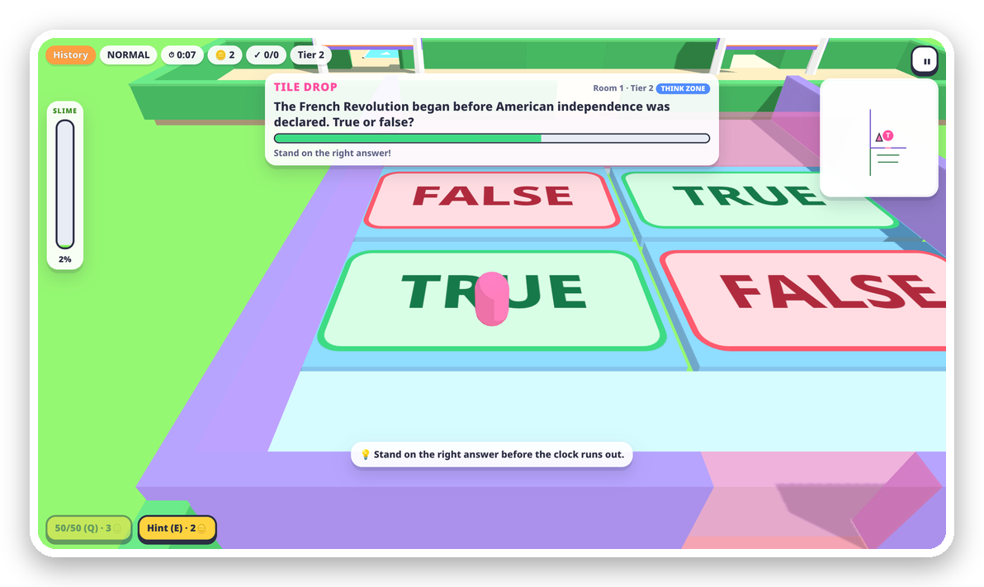




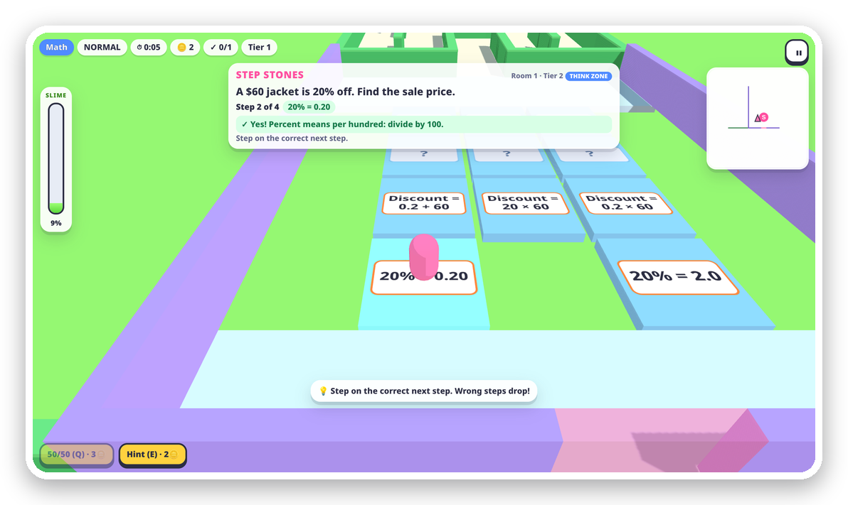
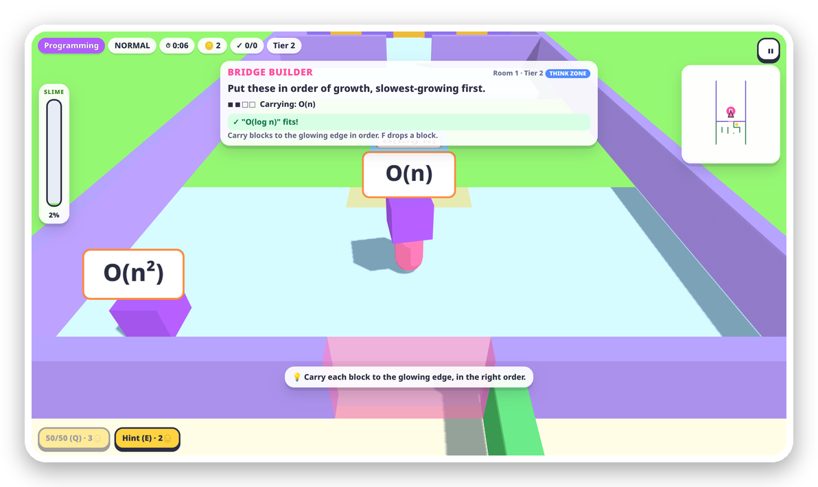


The maze is the quiz
02 · PROPOSED SOLUTION
Most learning games pause the fun for a quiz popup. Here, every answer is a place you run to.
EARLY CONCEPT PROTOTYPE
Answer with your feet
5 room types turn every question type into movement.
Wrong turns teach
A detour shows the answer, why, a worked example, a retry.
Adapts to every player
Harder after 2 right, easier after a miss; replay weak spots.
AI custom questions
DOOR RUSH multiple choice
TILE DROP true / false
Type a topic or paste notes; DeepSeek builds a live pack.
Live multiplayer races
Race friends through the same seeded maze as ghost beans.
A new maze every run
Seeded mazes with forks, dead ends, coins and rising slime.
USP Answers are places, not buttons. Mistakes become lessons, not game-overs.
STEP STONES multi-step problems
BRIDGE BUILDER put in order
Notes:
The problem: most learning games are a quiz with a costume. Play stops, a popup asks a question, play resumes. Our idea is that the maze is the quiz. Door Rush is multiple choice: run through the right door. Tile Drop is true or false: stand on the right tile before time runs out. Step Stones solves a problem one step at a time. Bridge Builder puts things in order. A wrong answer drops you into a detour that teaches the answer and gives a retry, while the slime keeps rising. The screens are from an early concept prototype. On top, we plan AI-made questions on any topic and live multiplayer races.

Slide 3

One loop, from pick to escape
03 · TECHNICAL APPROACH
PROGRESS
1
2
3
4
5
✓
door opens, slime drops
SELECT
GENERATE
NAVIGATE
CHALLENGE
EVALUATE
WIN / LOSE
domain + difficulty
seeded maze + rooms
3D bean, minimap
room asks a question
check, adapt tier
portal = qualified
slime 100% = out
✗
DETOUR
explain, example, retry
not finished? back into the maze, next room
PLANNED BROWSER CLIENT
AI QUESTIONS
Maze: DFS backtracker + braiding on a seeded PRNG: one seed, one identical maze.
UI React DOM + zustand: HUD, menus, results
Node proxy → DeepSeek API, key stays on server
Adaptive picker: tier staircase, scored by recency and weak concepts.
Render three.js + React Three Fiber
AI pipeline: JSON schema → validator → cached pack; built-in bank as fallback.
Engine TypeScript, fixed 120 Hz step, own collision
MULTIPLAYER
Multiplayer: share the seed, stream positions; each client runs its own course.
WebSocket relay: shared seed + positions 10/s
Content JSON packs + validator, QuestionSource
Test plan: a headless bot plays every generated course before release.
Notes:
This is the loop from the brief: select, generate, navigate, challenge, evaluate, then progress or penalty, and a win or lose check. The planned engine is plain TypeScript with a fixed 120 Hz step and its own collision, so it can run headless and a bot can play every generated course as a test. Rendering will use three.js through React Three Fiber, and the HUD React with zustand. Mazes come from a depth-first backtracker with braiding, seeded so one seed always gives the same maze. AI questions will go through a small Node proxy to DeepSeek, be validated against our question schema, and be cached. Multiplayer only needs to share the seed and positions, because every client can build the same course itself.

Slide 4






Feasible, low-cost, low-risk
04 · FEASIBILITY & VIABILITY
4
5
3
0
domains at launch: math, science, history, programming
room types, one for each question format
difficulty levels, plus adaptive tiers
installs: runs on laptops and phones from a link
ROADMAP
FEASIBILITY
RISKS → MITIGATIONS
Concept & design
WE ARE HERE
Proven web stack: three.js + React
Wrong AI facts
brief, mechanics, architecture
schema validator, second-pass check, teacher review
Pure browser, touch for phones
Core prototype
maze, 5 rooms, detour, slime
Modular: AI + multiplayer plug in
AI latency
Content & adaptivity
generate in the hub before the run; built-in bank fallback
question packs, tiers, weak spots
VIABILITY
Leaked API key
AI custom questions
Core is static files: free hosting
key stays on a server proxy, never in the browser
DeepSeek packs from topics or notes
One AI call = one cached pack
Lag in races
Multiplayer & pilot
live races, a classroom trial
Relay forwards positions only
each client simulates locally; ghosts interpolate
Notes:
Feasibility: every part uses proven web technology that runs in any browser, including phones, and the design is modular, so AI questions and multiplayer plug in later. Viability: the core is static files, so hosting is free tier. AI generation makes a whole question pack per call and caches it, and the multiplayer relay only forwards positions, so servers stay tiny. The roadmap goes from concept, where we are now, to a core prototype, then content and adaptivity, AI questions, and finally multiplayer and a classroom pilot. The main risks are wrong AI facts and latency; we plan schema validation, a second check and a built-in question bank as fallback.

Slide 5
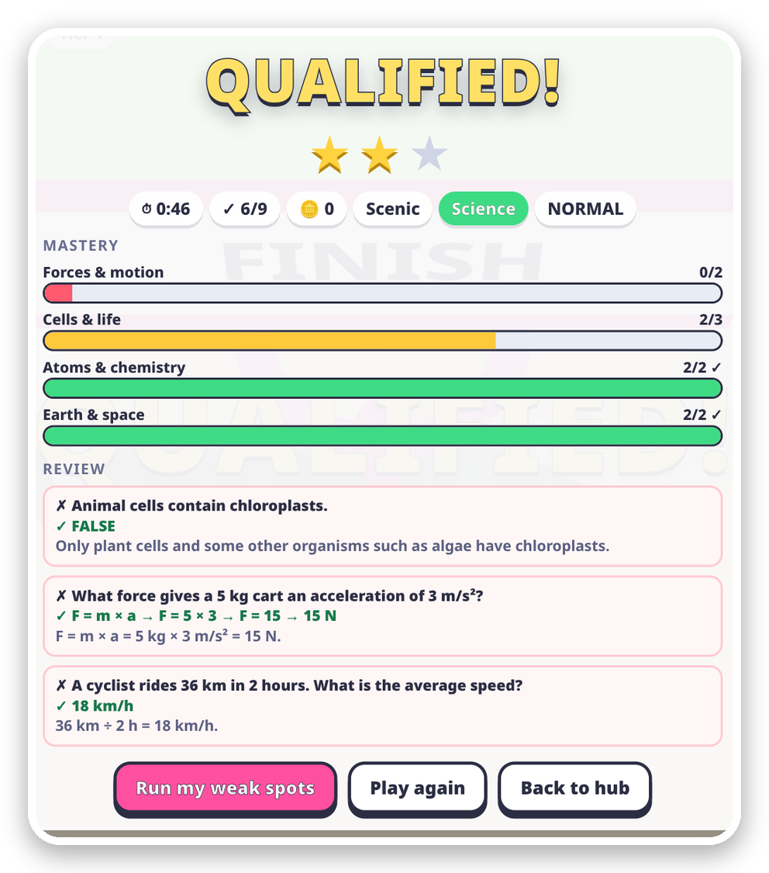



Mistakes become lessons
05 · IMPACT & BENEFITS
EARLY CONCEPT PROTOTYPE
Students
TRY
answer in the maze
Active recall in every room, safe low-stakes mistakes, and races with friends.
ADAPT
FEEDBACK
tier + weak spots
instant ✓ or ✗
Teachers
Questions from your own notes in seconds, plus a weak-spot report per concept.
THE LEARNING LOOP
RETRY
EXPLAIN
Schools
a similar question
answer + worked example
No installs, runs on old laptops and phones; read-aloud, reduced motion, touch.
Planned: every run ends with mastery per concept and a review of every miss.
Notes:
The impact is in the loop. You try by moving, you get instant feedback, a wrong answer explains itself with a worked example, you retry a similar question, and the game adapts. Each run is designed to end with mastery per concept and a review of every miss, with one button to replay weak spots. Students get active recall and safe mistakes, teachers can turn their own notes into a game in seconds, and schools need nothing but a browser.

Slide 6
Grounded in learning science
06 · RESEARCH & REFERENCES
RESEARCH SAYS
SO THE GAME DOES
Every room is a retrieval attempt, answered by moving
REFERENCES
Testing effect
1 Roediger & Karpicke (2006). Test-enhanced learning. Psychological Science, 17(3).
2 Hattie & Timperley (2007). The power of feedback. Review of Educational Research, 77(1).
3 Metcalfe (2017). Learning from errors. Annual Review of Psychology, 68.
4 Bjork & Bjork (2011). Making things hard on yourself, but in a good way. Psychology and the Real World.
5 Csikszentmihalyi (1990). Flow: The Psychology of Optimal Experience.
6 Cepeda et al. (2006). Distributed practice in verbal recall tasks. Psychological Bulletin, 132(3).
7 Wouters et al. (2013). Cognitive and motivational effects of serious games. J. Educational Psychology, 105(2).
8 Clark, Tanner-Smith & Killingsworth (2016). Digital games, design, and learning. Review of Educational Research, 86(1).
9 Buck (2015). Mazes for Programmers. Pragmatic Bookshelf.
10 Fiedler (2004). Fix Your Timestep! gafferongames.com.
11 Docs: three.js, React Three Fiber, DeepSeek API. Art direction: Fall Guys (Mediatonic, 2020).
Roediger & Karpicke, 2006
Feedback
Instant ✓ or ✗ on the door, tile or step you chose
Hattie & Timperley, 2007
Learning from errors
A wrong answer opens a detour: answer, why, worked example, retry
Metcalfe, 2017
Desirable difficulty & flow
The adaptive tier keeps the challenge just above skill
Bjork & Bjork, 2011; Csikszentmihalyi, 1990
Spacing
Weak-spot runs bring missed concepts back later
Cepeda et al., 2006
Games that teach
The learning is the core mechanic, not a popup
Wouters et al., 2013; Clark et al., 2016
Notes:
Each mechanic comes from a research result. Retrieval practice beats rereading, so every room is a retrieval attempt. Feedback is one of the strongest levers, so every answer gets instant feedback. Errors followed by corrective feedback help learning, which is the detour. Desirable difficulty and flow motivate the adaptive tier, spacing motivates weak-spot runs, and meta-analyses show games teach best when learning is part of the core mechanic.

