Slide 1
Lesson 1
What is HTML? Your first web page
Today you learn what HTML is, write titles and text, and build a full web page.
Lesson 1

Slide 2
Part 1: Websites and tags
Which websites do you know? YouTube, Google, Roblox, Wikipedia... Every one of them is made with HTML.
A website is a file. The browser (Chrome) reads the file and shows it on the screen.
Lesson 1

Slide 3

Part 1: Websites and tags
Your file goes into Chrome. Chrome turns it into a page.
Lesson 1

Slide 4
Part 1: Websites and tags
HTML is made of tags. A tag tells the browser what something is: a title, some text, a picture.
A tag is like a box: open it, put something inside, close it.
UZ: Tag bu quti: ochamiz, ichiga yozamiz, yopamiz.
Lesson 1

Slide 5

Part 1: Websites and tags
Open the tag, put something inside, close the tag.
Lesson 1

Slide 6
Part 1: Websites and tags
Part | Code | Meaning
Opening tag | <h1> | Open the box
Content | Hello! | What is inside
Closing tag | </h1> | Close the box. It has a /
Lesson 1

Slide 7
Part 1: Websites and tags
Quick question: Which one is a closing tag?
A) <h1>
B) </h1>
C) <1h>
Lesson 1

Slide 8
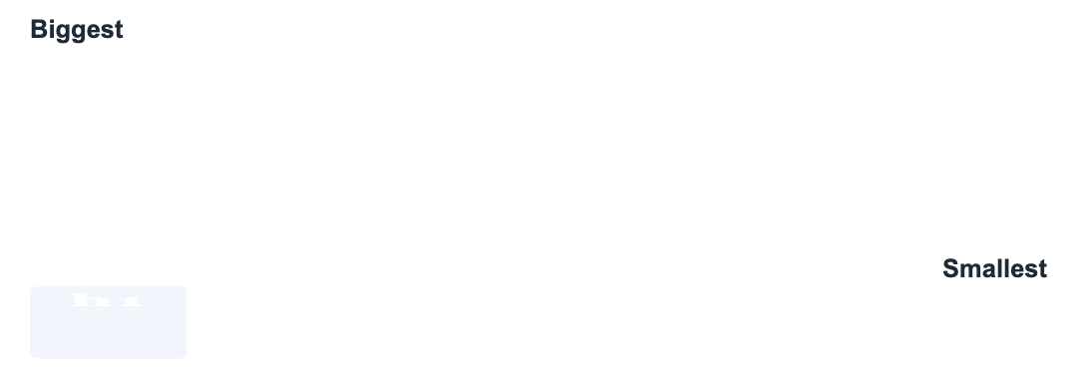
Part 2: Headings h1 to h6
Headings are titles. There are 6 of them. h1 is the biggest, h6 is the smallest.
Like stairs: every step down is a smaller title.
Lesson 1

Slide 9
Part 2: Headings h1 to h6
All 6 headings
<h1>Heading 1</h1>
<h2>Heading 2</h2>
<h3>Heading 3</h3>
<h4>Heading 4</h4>
<h5>Heading 5</h5>
<h6>Heading 6</h6>
Lesson 1

Slide 10
Part 2: Headings h1 to h6
Heading | Use it for | Example
h1 | The page title. Only ONE on a page | My Website
h2 | Big parts of the page | My Family, My Games
h3 | Small parts inside a big part | My Cat, My Dog
h4 to h6 | Very small titles. Not used much | Notes
Lesson 1

Slide 11
Part 2: Headings h1 to h6
UZ: h1 bu kitobning nomi, h2 bu boblar, h3 bu bob ichidagi kichik qismlar.
Quick question: Which heading is the biggest?
A) <h6>
B) <h1>
C) <h3>
Lesson 1

Slide 12
Part 3: Paragraphs
Headings are for titles. For normal text we use <p>, a paragraph. Every <p> starts on a new line.
Title, then text
<h1>My Cat</h1>
<p>My cat is called Momo.</p>
<p>She likes to sleep on my bed.</p>
Lesson 1

Slide 13
Part 3: Paragraphs
Quick question: Which tag is for normal text?
A) <h1>
B) <t>
C) <p>
Lesson 1

Slide 14

Part 4: The page skeleton and comments
A real page needs a skeleton. It is always the same. Every HTML page in the world starts like this.
html holds everything. head is hidden info. body is what you see.
Lesson 1

Slide 15
Part 4: The page skeleton and comments
The full page skeleton
<!DOCTYPE html>
<html>
<head>
<title>My Page</title>
</head>
<body>
<h1>Hello!</h1>
<p>This is my first page.</p>
</body>
</html>
Lesson 1

Slide 16
Part 4: The page skeleton and comments
Part | What it does
<!DOCTYPE html> | First line. Says: this is an HTML page
<html> | The big box around everything
<head> | Hidden info about the page
<title> | The name on the browser tab. Goes inside head
<body> | Everything you SEE: headings, text, pictures
Lesson 1

Slide 17
Part 4: The page skeleton and comments
UZ: head bu odamning boshi: ichida fikr bor, lekin ko'rinmaydi. body bu tana: hammasi ko'rinadi.
A comment is a note for people. The browser does not show it. It starts with <!-- and ends with -->.
Lesson 1

Slide 18
Part 4: The page skeleton and comments
Quick question: Where do headings and text go?
A) <head>
B) <body>
C) <title>
Lesson 1

Slide 19
Watch out!
Forgot the closing tag: <h1>Hello must be <h1>Hello</h1>
Wrong slash: <\h1> is wrong, </h1> is right
Different tags: <h1>Hello</h2> is wrong. Open and close the same tag
Text in the head. Everything you want to SEE goes in the body
Lesson 1

Slide 20
Practice and homework
Practice in class
1. Make a big title with your name, and a paragraph with your age.
2. Stairs: write all 6 headings, from h1 down to h6, with your own words.
3. There are 3 mistakes. Fix them.
4. Build a full page from zero: the skeleton, a title "About Me", an h1 and a p.
5. "My Favorite Animal" page: one h1, two h2 parts ("What it eats", "Where it lives"), a p under each h2, and a comment above each part.
Homework
1. "My Family": an h1, then a p about 3 people in your family.
2. Upside-down stairs: write the headings from h6 up to h1.
3. Your idea! Build any page you like. Use at least 3 things from today, for example <h1>Title</h1>, <p>Text</p>, <!-- note -->, <!DOCTYPE html>. No idea? Try: a superhero I made up, my football team, space and planets.
Lesson 1

