Slide 1
Lesson 3
Lists
Today you make shopping lists, top-5 lists and lists inside lists.
Lesson 3

Slide 2
Warm-up
1. Which tag makes a new line?
A) <hr> B) <br> C) <p>
2. Which tag says "this is IMPORTANT"?
A) <strong> B) <i> C) <small>
3. How do you write the 2 in H₂O?
A) <sup>2</sup> B) <sub>2</sub> C) <b>2</b>
Lesson 3

Slide 3
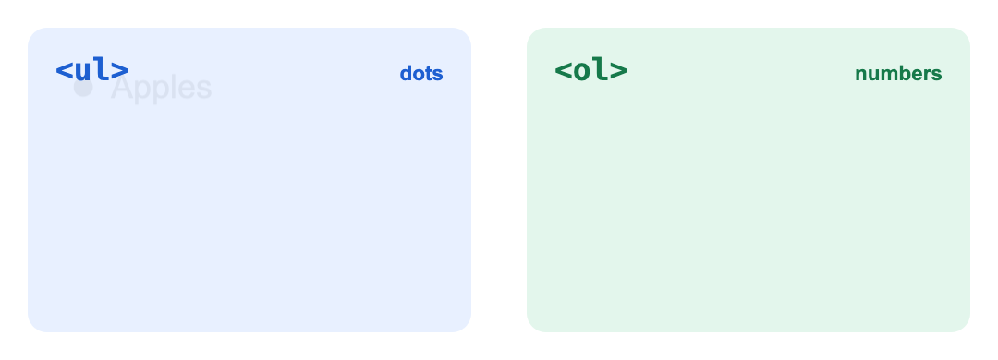
Part 1: Two kinds of lists
Lists are everywhere: shopping lists, game rules, top-5 lists. HTML has two kinds.
<ul> gives dots. <ol> gives numbers.
Lesson 3

Slide 4
Part 1: Two kinds of lists
Tag | Means | Use it when
<ul> | Unordered list (dots) | Order does not matter: a shopping list
<ol> | Ordered list (numbers) | Order matters: steps, a top 5
<li> | List item | Every item, in both lists
Lesson 3

Slide 5
Part 1: Two kinds of lists
UZ: ul: tartib muhim emas. ol: tartib muhim, raqamlar bilan.
A shopping list with dots
<ul>
<li>Apples</li>
<li>Milk</li>
<li>Bread</li>
</ul>
Lesson 3

Slide 6
Part 1: Two kinds of lists
Morning steps with numbers
<ol>
<li>Wake up</li>
<li>Brush teeth</li>
<li>Go to school</li>
</ol>
Lesson 3

Slide 7
Part 1: Two kinds of lists
Quick question: You write the steps to make tea. Which list?
A) <ul>
B) <ol>
C) No list
Lesson 3

Slide 8
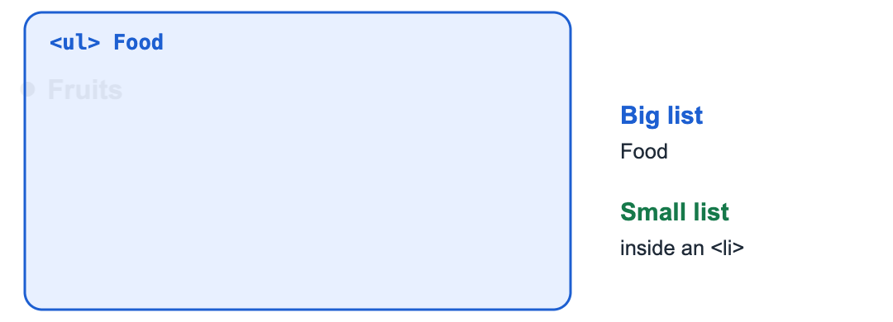
Part 2: Lists inside lists
An <li> can hold a whole new list. Like a box with smaller boxes inside.
The small list goes INSIDE the <li>, before </li>.
Lesson 3

Slide 9
Part 2: Lists inside lists
A list inside a list
<ul>
<li>Fruits
<ul>
<li>Apple</li>
<li>Banana</li>
</ul>
</li>
<li>Drinks</li>
</ul>
Lesson 3

Slide 10
Part 2: Lists inside lists
UZ: Ichki ro'yxat li ichiga yoziladi, </li> dan oldin.
Use spaces at the start of lines (Tab key) so you can see which list is inside which. The browser ignores them, but your eyes love them.
Quick question: Where does the small list go?
A) After </ul>
B) Inside the <li>, before </li>
C) In the <head>
Lesson 3

Slide 11
Part 3: Change the numbers
<ol> can start from another number, or use letters instead of numbers.
start and type are attributes: extra settings inside the opening tag
<ol start="5">
<li>Five</li>
<li>Six</li>
</ol>
<ol type="A">
<li>First</li>
<li>Second</li>
</ol>
Lesson 3

Slide 12
Part 3: Change the numbers
Attribute | What it does
start="5" | Start counting from 5
type="A" | A, B, C
type="a" | a, b, c
type="I" | I, II, III (Roman numbers)
reversed | Count down: 3, 2, 1
Lesson 3

Slide 13
Part 3: Change the numbers
Quick question: Which list shows A, B, C?
A) <ol type="A">
B) <ol start="A">
C) <ul type="A">
Lesson 3

Slide 14
Watch out!
Text outside <li>: every item needs its own <li>
Closing the small list in the wrong place. It must end before </li>
Using <ul> for steps. If order matters, use <ol>
Writing <ol start=5> with no quotes. Use start="5"
Lesson 3

Slide 15
Practice and homework
Practice in class
1. Make a list (dots) of 4 things in your school bag.
2. Top 5 games or cartoons, with numbers. Make number 1 strong.
3. There are 3 mistakes. Fix them.
4. Animals list: Pets (cat, dog) and Wild animals (lion, bear). Each group has its own small list.
5. Recipe page: an h1 with a food name, an h2 "You need" with a dots list, an h2 "Steps" with a numbers list of 4 steps.
Homework
1. "My day": a numbers list of 5 things you do after school.
2. "My family": a dots list of people. Under each person, a small list with 2 things they like.
3. Your idea! Build any page you like. Use at least 3 things from today, for example <ul><li>Milk</li></ul>, <ol><li>Wake up</li></ol>, <li>Item</li>, <li>Fruits<ul>...</ul></li>. No idea? Try: my best friend, robots, the sea and fish.
Lesson 3

