Slide 1
Lesson 5
Links
Today you make links: click a word and go to another website.
Lesson 5

Slide 2
Warm-up
1. How many <h1> should a page have?
A) One B) Two C) Ten
2. Which tag makes a line across the page?
A) <hr> B) <br> C) <li>
3. Which is the right order?
A) <p><strong>Hi</p></strong> B) <p><strong>Hi</strong></p>
Lesson 5

Slide 3
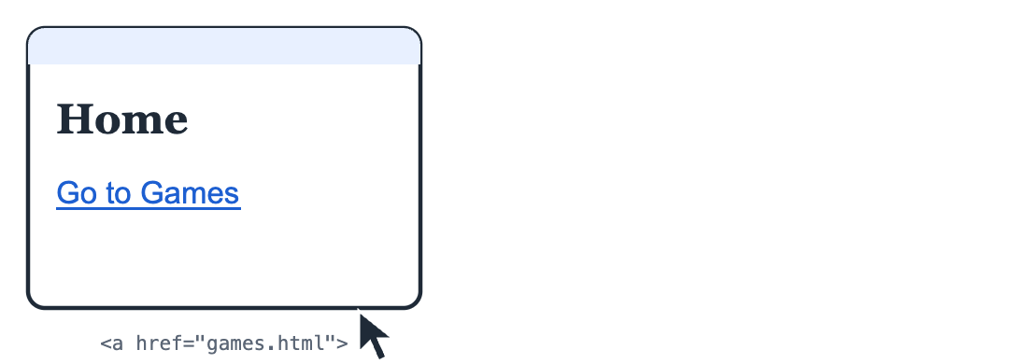
Part 1: Your first link
A link is a word you can click to go to another page. Links are what make the web a WEB: pages joined together.
Click the link and a new page opens.
Lesson 5

Slide 4
Part 1: Your first link
<a> makes a link. href says where it goes
<a href="https://www.wikipedia.org">Go to Wikipedia</a>
Lesson 5

Slide 5
Part 1: Your first link
Part | Code | Meaning
Tag | <a> | a = anchor, a link
Where to go | href="https://..." | The address of the page
Link text | Go to Wikipedia | The words you click
Lesson 5

Slide 6
Part 1: Your first link
UZ: href bu manzil: link qayerga olib boradi. Ichidagi so'z bosiladigan matn.
Quick question: Which part says WHERE the link goes?
A) The link text
B) href
C) <a>
Lesson 5

Slide 7
Part 2: Open in a new tab
Add target="_blank" and the link opens in a new tab. Your page stays open.
target="_blank" = new tab
<a href="https://www.nasa.gov" target="_blank">Space pictures</a>
Lesson 5

Slide 8
Part 2: Open in a new tab
Without target | With target="_blank"
Opens in the same tab | Opens in a new tab
Your page goes away | Your page stays open
Lesson 5

Slide 9
Part 2: Open in a new tab
In our live editor, always use target="_blank". Then the link opens properly in a new tab.
Quick question: What does target="_blank" do?
A) Makes the link blue
B) Opens a new tab
C) Deletes the link
Lesson 5

Slide 10
Part 3: A menu of links
Many links together make a menu. Put them in a list.
A link inside each <li>
<h2>My favorite sites</h2>
<ul>
<li><a href="https://www.wikipedia.org" target="_blank">Wikipedia</a></li>
<li><a href="https://www.nasa.gov" target="_blank">NASA</a></li>
<li><a href="https://www.youtube.com" target="_blank">YouTube</a></li>
</ul>
Lesson 5

Slide 11
Part 3: A menu of links
Add title="..." to show a small note when the mouse is over the link.
UZ: Link ichidagi matn aniq bo'lsin: "bu yerga bosing" emas, "Kosmos rasmlari".
Quick question: Which link text is better?
A) "Click here"
B) "Space pictures from NASA"
Lesson 5

Slide 12
Watch out!
Forgetting https:// at the start of a website address
Forgetting the quotes: href=wikipedia.org must be href="https://www.wikipedia.org"
Forgetting </a>: then the whole page becomes a link!
Link text "click here". Say where the link goes instead
Lesson 5

Slide 13
Practice and homework
Practice in class
1. Make one link to Wikipedia with the text "Learn everything", opening in a new tab.
2. Write a sentence with a link in the middle: "I like space pictures from NASA." Only "NASA" is the link.
3. There are 3 mistakes. Fix them.
4. A menu: an h2 "My links" and a dots list of 3 links (Wikipedia, NASA, YouTube), each with a title.
5. "Learn about animals" page: an h1, a p, and a numbers list of 3 animals. Each animal name is a link to its Wikipedia page, for example https://en.wikipedia.org/wiki/Lion.
Homework
1. Make 3 links to websites you like (ask a parent which ones are OK). Each opens in a new tab.
2. Write 2 sentences about your hobby. Put one link inside each sentence.
3. Your idea! Build any page you like. Use at least 3 things from today, for example <a href="https://www.nasa.gov">NASA</a>, target="_blank", title="Space". No idea? Try: cars, a magic world, my birthday party.
Lesson 5

