Slide 1
Lesson 12
Forms 1: boxes to type in
Today you make forms: boxes where people type their name, email, password and age.
Lesson 12

Slide 2
Warm-up
1. Which box holds the menu?
A) <nav> B) <footer> C) <header>
2. How many <main> on a page?
A) One B) Two C) Many
3. Which tag colors a few words inside a line?
A) <div> B) <span> C) <section>
Lesson 12

Slide 3
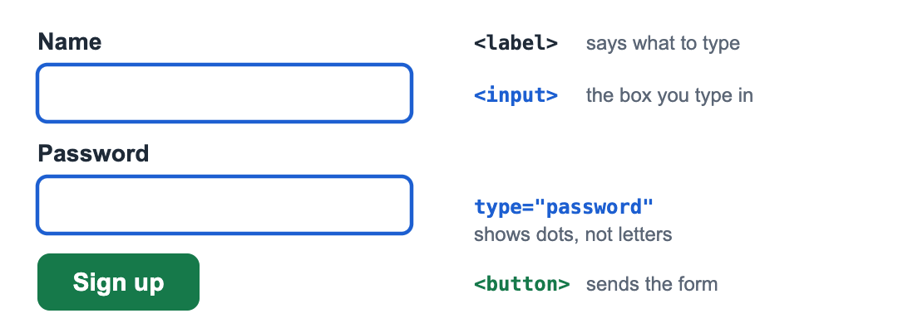
Part 1: Your first form
A form lets people send you information: sign up, write a message, answer a quiz.
label says what to type, input is the box, button sends it.
Lesson 12

Slide 4
Part 1: Your first form
A form with one box and a button
<form>
<label for="name">Your name</label>
<input type="text" id="name">
<button>Send</button>
</form>
Lesson 12

Slide 5
Part 1: Your first form
Tag | What it does
<form> | Holds the whole form
<label> | The words next to a box
<input> | A box to type in. No closing tag
<button> | The button that sends the form
Lesson 12

Slide 6
Part 1: Your first form
for="name" on the label and id="name" on the input join them. Click the label: the box gets ready for typing!
UZ: label ning for= qiymati input ning id= qiymati bilan bir xil bo'lsin.
Quick question: Which tag is the box you type in?
A) <label>
B) <input>
C) <form>
Lesson 12

Slide 7
Part 2: Different kinds of boxes
Change type and you get a different box.
Lesson 12

Slide 8
Part 2: Different kinds of boxes
4 types of input
<form>
<p>
<label for="email">Email</label>
<input type="email" id="email">
</p>
<p>
<label for="pass">Password</label>
<input type="password" id="pass">
</p>
<p>
<label for="age">Age</label>
<input type="number" id="age">
</p>
<p>
<label for="bday">Birthday</label>
<input type="date" id="bday">
</p>
<button>Sign up</button>
</form>
Lesson 12

Slide 9
Part 2: Different kinds of boxes
type | What you get
text | Any words
email | An email address. It checks the @
password | Dots instead of letters
number | Only numbers, with up and down arrows
date | A calendar to pick a day
Lesson 12

Slide 10
Part 2: Different kinds of boxes
Quick question: Which type shows dots instead of letters?
A) text
B) password
C) secret
Lesson 12

Slide 11
Part 3: Helpful extras
placeholder, required, min and max
<form>
<label for="user">Username</label>
<input type="text" id="user" placeholder="for example: ali2018" required>
<label for="age">Age</label>
<input type="number" id="age" min="5" max="15">
<button>Send</button>
</form>
Lesson 12

Slide 12
Part 3: Helpful extras
Extra | What it does
placeholder="..." | Grey hint text inside the box
required | You must fill it before sending
min="5" max="15" | The smallest and biggest number allowed
Lesson 12

Slide 13
Part 3: Helpful extras
UZ: required bo'lsa, bo'sh qoldirib yuborib bo'lmaydi.
Quick question: Which extra makes a box "must fill"?
A) placeholder
B) required
C) max
Lesson 12

Slide 14
Watch out!
Writing </input>. <input> has no closing tag
The label for and the input id are different
Using type="text" for a password: everyone can read it
Forgetting the <button>: there is no way to send
Lesson 12

Slide 15
Practice and homework
Practice in class
1. A form with a label "Favorite food", a text box and a button "Send".
2. A login form: Email and Password boxes, each with a label, and a "Log in" button.
3. There are 3 mistakes. Fix them.
4. "How old are you?" with a number box from 1 to 100, a placeholder "Your age", and required.
5. "Join my club" sign-up form: name (required), email, password, birthday (date), and a "Join" button. Each box has a label and a placeholder where it fits.
Homework
1. A form "Order a pizza": your name, a number box "How many?" (1 to 5) and an "Order" button.
2. A form "My birthday party": name, email and the party date, all required.
3. Your idea! Build any page you like. Use at least 3 things from today, for example <form> ... </form>, <label for="name">Name</label>, <input type="text" id="name">, type="email" / "password" / "number" / "date". No idea? Try: my dream house, my favorite cartoon, a day at the zoo.
Lesson 12

