Slide 1
Lesson 13
Forms 2: ticks, choices and messages
Today you add tick boxes, "pick one" buttons, drop-down lists and big message boxes to forms.
Lesson 13

Slide 2
Warm-up
1. Which tag is a box to type in?
A) <input> B) <label> C) <box>
2. Which type shows dots?
A) type="password" B) type="dots" C) type="text"
3. What does required do?
A) You must fill the box before sending B) Makes the box red C) Deletes the box
Lesson 13

Slide 3
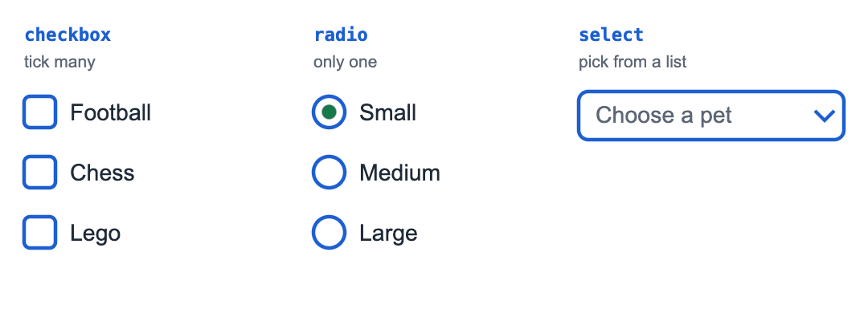
Part 1: Tick boxes and "pick one" buttons
checkbox: tick many. radio: only one. select: pick from a list.
Lesson 13

Slide 4
Part 1: Tick boxes and "pick one" buttons
checkbox and radio
<form>
<p>What do you like?</p>
<input type="checkbox" id="foot">
<label for="foot">Football</label>
<input type="checkbox" id="chess">
<label for="chess">Chess</label>
<p>Pizza size:</p>
<input type="radio" name="size" id="small">
<label for="small">Small</label>
<input type="radio" name="size" id="big">
<label for="big">Big</label>
</form>
Lesson 13

Slide 5
Part 1: Tick boxes and "pick one" buttons
type | You can choose | Example
checkbox | Many, or none | What do you like?
radio | Only ONE | Small or big pizza
Lesson 13

Slide 6
Part 1: Tick boxes and "pick one" buttons
Radio buttons in one group need the same name. That is how the browser knows only one can be picked.
UZ: radio guruhida name bir xil bo'lsa, faqat bittasini tanlash mumkin.
Quick question: You can pick only ONE answer. Which type?
A) checkbox
B) radio
C) text
Lesson 13

Slide 7
Part 2: Drop-down lists
<select> makes a drop-down list. Every choice is an <option>.
A drop-down with 3 choices
<form>
<label for="pet">Favorite pet</label>
<select id="pet">
<option>Dog</option>
<option>Cat</option>
<option>Fish</option>
</select>
</form>
Lesson 13

Slide 8
Part 2: Drop-down lists
Quick question: Every choice in a select is a...
A) <li>
B) <option>
C) <choice>
Lesson 13

Slide 9
Part 3: Big message boxes
<input> is for one line. For a long message use <textarea>. It DOES have a closing tag.
rows="4": 4 lines tall
<form>
<label for="msg">Your message</label><br>
<textarea id="msg" rows="4" placeholder="Write here..."></textarea><br>
<button>Send</button>
</form>
Lesson 13

Slide 10
Part 3: Big message boxes
Quick question: For a long message you use...
A) <input type="text">
B) <textarea>
C) <p>
Lesson 13

Slide 11
Watch out!
Radio buttons with different name: then you can pick all of them
Writing <input type="select">. A drop-down is <select> with <option>s
Forgetting </textarea>: the rest of the page goes into the box!
Labels without for: clicking the words does nothing
Lesson 13

Slide 12
Practice and homework
Practice in class
1. 3 checkboxes with labels: "I like cats", "I like dogs", "I like fish".
2. "Cats or dogs?" with 2 radio buttons. Only one can be picked.
3. There are 3 mistakes. Fix them.
4. A drop-down "Favorite color" with 5 colors. Blue is chosen at the start.
5. A "Pizza order" form: name, size (radio: small, medium, big), toppings (checkboxes: cheese, mushrooms, olives), drink (select), a message box, and an "Order" button.
Homework
1. A quiz form: "What is 2 + 2?" with 3 radio answers (3, 4, 5) and a Check button.
2. "My holiday": a drop-down of 4 countries, checkboxes for what to pack (3 things), and a textarea "Why?".
3. Your idea! Build any page you like. Use at least 3 things from today, for example <input type="checkbox">, <input type="radio" name="size">, <select><option>Cat</option></select>, <option selected>. No idea? Try: a superhero I made up, my football team, space and planets.
Lesson 13

