Slide 1
Lesson 9
YouTube, maps, video and sound
Today you put a YouTube video, a map, a video and a dinosaur roar on your page.
Lesson 9

Slide 2
Warm-up
1. Which tag makes one row in a table?
A) <td> B) <tr> C) <th>
2. Which tag makes a bold title cell?
A) <th> B) <td> C) <b>
3. One cell 2 columns wide:
A) colspan="2" B) rowspan="2" C) width="2"
Lesson 9

Slide 3
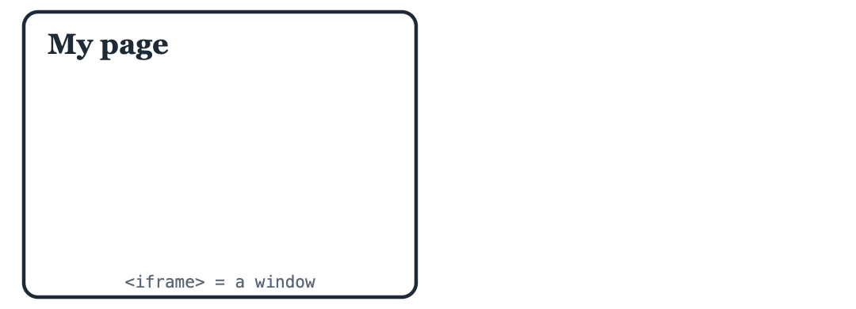
Part 1: YouTube videos
An <iframe> is a window inside your page that shows another website. YouTube gives you one for every video.
iframe is a window to another website. video and audio play files.
Lesson 9

Slide 4
Part 1: YouTube videos
The very first YouTube video, from 2005
<iframe width="400" height="225" src="https://www.youtube.com/embed/jNQXAC9IVRw" title="The first YouTube video" allowfullscreen></iframe>
Lesson 9

Slide 5
Part 1: YouTube videos
Part | Meaning
src | The video address. It has /embed/ in it
width, height | The size of the window
title | Says what is inside, for people who cannot see
allowfullscreen | Lets you watch it on the full screen
Lesson 9

Slide 6
Part 1: YouTube videos
1. On YouTube, open a video and click Share
2. Click Embed
3. Click Copy and paste the code into your page
Lesson 9

Slide 7
Part 1: YouTube videos
UZ: iframe bu sahifa ichidagi oyna: unda boshqa sayt ko'rinadi.
Quick question: Which tag shows a YouTube video on your page?
A) <video>
B) <iframe>
C) <youtube>
Lesson 9

Slide 8
Part 2: Maps
An iframe can show a Google map too. Put the name of a place after q=.
A map of Tashkent
<iframe width="400" height="300" src="https://www.google.com/maps?q=Tashkent&output=embed" title="Map of Tashkent"></iframe>
Lesson 9

Slide 9
Part 2: Maps
UZ: q= dan keyin shahar nomini yozing: xarita o'sha joyni ko'rsatadi.
Quick question: In the map address, where do you write the place?
A) After q=
B) After width=
C) In the title
Lesson 9

Slide 10
Part 3: Video and sound files
For a video FILE (not YouTube) use <video>. For sound use <audio>. Add controls to get the play button.
A video file with a play button
<video src="https://interactive-examples.mdn.mozilla.net/media/cc0-videos/flower.mp4" width="400" controls></video>
Lesson 9

Slide 11
Part 3: Video and sound files
A T-Rex roar!
<audio src="https://interactive-examples.mdn.mozilla.net/media/cc0-audio/t-rex-roar.mp3" controls></audio>
Lesson 9

Slide 12
Part 3: Video and sound files
Tag | Plays | Need
<video> | A video file (.mp4) | src, controls
<audio> | A sound file (.mp3) | src, controls
Lesson 9

Slide 13
Part 3: Video and sound files
Quick question: What gives you the play button?
A) play
B) controls
C) button
Lesson 9

Slide 14
Watch out!
Copying the normal YouTube link. The iframe needs the /embed/ link from Share, Embed
Forgetting controls: the video is there but you cannot press play
Forgetting </iframe>, </video> or </audio>. These tags DO need closing
No internet: videos and maps need the internet to load
Lesson 9

Slide 15
Practice and homework
Practice in class
1. Show the first YouTube video (code jNQXAC9IVRw) with width 400 and height 225.
2. "Where I live": an h2 and a map of your city.
3. There are 3 mistakes. Fix them.
4. "Dinosaur page": an h1, a p with a fact, and the T-Rex roar with controls.
5. "My media page": an h1, then 3 parts with h2: a YouTube video, a map of a place you want to visit, and the flower video. One p under each h2.
Homework
1. Find a YouTube video you like (ask a parent). Use Share, Embed and copy the iframe here.
2. A map of a place you want to visit, with an h2 above it saying why.
3. Your idea! Build any page you like. Use at least 3 things from today, for example <iframe src="https://www.youtube.com/embed/..."></iframe>, src="https://www.google.com/maps?q=Paris&output=embed", <video src="film.mp4" controls></video>, <audio src="roar.mp3" controls></audio>. No idea? Try: my best friend, robots, the sea and fish.
Lesson 9

