Slide 1
Lesson 2
Formatting text
Today you make your text bold, italic, highlighted and tiny, start new lines, and write special symbols.
Lesson 2

Slide 2
Warm-up
1. What is the first line of every HTML page?
A) <html> B) <!DOCTYPE html> C) <head>
2. Where does <title> go?
A) Inside <body> B) Inside <head> C) Before <!DOCTYPE html>
3. What is wrong here: <h1>Hello</h2>?
A) Nothing B) Open and close must be the same tag C) h1 does not exist
Lesson 2

Slide 3
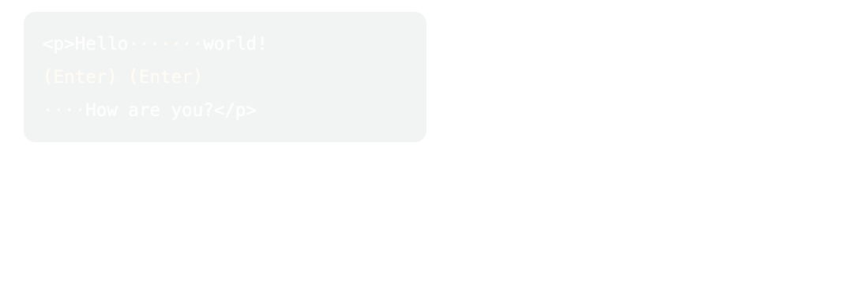
Part 1: New lines and lines
Surprise! The browser does not care about extra spaces or the Enter key. Many spaces become ONE space.
Many spaces and Enters are squeezed into one space. <br> makes a real new line.
Lesson 2

Slide 4
Part 1: New lines and lines
UZ: Browser ortiqcha probel va Enter ni ko'rmaydi. Yangi qator uchun br kerak.
<br> = new line. It has NO closing tag
<p>Roses are red,<br>
Violets are blue,<br>
HTML is fun,<br>
And so are you!</p>
Lesson 2

Slide 5
Part 1: New lines and lines
<hr> = a line across the page. Also NO closing tag
<h2>My Games</h2>
<p>I like Minecraft.</p>
<hr>
<h2>My Food</h2>
<p>I like pizza.</p>
Lesson 2

Slide 6
Part 1: New lines and lines
Quick question: You pressed Enter 5 times in your code. What does the browser show?
A) 5 empty lines
B) Nothing new, just one space
C) An error
Lesson 2

Slide 7
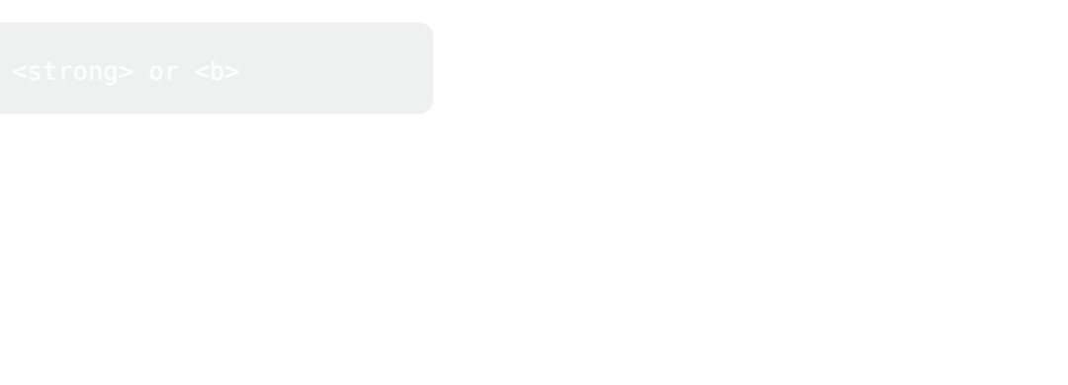
Part 2: Bold, italic, underline
Some words are more important. We can make them bold or *italic*.
Same word, different look.
Lesson 2

Slide 8
Part 2: Bold, italic, underline
strong, em and u
<p>Fire is <strong>hot</strong>. Do not touch it!</p>
<p>I <em>really</em> love cats.</p>
<p>This word is <u>underlined</u>.</p>
Lesson 2

Slide 9
Part 2: Bold, italic, underline
Tag | Look | Meaning
<strong> | bold | This is IMPORTANT
<b> | bold | Only looks bold
<em> | italic | Say it with feeling
<i> | italic | Only looks italic
<u> | underline | Use rarely: it looks like a link
Lesson 2

Slide 10
Part 2: Bold, italic, underline
UZ: strong va b ikkalasi qalin qiladi. Farqi: strong "bu muhim!" degani.
A tag can go inside another tag, like a small box in a big box. Close the inside box first.
Right | Wrong
<strong><em>Wow</em></strong> | <strong><em>Wow</strong></em>
Lesson 2

Slide 11
Part 2: Bold, italic, underline
UZ: Oxirgi ochilgan tag birinchi yopiladi.
Quick question: Which tag says "this is IMPORTANT"?
A) <b>
B) <strong>
C) <u>
Lesson 2

Slide 12
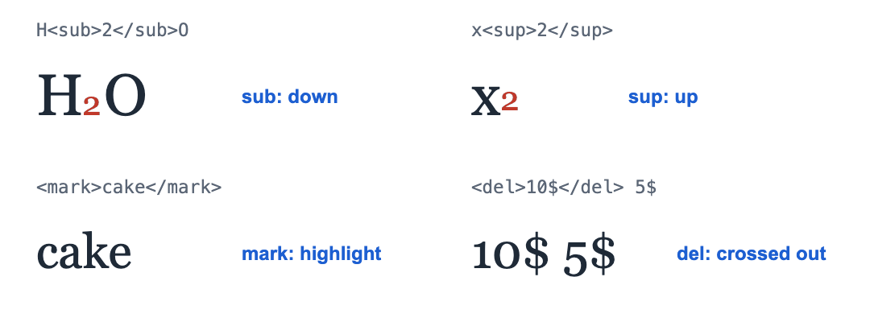
Part 3: Special text
sub goes down, sup goes up, mark highlights, del crosses out.
Lesson 2

Slide 13
Part 3: Special text
sub, sup, mark, del, small
<p>Water is H<sub>2</sub>O.</p>
<p>3<sup>2</sup> = 9</p>
<p>My favorite food is <mark>cake</mark>.</p>
<p>Price: <del>10$</del> 5$</p>
<p>Big text and <small>small text</small>.</p>
Lesson 2

Slide 14
Part 3: Special text
Tag | What it does | Example
<sub> | Small and DOWN | H₂O
<sup> | Small and UP | x², 1st
<mark> | Yellow highlight | like a marker pen
<del> | Crossed out (deleted) | old price
<small> | Smaller text | notes, small print
Lesson 2

Slide 15
Part 3: Special text
Quick question: Which tag puts the 2 in H₂O down?
A) <sup>
B) <sub>
C) <small>
Lesson 2

Slide 16
Part 4: Special symbols
How do you show < on the page? The browser thinks it is the start of a tag! We use a special code instead.
Code | Shows
&lt; | < (less than)
&gt; | > (greater than)
&amp; | & (and)
&copy; | © (copyright)
Lesson 2

Slide 17
Part 4: Special symbols
Every code starts with & and ends with ;
<p>5 &lt; 10</p>
<p>The h1 tag looks like this: &lt;h1&gt;</p>
<p>&copy; 2026 Ali</p>
Lesson 2

Slide 18
Part 4: Special symbols
Quick question: Which code shows < on the page?
A) &lt;
B) &gt;
C) &copy;
Lesson 2

Slide 19
Watch out!
Writing </br> or </hr>. <br> and <hr> have no closing tag
Pressing Enter many times for space. Use <br> or a new <p>
Wrong order: <strong><em>Hi</strong></em>. Close the inside tag first
Making everything bold. If everything is important, nothing is
Forgetting the ; in &lt;
Lesson 2

Slide 20
Practice and homework
Practice in class
1. Write a 4-line poem. Use <br> so every line starts on a new line.
2. Make the important words strong and the feeling words em.
3. There are 3 mistakes. Fix them.
4. Toy shop: the car was 20$, now 15$. Cross out the old price and highlight the new one. Then write 5² = 25 with sup.
5. "Fun Facts" page: an h1, 4 facts, at least 5 different tags from today, an <hr>, and a copyright line at the bottom.
Homework
1. Write a short poem or song you like, with <br> at the end of each line.
2. "About me": 3 sentences. Make 2 important words strong and 1 word em. Put an <hr> at the end.
3. Your idea! Build any page you like. Use at least 3 things from today, for example Line one<br>Line two, <hr>, <strong>hot</strong>, <em>really</em>. No idea? Try: my favorite food, dinosaurs, a trip I want to take.
Lesson 2

