Slide 1
Lesson 7
Images
Today you put pictures on your pages, change their size and make a picture you can click.
Lesson 7

Slide 2
Warm-up
1. What is the home page file called?
A) index.html B) home.html C) start.html
2. How do you link to your own page pets.html?
A) href="pets.html" B) href="https://pets" C) src="pets.html"
3. You changed the code but Chrome shows the old page. Why?
A) You did not save and refresh B) Chrome is broken C) HTML is too old
Lesson 7

Slide 3
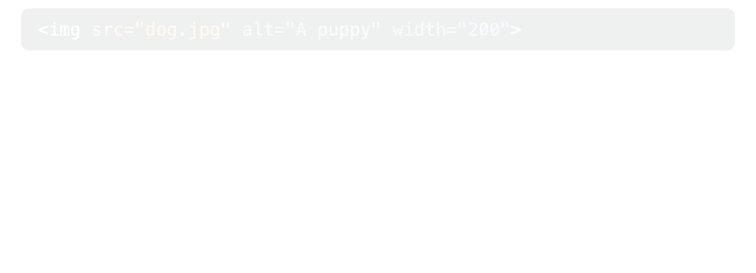
Part 1: The img tag
Pictures make a page fun. The tag is <img>. It has no closing tag: the picture is the content.
src is the picture, alt is the words you see if it cannot load.
Lesson 7

Slide 4
Part 1: The img tag
A picture from the internet
<img src="https://picsum.photos/id/237/400/300" alt="A black puppy">
Lesson 7

Slide 5
Part 1: The img tag
Part | Meaning
<img> | Image. No closing tag
src="..." | Source: where the picture is
alt="..." | Words that describe the picture, for people who cannot see it
Lesson 7

Slide 6
Part 1: The img tag
UZ: src bu rasm manzili. alt bu rasm haqida so'z: rasm ochilmasa, shu yoziladi.
Now break it on purpose: delete one letter from the src. What do you see instead of the picture? That is the alt!
Quick question: What does alt do?
A) Makes the picture bigger
B) Describes the picture in words
C) Adds a link
Lesson 7

Slide 7
Part 2: Picture size
width makes a picture wider or smaller. The number is in pixels, tiny dots on the screen.
Same picture, two sizes
<img src="https://picsum.photos/id/1074/400/300" alt="A lioness" width="150">
<img src="https://picsum.photos/id/1074/400/300" alt="A lioness" width="300">
Lesson 7

Slide 8
Part 2: Picture size
Use only width. The browser changes the height for you, so the picture is not squeezed.
Quick question: Which one changes the size of a picture?
A) alt="200"
B) width="200"
C) src="200"
Lesson 7

Slide 9
Part 3: Your own pictures, and pictures you can click
For your real website, put pictures in an images folder inside my-website. Then the src is the folder name, a /, and the file name.
A picture from YOUR folder
<img src="images/cat.jpg" alt="My cat Momo" width="300">
Lesson 7

Slide 10
Part 3: Your own pictures, and pictures you can click
1. In VS Code, make a new folder in my-website: images
2. Ask a parent to help you save a photo into it, for example cat.jpg
3. Write <img src="images/cat.jpg" alt="...">
Lesson 7

Slide 11
Part 3: Your own pictures, and pictures you can click
Put an <img> inside an <a> and the picture becomes a link!
Click the picture to go to Wikipedia
<a href="https://en.wikipedia.org/wiki/Pug" target="_blank">
<img src="https://picsum.photos/id/1025/400/300" alt="A pug in a blanket" width="250">
</a>
Lesson 7

Slide 12
Part 3: Your own pictures, and pictures you can click
Quick question: Your picture dog.png is in the images folder. What is the src?
A) src="dog.png"
B) src="images/dog.png"
C) src="images"
Lesson 7

Slide 13
Watch out!
Writing </img>. <img> has no closing tag
No alt. Every picture needs words that describe it
Wrong file name: Cat.JPG and cat.jpg are different names
Setting width AND a wrong height. The picture gets squeezed
Lesson 7

Slide 14
Practice and homework
Practice in class
1. Show the puppy picture with a good alt. Puppy: https://picsum.photos/id/237/400/300
2. An h2 "Wild animals" and 3 pictures (lioness 1074, leopard 219, walruses 1084), all width="200". Change only the number in the address.
3. There are 3 mistakes. Fix them.
4. Make the leopard picture a link to https://en.wikipedia.org/wiki/Leopard, opening in a new tab.
5. "Animal cards": for 3 animals, an h2 with the name, a picture (width="200") and a p with one fact. Make each picture a link to its Wikipedia page.
Homework
1. Put an images folder in my-website with one photo (ask a parent). Show it on index.html with alt and width. Copy the img line here.
2. On pets.html (or your third page), add 2 pictures from picsum.photos with good alt words.
3. Your idea! Build any page you like. Use at least 3 things from today, for example <img src="dog.jpg" alt="A dog">, alt="A dog", width="200", src="images/cat.jpg". No idea? Try: a superhero I made up, my football team, space and planets.
Lesson 7

