Slide 1
Lesson 8
Tables
Today you make tables: a timetable, a scoreboard and more.
Lesson 8

Slide 2
Warm-up
1. Which tag shows a picture?
A) <pic> B) <img> C) <src>
2. What does alt do?
A) Describes the picture in words B) Makes it bigger C) Makes it a link
3. Does <img> have a closing tag?
A) Yes, </img> B) No
Lesson 8

Slide 3
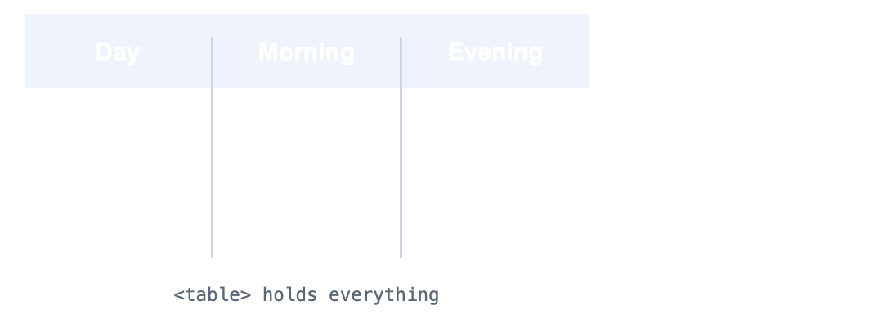
Part 1: Rows and cells
A table shows information in rows and columns, like a school timetable.
A table is built row by row, cell by cell.
Lesson 8

Slide 4
Part 1: Rows and cells
Tag | Means
<table> | The whole table
<tr> | Table row: one line across
<td> | Table data: one cell (box)
Lesson 8

Slide 5
Part 1: Rows and cells
UZ: tr bu qator. td bu bitta katak. Avval qator, keyin uning kataklari.
2 rows, 3 cells in each row. border="1" shows the lines
<table border="1">
<tr>
<td>Monday</td>
<td>School</td>
<td>Football</td>
</tr>
<tr>
<td>Tuesday</td>
<td>School</td>
<td>Chess</td>
</tr>
</table>
Lesson 8

Slide 6
Part 1: Rows and cells
Quick question: Which tag makes a new row?
A) <td>
B) <tr>
C) <table>
Lesson 8

Slide 7
Part 2: Header cells
The first row usually has the titles of the columns. Use <th> instead of <td>: it is bold and centered.
Lesson 8

Slide 8
Part 2: Header cells
<thead> holds the title row, <tbody> holds the rest
<table border="1">
<thead>
<tr>
<th>Day</th>
<th>Morning</th>
<th>Evening</th>
</tr>
</thead>
<tbody>
<tr>
<td>Monday</td>
<td>School</td>
<td>Football</td>
</tr>
<tr>
<td>Tuesday</td>
<td>School</td>
<td>Chess</td>
</tr>
</tbody>
</table>
Lesson 8

Slide 9
Part 2: Header cells
Tag | Means
<th> | Table header: a title cell, bold
<thead> | The top part, with the title row
<tbody> | The body, with all other rows
Lesson 8

Slide 10
Part 2: Header cells
Quick question: Which tag makes a bold title cell?
A) <th>
B) <td>
C) <title>
Lesson 8

Slide 11
Part 3: Big cells
A cell can be wider than one column: colspan="2". Or taller than one row: rowspan="2".
colspan="2": one cell, 2 columns wide
<table border="1">
<tr>
<th>Day</th>
<th>Morning</th>
<th>Evening</th>
</tr>
<tr>
<td>Saturday</td>
<td colspan="2">Fun day!</td>
</tr>
</table>
Lesson 8

Slide 12
Part 3: Big cells
UZ: colspan katakni eniga cho'zadi, rowspan bo'yiga.
Quick question: One cell 3 columns wide. What do you write?
A) rowspan="3"
B) colspan="3"
C) width="3"
Lesson 8

Slide 13
Watch out!
Writing <td> without a <tr> around it
Rows with different numbers of cells: the table looks broken
Forgetting border="1": the table has no lines and looks like plain text
Using <td> for the title row instead of <th>
Lesson 8

Slide 14
Practice and homework
Practice in class
1. A table with 2 rows: your name and age, and a friend's name and age. Use border="1".
2. "My pets" table with title cells Animal, Name, Age and 3 rows.
3. There are 3 mistakes. Fix them.
4. Times table: title cells "x", 1, 2, 3, then rows for 2 and 3 (2 × 1 = 2 ...).
5. Your week timetable: Day, Morning, Evening for Monday to Friday, plus Saturday with one "Fun day!" cell using colspan="2".
Homework
1. "My favorite foods" table: Food, Taste (sweet or salty), Score (1 to 10). 4 rows. Put it on one of your pages.
2. A football score table: Team, Played, Won, with 3 teams. Use thead and tbody.
3. Your idea! Build any page you like. Use at least 3 things from today, for example <table border="1">, <tr> ... </tr>, <td>Monday</td>, <th>Day</th>. No idea? Try: my favorite food, dinosaurs, a trip I want to take.
Lesson 8

