Slide 1
Hot Decks and Cold Values
Shalise S. Ayromloo, and Kelly R. Wilkin
U.S. Census Bureau, and Desert Research Institute
Federal Computer Assisted Survey Information Collection (FedCASIC)
April 6, 2022
Cleared For Public Release. Public-use Data.

Slide 2
Disclaimer
Disclaimer
These slides are released to inform interested parties of ongoing research and to encourage discussion of work in progress. The views expressed here are those of the authors and are not necessarily the U.S. Census Bureau’s. Any errors are solely those of the authors.

Slide 3
Background
Missing data is a problem for household surveys
Collect many items (variables), e.g.:
SIPP 2018 public-use file has over 4,000 questions
CPS basic monthly has about 400 questions
Goal is to make available a complete file
Correct for selection into item non-response
Avoid list-wise deletion of records
Missing items are imputed
Imputation may cause match bias

Slide 4
Hot Deck Imputation (HDI)
Most common method of imputation used by Census is the cell hot deck
Replaces missing values for a given target variable using the value reported by another survey participant with similar observational characteristics
Donor provides a value of the target variable to the recipient
Utility of HDI
Ensures only valid values are used for imputation
Can maintain logical relationships (e.g., men should not be imputed to be mothers)
Less complicated than model-based prediction methods (e.g., SRMI)
Not sensitive to model mis-specification
Less computationally expensive

Slide 5
HDI Considerations
Define the donor pool:
Which characteristics (stratifying variables) are used to match donors and recipients
Determining their relative “proximity” (e.g., exact matching, nearest neighbor)
If no donor is available, what value to use? (“cold” values)
Use of sampling weights
If a donor is used multiple times
If the target variable is correlated with weights

Slide 6
HDI at Census (e.g., SIPP)
Exact matching on a set of pre-defined stratifiers
Data editing processes variables row-wise (record by record)
If a record matches the set of stratifiers in the hot deck and the target is not missing, the hot deck cell associated with those characteristics is updated with that value. Repeats continuously as the file is processed
If a record has a missing target variable value, it is imputed from the value in the hot deck associated with the same characteristics (will show an example in just a moment)

Slide 7
HDI at Census (Continued)
If a record has a missing value and is imputed:
Donor is the most recent record with the same characteristics as the recipient to have non-missing target variable
The file is sorted by location (PSU) prior to editing. This means the donor and recipient will be from a “close” geographic area
If no donor is found, a default (“cold”) value is used
For example, if the first record in the file has a missing target variable value, there are no donors for it. Only option is a cold value
Emphasis is on choosing a hot deck where donors are likely. There is a tradeoff between predictiveness of target (i.e., adding more stratifiers) and ensuring few (to preferably no) cold values used

Slide 8
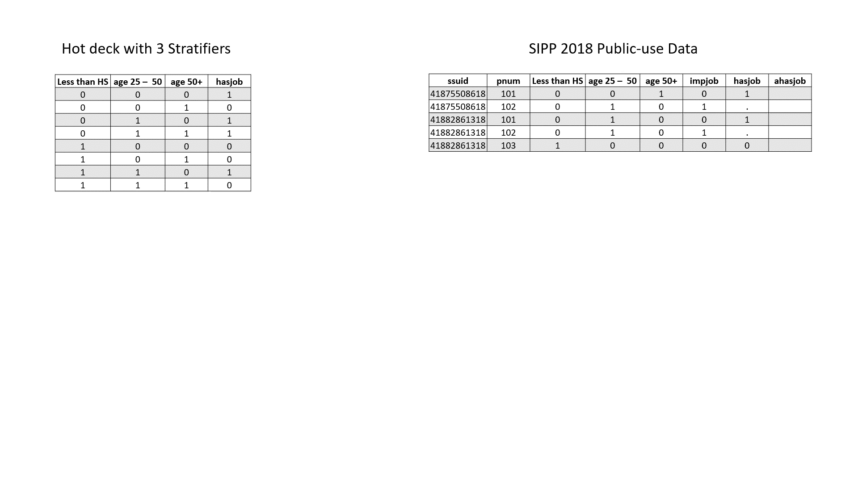
Example of Basic Hot Deck Initialized with Cold Values

Slide 9
Research Questions
Can we use machine learning (ML) to select features that comprise the hot deck?
Yes and no
If the ML algorithm predicts a broad set of covariates (thus opening the possibility of few donors), how can we improve the quality of initial cold values?
“mode of modes”?
Does HDI using the result of (1) and a method for (2) have better predictive performance than the status quo?
No statistical difference in our simple hot deck and SRMI

Slide 10
Data
Public-use Survey of Income and Program Participation (SIPP) 2018 Panel (reference year 2017)
Employment status in reference year collected at the person level
Restrict sample to age ≥ 15 in the reference period (i.e., universe for employment status questions in SIPP)
Variables that precede employment status are potential stratifiers

Slide 11


Data (Continued)
Target variable:
Missing job status indicator:

Slide 12
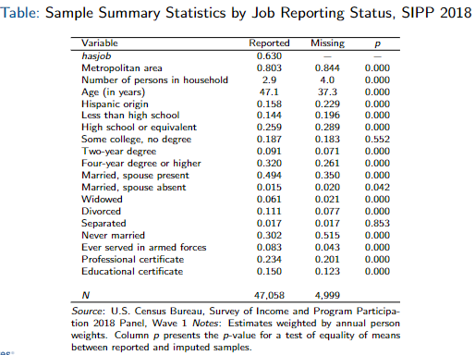
Summary Statistics

Slide 13
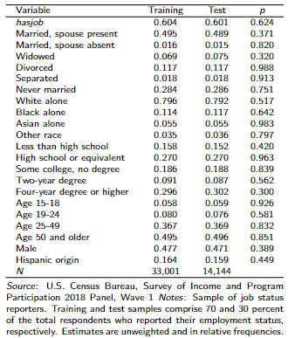
Summary Statistics

Slide 14
Recursive Feature Elimination (RFE)
Select the most predictive features for a target variable by recursively dropping the least predictive variables until a desired number of features is obtained
Specify a grid search that fits different models at different parameters
Choice: number of features out of 35
n_features_to_select: [3, 5, 8, 10, 12, 15, 20, 25, 30]
Split sample into training and test samples (70-30)
k-Fold cross validation for each (k = 5)
Decision Tree, Logistic Regression, Naive Bayes Bernoulli, Random Forest (default settings)

Slide 15
RFE (Continued)
Choose the model with highest precision score
Precision = TP / (TP+FP)
Assumes that the cost of false positives is high (if predicted to be employed, we want them to be employed!!)
Employment status affects downstream questions (e.g., poverty, program participation)
Train model on the set of records with non-missing employment status
Choose preferred model based on precision from test sample

Slide 16
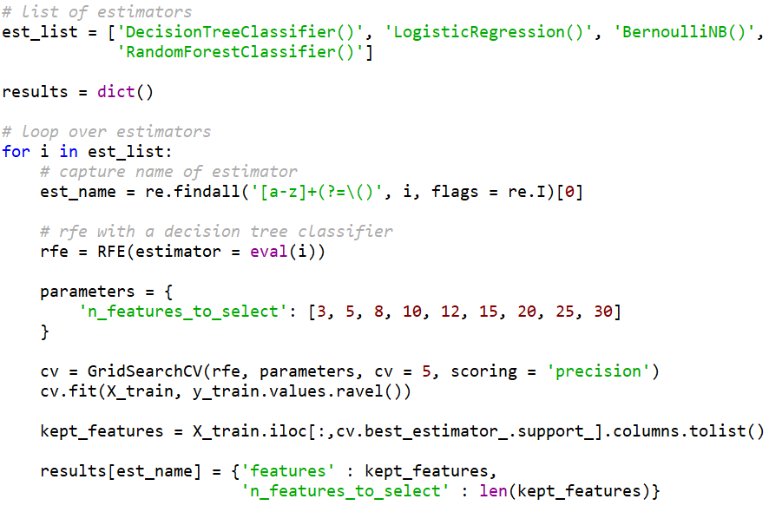
RFE: Sample Python Code

Slide 17
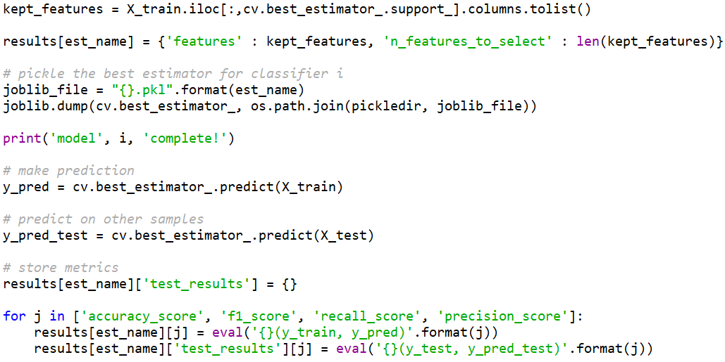
RFE: Sample Python Code

Slide 18
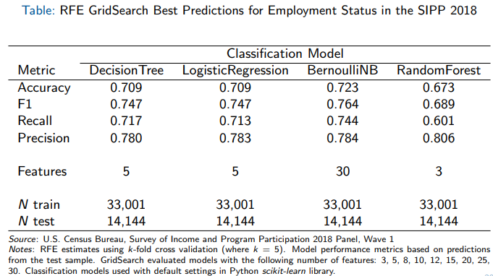
RFE: Results

Slide 19
Initialize Hot Deck with Modal Target as “Cold” Values
RFE produced k stratifiers
We need to initialize each cell with a plausible value of the target
No donor yet (e.g., the first record needs imputing)
No donor at all
We use the modal value of the target from the sample of non-missing records
What if there is no mode?

Slide 20
“Mode of Modes” for Uninitialized Cells
Recall: RFE produced k stratifiers
Sequentially restrict the set of stratifiers to k–m, where m = 1, 2, . . . , k–1
Instead of choosing one to drop, we look at all combinations of (k–m) stratifiers and get the mode for each
C(k, r) = k! /(r!(k−r )!) , where
k is the number of hot deck stratifiers and
r = k − m
Take mode of hasjob evaluated at each combination of stratifiers
Repeat this until a mode is achieved (ideally m is as small as possible)

Slide 21
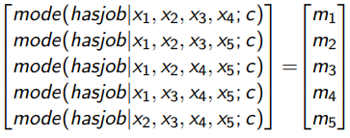
“Mode of Modes” Example
Let k = 5: stratifiers = [x₁, x₂, x₃, x₄, x₅]
For each cell c, set m = 1 and get mode evaluated at all combinations of k − m stratifiers:
ModeOfModes = mode(m₁, m₂, . . . , m₅)
If ModeOfModes exists, initialize cell c = ModeOfModes
Otherwise, set m = 2 and continue until it does (k − m = 1)

Slide 22
Random Forest Hot Deck
Less than HS | age 25 – 50 | age 50+ | hasjob
0 | 0 | 0 | 99
0 | 0 | 1 | 99
0 | 1 | 0 | 99
0 | 1 | 1 | 99
1 | 0 | 0 | 99
1 | 0 | 1 | 99
1 | 1 | 0 | 99
1 | 1 | 1 | 99
Less than HS | age 25 – 50 | age 50+ | hasjob
0 | 0 | 0 | 1
0 | 0 | 1 | 0
0 | 1 | 0 | 1
0 | 1 | 1 | 1
1 | 0 | 0 | 0
1 | 0 | 1 | 0
1 | 1 | 0 | 1
1 | 1 | 1 | 0
Hot Deck Structure
Hot Deck with Mode of Modes
Less than HS | age 25 – 50 | age 50+ | hasjob
0 | 0 | 0 | 1
0 | 0 | 1 | 0
0 | 1 | 0 | 1
0 | 1 | 1 | 99
1 | 0 | 0 | 0
1 | 0 | 1 | 0
1 | 1 | 0 | 1
1 | 1 | 1 | 99
Hot Deck with Modes

Slide 23
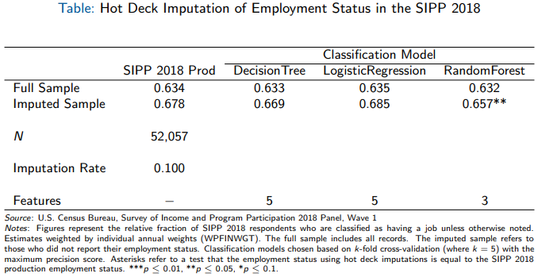
Hot Deck Imputation

Slide 24
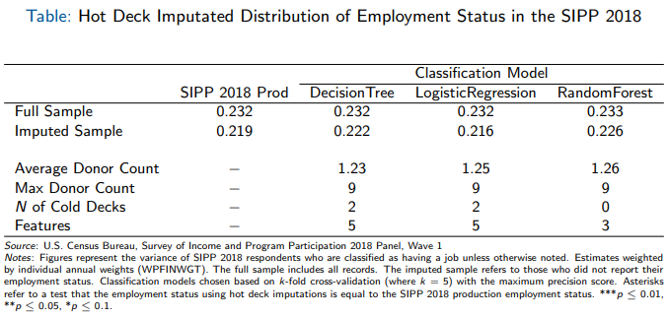
Imputation Performance

Slide 25
Conclusions
Random Forest Classifier with 3 features was the best estimator based on precision score (precision = 0.8)
Found no statistical difference in hasjob distribution between production SRMI and hot deck imputation based on 3 different classification models (mean and variance)
Employment status non-response may be associated with having a job

Slide 26
Summary
Developed a pipeline to (hot deck) impute for missing job status in the SIPP
Recursive Feature Elimination to choose the optimal number of features for a given a binary classifier
Train-test-split method (70-30)
Grid search (5-fold CV) across different feature counts (between 3 and 30) for each classifier
Construct hot deck using features from the model with the highest precision score
Developed “mode of modes” method for initializing hot deck
Compared imputed job status distribution to SIPP production

Slide 27
Discussion
Our fully saturated models result in logically inconsistent variable combinations (e.g., age 25–50, age 50+)
Is precision score the right performance metric?
Public-use data has limited features:
Best Logistic Regression for internal had 12 features
Best Logistic Regression for public has 5 features
Alternative measures of similarity (e.g., propensity scores) for matching donors to recipients?

Slide 28
Thank You!
Please direct all questions and comments to:
Shalise S. Ayromloo
Labor Force Statistics Branch
U.S. Census Bureau
shalise.ayromloo@census.gov
Kelly R. Wilkin
Center for Genomic Medicine
Desert Research Institute
kelly.wilkin@dri.edu

