Slide 1
CourseOverflow
Computing Habitat Programming Competition 2011
Better collaboration
Bryan Mishkin
Joseph Kaczmarek
Kiran Ryali

Slide 2
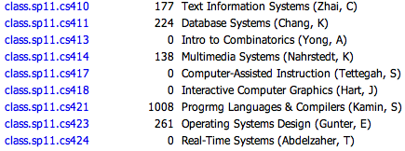
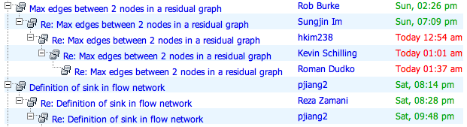
Existing Class Newsgroups
Used for:
Class discussion
Announcements
Clarifications
Provides:
Discussion threads
Basic search
That’s about it
html4nntp, available at news.cs.illinois.edu

Slide 3
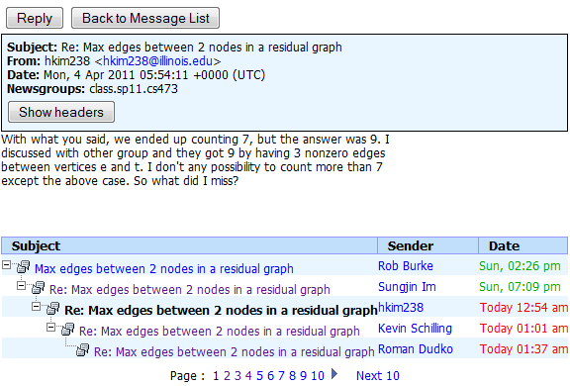
Problems
Hard to find good answers
Difficult to follow a thread
No incentive to contribute
Not knowing who to trust
Stuck in the 80s

Slide 4
We can do better

Slide 5


The Idea
Use social media to bring newsgroups into 21st century
With influence from
and

Slide 6
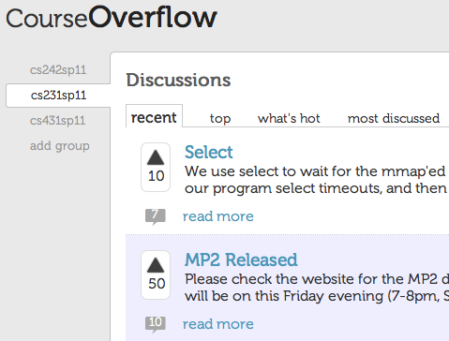
(Sexy) Client Demo
http://courseoverflow.web.cs.illinois.edu/CourseOverflow/html

Slide 7
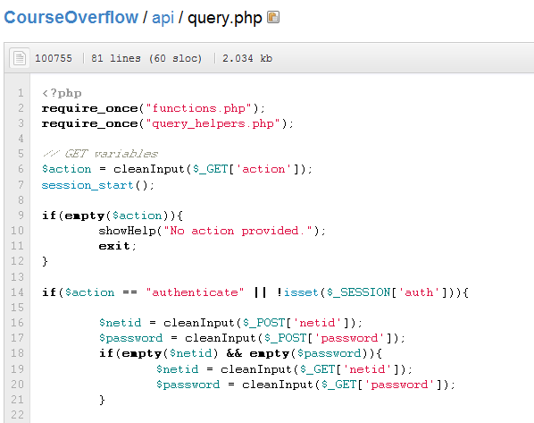
API Demo
http://courseoverflow.web.cs.illinois.edu/CourseOverflow/api

Slide 8
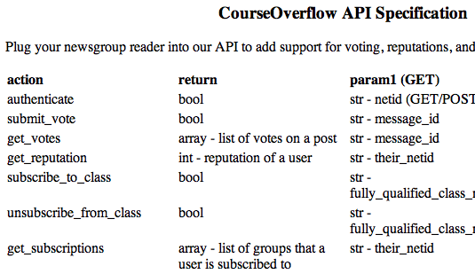
Future proofing the newsgroups
We built an API that newsgroup readers can plug into for:
User reputations based on voting
Remembering what classes students are in

Slide 9
Features we could still add
Auto-subscribe students to their class
Notifications when someone replies to you
Achievements and Badges
Code specific markup
“Follow” discussions

Slide 10
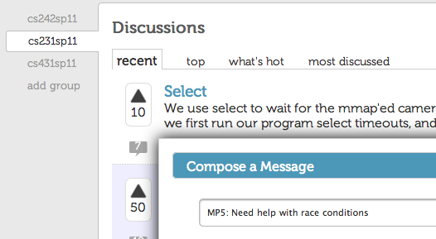
Thanks + Questions
University of Illinois at Urbana-Champaign

