Slide 1


CourseOverflow
Computing Habitat Programming Competition 2011
University of Illinois at Urbana-Champaign
Bryan Mishkin
Joseph Kaczmarek
Kiran Ryali
With influence from
and

Slide 2
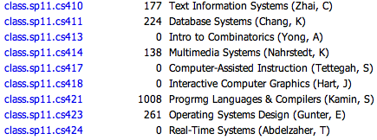
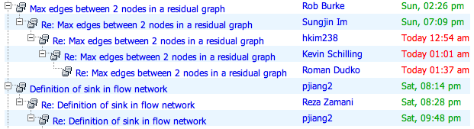
The CS Newsgroups
Used for:
Class discussion
Announcements
Clarifications
Provides:
Discussion threads
Basic search
That’s about it
html4nntp, available at news.cs.illinois.edu

Slide 3
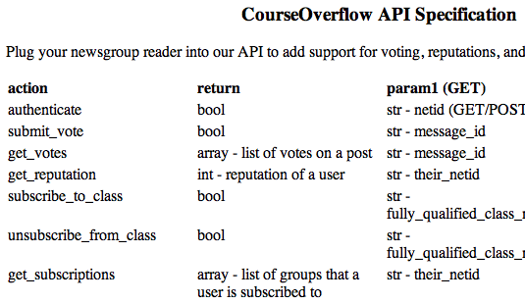



Extending the newsgroups
We built an API that newsgroup readers can plug into for:
User reputations based on voting
Remembering what classes students are in

Slide 4
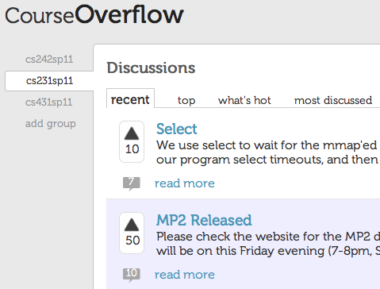
Making it pretty
We also mocked up a modern UI:
Cleaner
Better usability
Just plain sexy

Slide 5
Demo
courseoverflow.web.cs.illinois.edu/CourseOverflow

Slide 6
Features we could still add
Auto-subscribe students to their class newsgroups with UIUC Bluestem
Notifications when someone replies to you
Crown for the user with the highest-rep

Slide 7
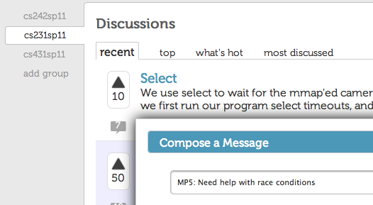
Thanks + Questions
University of Illinois at Urbana-Champaign

