Slide 1
Movie Score Prediction Generator
Kevin Ryan, Ryan Primus
CS 548: Applied Machine Learning
Fall 2024

Slide 2
Movie Score Prediction
Movies contain a wide variety of features:
- Actors, directors, genres, studios, producers, crew, set design, composer, etc.
People often rate movies, giving them a 3/5, a thumbs down, or maybe a like on an Instagram post.
But, how can we understand that a movie has done well?
Or….
Can we predict that a movie will do well based on these features?
Notes:
PN affects thz communications -> sample dataset of comms w/ PN and BER -> ML regressors use input variables to predict BER -> some input variables are more important than others -> feature importance

Slide 3
Movie Score Prediction
We created a…
Movie Score Prediction Generator
Insert up to 3 actors, 3 genres, 3 studios, and 1 director
Receive a predicted Letterboxd score!
Notes:
PN affects thz communications -> sample dataset of comms w/ PN and BER -> ML regressors use input variables to predict BER -> some input variables are more important than others -> feature importance

Slide 4
Intro
Dataset: 70,000+ points
Kevin ryan can explain dataset stuff and some regressors

Slide 5
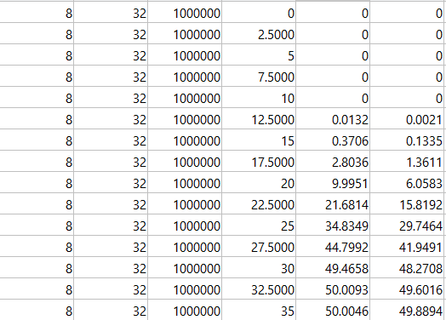
Sample Dataset
Pilot Length
Pilot Spacing
Symbol Rate
Phase Noise
Bit Error Rate
Other Bit Error Rate
2520 Tuples

Slide 6
Machine Learning in THz
We train regressors on our input features to predict our target feature
Regressors:
AdaBoost Regressor (ABR),
Gradient Boosting Regressor (GBR),
Random Forest Regressor (RFR),
k-Nearest-Neighbors Regressor (kNN)
Input Features:
Pilot Length, Pilot Spacing, Symbol Rate, Phase Noise
For our regressors’ predictions they followed this structure:
Target Feature(s):
BER, OBER
Notes:
- Should make another separate book for OBER

Slide 7
What is Feature Importance?
Feature Importance: Helps us understand which of our input features (Pilot Length, Pilot Spacing, etc.) of our dataset are the most important in predicting our output feature (BER, OBER)
Quantifies how valuable each feature is in a percent, all features add up to 1 or 100%
In our Python code, we used two built-in features from sklearn: “feature_importance_” and “permutation_importance”

Slide 8
Feature Importance Definition
For feature_importance_ in Python, the sklearn user guide states: The impurity-based feature importances.
The higher, the more important the feature. The importance of a feature is computed as the (normalized) total reduction of the criterion brought by that feature. It is also known as the Gini Importance.
Used in tree-based models, so we can use Gini Importance for ABR, GBR, and RFR. Can’t use it for kNN, we’ll get into that later.
feature_importances_ndarray of shape (n_features,)
The values of this array sum to 1, unless all trees are single node trees consisting of only the root node, in which case it will be an array of zeros.
RandomForestRegressor — scikit-learn 1.5.0 documentation

Slide 9
Feature Importance Explained
Gini Importance:
The importance of a feature is calculated as the total reduction of the Gini impurity brought by that feature.
Gini impurity measures the impurity of a node in a decision tree, giving more weight to more important features.
For each tree, Gini Importance quantifies the reduction in Gini impurity achieved by splitting nodes based on a particular feature. Features that consistently lead to greater impurity reduction across the ensemble are assigned higher Gini Importance scores.
Gini Importance is also known as the Mean Decrease of Impurity (MDI).
Feature Importance with Random Forests

Slide 10


Feature Importance Algorithm
feature_importance_ -> uses MDI
Mean Decrease of Impurity = Gini Importance
Importance of a Variable (Feature)
Mean Decrease of Impurity (MDI)
For this reason, Breiman [2001, 2002] proposed to evaluate the importance of a variable Xj for predicting Y by adding up the weighted impurity decreases p(t)∆i(st, t) for all nodes t where Xj is used, averaged over all trees ϕm (for m = 1, . . . ,M) in the forest:
where p(t) is the proportion Nt N of samples reaching t and where jt denotes the identifier of the variable used for splitting node t. When using the Gini index as impurity function, this measure is known as the Gini importance, Mean Decrease Gini, or Mean Decrease Impurity
In the context of single decision trees, Breiman et al. [1984] first defined the measure of importance of a variable Xj as Imp(Xj) = X t∈ϕ ∆I(s˜ j t , t), (6.1) where ˜s j t is the best surrogate split for st, that is the closest split defined on variable Xj that can mimic the actual split st defined at node t.
Understanding Random Forests: From Theory to Practice (arxiv.org)
Notes:
Taken directly from Gilles Loupe
Understand right side of Importance Variable
Impurity vs Entropy, related?

Slide 11
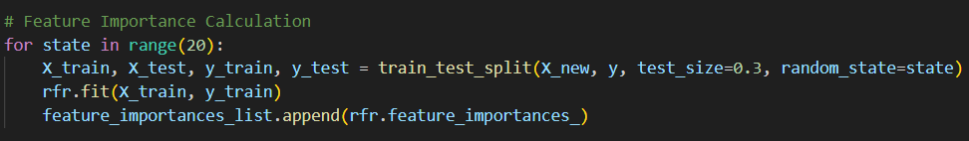
Feature Importance in Python

Slide 12
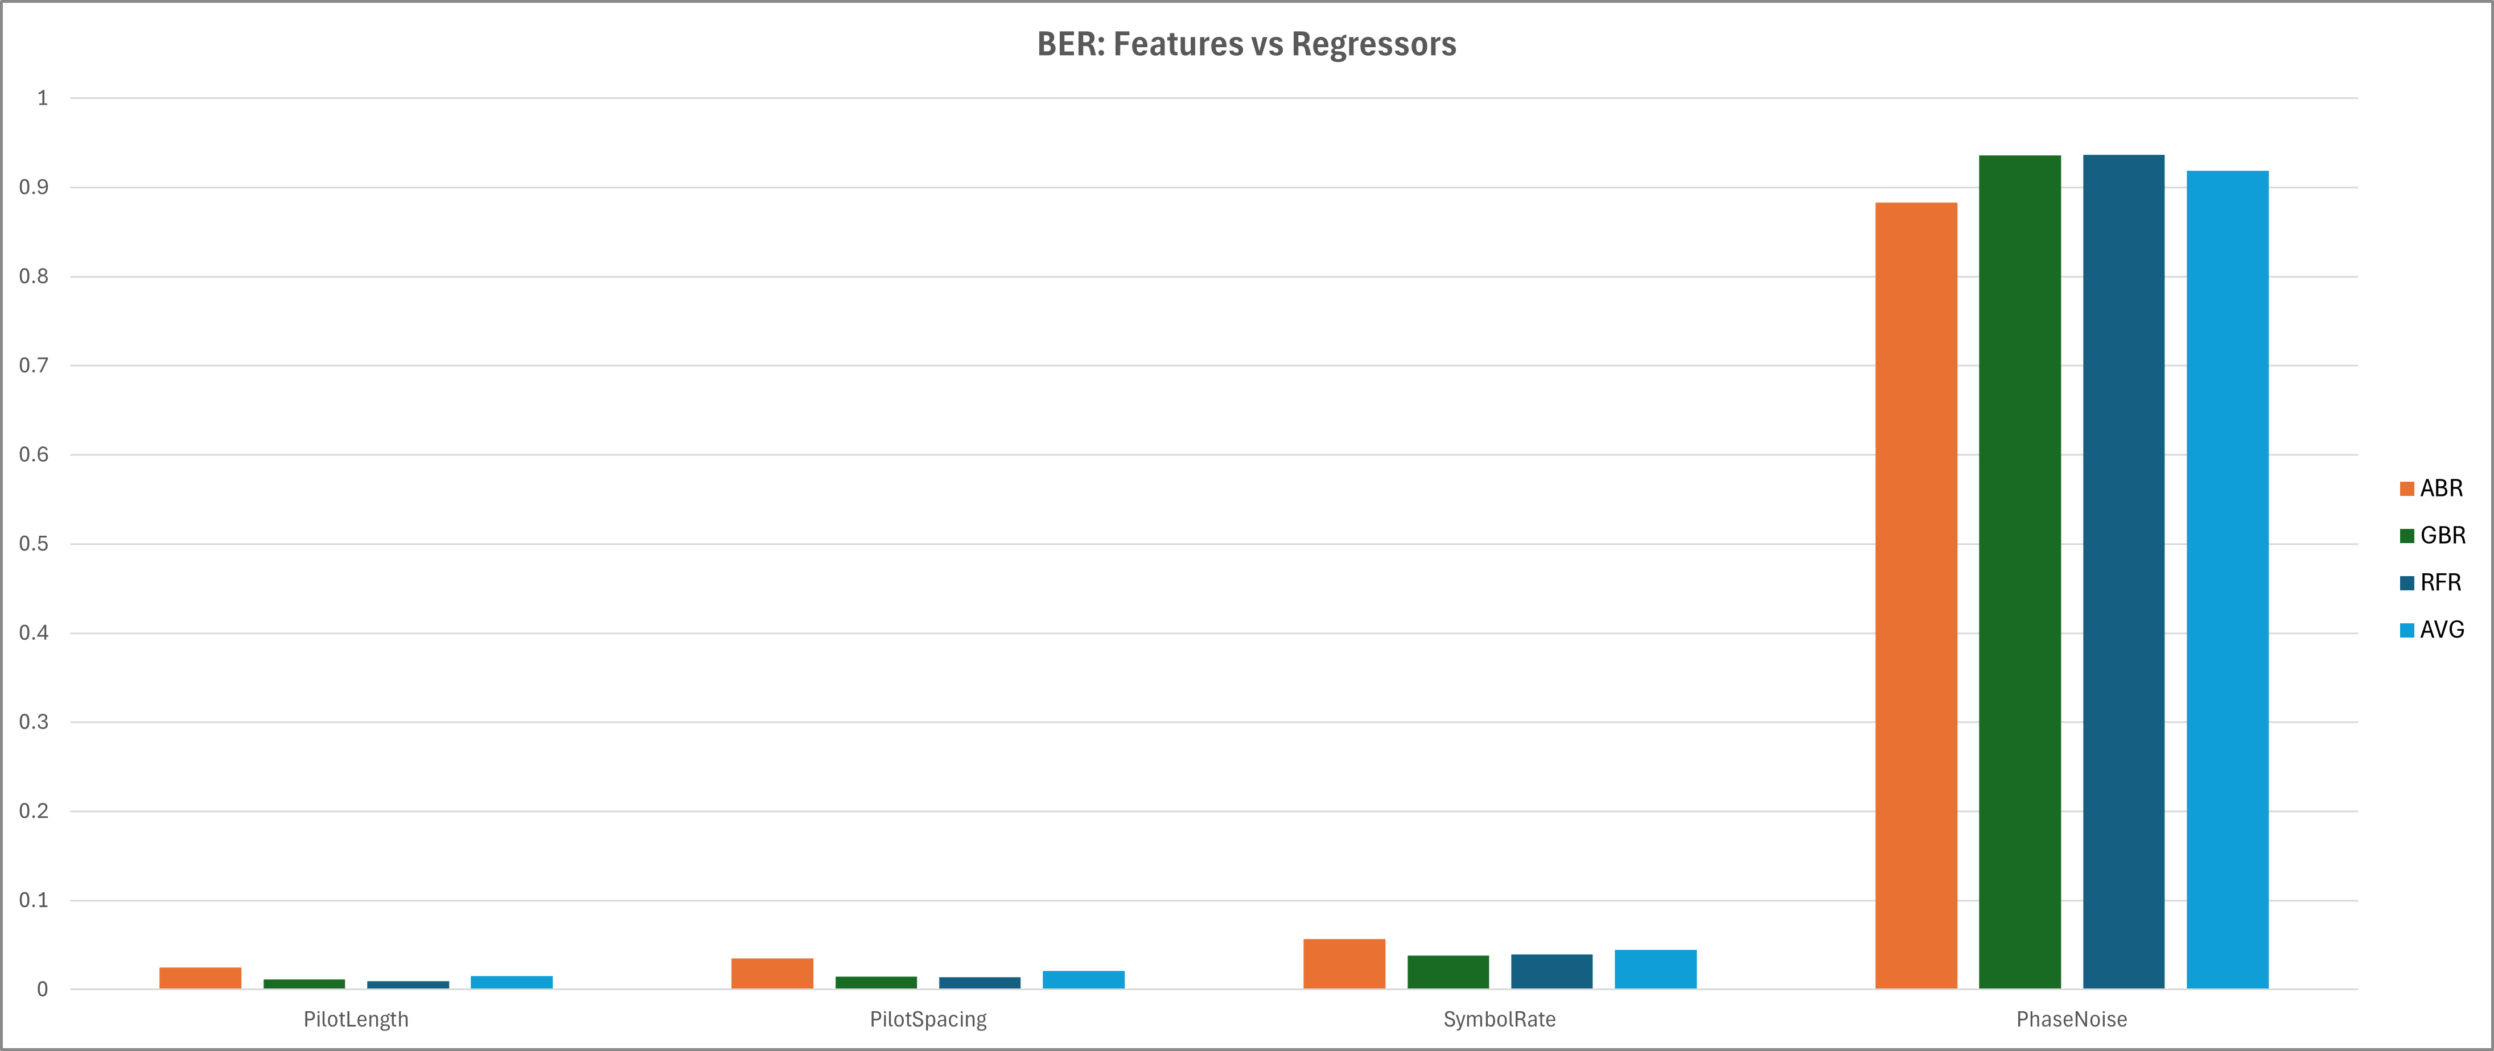
Feature Importance Graph: BER
Total Avg: |  | Average | St Dev
PilotLength |  | 0.015366 | 0.001179
PilotSpacing |  | 0.021201 | 0.001834
SymbolRate |  | 0.044718 | 0.002716
PhaseNoise |  | 0.918715 | 0.003896

Slide 13
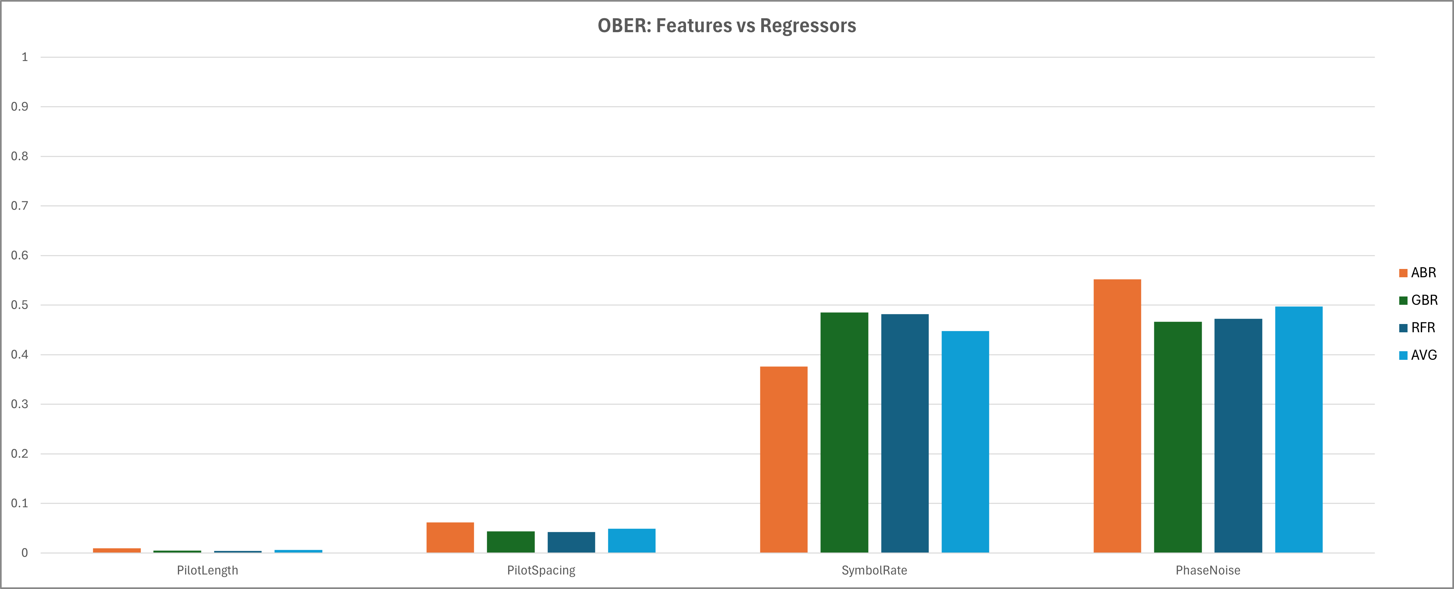
Feature Importance Graph: OBER
Total Avg: |  | Average | St Dev
PilotLength |  | 0.006212 | 0.001058
PilotSpacing |  | 0.049145 | 0.003314
SymbolRate |  | 0.447757 | 0.009436
PhaseNoise |  | 0.496887 | 0.009924

Slide 14
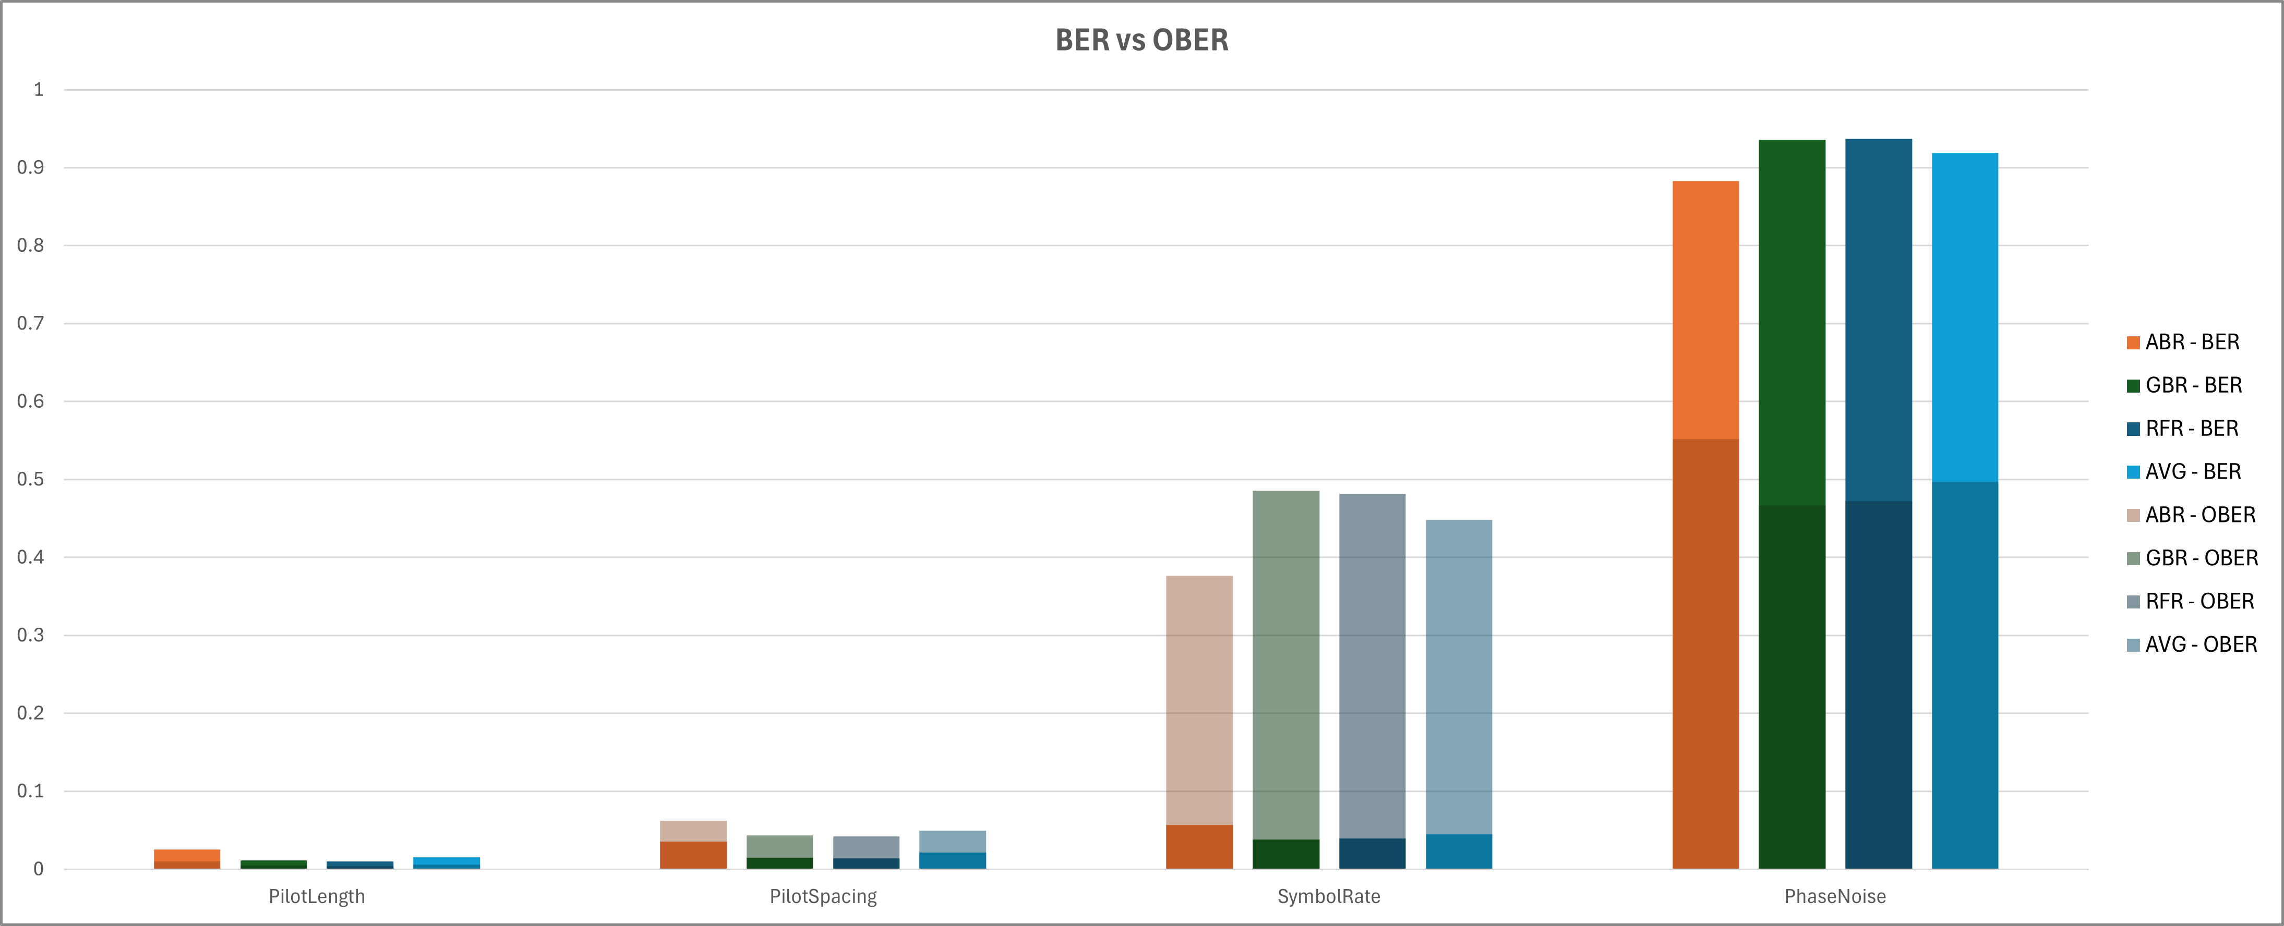
Feature Importance Graph: BER vs OBER
Notes:
Add BER prediction accuracy

Slide 15
Feature Importance Limitations
Feature importance is limited in certain ways.
Only used with tree-based models
Uses MDI on training dataset, can lead to overfitting and perform poorly on test dataset
Strongly biased towards high cardinality features, which can lead to non-accurate predictions
There is another importance we can use that counteracts these issues faced with feature importance:
Permutation Importance
Understanding Random Forests: From Theory to Practice (arxiv.org)
Notes:
Taken directly from Gilles Loupe

Slide 16
Permutation Importance Definition
For permutation_importance used in Python, the sklearn user guide states:
Permutation importance for feature evaluation [BRE].
The estimator is required to be a fitted estimator. X can be the data set used to train the estimator or a hold-out set. The permutation importance of a feature is calculated as follows. First, a baseline metric, defined by scoring, is evaluated on a (potentially different) dataset defined by the X. Next, a feature column from the validation set is permuted and the metric is evaluated again. The permutation importance is defined to be the difference between the baseline metric and metric from permutating the feature column.
permutation_importance — scikit-learn 1.5.0 documentation

Slide 17
Permutation Importance Explained
Permutation importance assesses the significance of each feature independently in out-of-bag cross-validated predictions, providing a more reliable and robust measure.
By evaluating the impact of individual feature permutations on predictions, it calculates importance. Permutation involves randomly shuffling a single feature’s values and measuring the resulting performance decrease (e.g., accuracy, F1-score). Comparing the model’s original and permuted values allows for a precise evaluation of feature importance.
Feature Importance with Random Forests

Slide 18
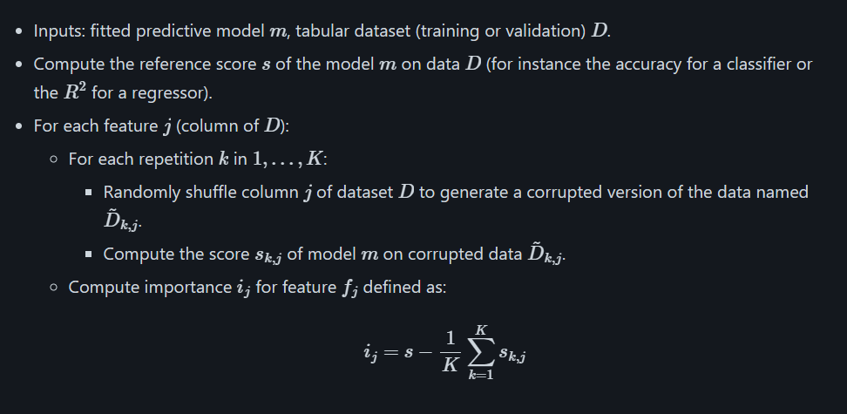
Permutation Importance Algorithm
permutation_importance from the sklearn algorithm:
permutation_importance — scikit-learn 1.5.0 documentation

Slide 19
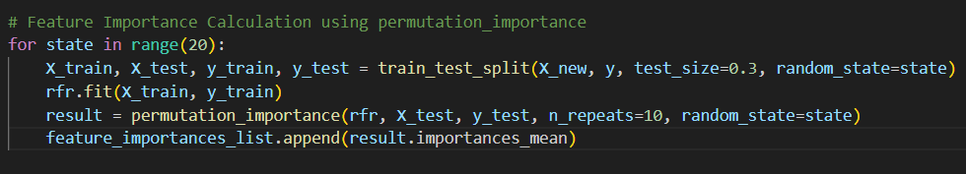
Permutation Importance in Python

Slide 20
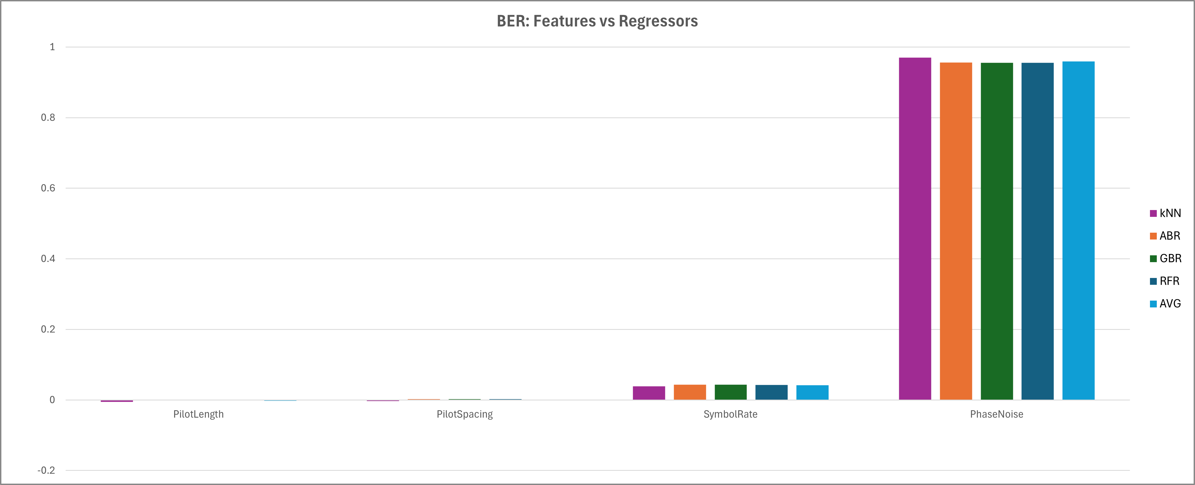
Permutation Importance Graph: BER
Total Avg: |  | Average | St Dev
PilotLength |  | -0.00203 | 0.002172
PilotSpacing |  | 0.000944 | 0.002621
SymbolRate |  | 0.041957 | 0.005277
PhaseNoise |  | 0.959134 | 0.007029

Slide 21
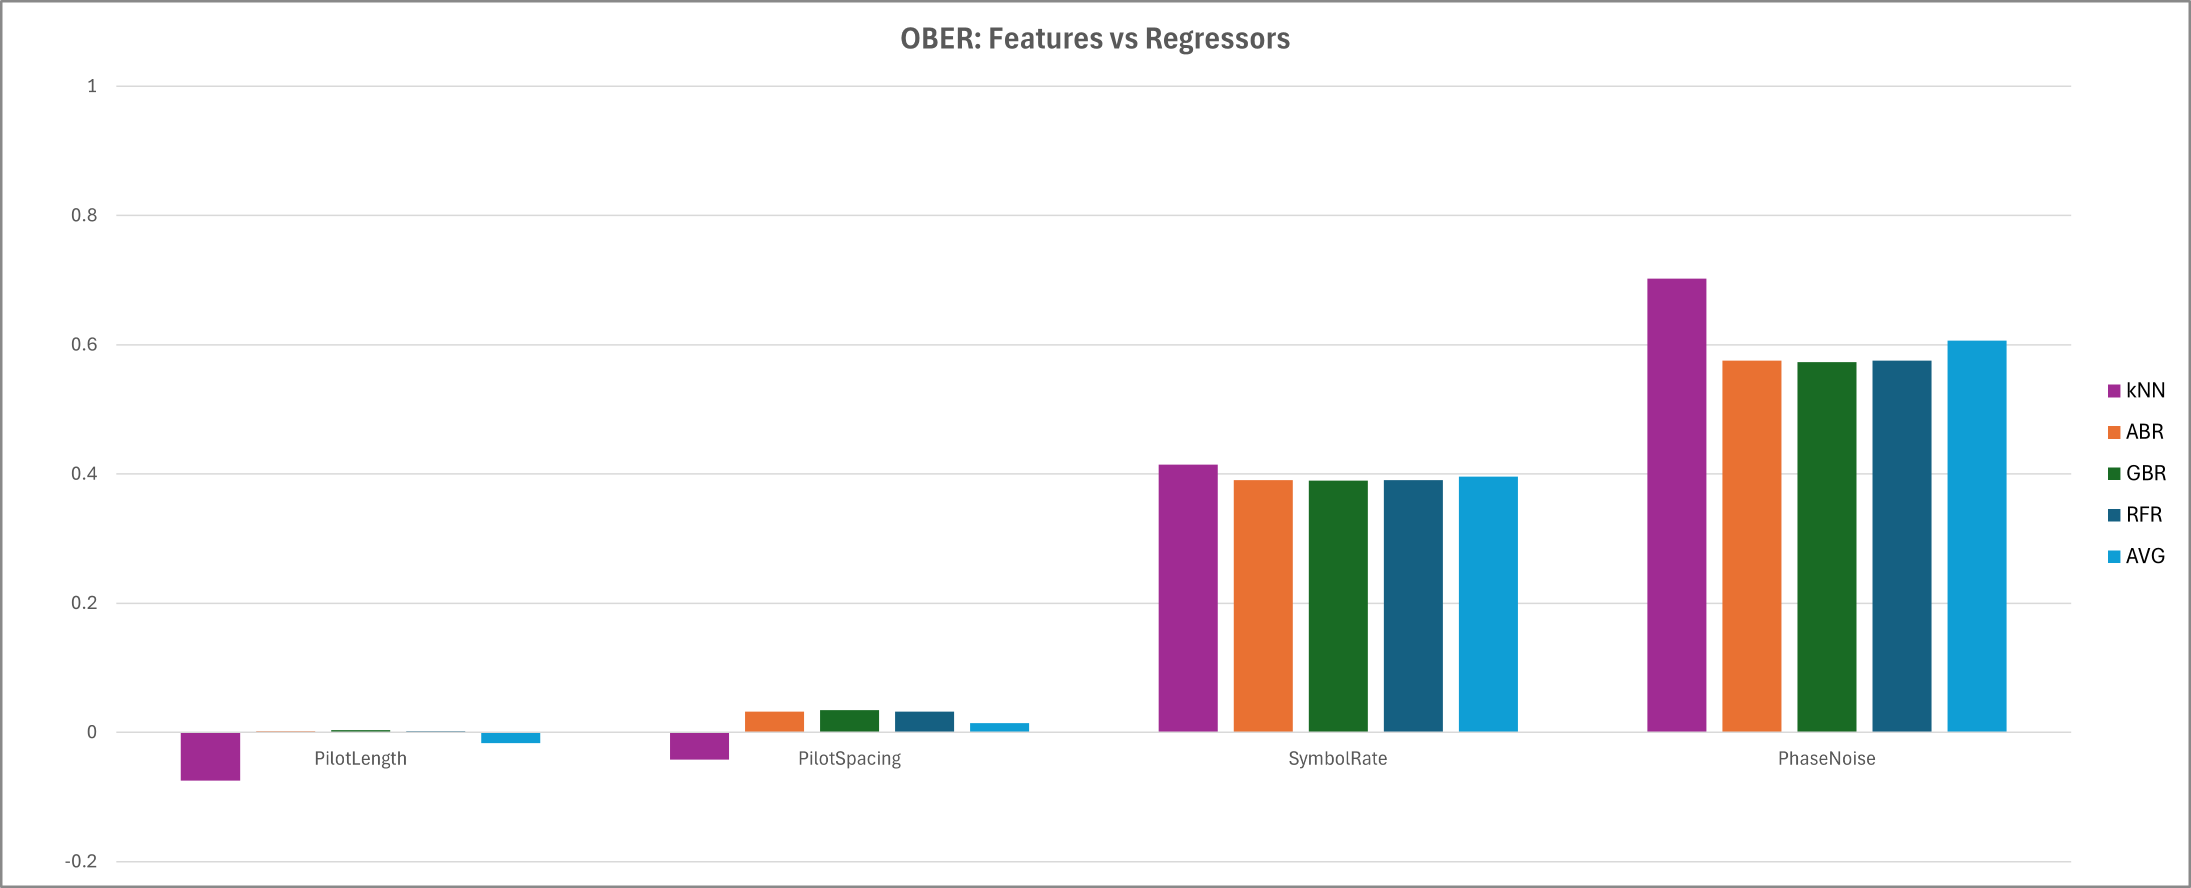
Permutation Importance Graph: OBER
Total Avg: |  | Average | St Dev
PilotLength |  | -0.01694 | 0.003272
PilotSpacing |  | 0.014172 | 0.004992
SymbolRate |  | 0.396166 | 0.013949
PhaseNoise |  | 0.6066 | 0.015978

Slide 22
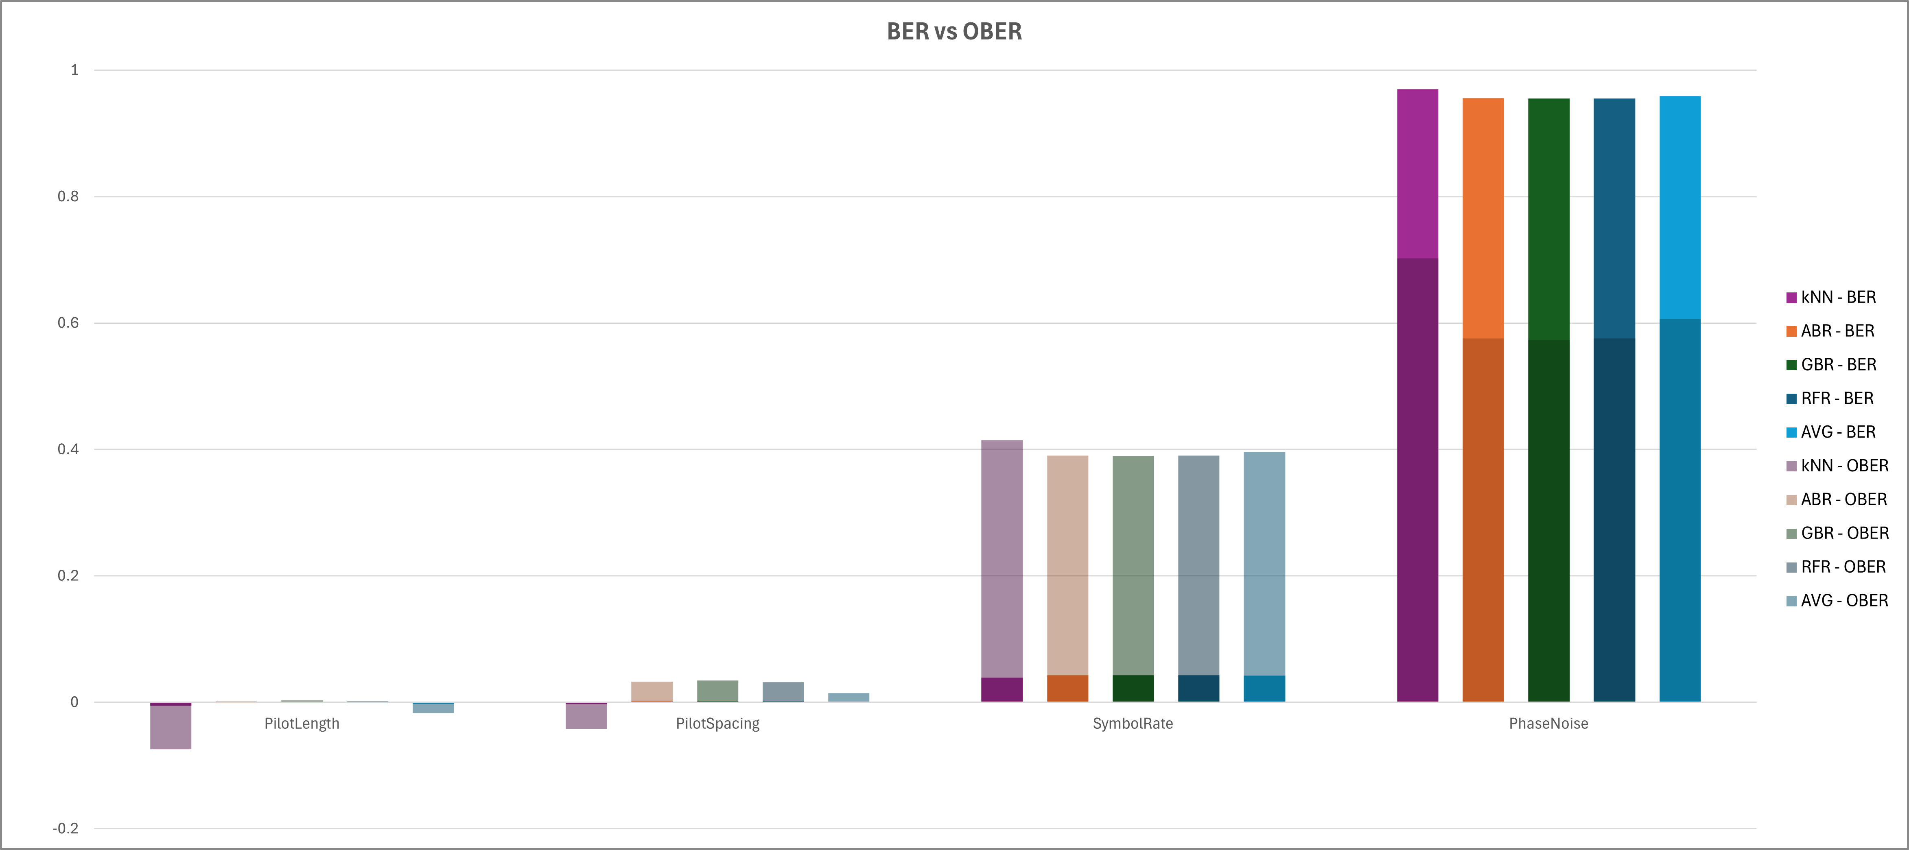
Permutation Importance Graph: BER vs OBER

Slide 23
FI and PI
Some notable takeaways from both Feature Importance (FI) and Permutation Importance (PI):
We see the same general trends for our features
Phase Noise is most important, followed by Symbol Rate, then Pilot Spacing and Pilot Length
Phase Noise importance decreases from BER to OBER
Symbol Rate importance increases as a result, Pilot Spacing and Pilot Length slightly increase

Slide 24
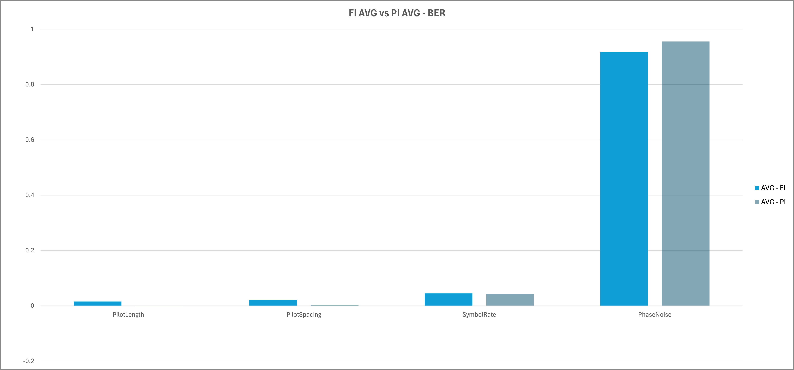
FI and PI

Slide 25
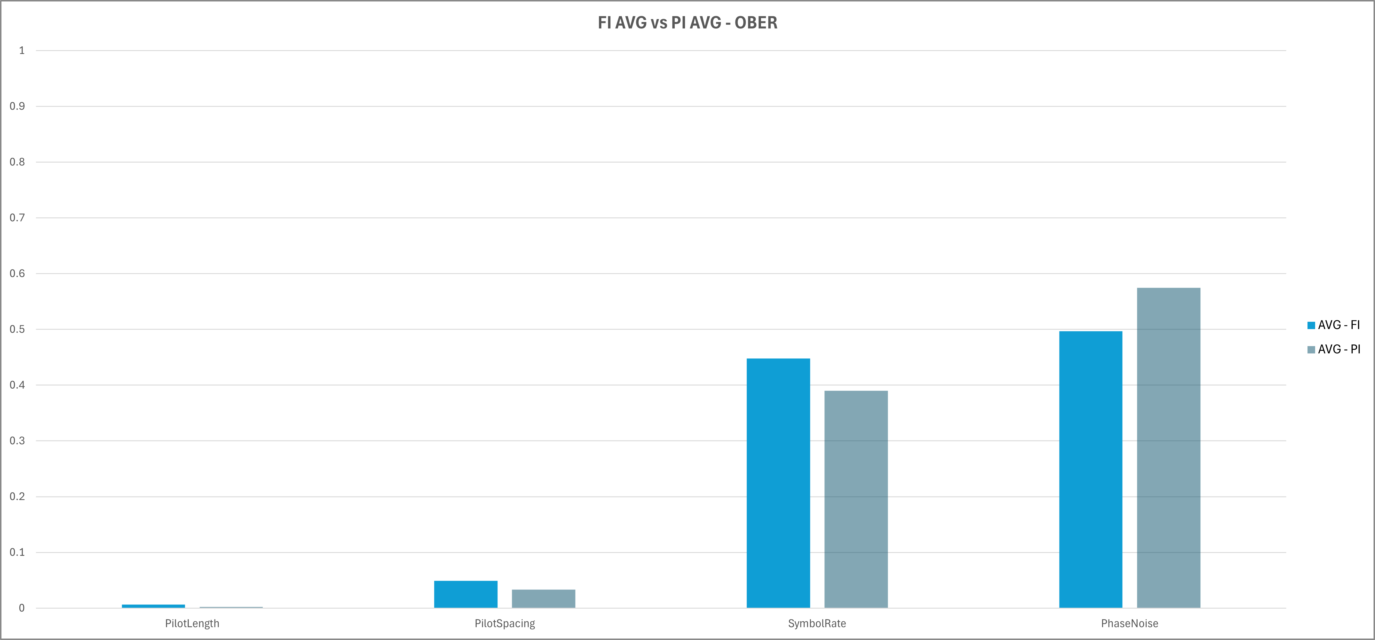
FI and PI

Slide 26
Analysis of our Importance
Comparing Feature Importance (FI) and Permutation Importance (PI):
For both BER and OBER, PI favors Phase Noise more than FI
Interesting as PI is less biased, which means PN is more important than we thought?
With more favor to Phase Noise, less favor to Symbol Rate
Symbol rate matters less than we thought with standard feature importance, no big deal
Pilot Length and Pilot Spacing have very, very small importance for both FI and PI
Pilot Length and Pilot Spacing are actually negative for BER and OBER in PI in kNN
Potentially hurting our predictions in kNN?

Slide 27
Final Summary
Overall: The same general trend is found between both FI and PI, with some minor differences between both. PI favors Phase Noise more than FI, which is interesting as PI is less biased than FI.
In terms of usage, we believe we could use either FI or PI, or both. FI is geared towards tree-based models, which works great for ABR, GBR, and RFR. PI is geared towards any type of model, which is why we used it because we couldn’t use FI for kNN.

Slide 28
What did we learn from our dataset?
We now know: It turns out that Phase Noise is the most important feature by far when it comes to predicting BER. However, with OBER, Phase Noise importance decreases by nearly half, giving rise to Symbol Rate as our next important feature. Symbol Rate quadruples in importance, and in some regressor cases (GBR, RFR) it is more important than Phase Noise. We also understand now that Pilot Spacing and Pilot Length have very small feature importance, both under 4% importance. They also could be hurting our BER/OBER prediction in kNN, with PI showcasing this.

Slide 29
Next steps
Introducing log scale for BER/OBER error calculation
Lesser BER values (0-10) have more importance than higher (25-50) when predicting BER/OBER
Continue feature prediction based on Phase Noise
Has been done with kNN, still figuring out ABR, GBR, RFR
Adding White Noise in addition to Phase Noise

Slide 30
References
RandomForestRegressor — scikit-learn 1.5.0 documentation
permutation_importance — scikit-learn 1.5.0 documentation
Understanding Random Forests: From Theory to Practice (arxiv.org)
Feature Importance with Random Forests - GeeksforGeeks

Slide 31
Questions?

Slide 32
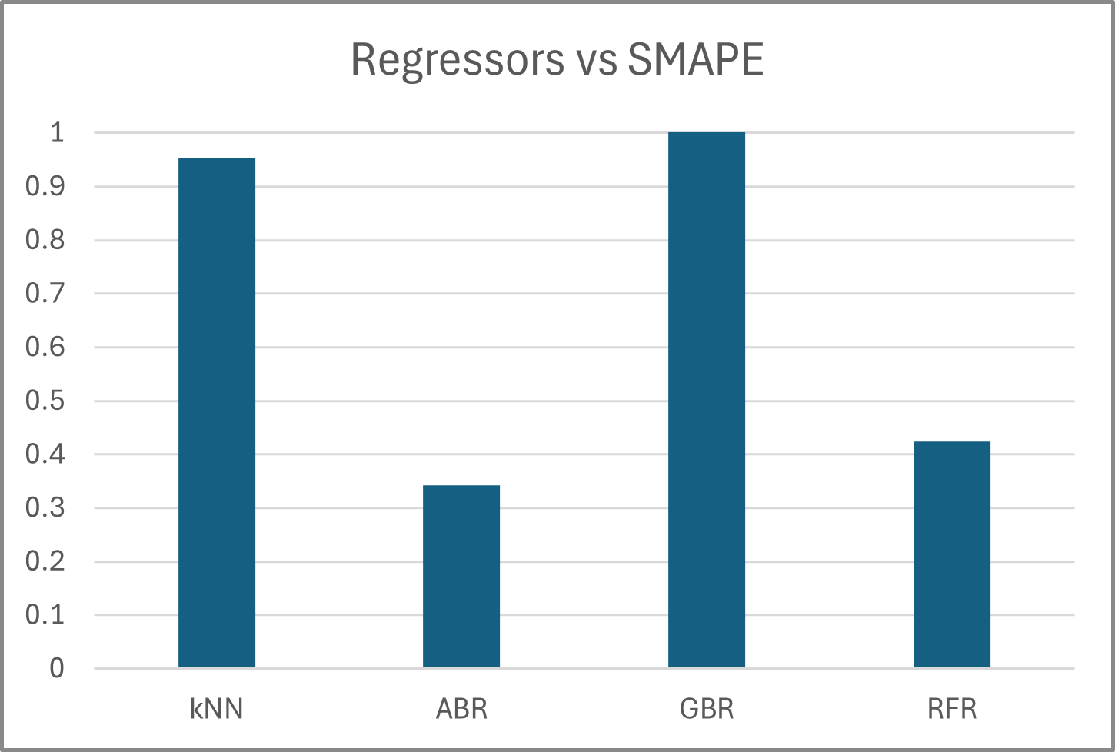
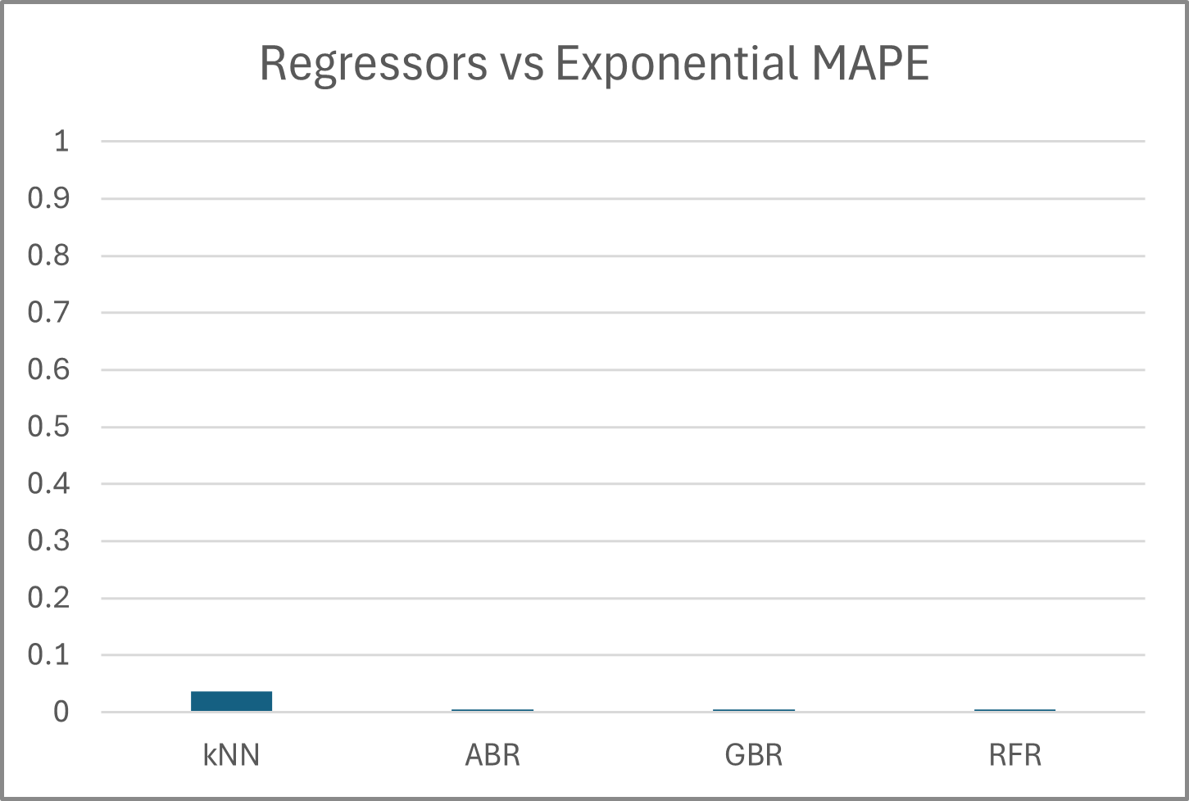
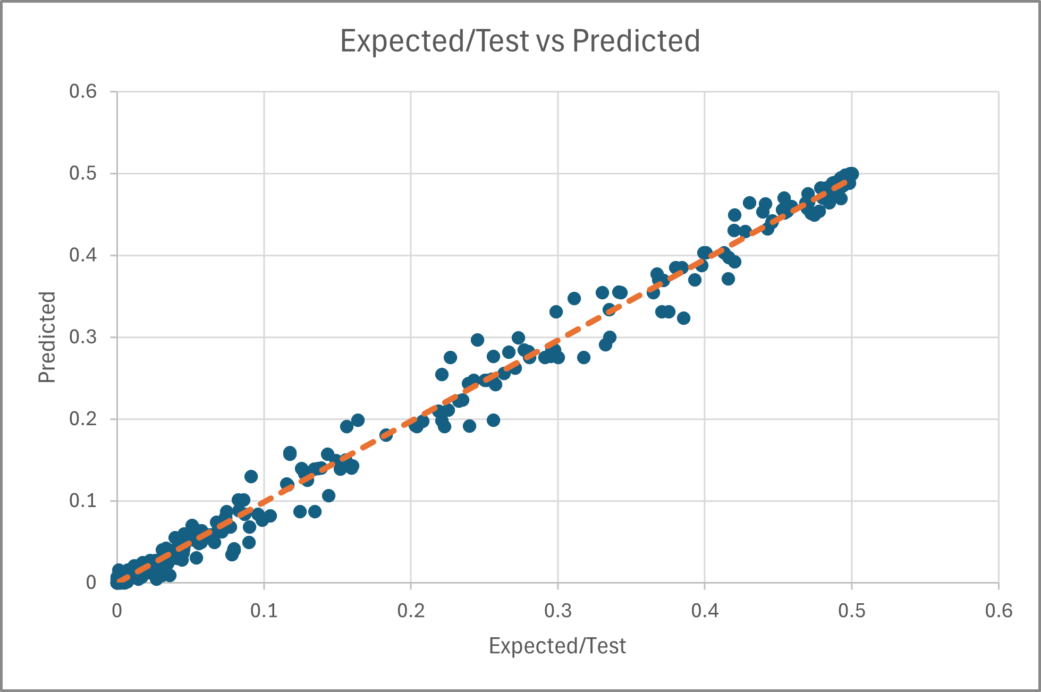

Slide 33
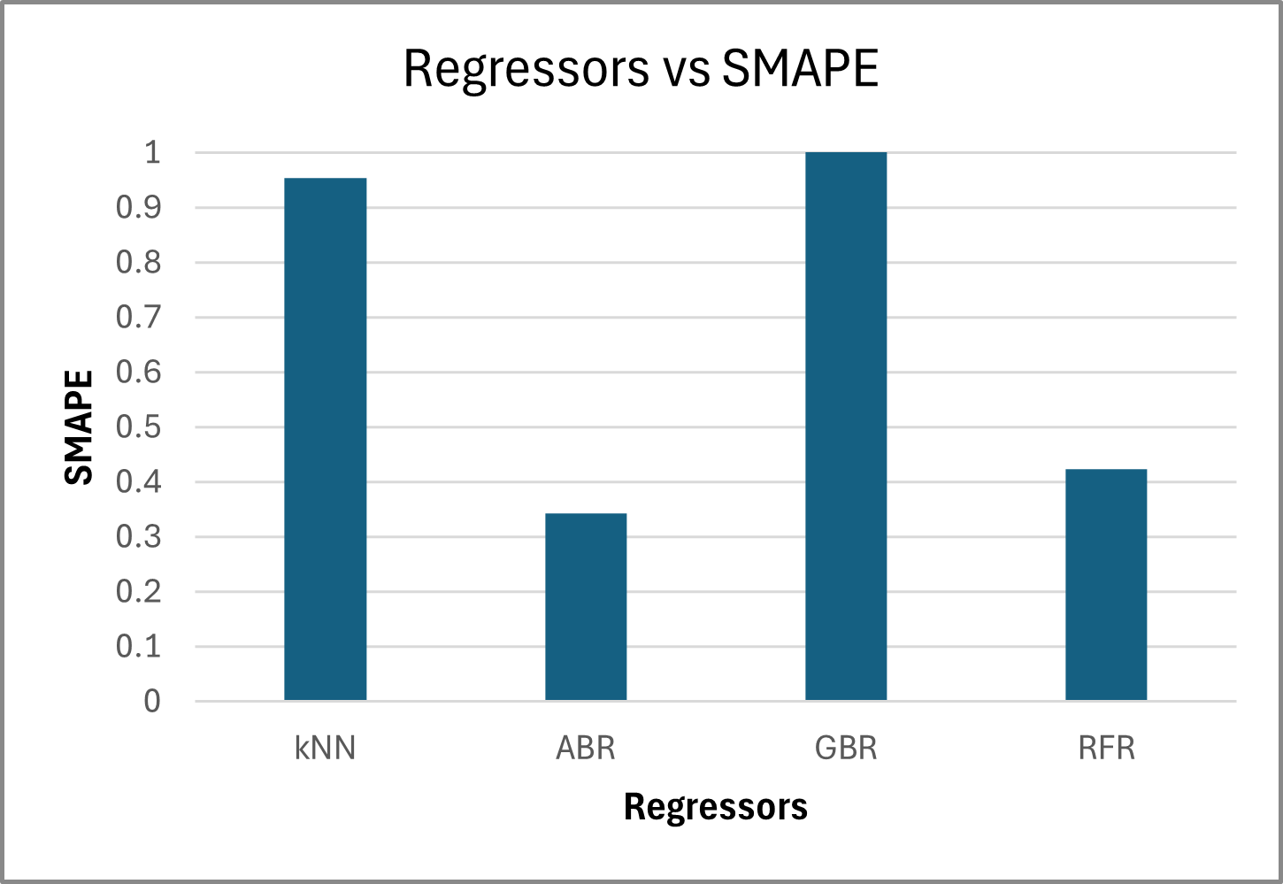
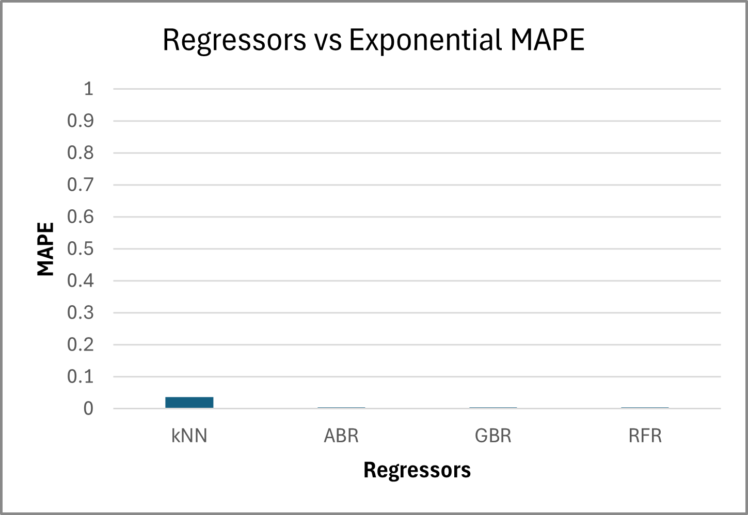
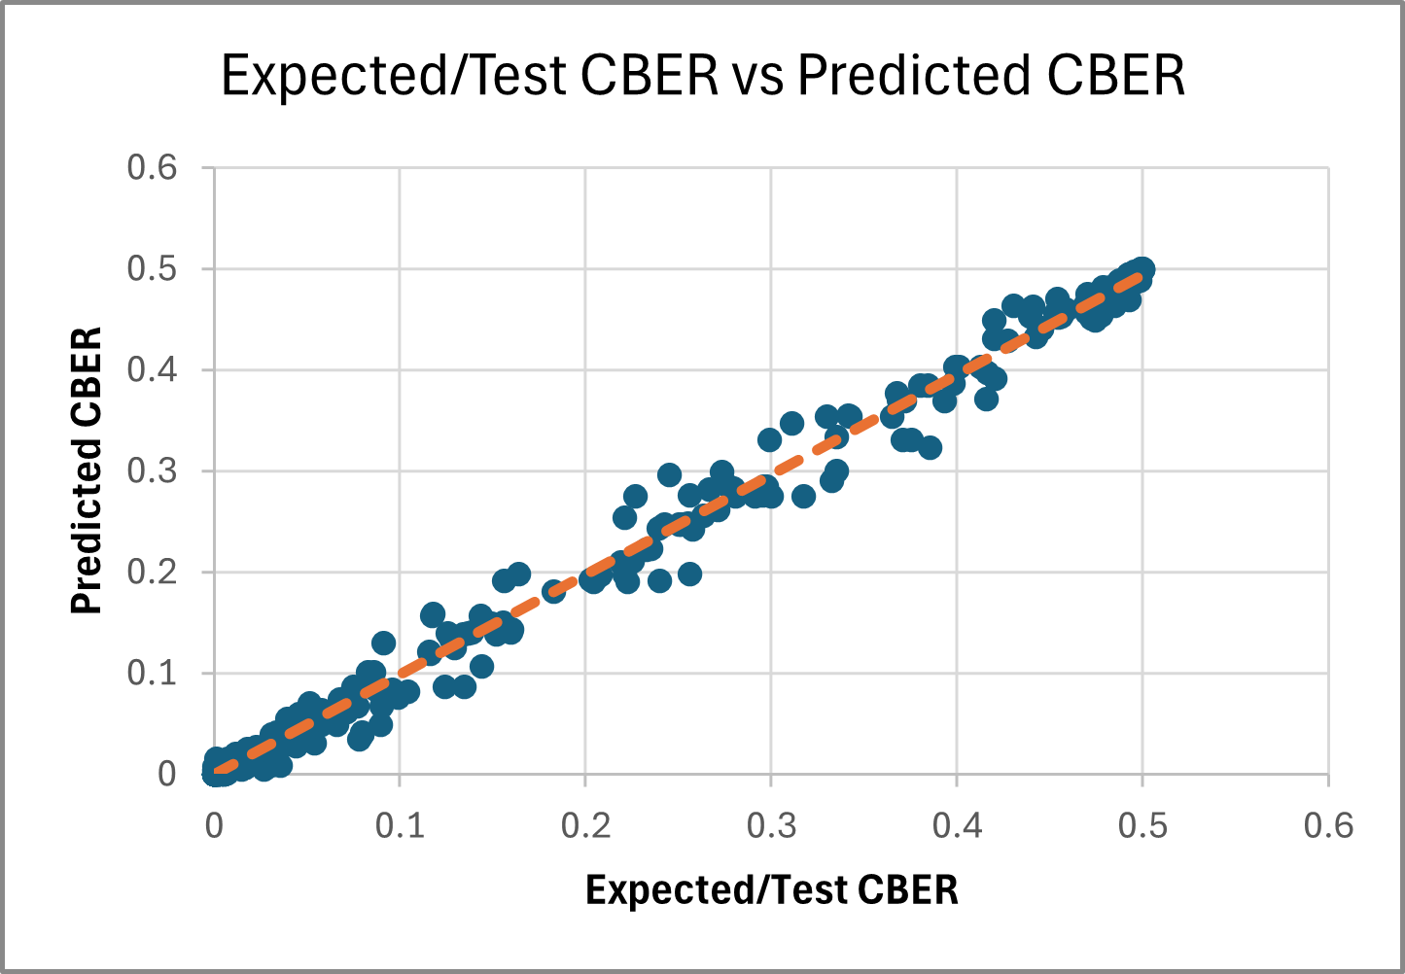

Slide 34
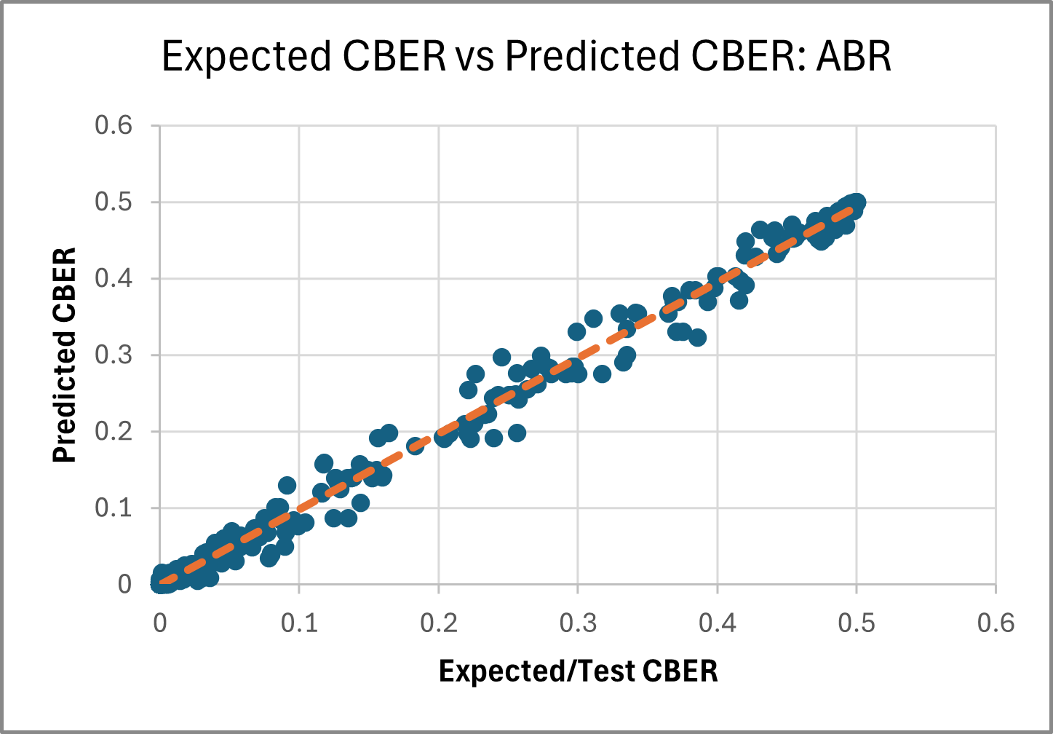

Slide 35
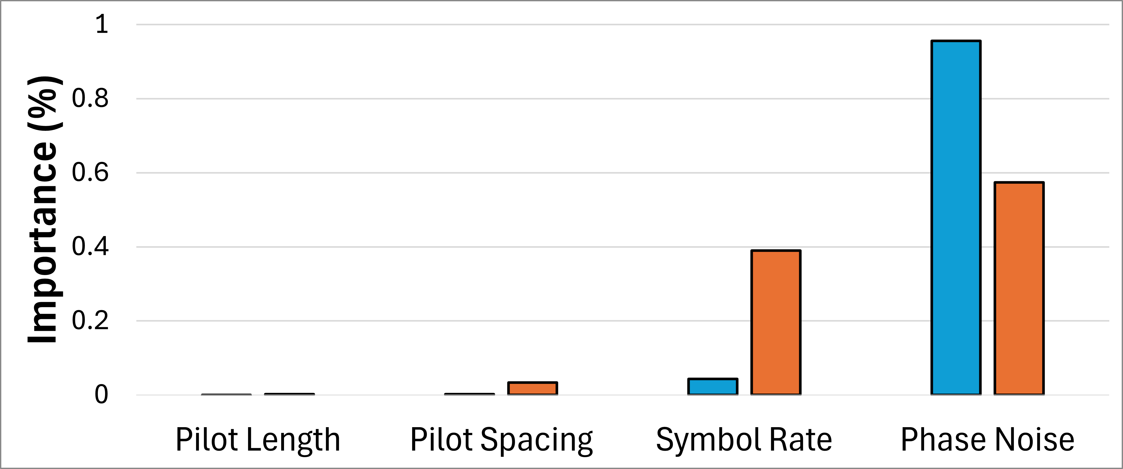
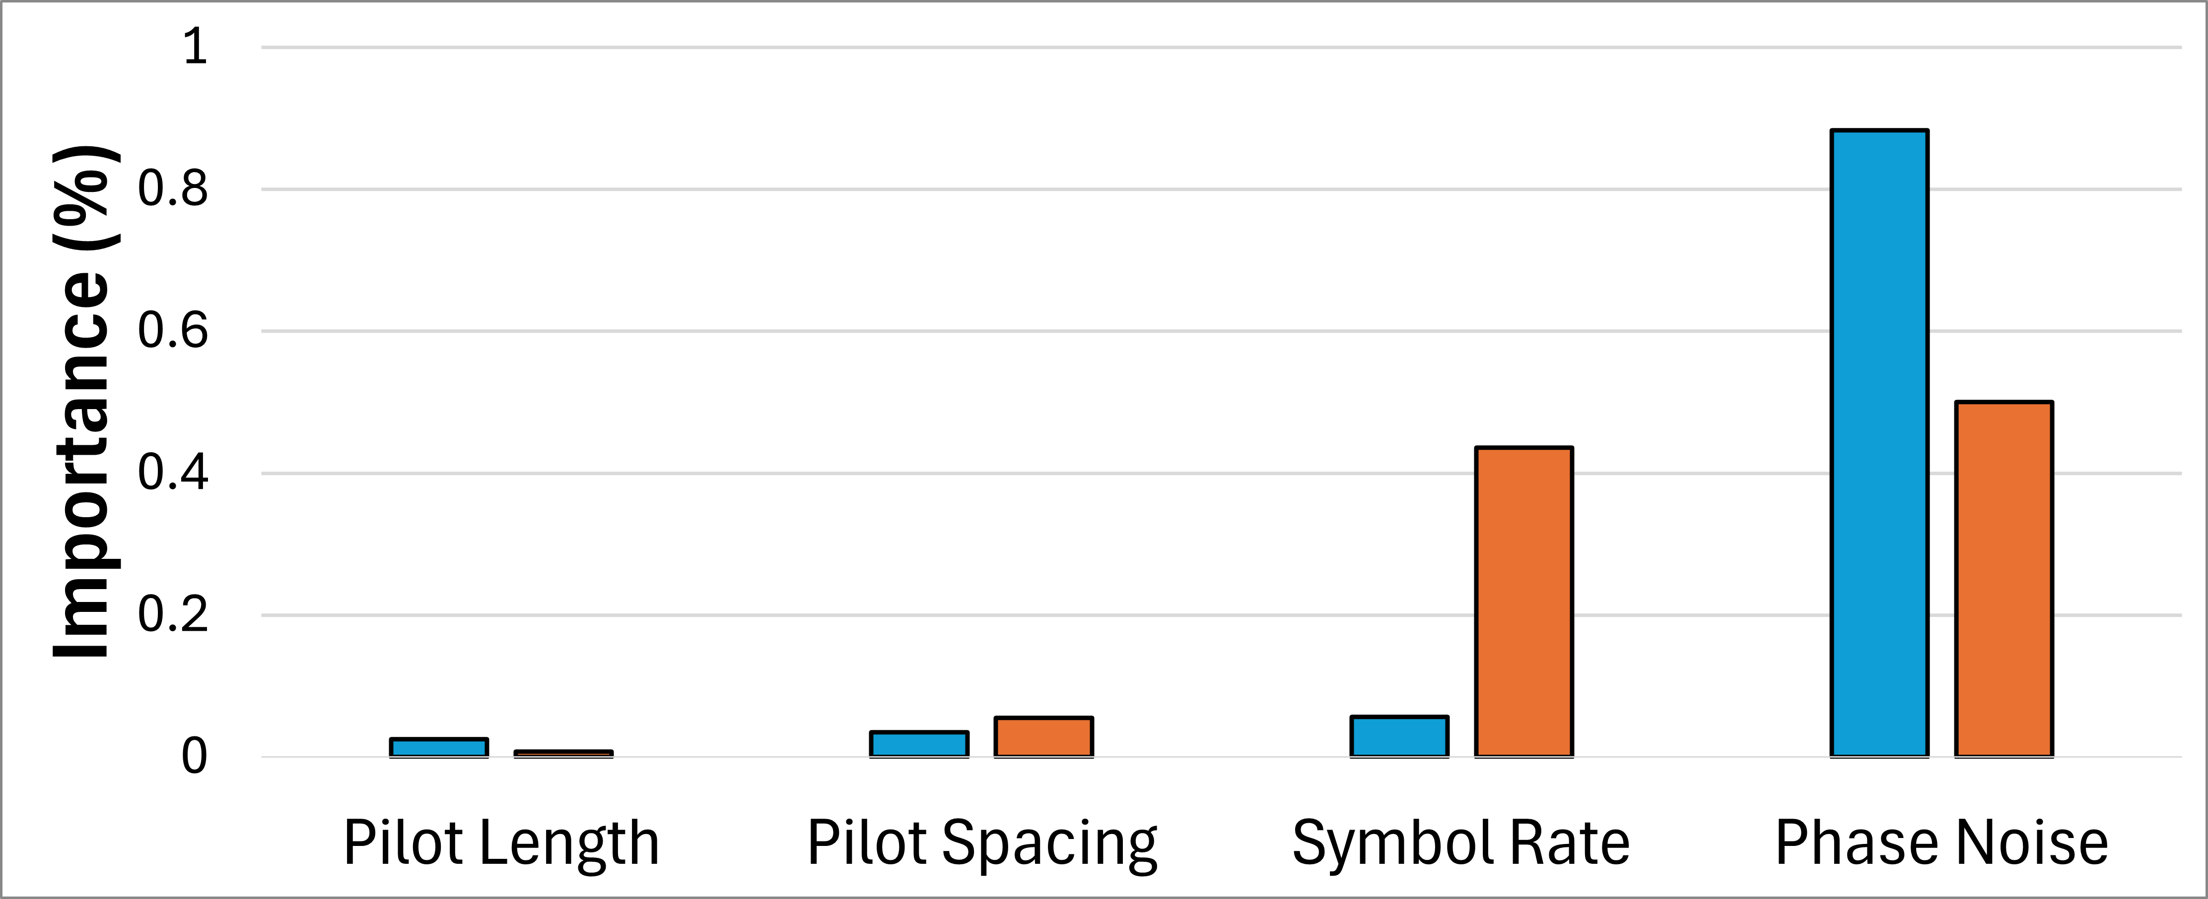
Baseline
Compensated
Baseline
Compensated

Slide 36
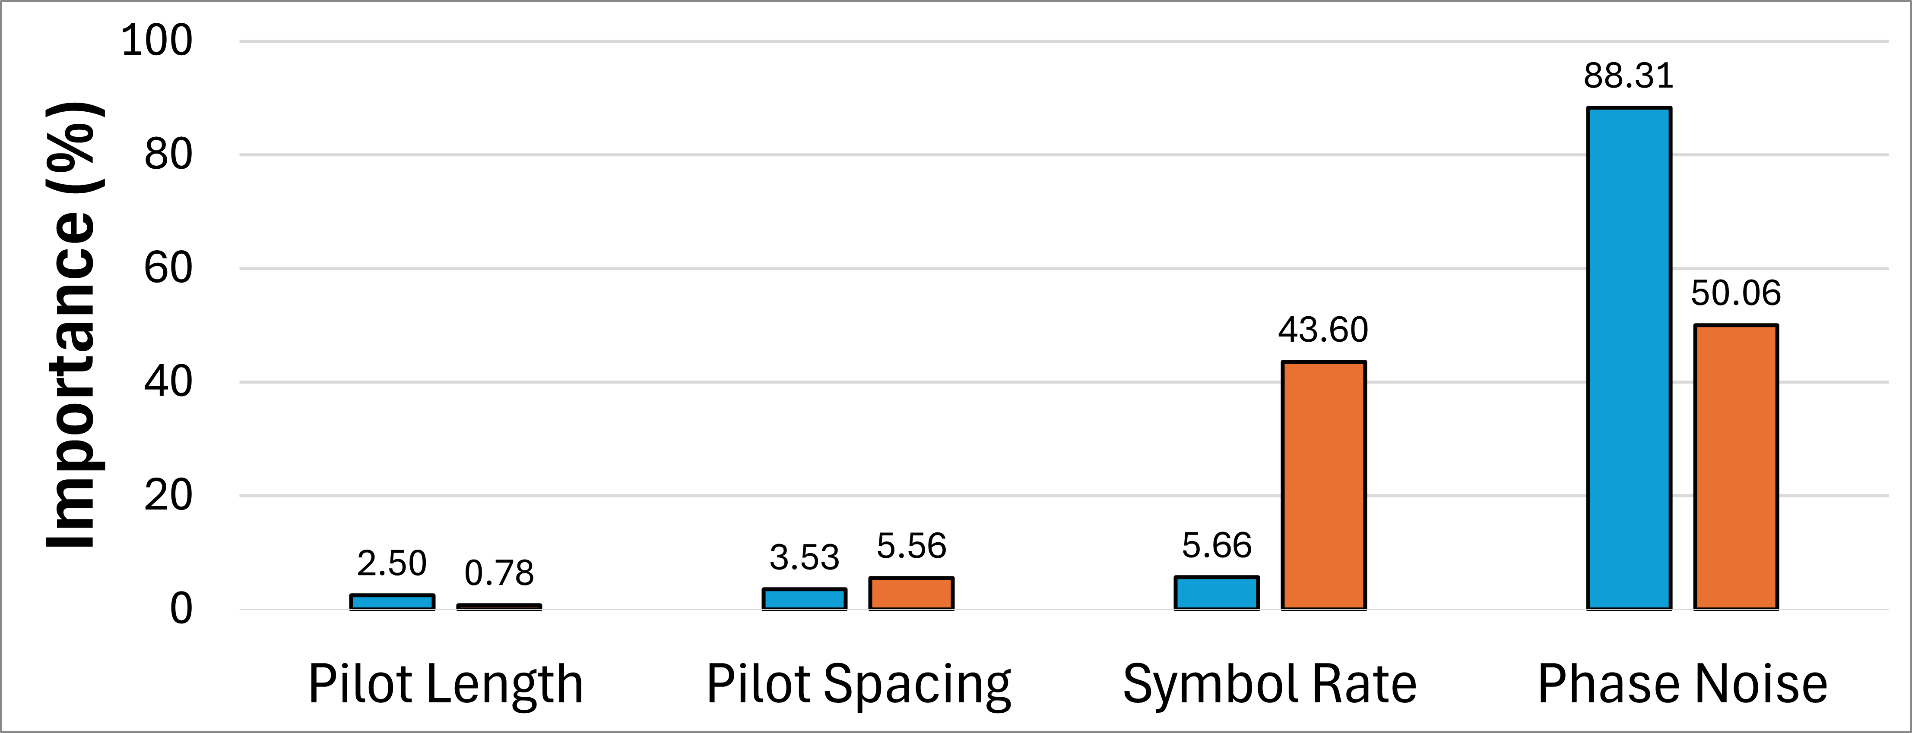
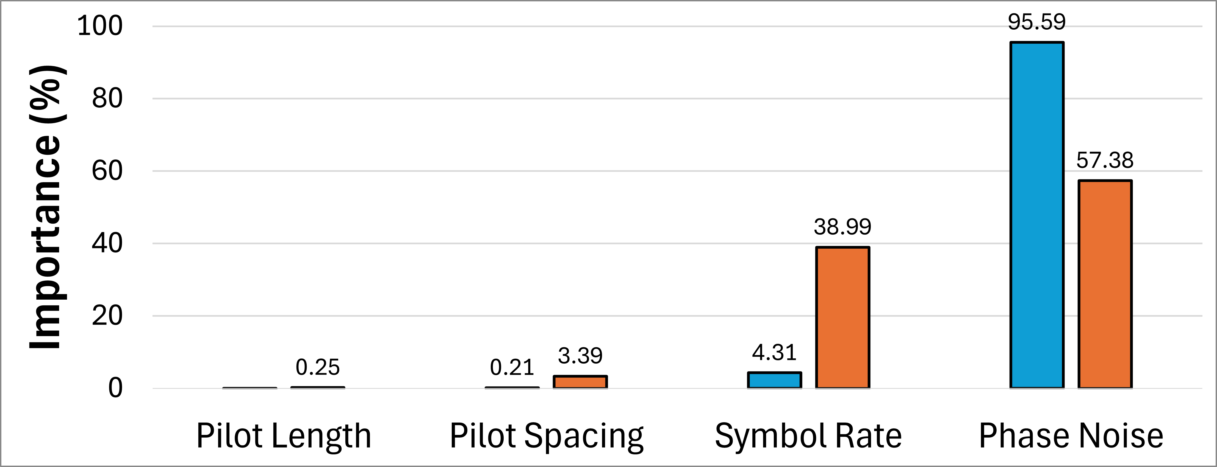
Baseline
Compensated
Baseline
Compensated
-0.11

Slide 37
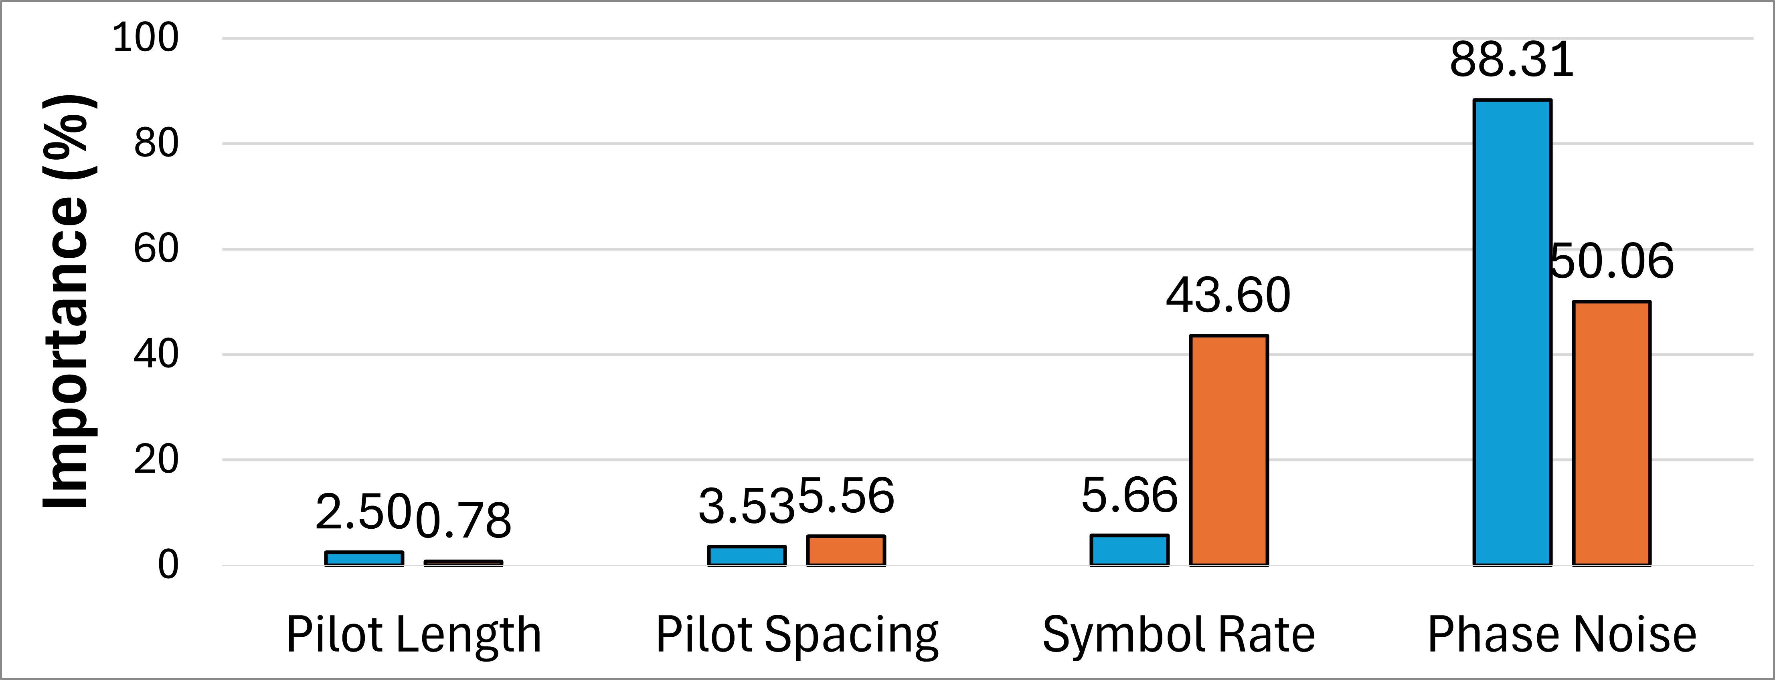
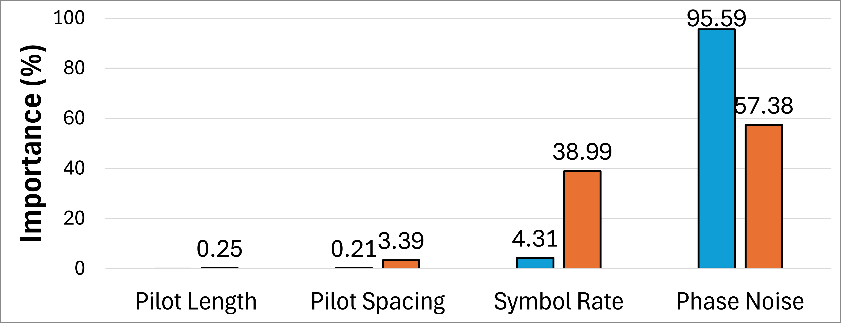
-0.11

Slide 38

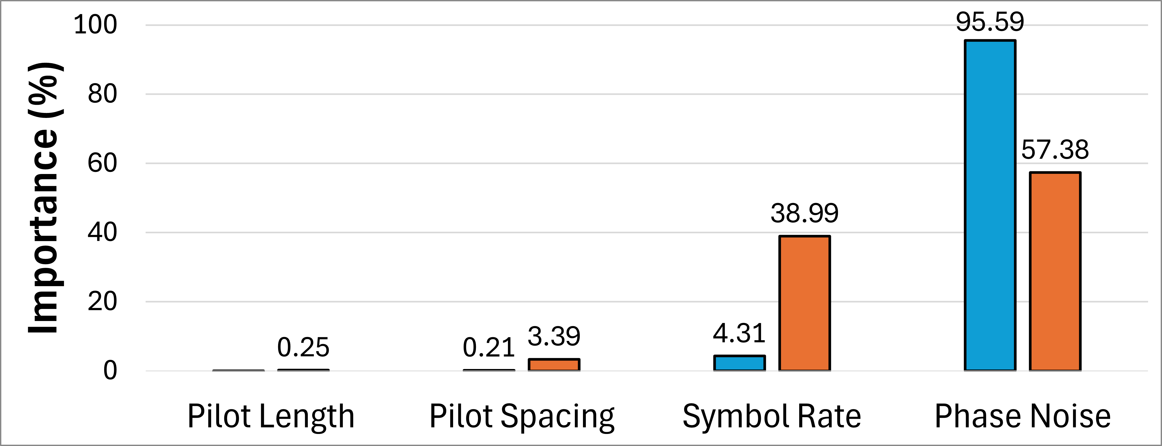
-0.11

Slide 39

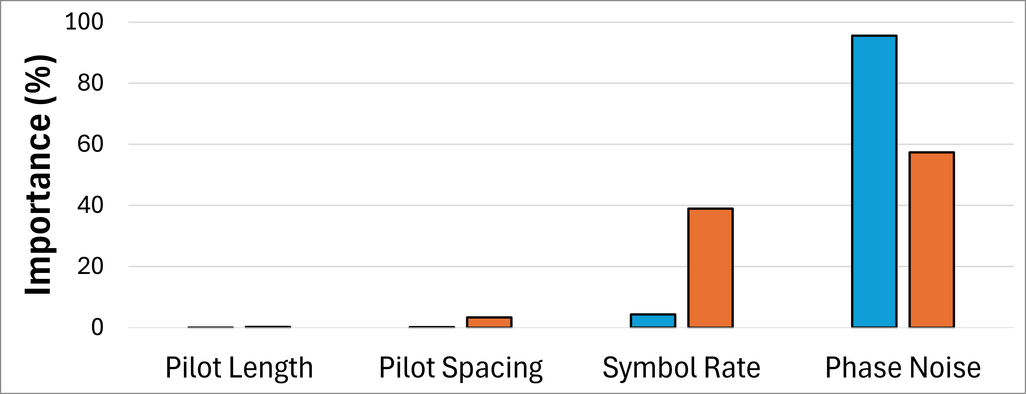

Slide 40
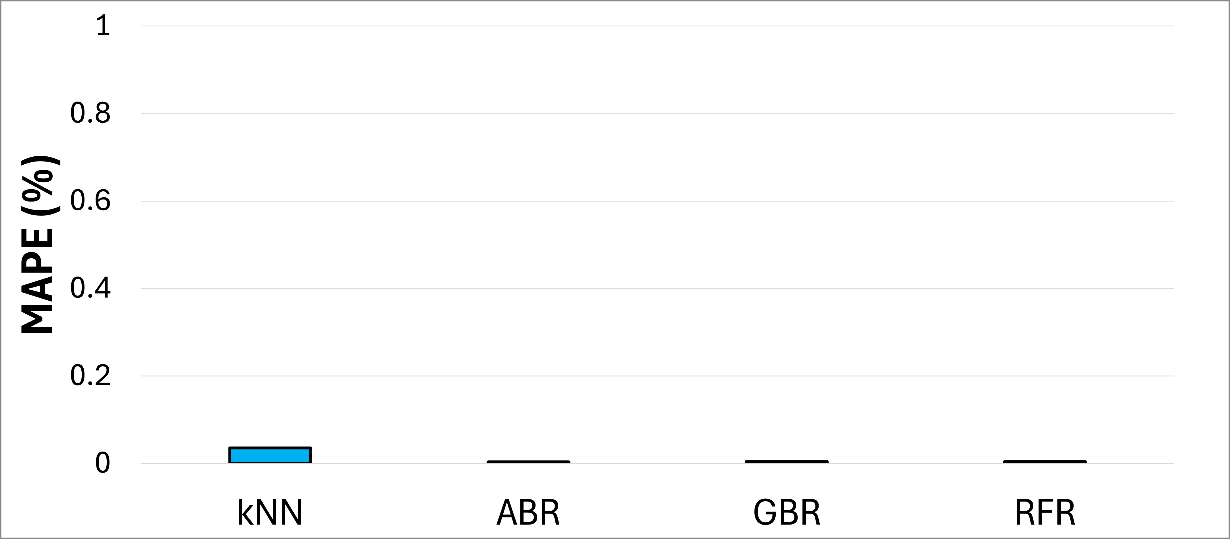
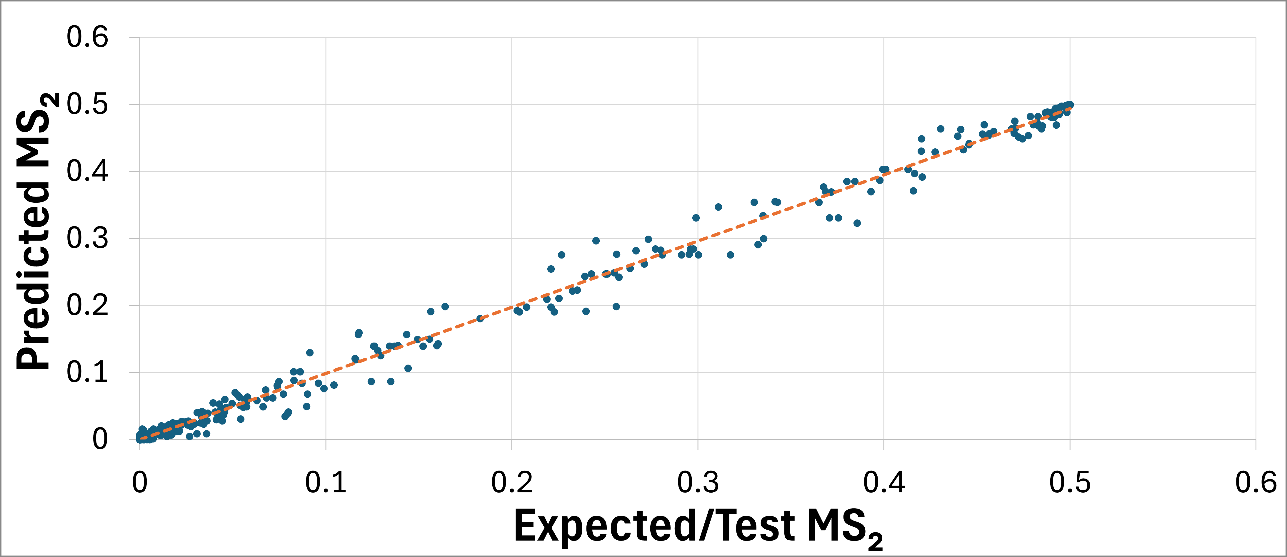

Slide 41
Layer (type) Output Shape Param # Connected to
==================================================================================================
iq_input (InputLayer) [(None, 128, 2)] 0 []
conv1d (Conv1D) (None, 128, 16) 176 ['iq_input[0][0]']
flatten (Flatten) (None, 2048) 0 ['conv1d[0][0]']
signal_input (InputLayer) [(None, 1)] 0 []
snr_input (InputLayer) [(None, 1)] 0 []
sample_input (InputLayer) [(None, 1)] 0 []
concatenate (Concatenate) (None, 2051) 0 ['flatten[0][0]',
'signal_input[0][0]',
'snr_input[0][0]',
'sample_input[0][0]']
dense (Dense) (None, 96) 196992 ['concatenate[0][0]']
modulation_output (Dense) (None, 6) 582 ['dense[0][0]']
==================================================================================================
Total params: 197750 (772.46 KB)
Trainable params: 197750 (772.46 KB)
Non-trainable params: 0 (0.00 Byte)

Slide 42
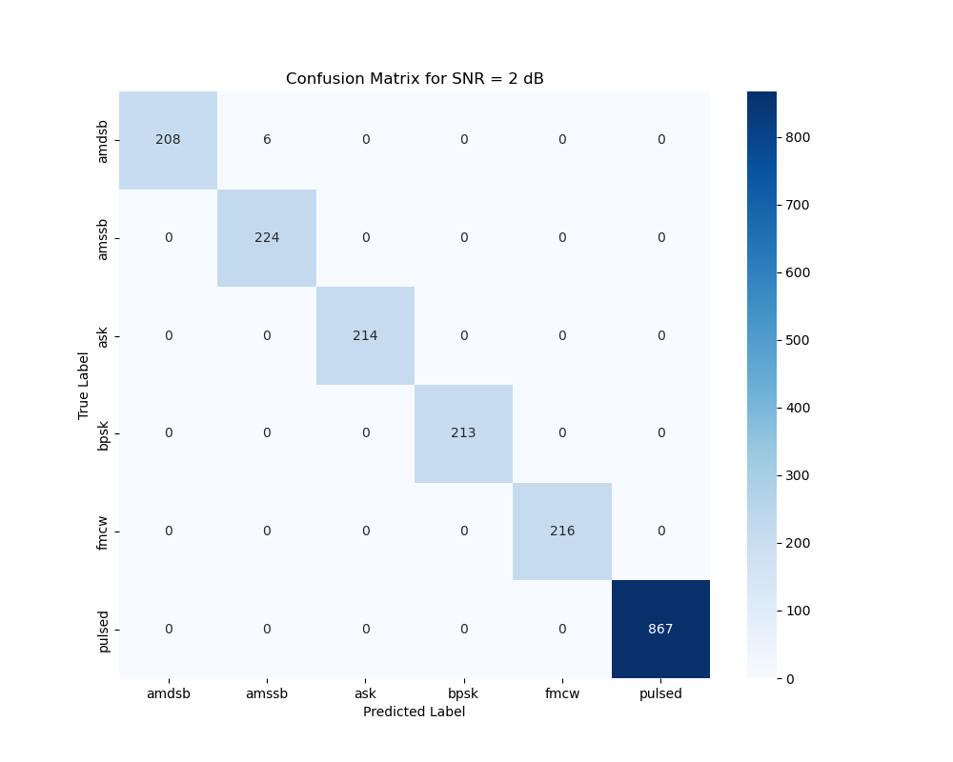
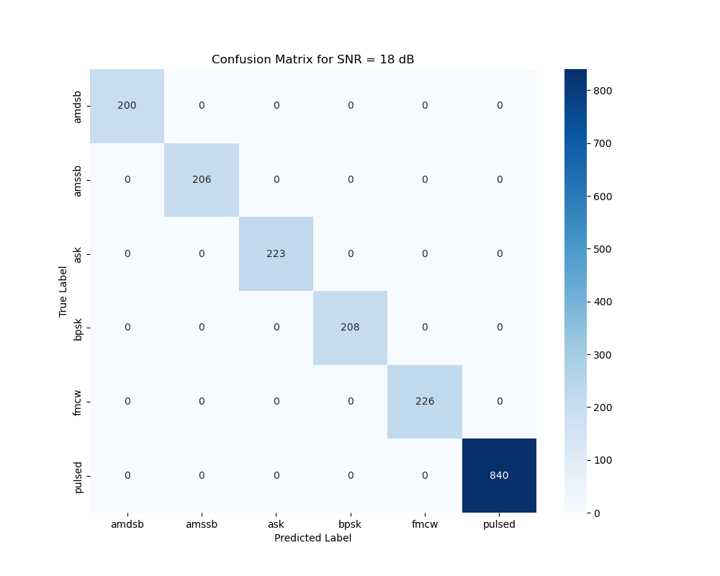

Slide 43
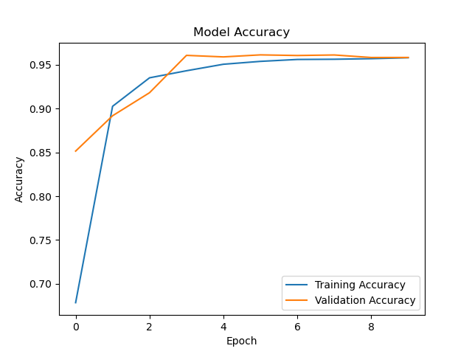

Slide 44
ABR
Differential Evolution
Train Data
Training
Mutation
Dataset
Train Data
Testing
Crossover
Parameter Initialization
Prediction
Selection
Optimal Result
Yes
Stopping Criteria
No

Slide 45
