Slide 1
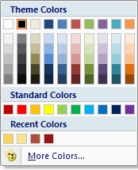
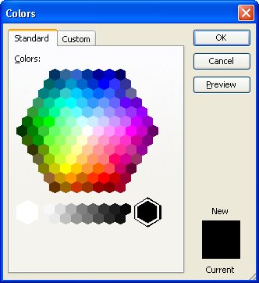
Calibri, 42pt, bold, gray
Product Name
Calibri, 18pt, gray
Presenter’s Name, BBA, AMII, ACII
Logo or illustration if any
Gray Color:
RGB: 127,127,127
CMYK: 49%, 38%, 27%, 18%
HSB: 0,0,50%
Office 2007
Office 2003

Slide 2
Calibri, 32pt, bold, gray
Highlight title when matched with current slide
Product Name
Definition
Calibri, 24pt, bold, gray
Definition
Coverage
Benefits
Extensions
Exclusions
Claim Procedure
Contact Us
Description of product
Calibri, 18pt, gray
Calibri, 16pt, gray

Slide 3
Example of Highlight
Product Name
2.54”
Contact us
Definition
Coverage
Benefits
Extensions
Exclusions
Claim Procedure
Contact Us
Forte Insurance (Cambodia) Plc.
Address: #325, Mao Tse Toung Blvd, Phnom Penh
Tel: 023 885 066 / 023 885 077
Fax: 023 882 798 / 023 982 907
Email: info@forteinsurance.com
sales@forteinsurance.com
claims@forteinsurance.com
2.54”

Slide 4
Example

Slide 5

Group Personal Insurance
Reth Sopharith, BBA, AMII

Slide 6
Group Personal Insurance
What is Group Personal Insurance?
Definition
Coverage
Benefits
Extensions
Exclusions
Claim Procedure
Contact Us
Group Personal Insurance provides protection and indemnity …

Slide 7
Group Personal Insurance
Contact us
Definition
Coverage
Benefits
Extensions
Exclusions
Claim Procedure
Contact Us
Forte Insurance (Cambodia) Plc.
Address: #325, Mao Tse Toung Blvd, Phnom Penh
Tel: 023 885 066 / 023 885 077
Fax: 023 882 798 / 023 982 907
Email: info@forteinsurance.com
sales@forteinsurance.com
claims@forteinsurance.com

