Slide 1
Residual Method & Behavioral Scores
Using data from A40-4, A197, and A182
July 11, 2016

Slide 2
No WMC model:
wj3.rcomp.raw~age+wj3.watt.raw+wj3.wid.raw+wasi.matr.raw+wasi.vocab.raw
WMC model:
wj3.rcomp.raw~age+wj3.watt.raw+wj3.wid.raw+wasi.matr.raw+wasi.vocab.raw+sspan.raw
Centered and scaled variables:
Word Attack (wj3.watt.raw)
Letter-Word (wj3.wid.raw)
Matrix Reasoning (wasi.matr.raw)
Vocab (wasi.vocab.raw)
Sentence Span (sspan.raw)
Centered variables:
Age
Other variables:
Reading comprehension (wj3.rcomp.raw)

Slide 3
Measures used in the Model

Slide 4
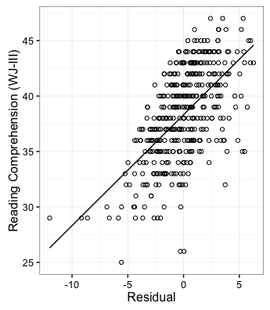
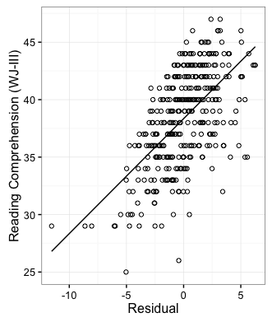
Reading Comprehension
No WMC
WMC
r =0.61, p < 0.001
r = 0.60, p < 0.001

Slide 5
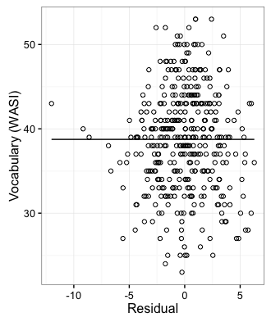
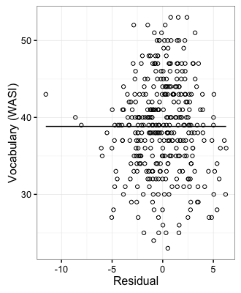
Vocabulary (WASI)
No WMC
WMC
r =0, p = 1
r = 0, p = 1

Slide 6
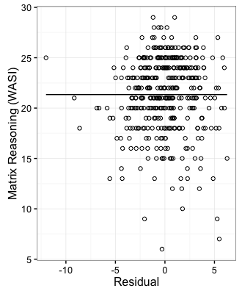
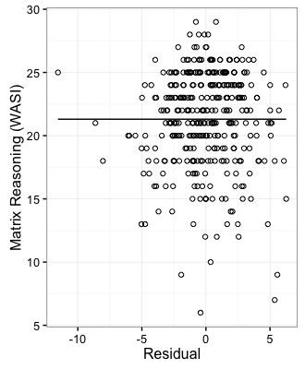
Matrix Reasoning
No WMC
WMC
r =0, p = 1
r = 0, p = 1

Slide 7
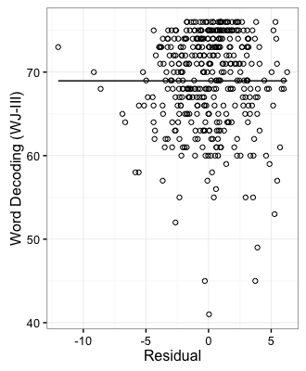
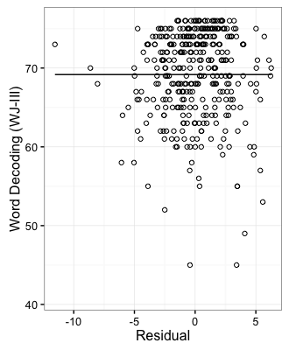
Word Decoding
No WMC
WMC
r =0, p = 1
r = 0, p = 1

Slide 8
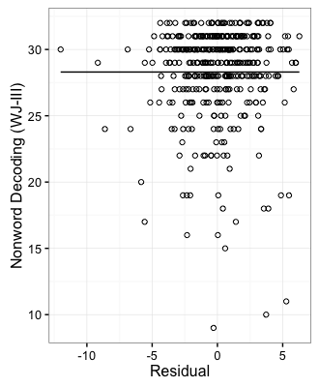

Nonword Decoding
No WMC
WMC
r =0, p = 1
r = 0, p = 1

Slide 9
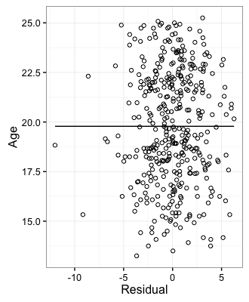
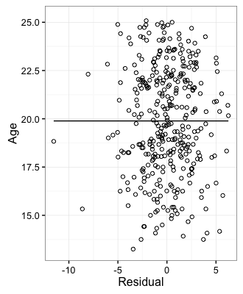
Age
No WMC
WMC
r = 0, p = 1
r = 0, p = 1

Slide 10
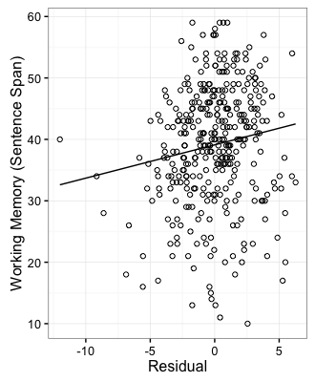
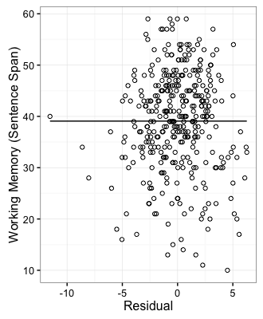
Working Memory
No WMC
WMC
r =0.14, p = 0.007
r = 0, p = 1

Slide 11
Measures not used in the Model

Slide 12
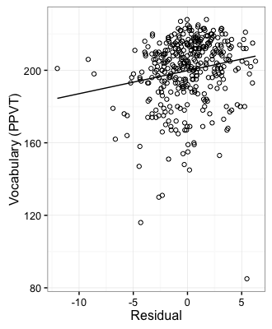
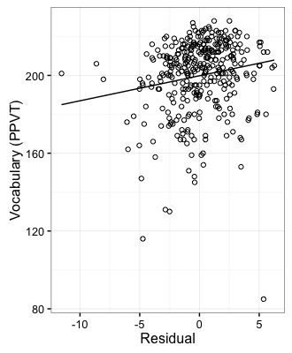
Vocabulary (PPVT)
No WMC
WMC
r =0.18, p = 0.0006
r = 0.17, p = 0.001

Slide 13
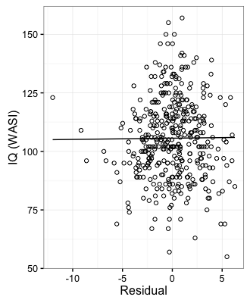
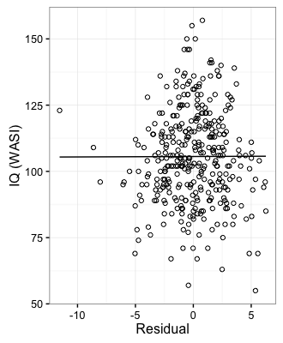
IQ (WASI)
No WMC
WMC
r =0.008, p = 0.88
r = 0.002, p = 0.96

Slide 14
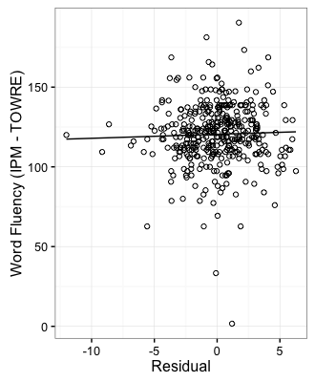

Word Fluency (TOWRE)
No WMC
WMC
r =0.03, p = 0.51
r =0.03, p = 0.51

Slide 15
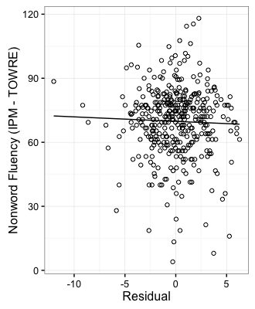
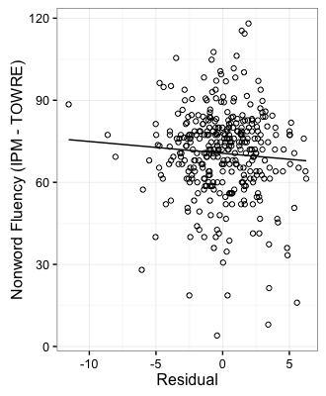
Nonword Fluency (TOWRE)
No WMC
WMC
r =-0.03, p = 0.51
r =-0.07, p = 0.20

Slide 16
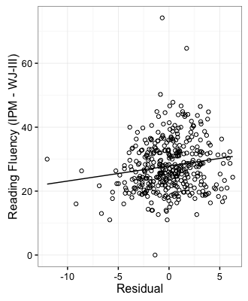
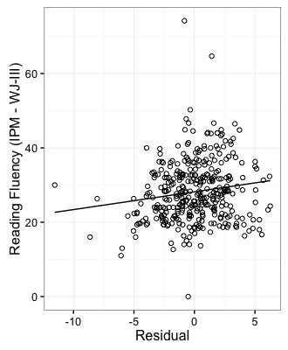
Reading Fluency (WJ-III)
No WMC
WMC
r =0.15, p = 0.003
r =0.15, p = 0.05

Slide 17
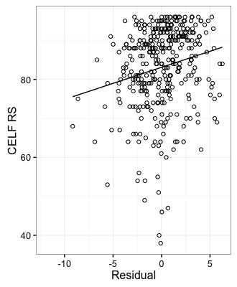
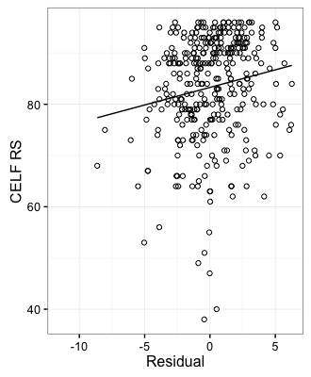
CELF Recalling Sentences
No WMC
WMC
r =0.19, p = 0.0002
r =0.16, p = 0.002

Slide 18
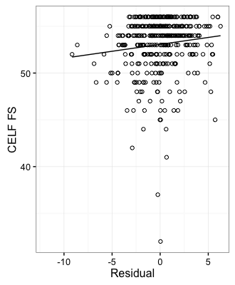
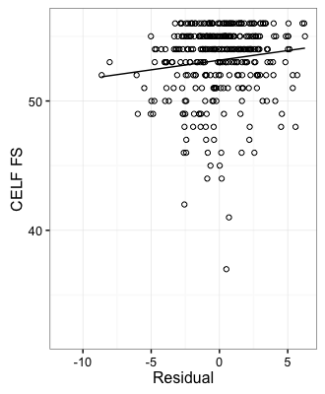
CELF Formulating Sentences
No WMC
WMC
r =0.12, p = 0.02
r =0.13, p = 0.02

Slide 19
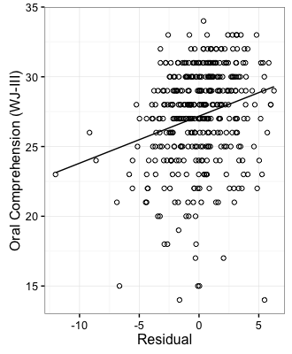
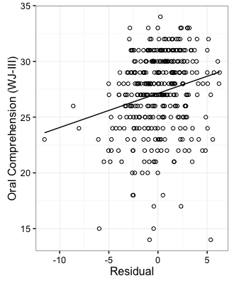
Oral Comprehension
No WMC
WMC
r =0.24, p < 0.001
r =0.22, p < 0.001

Slide 20
Observations
Measures used in the model are not correlated with residuals
WMC & No WMC models relate to behavioral scores similarly in everything except WMC
Residuals are not related to:
IQ
Word Fluency (words & nonwords)
Reading fluency
Residuals are related to (all positively):
Receptive vocabulary
CELF (RS & FS)
Oral comprehension

