Slide 1
Explore the world by bike
Paweł Kryzia
24 January 2021

Slide 2
INTRODUCTION
My project is aimed at people who like to explore the world by bike (also for car tourists). The idea is that on the basis of the pre-prepared route, the notebook will find (using Foursquare) tourist attractions, accommodation or restaurants located on or near the route (depending on whether you are traveling by bike or by car you will be able to increase or decrease the radius of the search)
In my project, for example, I will take into account the route from Krakow in Poland to the Italian capital Rome (I would like to visit Rome).
In the second part, I will use Foursquare to explore the monuments of Rome. Using k-mean clustering, I will group the found monuments, taking into account their location (coordinates) to as many groups as many days as I want to visit Rome.
Of course, the project will be versatile enough to change input data to explore other routes and cities.

Slide 3
OBJECTIVES
finding the nearest monuments, food and accommodation for any point of the route
grouping the monuments found in Rome to as many clusters as we choose days, based on their location

Slide 4
DATA
The data used in the project is firstly the coordinates of the waypoints downloaded from a GPX file prepared in one of the services that allow you to create and download such routes. The GPX file was previously converted to CSV format and uploaded to the notebook in this form. The file contains only waypoints and their coordinates (latitude and longitude), so we can easily convert it to a dataframe. Of course, the second source of data will be Foursquare.

Slide 5
EXPLORING A ROUTE
At the beginning, using the folium, we draw the entire route on the map of Europe based on a GPX route converted to a CSV file
Next, for the selected point of the route, using Foursquare, I search for monuments, food and accommodation. Using the Geolocator module, I can also search for objects for specific places along the route or next to the route. Selecting coordinates:
I use foursquare explore with categoryId parameter. I found the categories that interest me at: https://developer.foursquare.com/docs/build-with-foursquare/categories/

Slide 6
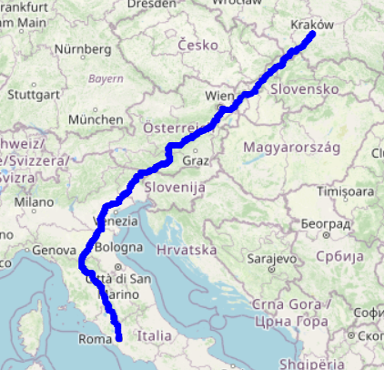
Map of the entire route

Slide 7
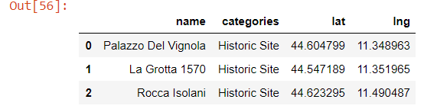
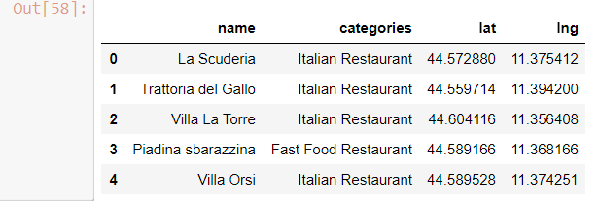
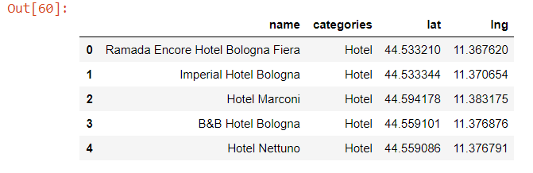
Places of interest found at the selected point on the route
Monuments
Food
Accommodation

Slide 8
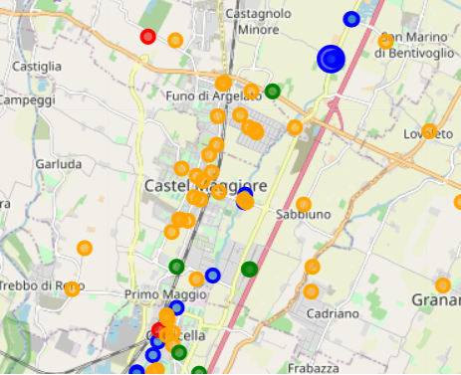
Map with the found places marked
monuments marked in red
food in orange
accommodation in green.
blue are waypoints.

Slide 9
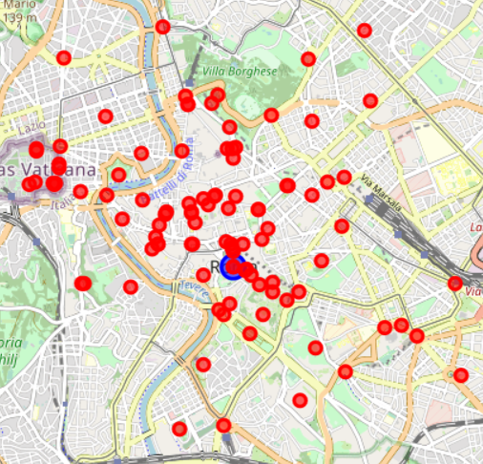
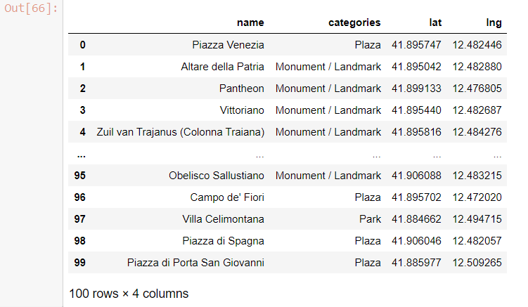
SIGHTSEEING IN ROME
The idea is to use Foursquare to find monuments in the chosen city (in my example it is Rome). Foursquare limits the results to 100, so we have 100 places to visit.

Slide 10
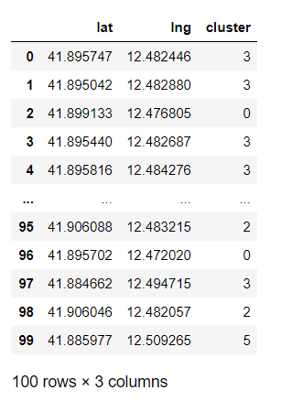
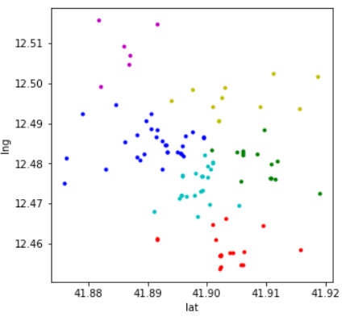
CLUSTERING
The last important step will be to group the results into a selected quantity (in my example, 6) by combining them into groups based on location. I will use for this k-means Clustering.
Visualization:

Slide 11
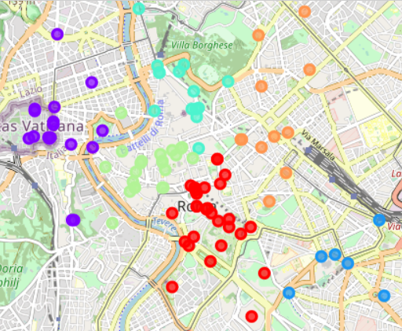
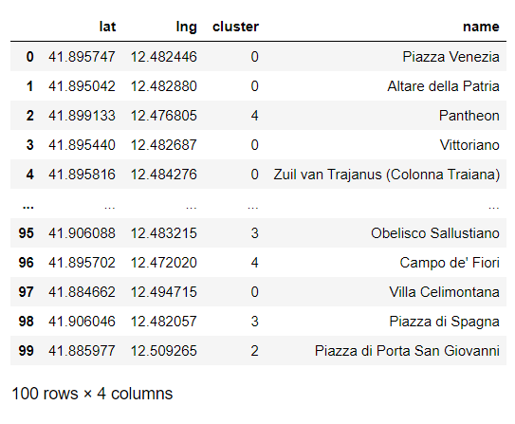
Visualization on the map

Slide 12
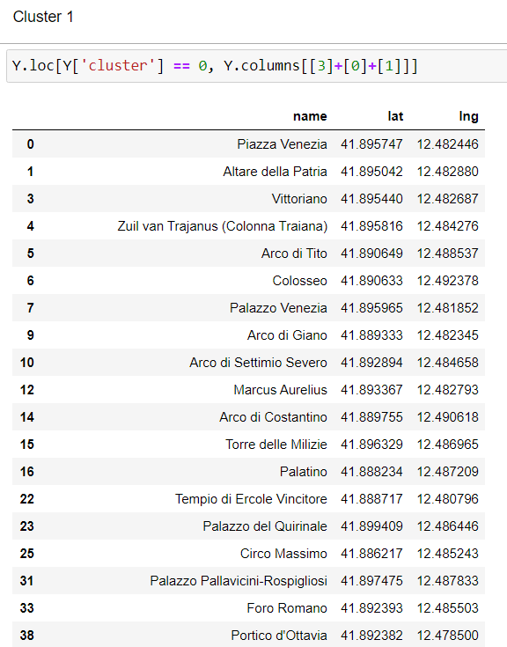
Cluster 1

Slide 13
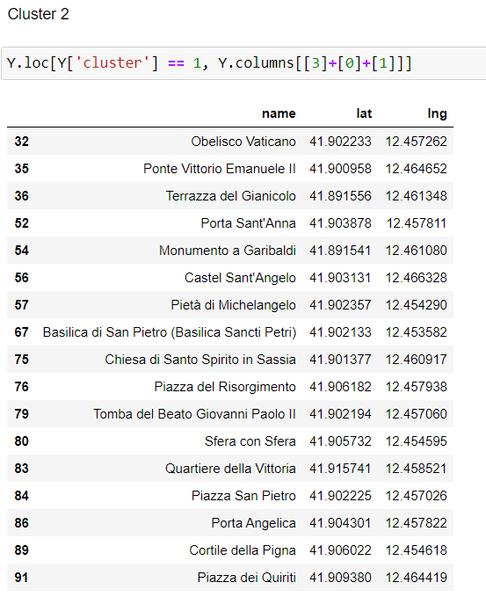
Cluster 2

Slide 14
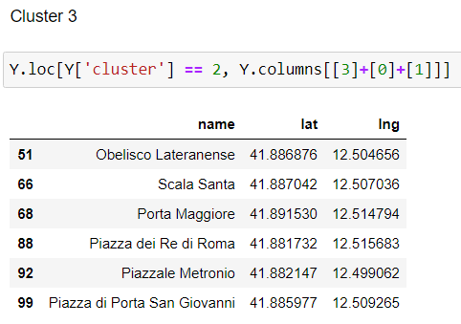
Cluster 3

Slide 15
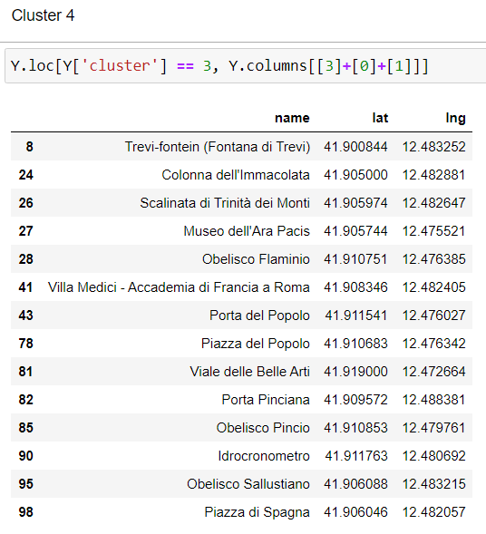
Cluster 4

Slide 16
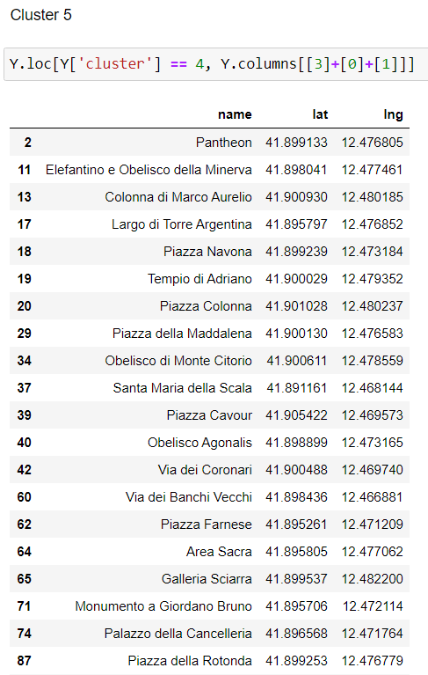
Cluster 5

Slide 17
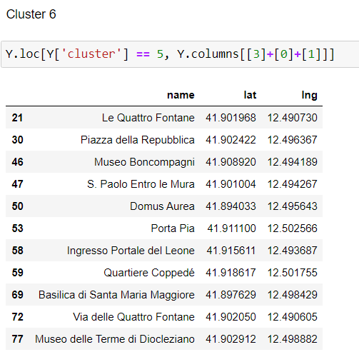
Cluster 6

Slide 18
SUMMARY AND CONCLUSIONS
One of the two main goals of this project was to facilitate travel and at the same time to explore places that we do not know and do not know what to see, where to stay for food or accommodation. The first part of the project solves this problem with the help of Foursquare. Provides information about such locations for the selected route point or city and visualizes them on the map.
The second part was to help in visiting the monuments of the selected city. K-means clustering helped to divide the monuments found by Foursquare into clusters based on their location. The number of clusters corresponds to the number of days we have for visiting. Some clusters contain too many objects, but we can choose the most interesting ones ourselves.

