Slide 1
CY315 · Wireless and Mobile Security
Defending the Wiretap Channel
A deep-RL approach to artificial-noise power allocation — when Alice's intel on Eve is noisy
Muhammad Ismail · Abubakar Butt · Usman Ali
2023453 · 2023352 · 2023581

Slide 2
The problem we're solving
Wireless is broadcast. Anything Alice transmits, Eve picks up too.
• Standard fix: artificial noise (AN) sprayed into Bob's null space — Bob hears clean signal, Eve hears signal + jam.
• The knob: how much power to put on the message vs the jamming.
• The classic answer (Goel & Negi, 2008): split it 50/50. Safe but leaves performance on the table.
• The textbook upgrade: optimise the split per channel. Works great — IF Alice has perfect information about Eve. She usually doesn't.
• Plug noisy intel into the textbook optimiser → a confidently-wrong answer that performs WORSE than doing nothing. We'll see this on the next plot.
Slide 2 / 13

Slide 3
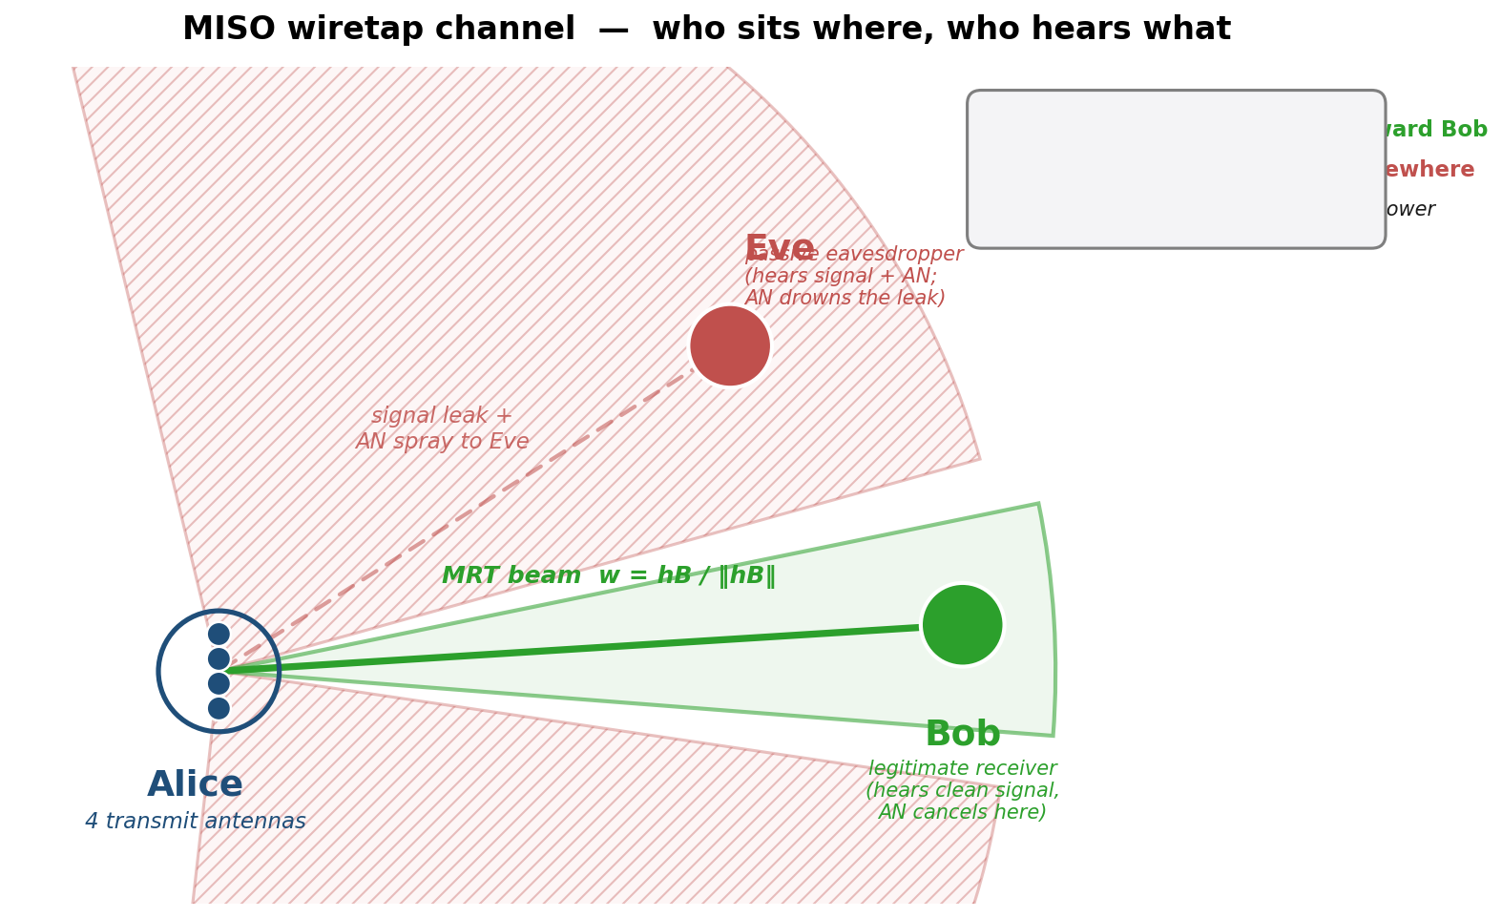
The setting — MISO wiretap channel
Alice (multi-antenna), Bob (legitimate), Eve (eavesdropper)
Imperfect CSI model
κ — CSI quality dial
κ = 1 perfect intel · κ = 0.4 our default · κ = 0 pure noise
Slide 3 / 13

Slide 4
Two classical answers — and why both fall short
Scheme 1 — Fixed (Goel & Negi, 2008)
Scheme 2 — Traditional optimiser
Always splits power 50/50. Pros Cannot be misled by bad intel. Always returns a sensible answer. Cons Sub-optimal whenever the channel is asymmetric. Leaves rate on the table at high SNR.
Per-channel argmax of Rs against the noisy ĥE. scipy bounded scalar (Brent's method). Pros Provably optimal at κ = 1. Cons Trusts ĥE blindly. At low κ the noise gets amplified, and the optimiser confidently picks the WRONG ρ.
Slide 4 / 13

Slide 5
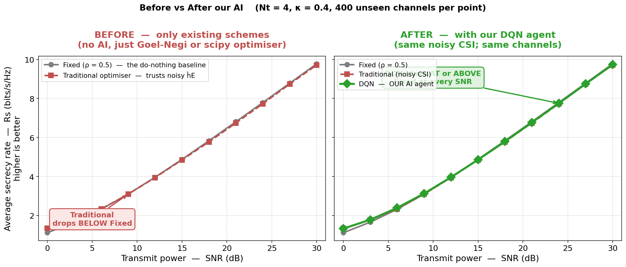
BEFORE vs AFTER our AI — same channels, same κ
Left: only existing schemes. Right: with DQN added.
X axis → Transmit power, SNR in dB (0 to 30)
Y axis → Average secrecy rate Rs (bits/s/Hz) — higher is better
Left panel: Traditional (red) drops BELOW Fixed (grey) — trusting noisy intel hurts. Right panel: DQN (green) holds at or above Fixed everywhere.
Slide 5 / 13

Slide 6
Our approach — train a policy that EXPECTS noisy intel
1. Reframe
2. Two key inputs
3. Single deployable model
Stop trying to find the closed-form optimum each call. Instead, train a policy off-line, across MANY noisy-intel scenarios, that learns when to trust ĥE and when to fall back to safe defaults.
Tell the agent how trustworthy its intel is → feed κ directly into its observation. Tell it the channel geometry → feed the alignment between Bob's beam and the noisy Eve estimate.
ONE trained network handles every (SNR, κ) it sees in the test set. No retuning, no re-optimising at run time. A forward pass replaces an iterative solver.
Slide 6 / 13

Slide 7
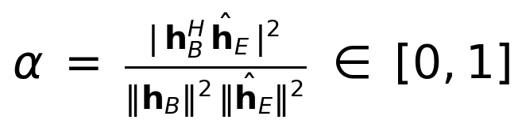
What the agent sees, what it does
State — 7 numbers describing the situation
Action
📡
Bob's channel strength
Pick one of 17 candidate splits between message and AN (steps of 0.05). Discrete → light DQN architecture, fast inference.
📡
Eve's (noisy) channel strength
⚡
Transmit SNR
🕒
What it picked last time
📊
How it scored last time
🎯
κ — intel quality
Network
📐
α — beam-vs-Eve alignment
Small feed-forward net, 7 inputs → 17 Q-values. Greedy at test time: pick the highest-Q action. Trained with Huber loss + Adam over 7000 episodes.
(α formally:)
Slide 7 / 13

Slide 8
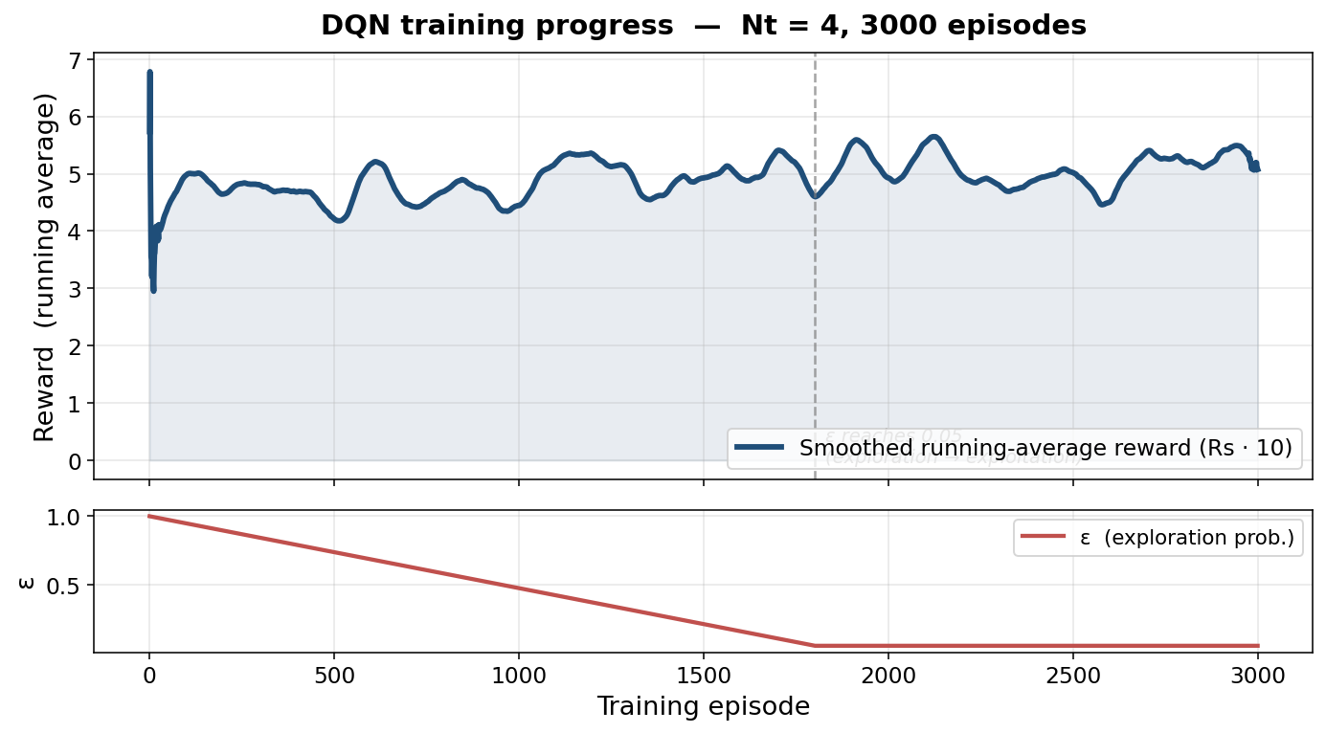
Training — one decision per channel, 7000 channels
7000
training episodes per Nt
≈ 38 s
training cost on a single CPU core
Nt ∈ {2, 4, 8}
three independent models, identical hyperparams
Smoothed running-average reward climbs as ε decays to 0.05; policy stabilises in the second half.
Slide 8 / 13

Slide 9
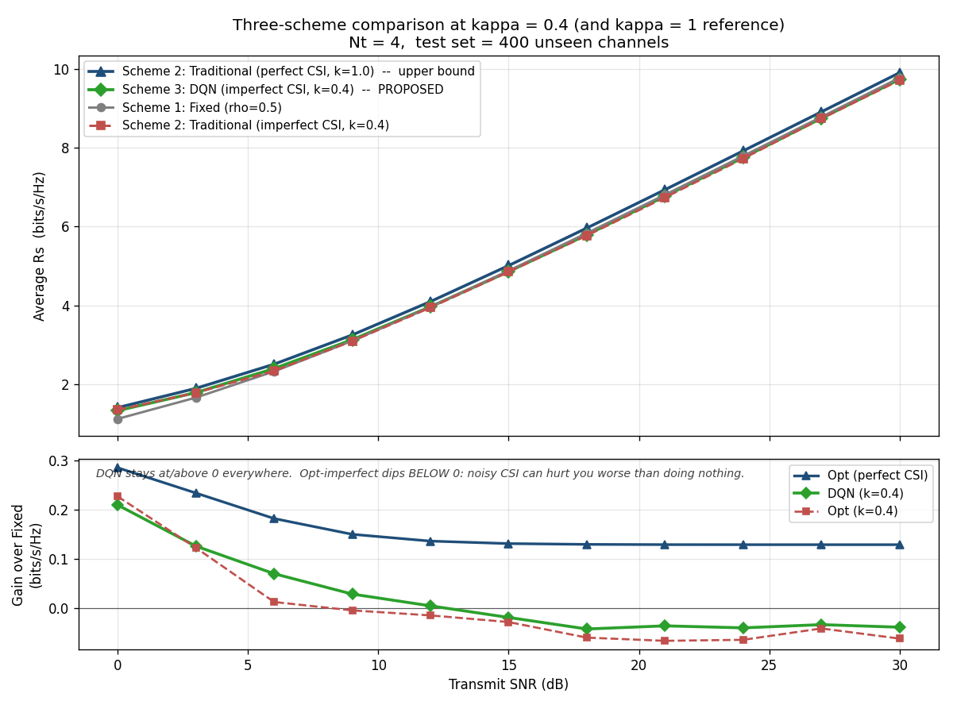
Headline result — three schemes, same channels
κ = 0.4, Nt = 4, 400 unseen channels per SNR point
X axis → Transmit SNR (dB)
Top Y → absolute Rs (bits/s/Hz); Bottom Y → gain over Fixed
DQN (green) sits at or above the Fixed baseline (grey) everywhere. Traditional (red, dashed) drops below. Same model, no retuning per SNR.
Slide 9 / 13

Slide 10
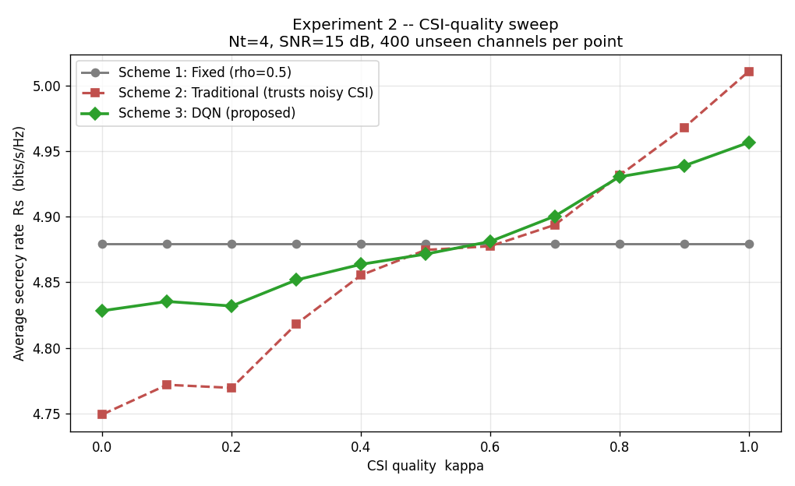
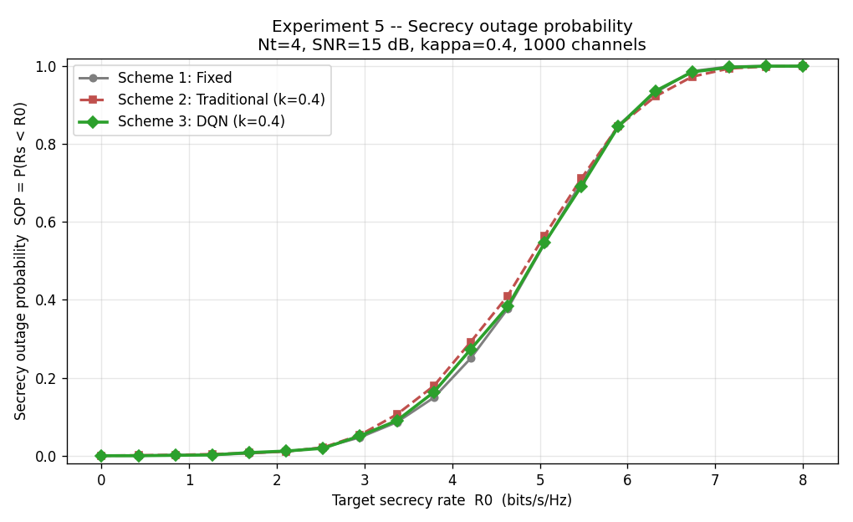
Robustness — the κ sweep and the outage curve
X → CSI quality κ ∈ [0, 1] Y → Rs (bits/s/Hz)
X → target rate R₀ Y → outage P(Rs < R₀)
Drag κ from 1 → 0. Traditional collapses below Fixed near κ ≈ 0.6. DQN never does.
Outage at the same scenario. At R₀ = 4 bits/s/Hz, DQN's outage ≈ 18% vs Traditional's ≈ 26%.
Slide 10 / 13

Slide 11
With vs Without our AI — the numbers
Average secrecy rate Rs (bits/s/Hz) across five operating points, same Monte Carlo channels
Scenario | Without AI: Fixed (ρ = 0.5) | Without AI: Traditional (noisy ĥE) | With AI: DQN (ours) | DQN gain over Traditional
Nt = 4, SNR = 15 dB, κ = 0.4 | 4.879 | 4.822 | 4.854 | +0.032
Nt = 4, SNR = 15 dB, κ = 0.2 (low intel) | 4.879 | 4.788 | 4.835 | +0.047
Nt = 8, SNR = 15 dB, κ = 0.4 | 6.026 | 5.992 | 6.048 | +0.057
Nt = 8, SNR = 15 dB, κ = 0.2 (worst case) | 6.026 | 5.964 | 6.043 | +0.079
Outage Pr[Rs < 4] at Nt = 4, SNR = 15, κ = 0.4 | ≈ 22 % | ≈ 26 % | ≈ 18 % | 30 % relative ↓
DQN beats the Traditional (noisy-CSI) optimiser at every scenario in the test set — by 0.03 to 0.08 bits/s/Hz.
All four scenarios use 400 unseen Monte Carlo channels. Outage row uses 1000 channels.
Slide 11 / 13

Slide 12
Live demo — Streamlit GUI
Switching to the browser — same model, you drag the sliders.
1.
2.
3.
4.
5.
Live test
SNR sweep
κ sweep
Outage
Geometry
Pick (Nt, SNR, κ). See three schemes compete side-by-side.
Hold κ, vary SNR. Watch the curves spread or converge.
Hold SNR, slide κ from 1 → 0. The headline story, live.
Empirical CDF. How often each scheme misses the target rate.
Conceptual sketch — Alice's beam, AN, Bob, Eve.
▶ streamlit run app/streamlit_app.py (default Nt = 8 — where the win is biggest)
Slide 12 / 13

Slide 13
Takeaways
1. Problem
2. Fix
3. Outcome
Plugging noisy intel into the textbook AN-allocation optimiser produces a confidently-wrong split. It actively underperforms the do-nothing baseline once intel quality drops below ~ 0.6.
Train a small DQN over random intel-quality scenarios. Feed the agent its own intel quality and a beam-alignment cue, so it knows when to trust the estimate and when to retreat to a safe default.
ONE trained policy beats the noisy-CSI optimiser at every Nt and every κ in the test set. Lower outage at the same target rate. ≈ 38 s training cost. Single-pass inference.
Slide 13 / 13

Slide 14
Thank you — questions?
github.com/MuhammadIsmail009/pls-dqn-miso
Muhammad Ismail · Abubakar Butt · Usman Ali

