Slide 1
Requirements Analysis and the Unified Process
Last Update: Thursday, September 6, 2001

Slide 2
Contents
Requirements Analysis: What and what?
Unified Process
OO Analysis and Design
  Basics
  UML
  Actors, Use cases

Slide 3
Requirements Analysis [1]
What is it?
  The process by which customer needs are understood and documented.
  Expresses “what” is to be built and NOT “how” it is to be built.
Example 1:
  The system shall allow users to withdraw cash. [What?]
Example 2:
  A sale item’s name and other attributes will be stored in a hash table and updated each time any attribute changes. [How?]

Slide 4
Requirements Analysis [2]
C- and D-Requirements
  C-: Customer wants and needs; expressed in language understood by the customer.
  D-: For the developers; may be more formal.

Slide 5
Requirements Analysis [2]
Why document requirements?
  Serves as a contract between the customer and the developer.
  Serves as a source of test plans.
  Serves to specify project goals and plan development cycles and increments.

Slide 6
Requirements Analysis [3]
Roadmap:
  Identify the customer.
  Interview customer representatives.
  Write C-requirements, review with customer, and update when necessary.
  Write D-requirements; check to make sure that there is no inconsistency between the C- and the D-requirements.

Slide 7
Requirements Analysis [4]
C-requirements:
  Use cases expressed individually and with a use case diagram. A use case specifies a collection of scenarios.
    Sample use case: Process sale.
  Data flow diagram:
    Explains the flow of data items across various functions. Useful for explaining system functions. [Example on the next slide.]
  State transition diagram:
    Explains the change of system state in response to one or more operations. [Example two slides later.]
  User interface: Generally not a part of requirements analysis though may be included. [Read section 3.5 from Braude.]

Slide 8
Data Flow Diagram
Employee Record
Overtime
rate
Get employee
file
Pay rate
Company records
*
Weekly
pay
Pay
ID
*
Overtime
pay
*
Regular
hours
Overtime
hours
Total pay
Worker
Deduct
taxes
Tax rates
Net pay
Check
Issue
paycheck

Slide 9
State Transition Diagram (STD)
Elevator example (partial):
EBP(e,f)
EBOFF (e,f)
EBON (e,f)
EBP(e,f)
EBOFF (e,f): Elevator e button OFF at floor f.
EBON (e,f): Elevator e button ON at floor f.
EBP(e,f): Elevator e button f is pressed.
EAF(e,f): Elevator e arrives at floor f.

Slide 10
Requirements Analysis [5]
D-requirements:
  Organize the D-requirements.
  Create sequence diagrams for use cases:
    Obtain D-requirements from C-requirements and customer.
    Outline test plans
    Inspect
  Validate with customer.
  Release:

Slide 11
Requirements Analysis [6]
  Organize the D-requirements.
    Functional requirements
      The blood pressure monitor will measure the blood pressure and display it on the in-built screen
    Non-functional requirements
      Performance
      The blood pressure monitor will complete a reading within 10 seconds.
      Reliability
      The blood pressure monitor must have a failure probability of less than 0.01 during the first 500 readings.

Slide 12
Requirements Analysis [7]
    (c) Interface requirements: interaction with the users and other applications
    The blood pressure monitor will have a display screen and push buttons. The display screen will….
    (d) Constraints: timing, accuracy
    The blood pressure monitor will take readings with an error less than 2%.

Slide 13
Requirements Analysis [7]
Properties of D-requirements:
  Traceability: Functional requirements
    D-requirement → inspection report → design segment → code segment → code inspection report → test plan → test report
  Traceability: Non-Functional requirements
    Isolate each non-functional requirement.
    Document each class/function with the related non-functional requirement.

Slide 14
Requirements Analysis [8]
Properties of D-requirements:
  3. Testability
    It must be possible to test each requirement. Example ?
  4. Categorization and prioritization

Slide 15
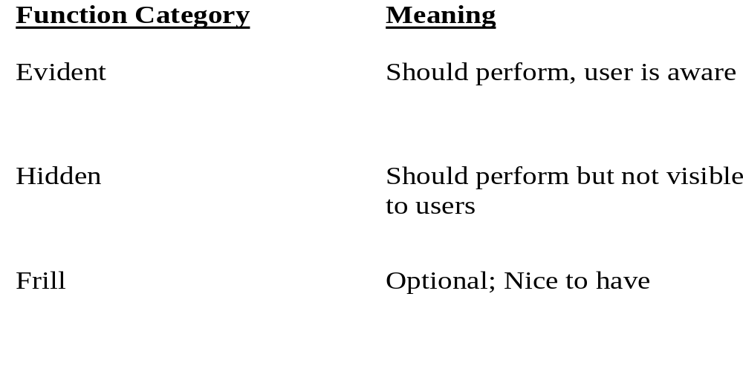
Categorizing Requirements
How to categorize system functions?

Slide 16
Prioritizing (Ranking) Use Cases
Strategy :
  pick the use cases that significantly influence the core architecture
  pick the use cases that are critical to the success of the business
  a useful rule of thumb - pick the use cases that are the highest risk!!!

Slide 17
Requirements Analysis [9]
Properties of D-requirements:
  5. Completeness
    Self contained, no omissions.
  6. Error conditions
  State what happens in case of an error. How should the implementation react in case of an error condition?

Slide 18
Requirements Analysis [10]
Properties of D-requirements:
  7. Consistency
    Different requirements must be consistent.
    Example:
    R1.2: The speed of the vehicle will never exceed 250 mph.
    R5.4: When the vehicle is cruising at a speed greater than 300 mph, a special “watchdog” safety mechanism will be automatically activated.

Slide 19
The Unified Process
Why a Process?
  Software projects are large, complex, sophisticated
  time to market is key
  many facets involved in getting to the end
Common process should
  integrate the many facets
  provide guidance to the order of activities
  specify what artifacts need to be developed
  offer criteria for monitoring and measuring a project

Slide 20
The Unified Process
Component based - meaning the software system is built as a set of software components interconnected via interfaces
Uses the Unified Modeling Language (UML)
Use case driven
Architecture-centric
Iterative and incremental
This is what makes
the Unified process
Unique
Component: A physical and replaceable part of a system that conforms to
and provides realization of a set of interfaces.
Interface: A collection of operations that are used to specify a service of a class or a component

Slide 21
The Unified Process
User’s
requirements
Software
Development
Process
Software
System

Slide 22
The Unified Process
Use Case driven
  A use case is a piece of functionality in the system that gives a user a result of value
Use cases capture functional requirements
Use case answers the question: What is the system supposed to do for the user?

Slide 23
The Unified Process
Architecture centric
  similar to architecture for building a house
Embodies the most significant static and dynamic aspects of the system
Influenced by platform, OS, DBMS etc.
Primarily serves the realization of use cases

Slide 24
The Unified Process
Iterative and Incremental
  commercial projects continue many months and years
  to be most effective - break the project into iterations
Every iteration - identify use cases,create a design, implement the design
Every iteration is a complete development process

Slide 25
The Unified Process
Look at the whole process
  Life cycle
  Artifacts
  Workflows
  Phases
  Iterations

Slide 26
The Life of the Unified Process
Unified process repeats over a series of cycles
Each cycle concludes with a product release
Each cycle consists of four phases:
  inception
  elaboration
  construction
  transition

Slide 27
The Life of the Unified Process
Time
Inception
Elaboration
Construction
Transition
Iteration
Iteration
Iteration
Iteration
Iteration
Iteration
Iteration
Iteration
1
1
1
1
Release 1
A cycle with its phases and its iterations

Slide 28
OO Analysis and Design
Compare and Contrast analysis and design
Define object-oriented analysis and design
Relate, by analogy, OO analysis and design to business organization.

Slide 29
What is Analysis and Design?
Analysis - investigation of the problem (what)
Design - logical solution to fulfill the requirements (how)
Notes:
Example for analysis: if a new computerized library information system is desired, what are the business processes related to its use.
Example for design: how exactly will the library information system software capture and record book loans?

Slide 30
What is OO analysis and design?
Essence of OO analysis - consider a problem domain from the perspective of objects (real world things, concepts)
Essence of OO design - define the solution as a collection of software objects (allocating responsibilities to objects)

Slide 31
Examples
OO Analysis - in the case of the library information systems, one would find concepts like book, library, patron
OO Design - emphasis on defining the software objects; ultimately these objects are implemented in some programming language; Book may have a method named print.

Slide 32

Example - contd.
Representation in analysis of concepts
Domain concept
Book
______
title
print()
Public class Book
{
public void print();
private string title;
}
Representation in OO programming language

Slide 33
What are the business processes?
First step - consider what the business must do; in the case of a library - lending books, keeping track of due dates, buying new books.
In OO terms - requirements analysis; represent the business processes in textual narration (Use Cases).

Slide 34
Business processes - contd.
Identifying and recording the business processes as use cases is not actually an object oriented activity; though a necessary first step.

Slide 35
Roles in the organization
Identify the roles of people who will be involved in the business processes
In OO terms - domain analysis
Examples - customer, library assistant, programmer, navigator, sensor, etc.

Slide 36
Who does what? Collaboration
Business processes and people identified; time to determine how to fulfill the processes and who does these processes
in OO terms - object oriented design; assigning responsibilities to the various software objects
often expressed in class diagrams

Slide 37
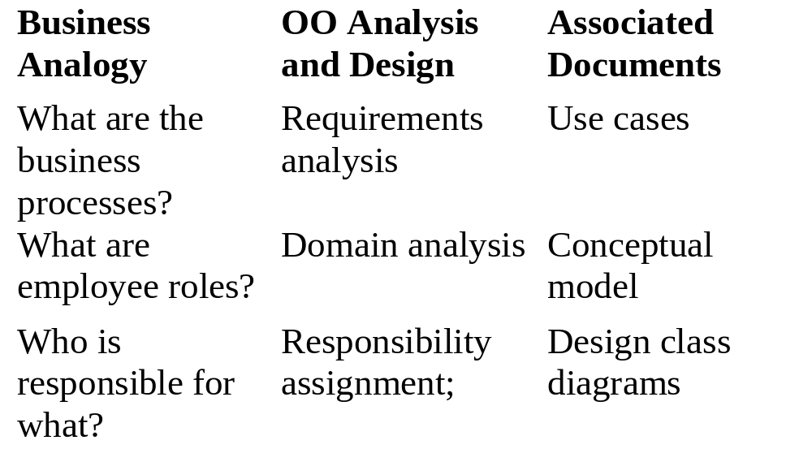
In Summary...

Slide 38
Simple example to see big picture
Define use cases
Define conceptual model
Define collaboration diagrams
Define design class diagrams
Example: Dice game a player rolls two die. If the total is 7 they win; otherwise they lose

Slide 39
Define use cases
Use cases - narrative descriptions of domain processes in a structured prose format
Use case: Play a game
Actors: Player
Description: This use case begins when the player picks up and rolls the die….
Notes:
Understanding the requirements including understanding the domain processes and the external environment

Slide 40
Define conceptual model
OO Analysis concerns
  specification of the problem domain
  identification of concepts (objects)
Decomposition of the problem domain includes
  identification of objects, attributes, associations
results can be expressed in conceptual model

Slide 41
Conceptual model - dice game
Player
_____
name
1
2
Die
____
facevalue
Rolls
1
2
DiceGame
Plays
Includes
1
1
Conceptual model is not a description of the software components;
it represents concepts in the real world problem domain

Slide 42
Defining collaboration diagram
OO Design is concerned with
  defining logical software specification that fulfills the requirements
Essential step - allocating responsibility to objects and illustrating how they interact with other objects
Expressed as Collaboration diagrams
Collaboration diagrams express the flow of messages between
Objects.

Slide 43
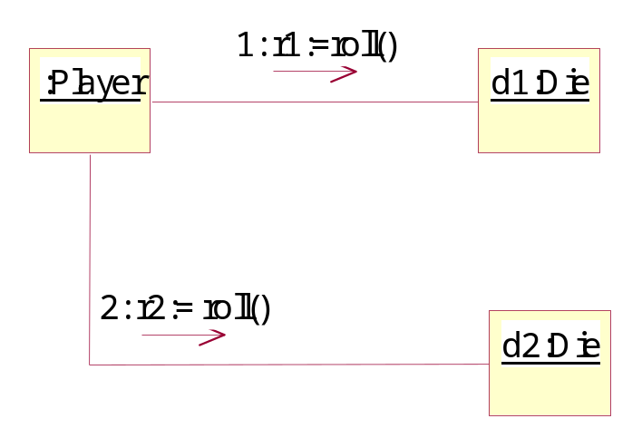
Example - collaboration diagram

Slide 44
Defining class diagrams
Key questions to ask
  How do objects connect to other objects?
  What are the behaviors (methods) of these objects?
Collaboration diagrams suggests connections; to support these connections methods are needed
Expressed as class diagrams

Slide 45
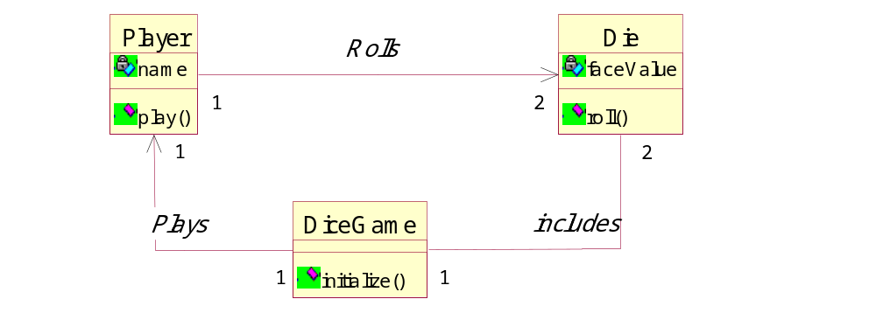
Example - Class diagram
A line with an arrow at the end may suggest an attribute.
For example, DiceGame has an attribute that points to an
instance of a Player

Slide 46
Defining Models and Artifacts
Objectives
  analysis and design models
  familiarize UML notations and diagrams
real world software systems are inherently complex
Models provide a mechanism for decomposition and expressing specifications

Slide 47
Analysis and Design models
Analysis model - models related to an investigation of the domain and problem space (Use case model qualifies as an example)
Design model - models related to the solution (class diagrams qualifies as an example)

Slide 48
Introduction to UML[1]
UML is NOT a methodology
UML is NOT a process
UML is NOT proprietary (Now under the OMG)
UML is strictly Notations

Slide 49
Introduction to UML[2]
Goals of UML notation
  Simple : requires only a few concepts and symbols
  Expressive : applicable to a wide spectrum of systems and life cycle methods
  Useful : focuses only upon those necessary elements to software engineering
  Consistent : the same concept and symbol should be applied in the same fashion throughout

Slide 50
Introduction to UML[3]
Goals of UML notation:
  Printable
  Extensible : users and tool builders should have some freedom to extend the notation
UML has different parts
  Views - shows different aspects of the system that are modeled, links the modeling language to the method/process chosen for development
  Diagrams - graphs that describe the contents in a view
  Model elements - concepts used in a diagram

Slide 51
Introduction to UML[4]
Component
View
Logical
View
Use Case
View
Deployment
View
Concurrency
View

Slide 52
Introduction to UML[5]
Use-case view : A view showing the functionality of the system as perceived by the external actors
Logical view: A view showing how the functionality is designed inside the system, in terms of the static structure and dynamic behavior
Component view: A view showing the organization of the code components

Slide 53
Introduction to UML[6]
Concurrency view: A view showing the concurrency of the system
Deployment view: A view showing the deployment of the system in terms of the physical architecture

Slide 54
Introduction to UML[9]
Model elements
  Class
  Object
  State
  Use case
  Interface
  Association
  Link
  Package ….

Slide 55
Introduction to UML[10]
Use Case diagram: External interaction with actors
Class/Object Diagram : captures static structural aspects, objects and relationships
State Diagram: Dynamic state behavior
Sequence diagram: models object interaction over time
Collaboration diagram: models component interaction and structural dependencies

Slide 56
Introduction to UML[11]
Activity diagram : models object activities
Deployment diagram : models physical architecture
Component diagram : models software architecture

Slide 57
Case study - Point of Sale
POS terminal should support the following
  record sales
  handle payments
many architectural layers
  presentation
  application logic (problem domain, service support)
  persistence
Emphasis - problem domain application objects

Slide 58
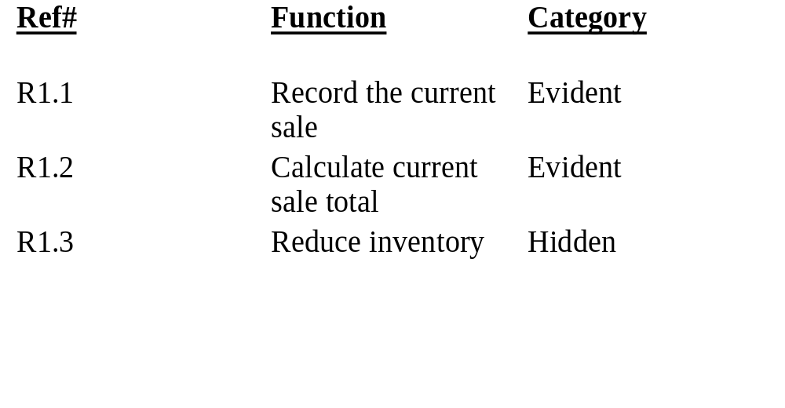
Understanding requirements

Slide 59
Analysis
Objectives
  Identification of Use cases
  Draw use case diagrams
  Ranking Use cases
  Contrast essential and real use cases

Slide 60
Use cases [1]
Excellent technique for improving the understanding of requirements
Narrative in nature
Use cases are dependent on having some understanding of the requirements (expressed in functional specifications document).

Slide 61
Use Cases [2]
Use case - narration of the sequence of events of an actor using a system
UML icon for use case

Slide 62
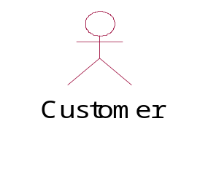
Actors [1]
Actor - an entity external to the system that in some way participates in the use case
An actor typically stimulates the system with input events or receives outputs from the system or does both.
UML notation for actor:

Slide 63
Actors [2]
Primary Actor - an entity external to the system that uses system services in a direct manner.
Supporting Actor- an actor that provides services to the system being built.
Hardware, software applications, individual processes, can all be actors.

Slide 64
Identification of Use Cases
Method 1 - Actor based
  Identify the actors related to the system
  Identify the processes these actors initiate or participate in
Method 2 - Event based
  Identify the external events that a system must respond to
  Relate the events to actors and use cases
Method 3 – Goal based
  [Actors have goals.]
  Find user goals. [Prepare actor-goal list.]
  Define a use case for each goal.

Slide 65
Identification of Use Cases[2]
To identify use cases, focus on elementary business processes (EBP).
An EBP is a task performed by one person in one place at one time, in response to a business event. This task adds measurable business value and leaves data in a consistent state..

Slide 66
Point of Sale - Actors
Actors:
  Cashier
  Customer
  Supervisor
Choosing actors:
  Identify system boundary
  Identify entities, human or otherwise, that will interact with the system, from outside the boundary.
  Example: A temperature sensing device is an actor for a temperature monitoring application.

Slide 67
Point of Sale - Use Cases
Cashier
  Log In
  Cash out
Customer
  Buy items
  Return items

Slide 68
Common mistake
Common error - representing individual steps as use cases
  Example: printing a receipt (Why?)

Slide 69
High level vs. Low Level Use cases[1]
Consider the following use cases:
  Log out
  Handle payment
  Negotiate contract with a supplier
These use cases are at different levels. Are they all valid? To check, use the EBP definition.
Log out: a secondary goal; it is necessary to do something but not useful in itself.
Handle payment: A necessary EBP. Hence a primary goal.

Slide 70
High level vs. Low Level Use cases [2]
Log out: a secondary goal; it is necessary to do something but not useful in itself.
Handle payment: A necessary EBP. Hence a primary goal.
Negotiate contract: Most likely this is too high a level. It is composed of several EBPs and hence must be broken down.

Slide 71
Use Case Diagram - Example
Process sale
Payment
Authorization
service
Cashier
Handle returns
<<actor>>
Tax calculator
Process rental
Manage security
<<actor>>
Accounting system
System administrator
Manage users
Use Case Diagram: illustrates a set of use cases for a system.

Slide 72
More on Use Cases
Try to describe use cases independent of implementation
Be as narrative as possible
State success scenarios (how do you measure the success of an use case)
A use case can have many scenarios (threads of execution)
Agree on a “format style” for use case description
Name a use case starting with a verb in order to emphasize that it is a process (Buy Items, Enter an order, Reduce inventory)

Slide 73
More on Use Cases
Document exception handling or branching
  when a “Buy Item” fails, what is expected of the system
  when a “credit card” approval fails, what is expected of the system

Slide 74
A sample Use Case
Use case: Buy Items
Actors: Customer, Cashier
Type: Primary, Essential
Description: A customer arrives at a checkout with
items to purchase. The cashier records
the purchase items and collects payment.

Slide 75
Ranking Use Cases
Use some ordering that is customary to your environment
  Example: High, Medium, Low
  Example: Must have, Essential, Nice to have
Useful while deciding what goes into an increment
Point of sale example:
  Buy Items - High
  Refund Items - Medium (Why?)
  Shut Down POS terminal - Low

