Slide 1
AWS DE Project
Mareddy Krishna Kishore Reddy
703284070
Mareddy.Kishore@enquero.Genpact.digital

Slide 2
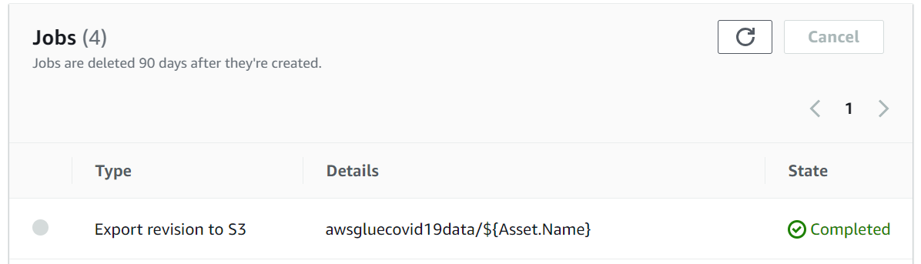
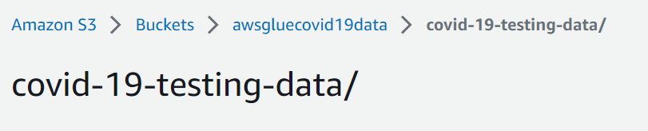
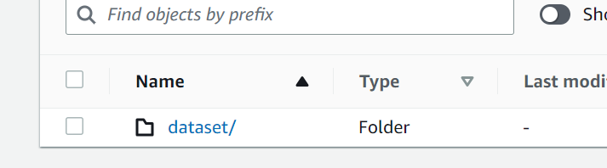
Import data to S3

Slide 3
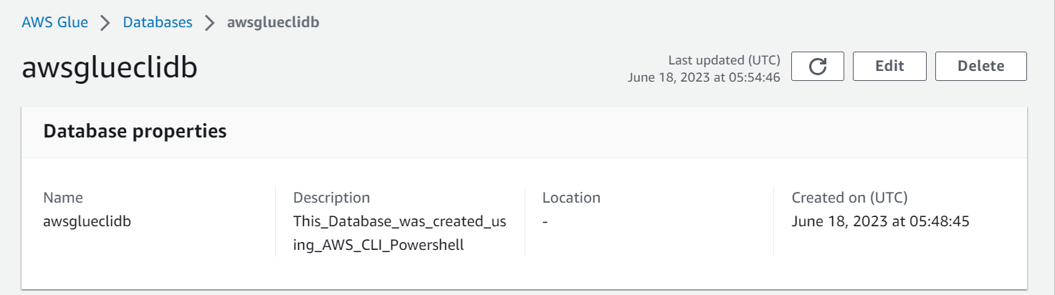
Create Glue DB
aws glue create-database --database-input '{\"Name\":\"awsglueclidb\",\"Description\":\"This_Database_was_created_using_AWS_CLI_Powershell\"}'

Slide 4
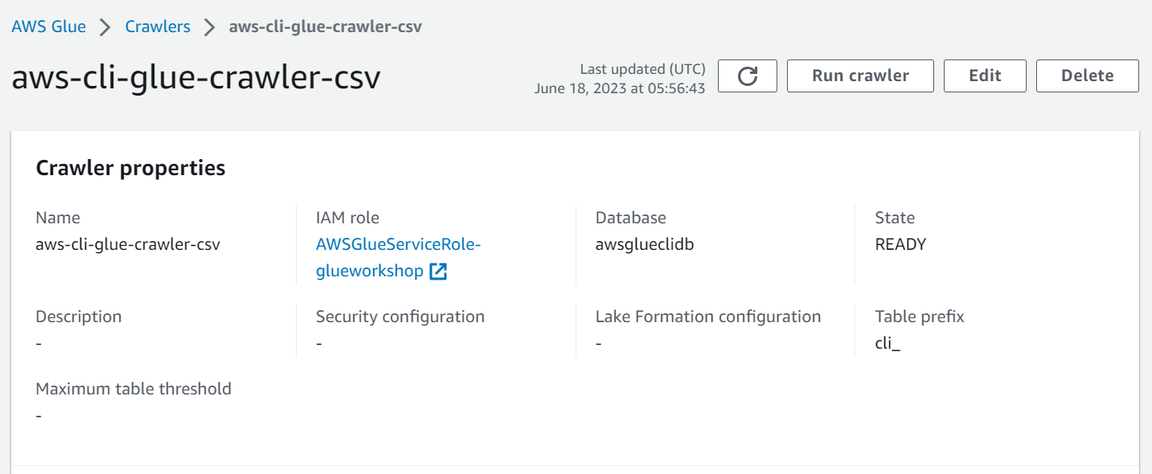
Glue Create Crawler for csv
aws glue create-crawler --name aws-cli-glue-crawler-csv --role AWSGlueServiceRole-glueworkshop --database-name awsglueclidb --table-prefix cli_ --targets '{\"S3Targets\": [{\"Path\": \"s3://awsgluecovid19data/covid-19-testing-data/dataset/csv\"}]}'

Slide 5
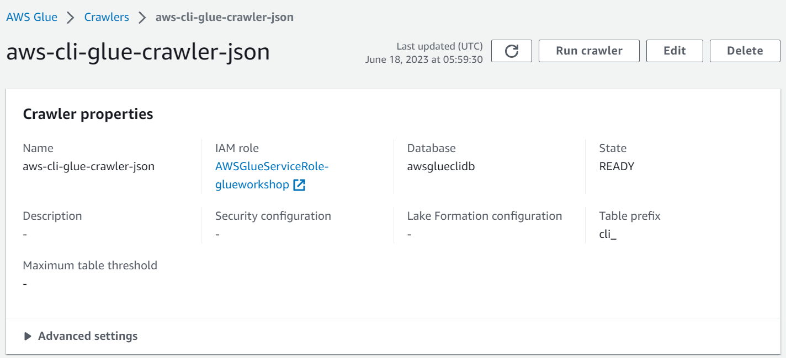
Create Glue Crawler for JSON
aws glue create-crawler --name aws-cli-glue-crawler-json --role AWSGlueServiceRole-glueworkshop --database-name awsglueclidb --table-prefix cli_ --targets '{\"S3Targets\": [{\"Path\": \"s3://awsgluecovid19data/covid-19-testing-data/dataset/json\"}]}'

Slide 6
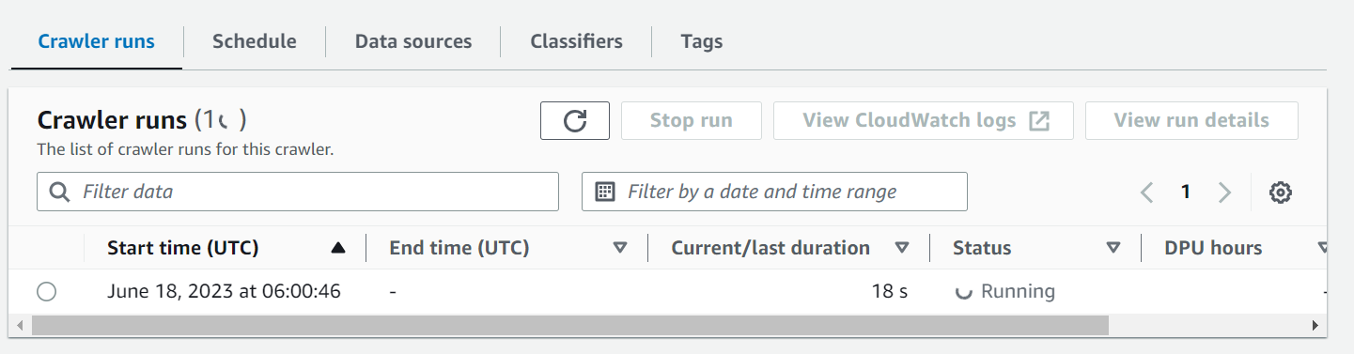
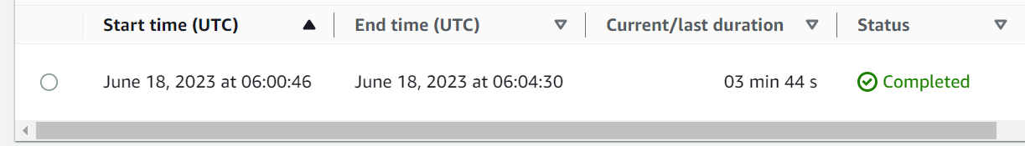
Run Crawlers
aws glue start-crawler --name aws-cli-glue-crawler-csv

Slide 7
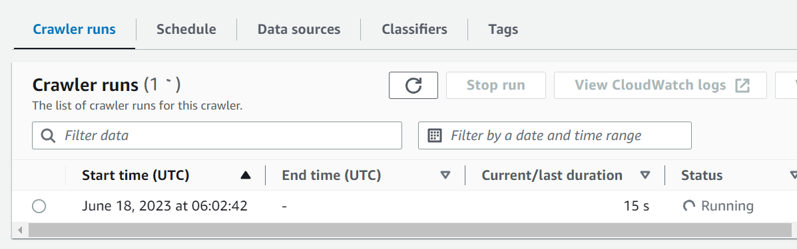
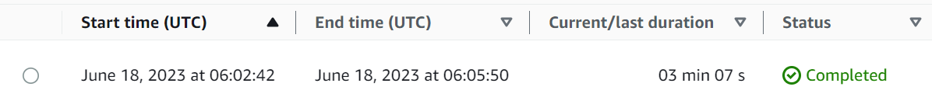
Run Crawlers
aws glue start-crawler --name aws-cli-glue-crawler-json

Slide 8
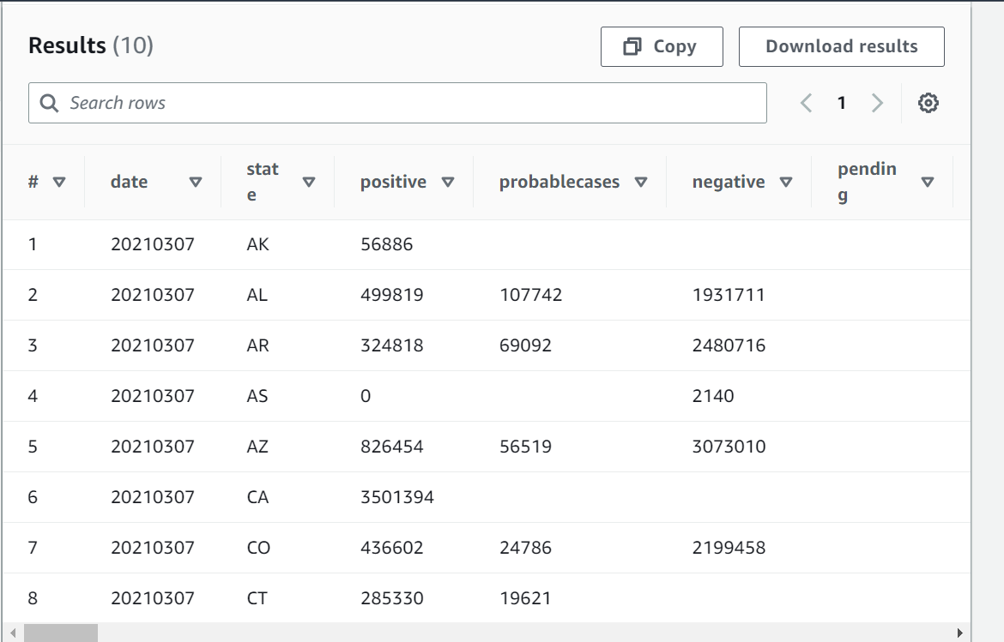
Athena Sample Data

Slide 9
Task 2: Deploying Glue Locally
Steps Followed to deploy and run Glue Locally:
Get Docker Image of Glue
Run the docker to start an interactive Jupiter Notebook:
Command used:
docker run -it -v ~/.aws:/home/glue_user/.aws -v $env:JUPYTER_WORKSPACE_LOCATION:/home/glue_user/workspace/jupyter_workspace/ -e AWS_PROFILE=$env:AWS_PROFILE_NAME -e AWS_ACCESS_KEY=$env:AWS_ACCESS_KEY -e AWS_REGION="us-east-1" -e AWS_SECRET_ACCESS_KEY=$env:AWS_SECRET_ACCESS_KEY -e DISABLE_SSL=true --rm -p 4040:4040 -p 18080:18080 -p 8998:8998 -p 8888:8888 --name glue_jupyter_lab amazon/aws-glue-libs:glue_libs_4.0.0_image_01 /home/glue_user/jupyter/jupyter_start.sh

Slide 10
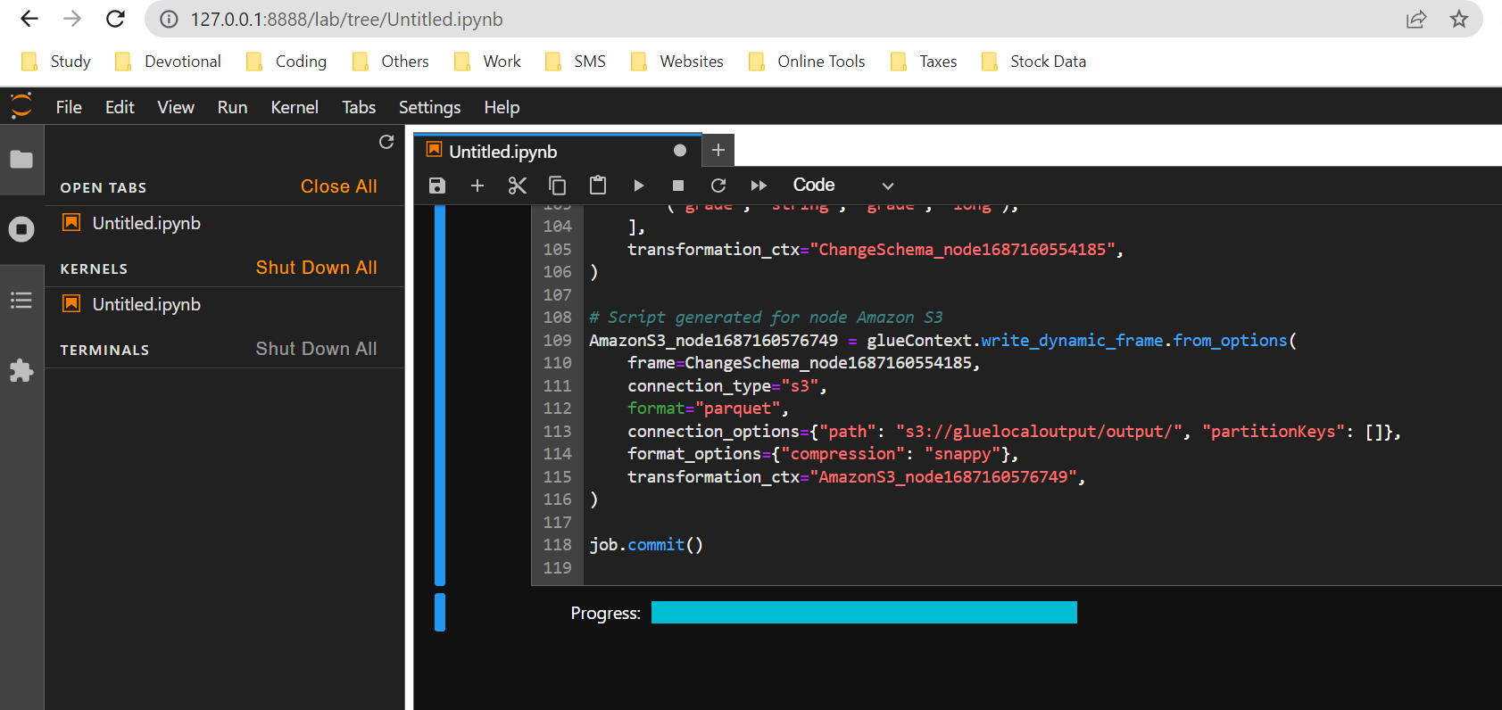
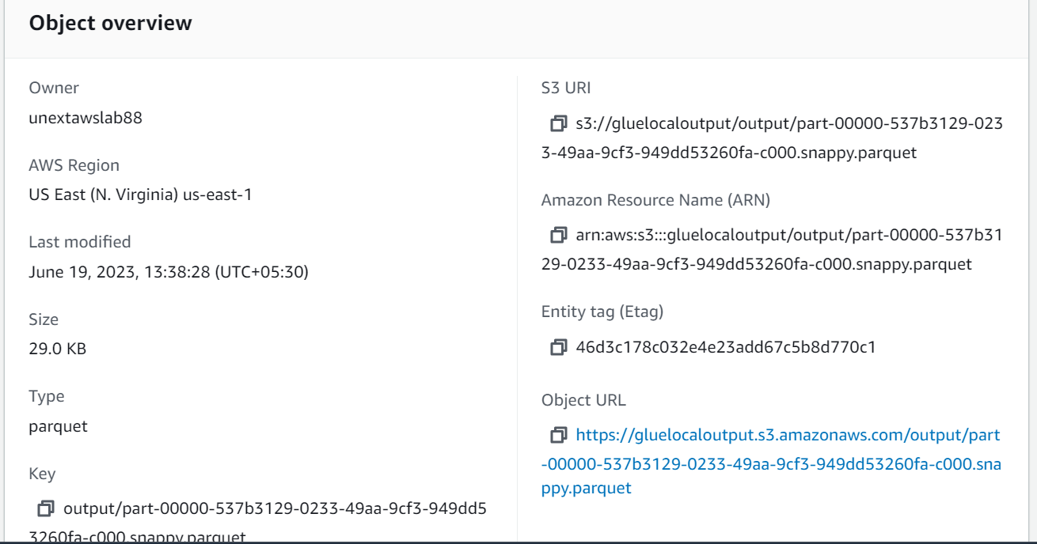
Running Glue Job
Steps:
Open Jupiter Lab and open PySpark Notebook
Run the Glue Job Script

Slide 11
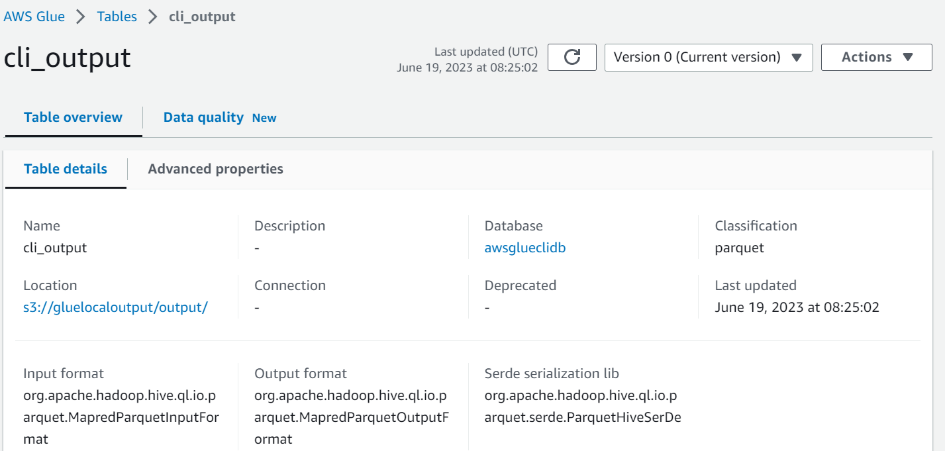
Running Crawler on Parquet File
Create Crawler:
aws glue create-crawler --name aws-cli-glue-crawler-pqt --role AWSGlueServiceRole-glueworkshop --database-name awsglueclidb --table-prefix cli_ --targets '{\"S3Targets\": [{\"Path\": \"s3://gluelocaloutput/output\"}]}’
Run Crawler:
aws glue start-crawler --name aws-cli-glue-crawler-pqt

Slide 12
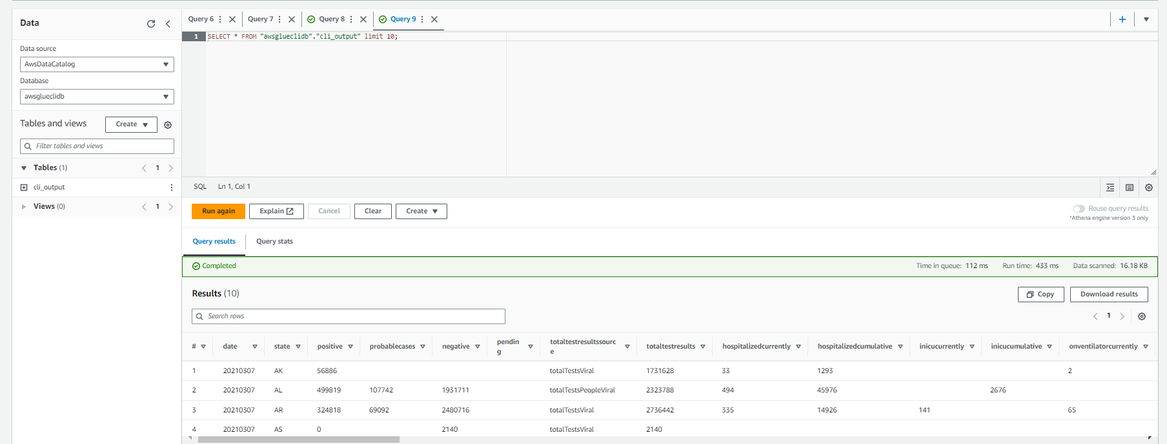
Verifying data in Glue Table with Athena

Slide 13
GitHub Repository
https://github.com/kryptoblockskrishna/AWS_DE_Submission/tree/AWS-DE-Project-Files

Slide 14
Thank You

