Slide 1
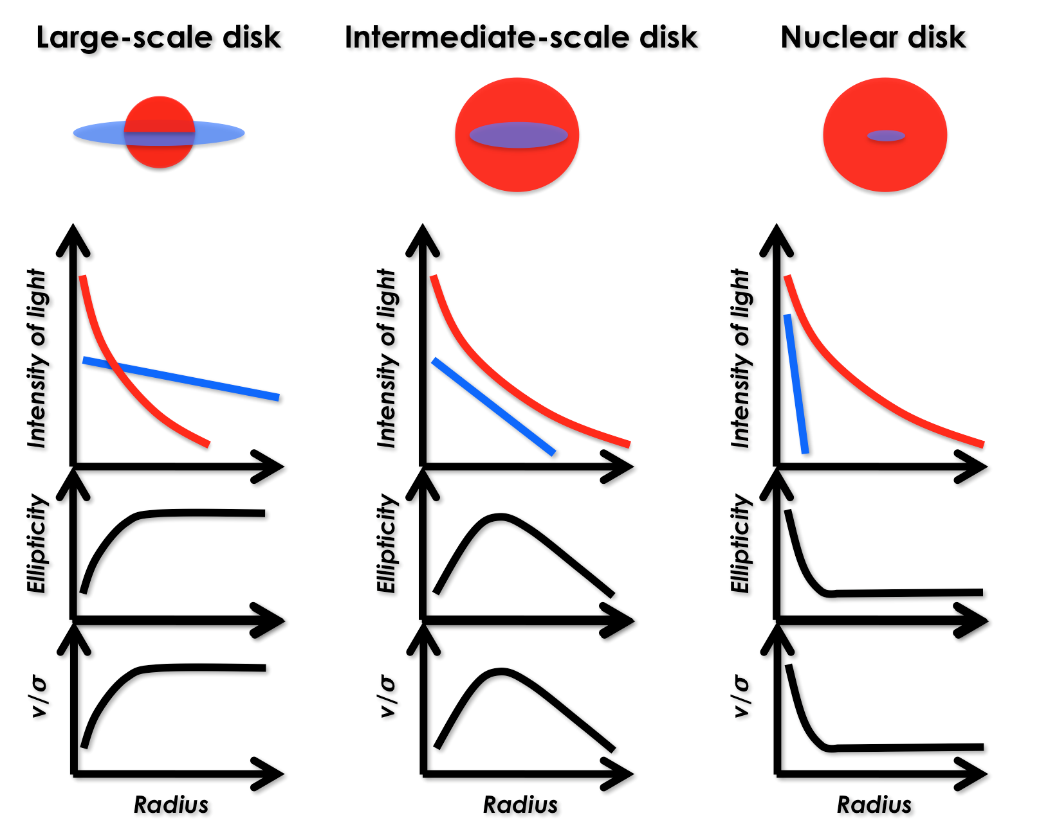
Ellipticals (slow rotators)
Bulge/Total
Elliculars (fast inner, slow outer)
1.00
E
Spirals
0.75
ES
Sa
0.50
S0
Sb
0.30
Sc
S0
Sa
0.15
Sd
0.08
Lenticulars
(fast rotators)
Sb
Sc
Sm
0.04
Sd
Spiral morphological type
Sm
0.00

Slide 2
Early-type
Late-type
1.00
E
slow
rotators
Sa
0.75
Sb
ES
fast inner
slow outer
0.50
Sc
S0
Sd
Bulge/Total
0.30
fast
rotators
0.15
S0
0.08
0.04
0.00

Slide 3
Early-type
Late-type
1.00
E
slow
rotators
Sa
0.75
fast
inner &
slow outer
Sb
ES
0.50
Sc
Spheroid/Total
S0
0.30
fast
rotators
Sd
S0
0.15
Sm
0.08
0.04
0.00

