Slide 1
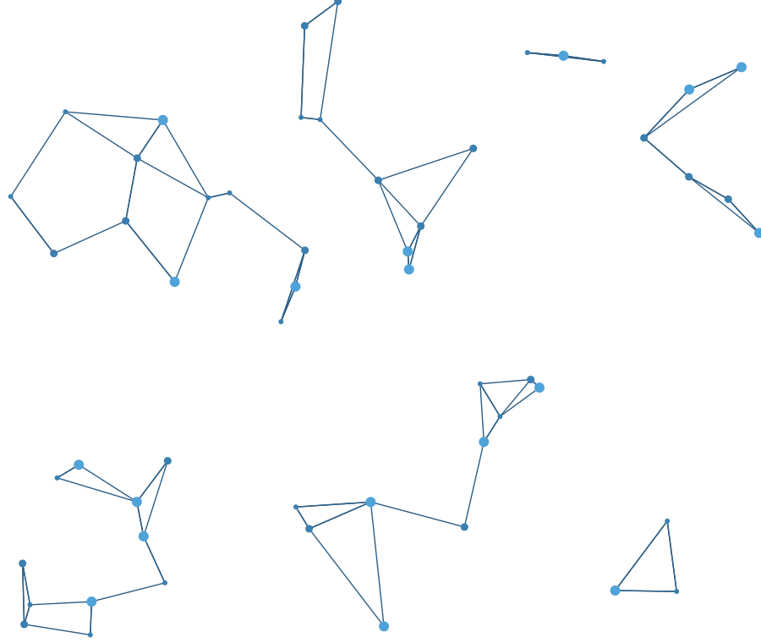
Project Atlas
Offline Intelligence and Data Operations Platform
Technical overview · Version 0.2.0 · November 2026
Notes:
Welcome. This deck walks through Project Atlas end to end: what problem it solves, how it is built, what each capability does, why it can be trusted, how it is deployed, and its honest status. Everything here comes from the repository: code, docs and recorded test, acceptance and benchmark results for release 0.2.0.

Slide 2
Atlas in one slide
An offline-first platform that turns authorized datasets and documents into evidence-backed, auditable analysis — with no cloud dependency at install time or at run time.
167
16
REST API operations
UI modules
111
13
Import, validate, resolve, explore, analyse, report
Every step keeps a pointer back to the source bytes
Software proposes; people decide — and are recorded
backend tests passing
file formats supported
13
0
data-quality checks
cloud services or telemetry
Notes:
The one-sentence pitch is on the left. The numbers on the right are all verifiable in the repo: 167 operations in docs/api.md, 16 navigation modules in the UI, 111 backend tests passing in the engineering report, 8 tabular plus 5 document formats, 13 quality checks, and no telemetry at all — enabling it is rejected at startup.

Slide 3



The problem Atlas solves
Messy inputs
Hard constraints
Accountability
Staff lists in CSV, suppliers in Excel, payments from a database, audit reports as PDF, e-mails. The same person is “Dr. Amelia Okafor” in one file and “Amelia Okafor” in another.
Sensitive data and air-gapped networks rule out cloud analytics. Ad-hoc scripts and spreadsheets lose provenance.
Conclusions will be challenged. Every number, link and finding must be traceable, reproducible and independently reviewed.
Atlas covers the whole chain — import to auditable report — in one installable product.
Notes:
Three forces shape the design. Data arrives messy and inconsistent; the environment often forbids the cloud; and the output must survive scrutiny. General BI tools lack row-level provenance and entity resolution, cloud platforms are off the table for sensitive or air-gapped work, and scripts cannot show a reviewer how a conclusion was reached.

Slide 4
How it works
SECTION 01
The end-to-end flow, the architecture and the principles behind it
Notes:
First, how the platform fits together.

Slide 5







From raw files to defensible findings
1
2
3
4
5
6
7
Import
Validate
Resolve
Explore
Analyse
Investigate
Report & audit
8 tabular formats, documents, originals hashed
Dry run, 13 quality checks, nothing written
Explainable matching, human review, revertible merges
Graph, search, timeline, offline maps
Reproducible runs, sandboxed SQL
Verbatim evidence, reviewed findings
Manifests, hash-chained audit log
Provenance at every hop: source file SHA-256 → dataset version → records (raw + normalized) → entities → relationships → analyses → report manifest
Notes:
This is the spine of the product. Data enters through a controlled import with a mandatory dry run, records are resolved into entities with human review, then explored and analysed, and finally turned into evidence, findings and reports. The strip at the bottom is the key idea: each object keeps a pointer to where it came from.

Slide 6
One process, five stores
Browser or desktop window — React UI, same origin, strict CSP
atlas-api — one Python process (FastAPI + uvicorn)
API routers
auth · admin · projects · data & jobs · entities + graph · search · documents · analysis · investigations · workflows · reports · ai · workspace
Cross-cutting
Argon2id · sessions · TOTP · RBAC · rate limits · config validation · job runner · network guard
Domain services
ingestion · ontology · entities · graph · search · documents · temporal · geospatial · analytics · ai · workflows · reporting · audit · backup
SQLite / PostgreSQL
Search index
Parquet per version
Files on disk
Local model runtime
system of record
FTS5 / tsvector, BM25
analytics & SQL
originals, exports
optional, loopback/LAN
Notes:
Atlas is a modular monolith: one process serves the API, runs background jobs and serves the UI. That keeps installation, upgrades and the security boundary simple — one place for authorization, one audit log. SQLite (or PostgreSQL on a LAN) is the system of record; FTS5 handles search; each dataset version gets an immutable Parquet copy for fast analytics; originals stay byte-identical on disk. The only external process is an optional local model.

Slide 7





Design principles you can see in the code
Offline-first
Evidence first
Explainable
Network guard blocks non-local connections; no telemetry; bundled maps and fonts
Raw values kept beside normalized ones; hashes and record links everywhere
Versioned, deterministic algorithms with visible inputs and evidence
Human in the loop
Reproducible
Tamper-evident
Merges, findings, AI suggestions and generated SQL need a person
Every analysis re-runs on recorded inputs and is checked by hash
Append-only audit log, hash chain, signed checkpoints
Notes:
These six principles are enforced in code, not just stated. For example, offline mode patches socket connections inside the process; matching is a versioned algorithm called er-1.1; analysis runs store input hashes; and the audit table has database triggers that reject updates and deletes.

Slide 8
Capabilities
SECTION 02
Ingestion, entity resolution, graph, search, analytics, AI and case work
Notes:
Now the capabilities, in the order data flows through them.

Slide 9
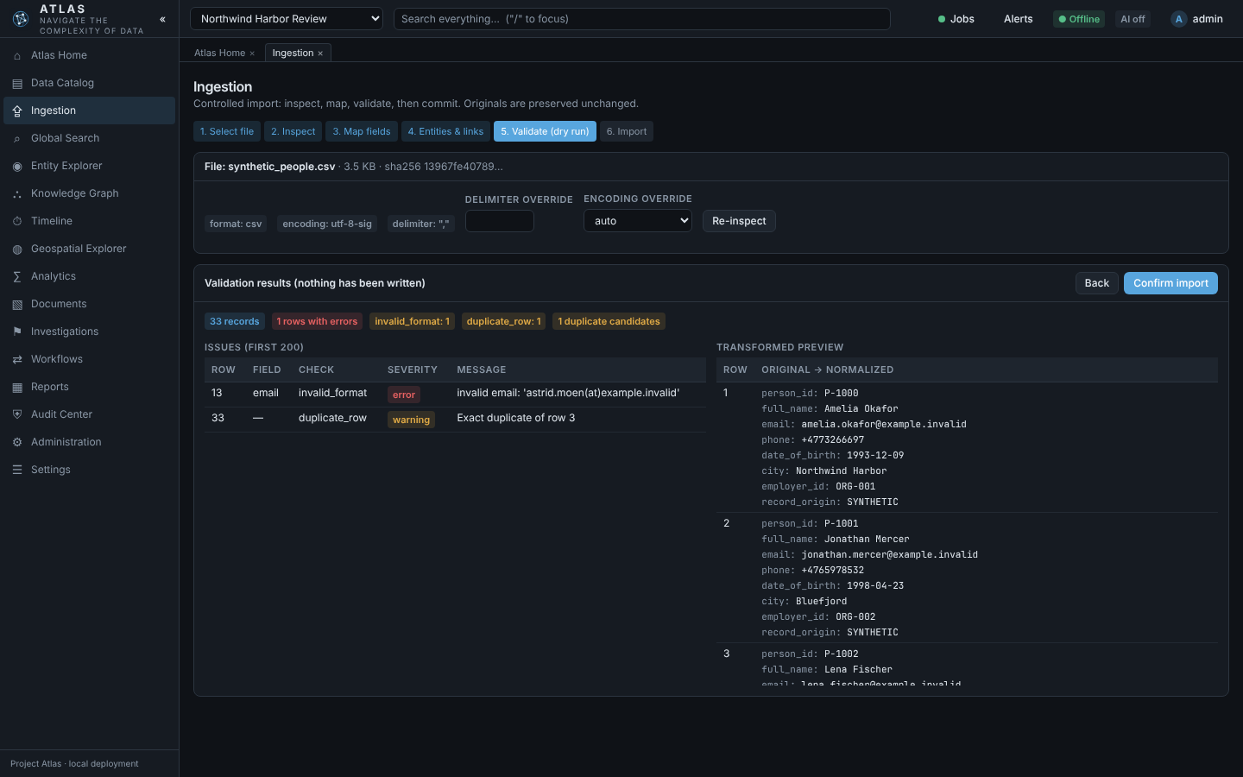
Every import gets a dry run first
1
Upload
type allow-list, magic bytes, SHA-256
2
Inspect
encoding, delimiter, column types
3
Map
types, time zones, sensitive fields, entities
4
Dry run
13 quality checks over the whole file
5
Commit
background job, one transaction
Synthetic transactions: timestamp and coordinate errors found, nothing written.
Originals are kept beside normalized values — reviewers always see what the source said.
Notes:
Import is a five-step pipeline. The dry run validates the entire file and runs 13 quality checks — parse errors, encoding and mojibake, invalid formats, timestamp and coordinate errors, duplicates, referential integrity, mixed units and schema drift — without writing anything. The commit is a background job inside one transaction, so failure leaves no partial data. Rows with invalid coordinates never get a map point: Atlas never invents data.

Slide 10
Entity resolution that explains itself
Blocking
DEMO PAIR | OUTCOME | WHY
Dr. Amelia Okafor ↔ Amelia Okafor | strong | same e-mail identifier
Jon Mercer ↔ Jonathan Mercer | strong | same phone identifier
Lena Fisher ↔ Lena Fischer | ambiguous | names only — human judgement
Rafael Ortiz ↔ Rafael Ortiz | not strong | phone identifiers conflict
Gunnar Thorsen | no match | nothing shared
shared name token or identifier
Compare
only fields both records have
Score
name .45 · identifier .35 · attribute .20
Band
strong ≥ .90 + agreeing identifier
Review
Exactly the outcomes in sample-data/expected_results.json — asserted by the test suite.
a person accepts or rejects
Missing data is never treated as agreement. Scores are similarity, not probability. Merges are fully revertible.
Notes:
Algorithm er-1.1 is deterministic and versioned. It only compares pairs that share a name token or identifier, only scores fields present on both sides, and can only call a match strong when an identifier agrees and none conflicts. The table shows the demo data: two strong matches, one ambiguous pair left to a person, and a same-name pair that is correctly not strong because the phone numbers conflict. Every merge stores a snapshot and can be reverted.

Slide 11
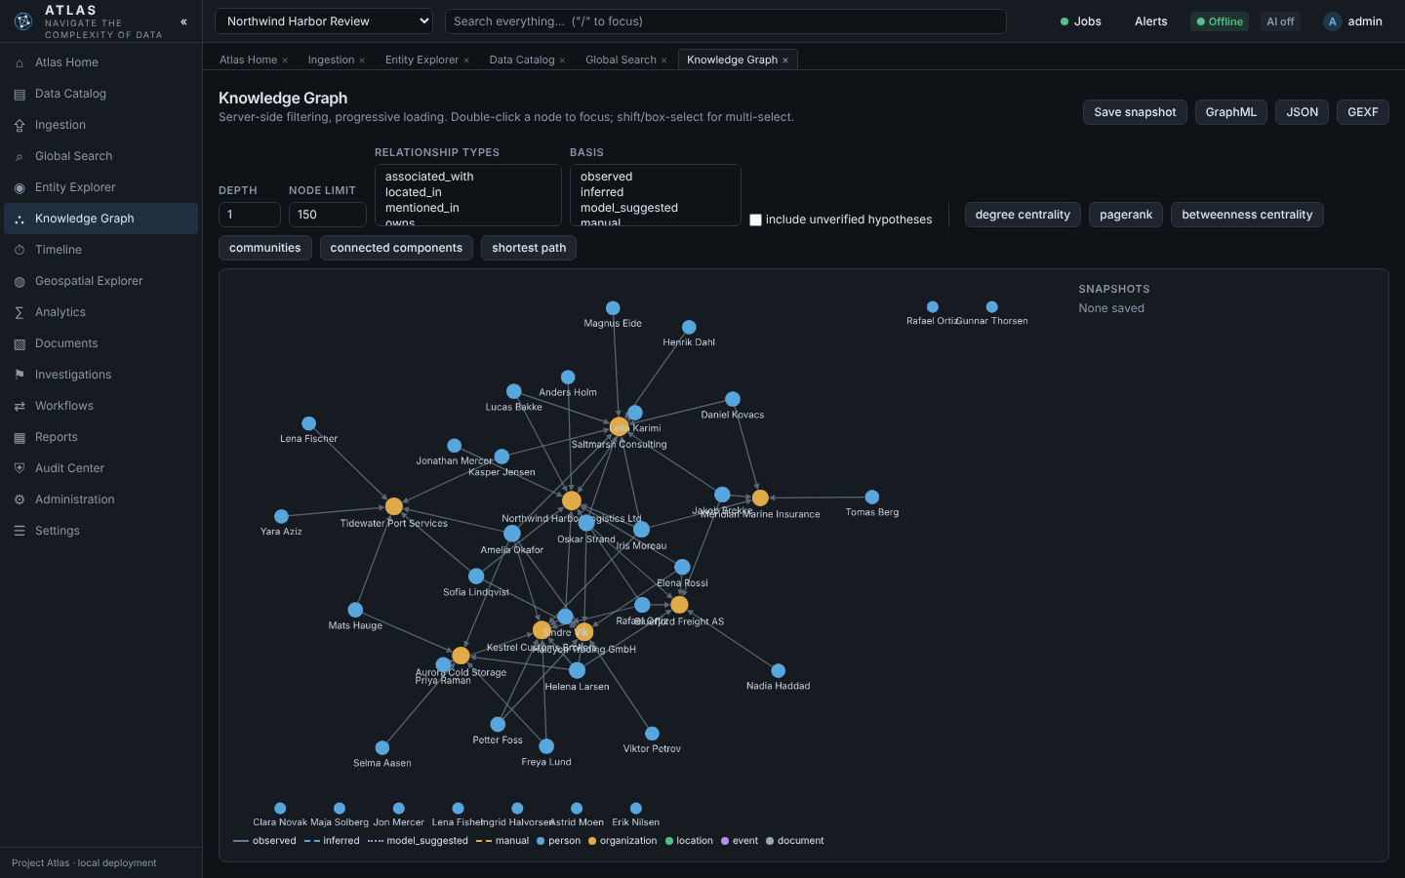
A knowledge graph honest about its sources
Every edge carries its basis
observed
stated directly by a source record
inferred
deterministic rule over data
model hypothesis
hidden until a reviewer verifies it
manual
created by a named user
Degree, PageRank, betweenness, Louvain communities, paths
Explain connection: per-hop evidence
Snapshots; GraphML, GEXF, JSON export
Confidence stays empty unless it was actually measured. A path shows recorded links — not intent.
Notes:
The graph labels every relationship with how it was created, and the UI encodes that basis in line style. Model-suggested relationships are stored as unverified and hidden until a reviewer accepts them. The overview loads the best-connected nodes first, which brought it from 6.6 to 0.9 seconds on about 100,000 edges. Explain connection lists every hop with its basis and a redacted evidence sample.

Slide 12
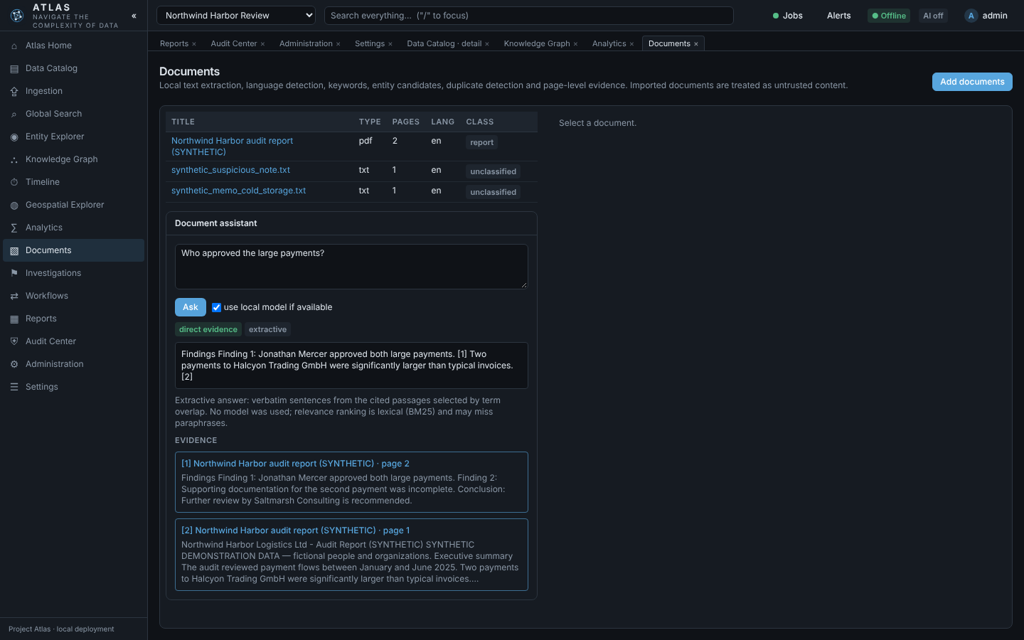
Search, documents and a grounded assistant
Unified search
"Bluefjord Freight"
phrase
Okaf*
prefix
Mercer AND payment
Boolean
type:entity Okafor
type filter
amount>50000
field filter
Document intelligence
PDF, DOCX, TXT, Markdown, EML with page-level evidence
Answers quote and cite pages — or decline
Embedded instructions flagged, never followed
“Who approved the large payments?” — answered by quoting the synthetic audit report, page 2.
Notes:
Search uses SQLite FTS5 with BM25 ranking; the query language is parsed and re-emitted, never passed raw, and restricted or sensitive content never enters results for users who may not see it. Documents are split into page-level passages; the assistant only answers from retrieved passages with citations and declines when there is no evidence. The sample data includes a prompt-injection note to prove embedded instructions are flagged and ignored.

Slide 13
Analytics you can reproduce — and SQL you can trust
Reproducibility by hash
SQL console: four independent layers
Recorded inputs
1 Static validation
version ids + content hashes, parameters, software versions
one SELECT/WITH statement; file, extension and config functions denied
Run
2 Permitted tables only
describe · frequency · trend · correlation · outliers · missing · time series
only readable datasets loaded; sensitive columns dropped
Result SHA-256
3 Locked engine
hash of the canonical result, stored with the run
in-memory DuckDB; external access off, configuration locked first
Reproduce
4 Resource limits
re-run and compare: identical, or changed inputs reported
rows, memory, threads and a wall-clock interrupt
Demo: outliers T-5007 and T-5023 flagged — with the not-evidence-of-wrongdoing disclaimer — and the reproduced hash is identical.
A test proves file access fails even with the validator deliberately bypassed.
Notes:
Each analysis run records exactly what it read and a hash of its result, so anyone can reproduce it months later and get either an identical hash or a report that inputs changed. The SQL console is defended in depth: even if the static validator missed something, the in-memory DuckDB has external access disabled and its configuration locked before the user's query runs, and resource limits stop runaway queries.

Slide 14


Optional local AI, under strict rules
“Ask your data”
You ask
Model drafts SQL
You review & run
Atlas computes
Model describes
plain-language question
validated, never auto-run
explicit click, sandboxed
deterministic table
labelled as model output
Local endpoint only
Cited and validated
A person decides
Loopback or private address enforced at startup and on every call. No hosted fallback.
Answers without valid citations are withheld; SQL is validated; hypotheses are stored unverified.
Merges, relationship hypotheses, SQL execution and report text all require explicit action.
Notes:
Every feature works without a model. If an organization runs one locally, Atlas uses it only for drafting and describing — computation stays deterministic. Note the status honestly: all AI paths are tested against a mock Ollama-compatible runtime, but have not yet been exercised against a real model.

Slide 15


Investigations, workflows and reports
Investigations
Workflows
Reports
Objective, scope and authorization basis
Verbatim evidence with revisions
Findings: draft → review → confirmed / disputed / rejected
No self-review; confirmation needs evidence
16 typed node types, validated ports
Preview on 200 rows, no side effects
Side effects need confirmation
Failure rolls back data writes
PDF, HTML, XLSX, CSV, JSON
Manifest: versions, parameters, redactions
SHA-256 of every export
Formula-injection protection
In the acceptance run, the downloaded PDF bytes matched the manifest SHA-256 exactly.
Notes:
The final stages make work accountable. Evidence must be a verbatim excerpt from its source and keeps a revision history. Findings follow a state machine where someone other than the author must confirm, with supporting evidence. Workflows are typed and versioned, previewable without side effects. Reports carry a manifest and hash; in the acceptance run the downloaded PDF bytes matched the manifest hash exactly.

Slide 16
Trust and operations
SECTION 03
Security, audit, offline assurance, deployment, testing and status
Notes:
Why the platform can be trusted, and how it is run.

Slide 17

Security enforced on every request
Argon2id passwords
PERMISSION | READ-ONLY | REVIEWER | ANALYST | DATA ENG. | PROJ. ADMIN
Read and search | ✓ | ✓ | ✓ | ✓ | ✓
Review matches | · | ✓ | · | ✓ | ✓
Analyses and SQL | · | ✓ | ✓ | ✓ | ✓
Reports, workflows, AI | · | · | ✓ | ✓ | ✓
Import, resolve, restricted data | · | · | · | ✓ | ✓
Sensitive fields, members | · | · | · | · | ✓
≥ 12 chars, rehash on parameter change
No default account
one-time setup token, deleted after use
Sessions
256-bit tokens, only hashes stored, sliding expiry
Brute force
rate limits + 15-minute lockout after 5 failures
Optional TOTP MFA
admin-issued one-time recovery tokens
404 for non-members
System administrators do not automatically see project data. Sensitive fields are redacted in records, SQL, analytics and exports.
other projects’ existence never revealed
Notes:
Authentication uses Argon2id, single-use setup tokens, hashed session tokens, lockout and optional TOTP. Authorization has two independent layers: global roles for administration and project roles for data — so a system administrator cannot read project data without membership. Input handling adds magic-byte checks, XML entity rejection, formula-injection protection, and a strict Content Security Policy. Limitations: host administrators remain trusted, data at rest relies on disk encryption, and no independent penetration test has been done yet.

Slide 18


Audit, backup and offline assurance
Hash-chained audit
Verified backups
Offline by design
SHA-256 over previous hash + canonical event
Triggers block UPDATE and DELETE
HMAC-signed checkpoints off-database
Verify reports the first broken sequence
Online SQLite snapshot + workspace files
Optional AES-256-GCM (scrypt key)
Verify: hashes, integrity, row counts
Restore moves current data aside first
Socket and DNS guard inside the process
No telemetry; no external assets
offline-check with a live probe
Workflow repeated in a no-network namespace
A test drops the trigger and edits a row: verification reports the exact broken sequence number.
Notes:
Three mechanisms provide assurance after the fact. The audit log is tamper-evident — a test drops the trigger, edits a row and verification pinpoints the exact sequence. Backups are verified before you need them and restores never delete current data. The network guard blocks non-local connections inside the process; for real air-gap assurance it must be combined with OS and network controls, which the docs state plainly.

Slide 19


Three ways to deploy the same code
Standalone desktop
Air-gapped workstation
Private LAN server
PyInstaller app; random loopback port; opens a chromeless browser window; SQLite in the user data folder
Offline bundle with every wheel and SHA256SUMS; install.sh verifies and installs with --no-index
Behind a TLS reverse proxy; LAN opt-in and TLS required in production; PostgreSQL in preview
pip install -e backend && (cd frontend && npm ci && npm run build) && atlas serve
atlas offline-check atlas backup --encrypt atlas verify-backup <file>
Notes:
The same code serves three profiles, and startup validation refuses unsafe combinations such as a LAN binding without opt-in, LAN production without TLS, a non-local AI endpoint in offline mode, or telemetry. Configuration is a set of ATLAS_ environment variables. Linux bundles were verified; Windows and macOS packages still need to be built on those systems.

Slide 20
Tested, measured and verified offline
111
backend tests passing
11
frontend unit tests
14/14
acceptance steps, incl. no-network phase
E2E
Playwright run across all modules
205k records · 5.5k entities · 100k relationships · search p95 374 ms · peak 1.29 GB
Notes:
All suites pass for 0.2.0. The acceptance scenario installs, creates the first admin, imports, resolves, analyses, reports, restarts, verifies the audit chain, backs up, then removes the network entirely and repeats the core workflow. The benchmark used 100,000 transactions and 5,000 people; measurements drove real fixes — import throughput roughly doubled and the graph overview went from 6.6 to 0.9 seconds.

Slide 21
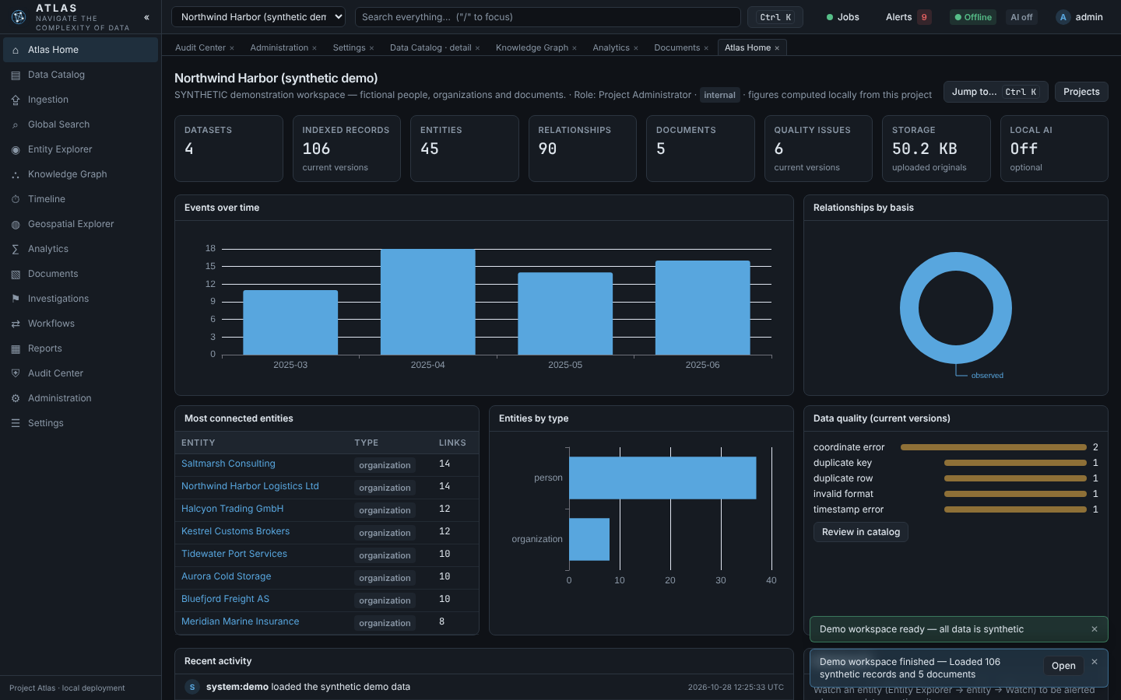
Guided demo: Northwind Harbor
1
Projects → Create demo workspace
2
Ctrl/⌘ K to jump anywhere
3
See the planted quality defects
4
Merge Dr. Amelia Okafor (strong match)
5
Explain a connection in the graph
6
Flag T-5007 and T-5023 as outliers
7
Ask the assistant; export a PDF report
All demo data is synthetic (seed 20251027, example.invalid e-mails).
Notes:
The fastest way to understand Atlas: create the demo workspace — four datasets, 106 records and five documents loaded through the normal audited pipelines in seconds — then follow these seven steps. Each one exercises a different module and has a known expected result documented in sample-data/expected_results.json.

Slide 22



Honest status of release 0.2.0
Complete and tested
Partial
Deferred or untested
All 16 modules and their APIs
Ingestion, resolution, graph, search
Analytics, SQL sandbox, reports
Audit, backup/restore, offline check
Linux offline bundle and desktop app
AI tested against a mock runtime
OCR path untested here
Language detection: 7 languages
No per-field or per-model grants
Workflow parameters edited as JSON
PostgreSQL (implemented, untested)
Windows and macOS packages
Native Tauri/Electron shell
Multi-process job workers
Independent penetration test
Biggest adoption gates for team use: PostgreSQL validation and an independent penetration test.
Notes:
Atlas documents its own gaps. The core product is complete and tested. Partial items are mostly about breadth — AI against a real model, OCR, more languages and finer permissions. The deferred column is what an adopter must weigh for multi-user or high-assurance deployments: PostgreSQL validation and an independent penetration test.

Slide 23
Suggested roadmap
Next release
Following
Later
Validate PostgreSQL end to end, add it to CI
Run the AI assistants against a real local model
Test OCR; build Windows and macOS packages
Independent penetration test
Per-project model allow-lists
Finer field permissions; workflow parameter forms
Multi-process job workers
Resumable mid-file imports
Polygon operations, richer offline basemaps
Recommendations derived from the engineering report’s partial, deferred and risk items — not recorded commitments.
Notes:
These priorities follow directly from the status matrix and risk list. The first horizon removes the biggest adoption blockers for team deployments; the second raises assurance; the third improves scale. They are suggestions for discussion, not commitments recorded in the repository.

Slide 24
Offline. Explainable. Auditable.
Try it: atlas serve → Projects → Create demo workspace
Full detail: docs/overview/Project-Atlas-Technical-Overview.pdf · docs/ in the repository
Notes:
To close: Atlas keeps control local, keeps the evidence, explains every automated step and leaves judgement to people. The fastest next step is the demo workspace. The 46-page technical overview PDF in docs/overview has every detail behind these slides. Questions?

