Slide 1
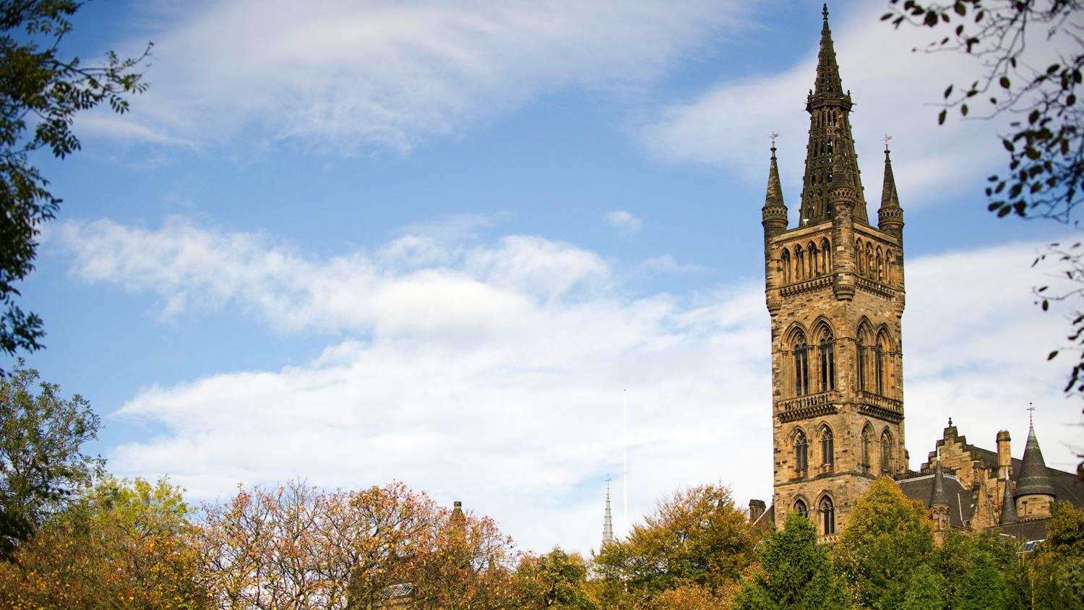



MSc Project Distributed Statistical Learning and Knowledge Diffusion in IoT Supervisor: Dr. Christos Anagnostopoulos
Kurt Portelli – 2222148p

Slide 2
Internet of Things (IoT)
Notes:
I’ll start of by explaining what the internet of things is ..

Slide 3
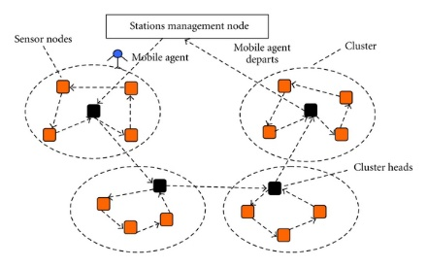
Internet of Things (IoT)
Everything is connected
Small chips/sensors
Computational capabilities
Make up large Sensor Networks
Generates massive amounts of data
Notes:
Well …
The idea is that everyday objects are connected to the internet
This is only possible due to processing chips becoming smaller.
This includes sensors capable of gathering information about their surroundings
Such networks can be made up of a large amount of devices in different locations.
Data is continuously read and transmitted to a central place/ concentrator

Slide 4
Real-Life scenario
Notes:
Let’s take a look at an existing real life scenario

Slide 5
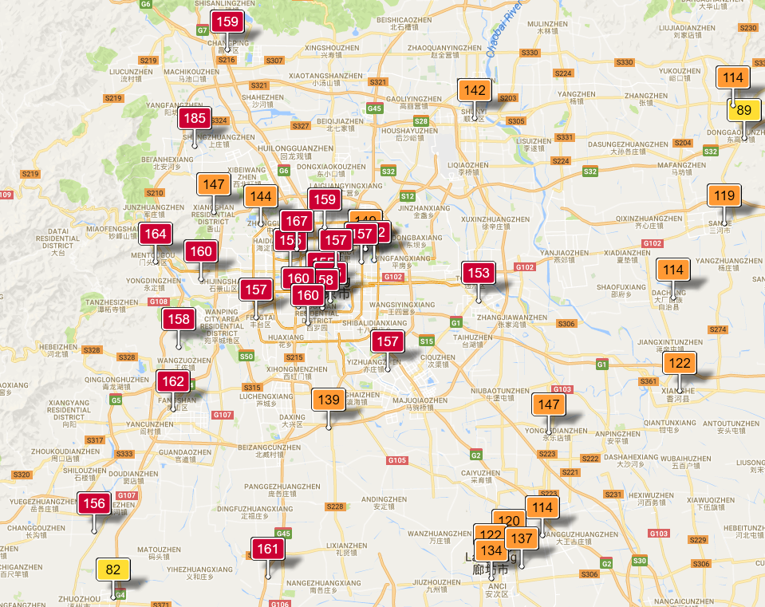
Air Pollution in Beijing
Notes:
These are existing stations in different location across Beijing.
They continuously gather data about the weather/ temperature/ pollutants / NO2
In our evaluation we used the full data set made up of 36 sensors.

Slide 6
Problem Definition
Notes:
So, what is exactly the problem we are tackling

Slide 7
Problem
Network:
Large networks of sensors
Continuous stream of data
Power consumption
Data transmission
Data aggregation
Data Storage
Querying at central node:
Real-time restriction for environment monitoring
Notes:
Imagine thousands of sensors continuously transmitting information about their environment.
This leads to massive costs. Including; power costs, data transmission, storage
Another issue is that the information transmitted needs to be accessible in real time from the concentrator.

Slide 8
Aims
Notes:
Next, we will look at our aims.

Slide 9
Aims
A system capable of simulating an IoT environment.
For each sensor; Extract knowledge from raw data (Using statistical learning)
Leverage this knowledge to improve network efficiency.
Using ensemble learning, minimize the error at the concentrator.
Evaluate the query performance of the naïve approach and our system.
Notes:
Develop a system capable of simulating an IoT environment.
For each sensor, using statistical learning we want to extract knowledge from raw data
Using this knowledge we want to improve network efficiency.
Using ensemble learning we would like to minimize the error at the concentrator
Compare the naïve system and our system.

Slide 10
Contributions
Network Efficiency
Ensemble Learning
Notes:
We have 2 contributions in Network Efficiency and Ensemble Learning.

Slide 11
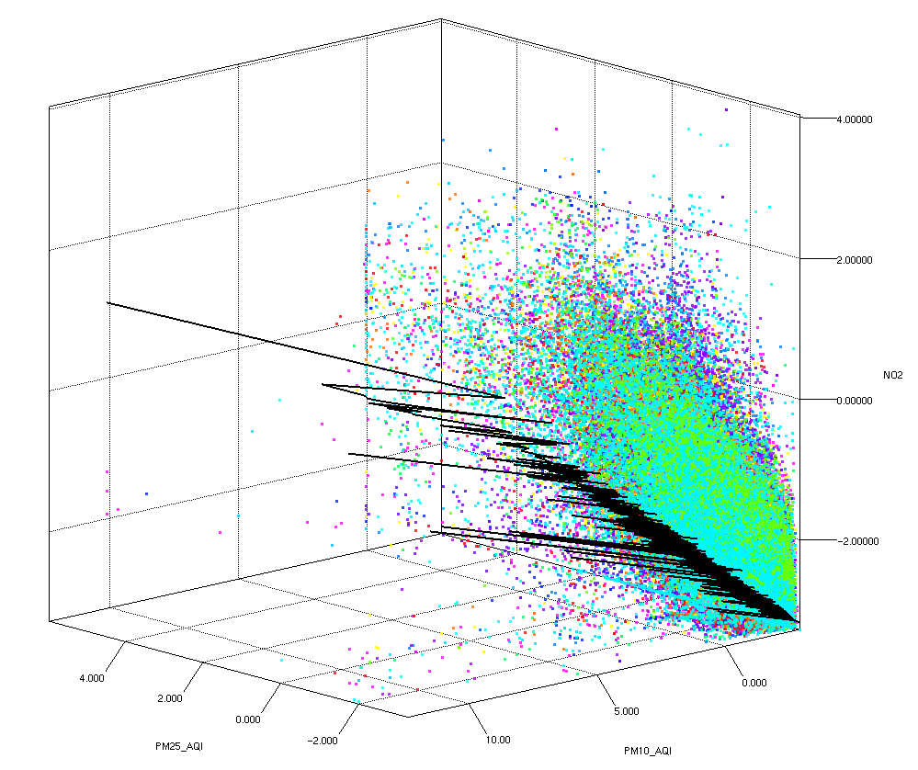

Online Stochastic Gradient Descent
Builds a relationship between the values
Creates the notion of knowledge
Measurable error in knowledge
Notes:
In our system we have a stream of data, thus, we use an online algorithm called online stochastic gradient descent
The 3D graph on the right shows the Beijing Air Quality data. Z-Axis – air pollutants diameter 2.5, X-Axis – air pollutants diameter 1.0 and Y-Axis NO2
When new data arrives we update the weights of the function displayed.
The black line is the function that the system learnt from the 3D data points.

Slide 12
Network Efficiency - Theta
New Data
E = local error
E’ = Calculate concentrator error
E-E’ > THETA ?
Yes
Transmit model and keep a copy
Update local model and clustering
No
Notes:
This is the algorithm which determines the network efficiency.
When new data is read, we first update the local model using online stochastic gradient descent.
Then the cluster, using kmeans.
Afterwards we calculate the local error and concentrator error (since we store a copy)
Then we only send the new model if the difference in error is larger than a predefined THETA.

Slide 13
Ensemble Learning
Each sensor transmits data representatives
Concentrator stores all data representatives
Notes:
Along with the regression model we transmit data representatives. An error associated with each representative, and the number of times it is used.
This would help the concentrator choose the ideal functions to use when a query arrives.

Slide 14
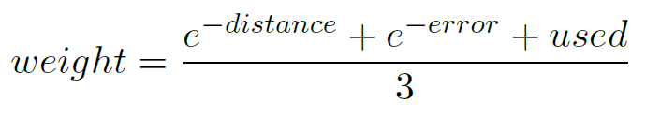
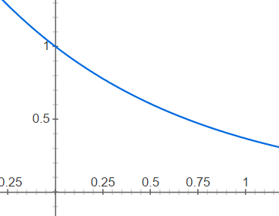

Reliability Function
With each cluster we associate an error and number of times used.
Note: all values are normalized
Notes:
This is the function used to calculate the weight at the concentrator.

Slide 15
Findings
Network efficiency study
Query accuracy
Notes:
I will now explain our findings.

Slide 16
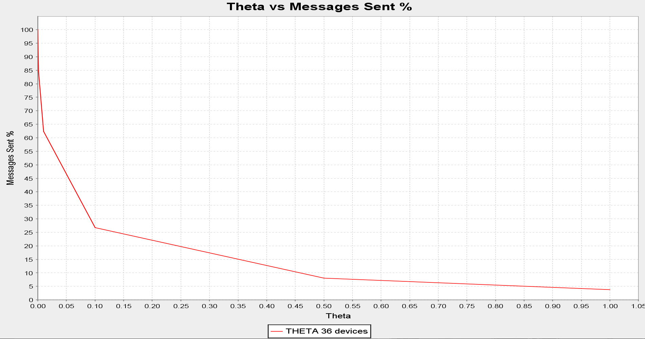
Theta vs Messages sent %
Notes:
This graph shows the THETA vs Messages Sent. Example at THETA 0 -100% of the messages are sent and at THETA 0.5 – 10% of the messages are sent.

Slide 17
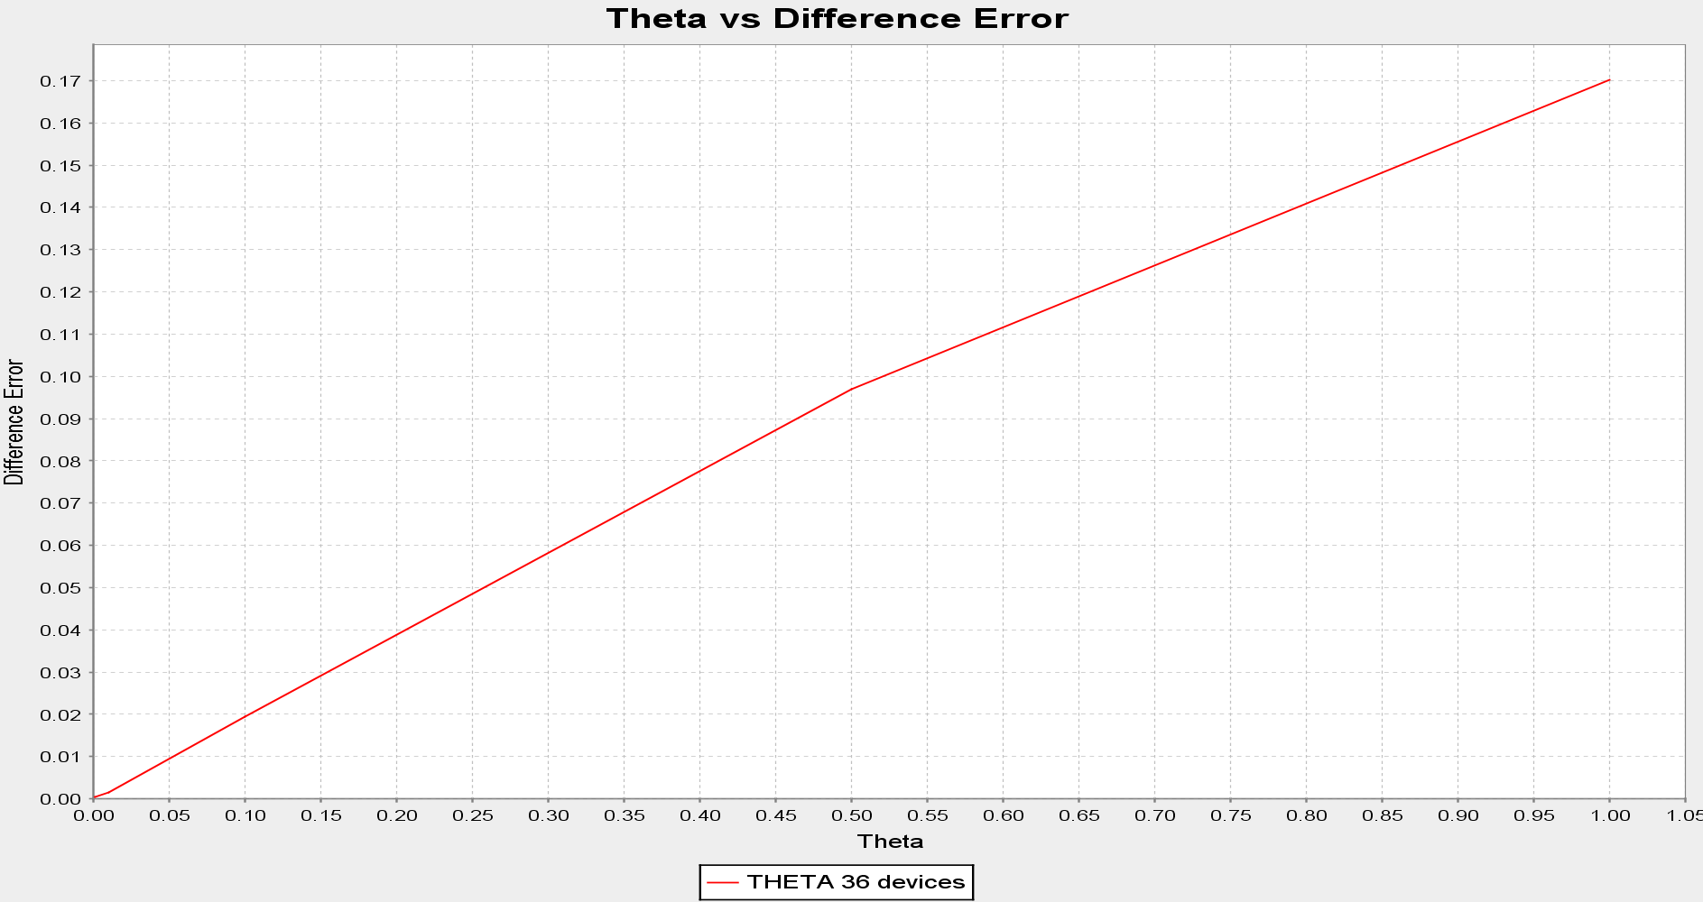
Theta vs Difference Error
Notes:
THETA represents how strict the system is towards updating the model at the concentrator. As one can see the large THETA is the larger the error.

Slide 18
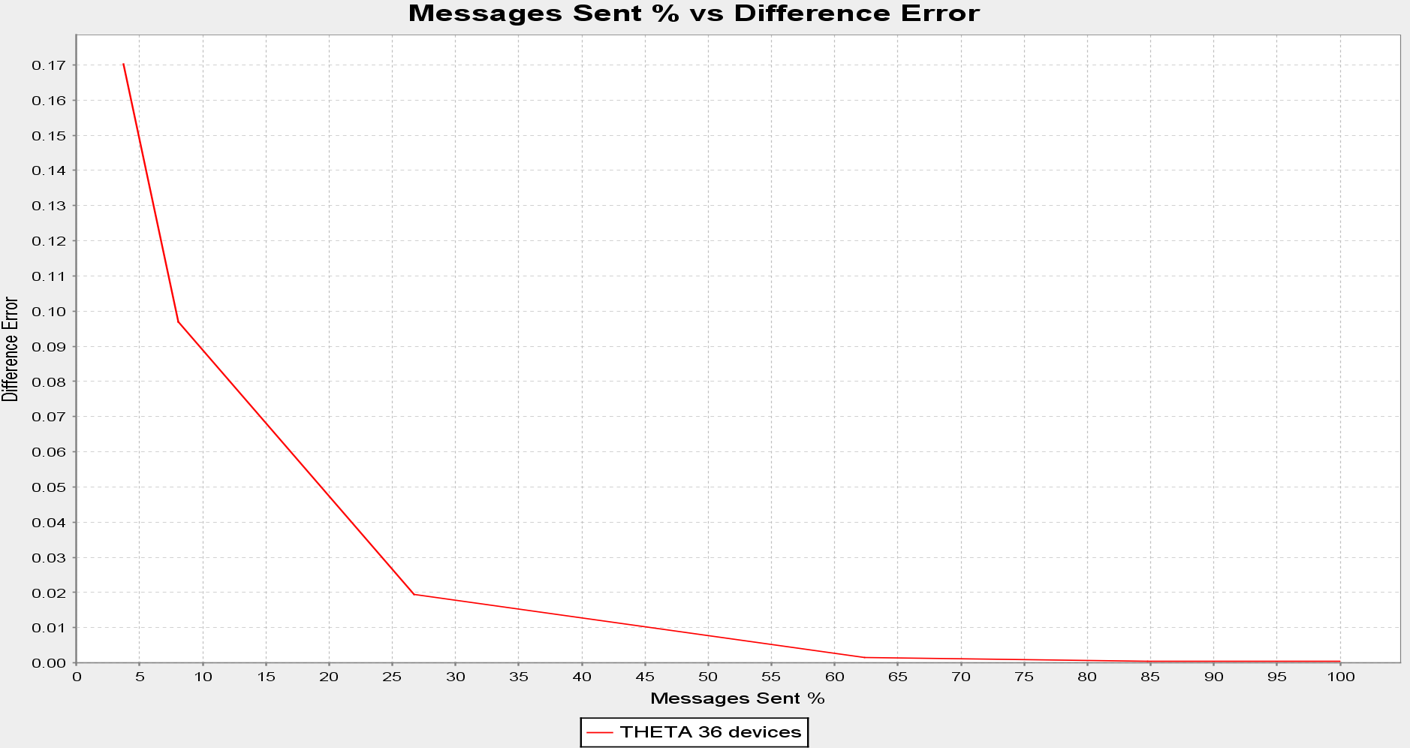
Messages Sent % vs Difference Error
Notes:
Joining the 2 graphs together by removing THETA we can see the relationship between messages sent and difference in error. An interesting thing is for example sending just 60% of messages has barely any effect on the overall error. Meaning that 40% of the messages had no new knowledge.

Slide 19
Query Accuracy – Theta 0.001
84.7% messages sent
Notes:
The next 2 slides now show the query accuracy at the concentrator using different algorithms at different THETA.
Baseline is the naïve model which transmits all the raw data.
Ideal is using the knowledge from only the right sensor. ( we know it since it is a test scenario)
Average is the one where we average all the functions
Distance is the one which uses only the closest functions depending on KNN
Reliability is the one which uses the functions with highest weight depending on KNN
From the 3D plot we can see that we should try to approach the Baseline. The average solution provides better results than the ideal suggesting there is a subset of functions better than the average. At higher KNN the Reliability algorithm provides better results than the average.

Slide 20
Query Accuracy – Theta 0.1
26.7% messages sent
Notes:
We can see the same things at a higher THETA.

Slide 21
Demo

Slide 22
Conclusion
Notes:
Now .. to conclude,

Slide 23
Conclusion
We have a system that:
Simulates an IoT environment
Extracts knowledge from raw data
Decides it is worth it to transmit the new knowledge.
Intelligently Quantizes the input space
Notes:
We have a system that simulates an IoT environment
Extracts and knowledge from raw data using statistical learning
Evaluates how useful the new knowledge is.
And only transmits it if it is useful.
Intelligently quantizes the input space.. Based on distance, error, usage.

