Slide 1



MSc Project Distributed Statistical Learning and Knowledge Diffusion in IoT Supervisor: Dr. Christos Anagnostopoulos
Kurt Portelli – 2222148p

Slide 2
Internet of Things (IoT)

Slide 3
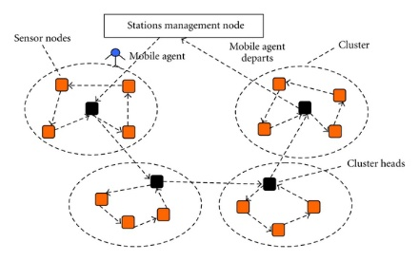
Internet of Things (IoT)
Everything is connected
Small chips/sensors
Computational capabilities
Make up large Sensor Networks
Generates massive amounts of data

Slide 4
Real-Life scenario

Slide 5
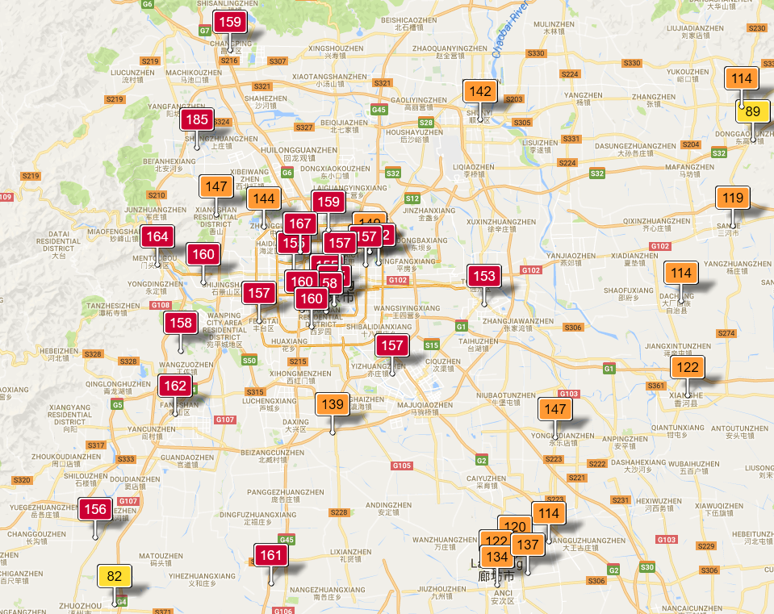
Air Pollution in Beijing

Slide 6
Problem Definition

Slide 7
Problem
Network:
Large networks of sensors
Continuous stream of data
Power consumption
Data transmission
Data aggregation
Data Storage
Querying at central node:
Real-time restriction for environment monitoring

Slide 8
Aims

Slide 9
Aims
A system capable of simulating an IoT environment.
For each sensor; Extract knowledge from raw data (Using statistical learning)
Leverage this knowledge to improve network efficiency.
Evaluate the query performance

Slide 10
Contributions
Network Efficiency
Ensemble Learning

Slide 11
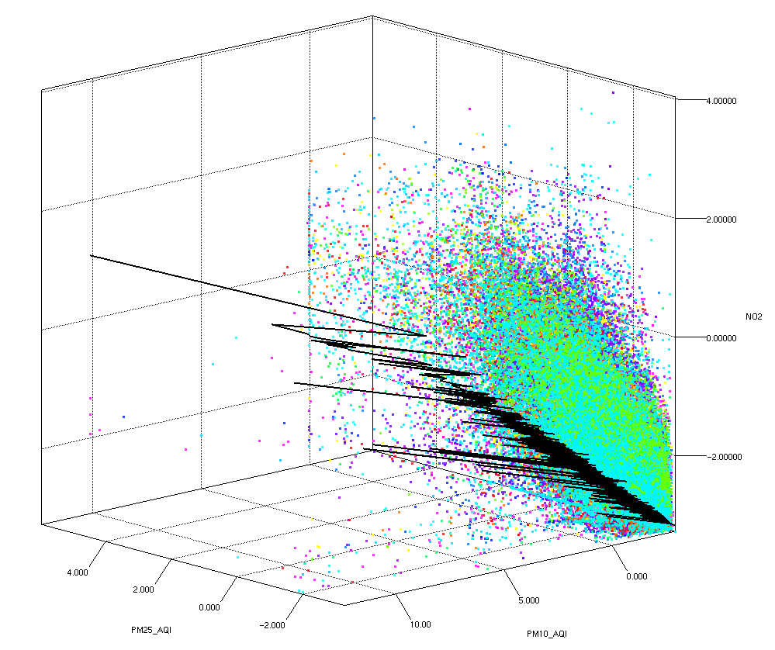

Online Stochastic Gradient Descent
Builds a relationship between the values
Creates the notion of knowledge
Measurable error in knowledge

Slide 12
Network Efficiency - Theta
New Data
E = local error
E’ = Calculate concentrator error
E-E’ > THETA ?
Yes
Transmit model and keep a copy
Update local model and clustering
No

Slide 13
Ensemble Learning
Each sensor transmits data representatives
Concentrator stores all data representatives

Slide 14
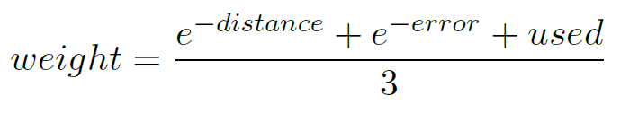
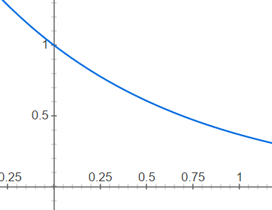

Reliability Function
Data representatives consider distance only
With each cluster we associate an error and number of times used.
Note: all values are normalized

Slide 15
Findings
Network efficiency study
Query accuracy

Slide 16
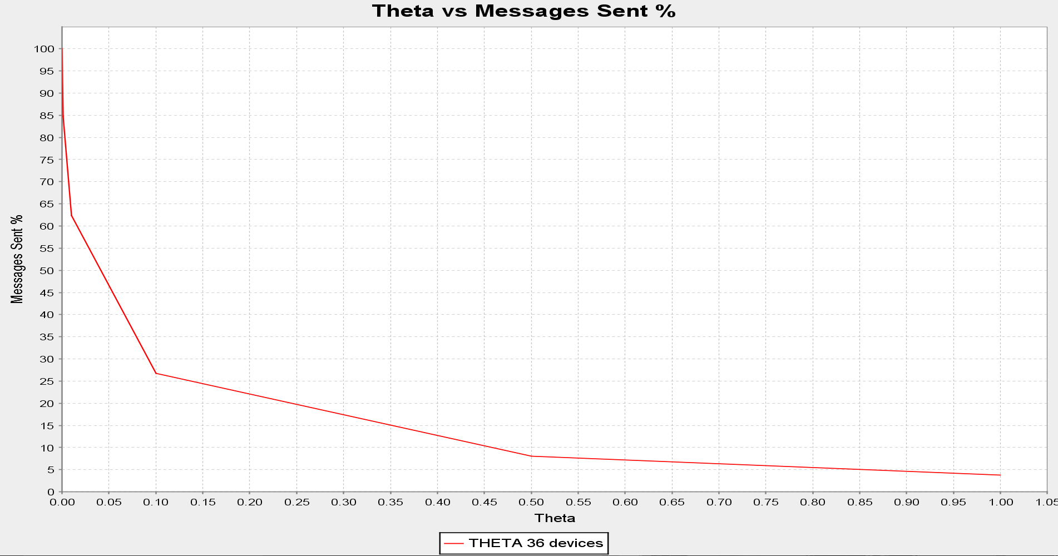
Theta vs Messages sent %

Slide 17
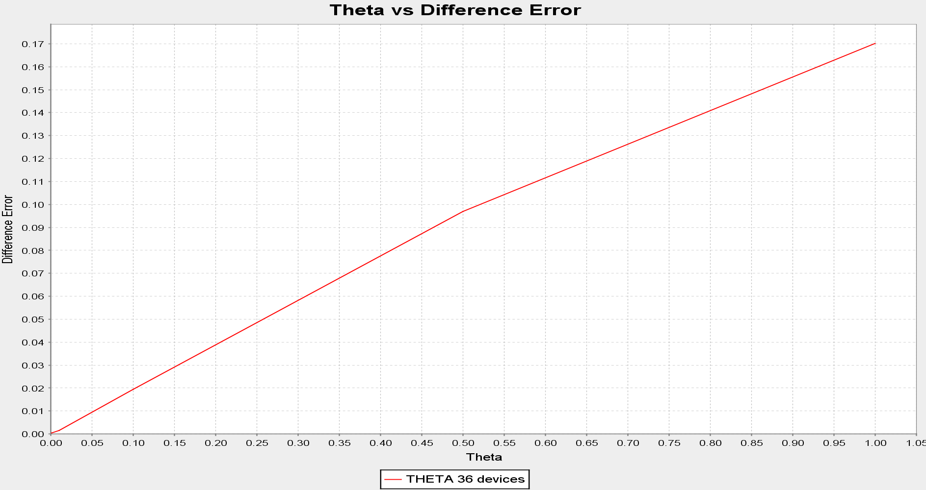
Theta vs Difference Error

Slide 18
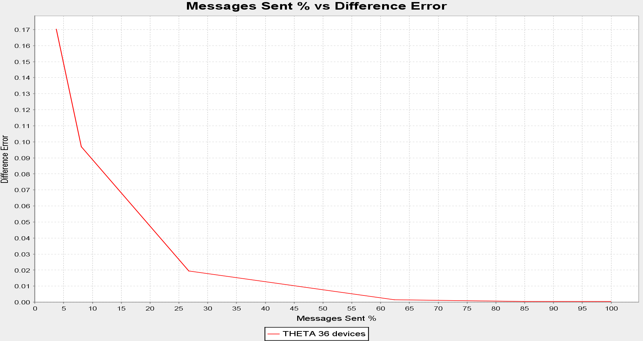
Messages Sent % vs Difference Error

Slide 19
Query Accuracy – Theta 0.001
84.7% messages sent

Slide 20
Query Accuracy – Theta 0.1
26.7% messages sent

Slide 21
Demo

Slide 22
Conclusion

Slide 23
Conclusion
We have a system that:
Simulates an IoT environment
Extracts knowledge from raw data
Decides it is worth it to transmit the new knowledge.
Intelligently Quantizes the input space

