Slide 1
✨Starlight Coffee
Cafe Loyalty Points on Blockchain with zk-privacy

Slide 2

What’s Starlight Coffee?
It’s a prototype of a Café ordering app where customers order coffee with a card/fiat and it gets converted to crypto, by a mock “onramp”.
Upon a completed Payment Request, the users can claim loyalty points.
The state of the points is saved in a Zero-Knowledge way on the blockchain, leaving no way for external observers to know anyone’s balances and make estimates about the Café’s turnovers.

Slide 3

Used solutions
Request Network
Starlight (an open source Solitity -> zApp transpiler)

Slide 4

The problem?
It can be difficult to track crypto payments for accounting purposes.
By making the loyalty points public, it could be possible for the competitors to guess the café’s turnovers.

Slide 5
The solution?
Use Request Network to match payments to a particular reference.
Use a “zApp” to maintain privacy for loyalty point balances.

Slide 6
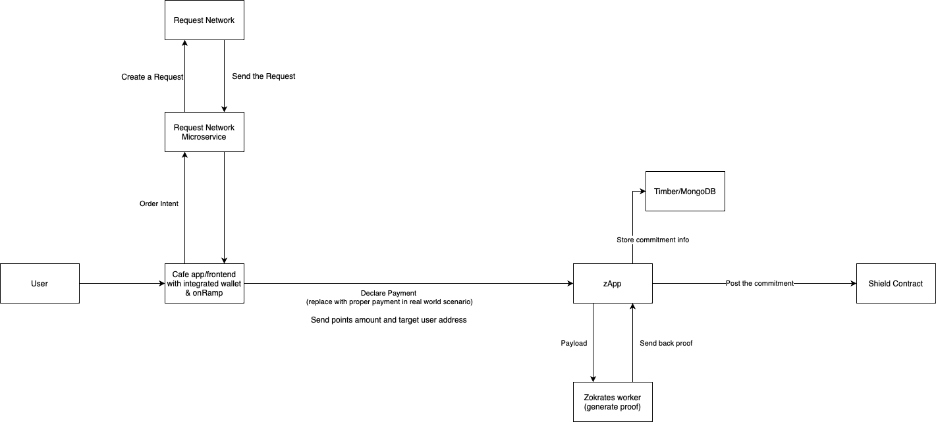
Let’s get technical!

Slide 7
Demo time!

