Slide 1
Cost of Concurrency in Hybrid Transactional Memory
Trevor Brown (IST Austria)
Srivatsan Ravi (University of Southern California)

Slide 2
Transactional Memory: a history
Hardware TM
Software TM
Hybrid TM
1993
1995-today
Today
Software implementation by Shavit-Touitou (‘95): “static” transactions
“Dynamic” STM by Herlihy et al. (‘03)
Incremental validation cost
TL2 by Dice et al. (‘06), NOrec by Spear et al. (‘06),...
Mitigate validation cost
Original proposal by Herlihy-Moss (‘93)
Exploit cache-coherence
Optimistic synchronization: buffer speculative updates
HTM support: Intel Haswell, IBM Power8,..
Different memory models and supported instructions
Hardware limitations and “spurious” aborts
Fallback to software transactions

Slide 3
Transactional Memory: a history
Hardware TM
Software TM
Hybrid TM
1993
1995-today
Today
Cost of Concurrency in Hybrid TMs?

Slide 4
Hybrid Transactional Memory (HyTM) Model
Transactions
Fast-path
Transactional operations
Data items
Executed in hardware
Exploit cache-coherence
HW primitives
Spurious aborts
Cache limitations
Base objects

Slide 5
Hybrid Transactional Memory (HyTM) Model
Transactions
Slow-path
Transactional operations
Data items
Executed in software
Reliable for large transactions
HW primitives
Slower execution time
Harder to verify
Base objects

Slide 6
Hybrid Transactional Memory (HyTM) Model
For fast-path transactions
Operate on “cached” memory state
Direct on Power8
Maintain TRACKING SET
Shared/exclusive mode
Capacity limit
Transactions
Transactional operations
For slow-path transactions
Operate directly on memory state
Data items
HW primitives
Direct access
Base objects
Cached access

Slide 7
Hybrid Transactional Memory (HyTM) Model
Tracking set aborts in fast-path transactions
Automatic contention detection for cached accesses
WRITE to base object B (EXCLUSIVE mode)
Tracking set is invalidated and T2 must abort
Fast-path
T2
A2
Fast-path or slow-path
T1
ACCESS base object B

Slide 8
Hybrid Transactional Memory (HyTM) Model
Tracking set aborts in fast-path transactions
Automatic contention detection for cached accesses
READ to base object B (SHARED mode)
Tracking set is invalidated and T2 must abort
Fast-path
T2
A2
Fast-path or slow-path
T1
WRITE base object B

Slide 9
Hybrid Transactional Memory (HyTM) Model
Committed fast-path transactions (only cached accesses) appear to execute atomically (single step)
Aborted or incomplete
Fast-path
T2
Execution indistinguishable to T1 from an execution in which T2 does not participate
Slow-path
T1

Slide 10
Instrumentation
Fast-path transactions intuitively need “instrumentation”
Detect overlap contention with slow-path
Global timestamp, ownership records, etc.
Instrumentation affects performance
Slow-path
Fast-path
W(X,1)
W(Y,1)
R(X)→?
T0
T1
Partial commit of X and Y
T1 must access “meta-information” to detect contention with T0

Slide 11
Cost of concurrency in HyTM
Sequential
Progressive
Minimal concurrency
More concurrency
Cost on slow-path transactions?
O(1) fast-path instrumentation
Ω(m) fast-path instrumentation

Slide 12
Linear validation cost in HyTM
Progressive opaque HyTM+Invisible reads ⇒ Linear time and space complexity for slow-path transactions
Fast-path
Slow-path
T_{m}
W(X_{m},1)
Commits
T₀
R(X₁)→0
R(X_{m-1})→0
R(X_{m})→1
(m-1) invisible reads of distinct data items
X₁ …. X_{m-1}
Read of X_{m} must return the value 1 updated by T_{m}

Slide 13
Linear validation cost in HyTM
Progressive opaque HyTM+Invisible reads ⇒ Linear time and space complexity for slow-path transactions
Slow-path
T₀
R(X₁)→0
R(X_{m-1})→0
R(X_{m})→1
T₀ does not observe T_{m} until the access of data item X_{m}
Fast-path
T_{m}
W(X_{m},1)
Commits
Read of X_{m} by T₀ must return the value 1

Slide 14
Linear validation cost in HyTM
Progressive opaque HyTM+Invisible reads ⇒ Linear time and space complexity for slow-path transactions
Slow-path
Cannot return value 1--cycle in serialization
T₀
R(X₁)→0
R(X_{m-1})→0
R(X_{m})→?
Fast-path
T_{m}
W(X_{m},1)
T_{m}
W(X₁,1)
Write new value to data item X₁ and commit
T₁
T₀
T₁
Fast-path

Slide 15
Linear validation cost in HyTM
Progressive opaque HyTM+Invisible reads ⇒ Linear time and space complexity for slow-path transactions
T₀ is invisible to fast-path transactions T₁ …… T_{m}
T₀
R(X₁)→0
R(X_{m-1})→0
R(X_{m})
Each fast-path transaction writes new values to data objects X₁ to X_{m-1}
T_{m}
W(X_{m},1)
W(X₁,1)
Fast-path
T₁
W(X_{m-1},1)
T_{m-1}

Slide 16
Linear validation cost in HyTM
Progressive opaque HyTM+Invisible reads ⇒ Linear time and space complexity for slow-path transactions
Slow-path
T₀
R(X₁)→0
R(X_{m-1})→0
R(X_{m})
T_{m}
W(X_{m},1)
Tracking set aborts: cannot contend on same memory location
W(X₁,1)
T₁
W(X_{m-1},1)
T_{m-1}

Slide 17
Validation cost in HyTM
Progressive opaque HyTM+Invisible reads ⇒ Linear time and space complexity for slow-path transactions
Slow-path
T₀
R(X₁)→0
R(X_{m-1})→0
R(X_{m})
Read of X_{m} must access m-1 distinct memory locations
T_{m}
W(X_{m},1)
W(X₁,1)
T₁
W(X_{m-1},1)
T_{m-1}

Slide 18
Validation cost in HyTM
Progressive opaque HyTM+Invisible reads ⇒ Linear time and space complexity for slow-path transactions
Slow-path
T₀
R(X₁)→0
R(X_{m-1})→0
R(X_{m})
Transaction T₀ must take at least ∑ i (i=1 to m-1)=Ω(m²) memory steps
T_{m}
W(X_{m},1)
W(X₁,1)
T₁
W(X_{m-1},1)
T_{m-1}

Slide 19
Cost of concurrency in HyTM
Sequential
Progressive
Minimal concurrency
More concurrency
Fast-path transactions aborted by non-conflicting ones or linear fast-path instrumentation cost and linear slow-path steps
Ω(m) fast-path instrumentation + Ω(m) slow-path steps per-read
O(1) fast-path instrumentation+O(1) slow-path reads

Slide 20
Cost of concurrency in HyTM
Sequential
Progressive
Minimal concurrency
More concurrency
Progressive STMs like TL2 circumvent the cost of validation for better performance, but impossible in progressive HyTMs!
Ω(m) fast-path instrumentation + Ω(m) slow-path steps per-read
O(1) fast-path instrumentation+O(1) slow-path reads

Slide 21
Cost of Concurrency in HyTM
 | Algorithm 1 | Algorithm 2 | Transactional Lock Elision | Hybrid Norec
Instrumentation in fast-path reads | per-read | constant | constant | constant
Instrumentation in fast-path writes | per-write | per-write | constant | constant
Validation in slow-path reads | Ω(|Rset|) | Ω(|Rset|) | none | Ω(|Rset|) only if concurrency
h/w-s/w concurrency | prog | prog for slow-path readers | zero | Not prog; small contention window
Direct accesses inside fast-path? | yes | no | no | yes

Slide 22
Experimental setup
Large-scale 2-socket Intel E7-4830 v3 with 12 cores per socket and 2 hyperthreads (HTs) per core, for a total of 48 threads
Each core has a private 32KB L1 cache and 256KB L2 cache (which is shared between HTs on a core)
All cores on a socket share a 30MB L3 cache
Non-uniform memory architecture (NUMA)
128GB of RAM, and runs Ubuntu 14.04 LTS.
All code was compiled with the GNU C++ compiler (G++) 4.8.4 with build target x86_64-linux-gnu and compilation options -std=c++0x -O3 -mx32

Slide 23
Experimental methodology
Six timed trials for several thread counts n
Prefilling: n concurrent threads perform 50% Insert and 50% Delete operations on keys drawn uniformly randomly from [0, 10⁵ ) until the size of the tree converges to a steady state (containing approximately 10⁵ /2 keys)
Measuring: Each thread performs (U/2)% Insert, (U/2)% Delete and (100 − U )% Search operations, on keys/values drawn uniformly from [0, 10⁵ ); U=0,10,40
Plots for Binary Search Tree (BST) microbenchmark
With (without) one (any) thread performing RangeIncrement operations
Capacity aborts on fast-path

Slide 24
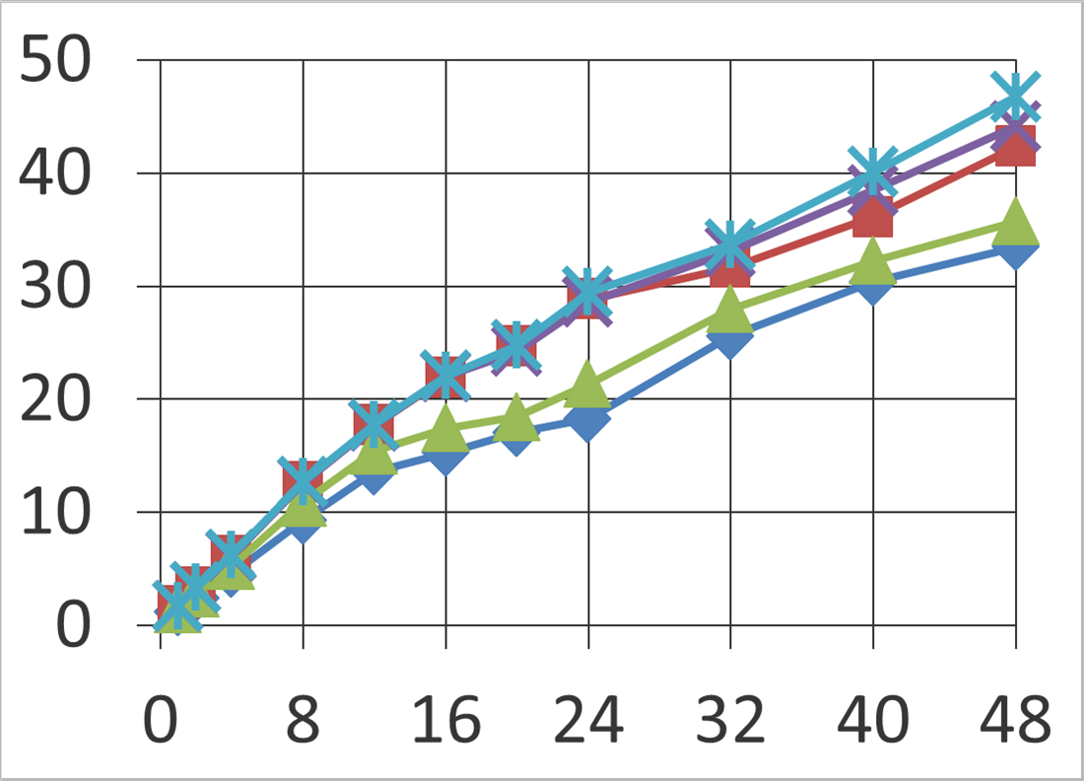
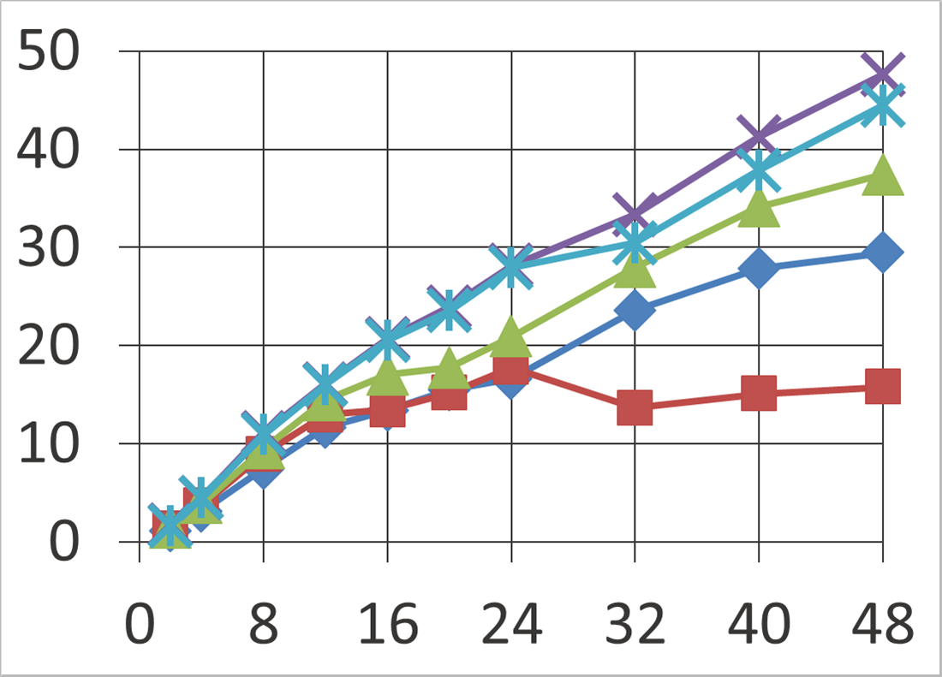
Cost of Concurrency in HyTM
0% updates: #threads vs. ops/microsec

Slide 25
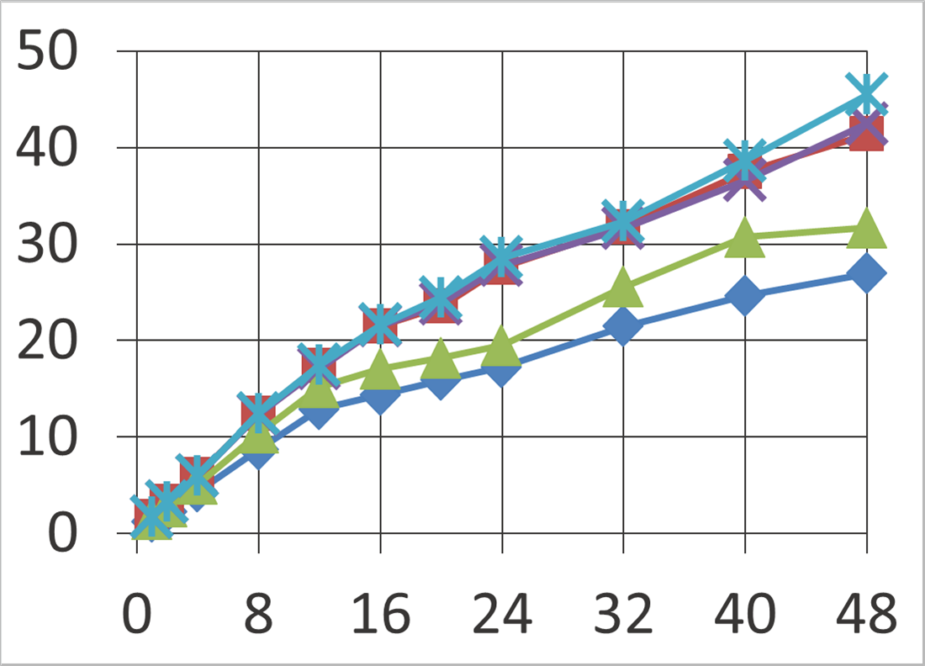
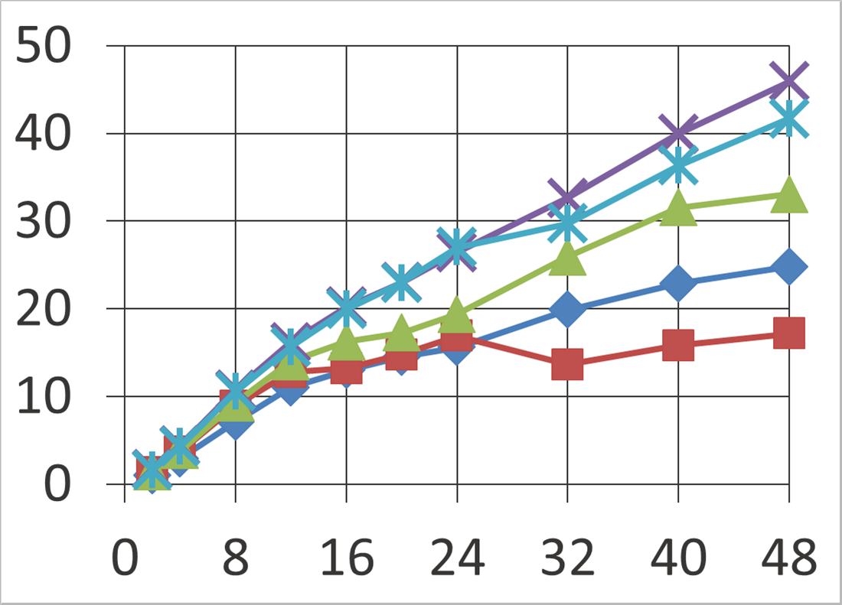
Cost of Concurrency in HyTM
10% updates: #threads vs. ops/microsec

Slide 26
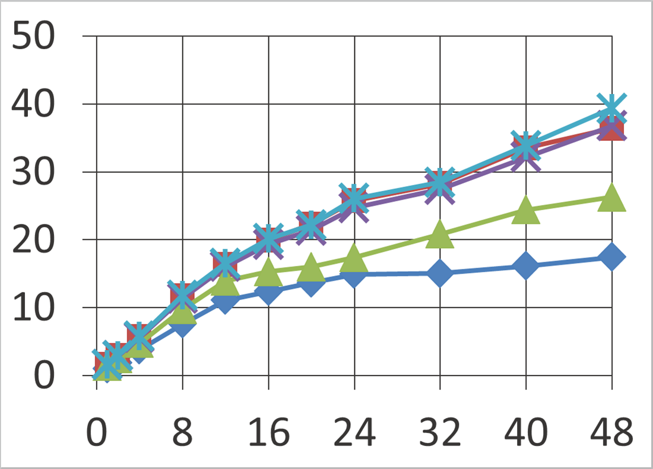
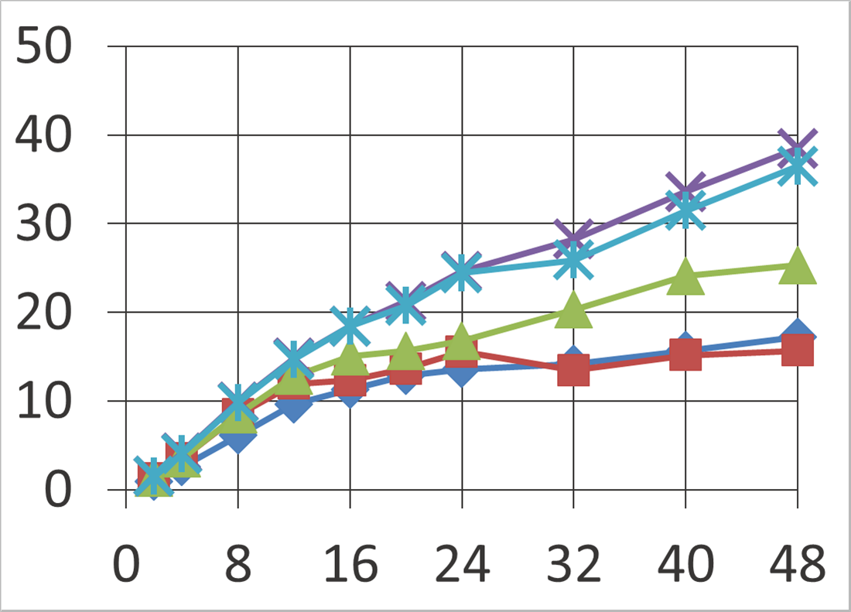
Cost of Concurrency in HyTM
40% updates: #threads vs. ops/microsec
Read-only workloads: costs purely down to fast-path
Algorithm 1 overhead due to linear instrumentation
Update workloads with RangeIncrement
TLE suffers due to global lock bottleneck
NUMA effects on update heavy workloads
From thread counts > 24
Hybrid noREC performs poorly to Algorithm 2 for same reasons as TLE

Slide 27
Circumventing the impossibilities?
Middle-path approach? Ongoing work
Almost uninstrumented “fast” fast-path
No concurrency with slow-path
Concurrent with middle-path
Ongoing experiments on Intel Haswell and IBM Power8 (STAMP and data structure microbenchmarks)
Completely different memory models
Power8 allows “direct” accesses inside hardware

Slide 28
Transactional memory is here to stay?
HyTM: an efficient “universal construction”?
Start with a “base” HyTM with minimal instrumentation overhead, maximal concurrency and little global metadata bottleneck
Dynamic implementation choices depending on workloads
Multi-path approach
Formal methods and verification techniques
Impact of cache hierarchy, cache-size and memory model on HyTM performance

