Slide 1
DMLO
by Santhosh Kumar K V

Slide 2
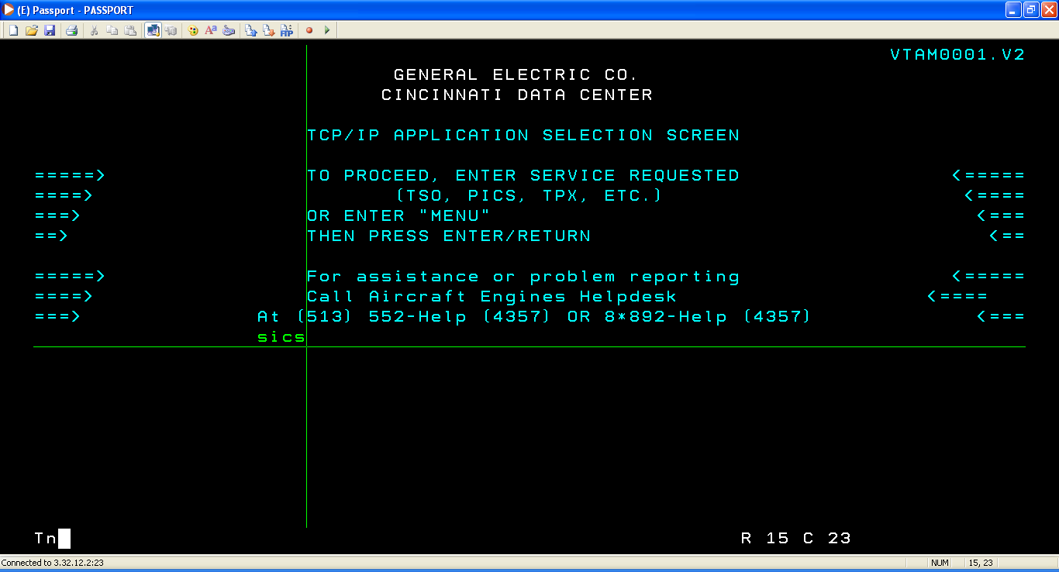
login

Slide 3
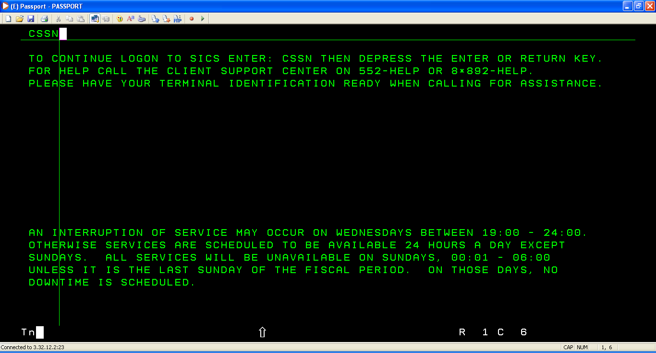
login

Slide 4
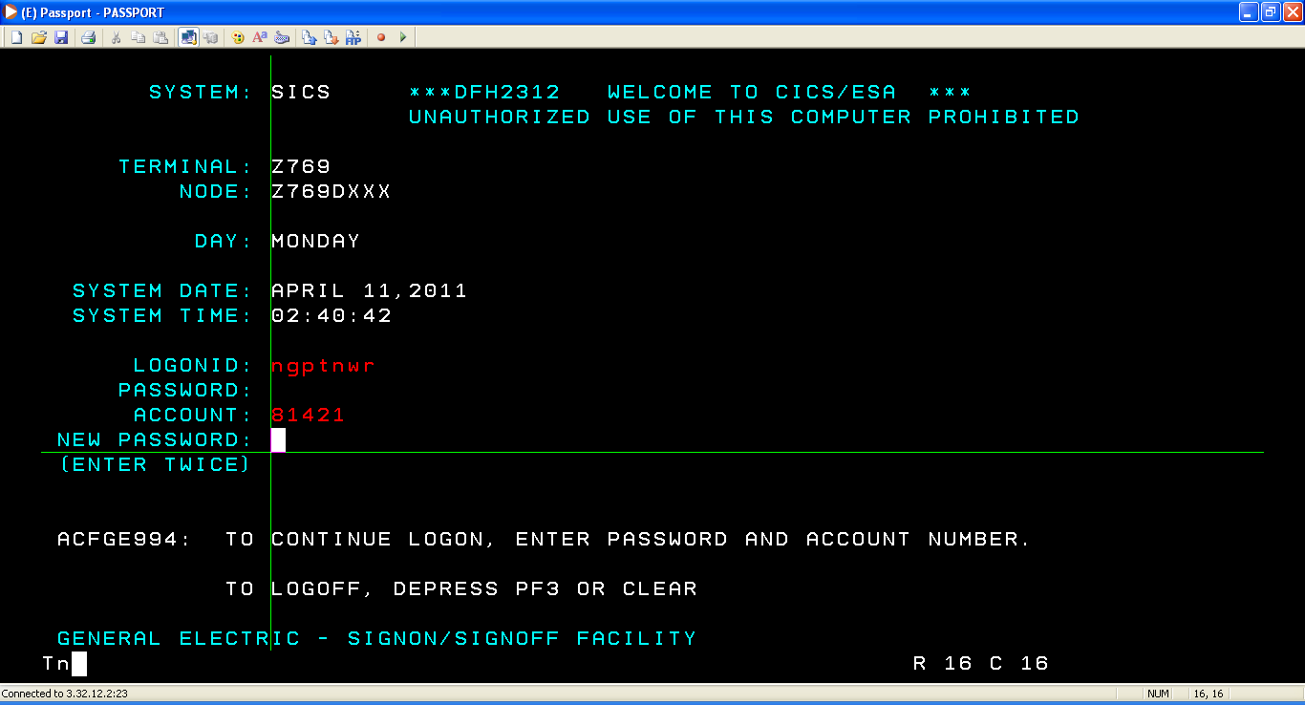
Give USERID,PASSWD and ACCOUNT INFO

Slide 5
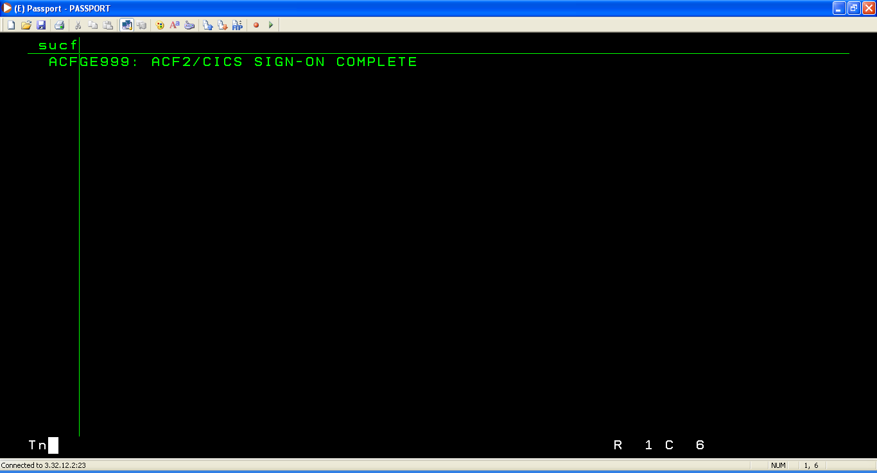
login

Slide 6
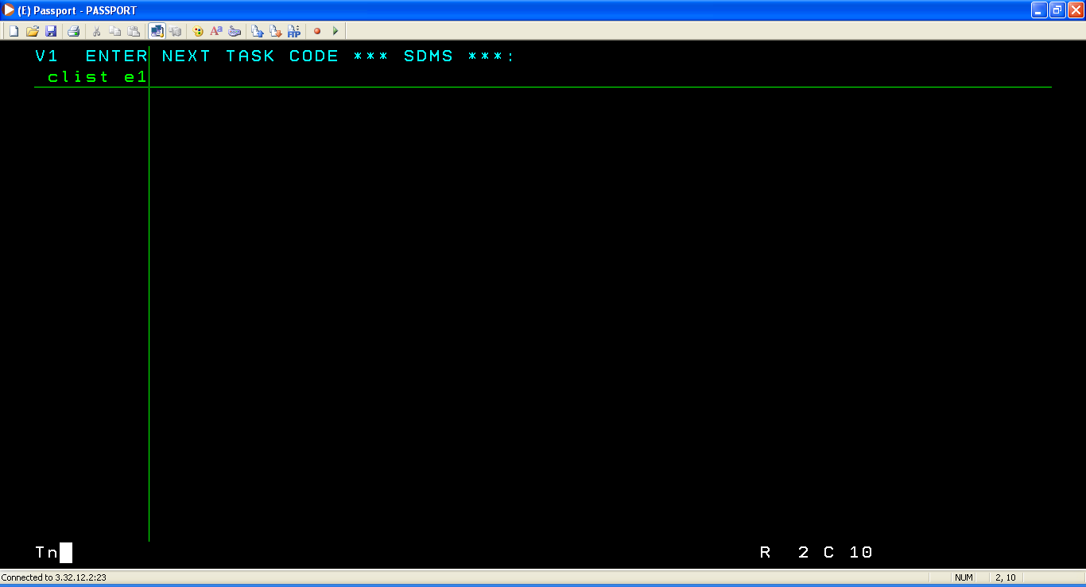
login

Slide 7
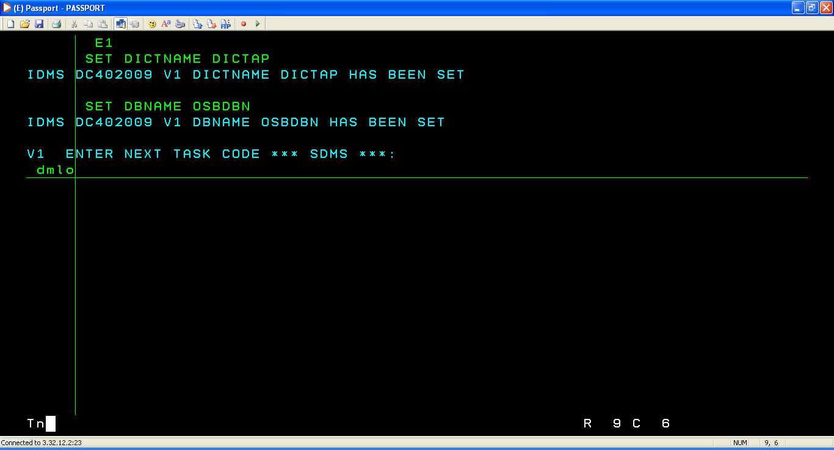
Type DMLO in this screen as shown

Slide 8
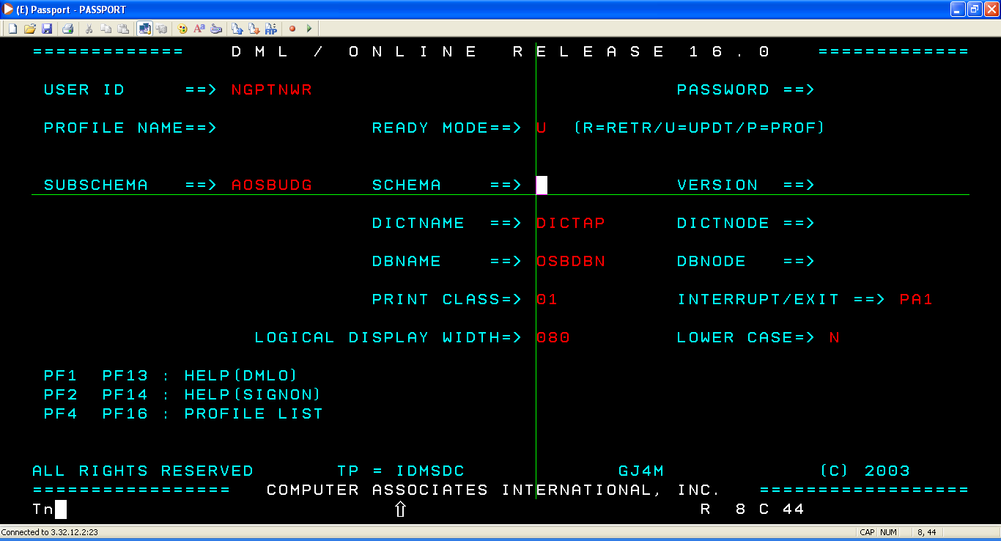
GIVE the details as shown. Set the ready mode to ‘U’ for update, ‘R’ for retrieval

Slide 9
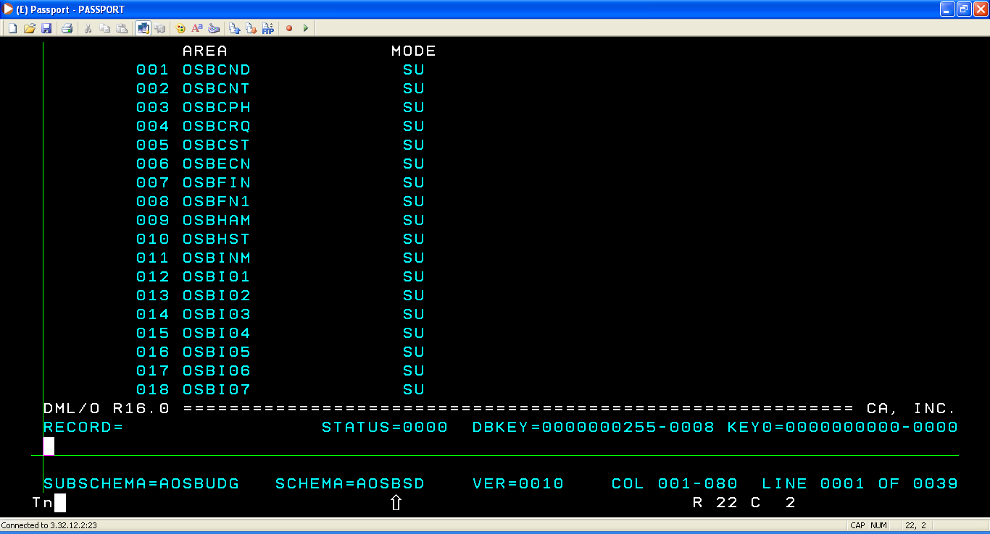
After providing the details as shown in previous slide press ‘ENTER’ to come to this screen

Slide 10
CASE 1: TO UPDATE THE EXISTING DATA

Slide 11
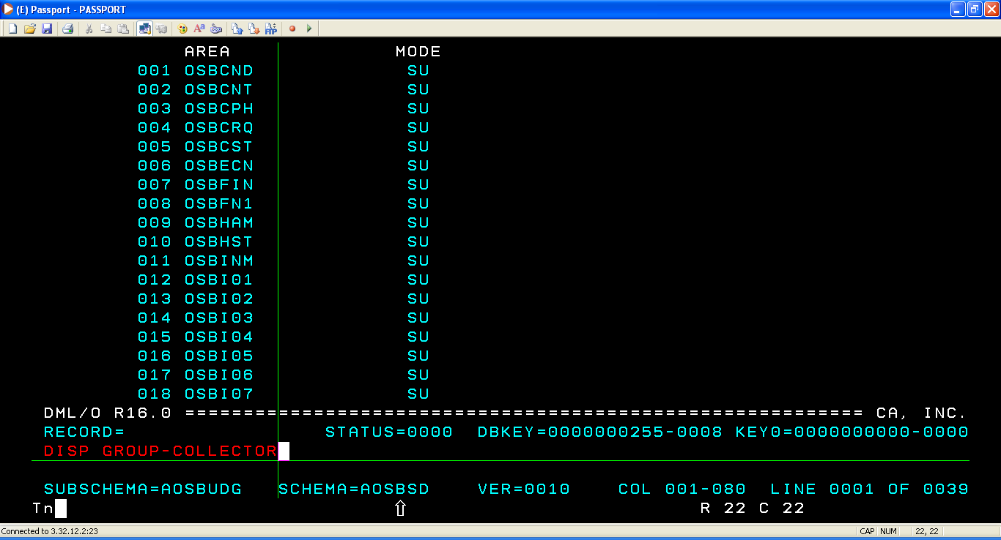
Use command DISP with record name and enter to get the screen as shown in next slide

Slide 12
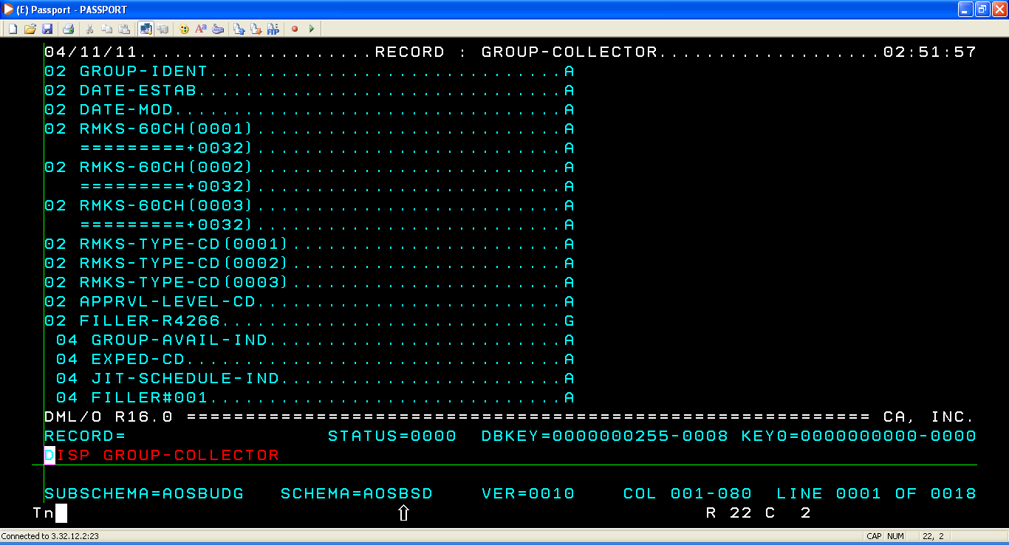

Slide 13
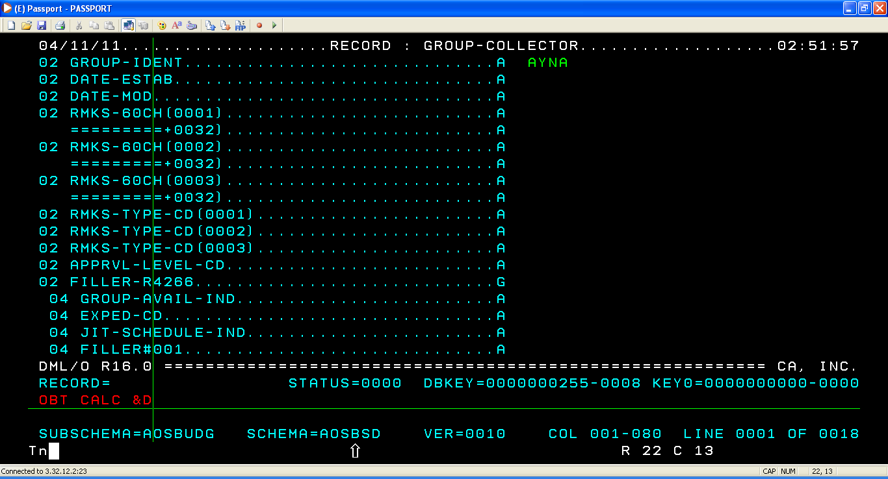
Give the key of the record details you want to edit and type the command OBT CALC &D as shown and press ENTER

Slide 14
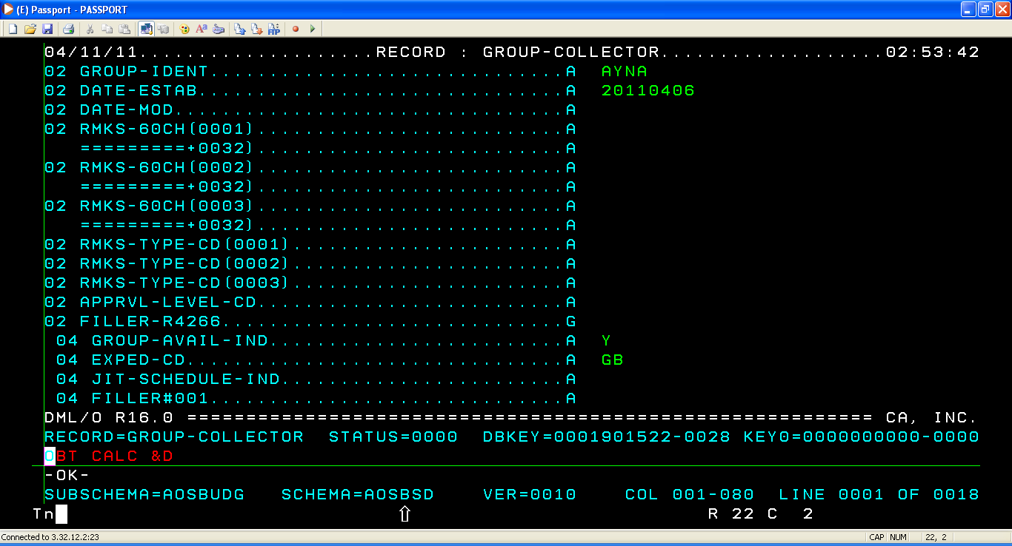
On ENTER we get all the details of the key record we provided

Slide 15
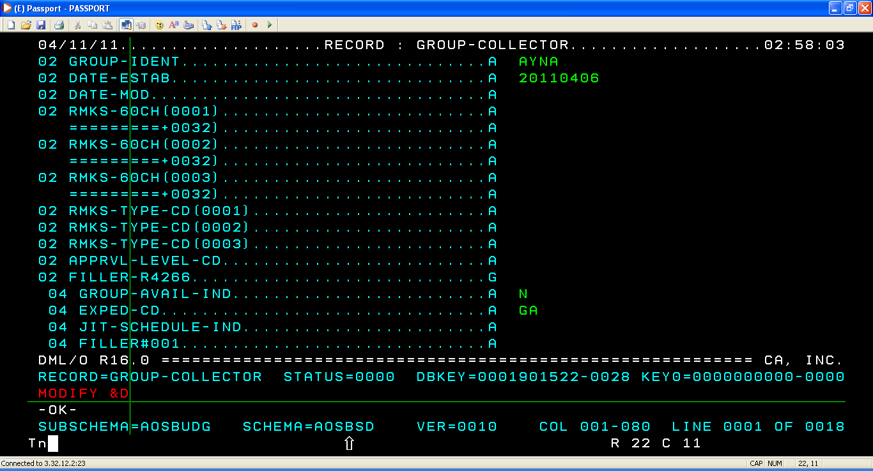
Make the changes u want and type MODIFY &D as shown. ENTER to modify.

Slide 16

COMMIT

Slide 17
CASE 2: TO STORE A RECORD

Slide 18
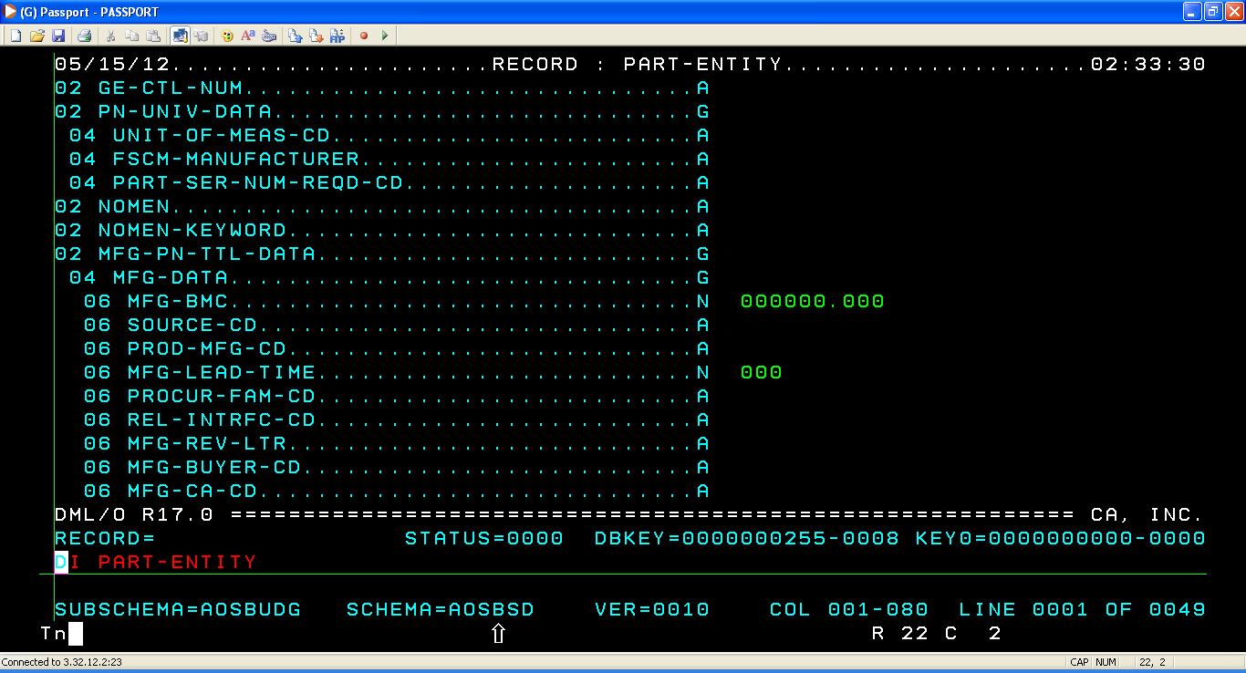

Slide 19
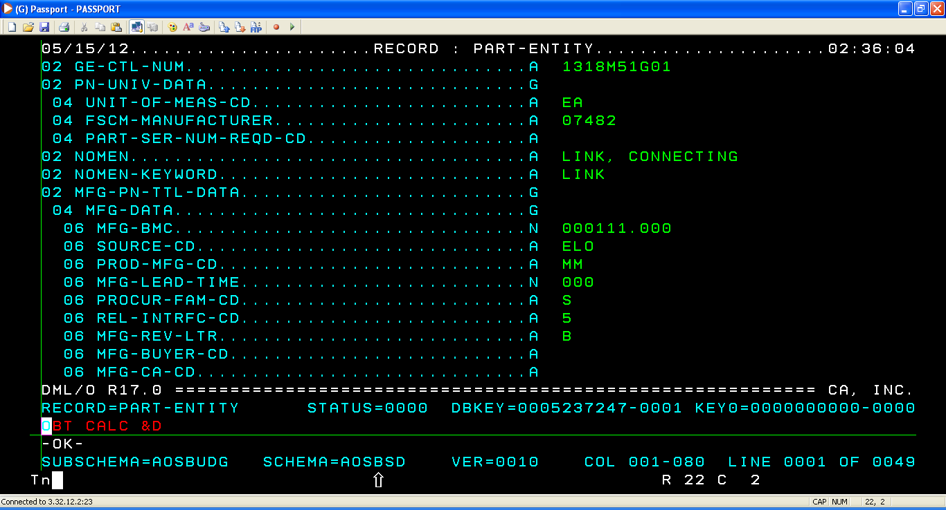
GIVE THE CALC VALUE AND GIVE THE COMMAND ‘OBT CALC &D’
Key value

Slide 20
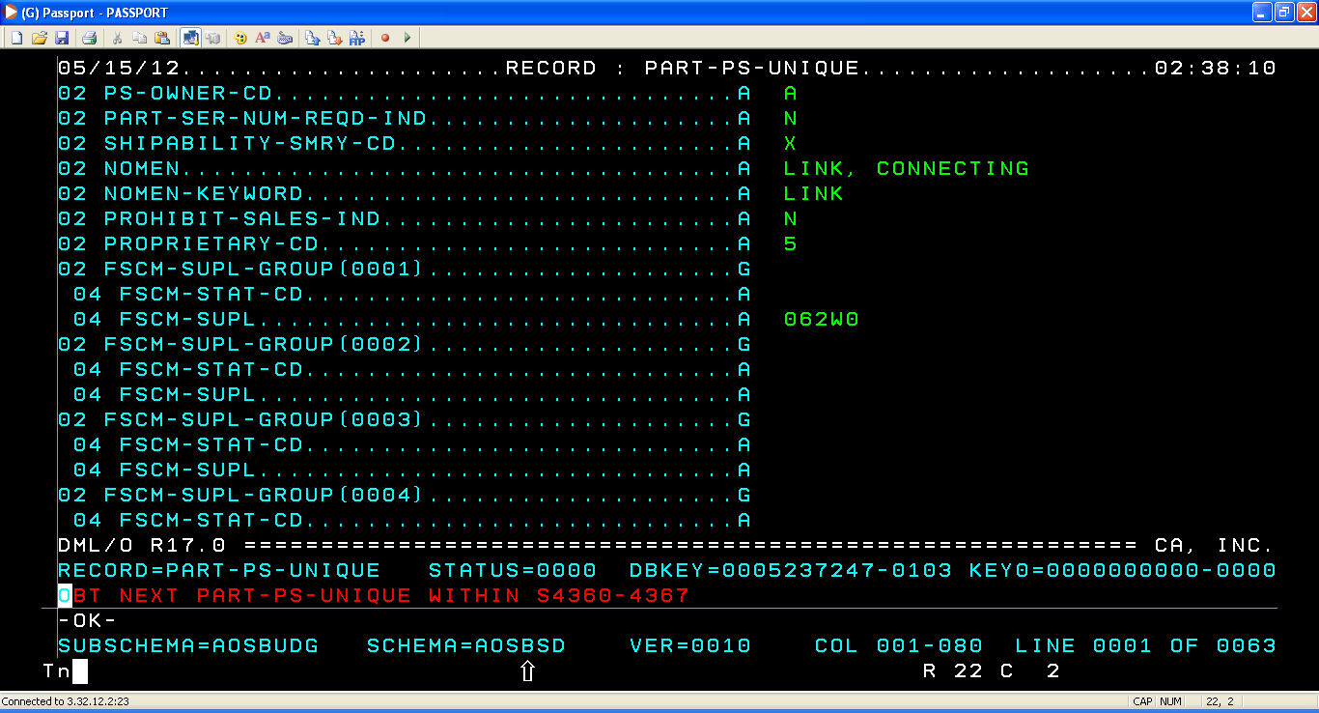
OBTAIN PART-PS-UNIQUE
PS-OWNER = A PRESENT

Slide 21
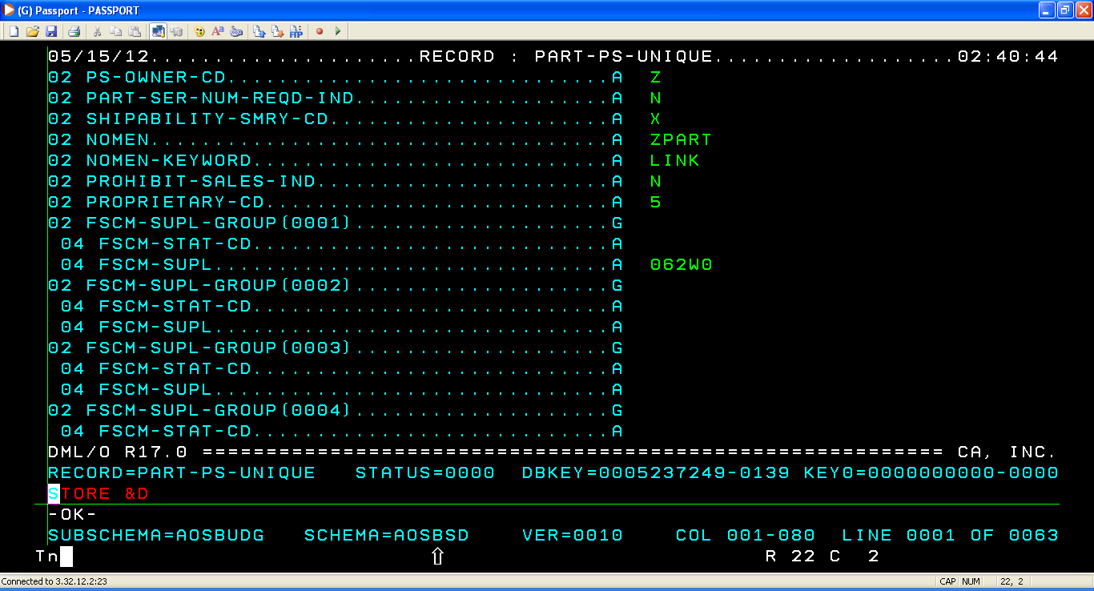
TO STORE PS-OWNER DATA FOR ‘Z’ EDIT THE DATA PRESENT THERE AND GIVE COMMAND ‘STORE &D’
VALUES ARE EDITED

Slide 22
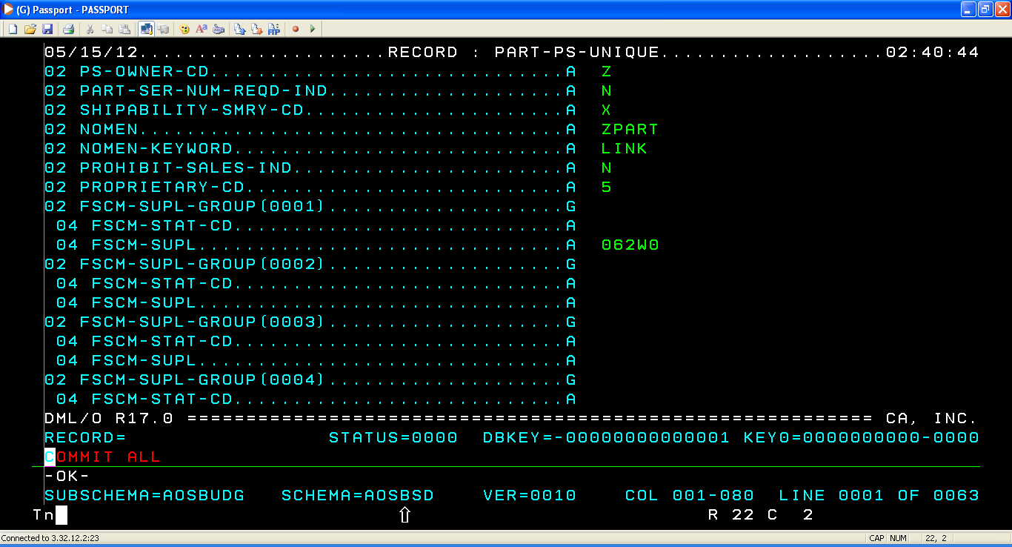
COMMIT ALL

Slide 23
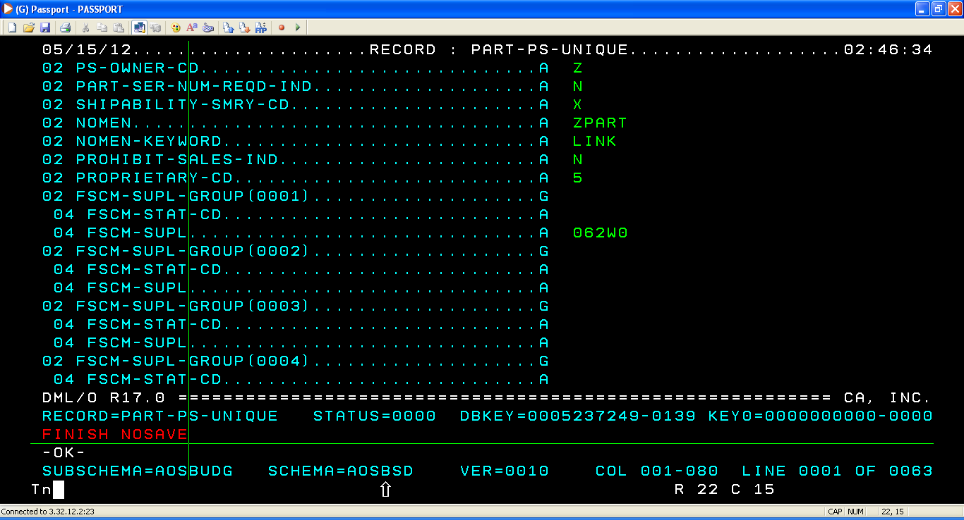
FINISH NOSAVE

Slide 24
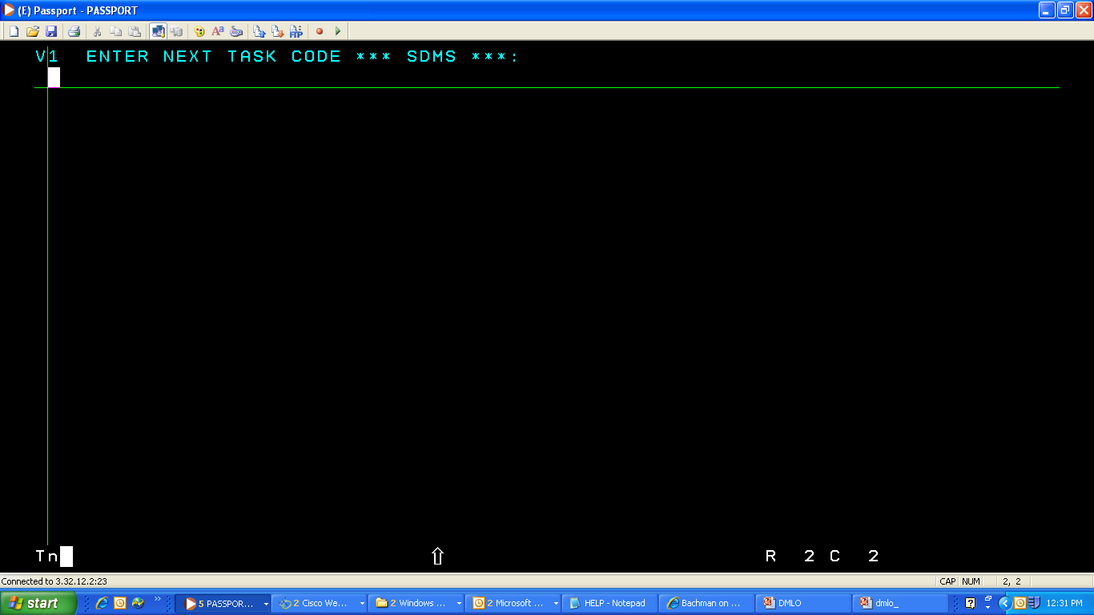
After NOSAVE we come back to this window.

Slide 25
Thank you

