Slide 1
Tolstoy Presentation
Michael Csida / Mark Youssef

Slide 2
Approach
Functional Programming Principles
Purity and Immutability
Use of STL Algorithms
Lambda Expressions and Currying
Map-Reduce Philosophy
Modular Design
Type Usage & Data Structures
I/O Operations & Functional Boundaries
Testing and Validation

Slide 3
Solution
Read all 3 Relevant Files Per Line
Process Book Lines into Chapter Data Structure, whilst Tokenizing each Word -> Multiple Chapters equate to one Book Data Structure
Process Terms into their own Data Structure
Go over each Chapter and Calculate the Density for both War and Peace Terms (entails Filtering & Counting)
Compare the Densities and Output the Result

Slide 4
FP vs OOP
FP: Pure Functions & Avoiding Mutable States
Advantages: Easy Reasoning, Parallel Processing, Testability & Modularity
Disadvantages: Learning Curve, Less Intuitive for Modelling Real World Applications, Performance Overhead in Languages not optimized for FP
OOP: Structuring Programs based on Objects and their Interactions
Advantages: Real-World Modelling, Reusability through Inheritance, Clear Structure
Disadvantage: Difficult to ensure Thread Safety, Complex Systems, Inheritance Hierarchies
Use Cases
FP: Parallelisation, Real Time Applications, Stateless Applications
OOP: UX Interfaces, Apps with Clear Domain Model, Large Software Systems

Slide 5
Lessons Learned
Failed Approaches
Usage of Ranges
Processing Terms with a Map Data Structure
Density using Levenshtein’s Distance
Findings
Map-Reduce Philosophy isn’t that hard
I/O Functions kill Performance
Interesting Problems
Keeping all Lambda Arguments in STL Loops “const”
Non working Ranges due to Cryptic Error Messages

Slide 6
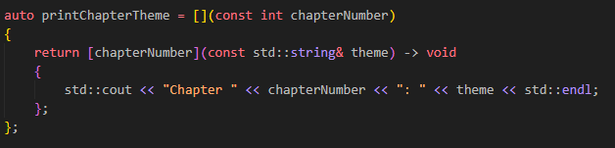
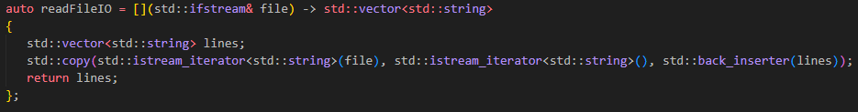
Non Functional Parts
I/O Functions

Slide 7
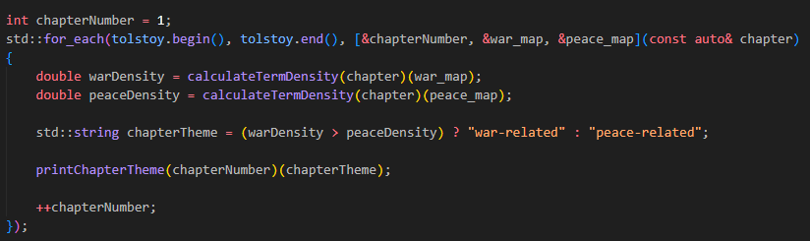
Non Functional Parts
Modification Outside Lambda

Slide 8
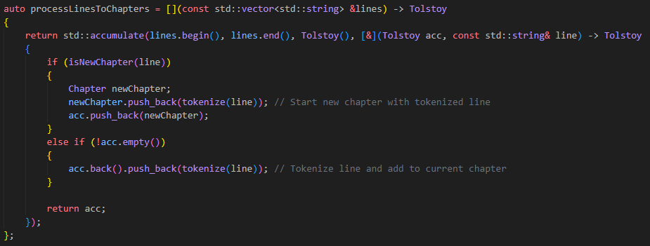
Non Functional Parts
Keeping Data Structure “Tolstoy” const

Slide 9
Live Demo
Tolstoy Code

