Slide 1
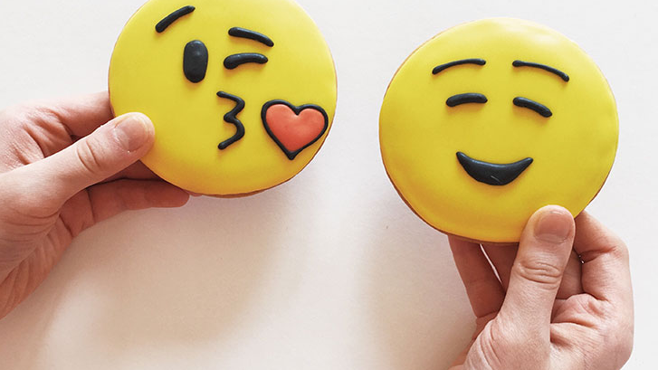
Speed Dating

Slide 2
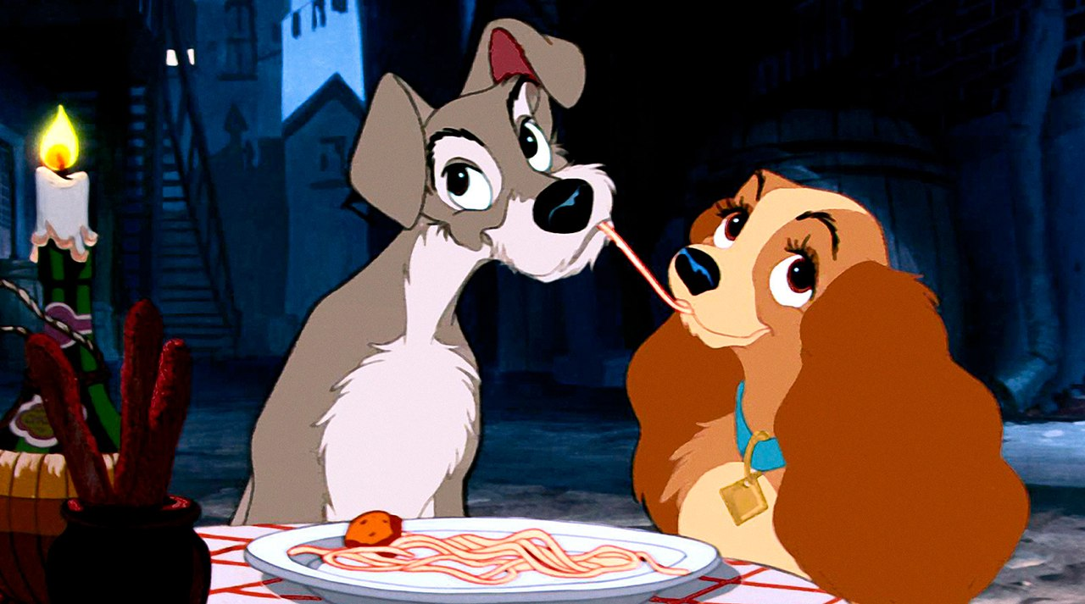
What made you want to go on a second date?
Think about your last first date

Slide 3
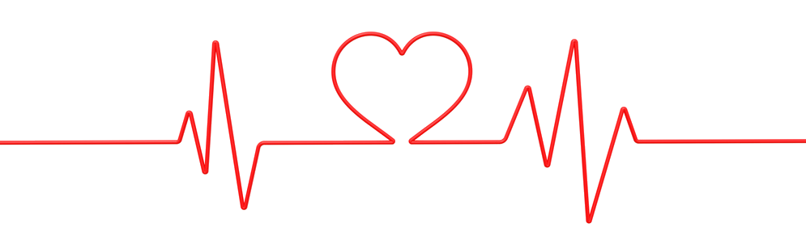
How do you find compatibility while speed dating?

Slide 4


Agenda
Attributes
Background
Limitation of the Analysis
Find Common
Interests

Slide 5
Background

Slide 6
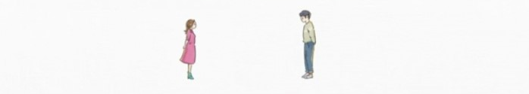
Background
Experimental speed
dating events
2002 - 2004
4 minutes
8378 rows x
195 columns
Pre- & Post- questionnaires

Slide 7
Background
Match
29 features used
Binary: 0 - not success; 1 - success
Gender
Binary: 0 - male; 1 - female
Variables
Used
17 Interests
10 Attributes

Slide 8
Find Common
Interests

Slide 9
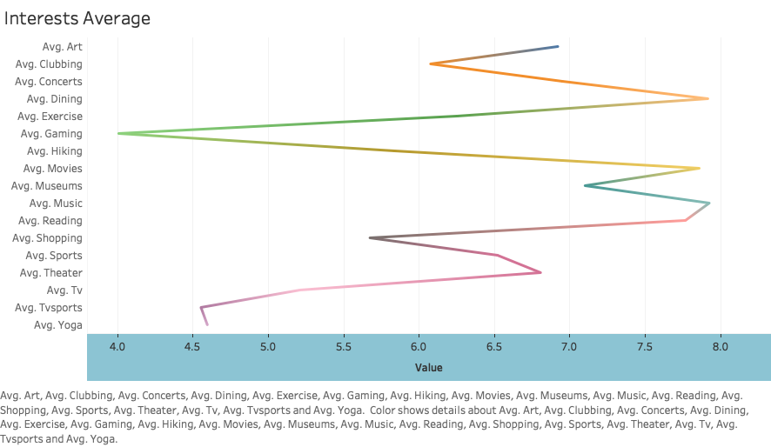



Find Common Interests
Dining
Music
Movies

Slide 10
Attributes

Slide 11
Attributes
Ambitious
Fun
Intelligent
Sincere
Attractive

Slide 12
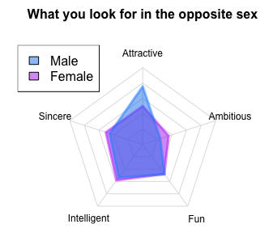
Attributes
Male：
Attractive (8)
Intelligent (6)
Sincere (5)
Female：
Intelligent (6)
Sincere (5)
Attractive (5)

Slide 13
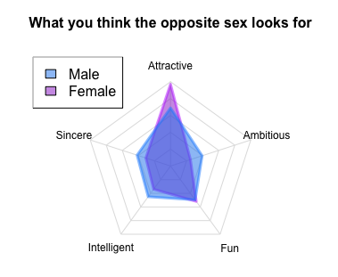
Attributes
Male：
Attractive (7)
Fun (5)
Intelligent (4)
Female：
Attractive (10)
Fun (5)

Slide 14
Attributes
Females seem to be smarter
Social structure theory: stereotypical gender role
- male stereotypical dimension: ambition
- female dimension: attractiveness
Female: attractive (red dress)
Male: knowledgeable & mindful
Attractive (7)
Fun (5)
Intelligent (4)
Attractive (8)
Intelligent (6)
Sincere (5)
Attractive (10)
Fun (5)
Intelligent (6)
Sincere (5)
Attractive (5)

Slide 15
Limitation

Slide 16
Limitation
Add Text
Simple PowerPoint Presentation
Subject: students in Columbia University
- age
- education background
Design: short term

Slide 17
Conclusion

Slide 18
Conclusion
Compatibility during speed dating?
Find common interests
Females: Physical attractiveness
Males: Knowledgeable & Earning potential
“Love is not an equation.………it’s the place you come back to, no matter where you headed.”
------- Jodi Picoult
Be the most authentic and comfortable self

Slide 19
THANK YOU

