Slide 1

MALMÖ 2600 · 2 OCTOBER 2026
INTERMEDIATE
HACKING
ONE TUNNEL. TWO STORIES.
PUBLIC FOOTHOLD → PRIVATE DATA + SYSTEM
A story about changing position, access and authority.

Slide 2

OPERATOR + COPILOT
CLAES // KRYSSAR
+ CODEX
CHAOS GREMLIN ENGINEERING
Security engineer in Malmö.
Purple-team labs, practical automation + AI.
kryssar.se · github.com/kryssar
linkedin.com/in/claesgyllhamn

Slide 3
THESIS
What makes this intermediate?
Short version: pattern recognition.
OBSERVE
HYPOTHESIZE
REPOSITION
Gather enough data to see the environment.
Hold several explanations and reduce uncertainty.
Choose the action that changes capability.
Then prove what changed.
OUTSIDE ─── DVWA ─── APP ─── WORKSTATION ─── SYSTEM ─── BLUE
03

Slide 4
INCIDENT ARC
One breach becomes an internal attack path
INITIAL ACCESS
INTERNAL RECON
TWO PAYOFFS
The public web server “conveniently” delivers the payload.
The foothold reveals routes, services and trust relationships.
Private data returns; developer context becomes SYSTEM.
Each decision changes what the attacker can do next.
OUTSIDE ─── DVWA ─── APP ─── WORKSTATION ─── SYSTEM ─── BLUE
04

Slide 5
STORY MAP
Outside, DMZ, inside
Trust zones and relationships matter more than the number of machines.
EXTERNAL / INTERNET
DMZ
INTERNAL
Hacktop
Internal Auction Service
attacker · 10.10.30.116
10.10.20.70:8090
Web Server / DVWA
DMZ foothold · 10.10.20.57
External Tool Host
Developer Workstation
CDN-backed staging
10.10.20.86:5985
Malcolm observes traffic around DVWA. Sysmon observes Windows.
OUTSIDE ─── DVWA ─── APP ─── WORKSTATION ─── SYSTEM ─── BLUE
05

Slide 6
ENTRY POINT
One click. One delivery route.
A familiar workflow turns the public web server into our way inside.
THE CLICK
THE DELIVERY
THE FOOTHOLD
one believable moment
payload crosses the boundary
DVWA runs it
THE FOOTHOLD STARTS CALLING OUT
OUTSIDE ─── DVWA ─── APP ─── WORKSTATION ─── SYSTEM ─── BLUE
06

Slide 7
DELIVERY
The file crosses the Internet
The delivery path puts our payload exactly where it needs to be.
External Tool Host
Internet
Web Server / DVWA
10.10.20.71:8080
HTTP 200
10.10.20.57
THE PAYLOAD
orbital-agent-update.bin
application/x-executable
11,587,744 bytes
OUTSIDE ─── DVWA ─── APP ─── WORKSTATION ─── SYSTEM ─── BLUE
07

Slide 8
ATTACKER DECISION
Defacement would be the easy ending
PROVE WE WERE HERE
LEARN WHAT THE FOOTHOLD IS WORTH
Deface the public page.
Visible, immediate and pedestrian.
Map routes, trust and reachable services before choosing the next action.
Control is a result. Reconnaissance turns it into an attack path.
OUTSIDE ─── DVWA ─── APP ─── WORKSTATION ─── SYSTEM ─── BLUE
08

Slide 9
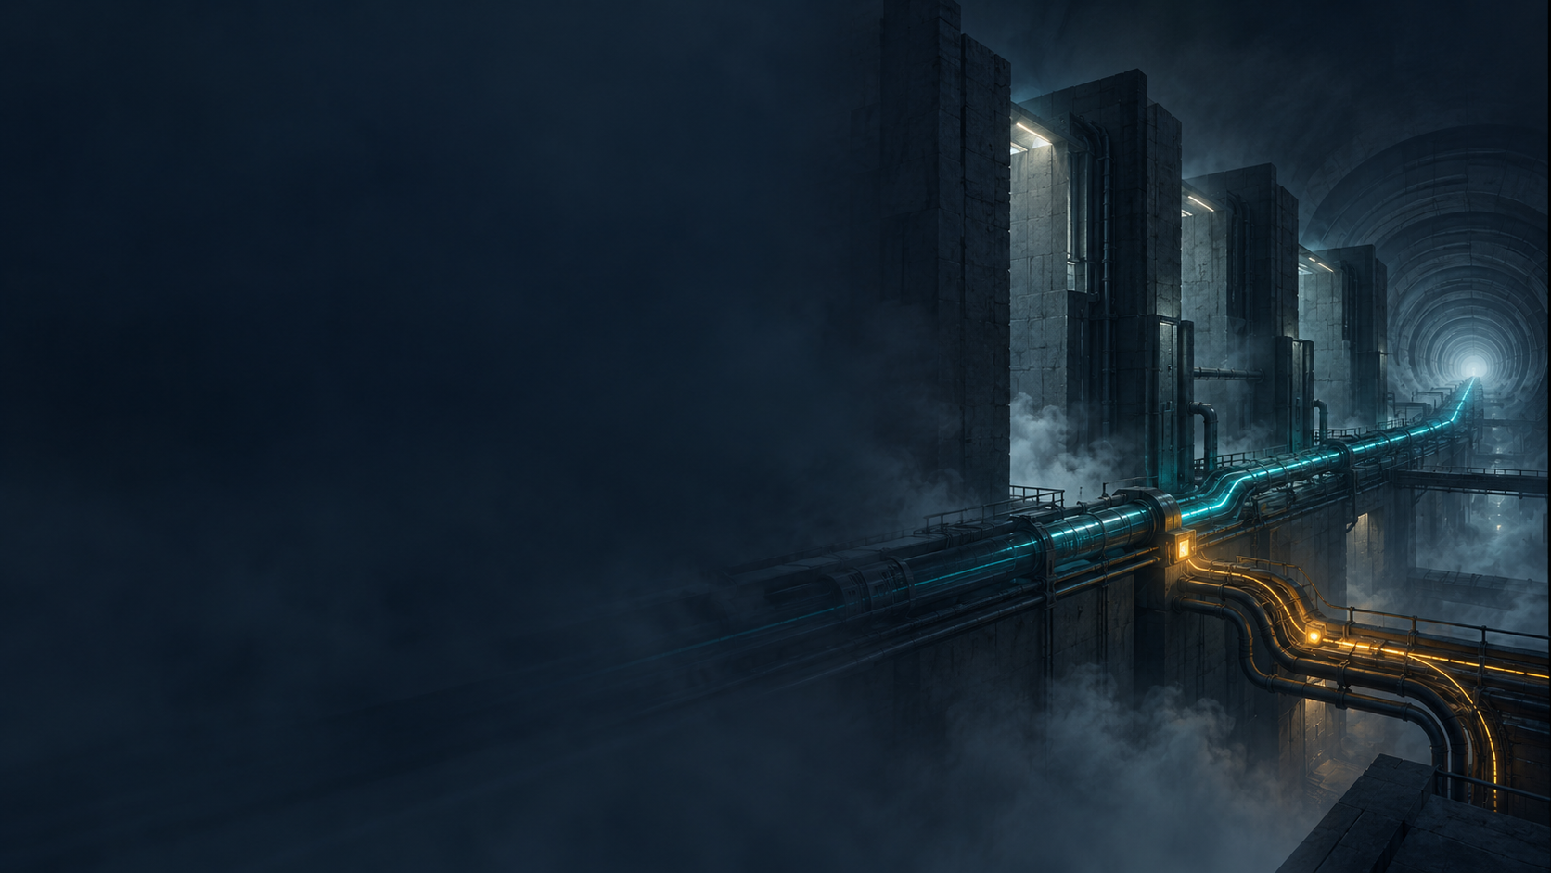
CONSTRAINT
Execution is not a route
INBOUND: BLOCKED
Hacktop
Web Server / DVWA
outside
inside DMZ
OUTBOUND: ALLOWED
So control travels in the direction the network already permits.
OUTSIDE ─── DVWA ─── APP ─── WORKSTATION ─── SYSTEM ─── BLUE
09

Slide 10
CALLBACK
DVWA calls outward; access comes back
Hacktop
Internet
Web Server / DVWA
Chisel server · :18443
HTTP 101 · WebSocket
Chisel client · www-data
Reverse SOCKS
Fixed reverse forward
127.0.0.1:11080
destination selected per request
127.0.0.1:18090
one selected service
OUTSIDE ─── DVWA ─── APP ─── WORKSTATION ─── SYSTEM ─── BLUE
10

Slide 11
BLUE SHADOW
The tunnel introduced itself
NETWORK VIEW
DVWA → HACKTOP
WHY BLUE CARES
10.10.20.57 → 10.10.30.116:18443
HTTP 101 · WebSocket
Sec-WebSocket-Protocol: chisel-v3
A public web server opens an unusual outbound WebSocket. The direction and protocol tell the story.
T1572 · PROTOCOL TUNNELING
OUTSIDE ─── DVWA ─── APP ─── WORKSTATION ─── SYSTEM ─── BLUE
11

Slide 12
POSITION CHANGE
Hacktop chooses; DVWA originates
Hacktop
DVWA
Internal destination
operator intent
observed network source
selected by operator
We did not become DVWA. We asked DVWA to connect for us.
OUTSIDE ─── DVWA ─── APP ─── WORKSTATION ─── SYSTEM ─── BLUE
12

Slide 13
BOUNDED DISCOVERY
Root changes what DVWA can tell us
ROOT ON LINUX
TRAFFIC PATTERN
SECOND LEAD
DVWA is ours, so we watch its network conversations.
Repeated WebSocket traffic points to an internal auction service.
Management traffic reveals a developer workstation.
The network tells us where to look before we scan.
OUTSIDE ─── DVWA ─── APP ─── WORKSTATION ─── SYSTEM ─── BLUE
13

Slide 14
METHOD SELECTION
Why reverse SOCKS?
REVERSE SHELL
BROAD ROUTED TUNNEL
REVERSE SOCKS
One destination at a time. Useful—but too narrow.
More reach than this story needs.
One outbound channel; choose each observed destination.
BEST FIT FOR TWO OBSERVED LEADS
OUTSIDE ─── DVWA ─── APP ─── WORKSTATION ─── SYSTEM ─── BLUE
14

Slide 15
RECON RESULT
We test the leads—not the subnet
CLOSED
10.10.20.70:80
wrong door
HTTP 200
10.10.20.70:8090/healthz
auction service answers
HTTP 405
10.10.20.86:5985/wsman
developer workstation answers
Two machines. Two branches. No spray-and-pray.
OUTSIDE ─── DVWA ─── APP ─── WORKSTATION ─── SYSTEM ─── BLUE
15

Slide 16
TRANSPORT CHOICE
SOCKS scouts; a fixed forward holds the door
DISCOVERY · REVERSE SOCKS
OPERATION · FIXED FORWARD
Hacktop:11080
Several destination-aware requests.
Question: what is there?
Hacktop:18090 → 10.10.20.70:8090
One explicit repeatable route.
Question: take me back there.
OUTSIDE ─── DVWA ─── APP ─── WORKSTATION ─── SYSTEM ─── BLUE
16

Slide 17
FIRST OBJECTIVE
Why the auction server?
NO DIRECT ROUTE
Hacktop
Web Server / DVWA
Internal Auction Service
cannot reach it directly
keeps talking to it
WebSocket · 8090
TUNNEL THROUGH DVWA
Traffic told us it mattered. The tunnel makes it reachable.
OUTSIDE ─── DVWA ─── APP ─── WORKSTATION ─── SYSTEM ─── BLUE
17

Slide 18
APPLICATION DECISION
The message reaches a private object
WebSocket
subscribe
object lookup
API1:2023 · BOLA
accepted
private-ledger
record found
client chooses object
access never checked
TERMINAL
request / response
{"type":"subscribe","auction_id":"private-ledger"}
{"type":"auction.snapshot",
"auction":{"id":"private-ledger","visibility":"private"}}
OUTSIDE ─── DVWA ─── APP ─── WORKSTATION ─── SYSTEM ─── BLUE
18

Slide 19
DATA PAYOFF
The private record comes back to Hacktop
Hacktop
Web Server / DVWA
Internal Auction Service
receives record
transports response
private-ledger
TERMINAL
WebSocket response
{"id":"private-ledger",
"visibility":"private",
"reserve_owner":"deathstar.procurement"}
OUTSIDE ─── DVWA ─── APP ─── WORKSTATION ─── SYSTEM ─── BLUE
19

Slide 20
OPERATIONAL RELATIONSHIP
The developer has to reach the web service somehow
Developer Workstation
Web Server / DVWA
Attacker on DVWA
maintains the web service
DMZ service
reuses that relationship
Legitimate operational access creates an interesting trust path.
OUTSIDE ─── DVWA ─── APP ─── WORKSTATION ─── SYSTEM ─── BLUE
20

Slide 21
SECOND BRANCH
The foothold reveals a Windows management surface
Web Server / DVWA
Developer Workstation
WinRM
10.10.20.57
10.10.20.86:5985
GET /wsman → HTTP 405
445 SILENT
3389 SILENT
5985 ANSWERS
A management surface worth investigating.
OUTSIDE ─── DVWA ─── APP ─── WORKSTATION ─── SYSTEM ─── BLUE
21

Slide 22
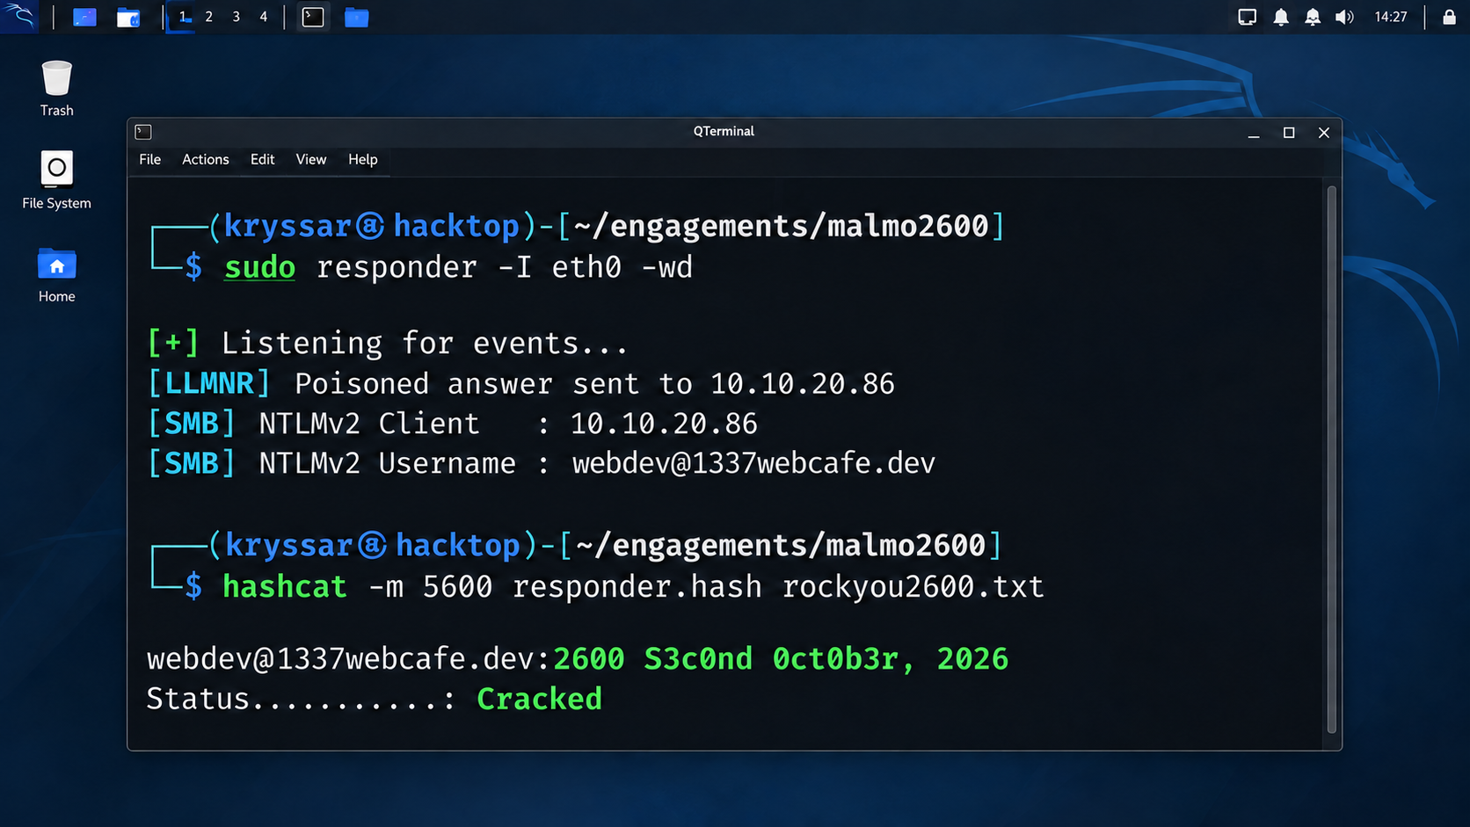
CREDENTIAL BRIDGE
A name-resolution leak becomes authenticated access
22

Slide 23
AUTHENTICATED ACCESS
The cracked identity opens the workstation
The login works—but only with standard-user authority.
TERMINAL
kali㉿hacktop · nc -lvnp 44444
NEW CAPABILITY
listening on [any] 44444 ...
connect to [10.10.30.116] from [10.10.20.86] 50167
hostname : SAGA-STEAM-WIN10
user : webdev@1337webcafe.dev
access : Standard user
The attacker can now act as the developer.
NEXT QUESTION
What does this user control that a privileged service trusts?
OUTSIDE ─── DVWA ─── APP ─── WORKSTATION ─── SYSTEM ─── BLUE
23

Slide 24
AUTHORITY PATTERN
A developer identity influences a privileged service
webdev@
1337webcafe.dev
Launch request
Steam Client Service
launcher.exe
Standard user
trusted by service
LOCAL SYSTEM
SYSTEM
A standard user controls an input that a SYSTEM service trusts.
OUTSIDE ─── DVWA ─── APP ─── WORKSTATION ─── SYSTEM ─── BLUE
24

Slide 25
SECOND PAYOFF
SYSTEM
Developer Workstation · Windows 10 Pro 19045
WORKSTATION
THE AUTHORITY CHANGES · 21:42:45Z
UTC=2026-09-29 21:42:45Z
user : nt authority\system
SID : S-1-5-18
access : SYSTEM
parent : steamservice.exe → launcher.exe
OUTSIDE ─── DVWA ─── APP ─── WORKSTATION ─── SYSTEM ─── BLUE
25

Slide 26
ENDPOINT VIEW
Sysmon records the authority jump
powershell.exe
steamservice.exe
launcher.exe
webdev · STANDARD USER
21:42:39.729
NT AUTHORITY\SYSTEM
SYSTEM · 21:42:45.480
WHERE IT WORKED
Windows 10 Pro 19045: SYSTEM
Server 2019: no authority change
The environment is part of the attack path.
OUTSIDE ─── DVWA ─── APP ─── WORKSTATION ─── SYSTEM ─── BLUE
26

Slide 27

CAMERA TURN
REWIND
THE INCIDENT
Same packets. Different questions.
Erase the attacker terminal.
Can blue reconstruct the path?

Slide 28
DEFENDER RECONSTRUCTION
Blue reconstructs the pivot
FILE RECEIVED
HTTP 101
CHISEL-V3
INTERNAL PROBES
PRIVATE RESPONSE
attachment lands
session upgrades
tunnel identified
source shifts inward
private data returns
CORRELATION
Direction, identity, time and protocol turn five ordinary events into one reconstructed path.
OUTSIDE ─── DVWA ─── APP ─── WORKSTATION ─── SYSTEM ─── BLUE
28

Slide 29
SENSOR QUALITY
1,115 alerts. Five events tell the story.
1,115
5
checksum alerts
linked events
one noisy sensor
one coherent path
More alerts do not mean more truth.
OUTSIDE ─── DVWA ─── APP ─── WORKSTATION ─── SYSTEM ─── BLUE
29

Slide 30
CLOSE
The commands change. The questions transfer.
Intermediate hacking is recognizing what changed—and what to do with it.
1.
2.
3.
4.
5.
What changed?
What does this component trust?
Who can influence that trusted input?
Which test reduces the most uncertainty?
What would the defender observe?
Questions · objections · better detections?
30

Slide 31
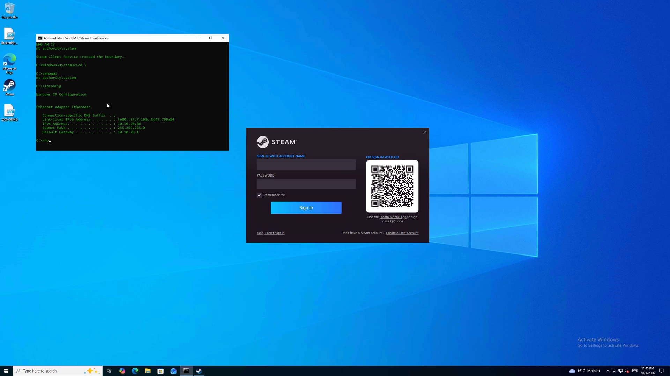
MALMÖ 2600 // OCTOBER 2026
DEMO OR DIE
Play demo.mp4 from the companion folder (16 seconds, silent)

Slide 32

THANK YOU // MALMÖ 2600
JOIN US
We need more skilled
geeks and nerds.
If this looked like your kind of trouble,
you should probably say hello.
SCIBER.IO
www.sciber.io
OPEN POSITIONS
sciber.careers.haileyhr.app
CLAES // KRYSSAR + CODEX

