Slide 1
Ruby Fall 2011 Project
Chris Larson & Andy Litzinger

Slide 2
Goals
Combine some things we learned in class
Get our feet wet with automatic flow chart composition
Eventually would like to automate chart of thePlatform SOA services

Slide 3
Things to improve
Use graphviz gem to create dot file and png

Slide 4
Have you seen this guy around the office?
<soon to have picture of grimacing Jasper>

Slide 5
Sometimes this does the trick…
<soon to have pic of happy Jasper with coffee>

Slide 6
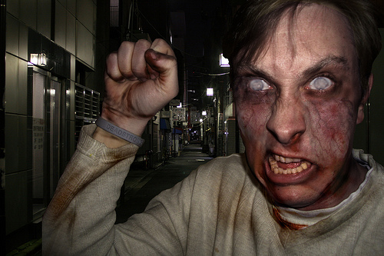
But sometimes it ends badly…

Slide 7
Hand this out at work
Have your colleagues take this handy quiz and avoid any unexpected unpleasantness…

