Slide 1

Ruby Fall 2011 Project
Chris Larson & Andy Litzinger
(we’re hiring! Ops, dev/ops, dev & QA!)
http://www.theplatform.com/about/careers

Slide 2
Goals
Combine some things we learned in class
Get our feet wet with automatic flow chart composition
Eventually would like to automate chart of thePlatform SOA services

Slide 3
Things to improve
Integrate with Sinatra or other web framework

Slide 4
Have you seen this guy around the office?

Slide 5
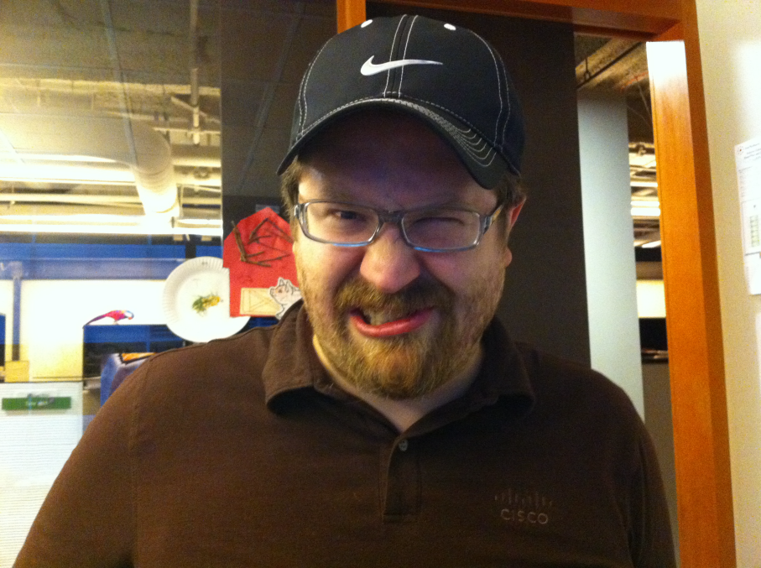

Slide 6
Sometimes coffee does the trick…

Slide 7
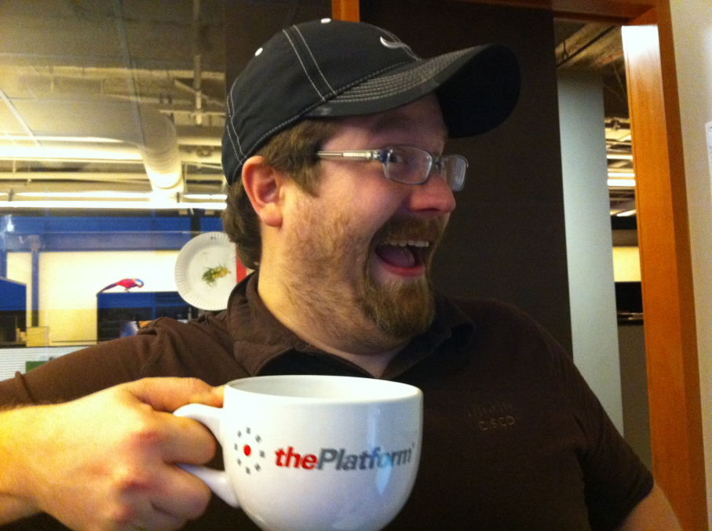

Slide 8

But sometimes it ends badly…

Slide 9
Hand this out at work
Have your colleagues take this handy quiz and avoid any unexpected unpleasantness…

