Slide 1
SCIENCE EXPLAINER · 5 MINUTES
500
Agents, then AI
agents in the model, scaled
1:1000 from 20.8 M buyers
312
What happens when you hand the
decision step of a social-science
simulation to a large language
model
monthly steps, 1991 to 2016
2
agent types use an LLM
Case: agent-based model of Germany's solar PV policy mix, 1991–2016
01 / 10
Notes:
Hi. A quick question first: what does the word "agent" mean? In computer science it's a program that acts on your behalf — something like a chatbot. In social science it's much smaller: a stand-in for a person or a firm. Today I want to show you what happened when we put the first kind of agent inside the second kind. Three parts: what an agent is, where the AI goes in, and what changed when it did.

Slide 2
THE IDEA · 1 OF 3
An agent is not an AI
SOCIAL-SCIENCE AGENT
AI AGENT
An agent is a small stand-in for a
person or a firm. It has a state —
what it owns, what it can spend.
It has a rule: when it buys, when
it produces. It has neighbours it
can see.
What it is
a few variables and
an if-then rule
a learned model with
a general interface
Where its behaviour comes from
written by the researcher,
inspectable line by line
learned from data,
not fully inspectable
What it is best at
testing a mechanism
you can state
producing a response
you cannot pre-state
The rules are the theory.
Both are useful, and they answer different questions. This talk puts the second one inside the first.
Agent-based modelling: the researcher writes the rules, the computer runs the population
02 / 10
Notes:
A social-science agent is a small piece of code standing in for a decision-maker. It has a state — what it owns, what it can spend. A rule — when it buys, when it produces. And neighbours it can see. Here is the key idea: the rules are the theory. If the rules are wrong, the model is wrong. Nothing is learned inside the agent; everything was written down by the researcher, and you can read it line by line. An AI agent is almost the opposite — flexible, general, and not fully inspectable. Both are useful. This talk is about putting the second one inside the first.

Slide 3
THE IDEA · 2 OF 3
Nobody plans the S-curve
Install a panel because your neighbour did, because the subsidy
changed, and because the price fell — and the curve appears on its
own. No agent in this model knows what a diffusion curve is.
saturation
take-off
slow start
Illustrative shape only — no data is plotted on this page.
Emergence: the aggregate pattern is an output of the micro rules, never an input
03 / 10
Notes:
Why build a model like this at all? Install a panel because your neighbour did. Install one because the subsidy changed. Install one because the price fell. Do that across a few hundred households and a pattern appears: a slow start, a take-off, a saturation. Nobody planned that curve. No agent in the model even knows what a diffusion curve is. That is the point of the method — the interesting result emerges from the rules. The curve on this page is a sketch, by the way; no data is plotted on it.

Slide 4
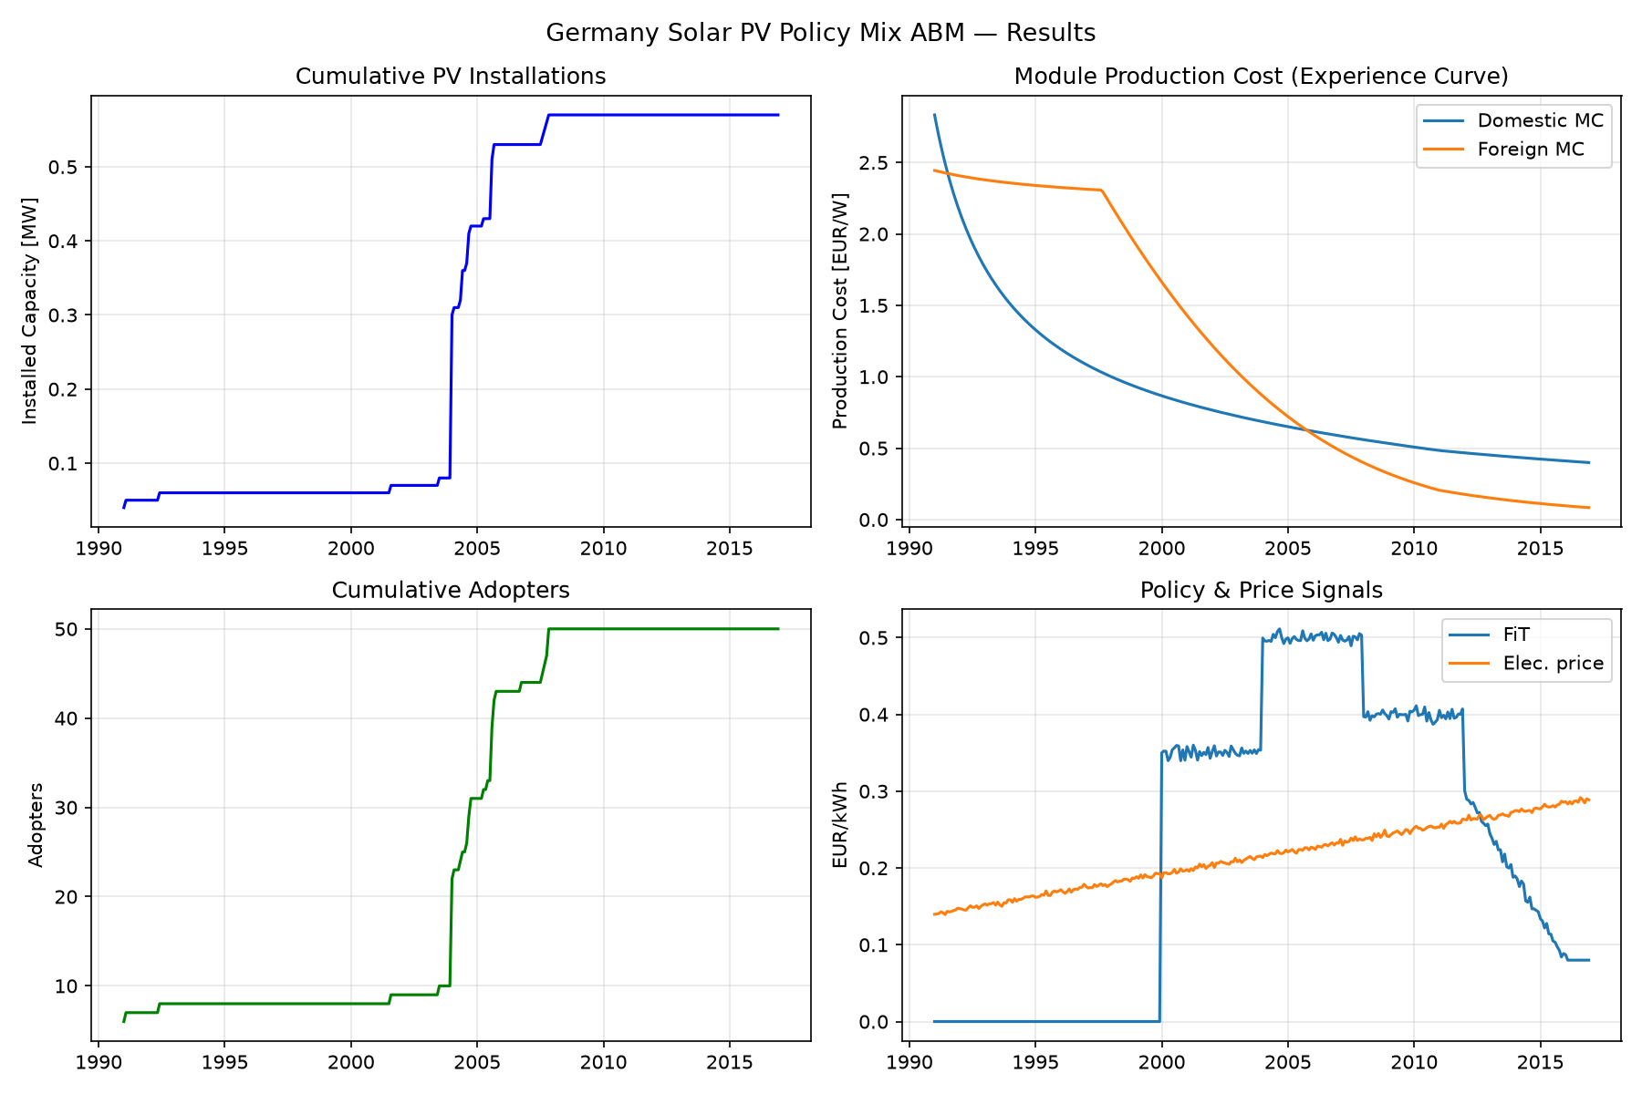
THE CASE · 3 OF 3
Three kinds of agent
Adopters · 500
households and firms, 1:1000 scale
Manufacturers · 2
one domestic, one foreign
Installers · 2
order queue and labour market
A macro environment supplies the
monthly price, subsidy and R&D signals.
Baseline: formula-only run, 312 ticks, seed 42, synthetic data
One tick is one month: macro signals, then adopters, installers, manufacturers, then the clock
04 / 10
Notes:
Our case is Germany's solar boom, 1991 to 2016. Three kinds of agent. Five hundred adopters — households and firms, scaled down a thousand-fold from about twenty million potential buyers. Two manufacturers, one domestic and one foreign. Two installers, handling the order queue and the labour market. Above them, a macro environment hands out the monthly signals: electricity price, feed-in tariff, media attention, and public research spending. One tick is one month. This is the baseline — formula only.

Slide 5
THE RULES · 1 OF 2
Two rules, written down
RULE 1 · THE ADOPTION DECISION
First the agent must get the idea — peers, information, awareness,
return. Then it must pass an economic test: the net present value
has to be non-negative, unless it is a hard-core environmentalist.
RULE 2 · THE COST OF A MODULE
Cost falls with cumulative production, learning by doing, and with
the knowledge built up by R&D, learning by research. The same
equation applies to every manufacturer in every month.
The consumer is a pure optimiser, and no manufacturer ever has to be persuaded to invest in R&D.
Both rules are calibrated to the published supplementary information of the original study
05 / 10
Notes:
What makes the agents move? Two rules. Rule one is adoption, and it happens in two stages. First the agent has to get the idea — neighbours, information, green-mindedness, expected return. Then it has to pass an economic test: net present value must be non-negative — unless it's a hard-core environmentalist, who installs anyway. Rule two is the cost of a module: it falls with cumulative production, learning by doing, and with the knowledge built up by research, learning by research. The same equation, every manufacturer, every month. So notice: the consumer is a pure optimiser, and no manufacturer ever has to be persuaded to invest.

Slide 6
THE RULES · 2 OF 2
The AI gets one step
STATE
DECISION — REPLACED
UPDATE
prices, knowledge,
orders, neighbours
buy or not, expand or not,
which R&D to fund
the model applies it and
advances one month
Manufacturers
Consumers
Every month the firm's decision now comes from a board of five
AI directors with different mandates. They vote, and they leave minutes.
A 5% sample of undecided adopters
is asked each month, instead of
running the equation.
If a call fails, the model falls back to the original equation, so the simulation never stalls.
State updates, accounting and the monthly loop stay in the original model
06 / 10
Notes:
So where does the AI go in? We did not hand over the model. We replaced one step: the decision. The state — prices, knowledge, orders, neighbours — is still the original model. The language model decides; the model applies the decision and moves to the next month. Two agent types were opened up. For manufacturers, the monthly decision now comes from a board of five AI directors with different mandates — they vote, and they leave minutes. For consumers, five per cent of the undecided adopters are asked each month. And if a call fails, the model falls back to the equation, so the simulation never stalls.

Slide 7
WHAT CHANGED · 1 OF 2
The rationality gate disappears
RULE-BASED CONSUMER
AI CONSUMER
must pass: net present value ≥ 0
otherwise: do not buy
the same market figures, no gate
the agent simply decides
WHAT THE EQUATION CANNOT HOLD
what the neighbours are doing · how it feels about the technology
what it expects from the next subsidy round
Mechanism verified in the code and in short live runs; the full 26-year comparison is still pending.
Baseline adoption in the formula model: 50 of 500 agents, about 10%, against a historical rate near 7%
07 / 10
Notes:
First change. The rule-based consumer has a gate: if the numbers don't work, you don't buy. The AI consumer gets the same figures, and there is no gate. It can buy because the neighbours are doing it, because it likes the technology, or because it expects the next subsidy round to be generous. Those are reasons an equation cannot hold — and they are how people actually behave. Our baseline ends at about ten per cent adoption, against a historical rate closer to seven. One honest caveat: we have verified this mechanism in the code and in short live runs; the full twenty-six-year comparison is still pending.

Slide 8
WHAT CHANGED · 2 OF 2
R&D becomes an argument
Five directors, five mandates
ONE REAL BOARD MEETING
Chair
long-run strategy and the policy window
3 : 1 : 1
CFO
cash, margin and capacity utilisation
expand · maintain · reduce
CTO
efficiency and the knowledge that cuts cost
CMO
order backlog and market demand
"The order book is filling and the policy
window is open: add capacity, and spend
this month's R&D on cost."
CSO
compliance and supply-chain resilience
The equation always cost-reduced silently. The AI board has to decide it — and can be outvoted.
The board's full minutes — every vote, reason and reservation — are written out after each meeting
08 / 10
Notes:
Second change: the manufacturer. In the formula model, cost reduction is silent and automatic. Here it has to be argued. Five directors, five mandates: chair, finance, technology, marketing, compliance. They disagree by design. In the first live board meeting the vote was three to one to one — the firm expanded, and it chose to spend that month's research budget rather than stand still. Every reason and every reservation is written into the minutes. So research stops being a setting in the code and becomes an argument you can read afterwards.

Slide 9
WHAT IT MEANS
A better model of people
What it buys
What it does not
reasons a formula cannot hold:
peers, emotion, expectations
the full 26-year AI run is not
finished, so no accuracy claim
disagreement inside the firm, with
minutes you can actually read
LLM decisions are not reproducible
run to run, and they cost money
a clean seam — the decision changes,
the accounting does not
a more realistic story is not
automatically a truer number
Every AI decision is schema-checked and falls back to the equation on failure.
The point is behavioural realism, not prediction accuracy
09 / 10
Notes:
So what does this buy? Behaviour an equation cannot express: peer pressure, emotion, expectations — and real disagreement inside a firm, with a record you can inspect. It also keeps a clean seam: the decision changes, the accounting does not. What it does not buy is accuracy. The long run is not finished; language-model decisions are not reproducible run to run; and each one costs money and time. A more realistic story is not automatically a truer number. Every AI decision is schema-checked and falls back to the equation — that is what makes the experiment safe to try.

Slide 10
The equations stay.
The AI only decides.
Agents gave the model its mechanism. The AI gave the agents a voice.
EQUATIONS · THE WORLD — prices, costs, orders, the monthly loop
THE AI · THE CHOICE — buy or not, expand or not, which R&D to fund
Case built on Nuñez-Jimenez et al. (2022), Research Policy — Germany's solar PV policy mix, 1991–2016
10 / 10
Notes:
Let me leave you with the boundary we drew. The equations stay. The world — prices, costs, orders, the monthly loop — is still the model. The AI only decides: buy or not, expand or not, which research to fund. Agents gave the model its mechanism. The AI gave the agents a voice. Thank you.

