Slide 1
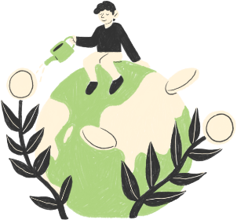
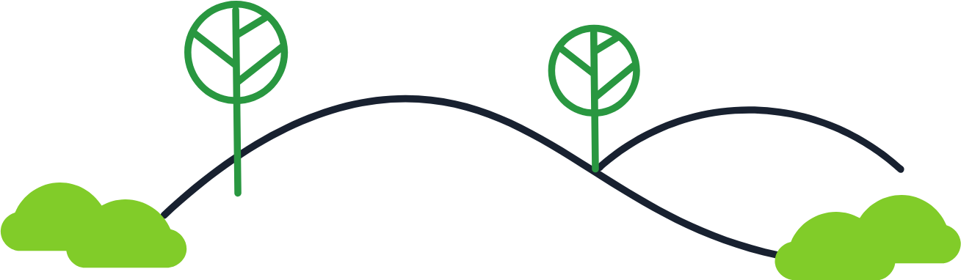
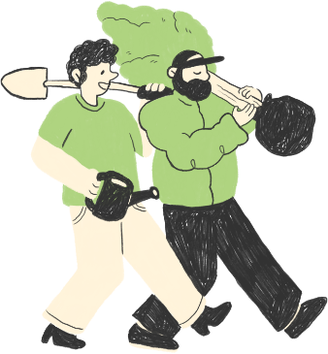
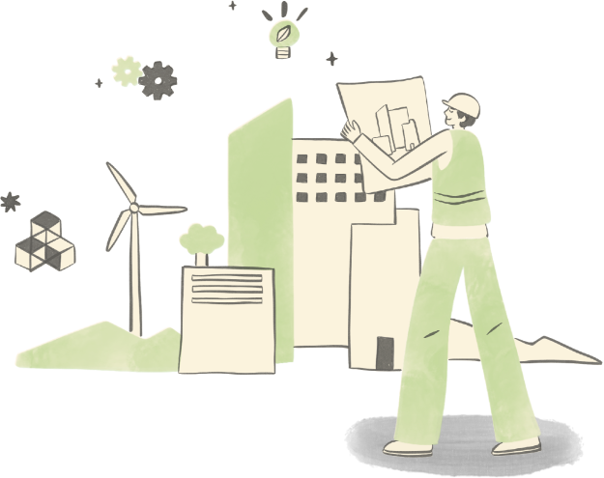
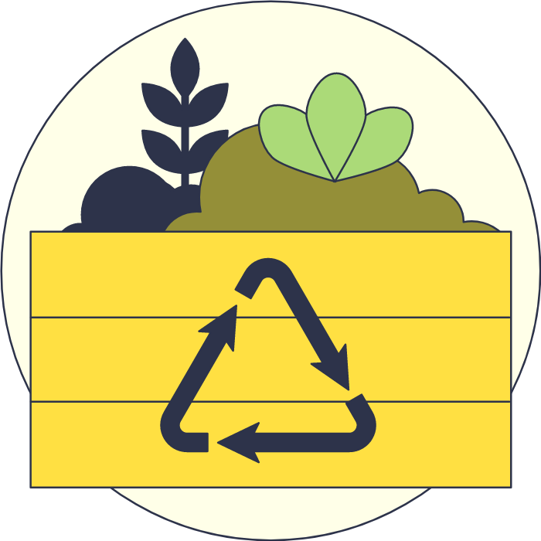
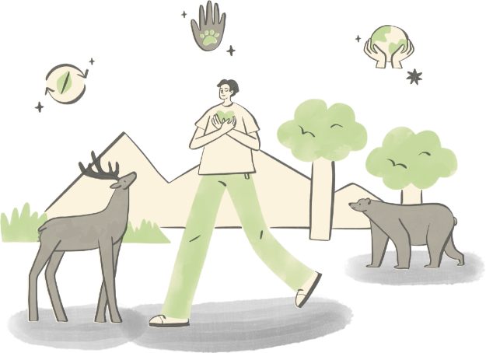
After Us
Anna Puteine and Krystyna Lopatych

Slide 2
The Setting and Core Idea
The game takes place several decades after a collapse caused by overconsumption and pollution.
Products were replaced instead of repaired, and waste piled up faster than nature could absorb it.
The player is one of the few survivors and starts with almost nothing.
The surroundings are full of plastic bottles, packaging, broken electronics, old clothes, and natural materials that people rarely think of as useful.
Every item raises the same question: is it waste or a resource? The answer depends on what the player knows.

Slide 3
Real Green Inventions
Most survival games use made-up crafting chains, like fire, then hammer, then axe. These teach nothing about the real world.
In After Us, every recipe is based on a real green invention that is not widely known. The recipes are the main content of the game.
Examples:
A plastic bottle of water left in the sun becomes a solar water disinfector
Seaweed becomes edible packaging
Waste and organic leftovers become bioplastics
Mushroom-based materials replace plastic
Composting turns leftovers into soil for growing food
Recipes are simplified for gameplay, but the ideas behind them are real.

Slide 4
Social Good Theme
Everyone produces waste every day, but climate change and pollution feel too big and distant to be personal. We wanted a game that connects one small decision to its long-term result.
What inspired us most were real inventions that show how valuable "trash" can be. Most people have never heard of them.
Main audience: teenagers and young adults (about 15-25), who will live with the consequences the longest. Casual gamers are the second audience, so the game is a fun survival game first, not a lecture.
Main UN goal: SDG 12 Responsible Consumption and Production.
Also related: SDG 13 Climate Action, SDG 3 Good Health, SDG 14 and 15 Life Below Water and on Land, and SDG 11 Sustainable Cities.

Slide 5
Every Item Is a Decision
The player can keep an item, reuse it, repair it, recycle it, or transform it. Throwing it away or burning it is also possible, and it is the fastest option.
Transforming uses the real green inventions. It needs knowledge, materials, and a workbench, but it has the highest long-term payoff.
Discarding is quick but adds pollution, and recycling is slow and needs energy. The player has to decide what the situation needs now and later.
The world reacts right away: burning waste darkens the sky and worsens the air, and cleaning an area makes the water and ground look healthier.
Sometimes the player needs a material that was thrown away earlier, such as a plastic bottle for water disinfection.

Slide 6
How the Game Progresses
The game has five levels, each about 15-30 minutes. The player explores, collects items, decides what to do with them, and builds toward the level goal.
The player keeps hunger, thirst, and health above zero and watches air pollution and temperature.
Recycling includes a short sorting mini-game, and better sorting returns more material.
The first level teaches the basic loop with familiar plastic waste. Later levels add pollution, climate extremes, scarcity, and new materials, and they unlock more of the lesser-known inventions.
In the final level, the player uses the methods learned along the way to build a small sustainable settlement with clean water, low-impact energy, food, and a working recycling loop. The world is improved, not completely fixed.

Slide 7
Message and Testing
The main message: discarded objects do not disappear, and with creativity many of them can become something useful again.
Reusing and repairing is better than recycling, recycling is better than throwing away, and short-term convenience often causes long-term problems.
By the end, the player should be able to explain at least one or two unusual recycling methods from the game.
We will test with 4-10 players and a short survey: can they name and explain an unusual method, and did they notice how their choices changed the world?

Slide 8
What Makes Us Different
Minecraft, Don't Starve, This War of Mine, Eco, and Terra Nil cover survival or ecology, and educational recycling games are usually simple sorting games. After Us combines these ideas in three ways:
Real, little-known green inventions are the gameplay, so the player learns concrete methods and not only that "pollution is bad"
Waste is part of the survival loop, and every used object is a decision
The message comes from experience in the game, not from text explanations
The prototype is planned as a single-player web game for a team of two.

Slide 9
Thank You

