Slide 1
Analyzing Spotify Trends and Predicting Song Popularity
By Danail Krzhalovski and Sandra Andovska

Slide 2
Music streaming services thank its growth to that they are able to react to new expectations of listeners, who want searchable music collections, automatic playlist suggestions, music recognition systems and more (Casey et al. 2008). Next to importance of recommendations, there is the importance of prediction of music popularity. In the music industry too, all parties have an interest in connecting consumers with content they will like and buy and it remains one of the biggest mysteries in the industry why some songs become popular while other songs fail to do so.
MOTIVATION

Slide 3
1. Data Collection 2. Data Exploration 3. Regression Models 4. Classification Models 5. Main Results and Discussion 6. Technical Appendix
OVERVIEW

Slide 4
1. DATA COLLECTION
Spotify is a digital music service that enables users to remotely source millions of different songs on various record labels. To recommend new music to users, and to be able to internally classify songs, Spotify assigns each song values from 13 different attributes/features. Spotify also assigns each song a popularity score, based on total number of clicks/listens. This dataset contains approximately 19000 songs from different Spotify playlists, which includes a popularity score and a set of metrics for each one. The dataset is available on Kaggle.

Slide 5
1. DATA COLLECTION
Using Excel, we merged the two .csv files into one, and carefully analyzed which columns to work with. Some were duplicates, such as the names of the song and artists present in both sheets, and some we found to be redundant – album name and playlist. We are working the following:
song_name: name of the song observed
arist_name: name of the artist.
song_duration: duration of the song in miliseconds, changed to minutes
acousticness: a confidence measure from 0.0 to 1.0 of whether the song is acoustic. 1.0 represents high confidence the song is acoustic.

Slide 6
1. DATA COLLECTION
liveness: detects presence of an audience in recording
danceability: describes how suitable a song is for dancing based on a combination of musical elements including tempo, rhythm stability, beat strength, and overall regularity
energy: a perceptual measure from 0.0 to 1.0 of intensity and activity
instrumentalness: predicts whether a song contains no vocals
key: represents the overall musical key the song is composed in. Integers map to pitches using standard Pitch Class notation. E.g. 0 = C, 1 = C#/Db, 2 = D, etc.

Slide 7
1. DATA COLLECTION
loudness: overall loudness of a song in decibels (dB)
speechiness: detects presence of spoken words in a song
tempo: estimated tempo of a song in beats per minute (BPM)
time signature: estimated overall time signature of a track (how many beats in each bar)
valence: measure from 0.0 to 1.0 describing musical positiveness
popularity: dependent variable in the range [0,100]

Slide 8
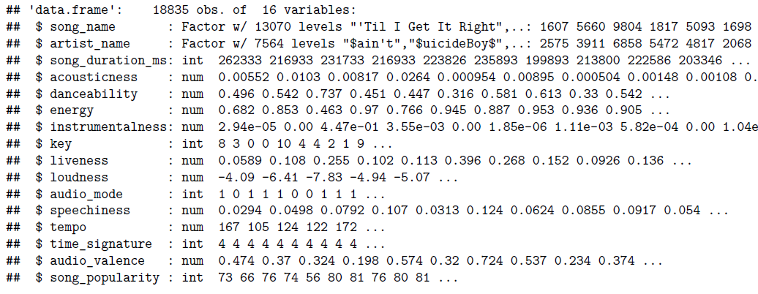

Slide 9
1. DATA COLLECTION
Data was already cleaned up and tidied, but some additional modifications had to
be made. We created factors for the ‘audio_mode’ and ‘key’ variables to make the data easier to interpret. Anyone with at least a bit of musical knowledge would prefer and actually find it easier to understand the analysis if the person could see the keys (C, C#, etc.) and modes (major, minor) instead of going back to the description of features to check their numerical values. We too transform the song duration from miliseconds to minutes, and factorize the time signature since it does not provide us a true numerical property.

Slide 10
2. DATA EXPLORATION
After checking for missing values and duplicates, we are now working with 14926 observations. Data was already cleaned up and tidied, but some additional modifications had to be made.
We created factors for the ‘audio_mode’ and ‘key’ variables to make the data easier to interpret. Anyone with at least a bit of musical knowledge would prefer and actually find it easier to understand the analysis if the person could see the keys (C, C#, etc.) and modes (major, minor) instead of going back to the description of features to check their numerical values. We too transform the song duration from miliseconds to minutes, and factorize the time signature since it does not provide us a true numerical property.

Slide 11
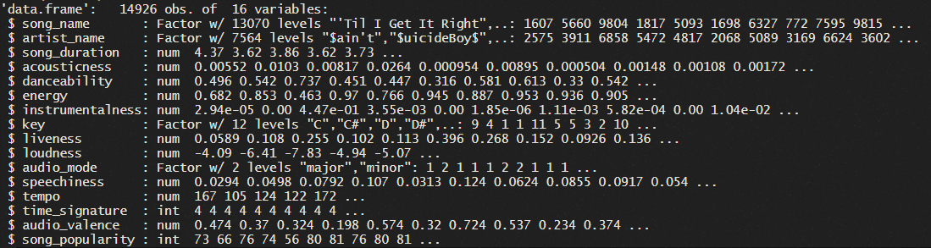
2. DATA EXPLORATION

Slide 12
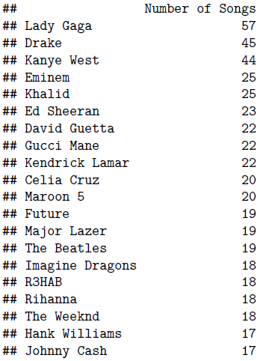
2. DATA EXPLORATION
We begin our analysis by checking which artists are a part of Spotify playlists the most. By looking at the entire list, we can see that all artists are from different time periods, genres and cultures, so we can say that our data is not biased towards a specific type of music nor a time period.
Notes:
Throughout the years, Lady Gaga has been dominant in the pop genre since 2010s, so the fact that she showed up first in our list does not surprise us. Following is Drake, a major influencer on all generations, bringig his fusion of hip hop and contemporary R&B with trap and dancehall music. Kanye West has too shown to be a remarkable alternative and experimental hip hop artist, with his fair share in the pop genre. Eminem is one of the most famous artists in hip hop making his debut in 1996. By looking at the entire list, we can see that all artists are from different time periods, genres and cultures, so we can say that our data is not biased towards a specific type of music nor a time period.

Slide 13
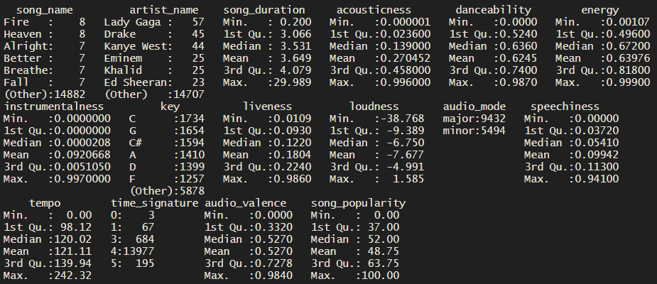
SUMMARIES OF THE DATA
Notes:
To review our dataset's content and shape, we provide the summaries and conclude that there is a lot of skewness in most of the predictors, except maybe for the duration of the song and valence. We can observe a negative skew in song popularity (our target variable) as well. The results are represented as follows, and we continue with a more detailed analysis.

Slide 14
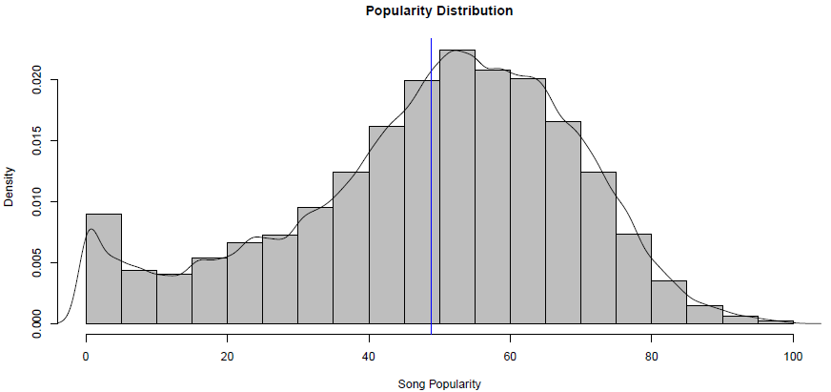
POPULARITY DISTRIBUTION
By taking a look at how the popularity scores are distributed, one thing is noticeable instantly. The data appears to be slightly negatively skewed, with majority of the songs having a popularity score more than 40. The mean popularity score at a value of 48.75 and median is 52.

Slide 15
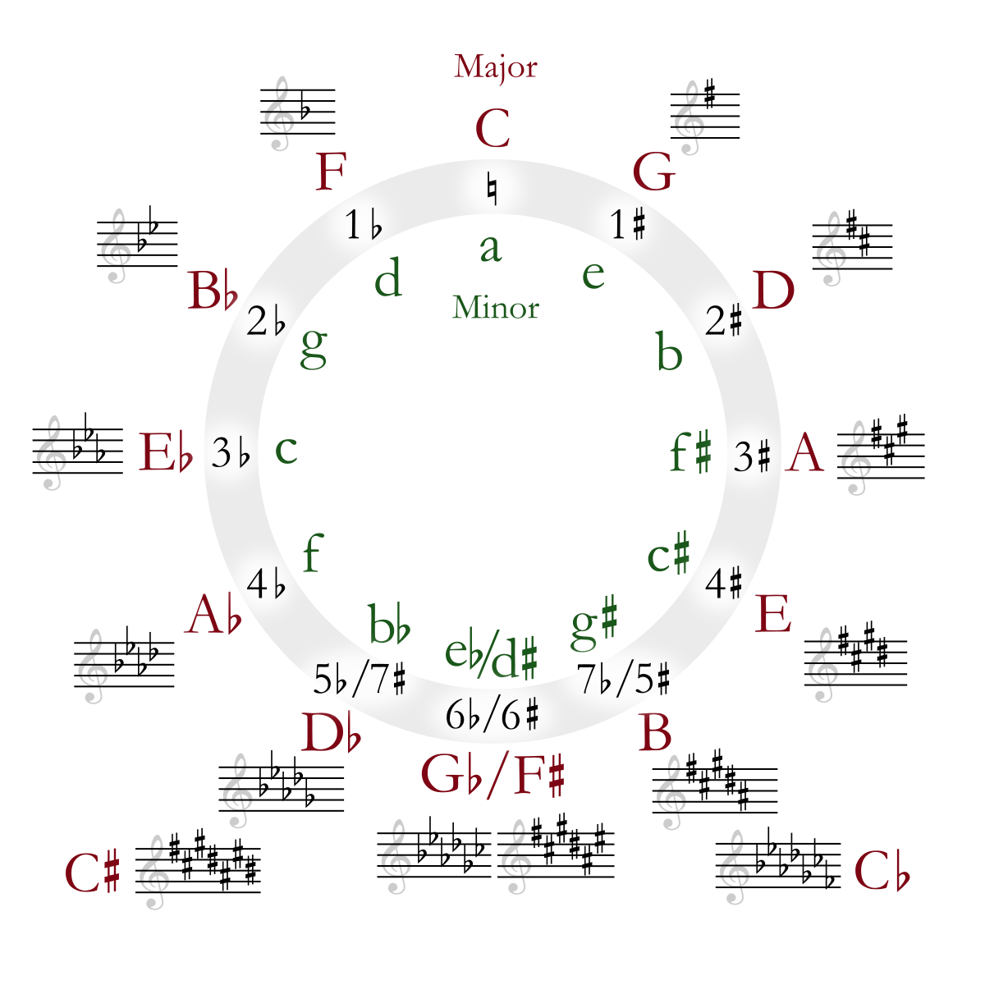
ASSUMPTION
We can assume that the audio mode, key, tempo and time signature of a song are composition elements, which we can make us of to describe and classify music.

Slide 16
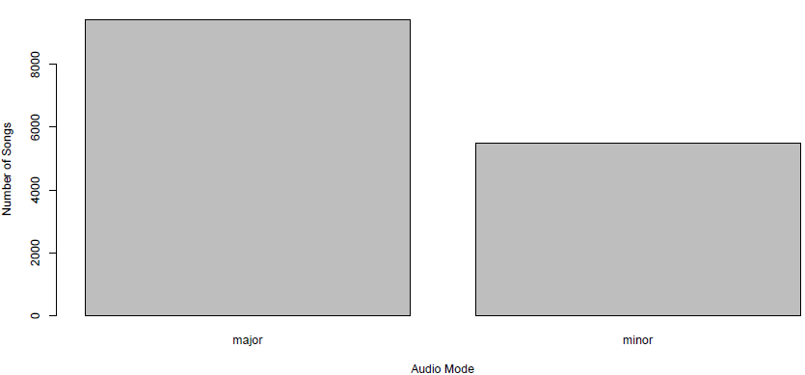
AUDIO MODE
The emotional center of music comes from one of two places: the major chord or the minor chord. If you’re listening to music and you can sense happiness and you’re at ease, you’re probably listening to a song that uses mostly major chords to create that feeling.

Slide 17
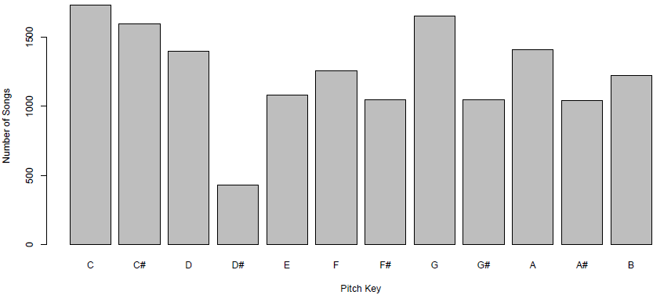
PITCH KEYS
In addition to the audio mode, the association of musical keys with specific emotional or qualitative characteristic was fairly common prior to the 20th century. When Mozart wrote a piece in a Ab major, for example, they were well aware that this was the ‘key of the grave’.

Slide 18
PITCH KEY INTERPRETATION
The most common key in our dataset is C:
C major: Completely pure. Its character is: innocence, simplicity, naivety, children’s talk.
C minor: Declaration of love and at the same time the lament of unhappy love. All languishing, longing, sighing of the love-sick soul lies in this key.
The least common key is D#:
D# major (equivalent to E-flat): The key of love, of devotion, of intimate conversation with God.
D# minor: Feelings of the anxiety of the soul’s deepest distress, of brooding despair, of blackest depression, of the most gloomy condition of the soul. Every fear, every hesitation of the shuddering heart.
Notes:
After doing some research, we were able to find poetic interpretations of these keys, written by Christian Schubart - a German poet, organist, composer, and journalist that layed out his thougts in “Ideas for an Aesthetic in Audio Art” (originally titled “Ideen zu einer Aesthetik der Tonkunst”), published in 1806 [2]:
• C# major (equivalent to D-flat): A leering key, degenerating into grief and rapture. It cannot laugh, but it can smile; it cannot howl, but it can at least grimace its crying. Consequently only unusual characters and feelings can be brought out in this key.
• C# minor: Penitential lamentation, intimate conversation with God, the friend and help-meet of life; sighs of disappointed friendship and love lie in its radius.
• G major: Everything rustic, idyllic and lyrical, every calm and satisfied passion, every tender gratitude for true friendship and faithful love,–in a word every gentle and peaceful emotion of the heart is correctly expressed by this key.
• G minor: Discontent, uneasiness, worry about a failed scheme; bad-tempered gnashing of teeth; in a word: resentment and dislike.

Slide 19
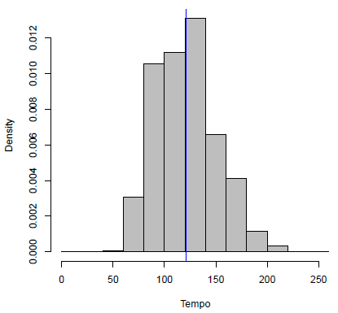
TEMPO
Popular songs tend to have a faster tempo with an average BPM of 121.105. This is commonly known as ‘allegro’, ranging from 120 – 156 BPM. Modern music tempos are in this range:
techno (120-140 BPM)
house (115-130 BPM)
hip-hop (80-120)

Slide 20
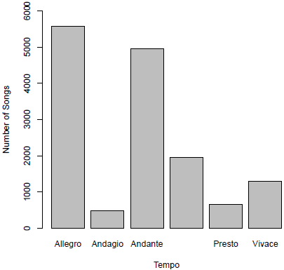
TEMPO CATEGORIES
Adagio - slowly with great expression (66-76 bpm)
Andante - at a walking pace (76-108 bpm)
Moderato - at a moderate speed (108-120 bpm)
Allegro - fast, quickly, and bright (120-156 bpm)
Vivace - lively and fast (156-176 bpm)
Presto - very, very fast (168-200 bpm)

Slide 21
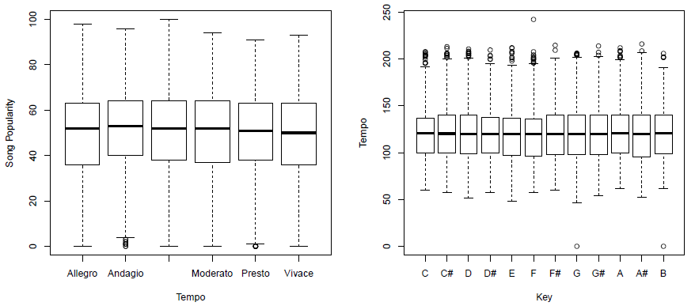
We also have a clear indication of the consistency of mean tempos across all songs and their popularities, with a symmetrical distribution. We could say that the data is approximately normally distributed in terms of the songs’ tempo. We too can observe a consistency of mean tempos across all keys.

Slide 22
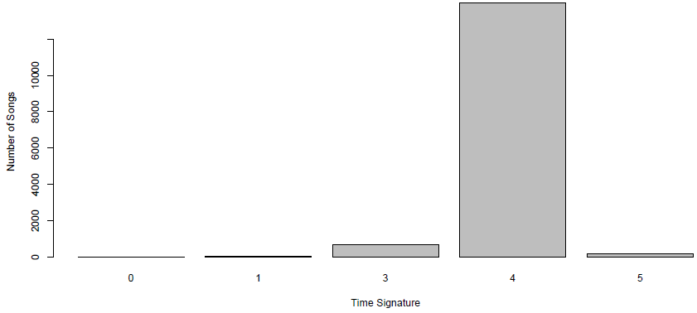
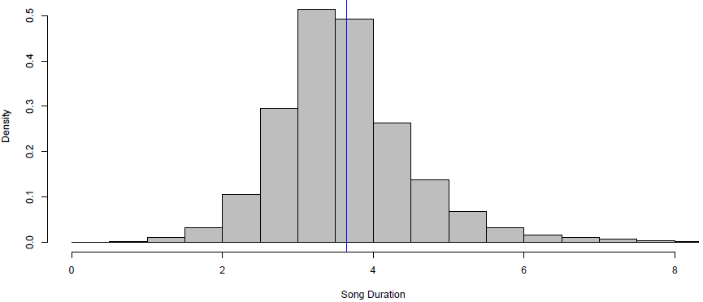
We can see that the most common time signature used in music is the 4/4 meter, known as ‘common time’, and that a song has an average duration of 3-4 minutes.

Slide 23
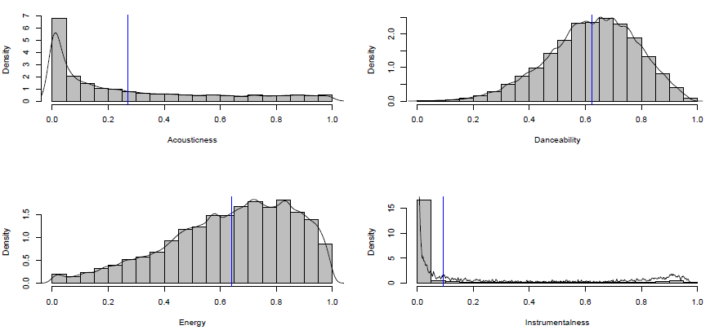
Distribution of acousticness, danceability, energy and instrumentalness of our data
Notes:
Danceability is most dense in the interval [0.5, 0.8] telling us that popular songs are quite danceable.
Energy peaks around 0.7 and is most dense around the same interval
Most songs are less instrumental

Slide 24
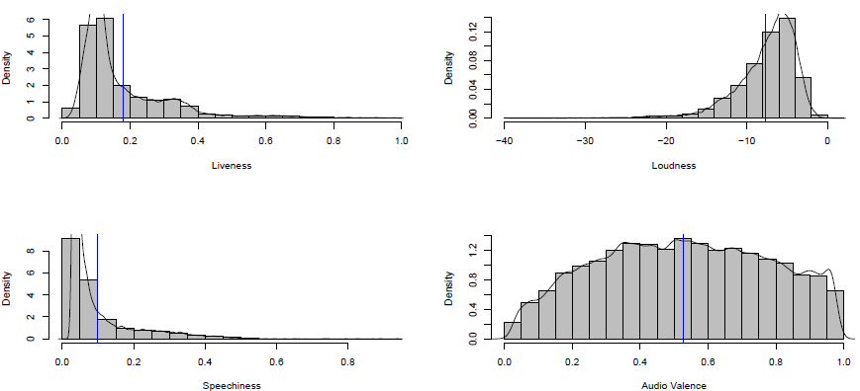
Distribution of liveness, loudness, speechiness and valence of our data
Notes:
The majority of the songs tend to have very low liveness, i.e. they are not recorded during a live session, and songs are between -10 and 0 dB.
Acousticness and speechiness seem to have a similar distribution, saying that most songs are acoustic and have less spoken words (which too might be concluded looking
at the instrumentalness over the songs).

Slide 25
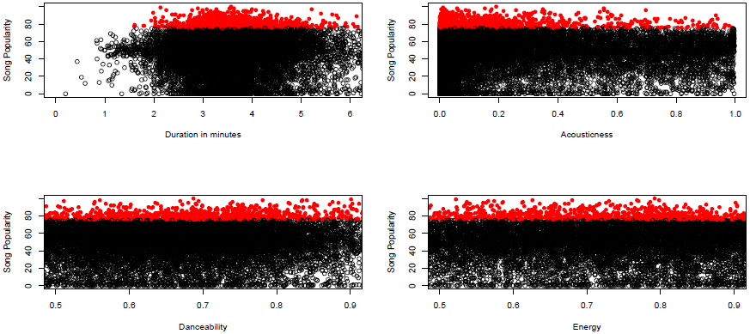
Because we deal with classification in the second part, we divide the song popularity into low and high. We choose a popularity score of 75, since this is the border of the top 25% of songs.
Notes:
Number of very popular songs: 981
Percentage of highly popular songs: 61%
• Songs that are more popular tend to last 3-4 minutes, and their acousticness level is below 0.2 meaning that the more a song is popular, the less likely that it’s acoustic.
• Danceability and energy have a very similar mass, saying when songs are more popular they have a moderate-to-high value in both of them, i.e. the songs are more danceable and energetic.

Slide 26
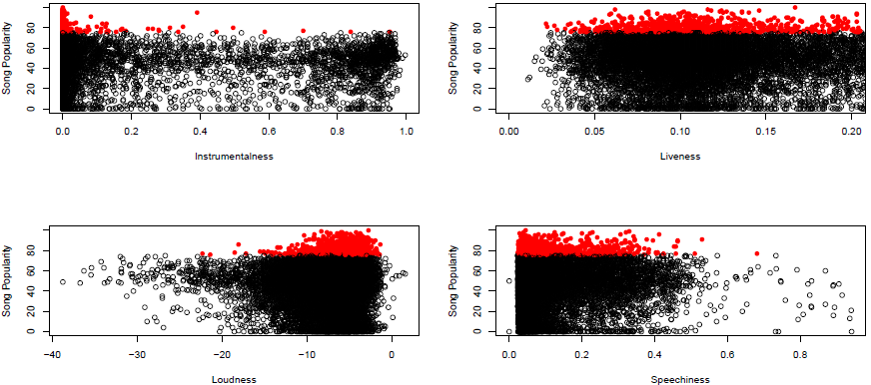
Notes:
• Instrumentalness is most likely to be 0 when a song is very popular, and when liveness is more than 0.8 we can say that there is strong likelihood that the song is studio-recorded. Our values of liveness for songs with popularity > 75 are concentrated around 0.1.
• Popular songs tend to be louder, mostly ranging from -6 to -4 dB, and contain less-to-no lyrics.

Slide 27
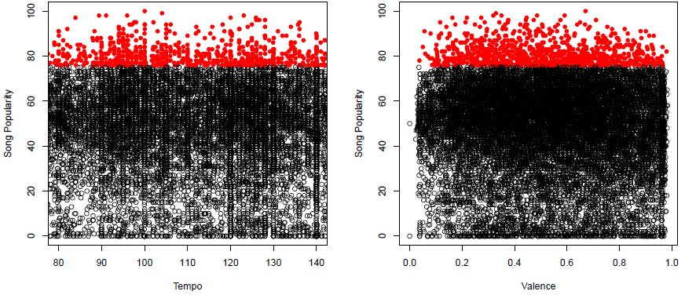
Notes:
As mentioned, the average tempo is around 120 BPM, with popular songs having a tempo in the range of (90,130). People also like to listen to moderately cheerful songs - just the right amount of mellow and happy.

Slide 28
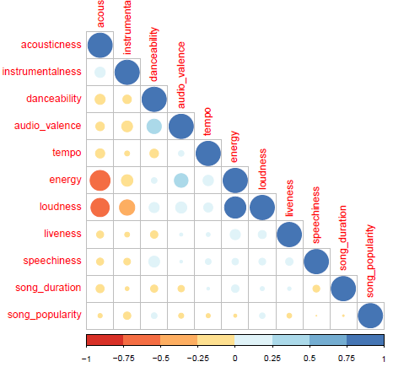
COLLINEARITY
We further need to check the covariance matrix to see the direction of the linear relationship between
variables, but since correlation measures both its direction and strength, we use a colour correlation plot
just to see how our data behaves.
Notes:
In the plots above, we observe in the strongest tones existing correlations between some of the predictors. The strongest correlation is between loudness and energy, meaning if the loudness of a track increases then chances of it being energetic are quite higher and vice versa. The second laRGESTt is a negative correlation
between energy and acosticness. Hence, we face a problem of multicollinearity.

Slide 29
3. REGRESSION MODELS
Judging by the looks of our data, and the relationship among the predictors and the response variable, we do not expect a linear model to help us predict a song’s popularity, but we do try out several:
Linear Regression
Ridge Regression
LASSO
Bayes Regression
To evaluate the results, we use Root Mean Squared Error. Mean Squared Error tells us how close a regression line is to a set of points, and we are simply taking its root.

Slide 30
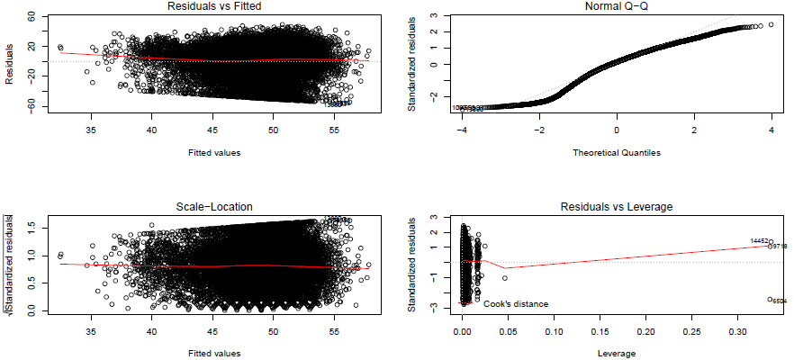
3.1 LINEAR REGRESSION
Notes:
We compared the full model and null model (the marginal distribution on response variable not taking into account any predictors, i.e. really just the mean of the outcome). By using the full model, RMSE equaled to 20.2, which is not a huge improvement from the null model. Neither has the variability around the mean been explained, now equaling to 2%. We suspected that effect of acousticness on popularity also depends on instrumentalness, similarly to how valance has an effect on popularity as it might be dependent on loudness and danceability. We too expected that the effect of loudness on popularity depends on liveness too, but since the interactions did not yield any significant improvements, we analyzed the residuals of the full model.
Residuals vs Fitted: no clear pattern in the residuals and they are symetrically distributed. Since, there isn’t any evidence of heteroscedasticity (non-constant variance in the errors).
Normal Q-Q: points fall along a line in the middle of the graph, but curve off in the extremities. This means our data has more extreme values. We could not fix the issue, because applying various transformation to the response variable yielded even worse results.
Scale-Location: presence of heteroscedasticity can be seen also from how the studentized residuals spread along the
ranges of predicted variables. We can see that the residuals are spread equally, even though our horizontal line isn’t quite straight.
Residuals vs Leverage: there are points which are outside the red dashed Cook’s distance line. These are points that would be influential in the model and removing them would likely alter the regression results. We remove them to fit the rest of the models.

Slide 31
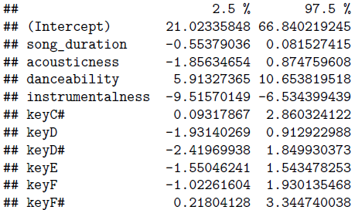
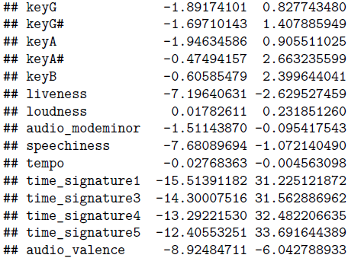
95% CONFIDENCE INTERVALS OF ESTIMATES
The estimates of the regression coefficients are subject to sampling uncertainty. Therefore, we will never exactly estimate the true value of these parameters from sample data in an empirical application.
Notes:
Many of the variables used in our multiple regression model were in fact not associated with the response (i.e. they are non-significant, low p values) and including such irrelevant variables leads to unnecessary complexity in the resulting model. This was also suspected when we constructed confidence intervals for the estimated coefficients of the regression. Some of the intervals did not contain 0, which leads to the rejection of the null hypothesis i.e. they should have a say in predicting song popularity. That is why we perform a feature selection using backward selection. We start with all variables in the model, and remove the variable with the largest p-value. The new (p-1) - variable model is fit, and the variable with the largest p-value is removed. Here, we consider Akaike Information Criterion (AIC) and remove model that shows lowest AIC.

Slide 32
3.1 LINEAR REGRESSION
Backward variable selection gave us the following model to work with:
The attributes that have the largest effect on song popularity using this model are:
Danceability with 8.481296, meaning with each unit increase, song popularity increases by roughly 8.48;
Instrumentalness with -8.017524, meaning with each unit increase, song popularity decreases by roughly 8.02;
Audio valence with -7.460624, meaning with each unit increase, song popularity decreases by roughly 7.46.
Notes:
Of course we all suspected that the more danceable a song is the more popularity it would gain, but what struck us off guard is that with every increase of audio valence of a song, its popularity decreases dramatically. We saw in the EDA that people tend to like not too happy songs, but it left us perplexed. This might be due to the fact that music features subtle and gradual changes along these dimensions (song attributes) within a broader emotion category remaining the same throughout the musical segment. Sometimes, listeners do not even perceive any discrete emotion in the music. They merely perceive a certain level of arousal. The effect of instrumentalness is clear, less vocals in a song do not seem that appealing the people’s taste.

Slide 33

3.1.1 REVIEW
Once we are done with training our model, we can not just assume that it is going to work well on data that it has not seen before. In other words, we can’t be sure that the model will have the desired accuracy and variance in production environment. We validate our model using 5-fold Cross Validation to calculate RMSE:
Because we couldn’t get a lower error, we suspect that the reason for this is either removing the energy variable (although it seemed justified at the time), or that the variable selection is not good enough, so we further use Ridge regression to impose a penalty term on predictors to impose a bias on the estimators and LASSO for the latter.
Notes:
The results vary from time to time, because of the constant update of “random.seed” - a vector containing the random number generator (RNG) state for random number generation in R. 9/20 times the reduced model turned out to be a better fit than the full model, but the error did not reduce significantly.
we split
5CV: the entire data randomly into 5 folds, because using 5 or 10 as these values have been shown empirically to yield test error rate estimates that suffer neither from excessively high bias nor from very high variance. We fit the model using the K-1 i.e. 4 folds, and validate the model using the the remaining K-th fold. We repeat this process until every K-fold serves as the test set. Then take the average of the scores, which will be the performance metric for the model.

Slide 34
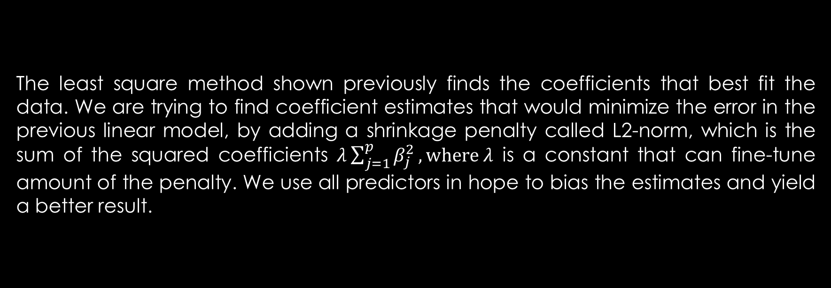
3.2 RIDGE REGRESSION
The least square method shown previously finds the coefficients that best fit the data. We are trying to find coefficient estimates that would minimize the error in the previous linear model, by adding a shrinkage penalty called L2-norm, which is the sum of the squared coefficients $λ\sum_{j=1}^{p}{β_{j}^{2}}, where λ$ is a constant that can fine-tune amount of the penalty. We use all predictors in hope to bias the estimates and yield a better result.

Slide 35
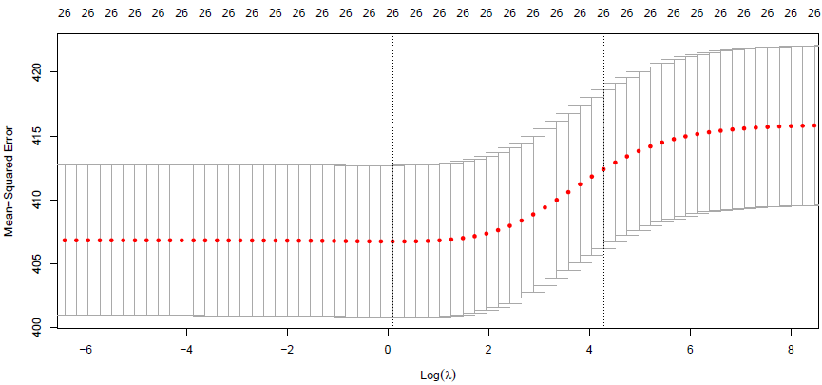
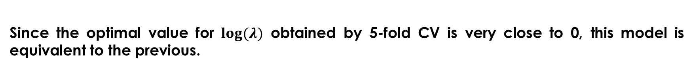
Since the optimal value for $log(λ)$ obtained by 5-fold CV is very close to 0, this model is equivalent to the previous.
Notes:
This penalty is small when the coefficient estimates are close to zero, so it has the effect of shrinking towards 0. The tuning parameter lambda serves to control the
relative impact of these two terms on the regression coefficient estimates. As lambda increases, the flexibility of the ridge regression fit decreases, leading to decreased variance but increased bias. This too may resolve the issue of multicollinearity, therefore we include the “energy” variable in this model.

Slide 36
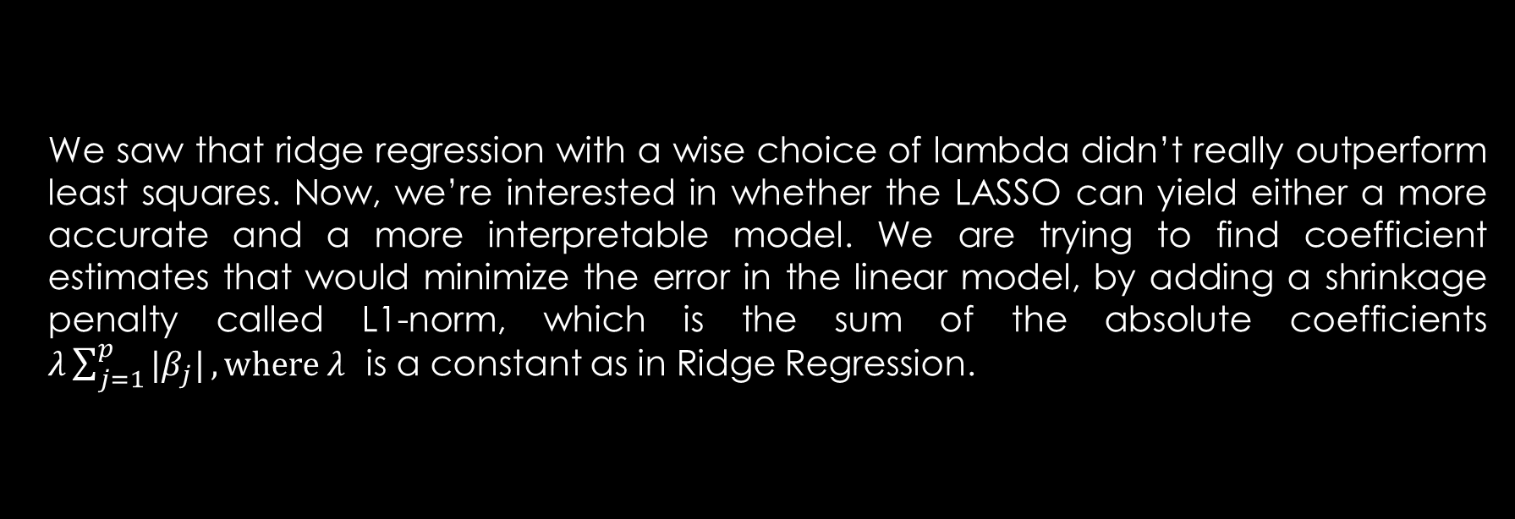
3.3 LASSO
We saw that ridge regression with a wise choice of lambda didn’t really outperform least squares. Now, we’re interested in whether the LASSO can yield either a more accurate and a more interpretable model. We are trying to find coefficient estimates that would minimize the error in the linear model, by adding a shrinkage penalty called L1-norm, which is the sum of the absolute coefficients $λ\sum_{j=1}^{p}{{|β}_{j}|}, where λ$ is a constant as in Ridge Regression.
Notes:
Variables with a regression coefficient equal to zero after the shrinkage process are excluded from the model. Variables with non-zero regression coefficients variables are most strongly associated with the response variable. The lasso implicitly assumes that a number of the coefficients truly equal zero, so, in general, it should perform better in a setting where a relatively small number of predictors have substantial coefficients.

Slide 37
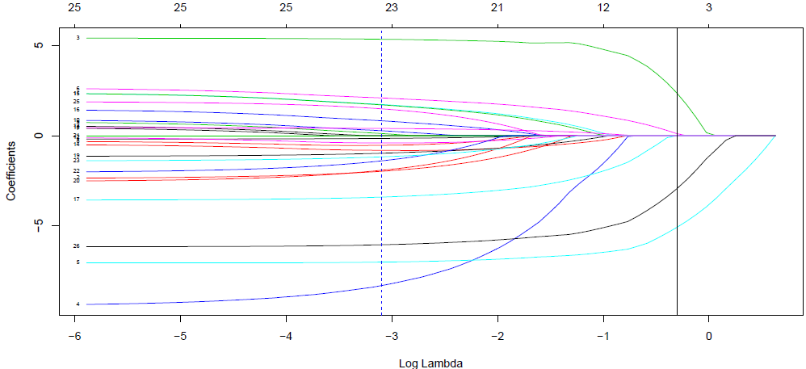
Using 5-fold CV the optimal $log(λ)$ obtained is nearly -3, and the model obtained is
Notes:
This penalty is small when the coefficient estimates are close to zero, so it has the effect of shrinking towards 0. The tuning parameter lambda serves to control the
relative impact of these two terms on the regression coefficient estimates. As lambda increases, the flexibility of the ridge regression fit decreases, leading to decreased variance but increased bias. This too may resolve the issue of multicollinearity, therefore we include the “energy” variable in this model.

Slide 38

3.4 REVIEW
We see that what makes a song popular, according to LASSO, is people's perception of danceability and valence. As mentioned previously, songs that are more danceable, such as club songs which we sing to, end up being more popular than the ones containing no vocals. We see LASSO considers whether a song has an overall key of C as an important factor to our analysis. We see that 80% of the observations with an overall musical key C are in fact with an audio mode in major. This means that people tend to enjoy innocently happy, childlish-like songs, and LASSO studies this as important. The results from these models are the following:

Slide 39
3.5 BAYESIAN APPROACH
We show another approach which is more intuitive and close to how we think about probability in everyday life and yet is a very powerful tool: Bayesian statistics, which has its foundations on conditional probability and Bayes theorem. There is a key element when we want to build a model under Bayesian approach: the Bayes factor - the ratio of the likelihood probability of two competing hypotheses (usually null and alternative hypothesis) and it helps us to quantify the support of a model over another one.
Notes:
. We use the “BAS” package to conduct a Bayesian regression, using Bayesian Model Averaging (BMA) that provides a mechanism for accounting model uncertainty, and we
indicate following parameters:
• Prior: Zellner-Siow Cauchy that uses a Cauchy distribution extended for multivariate cases. This is an approximation to the Jeffreys-Zellner-Siow prior that uses the Jeffreys prior on sigma and the Zellner-Siow Cauchy prior on the coefficients.
• Model prior: Uniform as a prior distribution on models, to assign equal probabilities to all.
• Method: Markov Chain Monte Carlo (MCMC) to improve model search efficiency.

Slide 40
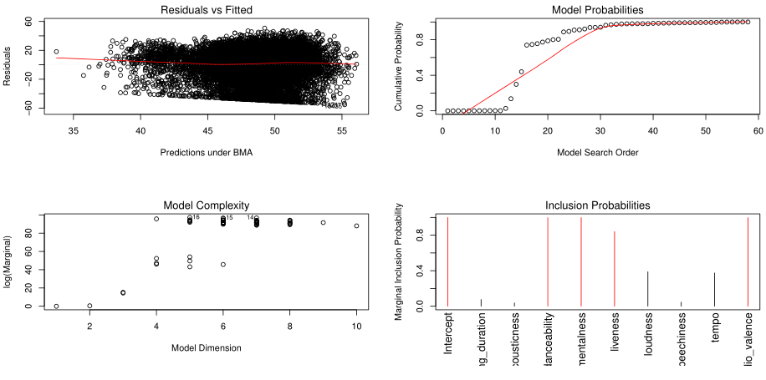
We analyze the residuals and see how they differ from the regular multivariate linear regression observed previously.
Notes:
• Residuals vs Fitted: no clear pattern in the residuals and they are symmetrically distributed. Heteroscedasticity has e been confirmed yet again.
• Model Probabilities: displays the cumulative probability of the models in the order they are sampled. This shows that the cumulative probability starts to level off after 20 model trials as each additional models adds only a small increment to the cumulative probability. The model search stops at 50-something, instead of enumerations of 2^9 combinations.
• Model Complexity shows the dimension of each model, that is the number of regression coefficients including the intercept versus the log of the marginal likelihood of the model. In this case, we can see that highest log marginal can be reached from 5 to 8 dimensions.
• Inclusion Probabilities: observe the marginal posterior inclusion probabilities for each of the covariates, with marginal posterior inclusion probabilities that are greater than 0.5 shown in red (important variables for explaining the data and prediction). In the graph, we can see that the most important predictors include those obtained with LASSO as well as liveness.

Slide 41
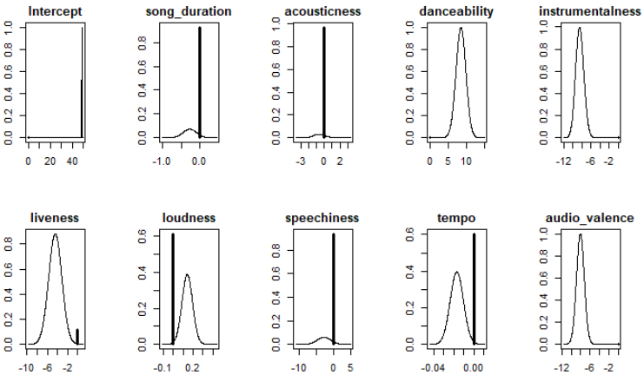
Obtaining the coefficient estimates and standard deviations to be able to examine the marginal distributions for the significant predictors:
Notes:
The vertical line corresponds to the posterior probability that the coefficient equals to 0. On the other hand, the shaped curve shows the density of possible values where the coefficient is non-zero. It is worthy to mention that the height of the line is scaled to its probability. This implies that intercept and danceability, instrumentalness and audio valence show no line denoting non-zero probability.

Slide 42
3.6 RESULTS AND DISCUSSION
MODEL | RMSE
LINEAR | 20.19
RIDGE | 20.25
LASSO | 20.21
BAYES | 20.14

Slide 43
3.6 RESULTS AND DISCUSSION
What we can conclude is that with an increase in the value of danceability, a song gains in popularity. This has been confirmed by all models. As has the fact that if a song is more instrumental it gains less popularity. What perplexed us was the fact that valence had a negative effect on our target variable. This means that the more happy a song sounds, the less popularity score it will obtain. This might be due to the fact that music features gradual changes along these dimensions (song attributes) within a broader emotion category remaining the same throughout the musical segment. Sometimes, listeners do not even perceive any discrete emotion in the music. They merely perceive a certain level of arousal. What may be of greater impact, according to LASSO, is whether or not the songs has an overall key C#: giving us a strange, but pleasant feeling, sometimes uneasy but freeing. What is certain is that even regularizing our linear regression fit did not yield better results, not even when the statistical analysis is undertaken within the context of Bayesian inference. This gives us the motivation to try predicting popularity from another angle.

Slide 44
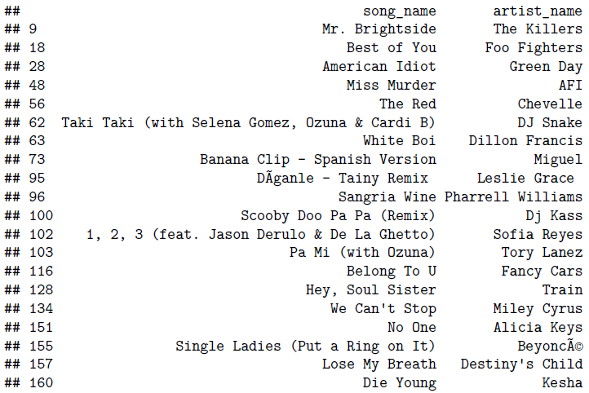
Songs in C#

Slide 45
4. CLASSIFICATION MODELS
We now use classification models to predict the probability a song is highly popular among users (i.e. has a popularity score above 75). We fit our models to predict the probability of a song being very popular: P(Y = high popularity | X), via:
Logistic Regression
Quadratic Discriminant Analysis
K – Nearest Neighbours
Bayes Classification
The evaluation metrics used are: accuracy, recall (True Positive Rate) and precision. Instead of cross validation, we see how the models generalize using a single validation (test) set approach.

Slide 46
4.1 CHOICE OF MODEL
Opposite to the linear regression model at the beginning, different predictors turned out significant when we fit the full logistic regression model. Not all had a great contribution to the response variable, so post appropriate hypothesis testing – the following model obtained through backward variable selection was chosen:

Slide 47
4.1 LOGISTIC REGRESSION
The estimates now give the change in the log odds of the outcome for a one unit increase in the predictor variable. Here we report the most significant:
• Valence, the log odds of a song being popular decreases by 0.9;
• Acousticness, the log odds of a song being popular decreases by 0.75;
• Danceability, the log odds of a song being popular increases by 1.87;
• Energy, the log odds of a song being popular decreases by 2.53;
• Instrumentalness, the log odds of a song being popular decreases by 3.82.

Slide 48
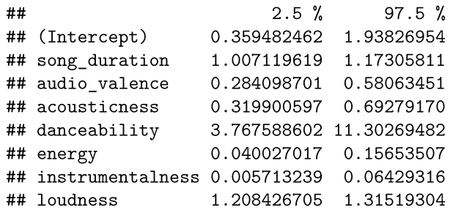
95% CONFIDENCE INTERVALS IN TERMS OF THEIR EFFECT ON THE LOG ODDS OF A SONG BEING POPULAR

Slide 49
RESULTS ON TRAINING AND TESTING SET
TRAINING PREDICTIONS
TESTING PREDICTIONS
TP = 565 | FN = 220
FP = 4398 | TN = 6758
TP = 144 | FN = 52
FP = 1114 | TN = 1675
Notes:
We use a threshold of To improve these results, we can construct a ROC curve that will show us the optimal threshold for our data to help deal with the trade-off between TPR (sensitivity) and specificity (1-FPR).

Slide 50
RESULTS ON TRAINING AND TESTING SET
METRIC | TRAINING | TESTING
AUC | 71.7% | 72%
ACCURACY | 61.33% | 60.94%
TPR/RECALL | 71.97% | 73.47%
PRECISION | 11.38% | 11.45%
Notes:
AUC is equivalent to the probability that a randomly chosen positive instance is ranked higher than a randomly
chosen negative instance.
Accuracy tells us the proportion of observation the model has classified correctly, i.e. 1-Overall Error Rate. (TP+TN/all)
True Positive Rate or Recall showing percentage of relevant instances that are retrieved i.e. what prportion of songs that are actually with a high popularity score were diagnosed as such. (TP/TP+FN)
Precision: a measure that tells us what songs classified as highly popular are actually that popular. (TP/TP+FP)

Slide 51
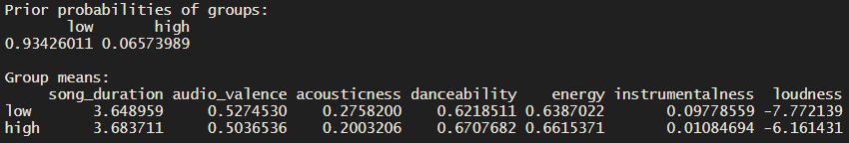
4.2 QDA
We now try to fit a non-linear boundary between classifiers. To do so, we perform a Quadratic Discriminant Analysis on our dataset, assuming that the observations from each class are drawn from a Gaussian distribution, and plugging estimates for the parameters into Bayes’ theorem in order to perform prediction. It assumes that each class has its own covariance matrix.
Notes:
The prior probabilities of the group tell us that 93.42% of training data corresponds to a song having
popularity score below 75, while only 6.57% of the observations are very popular among users.
QDA also provides us the group means - estimated average of each predictor within each class. These
suggest that when songs have a high popularity score, their song duration, danceability, enery and loudness
are greater than in songs with low popularity score. We expected valence to be greater too, but we suspect
that this might be due to classes being unbalanced...unless people do feel better with pleasing and mellow
music, but not too energetic and danceable. On the contrary, songs with low popularity tend to have greater
acousticness and instrumentalness values, which does not come as a surprise.

Slide 52
RESULTS ON TESTING SET
TP = 28 | FN = 168
FP = 144 | TN = 2645
METRIC | SCORE
ACCURACY | 89.55%
TPR/RECALL | 14.29%
PRECISION | 16.28%
Notes:
We use a threshold of To improve these results, we can construct a ROC curve that will show us the optimal threshold for our data to help deal with the trade-off between TPR (sensitivity) and specificity (1-FPR).

Slide 53
4.3 Naïve Bayes Classification
We additionally decide to fit a generative model - Naive Bayes, which is a classification technique based on Bayes’ Theorem with an assumption of independence among predictors. In simple terms, a Naive Bayes classifier assumes that the presence of a particular feature in a class is unrelated to the presence of any other feature.

Slide 54
RESULTS ON TESTING SET
TP = 71 | FN = 125
FP = 459 | TN = 2230
METRIC | SCORE
ACCURACY | 80.44%
TPR/RECALL | 36.22%
PRECISION | 13.4%
Notes:
Although accuracy and precision are higher when compared to the logistic classifier, they are lower when compared to QDA. But, TPR has increased to 36 with respect to QDA's results, meaning that now a higher rate of correctly classifying songs with high popularity.

Slide 55
4.4 K-Nearest Neighbours
Since we suspect that songs that share similar features have approximately the same popularity score, we perform a K-Nearest Neighbour classification for the test set from training set. Unlike most algorithms, this algorithm is non-parametric which means that it does not make any assumptions about the dataset. This makes it more effective since it can handle realistic data.
We set K=1, meaning that our model will classify a song based on most similar features with another already classified observation in the training set.

Slide 56
RESULTS ON TESTING SET
TP = 24 | FN = 172
FP = 172 | TN = 2617
METRIC | SCORE
ACCURACY | 88.48%
TPR/RECALL | 12.24%
PRECISION | 12.24%
Notes:
When setting K=1, the model's accuracy is similar to QDA - which is far better than what we got using logistic regression. Precision now which in comparison to QDA now is not much, but higher than logistic regression. As with QDA and Bayes, using KNN we get better results than the logistic regression model.

Slide 57
4.5 RESULTS AND DISCUSSION
METRIC | LOGISTIC | QDA | BAYES
ACCURACY | 60.94% | 89.55% | 80.44%
TPR/RECALL | 73.47% | 14.29% | 36.22%
PRECISION | 11.45% | 16.28% | 13.4%
1-NN
88.48%
12.24%
12.24%

Slide 58
4.5 RESULTS AND DISCUSSION
Looking at the results of the classifiers, we can say with certainty that QDA performed the best in term of accuracy. We get a similar accuracy using 1-NN, but we suspect that setting K=1 induces high variance and an overly flexible decision boundary. Since we have a sufficient number of training examples, and the variance of the classifier is not a major concern, QDA serves as a compromise between K-NN and the logistic regression approach. Though not as flexible as KNN, it still yielded better results, including the ones for precision and recall. But, by fitting the Naive Bayes Classification model, we obtained an accuracy rate of somewhere in between these, but a recall (TPR) which outperformed both QDA and 1-NN. This might be due to the naive assumptions, i.e. independence among features, but speed does come at a cost. Logistic regression gives a recall rate almost 5 times larger than QDA and twice as large in comparison to Bayes. This does comes as a surprise, since it supports only linear solutions, but we suspect that this is due to the classes being unbalanced.

Slide 59
5. NOTES
There appear to be other factors missing that could potentially help in determining whether a song is popular or not, as well as it popularity score in the regression case.
Factors that might contribute could be:
Whether an artist has had previous hits;
Collaborations between artists;
Genre of the song;
and similar.

Slide 60
THANK YOU

