Slide 1


Effective Analog/Mixed-Signal Circuit Placement Considering System Signal Flow
Keren Zhu, Hao Chen, Mingjie Liu, Xiyuan Tang, Nan Sun and David Z. Pan
ECE Department
The University of Texas at Austin
This work is supported in part by the NSF under Grant No. 1704758, and the DARPA ERI IDEA program
Notes:
Add Acknowledgment

Slide 2

Speaker – Keren Zhu
Keren Zhu is a Ph.D. student at ECE Department at UT Austin under supervision of Prof. David Z. Pan.
Keren Zhu’s research interests include general topics in VLSI physical design with a focus on analog layout automation.

Slide 3


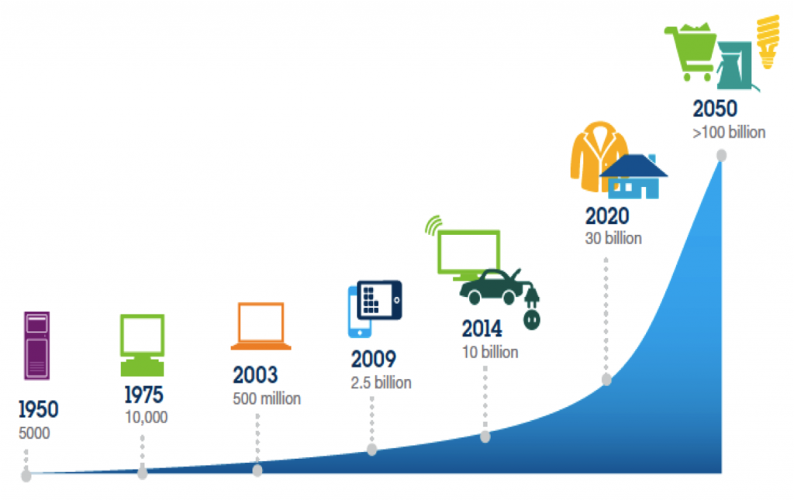


Background: Automating AMS Layouts
There are high demand for analog and mixed signal (AMS) circuits
Drawing AMS layouts are still manual and cost time
Communication
Sources: IBM
Advanced computing
Healthcare

Slide 4
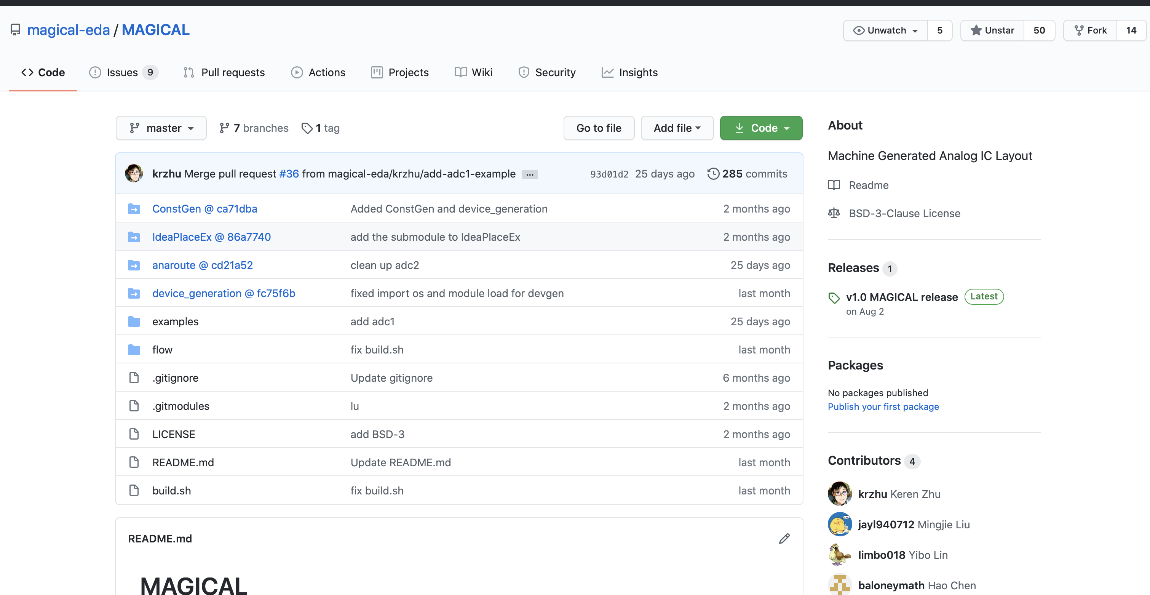

Background: MAGICAL
This work is part of MAGICAL
Machine Generated Analog IC Layout
https://github.com/magical-eda/MAGICAL
Placer codes
Benchmark netlists
(sanitized)

Slide 5
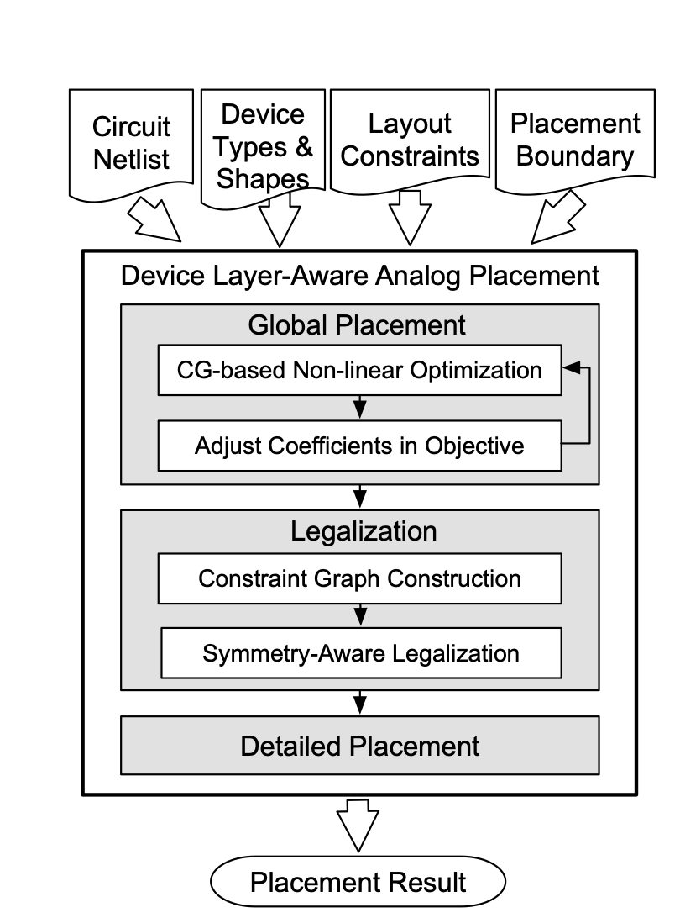
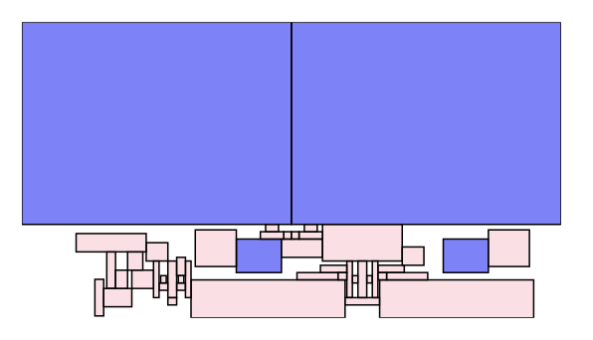
Motivation: placer v1
Placer v1. [Xu+ ISPD19]
First version of MAGICAL placer prototype
Abstracted problem formulation
Not really consider performance yet
NLP+LP
B. Xu, S. Li, C.-W. Pui, D. Liu, L. Shen, Y. Lin, N, Sun and D. Z. Pan, "Device Layer-Aware Analytical Placement for Analog Circuits," ISPD’19

Slide 6
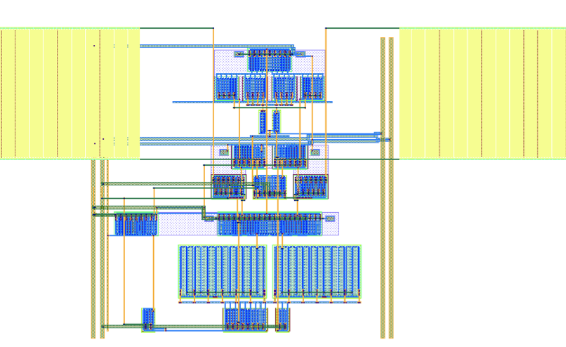
Motivation: router v1
Placer v1. [Xu+ ISPD19]
Router v1. [Zhu+ ICCAD20]
First version of MAGICAL router
LVS correct
Start working on optimizing performance with simulation results
OTA/Comparator benchmarks
K. Zhu, M. Liu, Y. Lin, B. Xu, S. Li, X. Tang, N. Sun and D. Z. Pan, ”GeniusRoute: A New Routing Paradigm using Generative Neural Network," ICCAD’19

Slide 7
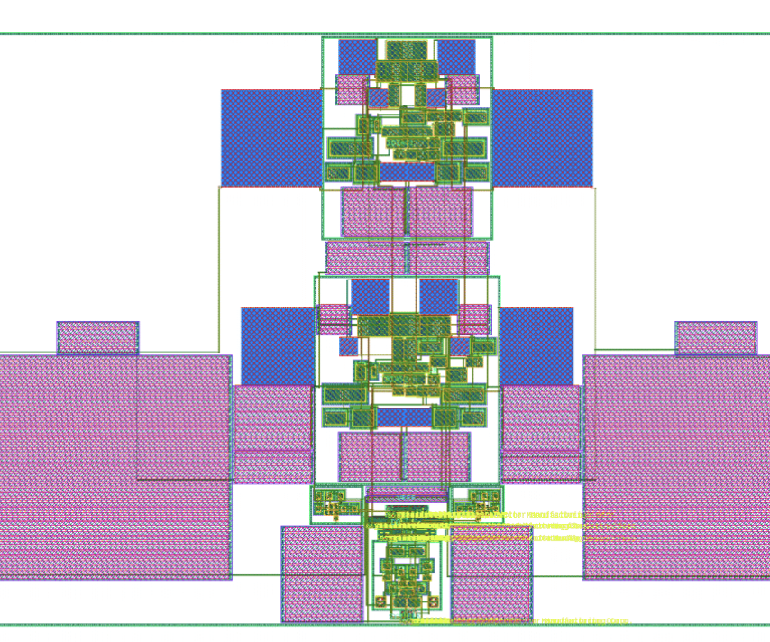
Motivation: hierarchical flow
Placer v1. [Xu+ ISPD19]
Router v1. [Zhu+ ICCAD19]
Hierarchical flow [Liu+ DAC20]
MAGICAL start working on ADC
Automatically tuning parameters for building block-level performance
Manual tuning on top-level placement
M. Liu, K. Zhu, X. Tang, B. Xu, W. Shi, N. Sun and D. Z. Pan, ”Closing the Design Loop: Bayesian Optimization Assited Hierarchical Analog Layout Synthesis," DAC’20

Slide 8
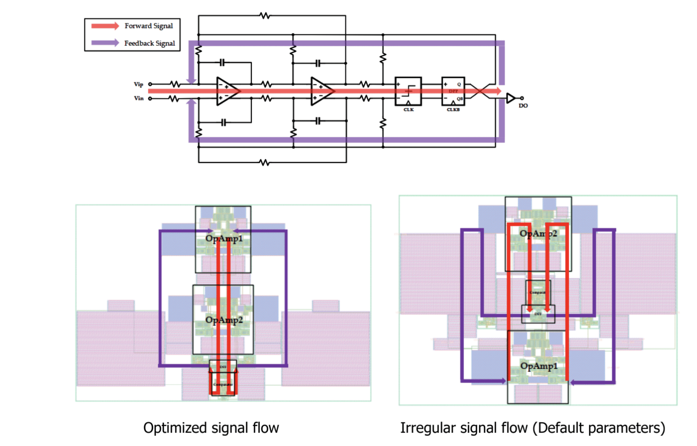
Problem 1: system signal flow
Manual tuned in DAC20

Slide 9
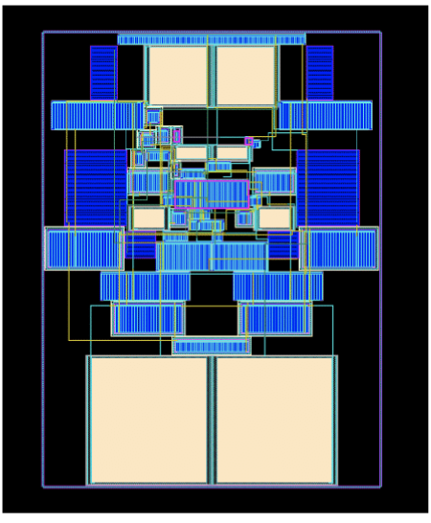
Problem 2: sensitive building block performance
Placer is not robust
  Sensitive to the initial condition and parameters
  Good results need some luck
  Numerical optimization need to be improved
IR drop is an issue
  Placer should consider more in planning power routing

Slide 10
Motivation: placer v2
Placer v1 [Xu+ ISPD19]
Router v1 [Zhu+ ICCAD19]
Hierarchical flow [Liu+ DAC20]
Placer v2 [Zhu+ ICCAD20]
This work

Slide 11
Motivation: router v2
Placer v1 [Xu+ ISPD19]
Router v1 [Zhu+ ICCAD19]
Hierarchical flow [Liu+ DAC20]
Router v2 [Chen+ ICCAD20]
Placer v2 [Zhu+ ICCAD20]
This work
2A.3 Toward Silicon-Proven Detailed Routing for Analog and Mixed-Signal Circuits

Slide 12
Motivation: router v2
Placer v1 [Xu+ ISPD19]
Router v1 [Zhu+ ICCAD19]
Hierarchical flow [Liu+ DAC20]
Router v2 [Chen+ ICCAD20]
Placer v2 [Zhu+ ICCAD20]
This work
2A.3 Toward Silicon-Proven Detailed Routing for Analog and Mixed-Signal Circuits

Slide 13
Placer v2 contributions in high-level view
Magical placer v2 has:
New Power Net WL model
New System Signal Flow Cost
Self-adaptive multiplier updates
Gradient-based NLP optimization
Building Block Level
System Level

Slide 14
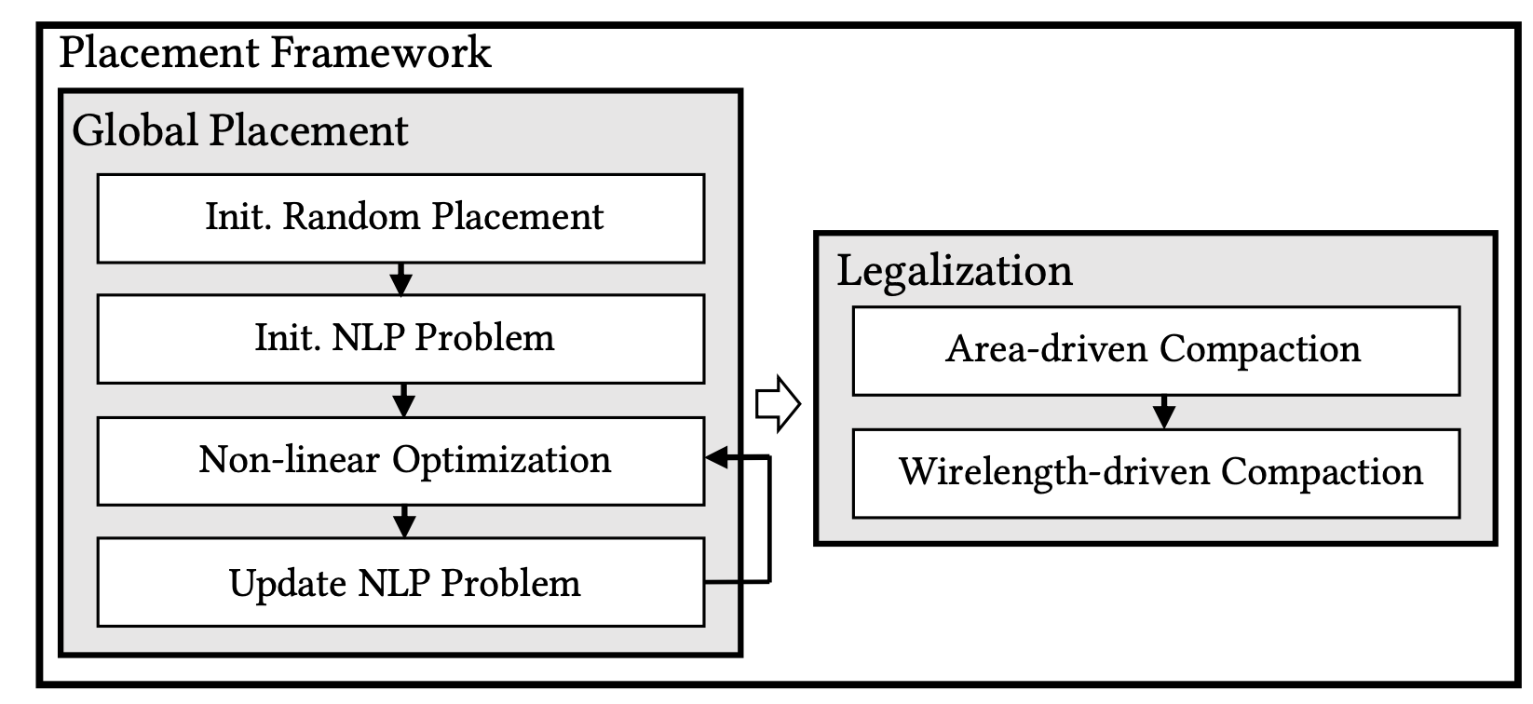
Placer v2 flow
Global placement decides the rough locations of each blocks
  Iterative numerically solve non-linear optimization problem
  Increase penalty multipliers for overlapping, etc. in each iteration
Legalization ensure spacing and symmetry
  Constraint graph + Linear programming

Slide 15
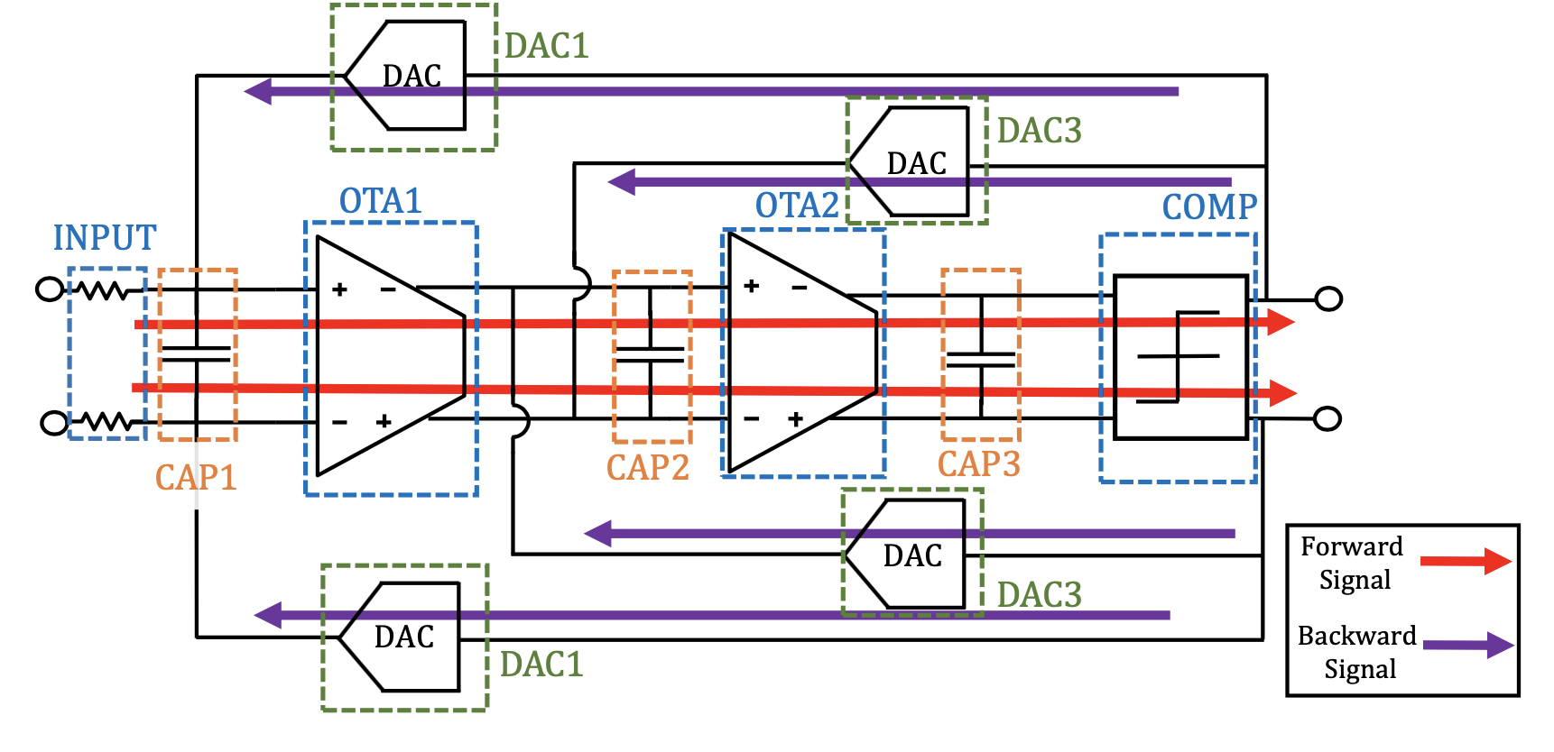
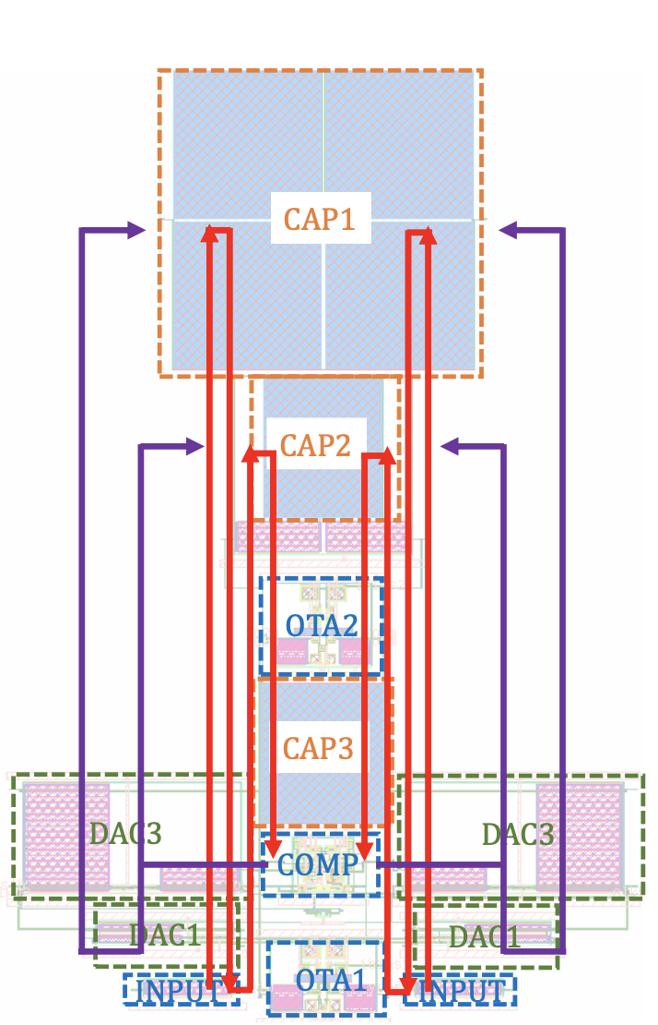
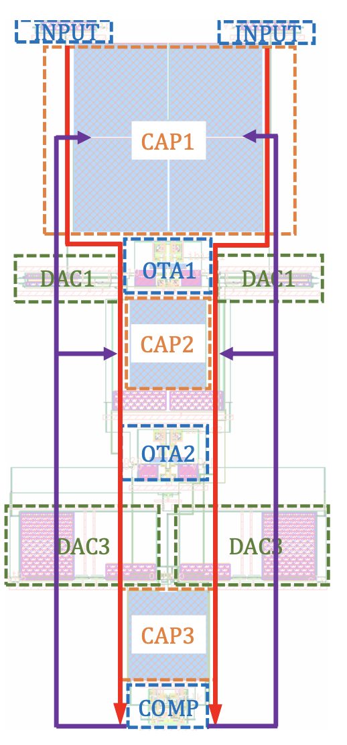
System signal flow cost formulation
Want straight signal flow

Slide 16
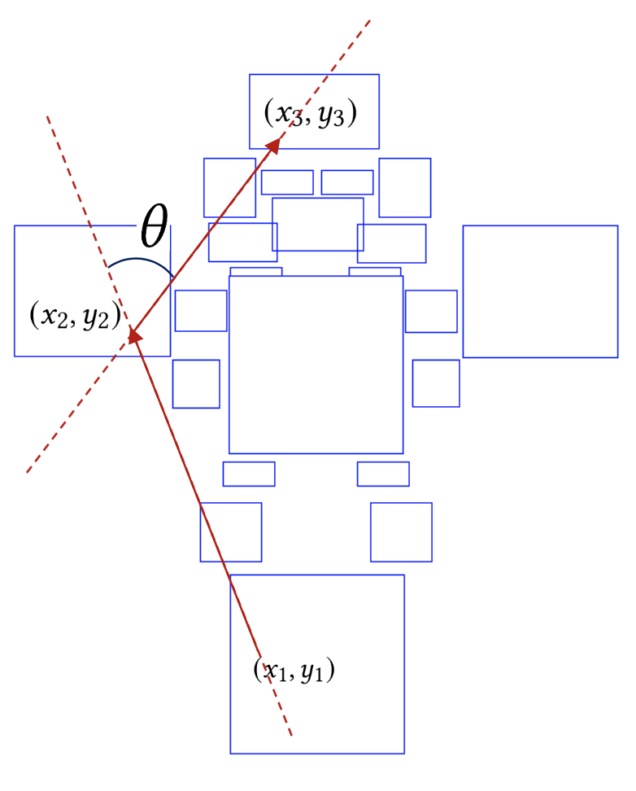
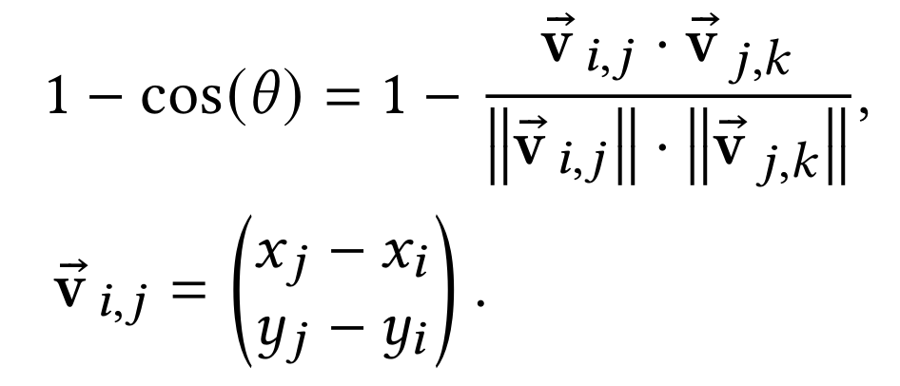
System signal flow cost formulation
Minimize the angle θ

Slide 17
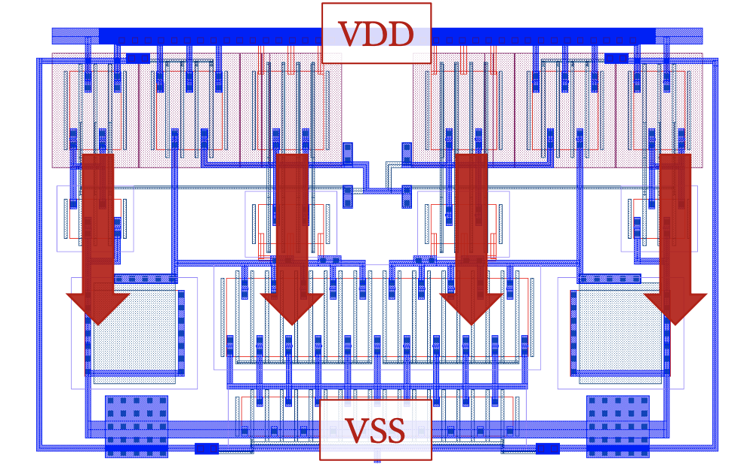
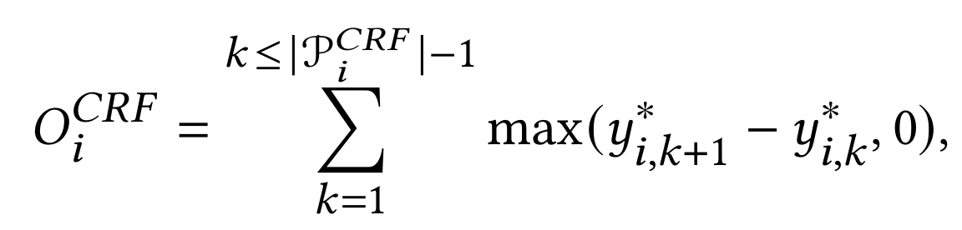
Fit more accurate power WL model
Disclaimer: this WL model is targeting for MAGICAL router v2
Pin-to-stripe power routing

Slide 18
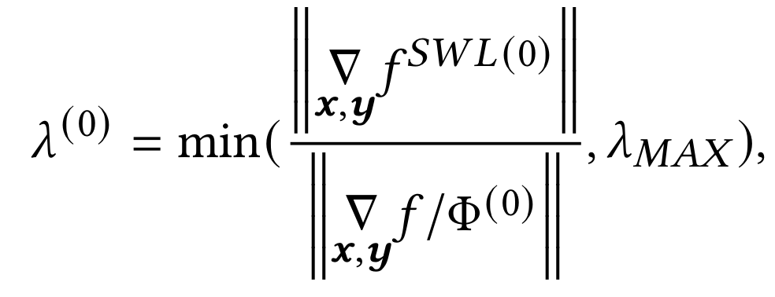
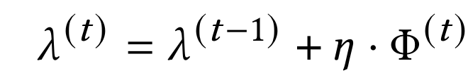
Better multiplier updating scheme
For better numerical robustness
Matching initial gradient norm
  Encourage comparable efforts to different costs
Subgradient method to increase penalty
Use WL as common reference
Increase penalty based on how much is the violations

Slide 19
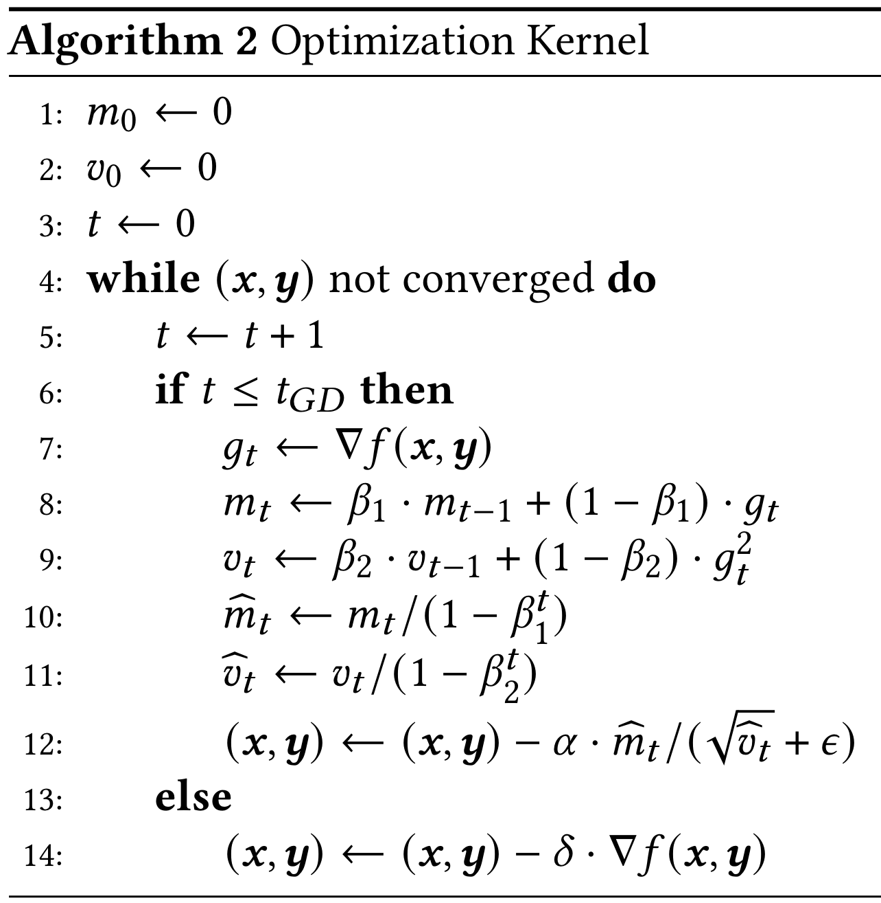
Gradient-based optimization
Disclaimer: not well tuned. Adam with lower step size itself might also works
How to update multipliers is in general more important than optimization kernels
Adam optimizer for general cases
Vanilla gradient descant when convergence is slow

Slide 20
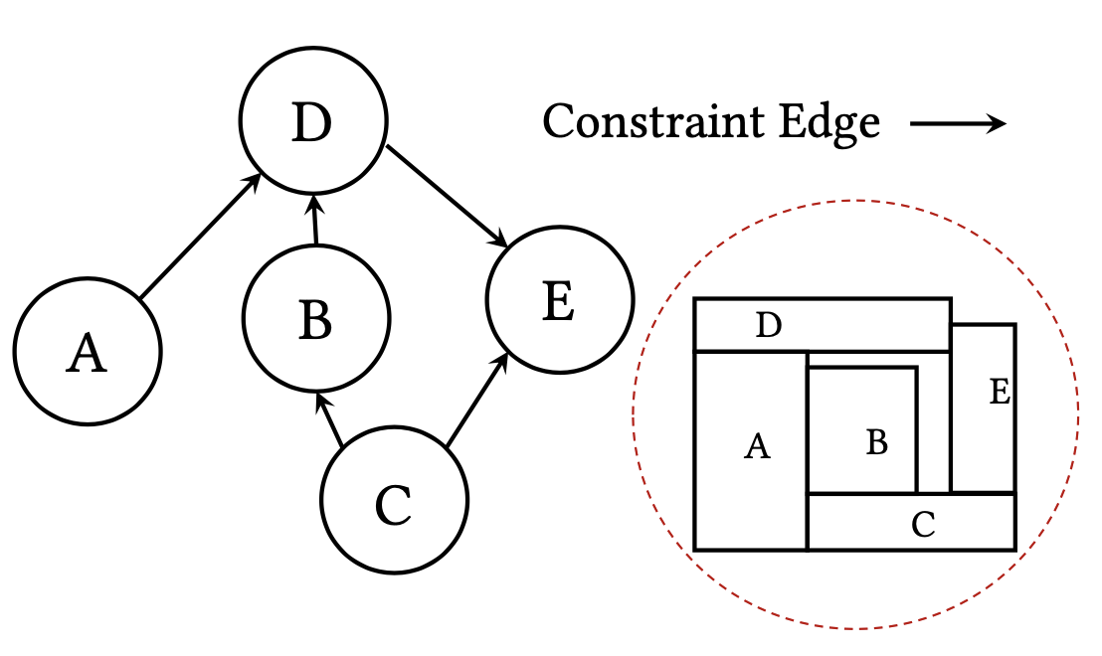
Legalization
Generate a relational constraints and use linear programming to solve the compaction
Similar to [Xu+ ISPD’19]

Slide 21
Experimental results on two ADCs
System signal flow boosts the performance for two CTDSM ADCs
Circuits |  | Schematic | Without SSF | With SSF
ADC1 | SNDR (dB) | 66.2 | 61.4 | 63.6
 | SFDR (dB) | 76.9 | 75.0 | 77.1
 | THD (dB) | 75.0 | 70.6 | 73.8
 | ENOB (bits) | 10.70 | 9.90 | 10.27
 | Power (mW) | 0.837 | 0.864 | 0.870
ADC2 | SNDR (dB) | 67.1 | 59.6 | 66.3
 | SFDR (dB) | 82.0 | 67.0 | 80.2
 | THD (dB) | 77.6 | 66.5 | 76.4
 | ENOB (bits) | 10.85 | 9.61 | 10.71
 | Power (mW) | 0.677 | 0.740 | 0.757

Slide 22
Experimental results on block-level circuits
Outperform [Xu+ ISPD19] in both
  WL and area
  More details in the paper
CKTs | ISPD’ 19 |  |  |  | This Work
 | Area | HPWL | RWL | VIA | Area | HPWL | RWL | VIA
COMP | 223 | 104 | 267 | 21 | 187 | 101 | 196 | 13
OP1 | 2366 | 767 | 1234 | 97 | 1584 | 691 | 905 | 84
OP2 | 2529 | 416 | 914 | 44 | 2047 | 466 | 732 | 50

Slide 23
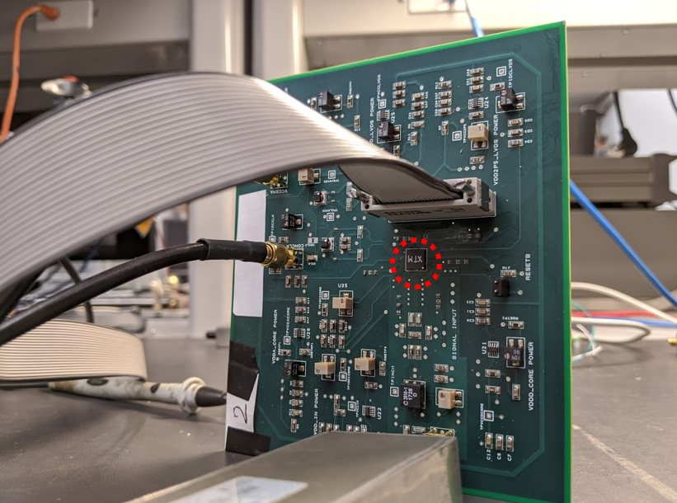
The ADC2 chip
The ADC2 core using the proposed placer has been taped-out and verified in measurements
ADC2

Slide 24
Conclusion
System signal flow is effective for two CTDSM-ADCs
  Confirm with designers that this is a general approach for a broader range of circuit classes
Better numerical optimization is effective in NLP global placement
Fitting WL model to the target model is effective
  Important for nets with special routing strategy
Future works:
  Placement and routing techniques for specific circuit classes
  Advance technology nodes
    E.g. FinFET technology

