Slide 1

GeniusRoute: A New Analog Routing Paradigm Using Generative Neural Network Guidance
Keren Zhu, Mingjie Liu, Yibo Lin, Biying Xu, Shaolan Li, Xiyuan Tang, Nan Sun and David Z. Pan
ECE Department
The University of Texas at Austin
This work is supported in part by the NSF under Grant No. 1704758, and the DARPA ERI IDEA program

Slide 2
Outlines
Introduction and Problem Formulation
GeniusRoute Framework
Experimental Results
Conclusion
Notes:
In the presentation today, I will first go through the introduction and background to the topic, then the main framework of geniusroute. Followed by the experimental results and conclusion.

Slide 3


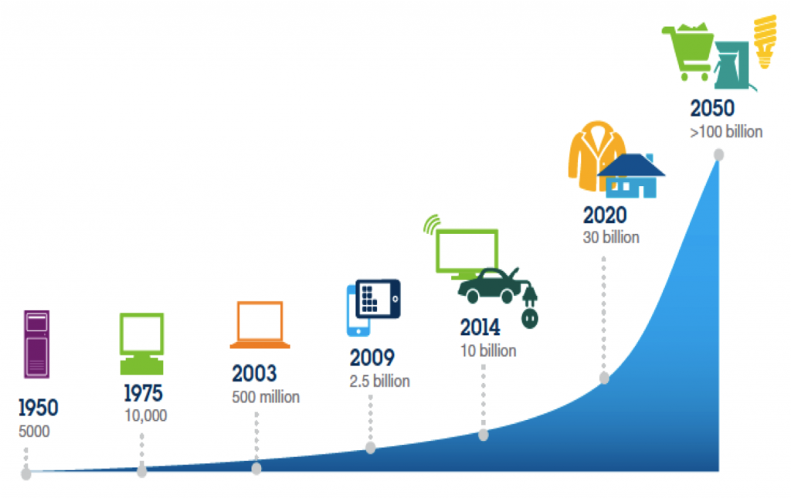


High Demand of Analog/Mixed-Signal IC
Anything related to sensors needs analog!
Internet of Things (IoT), autonomous and electric vehicles, communication and 5G networks…
Communication
Sources: IBM
Advanced computing
Healthcare
Notes:
The largest motivation to this work, is actually the high demand of analog and mixed signal IC. I believe most of the audience is awared that, most of the applications related to sensoring, need some analog and mixed signal part, to build up an interface between real world analog domain and digital Boolean logic domain.
As application such as IOT, autonomous and 5G communication expected to growing. People believe the market for analog IC will keep growing in the future. With this background, time-to-market for analog circuits could be invaluable in industry.

Slide 4
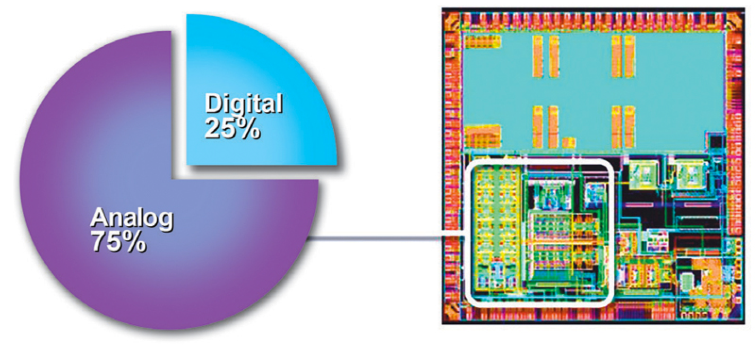
A Bottleneck in IC Design: Analog/Mixed-Signal
Analog parts of IC take large design efforts
A major reason: analog circuit layout is usually done manually
[IBS and Dr. Handel Jones, 2012]
Notes:
However, although AMS circuits are of high demand, designing analog IC has become a bottleneck in modern VLSI eco-system. As we can see, analog part can take significant portion of design efforts in a mixed-signal chips. A major reason behind is that the analog circuit layout is still done heavily manually even though its digital counterpart has seen success in automatic design for decades.

Slide 5
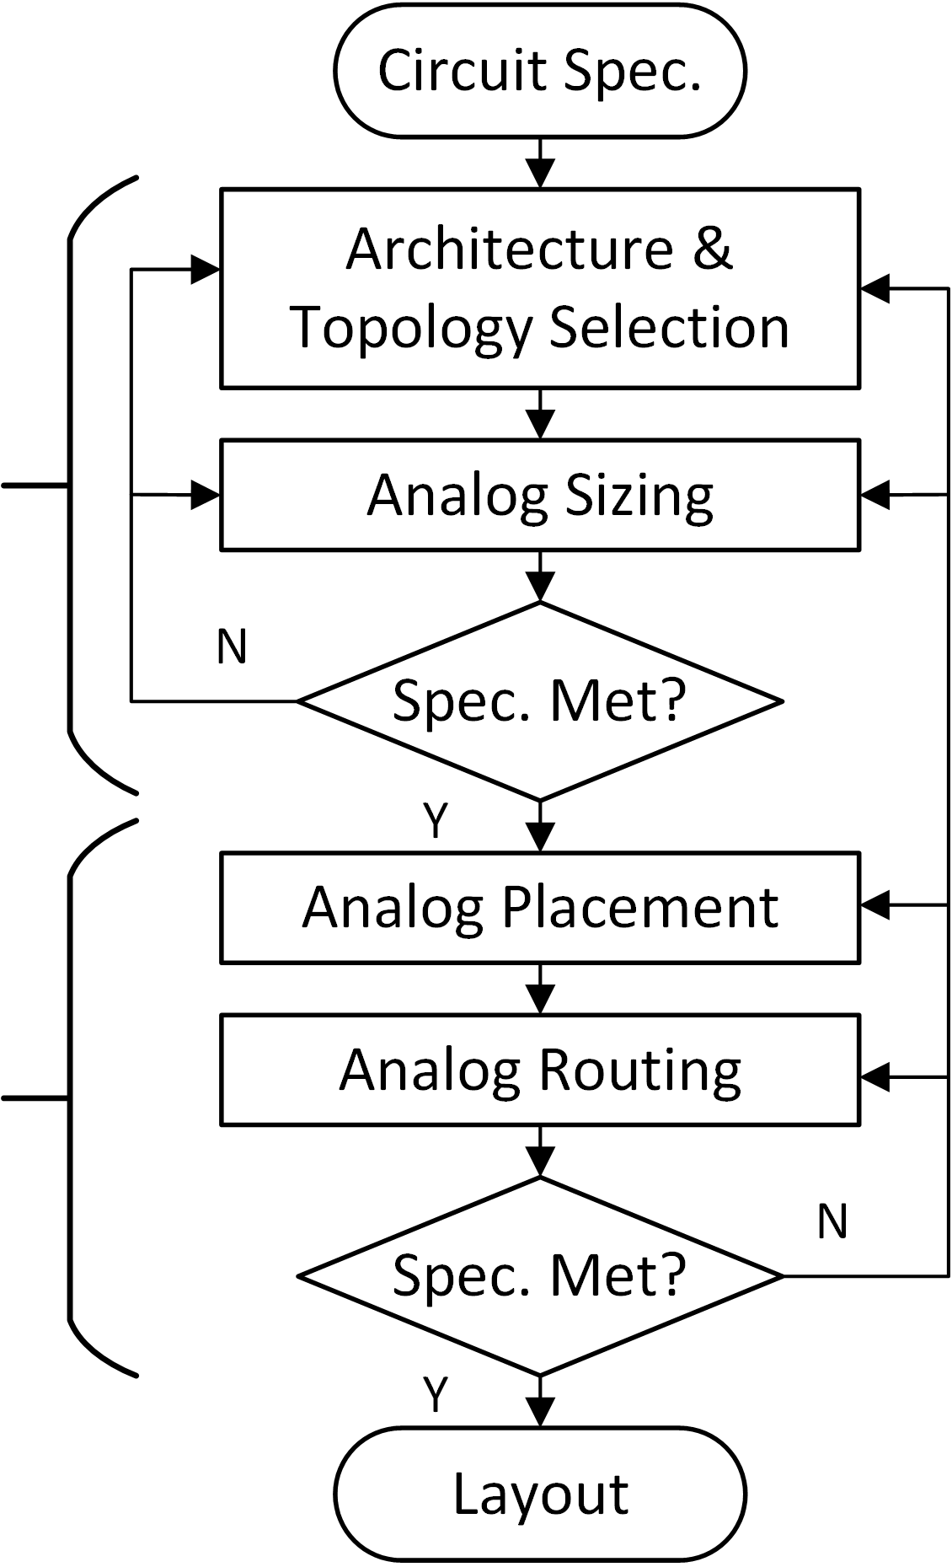
Typical Automatic Analog Circuit Design Flow
Automated analog design often consists of front-end and back-end flows
Physical design (back-end) is separated in placement and routing
Front-end
Electrical
Design
Back-end
Physical
Design
Notes:
This slide shows a typical analog circuit design flow. Note that many parts of this flow chart is still “rarely used” in real world design practices.
Essentially, the design flow for an analog circuit is divided into front-end and back-end side.
In the front-end side, the schemetic of the circuit is designed, with proper architecture and transistor sizing.
After the schemetic is decided, the back-end design will implement the physical layout of the circuits. This process is usually further decomposed into placement and routing.
In the placement step, the devices and sub-components are placed on the layout. And in the routing step, the metal interconnection is synthesized to connect the pins of the nets.
In today’s presentation, we will focus on the routing step in this flow.

Slide 6
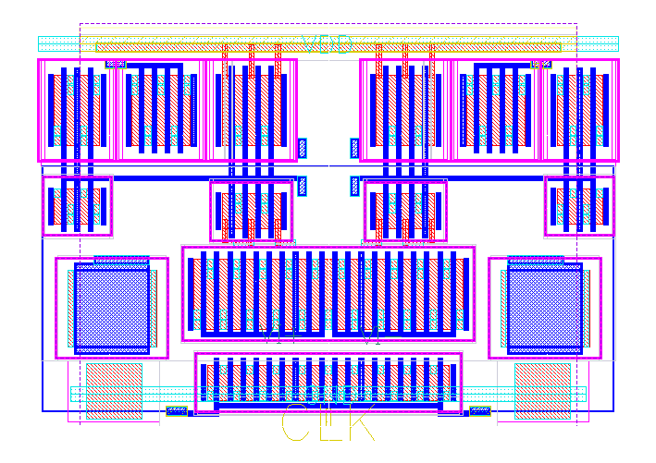
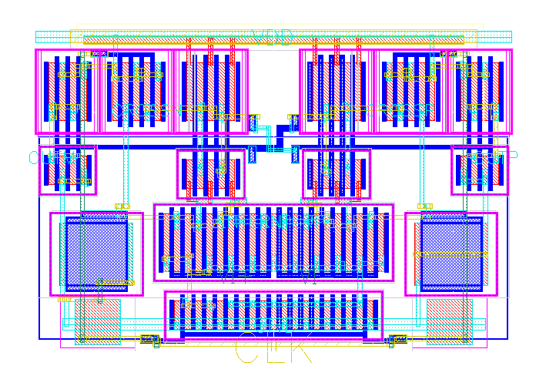
Analog Routing Problem
Placement
Routed Layout
Notes:
This page shows an example of the routing. In the left is a result of placed comparator and in the right, the metal connection is added to the layout.
One thing we should notice is that analog circuits often is layouted in a symmetric way to ensure the matching of differential components. Place or route the layout in a unpleasant way will cause significant downgrade on the post-layout performance.
The sensitive layout dependent effects is the fundamental difference between analog routing and conventional digital routing.

Slide 7
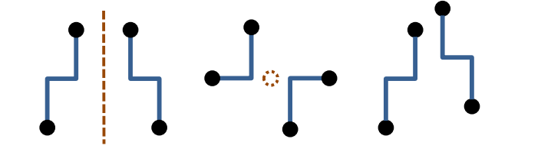
Challenges in Formulating Analog Routing Problem
Symmetry constraints are widely accepted
[Ou et al., 2014]
Shielding,
Avoid active region,
…
No standard rule for additional constraints. Design-dependent.
Automatically learn from human layouts?
Notes:
Before going into the detailed geniustourte algorithm, let’s take a look into the problem formulation of analog routing problem in the existing works.
For decades, symmetry has been widely adopted as an essential component of the analog routing problem. Basically route nets symmetrically can help ensure the matching of parasitics and coupling on the critical nets, which is very crucial to the analog circuit performance.
In addition to the symmetric constraints, there have been multiple different constraints proposed in the research. For example, shielding the critical nets and avoid routing over the active region of transistors. However, unlike the symmetric constraint, we found that such handcrafted heurisitcs have difficulty in demonstrating effectiveness in post layout performance, and are not widely used in manual layout design practices.
Let’s rethink the problem in this way. In the past years, the automation community try to attack the analog routing problem by learning from human layout engineers. We think the analog routing problem is driven by constraints that we summarize from the manual layout experience.
So the geniusroute is trying to push this idea a little bit further. Instead of summarizing human layout intelligence by giving explicit constraints. Geniustoute try to automatically learn those knowledge leveraging ML.

Slide 8
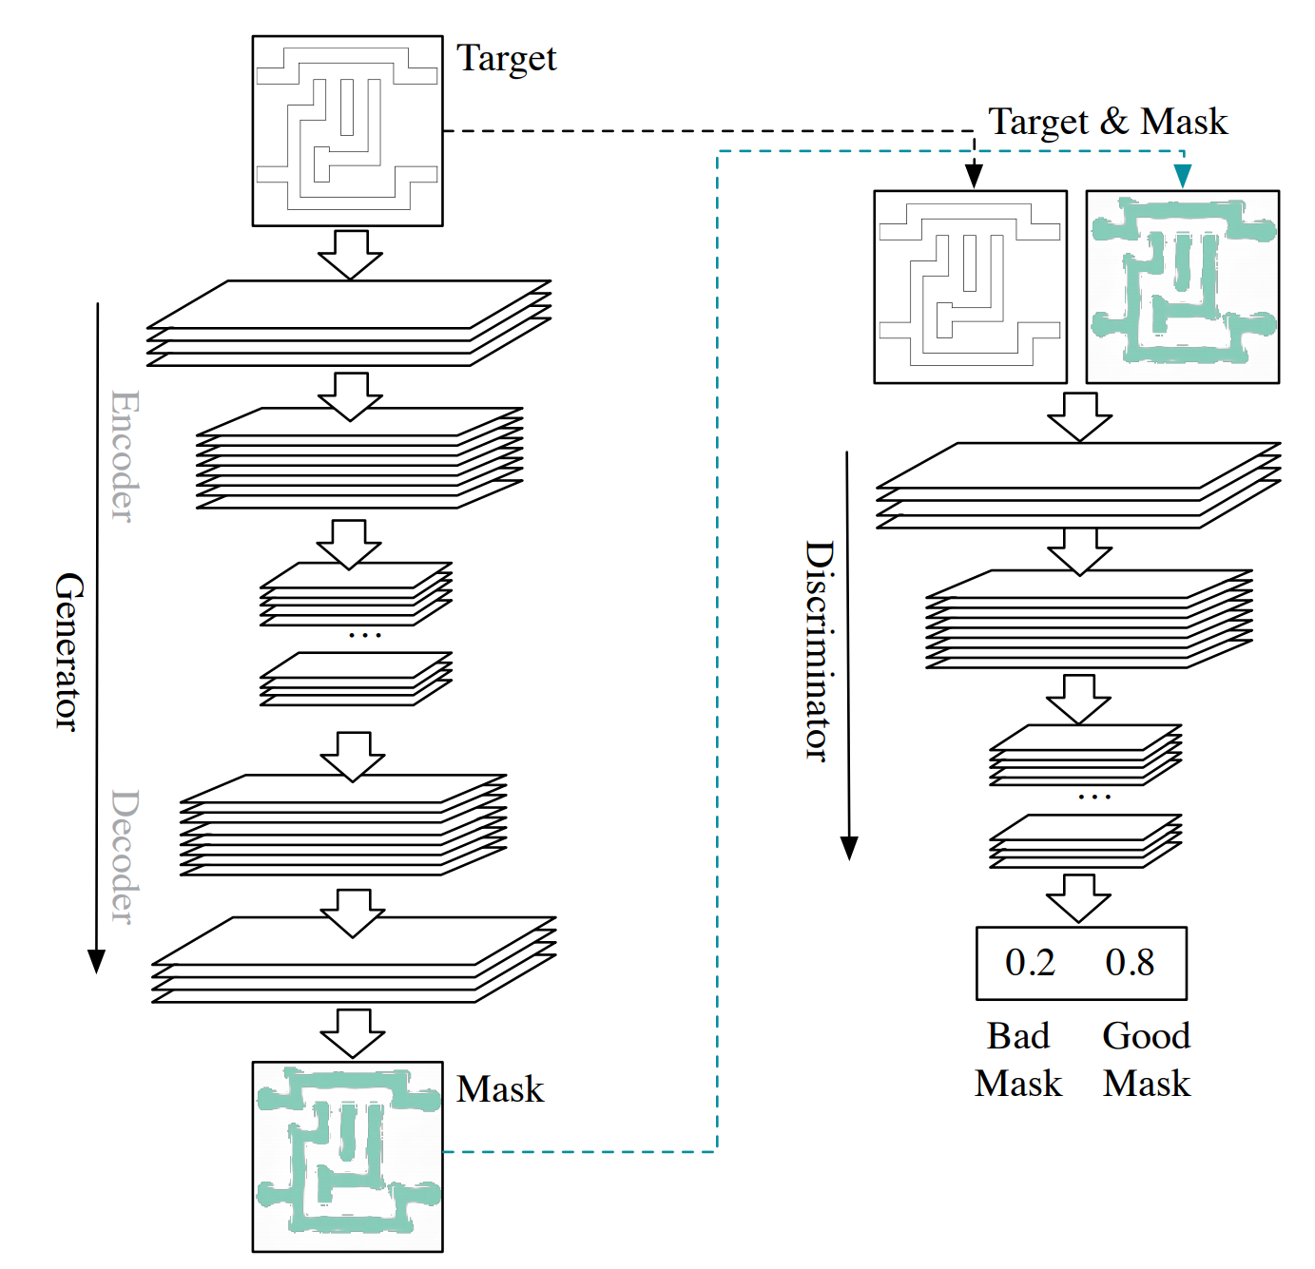
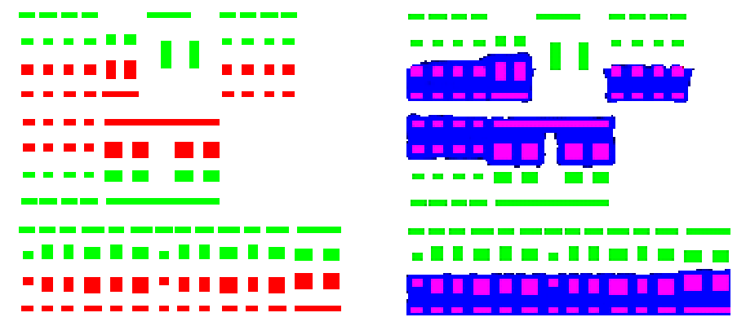
Emerging Machine Learning Applications
Lithography: GAN-OPC
Physical Design: WellGAN
[Yang et al., 2018]
[Xu et al., 2019]
Notes:
Since the past a few years, there have been successes in applying ML techniques in CAD.
On the left is the work called GAN-OPC which uses GAN in the lithography design automation. On the right is a work published in the DAC this year. In fact it is one of the early work inspire the geniusroute idea. The WellGAN framework learn the pattern that human draw the n-well for analog circuirts and automatically generate the wells mimicking the learned knowledge.
Geniusroute extends this idea to the routing problem.

Slide 9
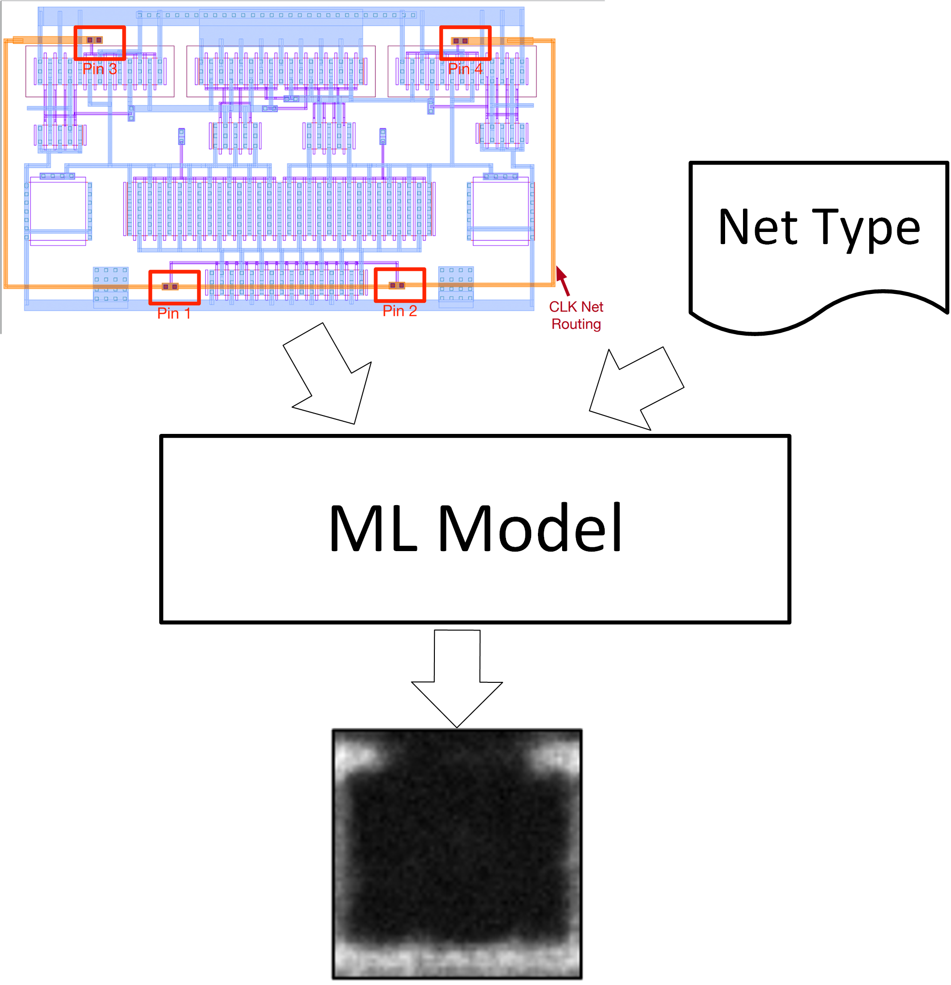
Automatically Learn Guidance from Human Layouts
Learn routing guidance
  Where the human would likely to route the nets
Extract training data from labeled layouts
Apply learned model to automatic routing as guidance
Notes:
The idea of geniusroute is to learn the way human routing different types of nets by ML model. And use the learned model as a guidance to the automated routing.
Basically we learn where the human is likely to route the nets when seeing the input placement.

Slide 10
A ML-Guided Routing Problem
Heuristic constraints: use a set of detailed heuristics as routing constraints
Placement
Explicated Constraints
Routing
Conventional Approach
Routing guide: routing strategies learned from human
Symmetric Constraints
+
ML-based Routing Guide
Placement
Routing
GeniusRoute Approach
Notes:
This page shows the comparison between conventional analog routing problem and geniustoute problem.
In our framework, instead of tuning the routing by handcrafting a large set of constraits, we only honor the most widely-adopted symmetric constraints and use a ML model to guide the automatic routing.
In short, we propose a new paradigm to learn human layout intelligence in a highly-automatic manner.

Slide 11
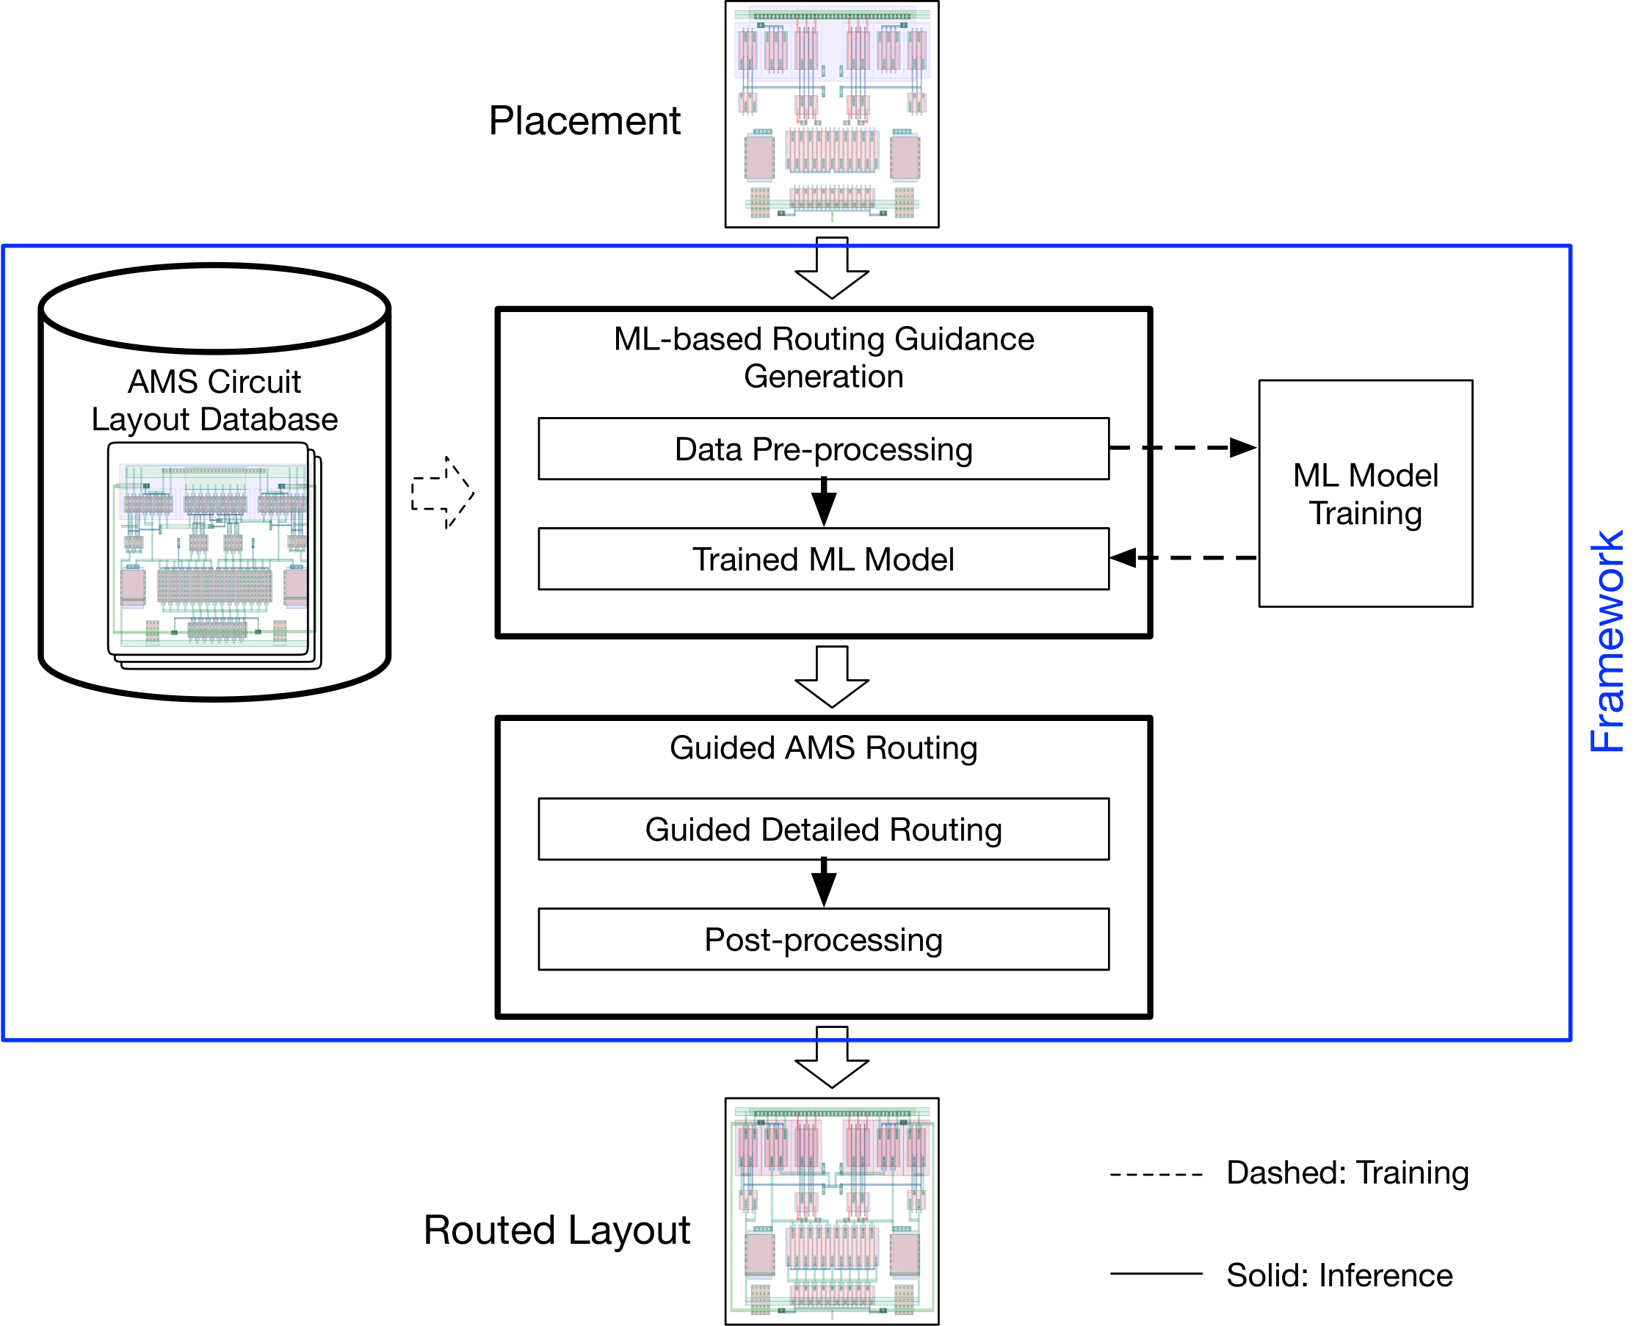
The GeniusRoute Flow
Learn from GDS layouts
Pre-process layouts into images
Predict routing probability using autoencoder
Use prediction as detailed routing guidance
Notes:
This slide show the entire framework of the geniusroute. Don’t worry about the complicated flow chart at this moment, we will go through in details of each components.
Basically, the geniusroute framework extract images from manual GDS layouts, use those images to build up the ML model and use the ML model to guide the automatic routing.

Slide 12
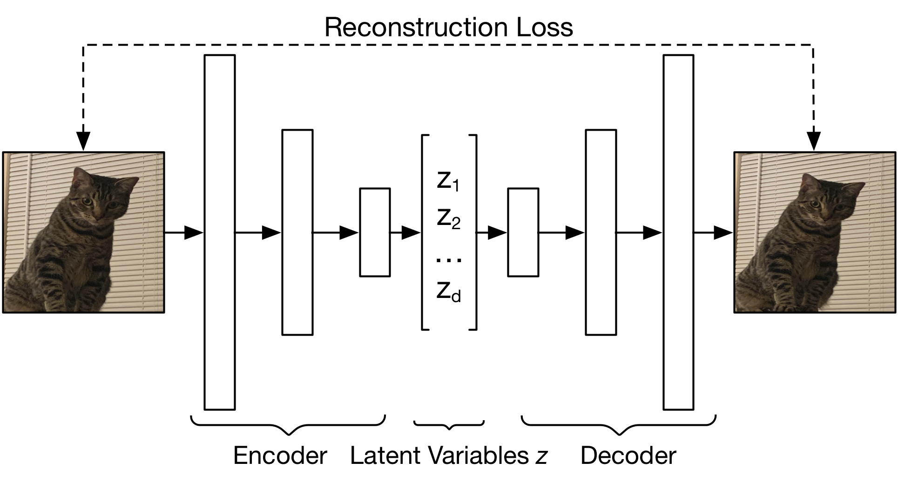
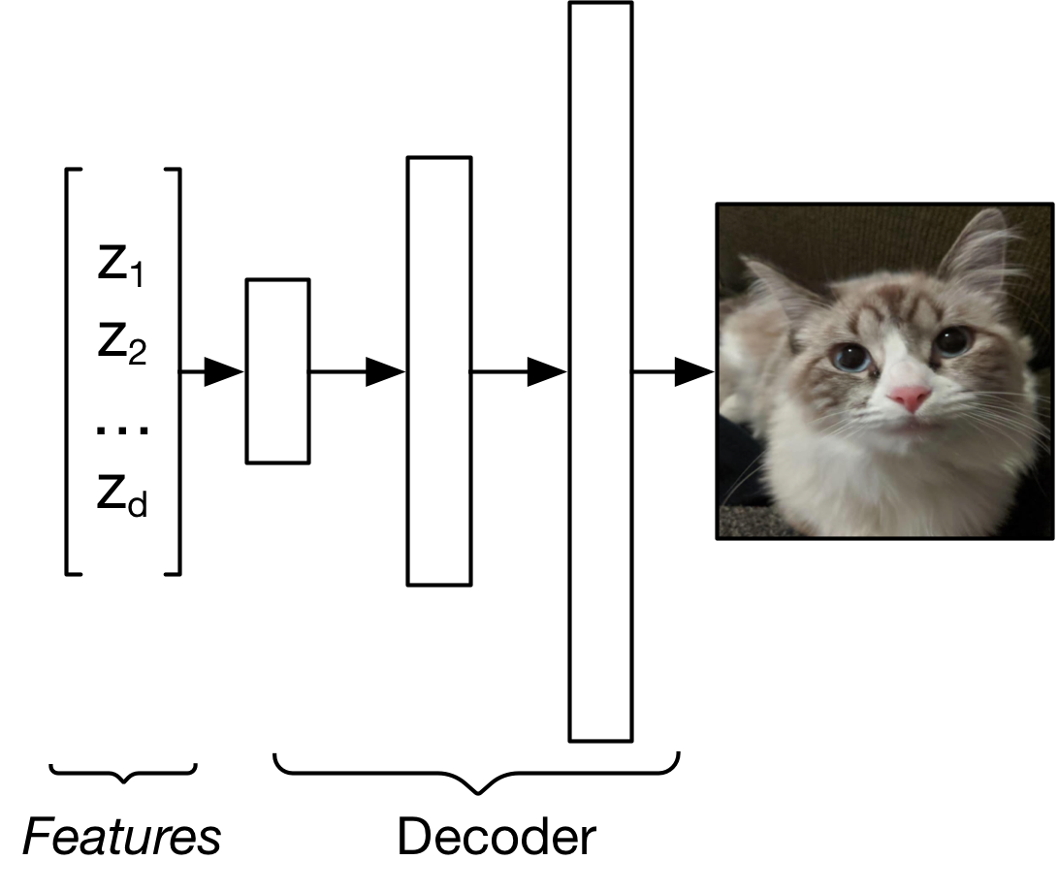
Generating Images with Generative Neural Network
Notes:
Before going into the detailed algorithm, let me give a short introduction to the generative neural network model.
Neural network is essentially a non-linear function that transforming a vector to another vector. We can use it to transform a low dimension feature vectors into a high dimension image.
For example, we could have a function that mapping the features such as the color of the fur of a cat, to a real cat image.
Of course, obtain such function directly is extremely difficult. We don’t have a clear idea which are the features and how to relate the features to the generating images.
One of the classical approaches to this problem is auto-encoder. As shown in the slide, an encoder and a decoder is trained together. The encoder compress an image into a low dimension latent variable vector and the decoder reconstruct the vector into images. By minimizing the difference between the original image and the reconstructed image, we can get the encoder and decoder we want.
The simple autoencoder model is a basis of geniusroute framework.

Slide 13
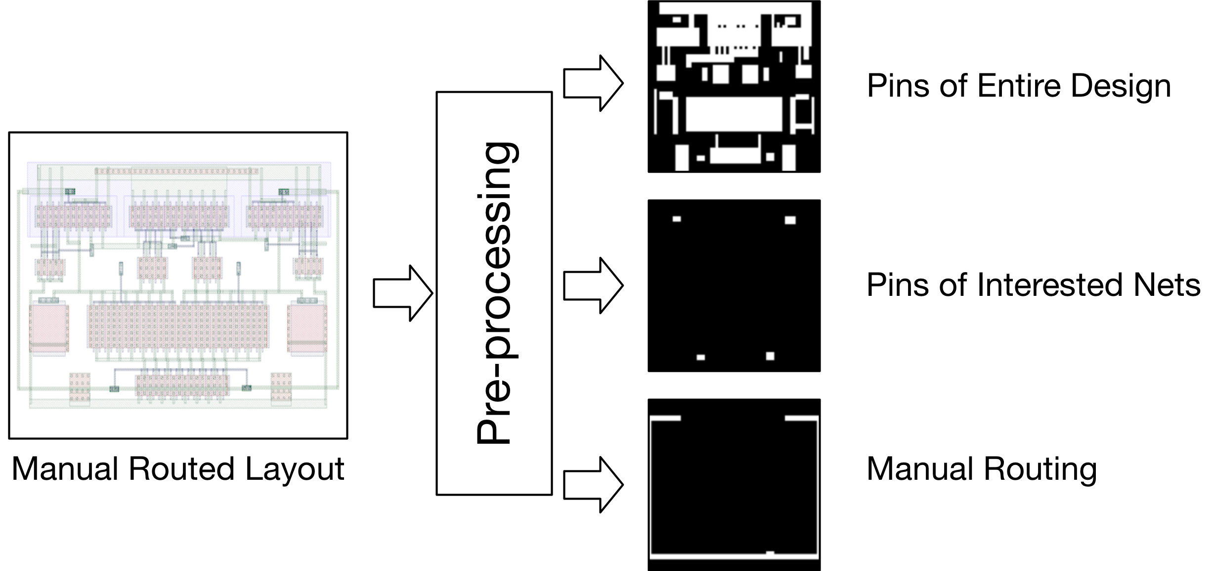
Data-Preprocessing: Extracting Routing from Layouts
Extract “pins” and routing of nets
Three categories of models:
  Symmetric nets
  Clocks
  Power and Ground
Notes:
In the first step, we extract several images from the GDS layouts. Basically we define the concept of pins which represent the beginning point of the routing nets. We extract the pins for the entire placement so that we can have some global view to the model. We extract the pins of the net we want to learn or predict. When we want to learn from human layout, we extract its actual routing. When we are using geniusroute for routing new designs, we don’t have the last image since we are only given the placement.
For different types of nets, we train different models to learn the different strategies of routing.

Slide 14
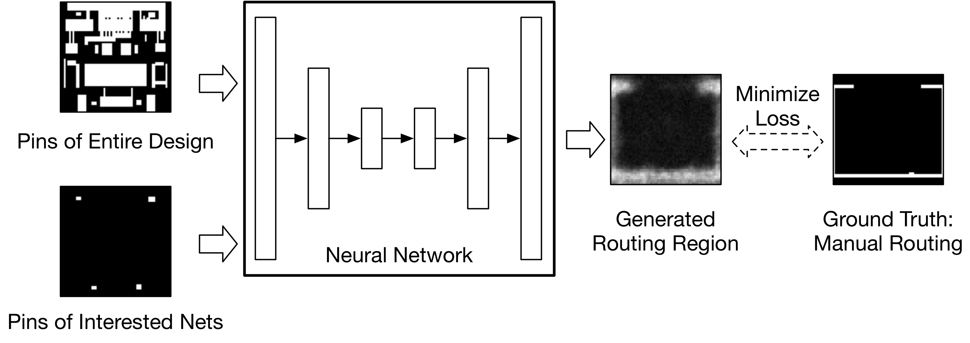
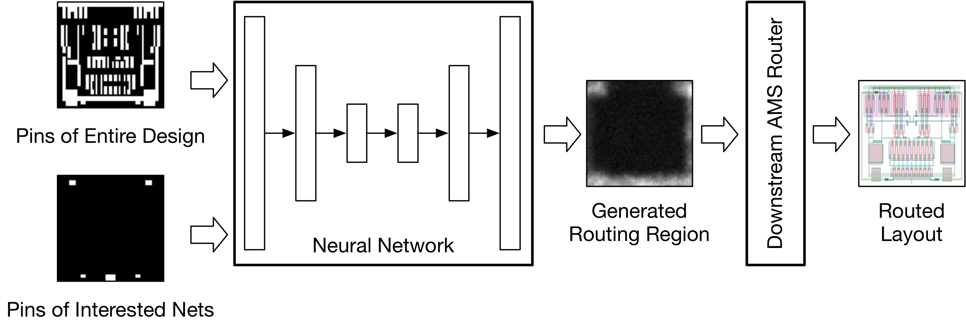
GeniusRoute: Learning Routing Patterns from Human
Training Phase
Do we have enough data?
Inference Phase
Trained
Notes:
After obtaining the images, we can now move on to the ML model.
In the training phase, we train our ML model to learn the routing guidance. We use the extracted routing image as the ground truth and use the ML model towards them.
In the inference phase, we want to use our trained ML model for routing new designs. We use the trained model to generate the routing guidance for unseen placement, and feed the routing guidance to the downstream router to finish the routing.
So far so good. We already get the whole framework picture. Looks easy. Is there any challenge?
The answer is yes. Data. Manual layouts are expensive. It would takes hours, days or even longer for a layout engineer to implement a layout. Especially for the specific domain of circuits and certain types of nets.

Slide 15
3-Stage Semi-supervised Training Algorithm
Labeled layouts are hard to get
Could rely on unlabeled data to help train the model
Unlabeled
Data
Unsupervised
Pre-train
Neural
Network
Labeled
Data
Supervised
Training
Notes:
To tackle the data-efficiency problem, we propose a semi-supervised training algorithm.
We found that although labeled data that fit our problem is rare. We have much larger amount of unlabeled layouts. They might not able to provide good knowledge on how human engineer route the critical nets, but can help us to get a general feature representation of the layouts.
Here we present our 3-stage training.

Slide 16
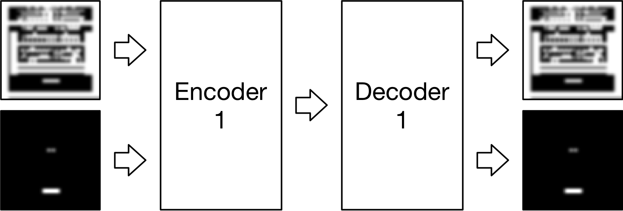
Stage 1: Unsupervised Feature Extraction using VAE
Use cheap unlabeled data to learn a general feature extraction
Extracted
Features
Notes:
In the 1st stage, we train our encoder and decoder in an unsupervised way. We use the unlabeled data for the image reconstruction task. So that we can learn the feature extraction in a much more general space. This is beneficial to the overall data efficiency.
Basically this stage is a standard variational autoencoder. We get the feature extraction or the ecoder network that extracts features from two placement images

Slide 17
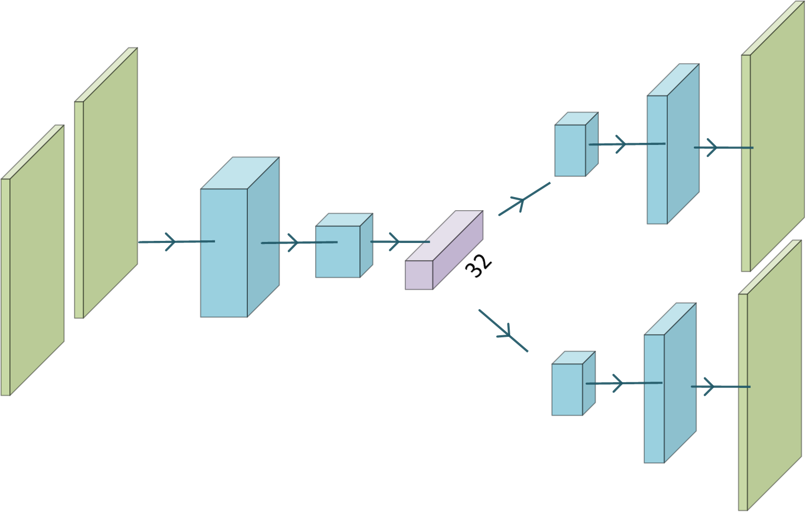
Network Architecture: Unsupervised for Stage 1
Conv
Conv
FC
Conv
Conv
Conv
Conv

Slide 18
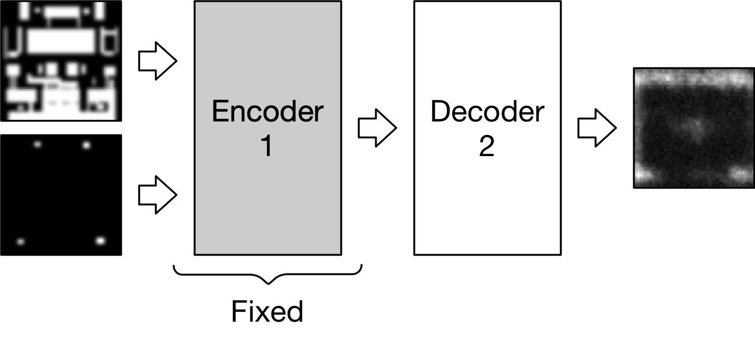
Stage 2: Supervised Decoder Training
Fix the feature extraction to learn the generative model
Extracted
Features
Notes:
In the 2nd stage, we perform the supervised learning to learn the routing patterns. We use the encoder learned from stage 1 and fix its weights in this stage. In pricinple, in this stage we are just training the decoder network that transform the extracted features into the routing guidance.

Slide 19
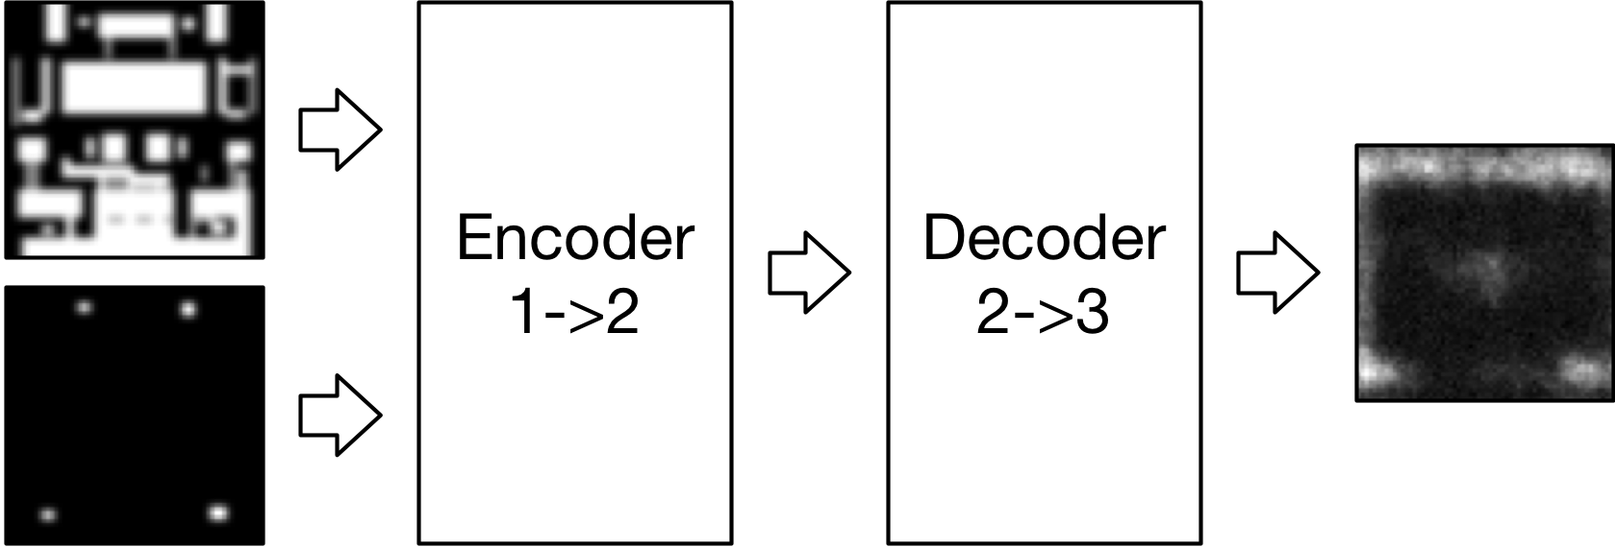
Stage 3: Supervised Decoder Fine-Tune
Fine-tune the network for better accuracy with lower learning rate
Extracted
Features
Notes:
Of course, by fixing the encoder, the accuracy is affected because it loss the flexibility to capture the placement features that are more critical to the routing decision. Therefore in 3rd stage, we further fine tune the network by allowing weights of decoder to change. But with a much lower learning rate.

Slide 20
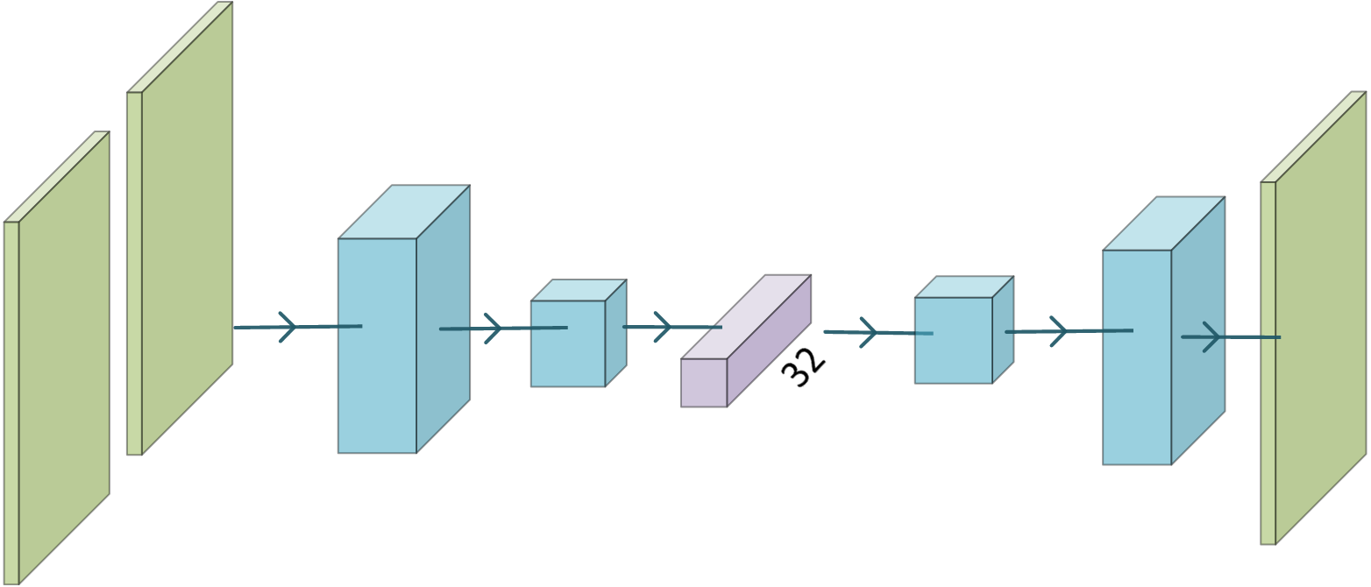
Network Architecture: Supervised for Stage 2&3
FC
Conv
Conv
Conv
Conv

Slide 21
Framework Implementation and Environment Setup
Data preprocessing: C++
ML model: Python with Tensorflow
Router: Modified maze routing in C++
Simulation: Cadence ADE simulator with TSMC 40nm PDK

Slide 22
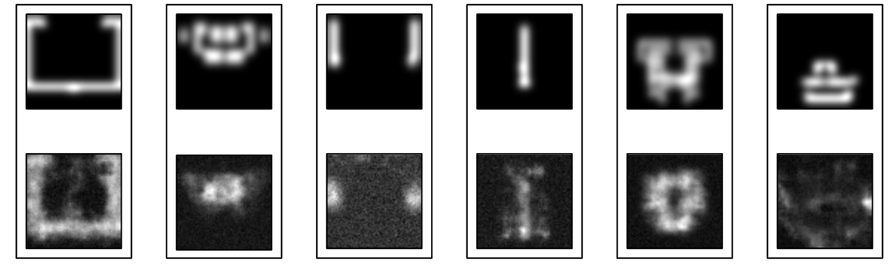
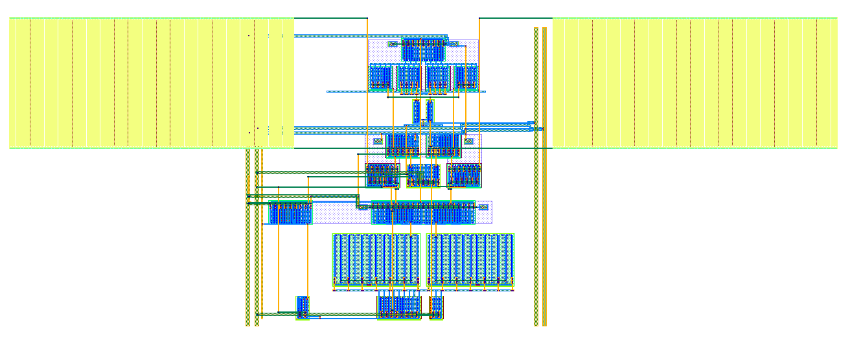
Experimental Result Examples
Ground Truth
Model
Output
Prediction
Routed
Layout
Notes:
Let’s see some experimental results. On the top is some example outputs from the trained model. We can see most of them actually captures the big picture of the routing. But there is still some failure. Notable the last one. That one is from the power/ground model. We think the fundamental reason behind is that the way human engineer route the power/ground nets don’t have strategy as clear as differential nets or clocks.
The bottom shows an example of

Slide 23
Experimental Results: Simulation Results
  Test on comparators and OTAs
  Evaluate with post layout simulation
  Compare with manual layout and previous methods
COMP1 | Schematic | Manual | w/o guide | GeniusRoute
Offset (uV) | / | 480 | 2530 | 830
Delay (ps) | 102 | 170 | 164 | 163
Noise (uVrms) | 439.8 | 406.6 | 439.7 | 420.7
Power (uW) | 13.45 | 16.98 | 16.82 | 16.8
Closer results to the manual layout
Notes:
Let’s look into some simulated results. We can see the proposed geniusroute can produce post-layout performance much closer to the manual layouts using ML generated routing guidance

Slide 24
Experimental Results: More Simulation Results
COMP1 | Schematic | Manual | w/o guide | GeniusRoute
Offset (uV) | / | 480 | 2530 | 830
Delay (ps) | 102 | 170 | 164 | 163
Noise (uVrms) | 439.8 | 406.6 | 439.7 | 420.7
Power (uW) | 13.45 | 16.98 | 16.82 | 16.8
COMP2 | Schematic | Manual | w/o guide | GeniusRoute
Offset (uV) | / | 550 | 1180 | 280
Delay (ps) | 102 | 196 | 235 | 241
Noise (uVrms) | 439.8 | 380.0 | 369.6 | 367.8
Power (uW) | 13.45 | 20.28 | 20.23 | 20.15
OTA | Schematic | Manual | wo/ guide | GeniusRoute
Gain (dB) | 38.20 | 37.47 | 36.61 | 37.36
PM (degree) | 64.66 | 72.46 | 94.68 | 76.40
Noise (uVrms) | 222.0 | 223.7 | 292.7 | 224.8
Offset (mV) | / | 0.88 | 3.21 | 0.39
CMRR (dB) | / | 59.61 | 58.52 | 59.15
BW (MHz) | 110.5 | 102.5 | 232.1 | 107.3
Power (uW) | 776.93 | 757.35 | 715.11 | 787.82

Slide 25
Conclusion
GeniusRoute
  A new methodology to automatic learn from human layout and apply in automatic flow
  Semi-supervised learning algorithm for data-efficiency
  Experimental results show closed-to-human post layout simulation
Future directions
  How to overcome the challenge of obtaining human layouts for labeled data

Slide 26
Thank you!

Slide 27
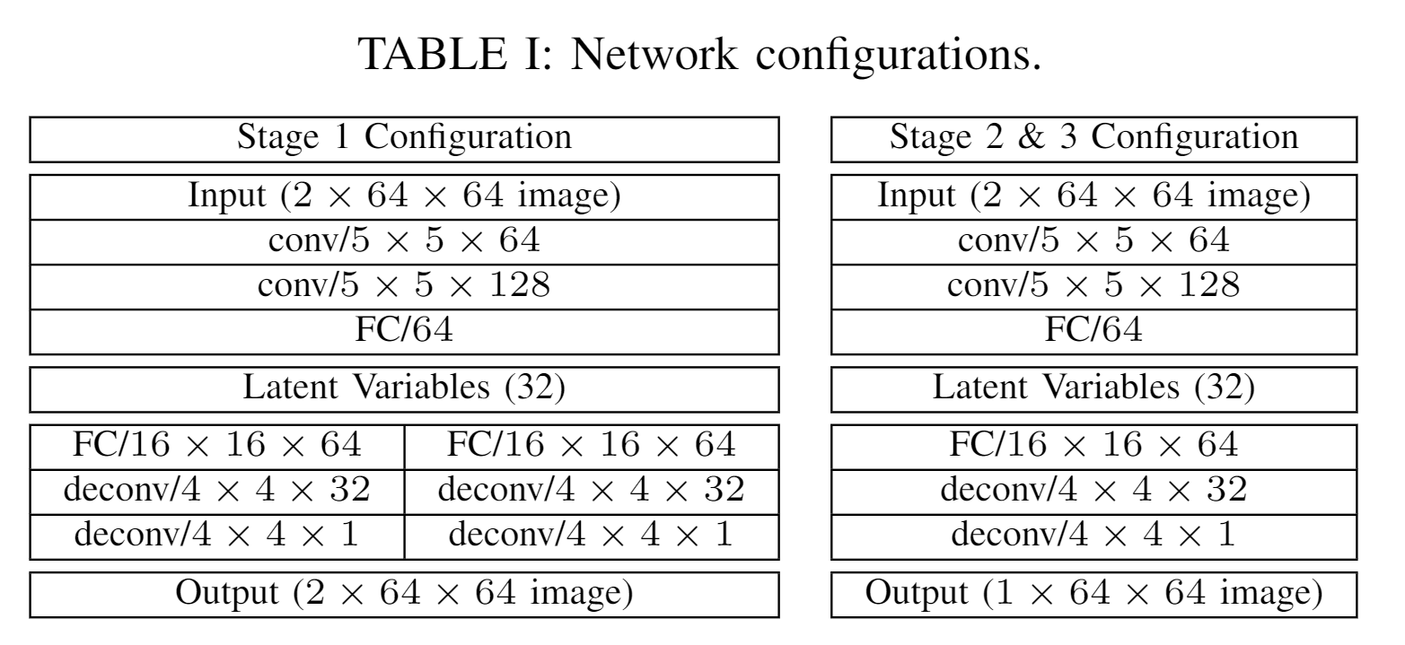
Backup

Slide 28
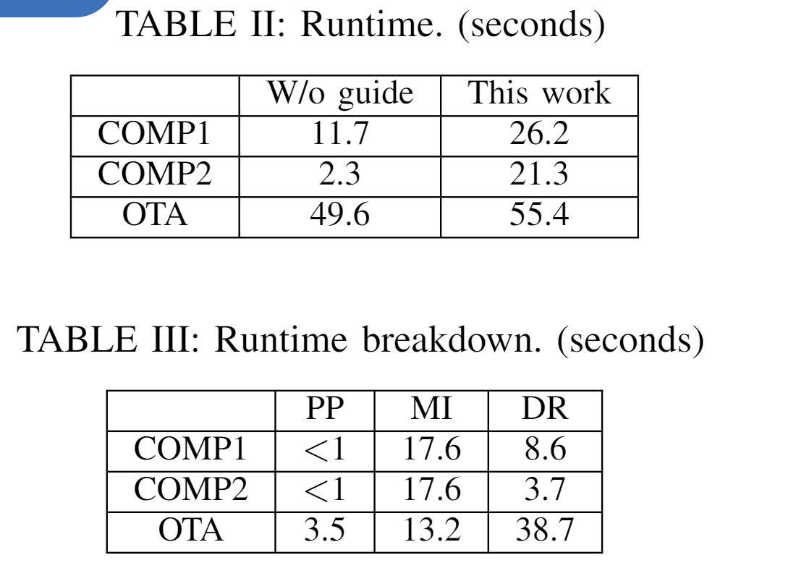
Backup

