Slide 1
Towards Decrypting the Art of Analog Layout: Placement Quality Prediction via Transfer Learning
Mingjie Liu*, Keren Zhu*, Jiaqi Gu, Linxiao Shen, Xiyuan Tang, Nan Sun, and David Z. Pan
Dept. of Electrical and Computer Engineering
The University of Texas at Austin
* Indicates equal contributions.
Notes:
1

Slide 2
Outline
Introduction and Motivation
UT-AnLay Dataset with MAGICAL
Placement Quality Prediction
Improved Data Efficiency with Transfer Learning
Conclusions

Slide 3
Outline
Introduction and Motivation
UT-AnLay Dataset with MAGICAL
Placement Quality Prediction
Improved Data Efficiency with Transfer Learning
Conclusions

Slide 4


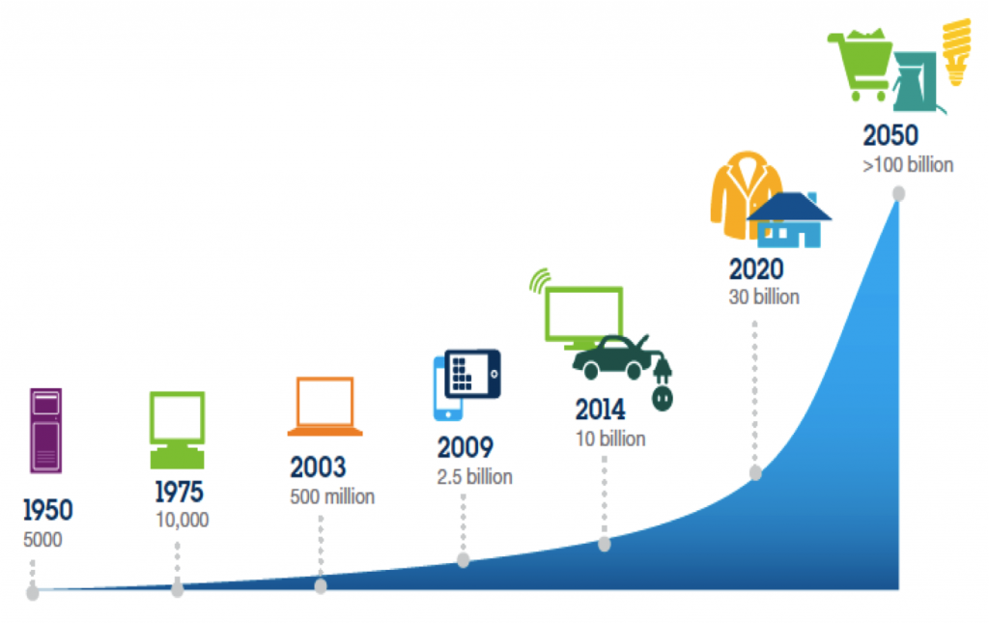

Analog/Mixed-Signal IC Demand
High demand of analog/mixed-signal (AMS) IC in emerging applications
Advanced computing
Communication
Healthcare
Automotive
Image Sources: IBM, Ansys, public technology

Slide 5
Analog/Mixed-Signal IC Design Challenges
Typical modern SoCs:
  Less than 25% total die area for analog; however, 75% or more design efforts
Analog/mixed-signal IC design still heavily manual in various stages
  Very time-consuming and error-prone
Design Efforts
Mixed-Signal SoC
Image Sources: IBS and Dr. Handel Jones, 2012

Slide 6
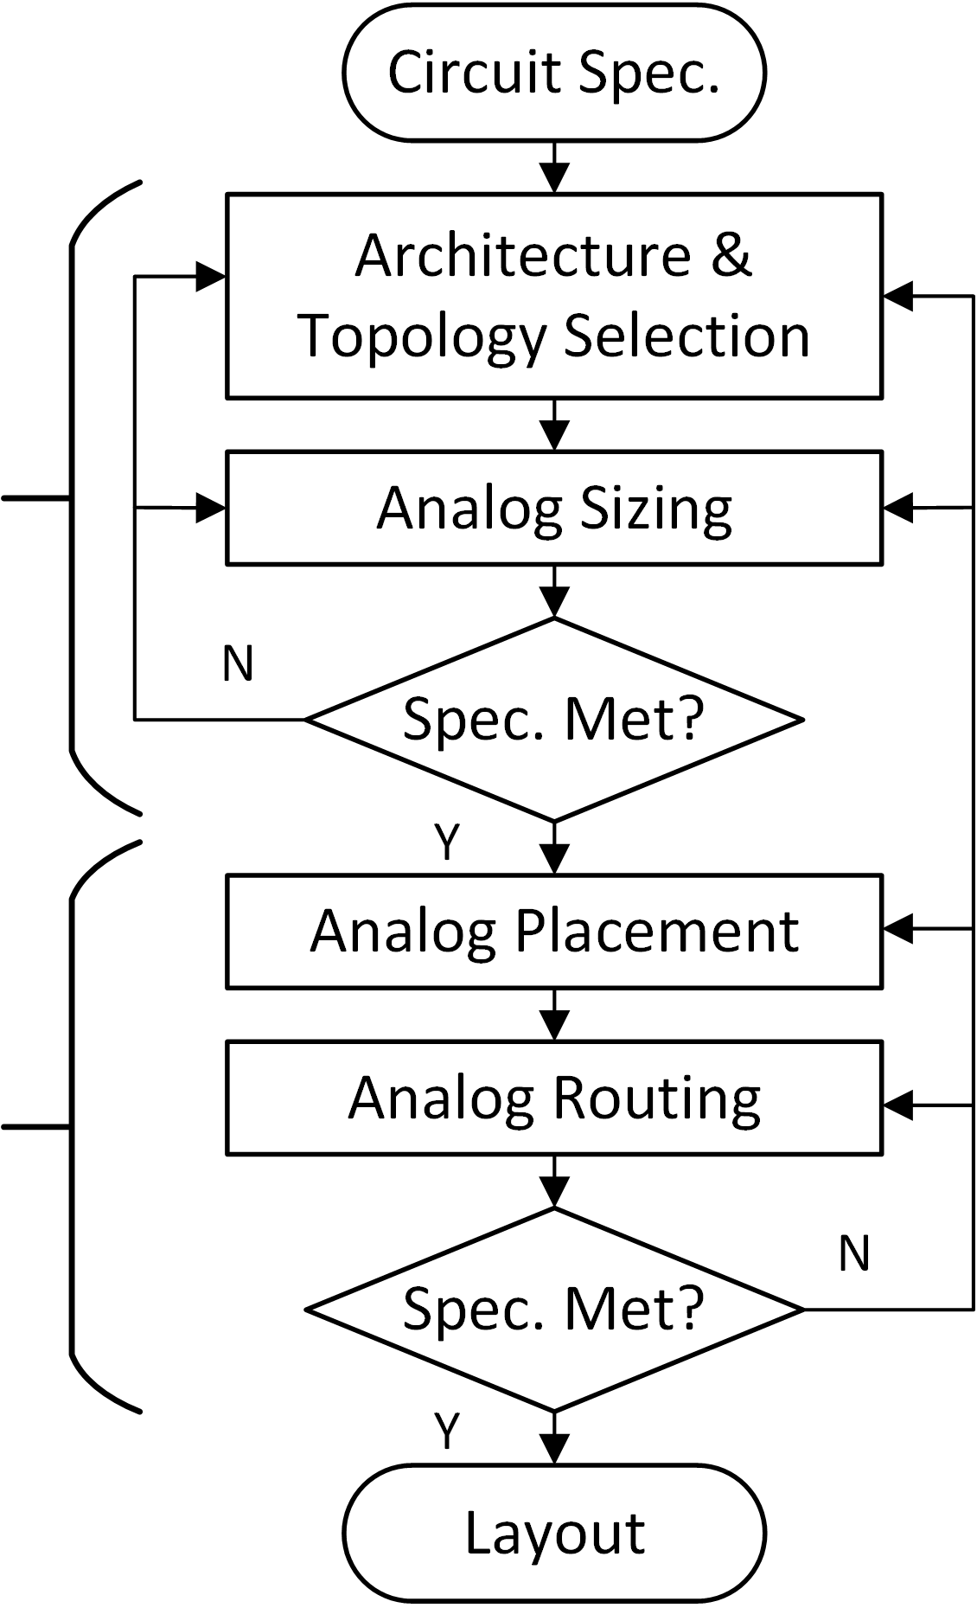
Analog/Mixed-Signal Design Flow
Repetitive iterations and feedback during manual design flows
Close interactions with circuit designers and layout engineers
Our focus is on back-end physical design (layout) stage
Provide design closure and guarantee to meet specification, manufacturability, reliability, etc…
Front-end
Electrical
Design
Back-end
Physical
Design

Slide 7
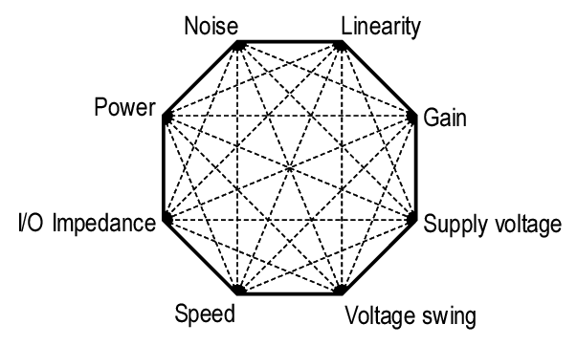
Challenges in Analog Layout Design
Multiple performance trade-offs
  No uniform representation for performance
  Each design is “unique”
Complex layout dependent effects
  BSIM4 model >250 parameters
  Increased parasitic
  Well proximity effect (WPE), substrate noise coupling, etc…
Complex layout design rules
Behzad Razavi, 2000
[Xi et al., BSIM4.3.0 Mosfet Model, 2003]

Slide 8
Prior Works on Analog Layout
Sensitivity analysis based optimization:
  Model how parasitic effects performance
  Some guarantee on performance
  Simulations are too expensive for systems
Heuristic constraint based:
  Encode in layout algorithms
  Enforced satisfiability for crucial effects: symmetry
  Difficult to enumerate
  No room for trade-offs: contradictory constraints
  Limited guarantee towards performance
How can we guide the back-end physical design process to ensure post-layout performance?

Slide 9
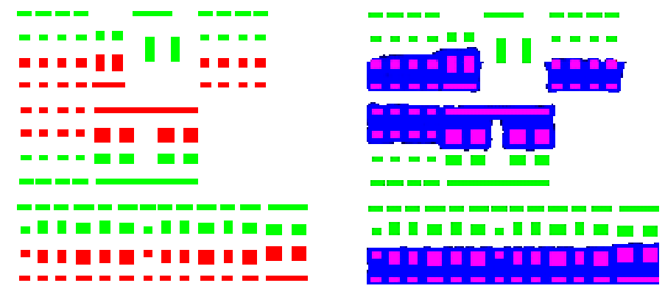
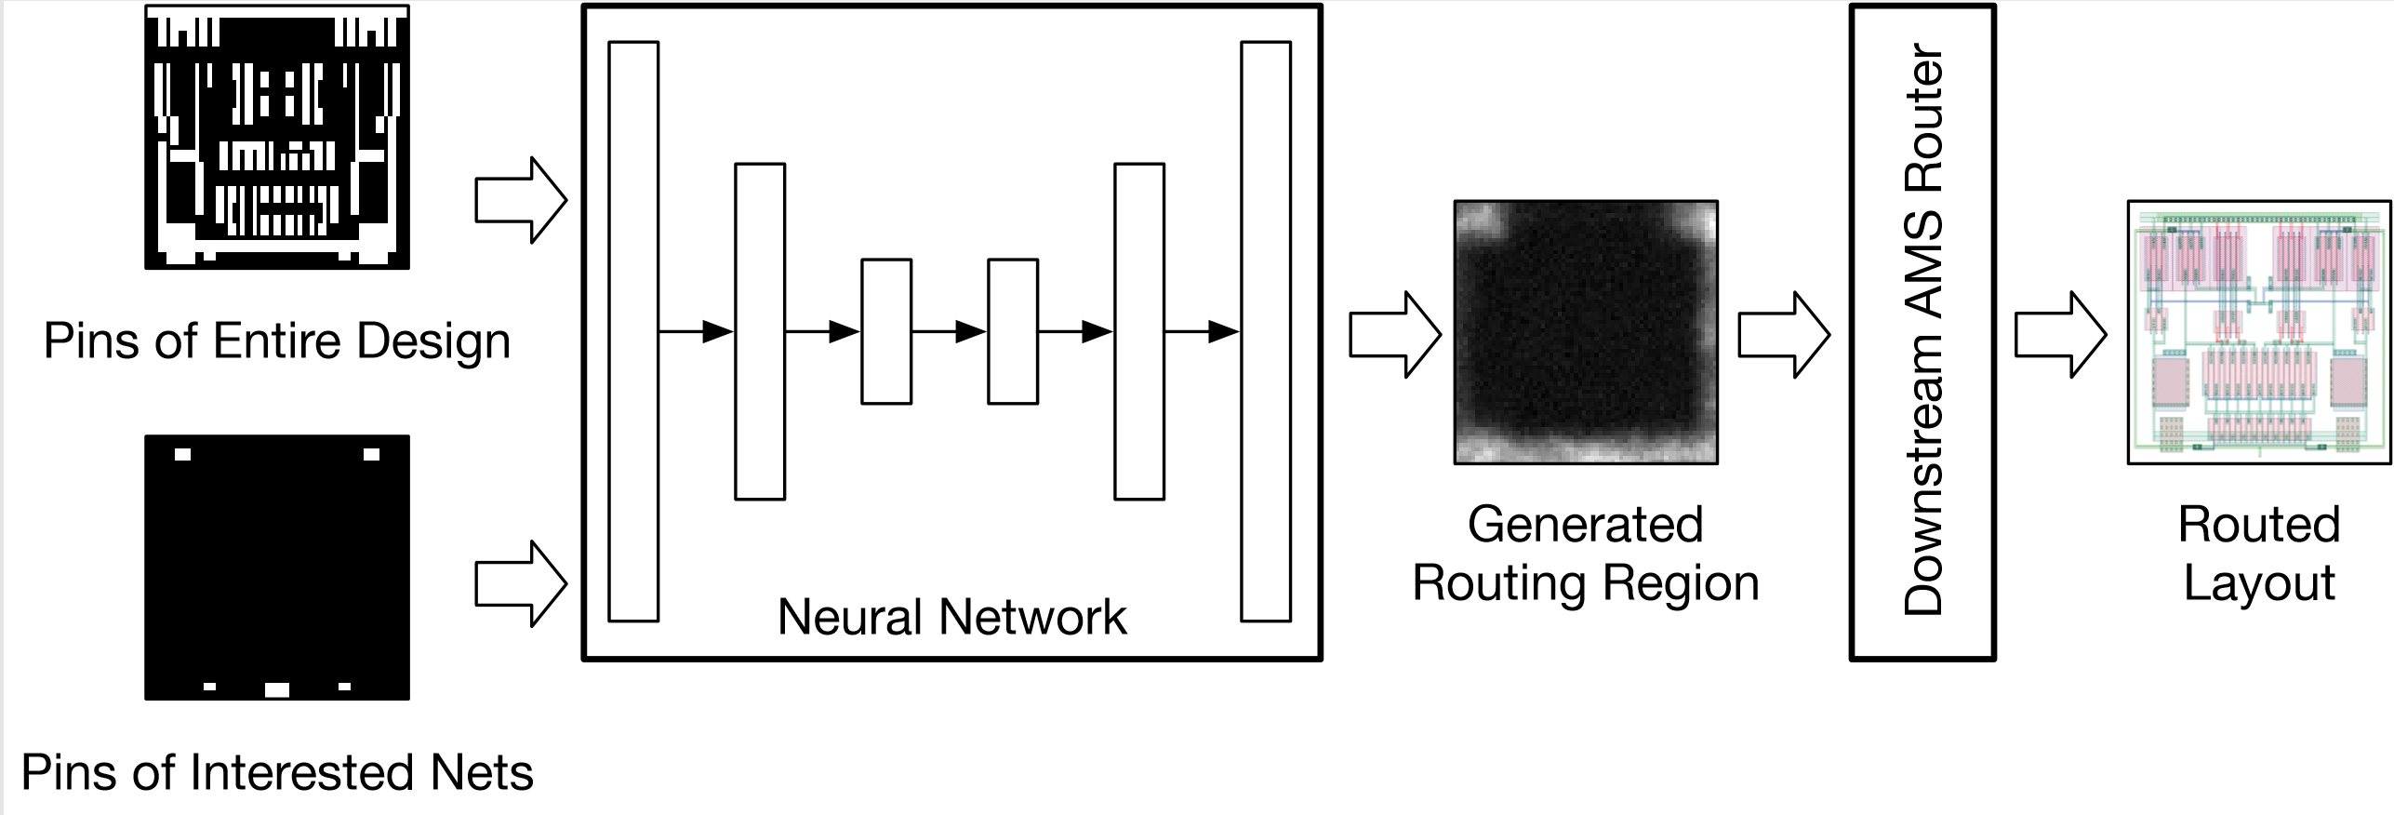
Prior Works on Analog Layout
Leveraging generative neural network
  WellGan and GeniusRoute
  Data hungry algorithms
  Good human layout examples
  Technology dependent: difficult to share data
  No explicit optimization on performance
[Xu et al., DAC, 2019]
[Zhu et al., ICCAD, 2019]

Slide 10
Prior Works on Analog Layout
Leveraging generative neural network
  WellGan and GeniusRoute
  Data hungry algorithms
  Good human layout examples
  Technology dependent: difficult to share data
  No explicit optimization on performance
Can we generate a layout dataset to model layout effects impacting performance?
[Xu et al., DAC, 2019]
[Zhu et al., ICCAD, 2019]

Slide 11
Decrypting the Art of Analog Layout
“The process of constructing layouts for analog and mixed signal circuits have stubbornly defies all attempts at automation.” [Hastings, The Art of Analog Layout, 2001]
Our contributions:
  A model for placement quality prediction for fast design space explorations
  Automatically generated simulated layout training data with MAGICAL
  3D convolutional neural network with coordinate channel embeddings
  Leveraging transfer learning for improved data efficiency
  Open-sourced on GitHub: https://github.com/magical-eda/UT-AnLay

Slide 12
Outline
Introduction and Motivation
UT-AnLay Dataset with MAGICAL
Placement Quality Prediction
Improved Data Efficiency with Transfer Learning
Conclusions

Slide 13
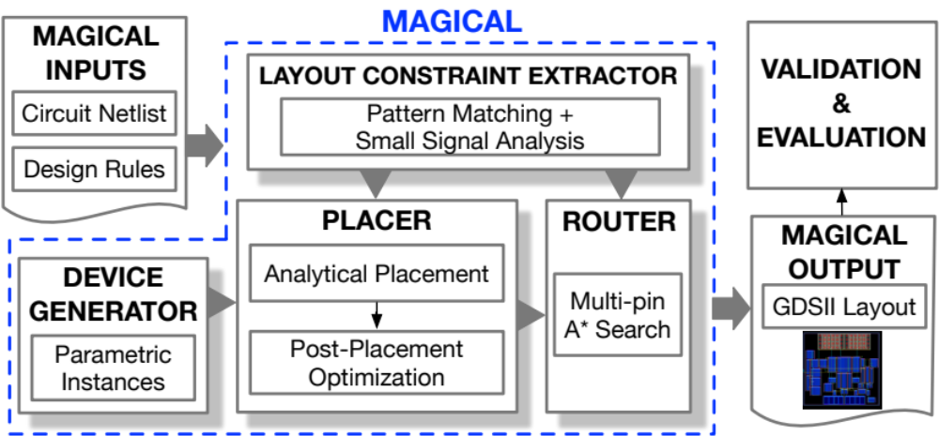
MAGICAL Layout System Framework
Input: unannotated netlist
Output: GDSII Layout
Key Components:
  Device Generation
  Constraint Extraction
  Analog Placement
  Analog Routing
Fully-automated (no-human-in-the-loop)
Guided by analytical, heuristic, and machine learning algorithms
Open-sourced on GitHub: https://github.com/magical-eda/MAGICAL

Slide 14
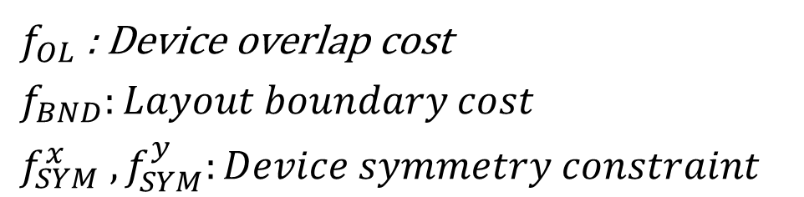
Analytical Global Placement
Objective:
Performance:
  Wirelength term (half-perimeter wirelength):
Relaxed Constraints:
$$Objective = f_{WL}+ a∙f_{OL}+ b∙f_{BND} + c∙\left(f_{SYM}^{x} + f_{SYM}^{y}\right)$$
$$f_{WL} = Σ_{n_{k}}(\max_{i∈n_{k}}{x_{i}}−\min_{i∈n_{k}}{x_{i}}\underset{i∈n_{k}}{+ max}{y_{i}}−\min_{i∈n_{k}}{y_{i}})$$
$f_{OL}$ : Device overlap cost
$$f_{BND}:Layout boundary cost$$
$$f_{SYM}^{x} , f_{SYM}^{y}:Device symmetry constraint$$

Slide 15
Analytical Global Placement
Wirelength term (half-perimeter wirelength):
  Not a good indication of performance
  Different nets should have different importance
  Different penalty term indicating net criticality
  Allow multiple layout solutions for same schematic
$$f_{WL} = Σ_{n_{k}}(\max_{i∈n_{k}}{x_{i}}−\min_{i∈n_{k}}{x_{i}}\underset{i∈n_{k}}{+ max}{y_{i}}−\min_{i∈n_{k}}{y_{i}})$$
$$f_{WL} = Σ_{n_{k}}α_{n_{k}}(\max_{i∈n_{k}}{x_{i}}−\min_{i∈n_{k}}{x_{i}}\underset{i∈n_{k}}{+ max}{y_{i}}−\min_{i∈n_{k}}{y_{i}})$$

Slide 16
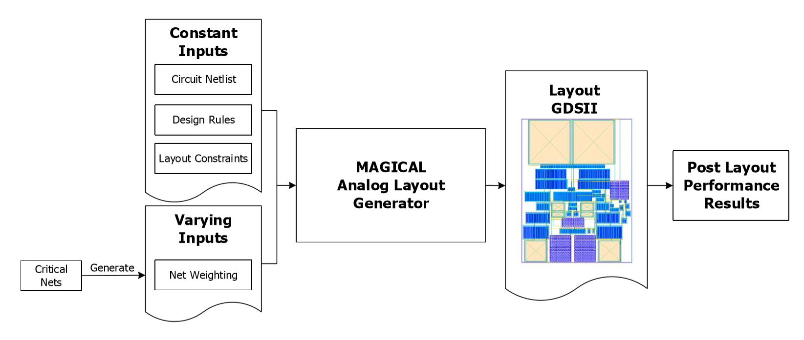
Data Generation with MAGICAL

Slide 17
Data Generation with MAGICAL
UT-AnLay Dataset:
  Industrial level parasitic extraction and simulation tool
  Custom designed testing benchmark suite
  Over 16,000 different layout for each design
Design | Stage | Compensation | Layouts
OTA1 | 3 | Nested Miller | 16376
OTA2 | 3 | Nested Miller | 16381
OTA3 | 2 | Miller | 16384
OTA4 | 2 | None | 16363

Slide 18
UT-AnLay Dataset
UT-AnLay Dataset:
  Circuit netlist
  Device boundary box
  Device placement coordinates (with pin coordinates)
  Post layout simulation results
  Routing information
  Currently only OTA circuits
  Currently only in TSMC 40nm technology

Slide 19
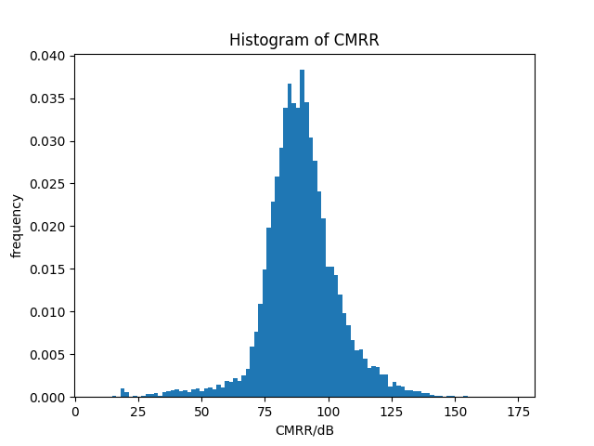
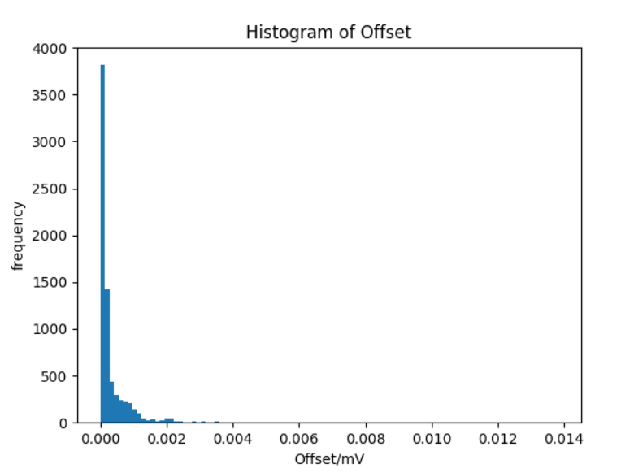
Data Generation with MAGICAL
UT-AnLay Dataset:
  Noticeable difference in layout implementations
  High variations in some performance
    CMRR and offset -> Large variation
    Gain, power, phase margin etc. -> Small variation

Slide 20
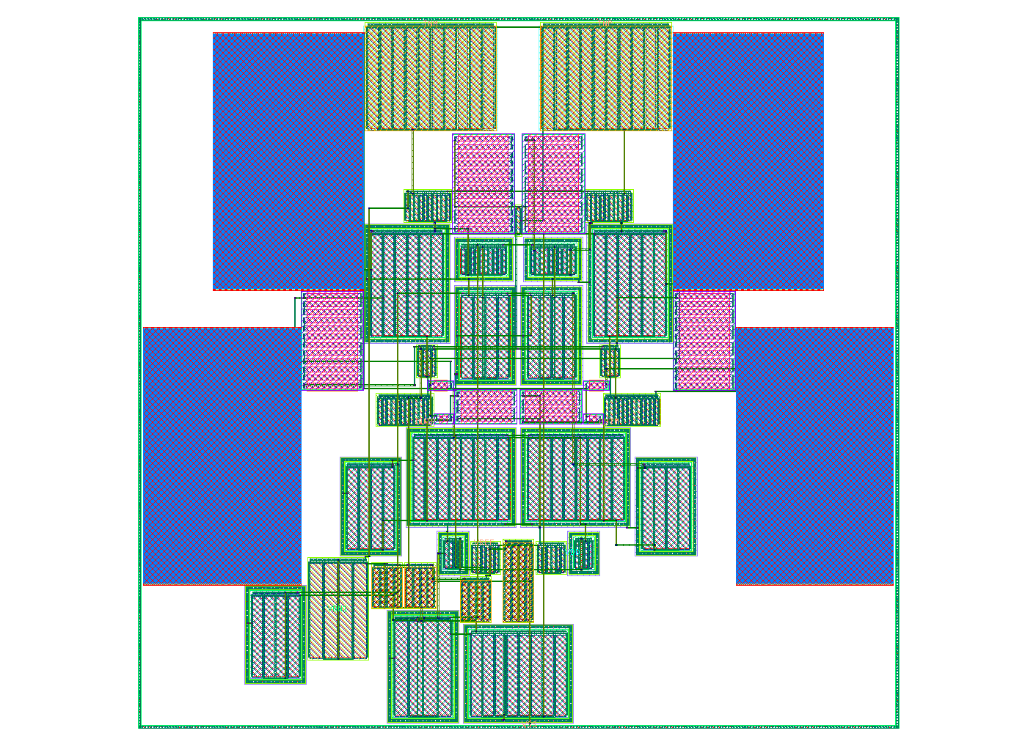
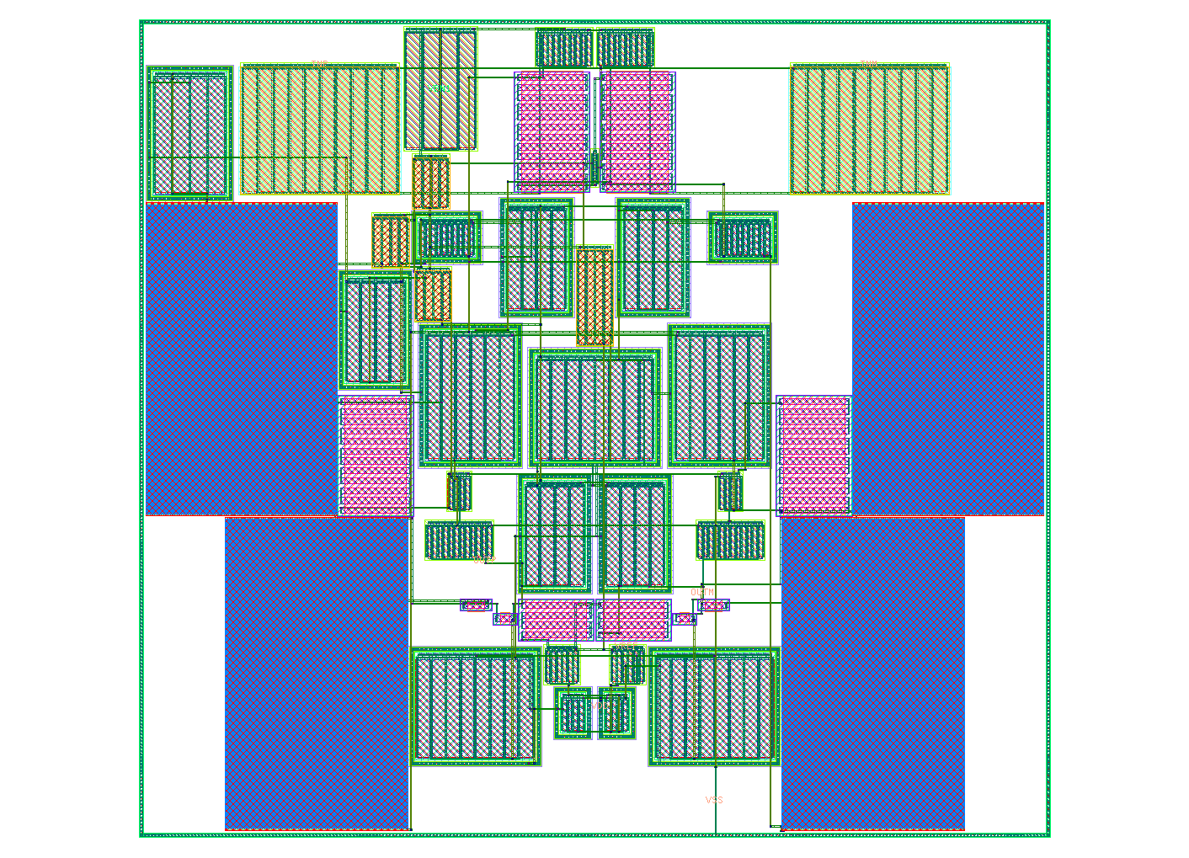
Layout Examples

Slide 21
Layout Examples
Offset (mV) | ~ 0
CMRR (dB) | 110
DC Loop Gain (dB) | -0.02
Bandwidth (MHz) | 41.8
Phase Margin | 65.7
Power (mW) | 0.25
???
Offset （mV) | 5.0
CMRR (dB) | 76.3
DC Loop Gain (dB) | -0.01
Bandwidth (MHz) | 42.6
Phase Margin | 65.7
Power (mW) | 0.26

Slide 22
Outline
Introduction and Motivation
UT-AnLay Dataset with MAGICAL
Placement Quality Prediction
Improved Data Efficiency with Transfer Learning
Conclusions

Slide 23
Early Design Pruning
Traditional automated analog layout generators
  Human in the loop
  Infer new heuristics and constraints
  Poor generalizability and little flexibility
New Heuristics/Constraints
Placement
Routing
Extraction
Simulation

Slide 24
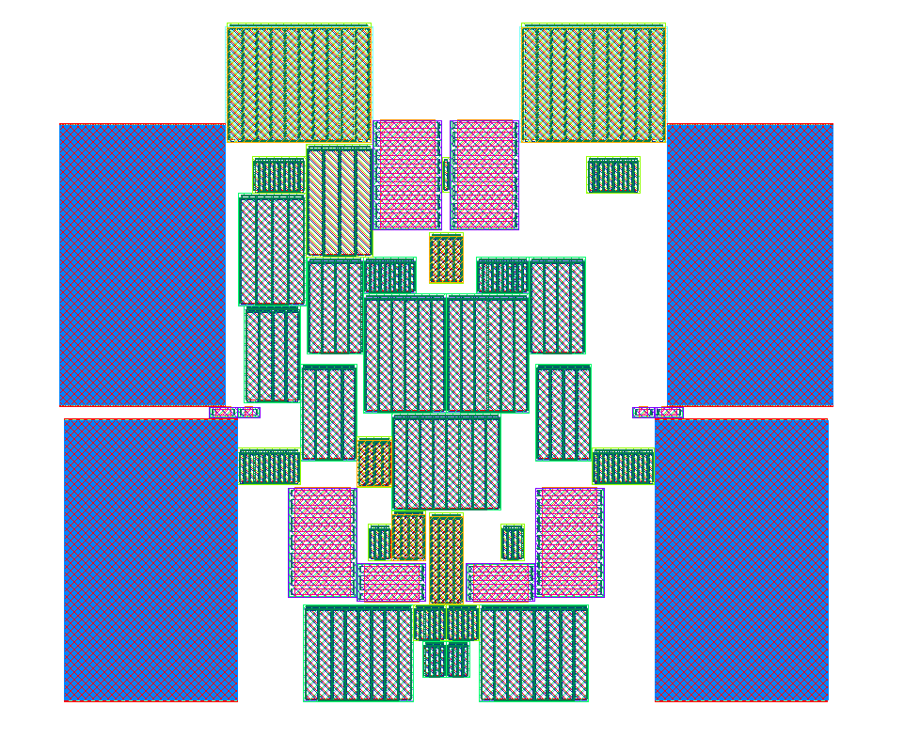
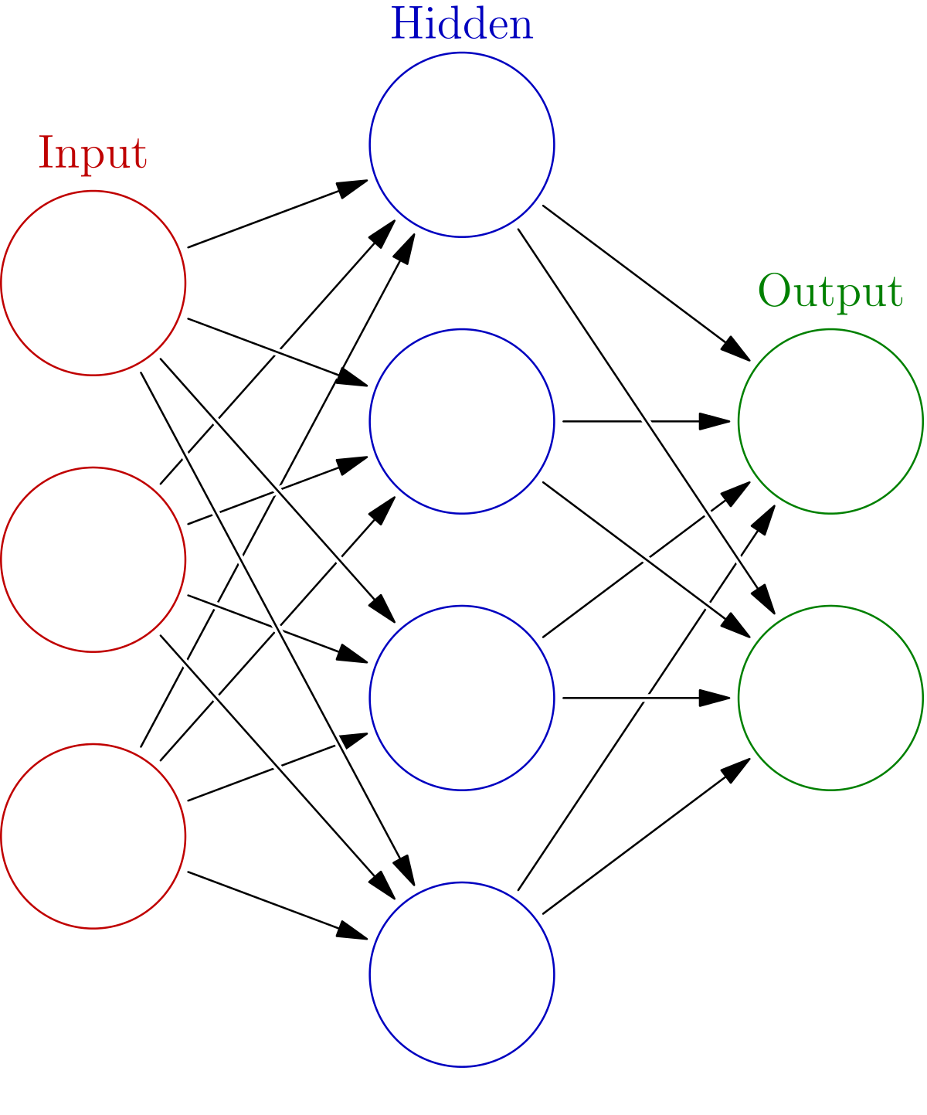
Early Design Pruning
Design exploration and early design pruning
  Generating layout is “cheap”
  Verifying functionality is expensive
  Predict performance in early design stage
Explore new design
Placement
Downstream

Slide 25
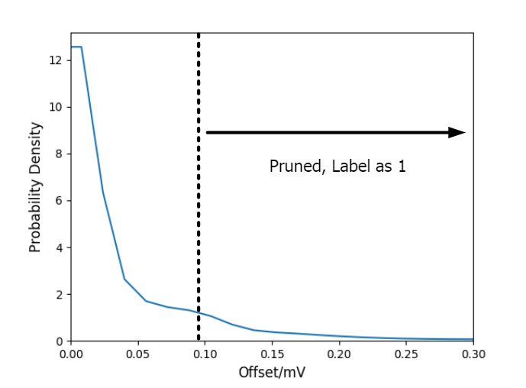
Layout Quality
Define layout quality with post layout simulation
  Layout sensitive performance: CMRR and offset
Formulate problem into binary classification
  Balanced: Worst 25% vs Best 25%
  Imbalanced: Worst 25% vs Rest 75%

Slide 26
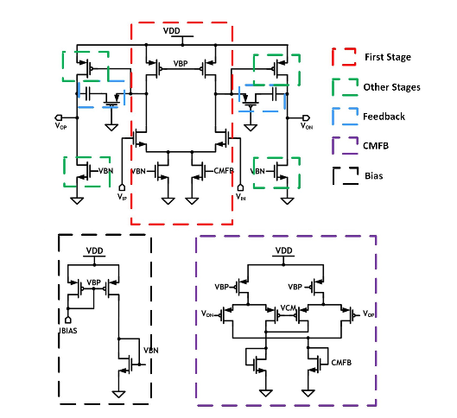
Placement Feature Extraction
Placement feature extraction:
  Device location and size: images
  Circuit topology: separating devices to different channels
  Device types: image intensity
  Pin location: routing congestion map

Slide 27
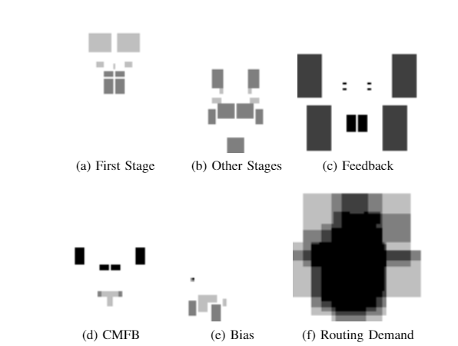
Placement Feature Extraction

Slide 28
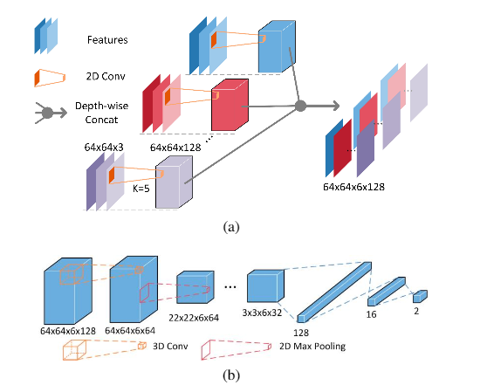
3D CNN Model
Coordinate channel embedding
  Additional channel for numerical coordinates
3D CNN
  Depth-wise convolution
  Interactions between different channels
[R. Liu et al., NIPS, 2018]
[S. Ji et al., IEEE T. Pattern Anal, 2013

Slide 29
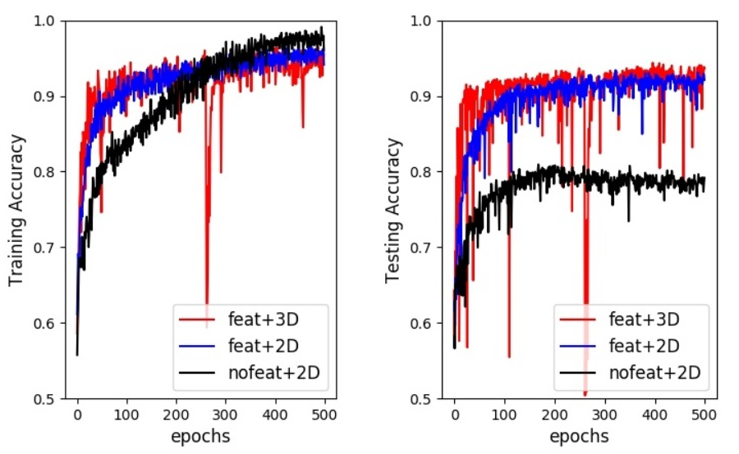
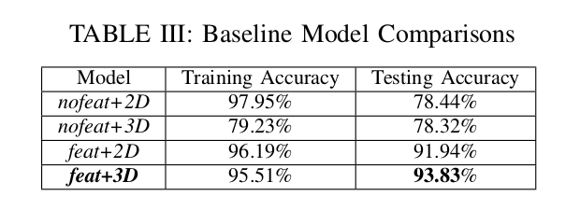
Model Selection
Dataset: OTA1 with balanced labeling
Feature is of utmost importance
3D CNN helps a little with generalization

Slide 30
Outline
Introduction and Motivation
UT-AnLay Dataset with MAGICAL
Placement Quality Prediction
Improved Data Efficiency with Transfer Learning
Conclusions

Slide 31
Transfer Learning
Source Domain
(x_{s}, y_{s})
Train
Source Model
fs: X_{s} -> Y_{s}
Initialize
Target Domain
(x_{s}, y_{s})
Fine-tune
Source Model
ft: X_{t} -> Y_{t}
Transfer learning:
  Train model on source domain with abundant data
  Fine-tune model on target domain with limited data

Slide 32
Transfer Learning
Source Domain: OTA1
Target Domains:
  OTA2: Same schematic and performance metric different sizing
  OTA3: Different schematic same performance metric
  OTA4: Different schematic and performance metric
Data utilization α:
  Percentage of available training data in target domain
  20% reserved for testing αmax = 0.8

Slide 33
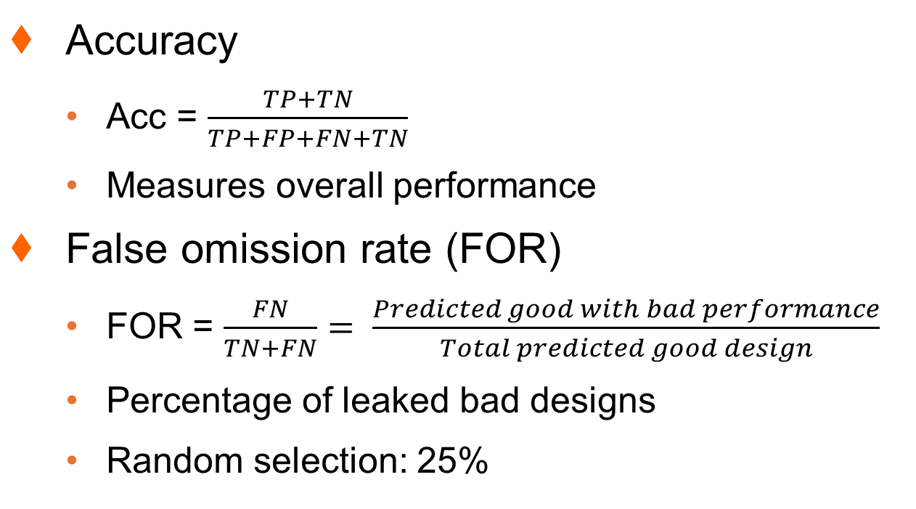
Evaluating Metrics
Accuracy
  Acc = $\frac{TP+TN}{TP+FP+FN+TN}$
  Measures overall performance
False omission rate (FOR)
  FOR = $\frac{FN}{TN+FN}= \frac{Predicted good with bad performance}{Total predicted good design}$
  Percentage of leaked bad designs
  Random selection: 25%
Golden Label
Positive
Negative
Positive
TP
FP
Prediction
Negative
FN
TN
Detailed results on precision, recall and F1 score omitted for simplicity

Slide 34
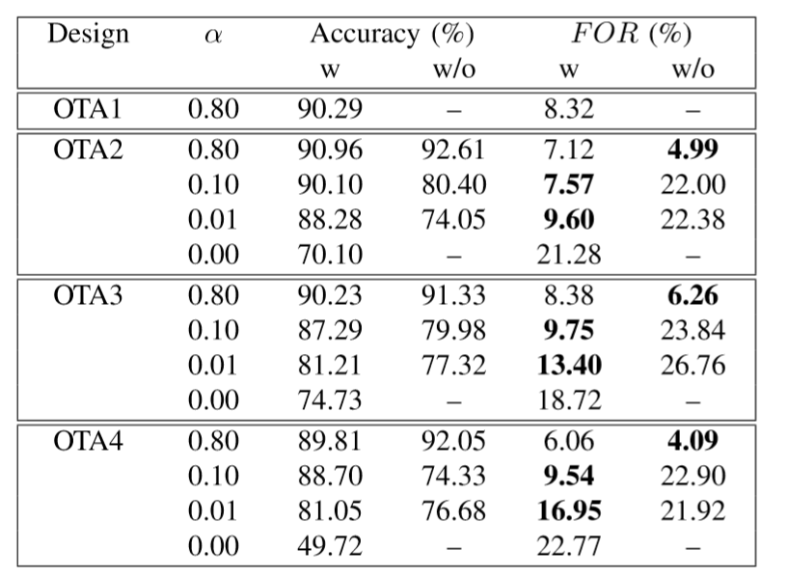
Evaluating Metrics
Transfer learning improves results compared with random initialization
w are transfer learning results, w/o are retraining with random initialization

Slide 35
Transfer Learning Results
Transfer learning improves results compared with random initialization
Results improves with more training data in target domain
w are transfer learning results, w/o are retraining with random initialization

Slide 36
Transfer Learning Results
Transfer learning improves results compared with random initialization
Results improves with more training data in target domain
Satisfactory results in transfer learning with only 1% data (160 layouts)
w are transfer learning results, w/o are retraining with random initialization

Slide 37
Transfer Learning Results
Transfer learning improves results compared with random initialization
Results improves with more training data in target domain
Satisfactory results in transfer learning with only 1% data (160 layouts)
Applying baseline model without transfer learning produce bad results
w are transfer learning results, w/o are retraining with random initialization

Slide 38
Transfer Learning with Few-shot Examples
What is the limit? Can 0.1% data work (16 layouts)?
Testing data 20%, 200 times of training
Issues: Data distributions in train/test varies significantly
Sorted Train
Performance
25%
Sorted Test
Performance
25%
Worst
Best

Slide 39
Transfer Learning with Few-shot Examples
What is the limit? Can 0.1% data work (16 layouts)?
Testing data 20%, 200 times of training
Issues: Data distributions in train/test varies significantly
Sorted Train
Performance
25%
Sorted Test
Performance
Test Data Distribution
Worst
Best

Slide 40
Transfer Learning with Few-shot Examples
Random select 16 layouts (0.1%) as transfer learning data
Label training data according to relative rank in training set
Relabel testing set according to the training set
Repeat experiment for 100 times for each transfer target

Slide 41
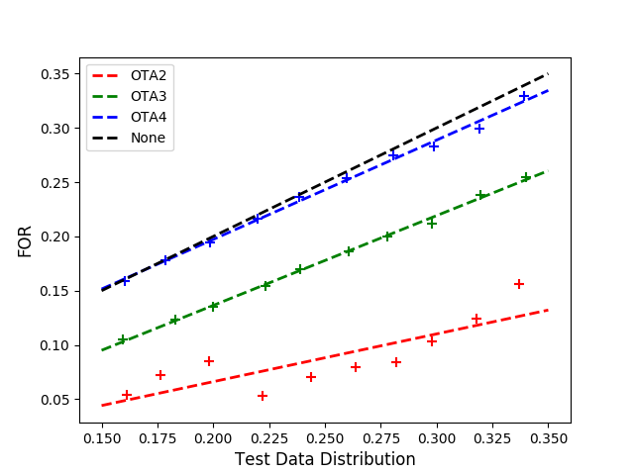
Transfer Learning with Few-shot Examples
Improvement gained from transfer learning is related with task difficulty
OTA2: Same design and performance metric different sizing
OTA3: Different design and same performance metric
OTA4: Different design and different performance metric
Random Select
Ideal

Slide 42
Outline
Introduction and Motivation
UT-AnLay Dataset with MAGICAL
Placement Quality Prediction
Improved Data Efficiency with Transfer Learning
Conclusions

Slide 43
Conclusions
UT-AnLay:
  A dataset for post layout performance modeling
  Include placement solution and post layout simulation results
Our preliminary work:
  Placement quality prediction
  Improved data efficiently with transfer learning
Open-sourced data and model:
  https://github.com/magical-eda/UT-AnLay
Open-sourced MAGICAL layout generator:
  https://github.com/magical-eda/MAGICAL

Slide 44
Thank You
Notes:
44

