Slide 1

Exploring Logic Optimizations with Reinforcement Learning and Graph Convolutional Network
Keren Zhu, Mingjie Liu, Hao Chen, Zheng Zhao and David Z. Pan
ECE Department
The University of Texas at Austin
Notes:
Add Acknowledgment

Slide 2
Background: logic optimization in VLSI design
Modern VLSI design:
Abstract architecture -> physical layout
Logic synthesis and technology mapping:
RTL -> Netlist
Logic optimization:
Optimize the logic in logic synthesis
Sequential and combinational
This work focus on combinational logic
System Specification
RTL
Logic Synthesis
Technology Mapping
Physical Synthesis
Manufacturing

Slide 3
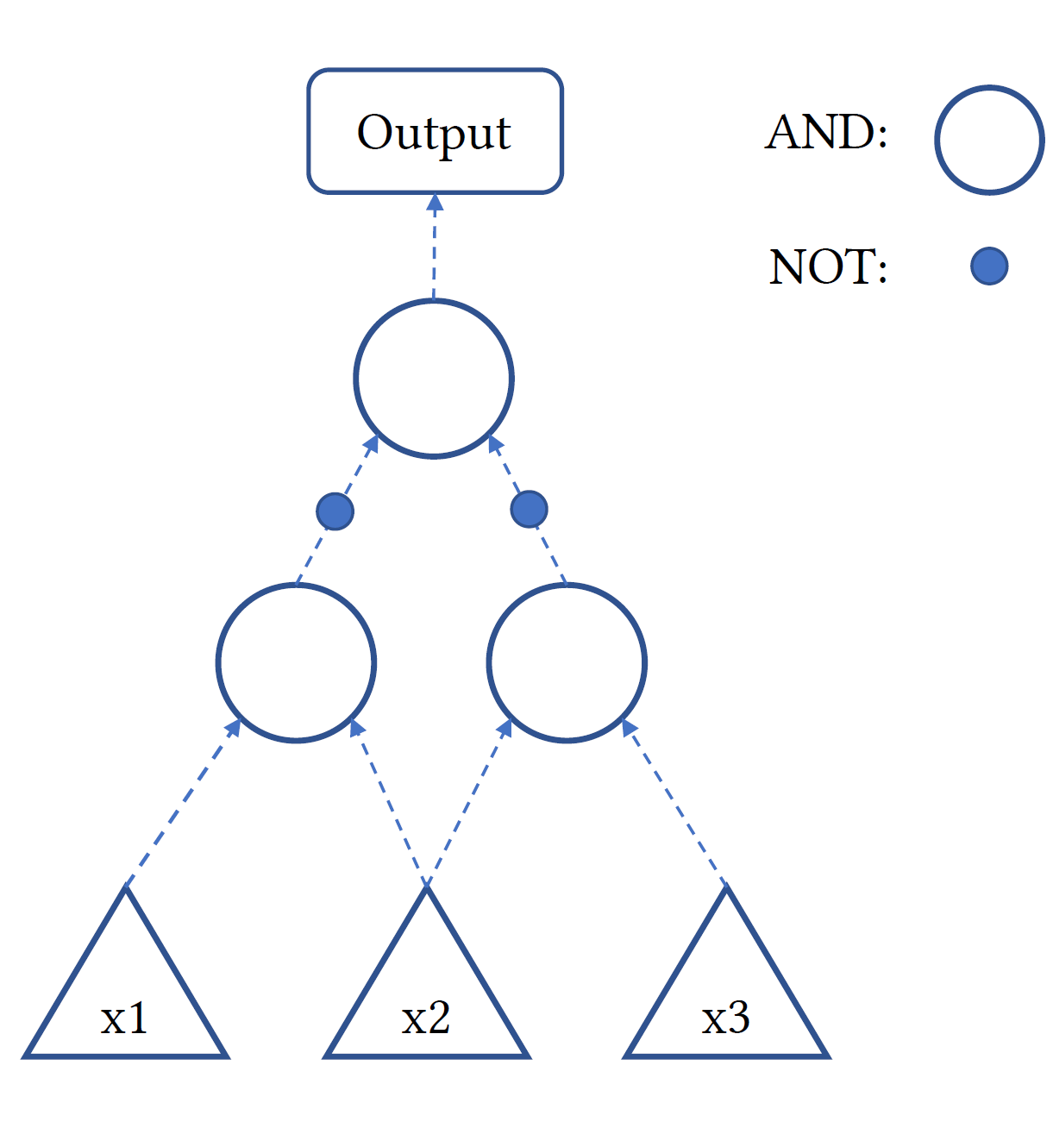

Combinational logic is often represented as logic graph
Standardized logic graph
AIG, MIG etc.
This work focus on AIG
Operations on graph can preserve the Boolean logic but change the graph
Balance, rewrite etc.
Modern heuristic use a sequence of operation to optimize the logic graph in number of nodes and logic depth

Slide 4
Question: what is the optimal operation sequence?
There are some well-known heuristic
E.g. resyn2 in ABC
The effectiveness of an operation sequence is design-dependent
Different circuits have different optimal operation sequence
Question: how to efficiently explore the search space and find good sequences for a new circuit?

Slide 5
Operation sequence as an MDP
The user can observe the current AIG graph
The user command ABC to execute an operation on the graph
The user then observe the new graph
The user want to optimize the graph by repeating this process
ABC
Operation
New graph
User

Slide 6
Operation sequence as an MDP
Then we can formulate this process as a Markov Decision Process (MDP)
Action: operation
State: logic graph
Reward: improvements
The process is of Markov property
Each operation on the graph is deterministic and not depend on the past
The state is fully observed
Logic graphs contain all the information we need
Environment
Action
State
Reward
Agent

Slide 7
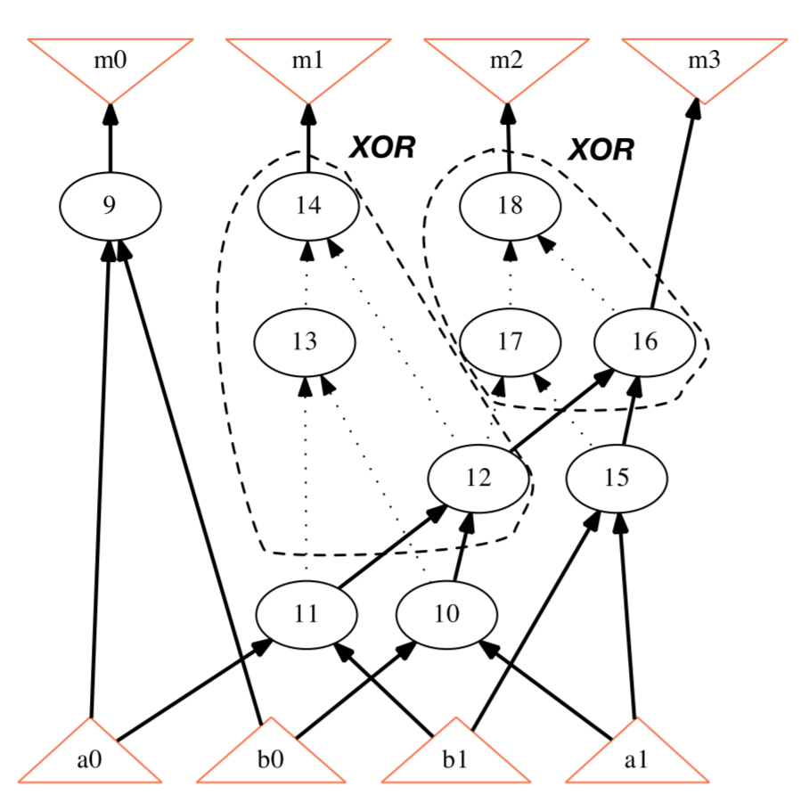
Key challenge: state representation
Reinforcement learning (RL) algorithms often need vector state representation with fixed dimension
Graph statists can help describing the graph, but not enough
We also use past action record and graph convolutional network for better state representation
An AIG graph
Courtesy: [Yu+ TCAD18]

Slide 8
Graph convolution network for graph vectorization
We use graph convolutional network for assisting state representation
We use the type as node feature and let graph convolution to aggregate the neighboring features into the nodes
We take the mean of the graph nodes to obtain a vectorized representation
Node
Average
Graph
Representation

Slide 9
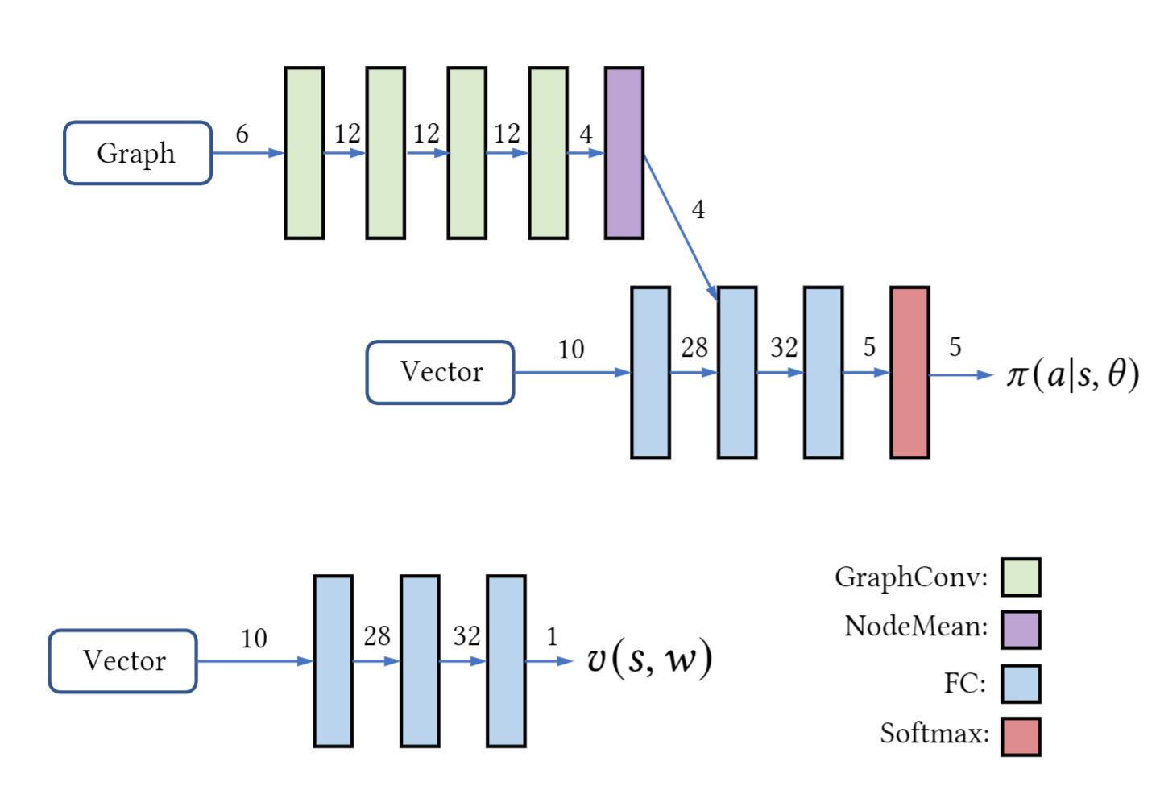
Policy Gradient RL agent
Policy gradient methods estimate the value of actions
The RL agent explore the space and update the action value estimation
We use a simple network for estimating state value as baseline
Action Value
Baseline

Slide 10
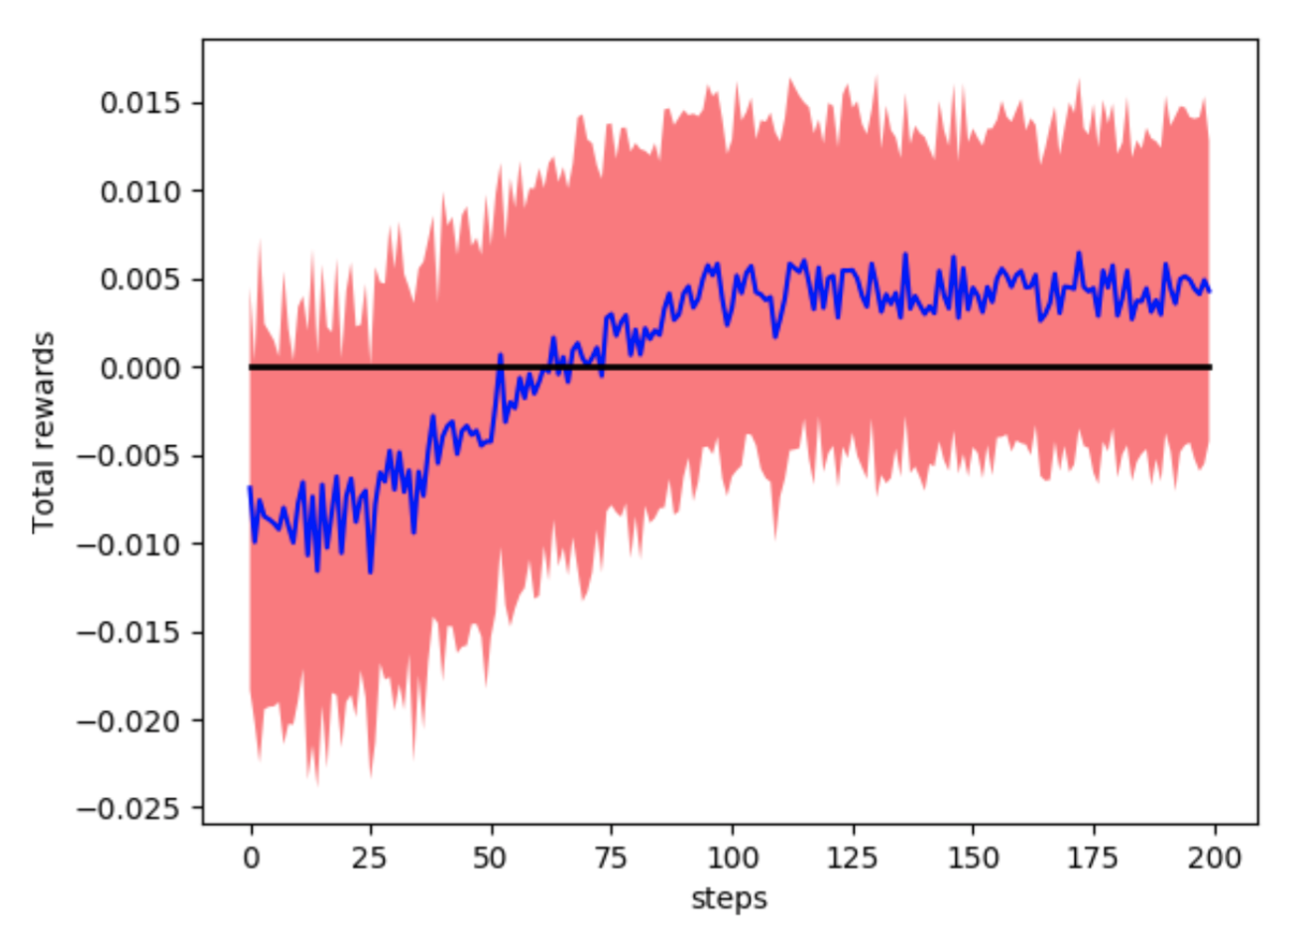
Experiments: average return
We use the RL agent to generate operation sequence of 18
The same length of running resyn2 twice
We compare the total rewards over episode
RL agent is learning something

Slide 11
Experiments: optimizing the number of nodes
Optimize number of nodes
Benchmark | Initial |  | Resyn2 twice |  | This work (averaged)
 | # Nodes | Depth | # Nodes | Depth | # Nodes | Depth
i10 | 2675 | 50 | 1804 | 32 | 1730.2 | 40.3
c1355 | 504 | 25 | 390 | 16 | 386.2 | 17.6
c7552 | 2093 | 29 | 1416 | 26 | 1395.4 | 27.4
c6288 | 2337 | 120 | 1870 | 89 | 1870.0 | 88.0
c5315 | 1780 | 37 | 1295 | 26 | 1337.4 | 27.2
dalu | 1371 | 35 | 1103 | 31 | 1039.8 | 33.2
k2 | 1998 | 23 | 1186 | 13 | 1128.4 | 19.8
mainpla | 5346 | 38 | 3583 | 26 | 3438.4 | 25.0
apex1 | 2665 | 27 | 1966 | 17 | 1921.6 | 19.2
bc0 | 1592 | 31 | 899 | 17 | 819.4 | 18.6
Ratio | 1.0 | 1.0 | 0.717 | 0.702 | 0.698 | 0.757

Slide 12
Conclusion
RL algorithm can be applied to the problem of finding a good operation sequence in optimizing combinational logic graph
Graph mining techniques are useful in extracting information into vectors
The source codes have been released to public
https://github.com/krzhu/abcRL

Slide 13
Future directions
How to obtain how information from the graph?
Graph convolutional network cannot extract the dedicated logic hierarchy from the graphs
The usage of past experience in state representation break the perfect Markov property
More principal method on vectorizing the graph
A more generalized action space
Currently assume a small discrete action space. How to extend it to general continuous space?
Multi-objective optimization
More efficient search space exploration

