Slide 1
REACT TUTORIAL
Part 1: Basics
Krzysztof Kicinger, May 2018

Slide 2
Agenda
JSX
Elements and Components
State vs Props
Stateless and Functional Components
Component Lifecycle

Slide 3
React introduction
JS library for UI
Component-Based
Declarative

Slide 4
JSX
JSX = Syntax extension to JavaScript (not template language)
React and JSX:
React embraces the fact that rendering logic is coupled with other UI logic
React separates concerns not technologies using Components
React does not require JSX
Notes:
JSX:
Extension to JavaScript, it is neither a String nor HTML
Not template language but -> Language + Java Script
JSX -> Elements
React and JSX:
Embraces the fact that rendering is inherently coupled with other UI logic (events, state changes handling)
Resources:
https://reactjs.org/docs/introducing-jsx.html
https://reactjs.org/docs/jsx-in-depth.html

Slide 5
JSX Features
Embedded Expressions
JSX is compiled to regular JS
Composition
Can have attributes and properties (camelCase)
Prevents XSS Injection Attacks
Represents React Element (https://babeljs.io/repl/)
Automatic semicolon insertion
Notes:
JSX:
https://reactjs.org/docs/introducing-jsx.html

Slide 6
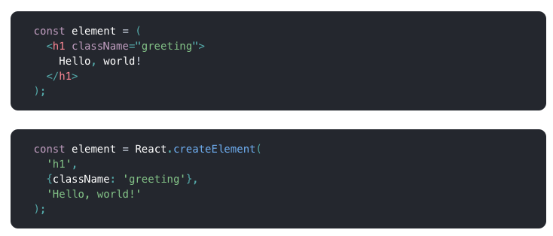
JSX vs React elements
Notes:
JSX compiles to React.createElement(…)
React.createElement creates an object:
type –
props
REACT ELEMENT:
description of the component that should be displayed on the page
React uses those elements to construct the DOM and keep it up to date
IMMUTABILE – React sees if the change has been changed through the reference change
If JSX compiles to React.createElement – we need it in the Scope (import React from ‘react’)

Slide 7
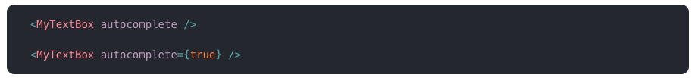
JSX - Properties
JS Expressions (if and for are not expressions in JS!)
String literals – both as literal and as expression
Default property value: TRUE (avoid, misleading)
Spread operator – { …props }

Slide 8
JSX - Composition
props.children – all expressions between opening and closing tag
Children types:
String Literals
JSX Elements (objects and arrays)
JS Expressions
Ignored values:
Boolean values (false, true)
null
undefined
Ignored values are great for conditional rendering

Slide 9
COMPonents vs instances vs elements
Elements
Component Instances
Components
Notes:
Resources:
https://reactjs.org/blog/2015/12/18/react-components-elements-and-instances.html
https://medium.com/@fay_jai/react-elements-vs-react-components-vs-component-backing-instances-14d42729f62

Slide 10
COMPONENTS
Blueprint for instances
Two types of components:
Class Component (props and state)
Function Component (props)
Components:
Input: properties
Output: encapsulated element trees (DOM nodes, elements)
Composes independent parts of UI without relying on internal DOM structure

Slide 11
COMPONENT INSTANCES
Single component which is visible on the screen
Encapsulates local state and properties (per instance)
Never created directly:
React takes full responsibility
Created when ReactDOM.render() method is used
Only class components have instances

Slide 12
ELEMENTS
Plain JS object describing a component instance or DOM node and its desired properties:
type – String, function, class
props – properties passed to element
key – uniquely identifies React element, optimization purposes
ref – points to underlying DOM element
Immutable
Cheap - much lighter than actual DOM elements
Composes a Virtual DOM
No methods, just data
Notes:
React Elements features:
Descriptions not actual instances
Don’t refer to anything on the screen
Can be thrown away, created and it won’t matter much
Easy to traverse
An element describing a component is also an element, just like an element describing the DOM node. They can be nested and mixed with each other.

Slide 13
VIRTUAL DOM
Description of what the DOM should look like
Optimized diff’ing algorithm
ReactDOM.render()
Takes a Virtual DOM
Renders Actual DOM
Notes:
Resources:
https://reactjs.org/docs/reconciliation.html

Slide 14
React reconciliation
Top-down approach
Starts when one of the following methods is invoked:
ReactDOM.render()
setState()
Results in the DOM tree
Optimized – skips parts where props are the same
Notes:
Resources:
https://reactjs.org/docs/reconciliation.html

Slide 15
STATE vs PROPS
State:
Mutable local (private) state of component instance
Fully controlled by the component
Initialization: this.state = { } (base constructor)
Updates: this.setState({})
Never update component’s state directly
Properties:
Immutable (read-only)
React components must act like pure function with respect to their props
Data flow is unidirectional:
State is specific to particular component
Data flows from parent down to children through properties
Notes:
Pure functions:
Do not change their inputs
Always return the same result for the same inputs

Slide 16
Three rules of state
Never modify state directly:
Does not re-renders a component
Reconciliation process is not invoked
Use: this.setState({})
State updates may be asynchronous:
Props and state may be updated asynchronously
Never rely on them when calculating the next state
Use: this.setState((prevState, props) => { … })
States updates are merged:
Mulitple setState(..) invocations are batched into a single update
Shallow update
Notes:
Shallow updates:
current state and update is merged
The only thing replaced is the update part

Slide 17
CLASS component
JS class that extends Component or PureComponent
Contains both state (mutable) and props (immutable)
Must implement render() function that returns exact component
Have lifecycle hooks

Slide 18
Component vs pure component
Pure Component:
The same as Component
Handles shouldComponentUpdate
Props/State update – shallow comparison on both
Never mutate objects or arrays but create new instance of them
More performant
Component:
No shallow comparison
Component always re-renders by default
Notes:
Shallow comparison - 101
Primitives – tests whether two values are the same
References – tests whether points to the same object

Slide 19
FUNCIONAL COMPONENT
JS function that corresponds to the render() method
(props) => COMPONENT
Do not have state
Do not have lifecycle hooks
More performant than Class Component

Slide 20
COMPONENT LIFECYCLE - mouting
constructor(props)
getDerivedStateFromProps()
componentWillMount()
render()
componentDidMount()
componentWillUnmount()

Slide 21
COMPONENT LIFECYCLE - updating
componentWillReceiveProps(props)
getDerivedStateFromProps()
shouldComponentUpdate(nextProps, nextState)
componentWillUpdate(nextProps, nextState)
render()
getSnaphotBeforeUpdate()
componentDidUpdate()

Slide 22
HANDS-ON

