Slide 1







Research on Data Technologies
Chris
14.08.2023

Slide 2



OUTLINE
Executive Summary
Introduction
Methodology
Results
Visualization – Charts
Dashboard
Discussion
Findings & Implications
Conclusion
Appendix

Slide 3

EXECUTIVE SUMMARY
Current Technology Usage
Top languages worked with:
HTML/CSS
Bash/Shell/PowerShell
C#
Top database worked with:
Microsoft SQL Service
MySQL
MongoDB
Future Technology Trends
Desired Languages
JavaScript
HTML/CSS
Desired Databases
PostgreSQL
MongoDB

Slide 4

INTRODUCTION
The research question was what are the current and future technology trends in the IT industry
The answer to the research question may help to adjust products and services to the market needs, as well as help future programmers get a job.
A survey was conducted to help answer the research question

Slide 5

METHODOLOGY
A survey was conducted to obtain the data
The data was cleaned and prepared for analysis
Duplicates were removed
Missing values were replaced by the average value or most frequency
The data was then analyzed, and conclusions were drawn
The visualizations of the data support the main findings

Slide 6

RESULTS

Slide 7
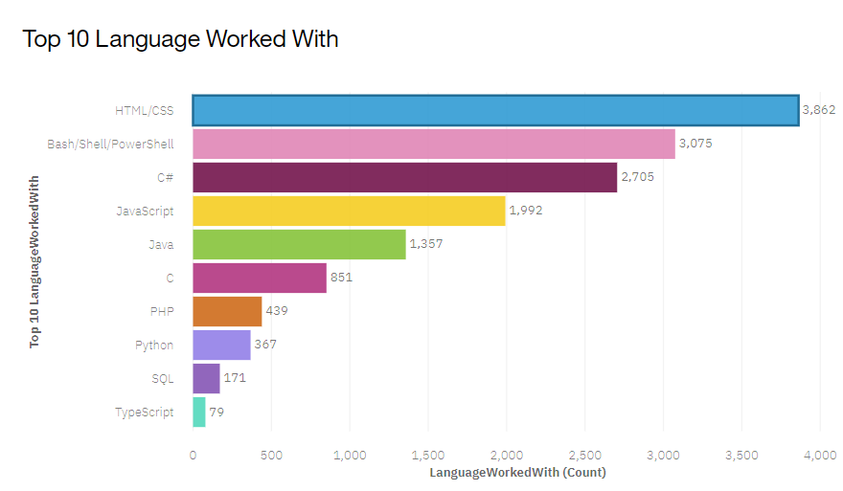
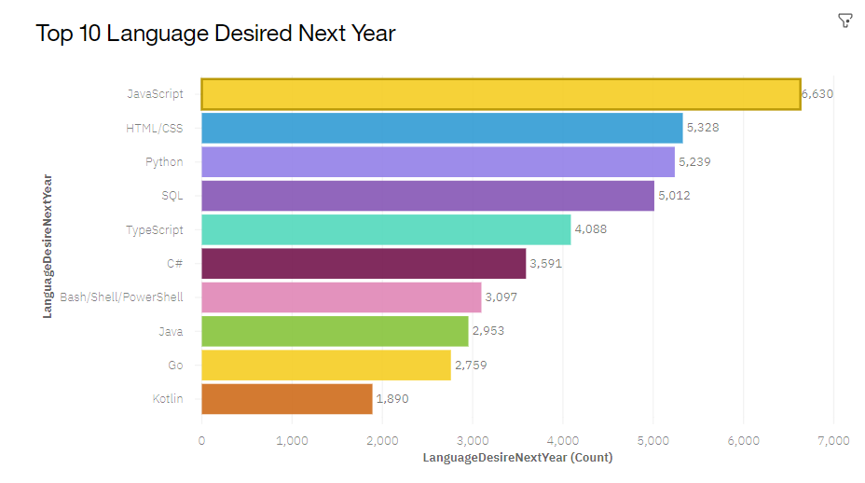
PROGRAMMING LANGUAGE TRENDS
Current Year
Next Year
<Bar chart of top 10 programming languages for the current year goes here.>
< Bar chart of top 10 programming languages for the next year goes here.>

Slide 8
PROGRAMMING LANGUAGE TRENDS - FINDINGS & IMPLICATIONS
Findings
Current most popular languages are HTML/CSS, Bash/Shell/PowerShell and C#
Future most popular languages are JavaScript, HTML/CSS and Python
Implications
HTML/CSS remain important languages in the programming industry
Python and JavaScript are becoming more important

Slide 9
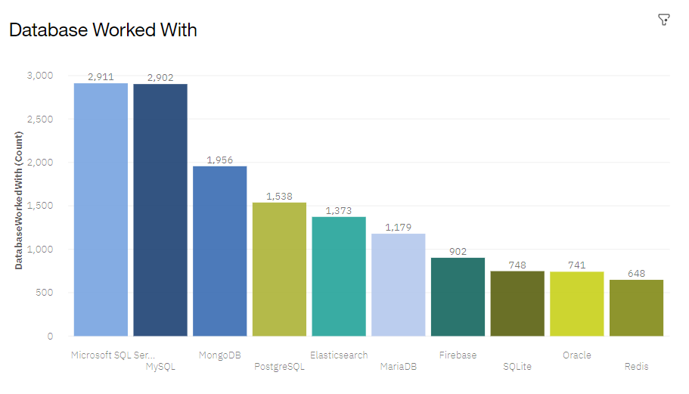
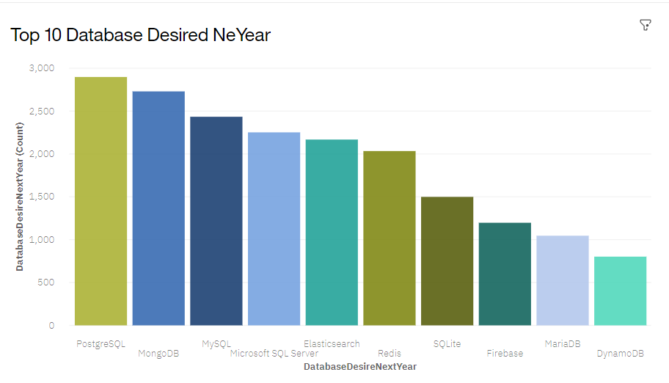
DATABASE TRENDS
Current Year
Next Year
< Bar chart of top 10 databases for the current year goes here >
< Bar chart of top 10 databases for the next year goes here.>

Slide 10
DATABASE TRENDS - FINDINGS & IMPLICATIONS
Findings
Currently most popular Databases are Microsoft SQL Server, MySQL and MongoDB
Future most popular Databases are PostgreSQL, MongoDB and MySQL
Implications
PostgreSQL is becoming more popular
MySQL and MongoDB remain important in the IT industry

Slide 11
RESPONDENTS – FINDINGS
Findings
Majority of the respondents were men
Most of the responses were from United States
Most of the respondents were in the age 22 – 35
Most of the respondents have Bachelor’s degree

Slide 12

DASHBOARD
The dashboard is available at:
https://eu-de.dataplatform.cloud.ibm.com/dashboards/f39cea65-6c09-40f3-9eb8-e4dc114e721e/view/7829c00a32ac68e276fcbde407ca2f007433275ebabbd20683d37b490d657197f33f1a99c82d4358de420130a7be1b59c8

Slide 13
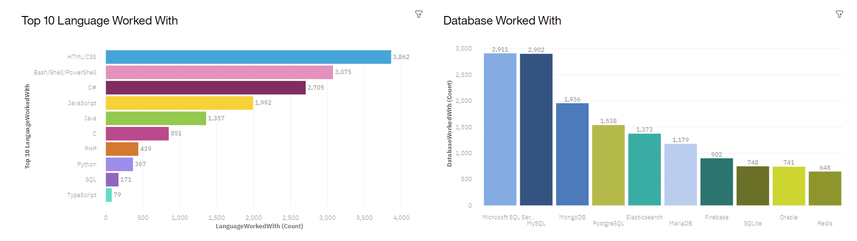
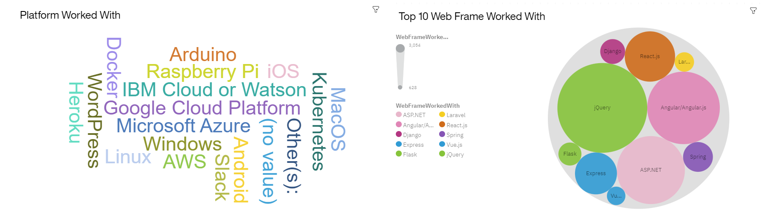
Current Technology Usage

Slide 14
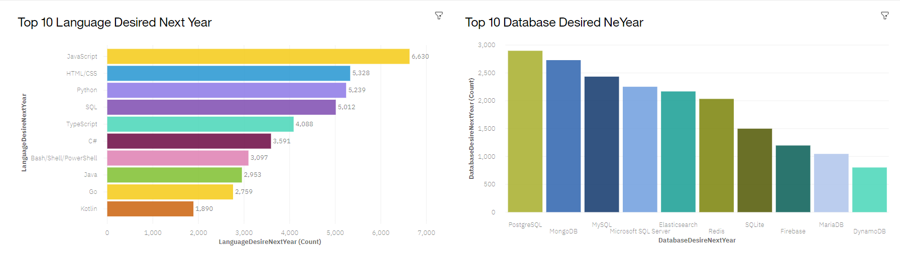
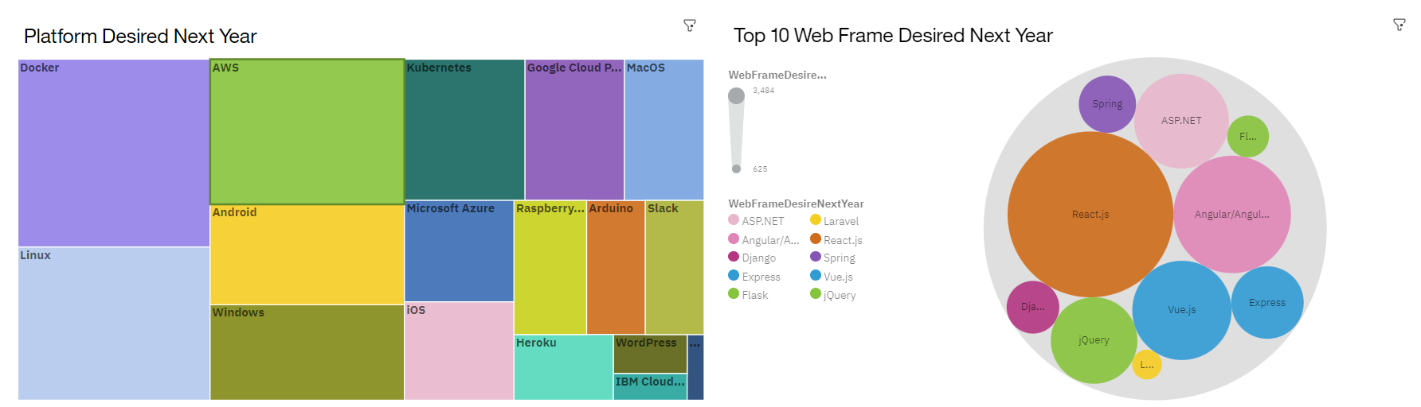
Future Technology Trend

Slide 15
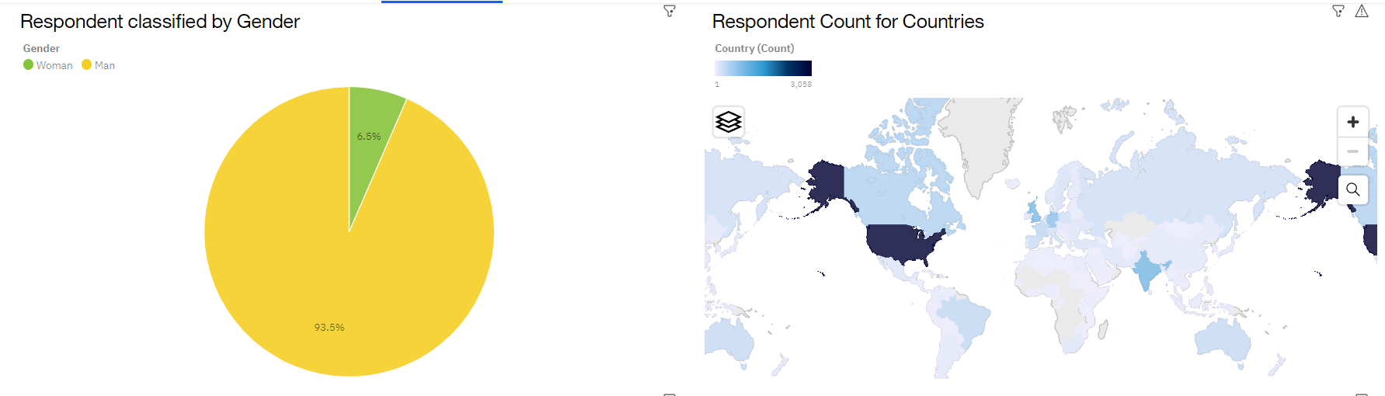
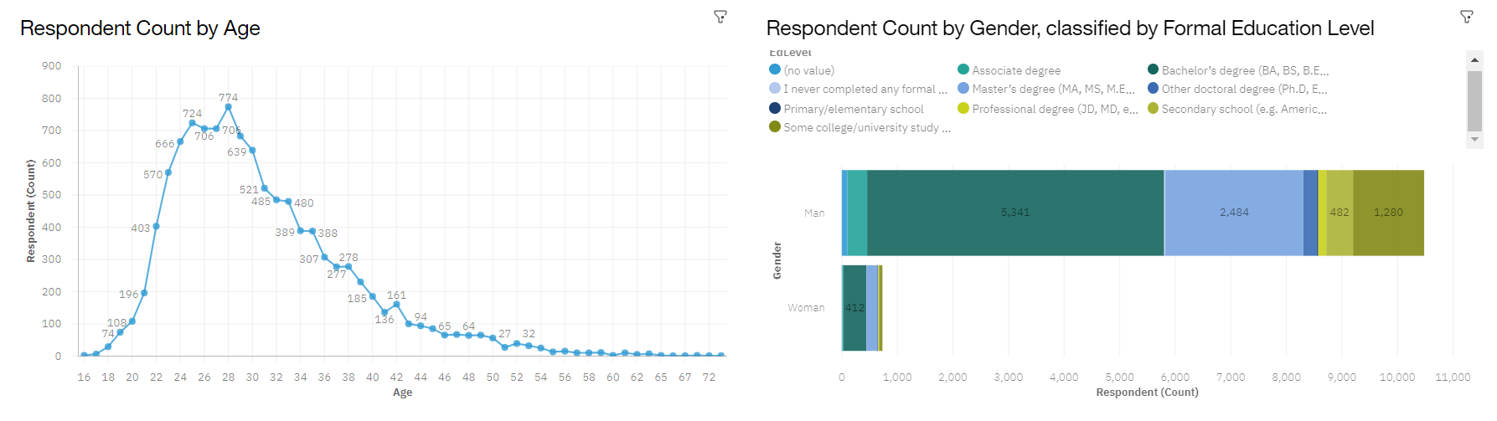
Demographics

Slide 16
DISCUSSION
How can we improve our products based on our findings?
How can we predict future salaries of programmers?
How does emerging technologies influence current and future trends?

Slide 17
Overall Finding and Implications
Findings
Current most popular languages are HTML/CSS, Bash/Shell/PowerShell and C#
Currently most popular Databases are Microsoft SQL Server, MySQL and MongoDB
Majority of the respondents were men
Implications
HTML/CSS remain important languages in the programming industry
PostgreSQL is becoming more popular
The problem of inequality is still unsolved in the IT industry

Slide 18

CONCLUSION
Some programming languages remain important, such as HTML/CSS and JavaScript, while other gain popularity, such as Python and SQL
In case of Databases, MongoDB and MySQL remain popular, while PostgreSQL is becoming more important
Among important platforms there is Docker, Linux, and AWS
Popular Web Frames include Query.js and React.js

Slide 19

APPENDIX
https://cf-courses-data.s3.us.cloud-object-storage.appdomain.cloud/IBM-DA0321EN-SkillsNetwork/labs/datasets/Programming_Languages.html
https://cf-courses-data.s3.us.cloud-object-storage.appdomain.cloud/IBM-DA0321EN-SkillsNetwork/labs/module%201/Accessing%20Data%20Using%20APIs/jobs.json

Slide 20
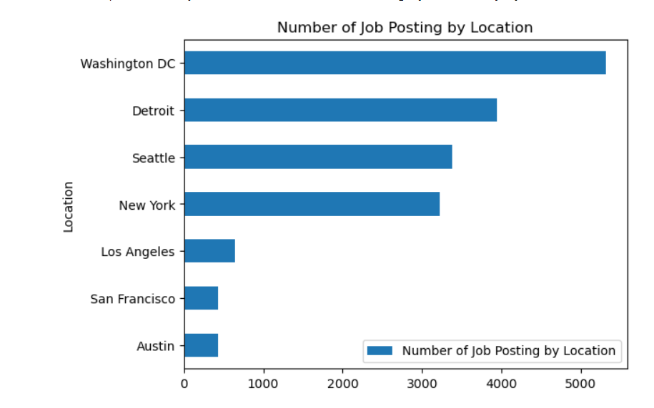
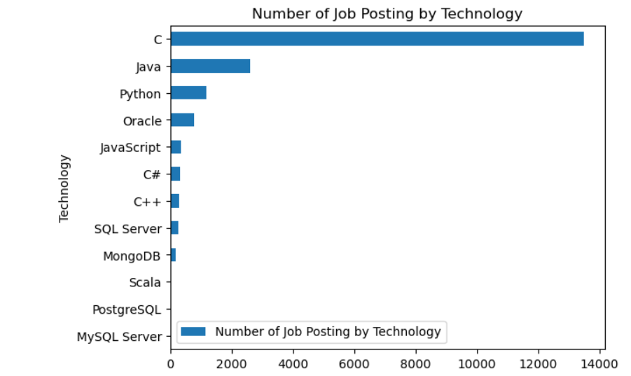
JOB POSTINGS

Slide 21
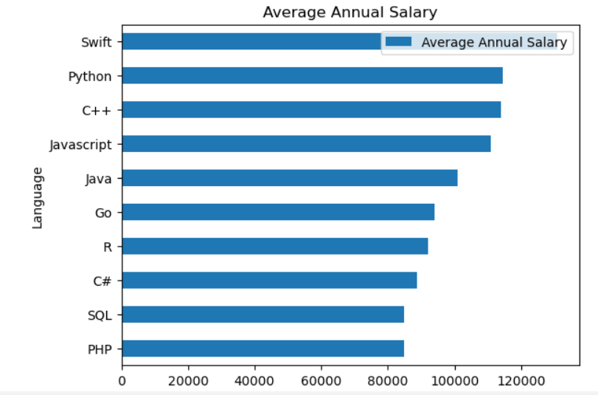
POPULAR LANGUAGES

