Slide 1
AIMMS Campus Robust optimization
Part 2: Static robust optimization

Slide 2
Part 2: Plan
The goal and the unavoidable issues
Defining the set of events to be robust to
Solution methods
Case study: World Food Programme
Exercises

Slide 3
The goal and the unavoidable issues

Slide 4
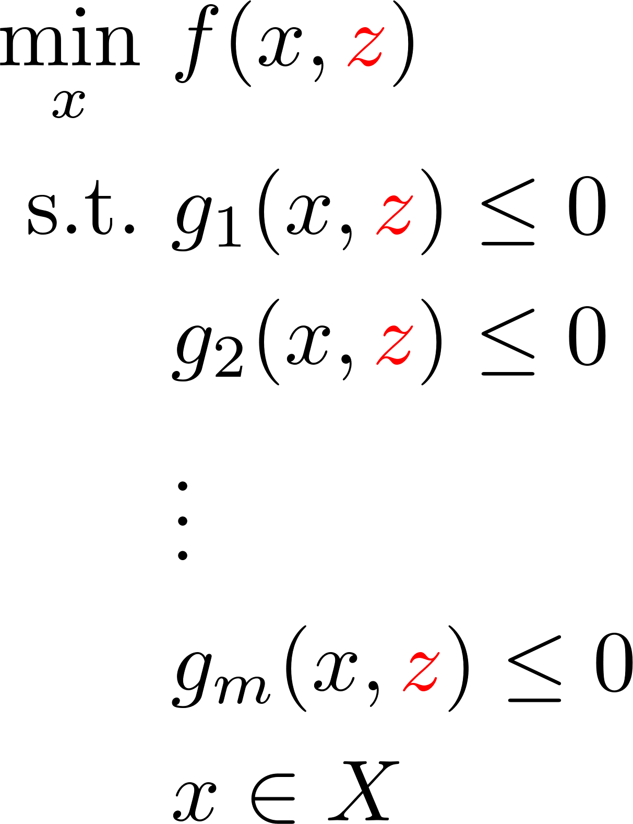
Uncertain model

Slide 5
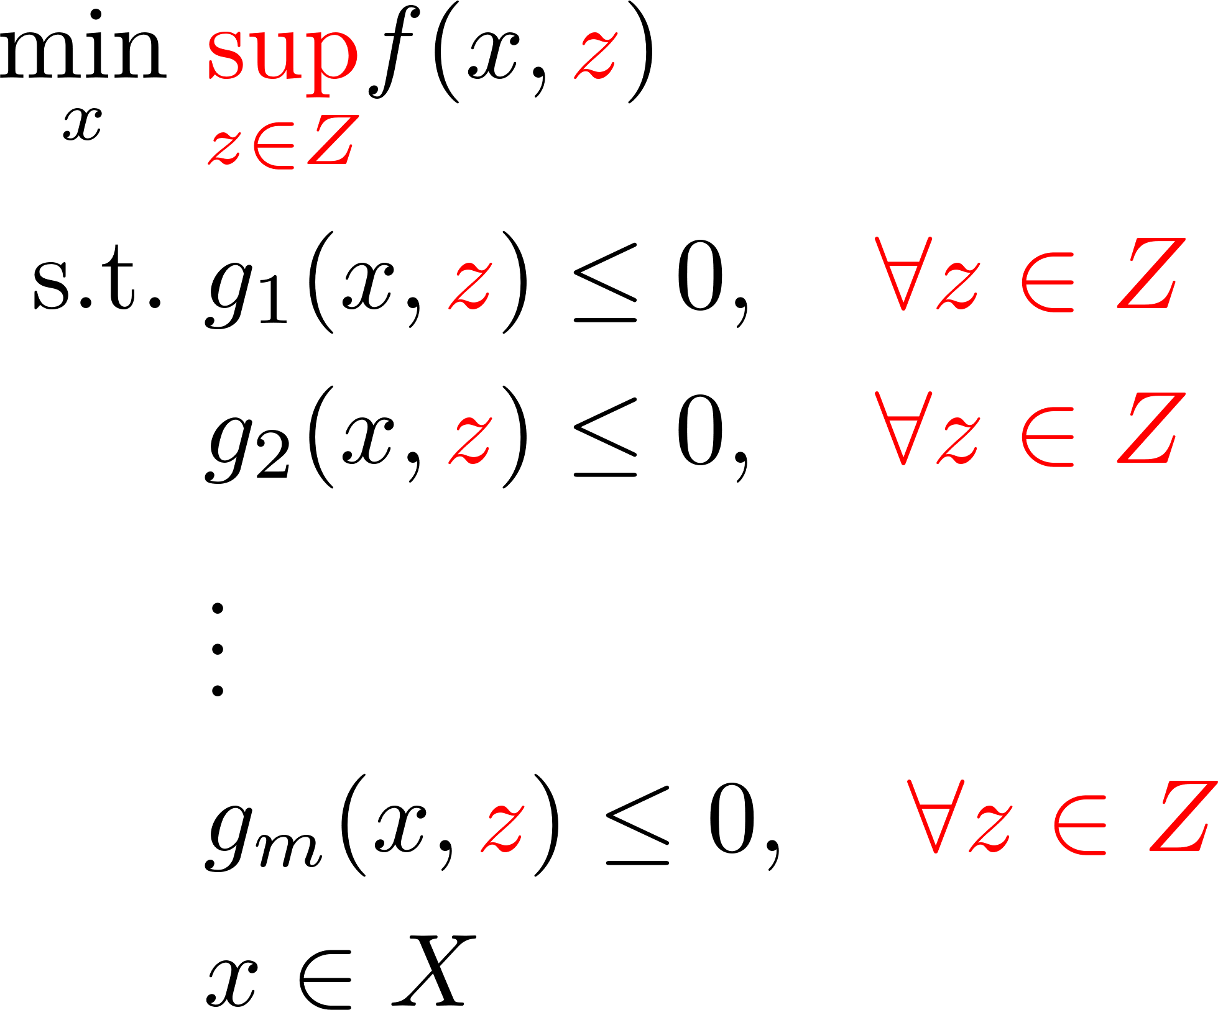
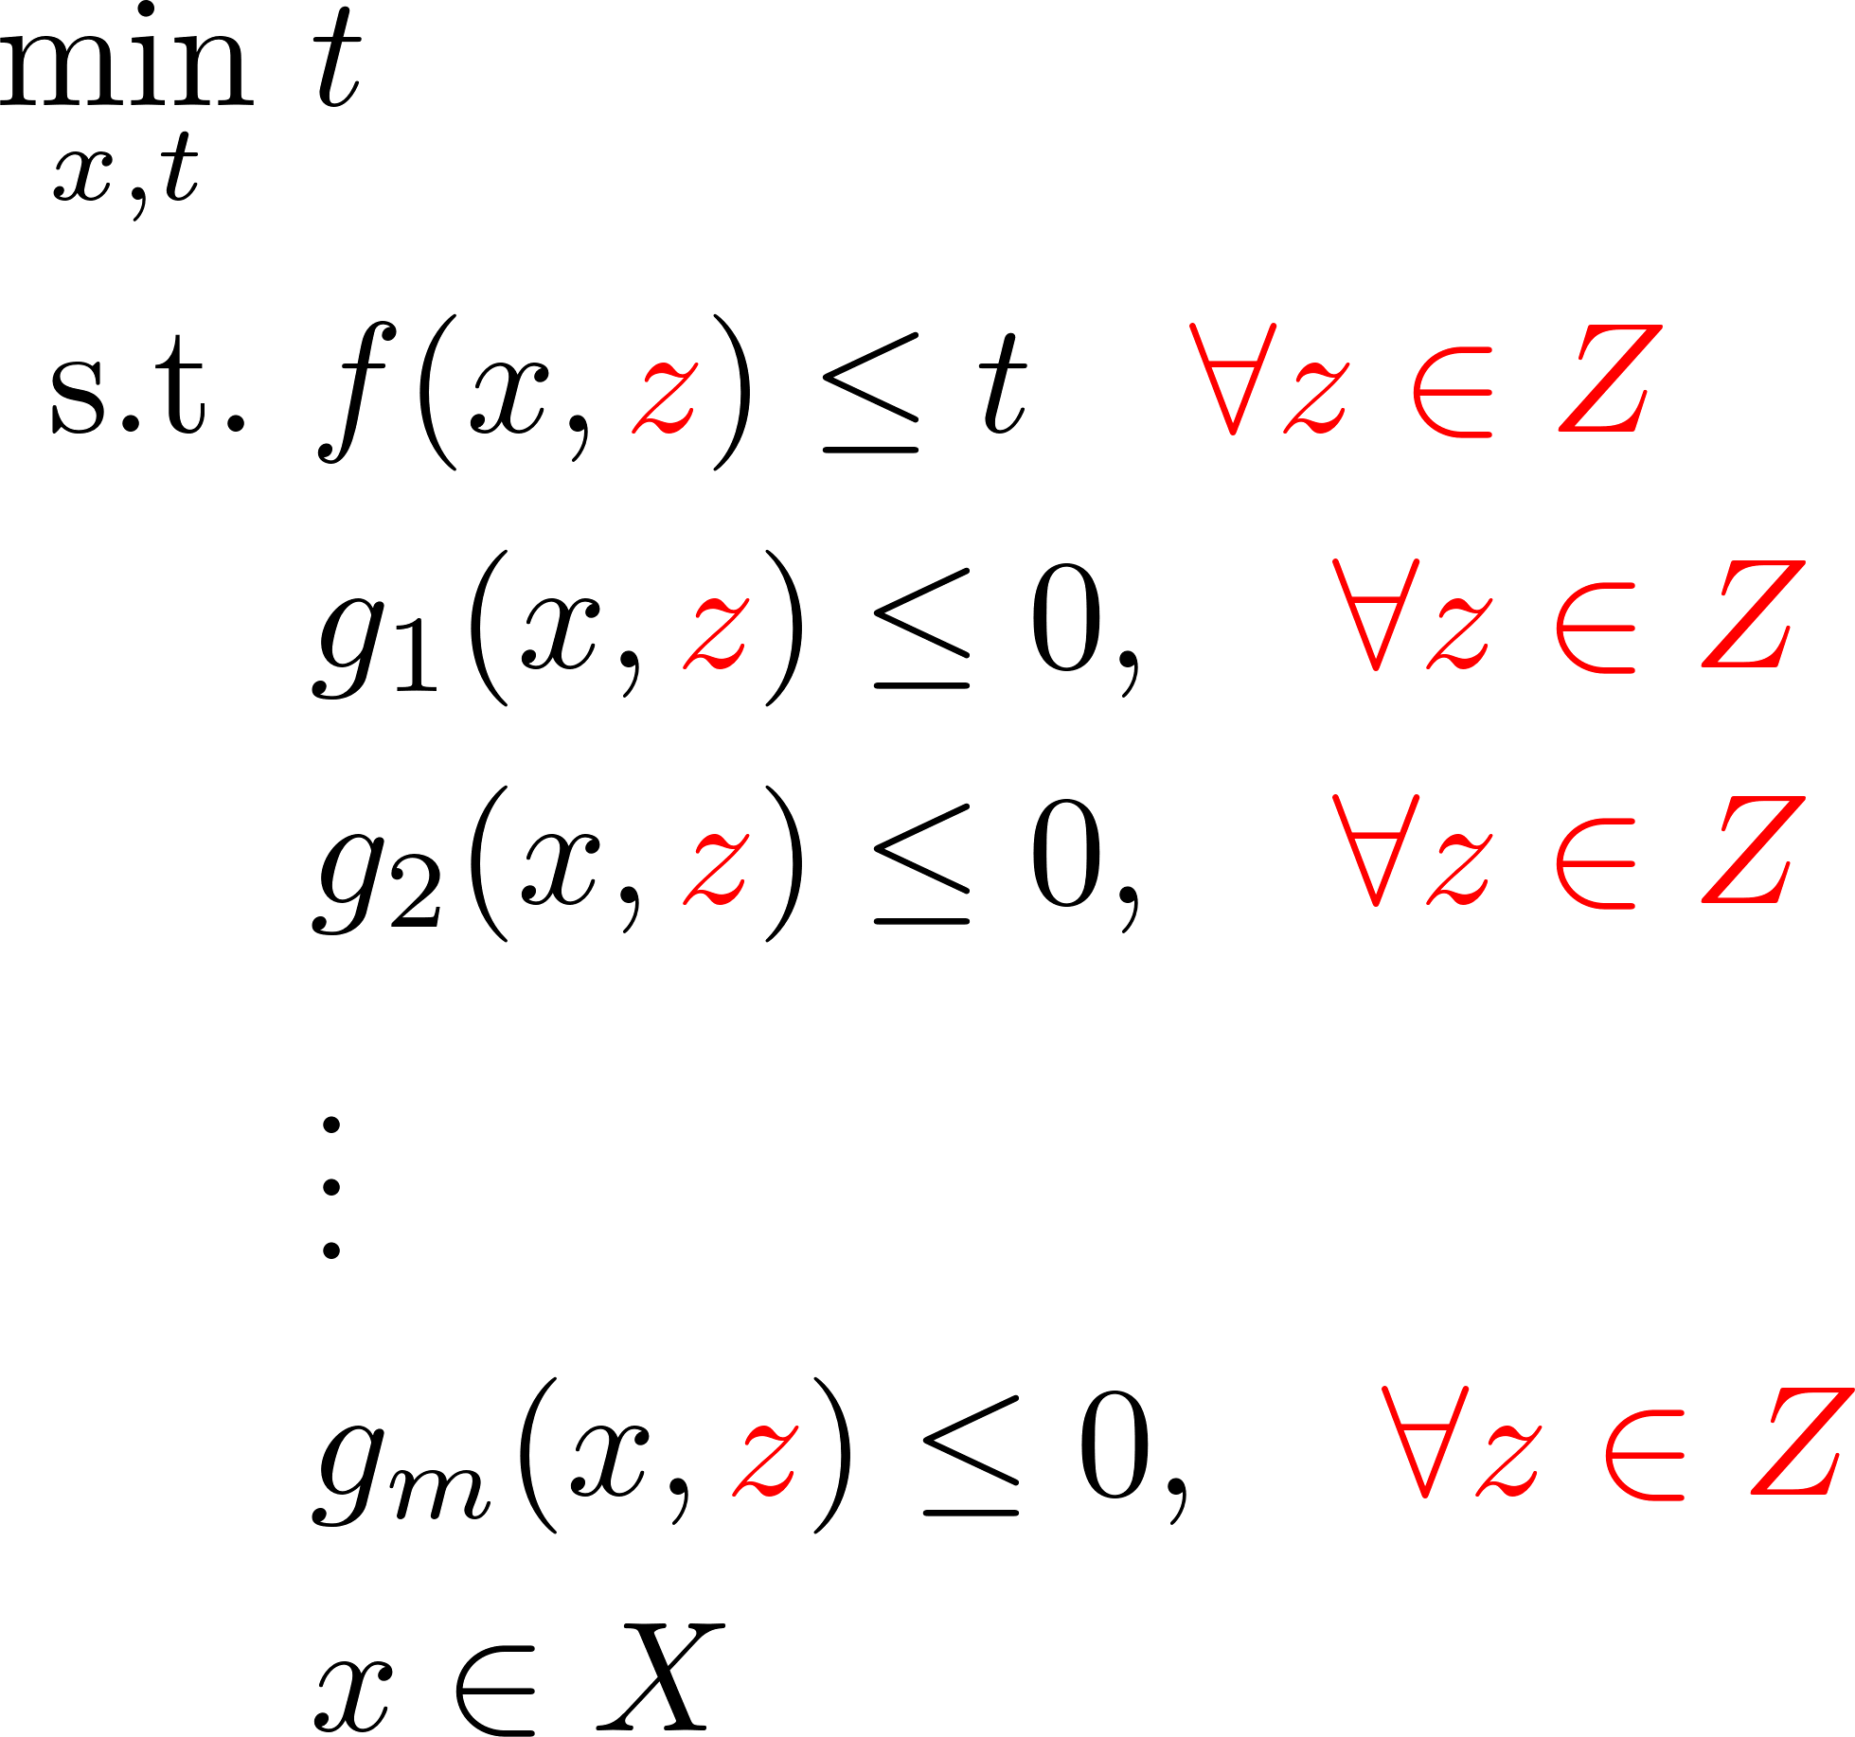

Optimize for the worst-case

Slide 6
Less solutions to choose from

Slide 7
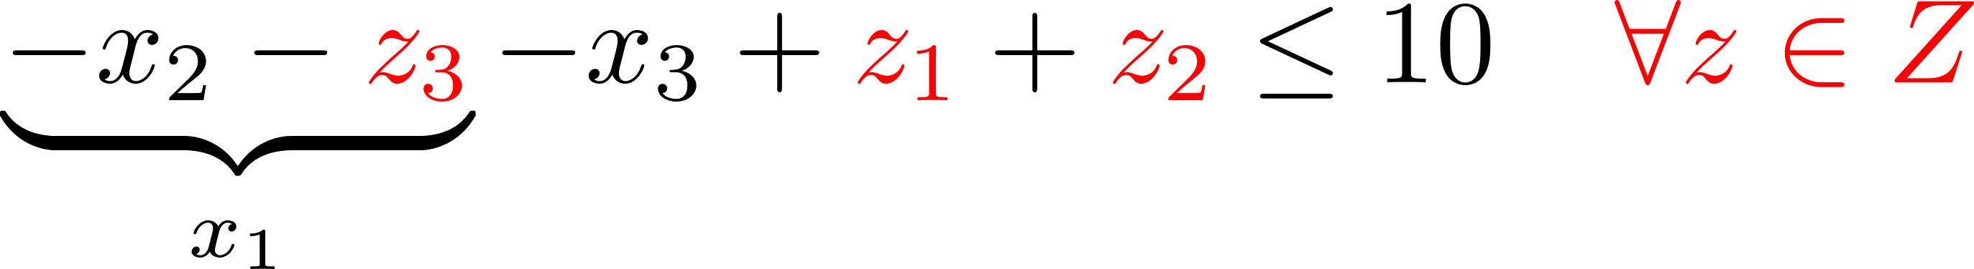
Modelling 1: Equality constraints
Solution: eliminate e.g. $x_{1}$ by means of
Plug it everywhere where $x_{1}$ was:

Slide 8
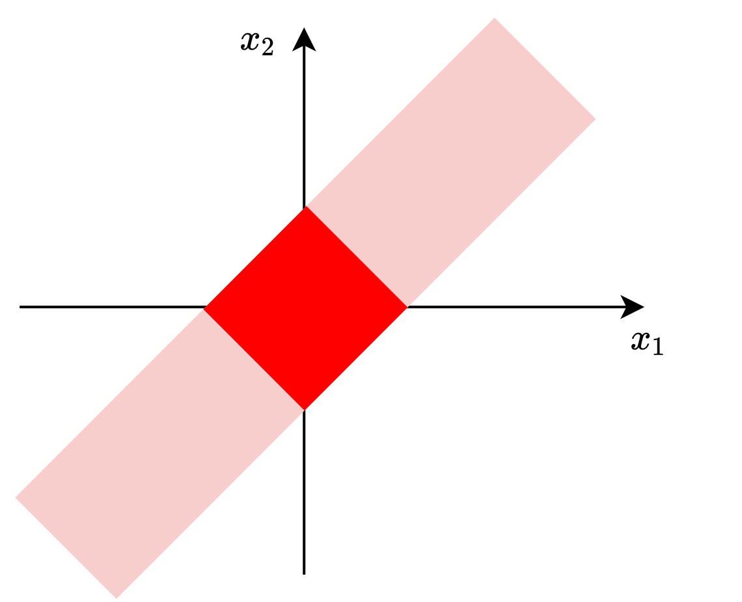
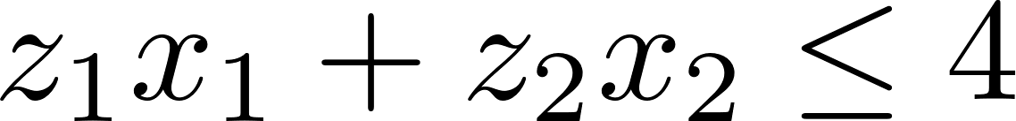
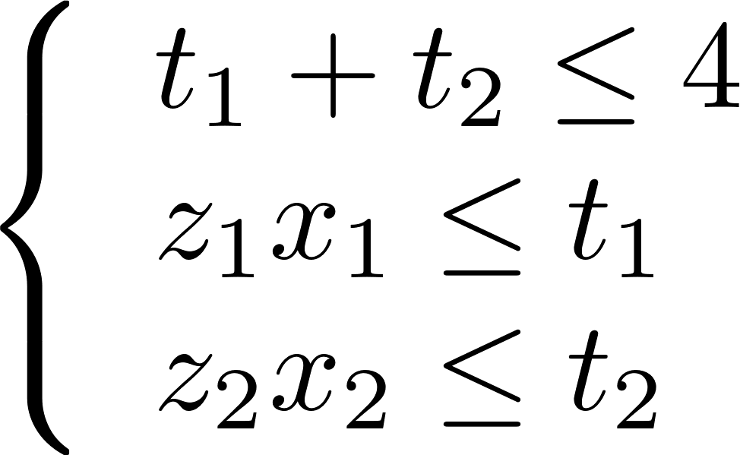
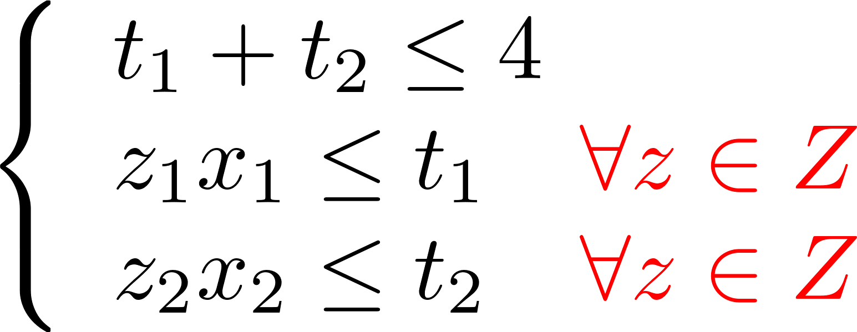
Modelling 2: (Non)-equivalent formulations
Compare:
and

Slide 9
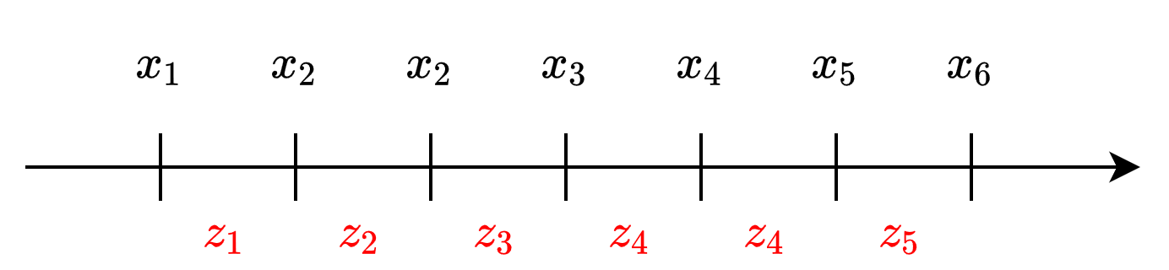
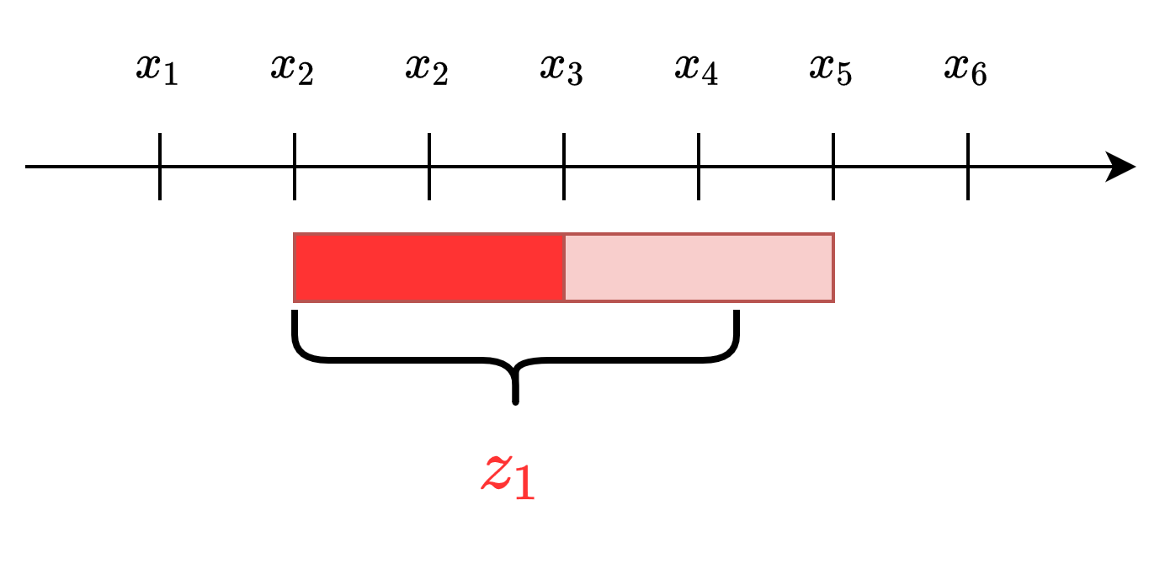
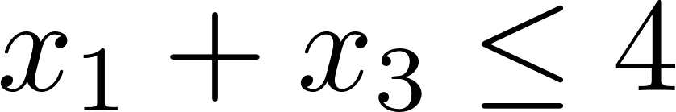
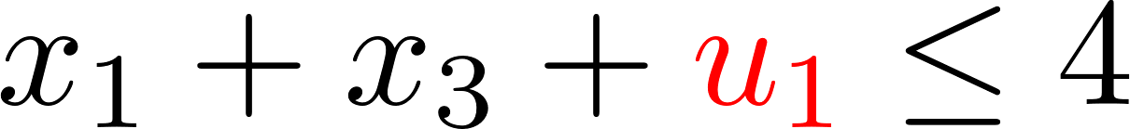
Modelling 3: (Non)-temporal uncertainty

Slide 10
Let’s discuss these issues on the problems we solved

Slide 11
Uncertainty sets

Slide 12
Optimize for the worst-case

Slide 13
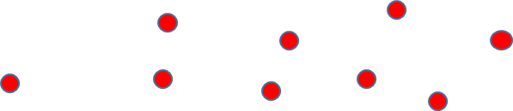
Building the uncertainty sets

Slide 14
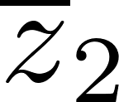
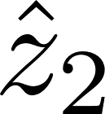
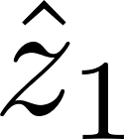
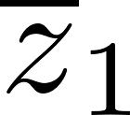
Budgeted uncertainty

Slide 15
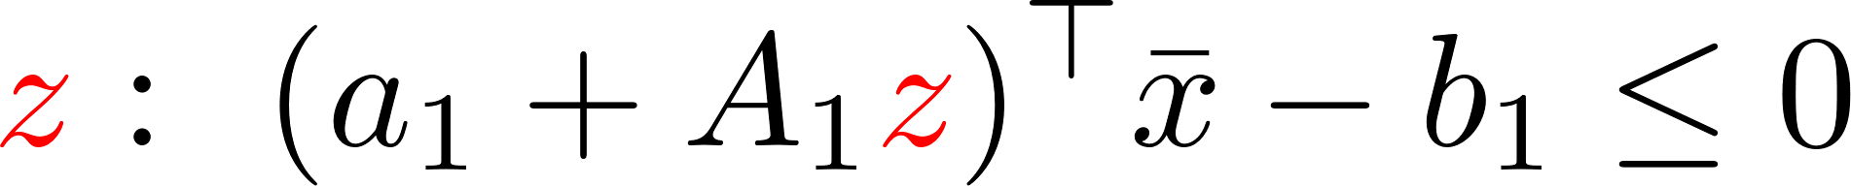
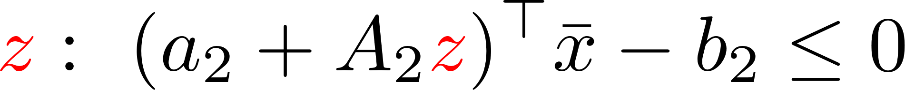
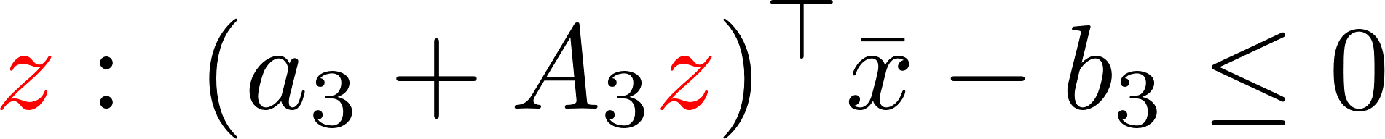
Uncertainty set construction
Important uncertainties
How much can you chew
Avoid „everything going wrong at the same time
Calibration after solving

Slide 16
Let’s practice uncertainty set selection on our problems

Slide 17
Solution methods

Slide 18
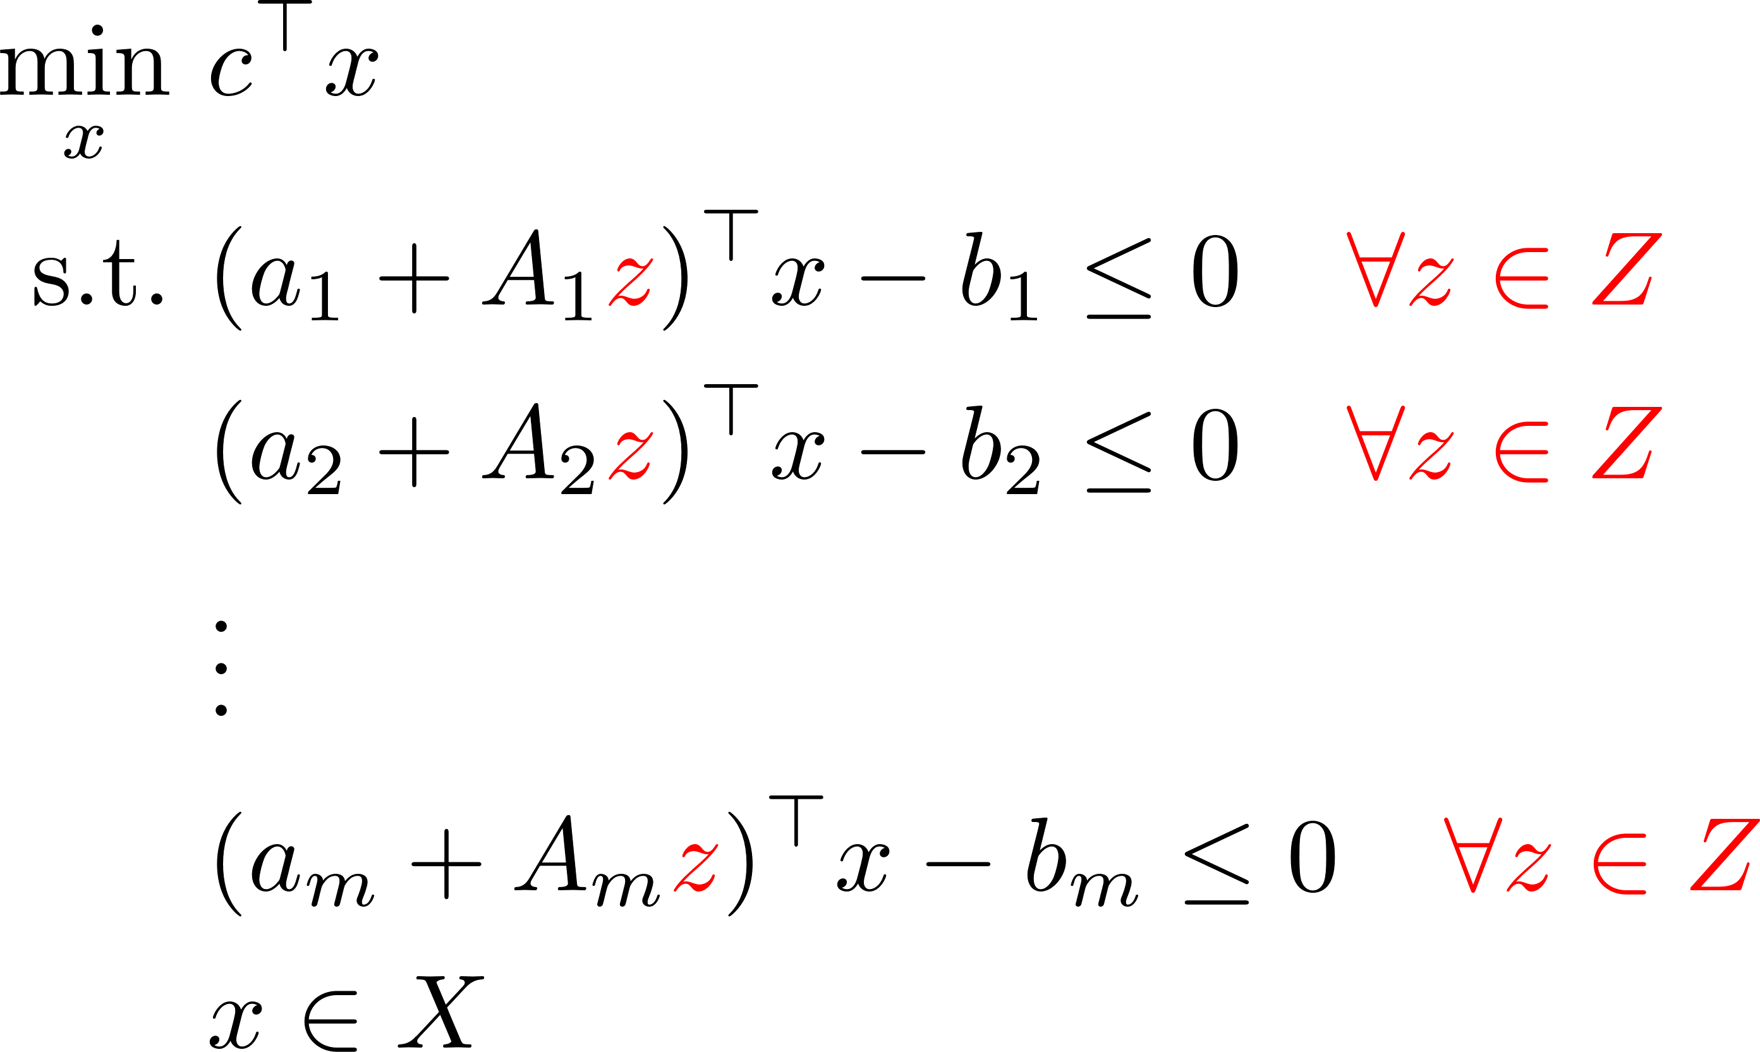
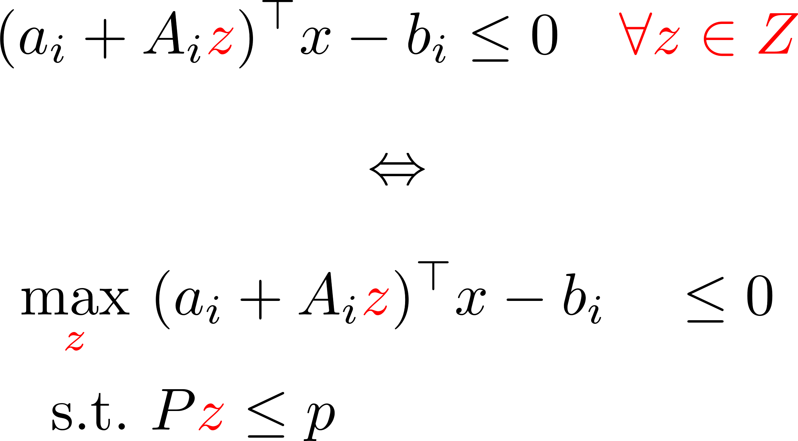

From now on – linear setting

Slide 19
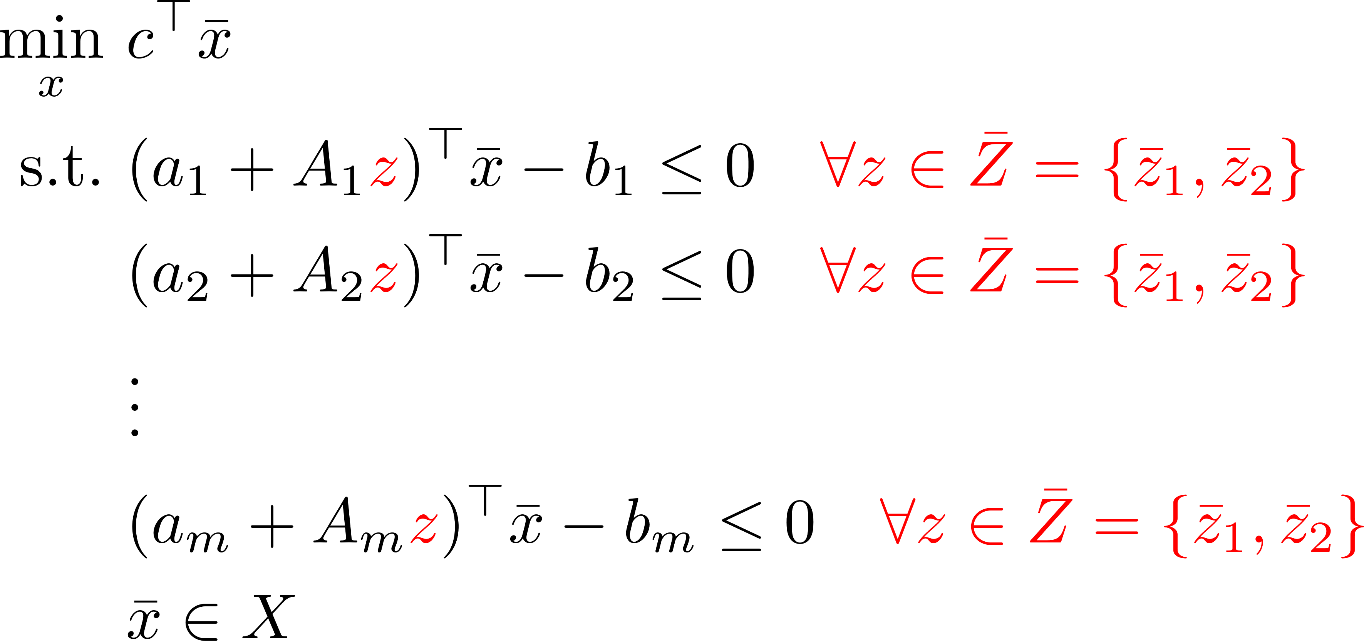
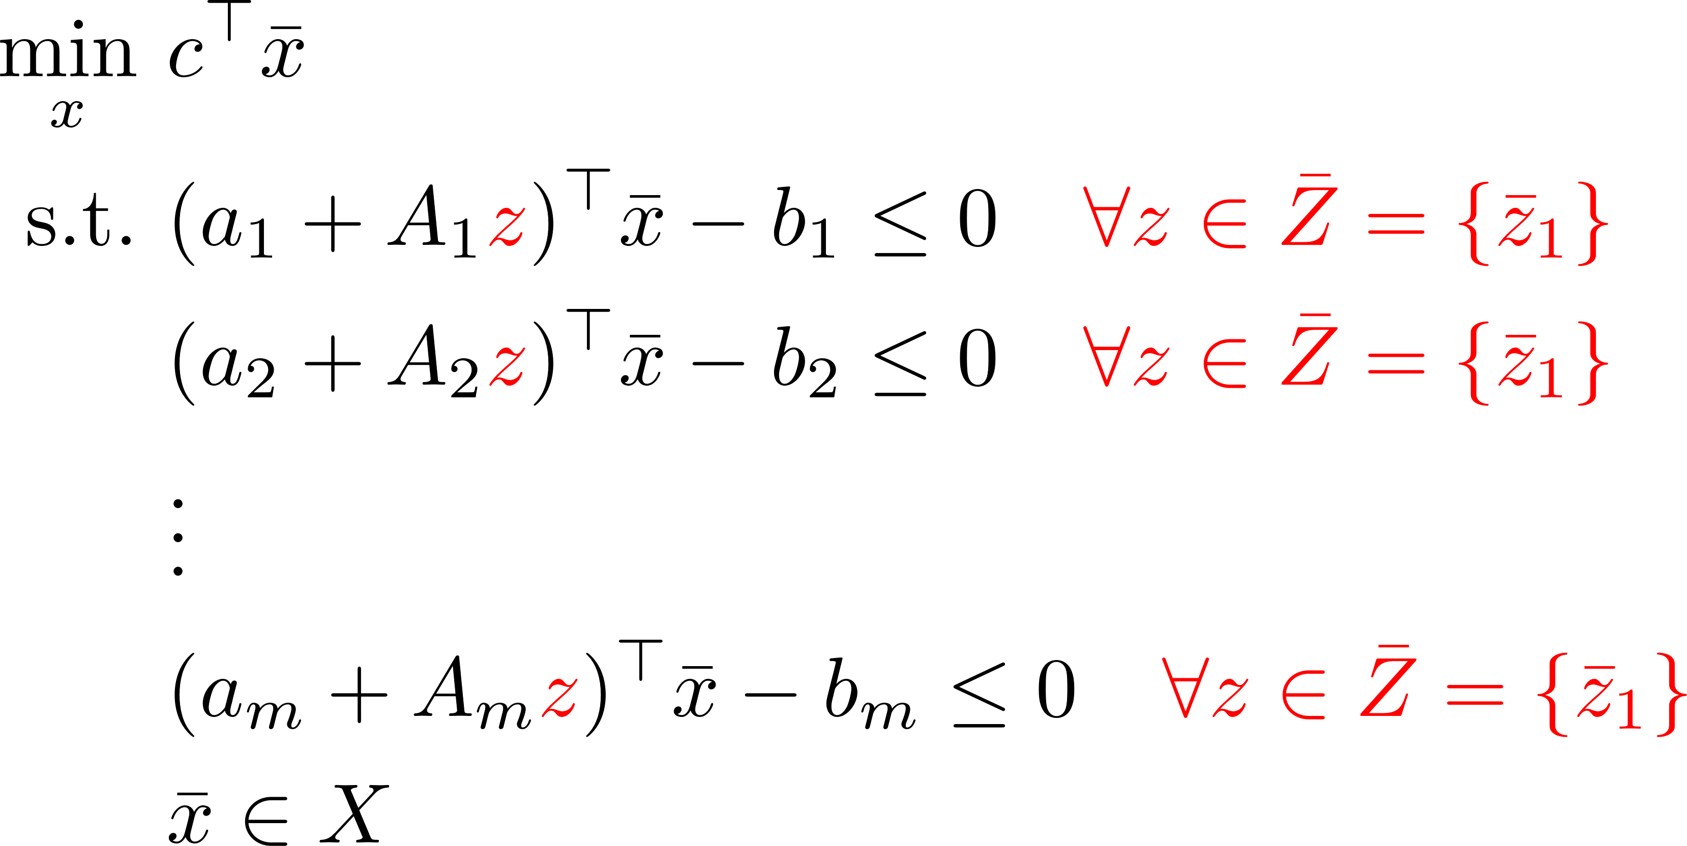


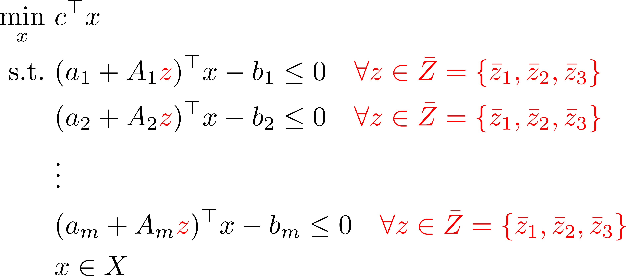
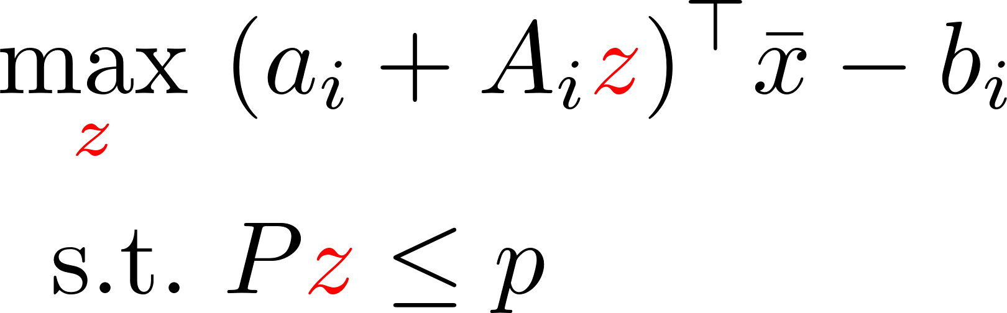
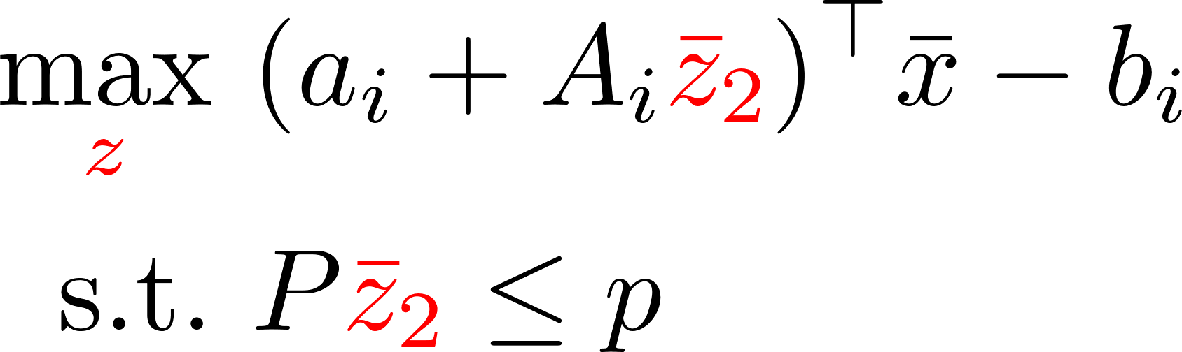

Adversarial approach
Master problem
Pessimization subproblem

Slide 20


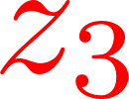

Slide 21
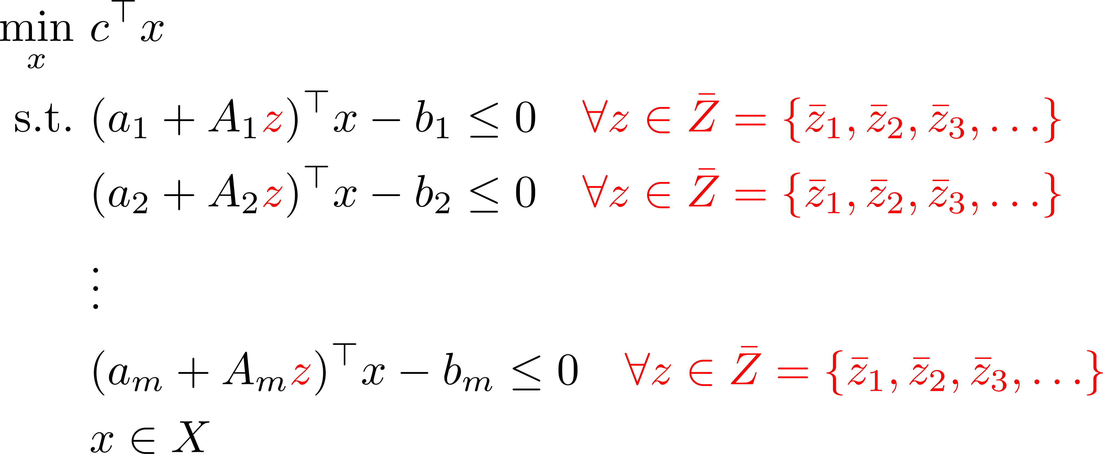
Adversarial approach criticism

Slide 22

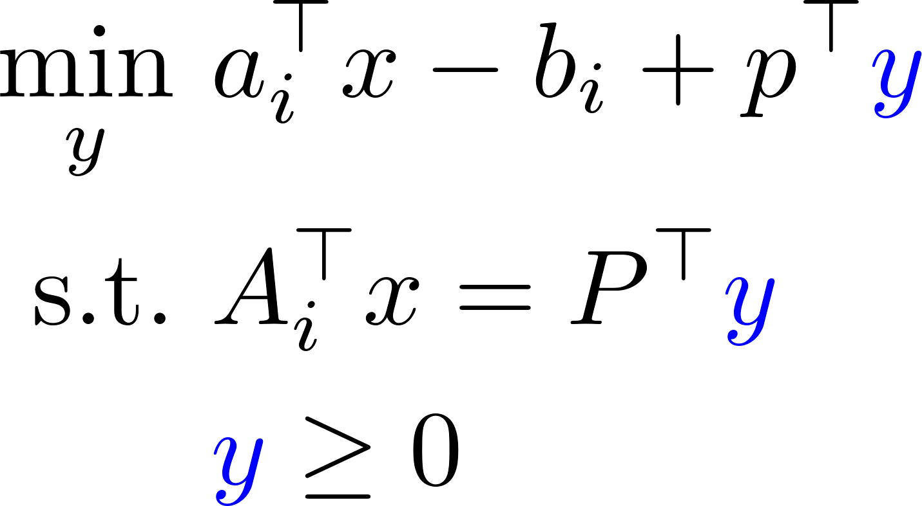
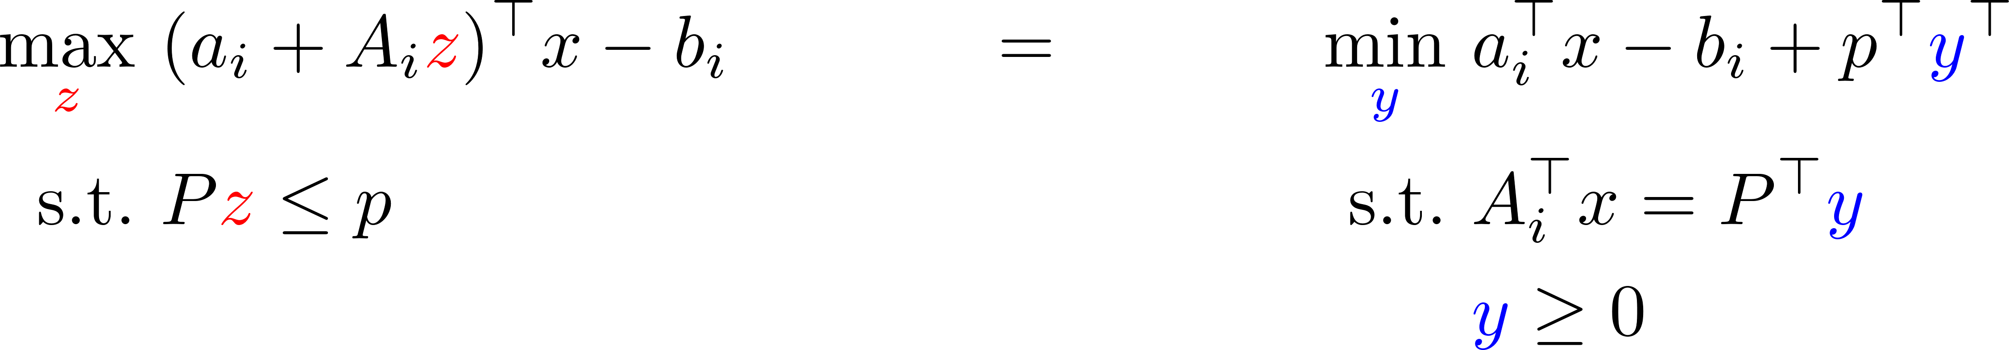
Self-choosing worst-case scenario
Primal problem
Dual problem

Slide 23
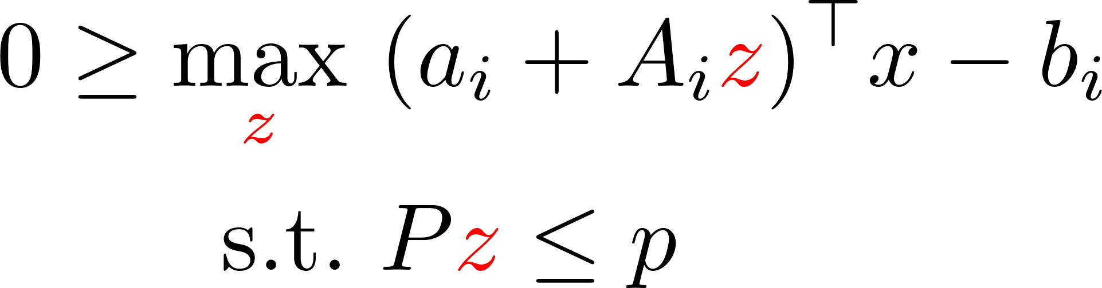
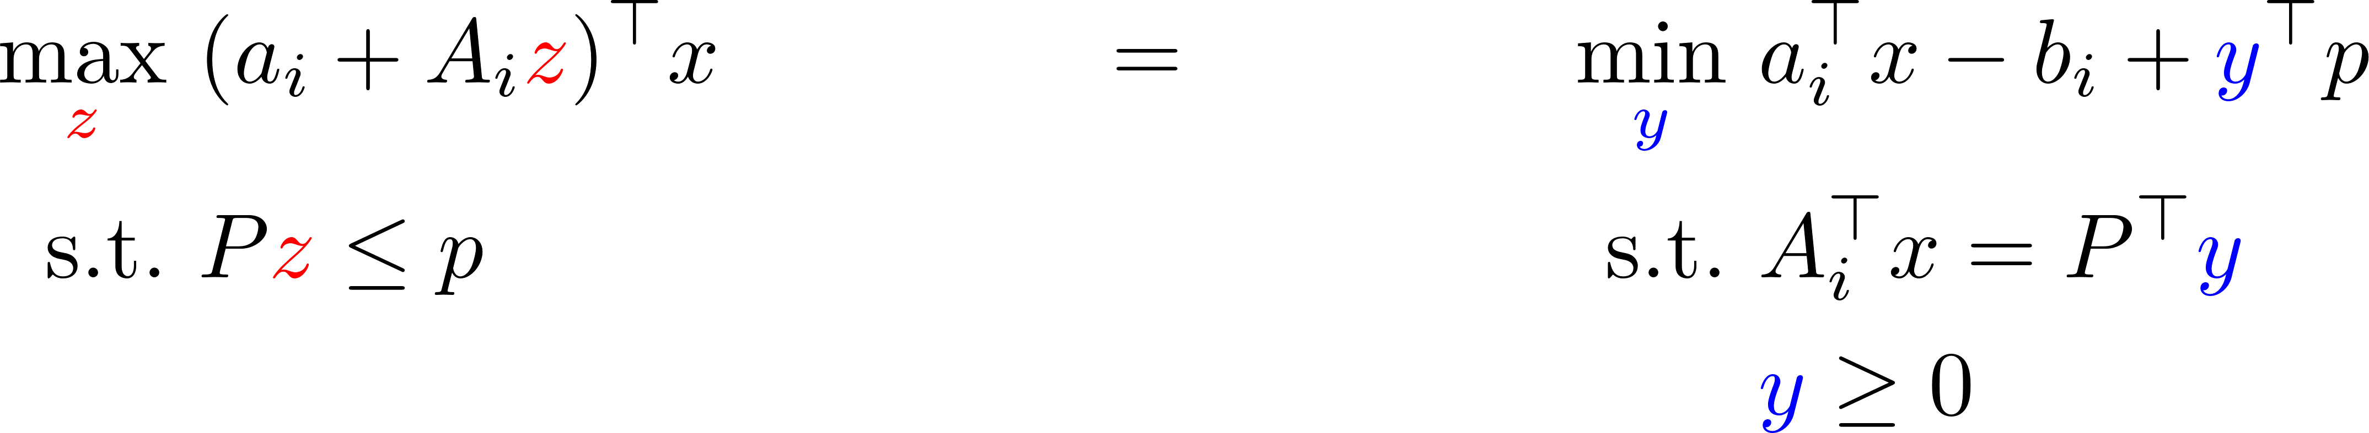
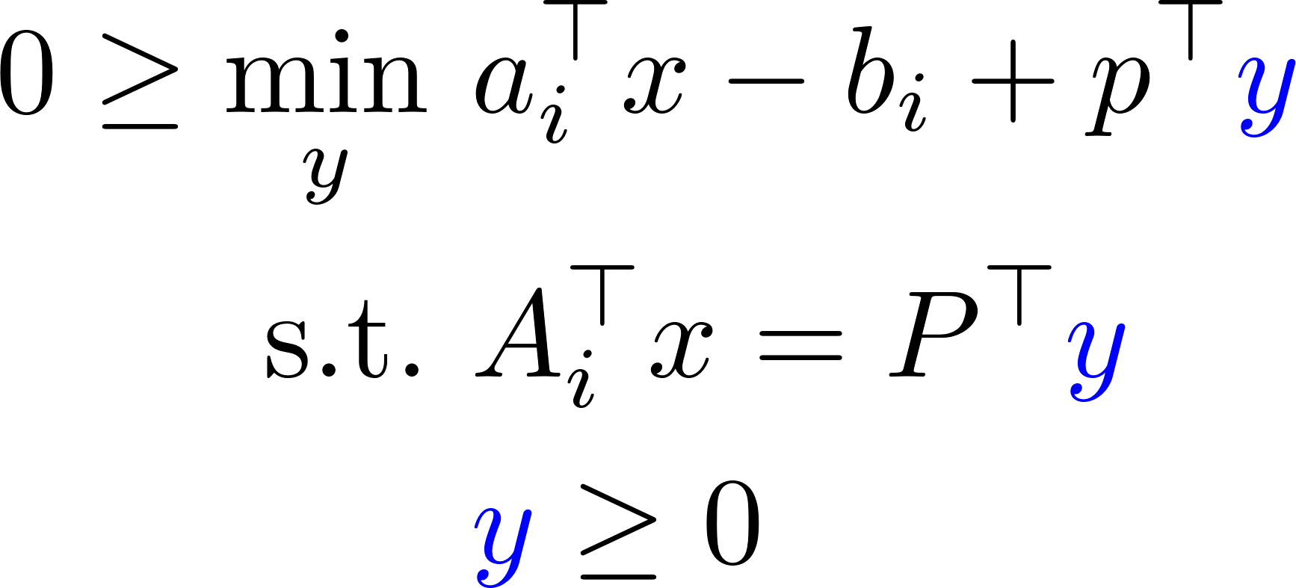
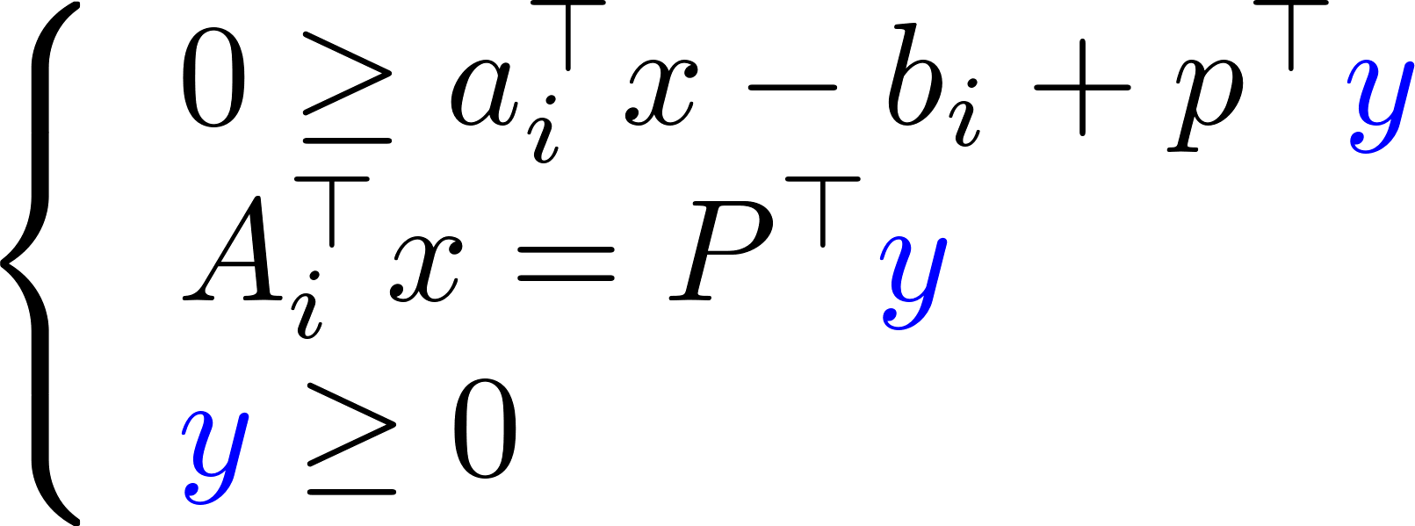
Key trick
We want
We know
Hence we take

Slide 24
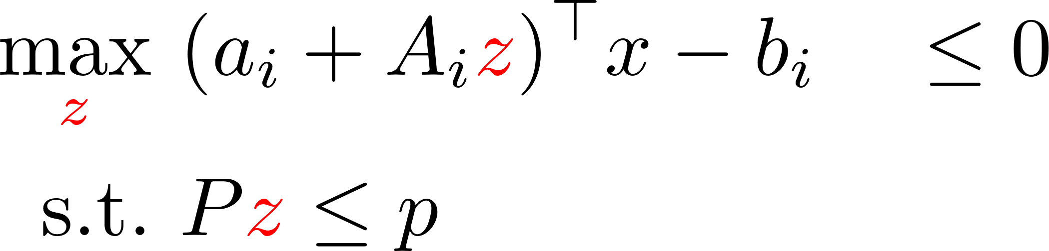
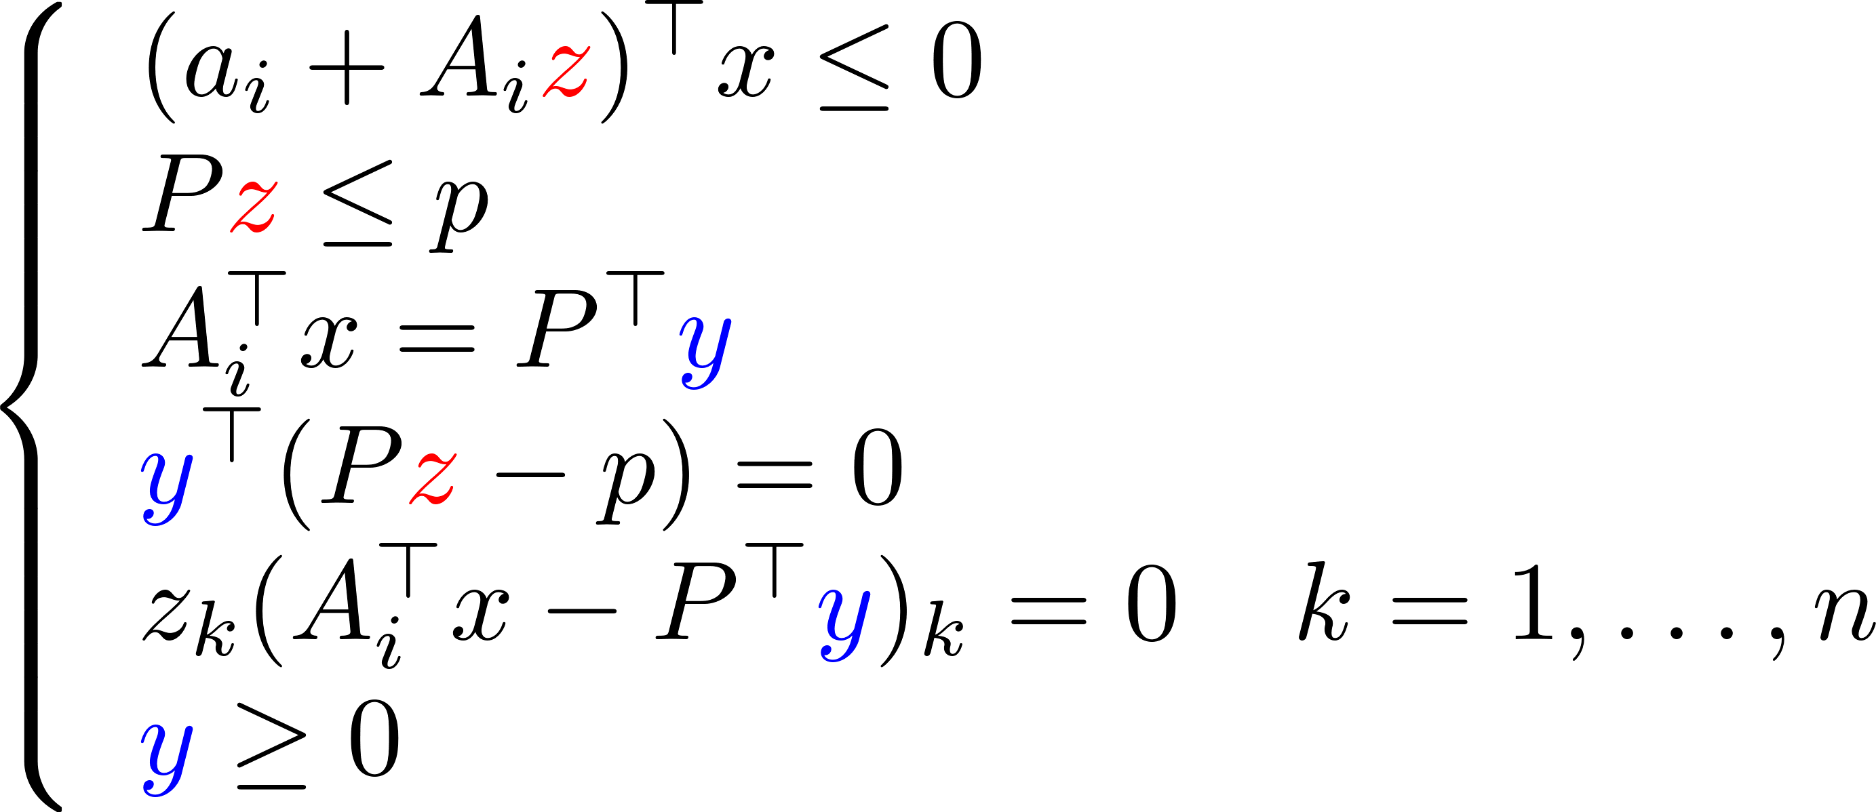
What just happened
KKT conditions:

Slide 25
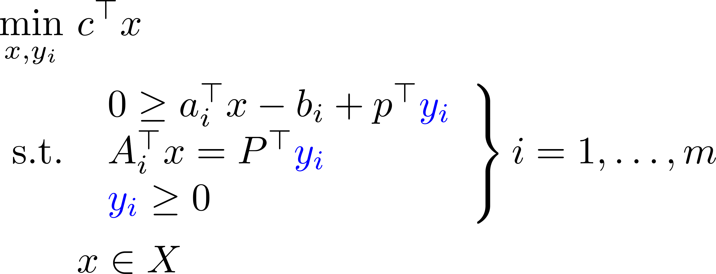
Problem becomes

Slide 26
Summary
Adversarial approach
Simple to implement
Fast on moderate size problems
Problem size increases
Typically never reach full robustness
Robust counterparts
Concise
Single problem to solve
Problem size increases at the start
Deriving the robust counterparts
What if uncertainty integer?

Slide 27

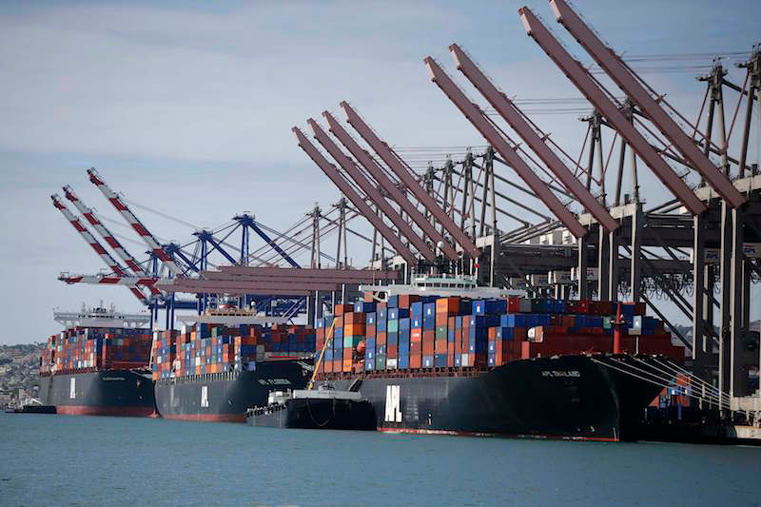
Main sources of uncertainty
Procurement price forecasting
Port congestion prediction

Slide 28
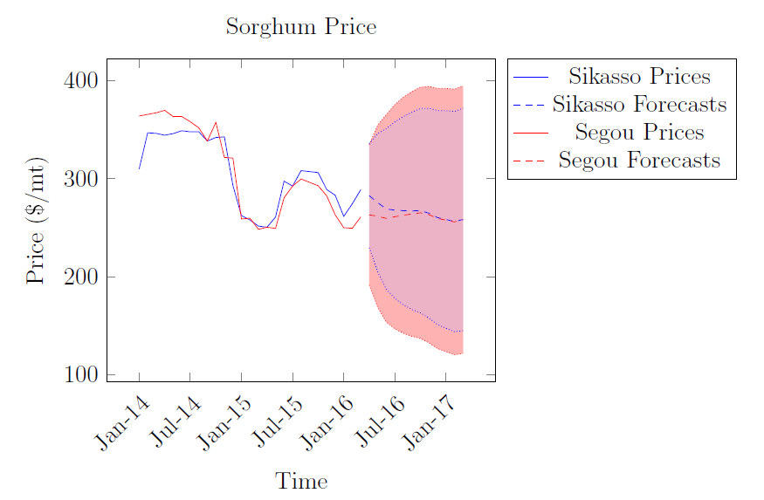
Need for robustness
Uncertainty in procurement prices & exchange rates
Source: Badenbroek (2017)

Slide 29

ROBUST OPTIMIZATION
OPTIMIZATION
REALITY

Slide 30

Multi-commodity min cost flow model
$$\min_{F}{ }\sum_{i∈N_{S},j,k}{pc_{ik}∗F_{ijk}+\sum_{i,j,k}{tc_{ijk}∗F_{ijk}+\sum_{i,j,k}{hc_{j}∗F_{ijk}}}}$$
s.t.:
Flow is preserved $\sum_{i}{F_{ijk}=\sum_{i}{F_{jik}, ∀j∈N_{P}∪N_{W}, ∀k∈K}}$
All beneficiaries receive a food basket $\sum_{i}{F_{ijk}≥dem_{j}∗rat_{k}, ∀j∈N_{B}, ∀k∈K}$
Flows are non-negative $F_{ijk}≥0, ∀i∈N,j∈N,k∈K$
uncertain
+ capacities on the nodes and arcs
Notes:
template

Slide 31
Multi-commodity min cost flow model
uncertain
$$\min_{F}{ }\sum_{i∈N_{S},j,k}{pc_{ik}∗F_{ijk}+\sum_{i,j,k}{tc_{ijk}∗F_{ijk}+\sum_{i,j,k}{hc_{j}∗F_{ijk}}}}$$
$=p^{T}q$
Worst-case
Put all $pc_{ik}$ into one vector $p$
Put all ${\sum_{j}{F_{ijk}}}_{}$ into one vector $q$
$${\overline{p}}^{T}q+ θ\sqrt{q^{T}Vq}$$
where $\overline{p}$ is the expectation, and $V$ the covariance matrix
Notes:
template

Slide 32
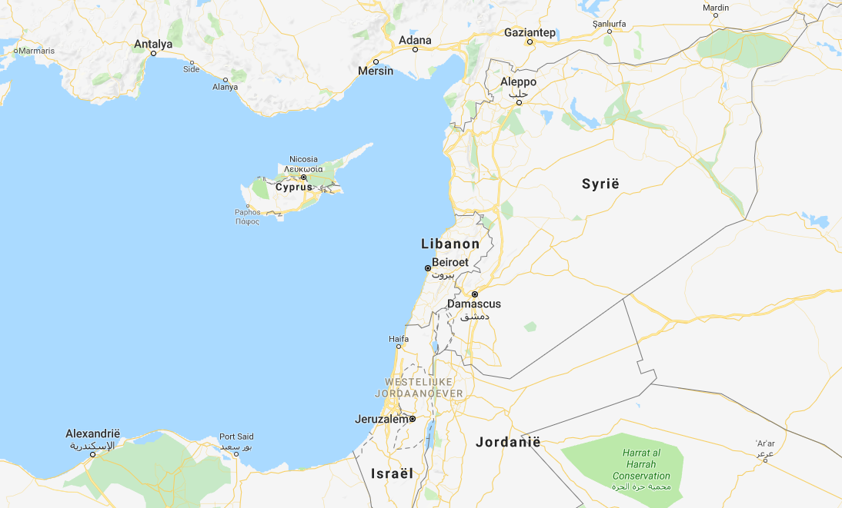





Syria case
Food basket
>
Sourcing
>
Delivery

Slide 33
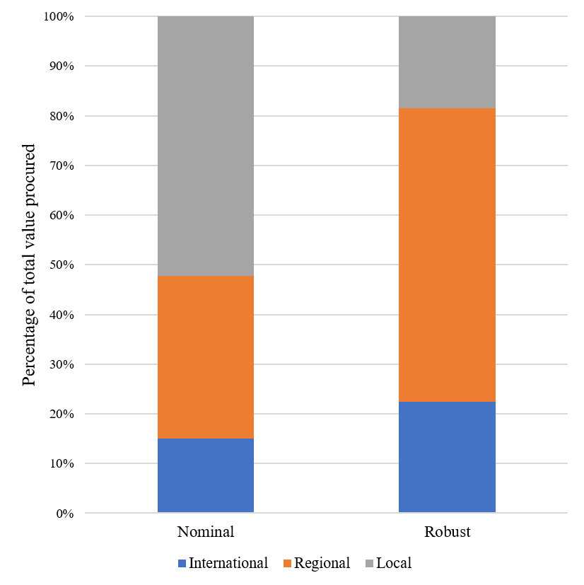
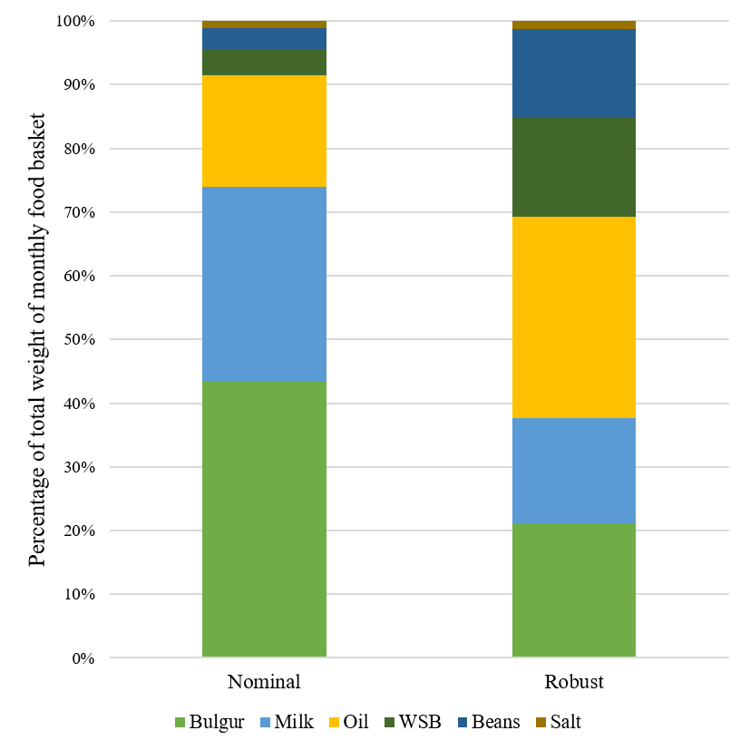
Robust vs. Nominal

Slide 34
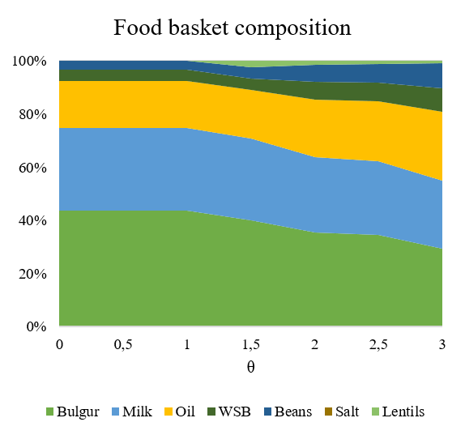
Food basket composition

Slide 35
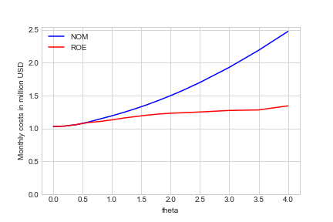
WC comparison Nominal and Robust solution

Slide 36
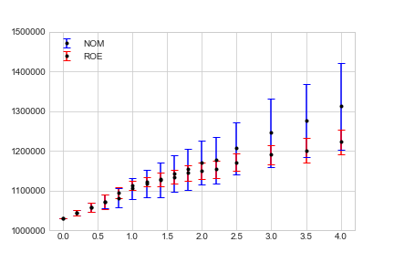
„Robust” solution = higher risk mitigation than „Nominal”
Sampling from the ellipsoidal uncertainty set
Monthly costs
in USD
θ

Slide 37
Exercises

Slide 38
Exercise
Formulate a robust optimization version of the problems we considered
Encode them into Python

