Slide 1
AIMMS Campus Robust optimization
Part 1: Uncertainty and its impact

Slide 2
About myself
PhD in Operations Research, Tilburg University
2016-17: Postdoc at the Technion – Israel Institute of Technology with Aharon Ben-Tal – the „father” of robust optimization
2017-20: Erasmus University Rotterdam
2020-now: TU Delft
Research: mostly robust optimization
Currently co-authoring a textbook: https://jckantor.github.io/MO-book/intro.html
Consulting work since 2021

Slide 3
Idea of this course in one slide

Slide 4
Setting the expectations
Optimization is usually deployed on large problems
Adding uncertainty to a model only makes it larger
So the pragmatic goal should be:
build, without overcomplicating the model, a solution that avoids huge disruptions that can follow from small data changes

Slide 5
Plan of the three parts of this course
Robustness analysis
Static robust optimization
Adjustable robust optimization

Slide 6
Coding-wise
First: simple modelling in Python to see the mathematical inner workings
Then, show you how to use the AIMMS robust optimization module
Resources
http://github.com/krzysztofpostek/AIMMS_campus

Slide 7
Part I – Motivation and robustness analysis
Mathematical optimization & Uncertainty
What Machine Learning gets right and Optimization doesn’t
Case study: World Food Programme
Outline of the rest of the course.
Mathematical and coding exercises

Slide 8
Mathematical optimization & Uncertainty

Slide 9
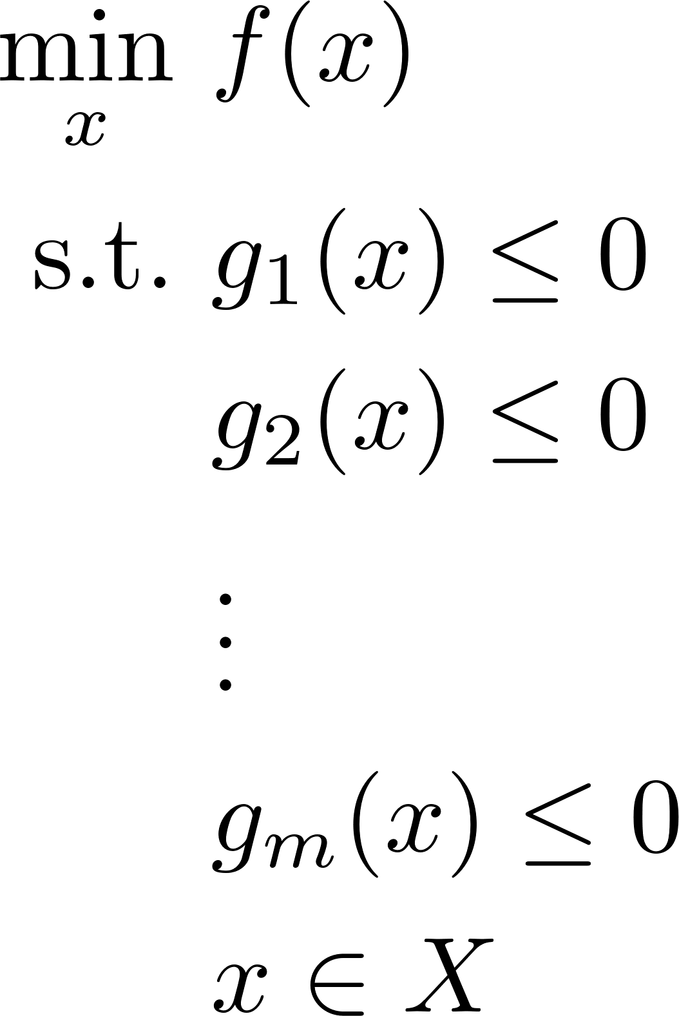
Mathematical optimization

Slide 10
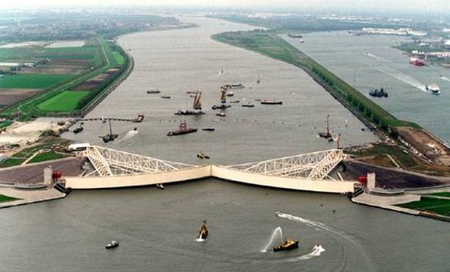
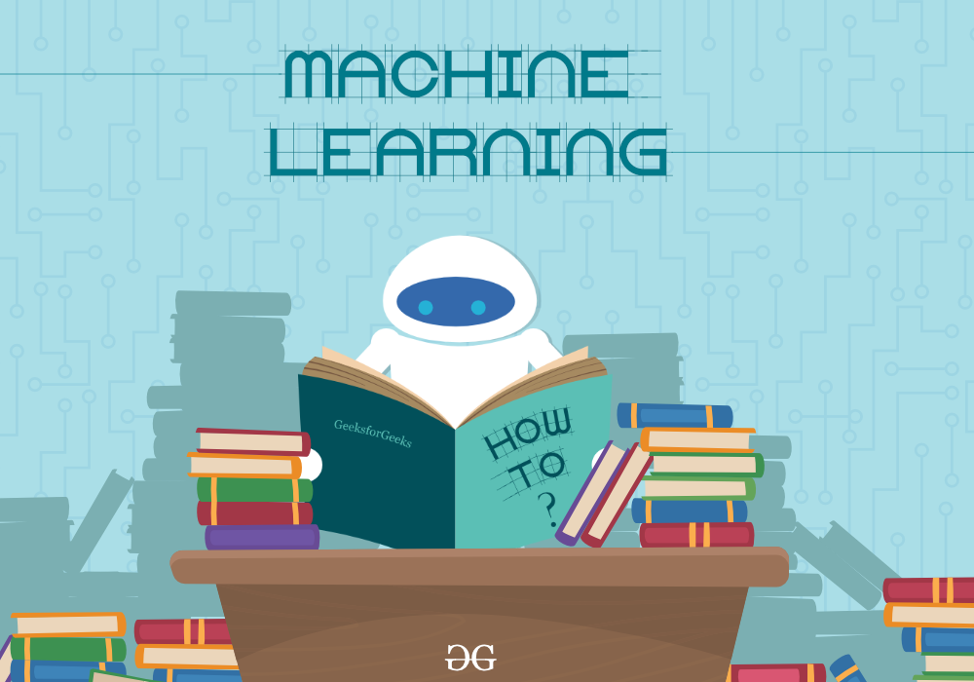




Applications

Slide 11
Optimal solutions – superior yet fragile

Slide 12
Sources of uncertainty
Forecasts
Measurement
Implementation

Slide 13
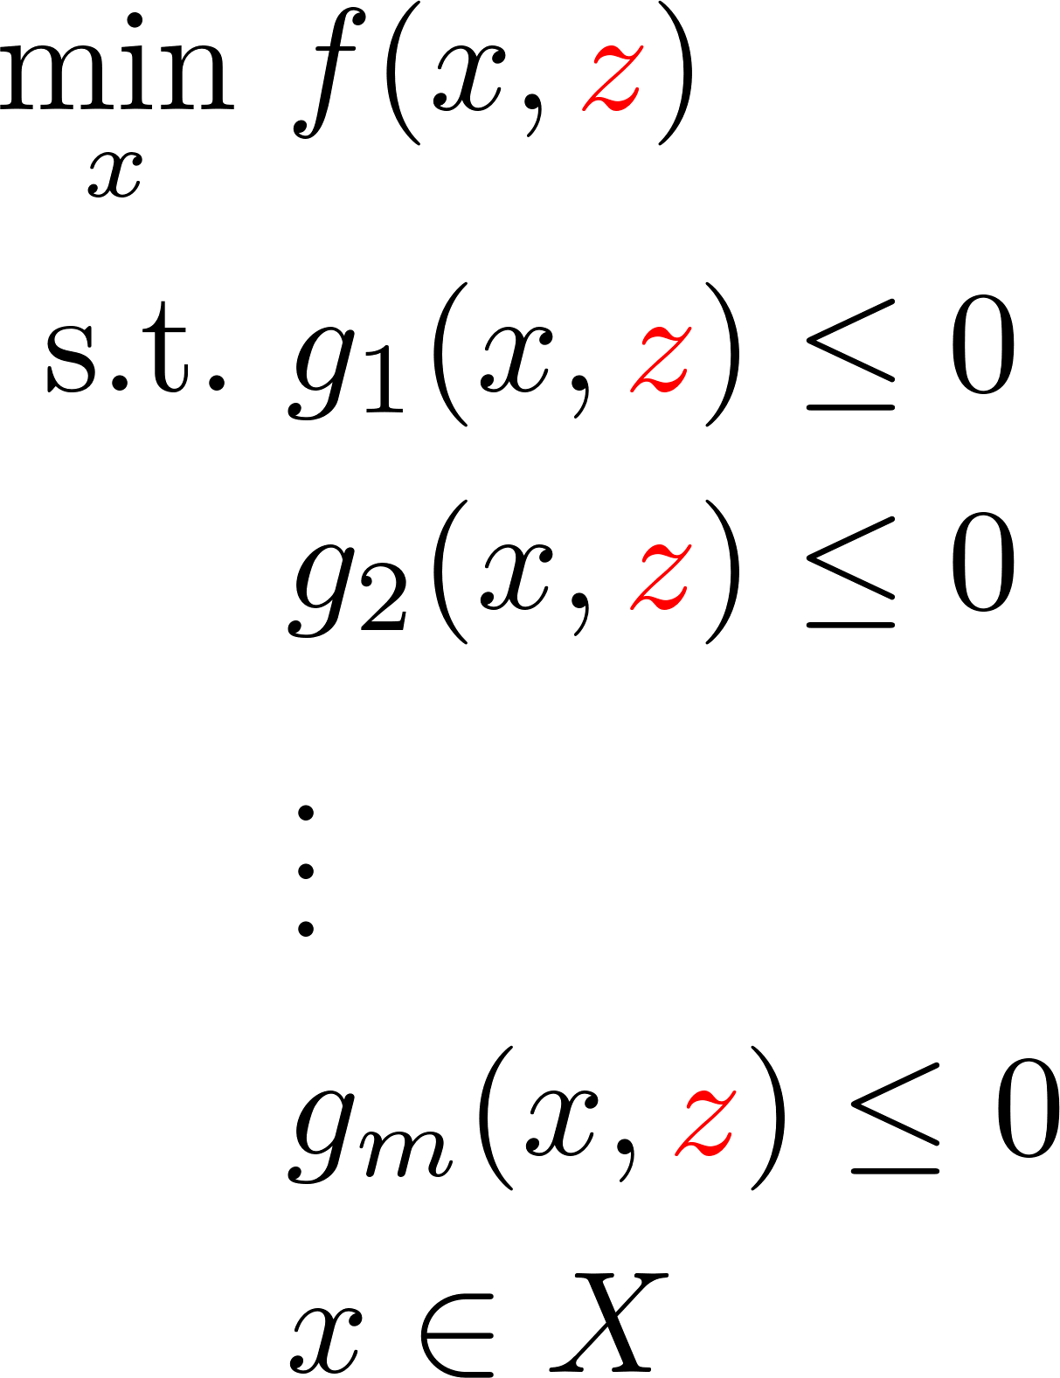
Uncertain model

Slide 14
What ML gets right and Optimization gets wrong

Slide 15
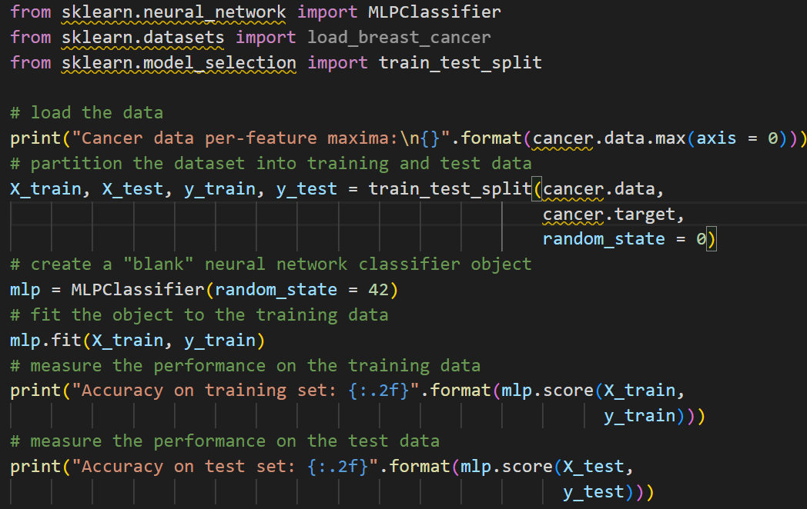

Slide 16
Out-of-sample performance
Solutions have to work on the data they will interact with, not the data they were fit to...

Slide 17
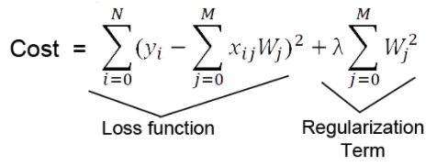
ML response: Loss function and regularizers

Slide 18


Uncertainty = World - Data

Slide 19
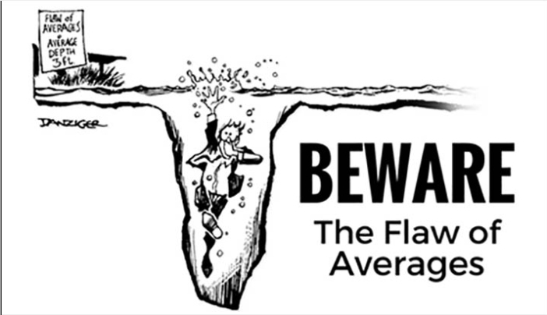
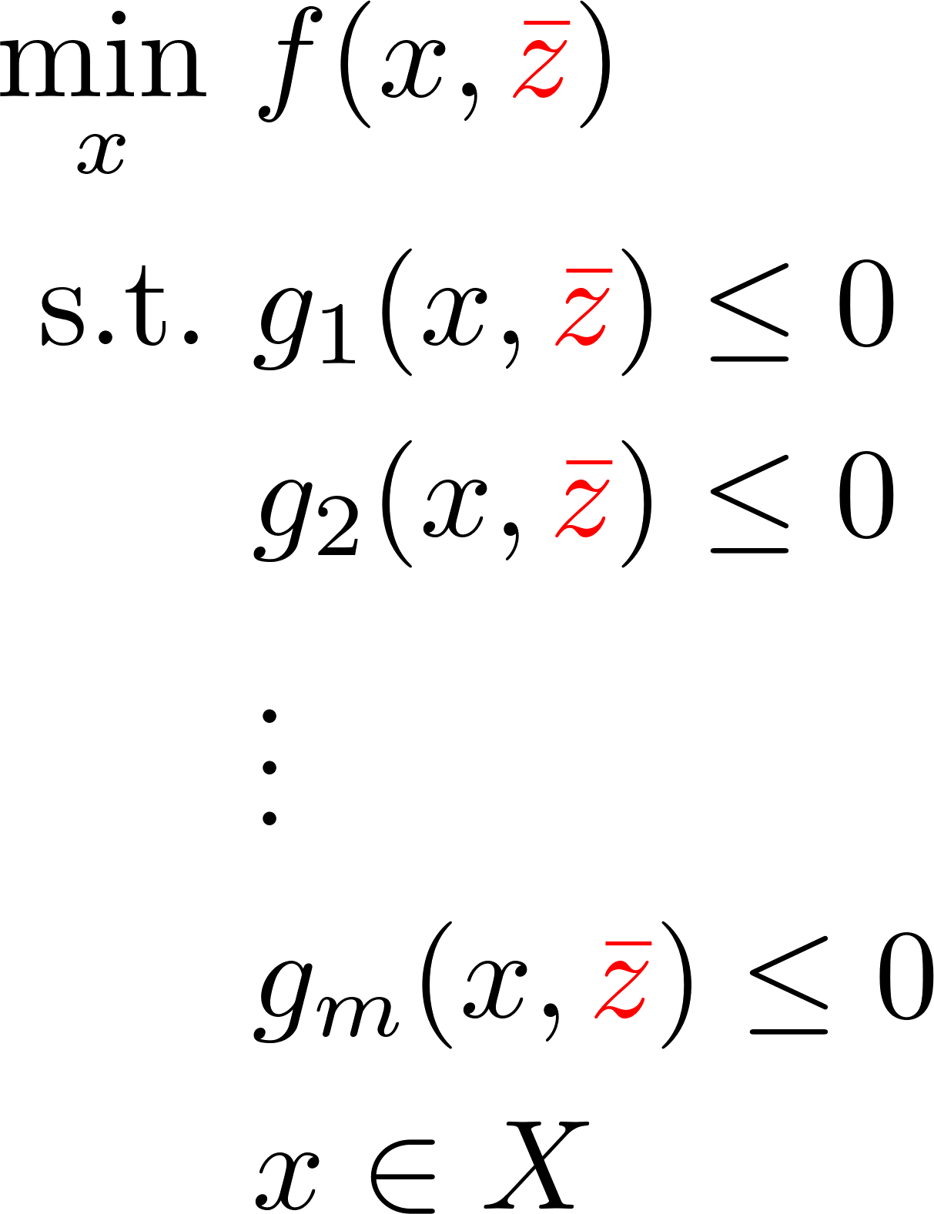

Optimization response 1: One value

Slide 20
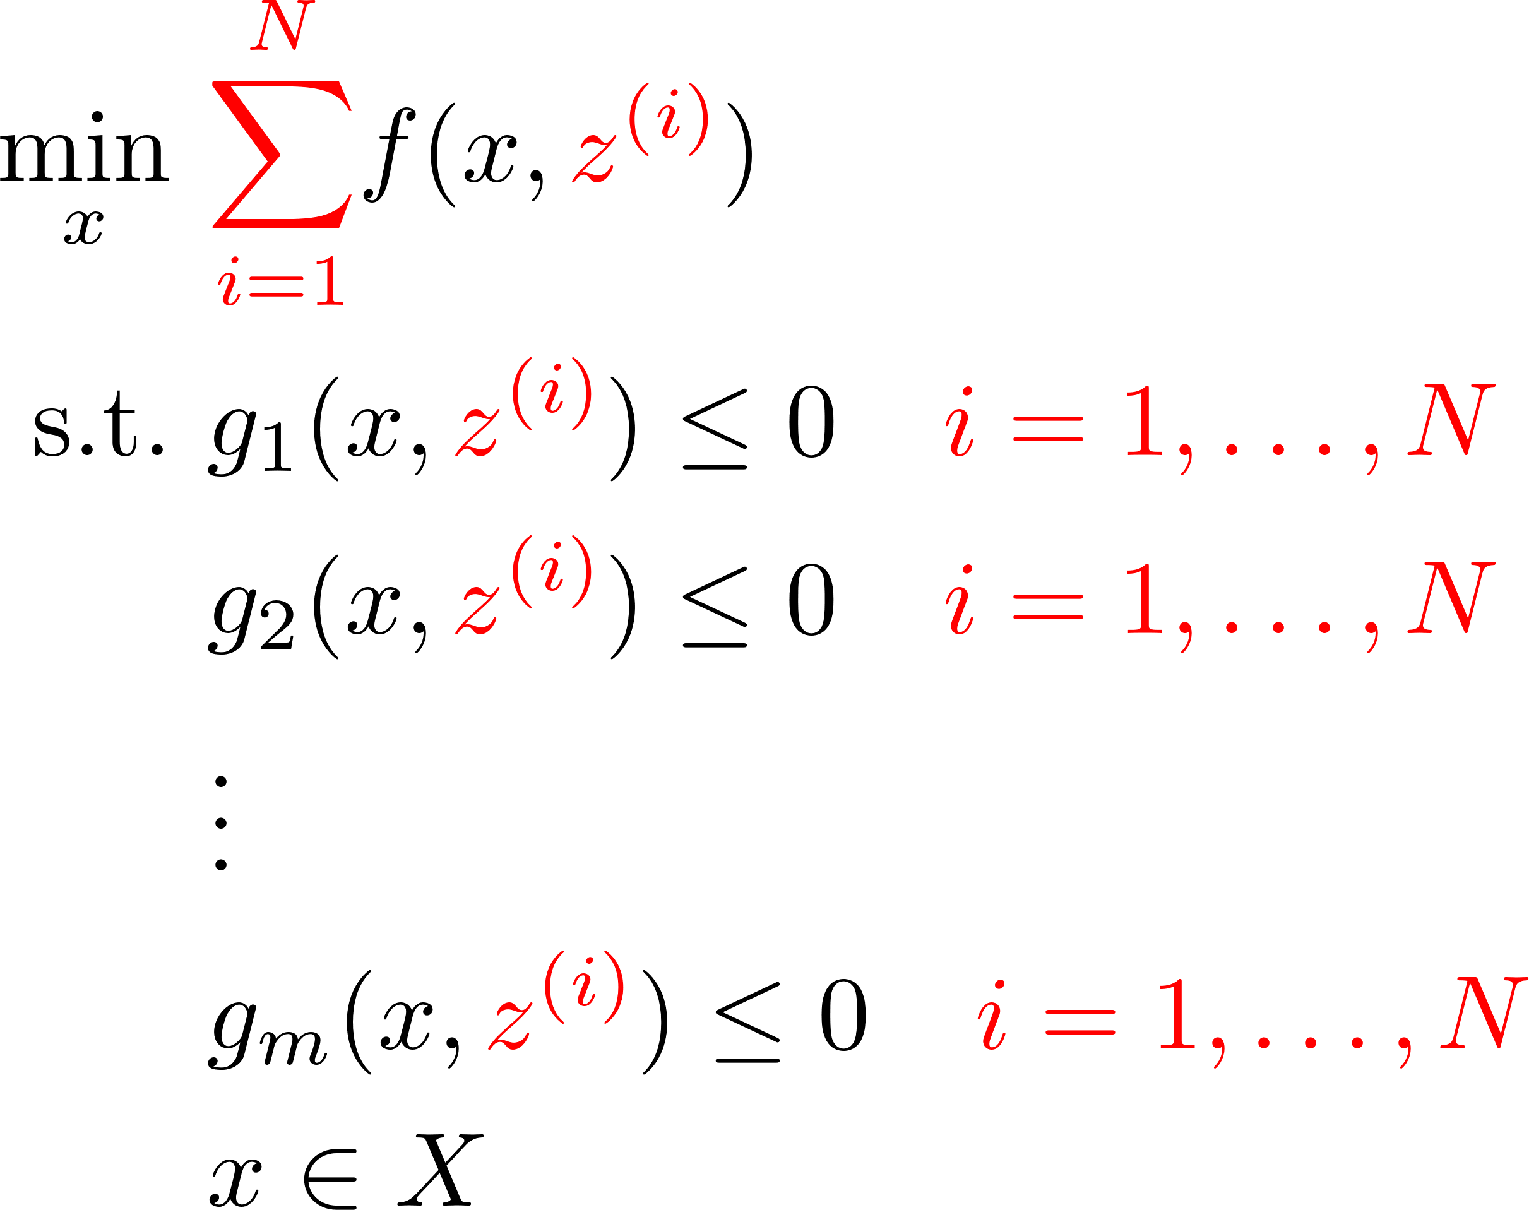
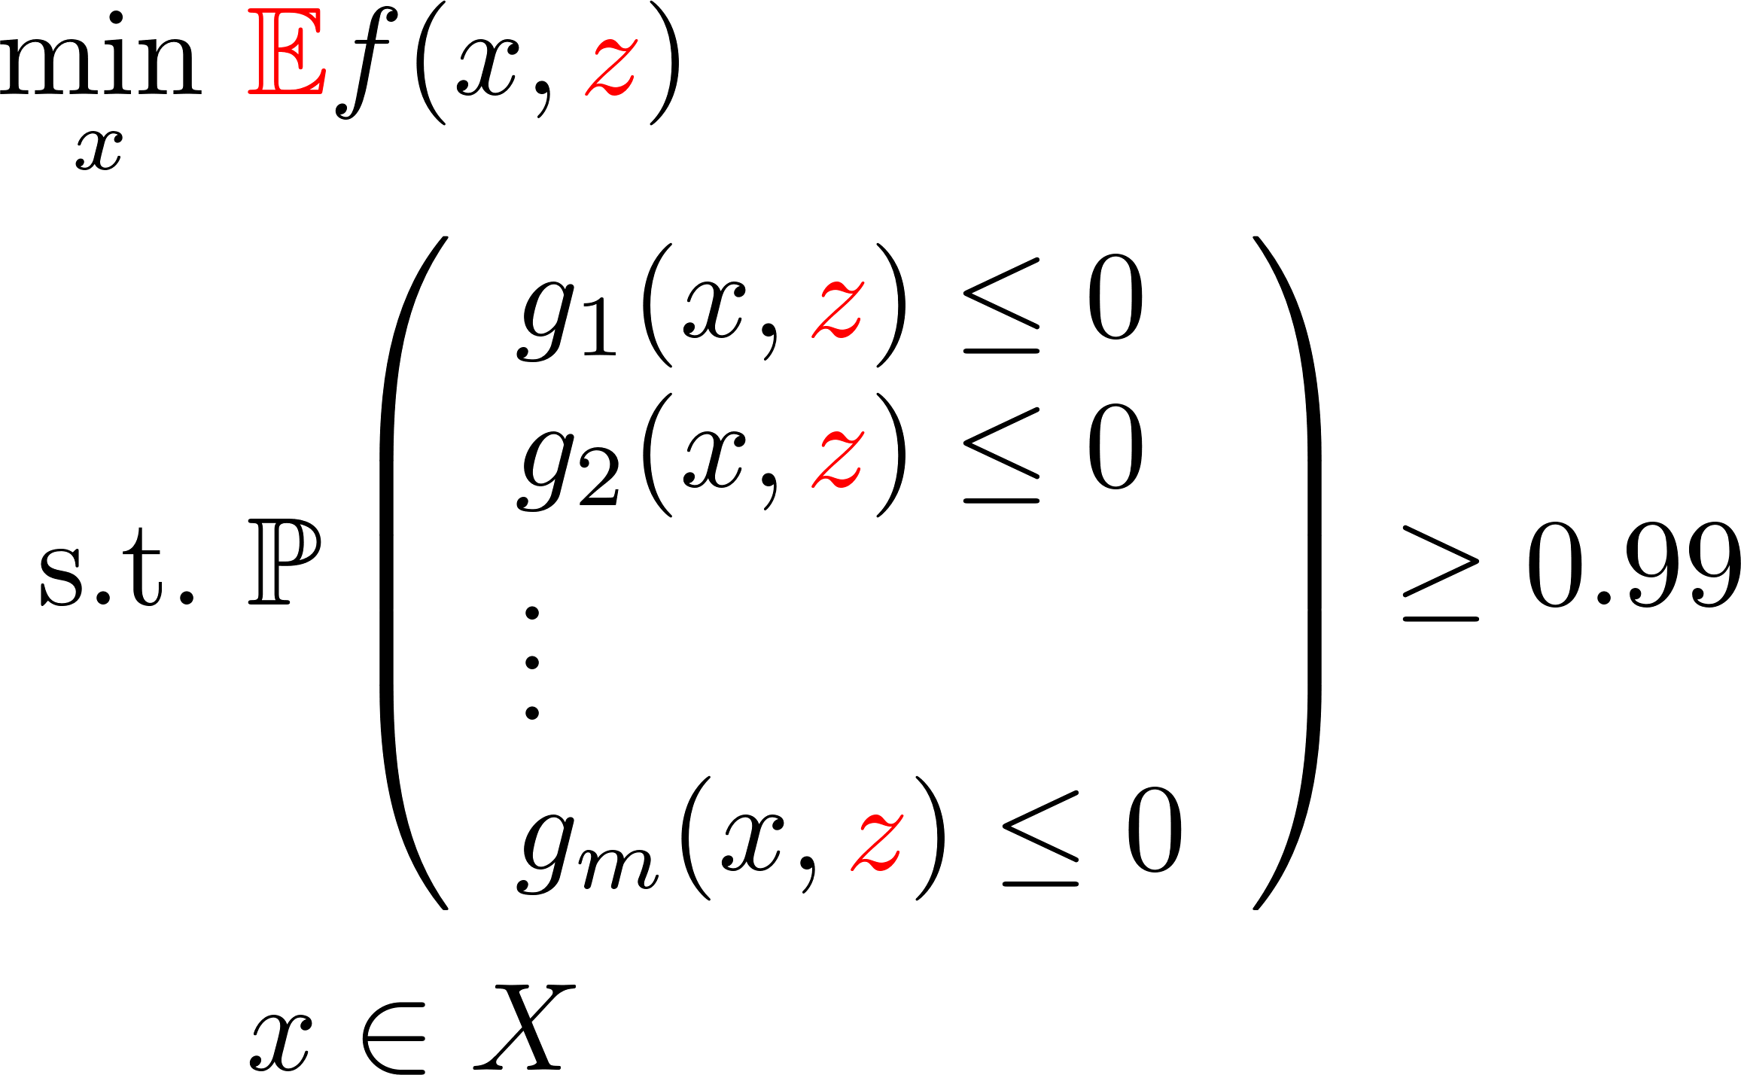
Optimization response 2: Avg performance

Slide 21

ROBUST OPTIMIZATION
OPTIMIZATION
REALITY

Slide 22
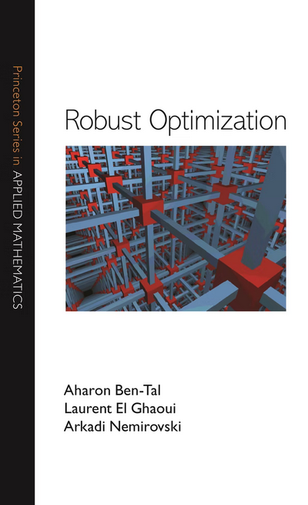
Robust Optimization (2009)

Slide 23
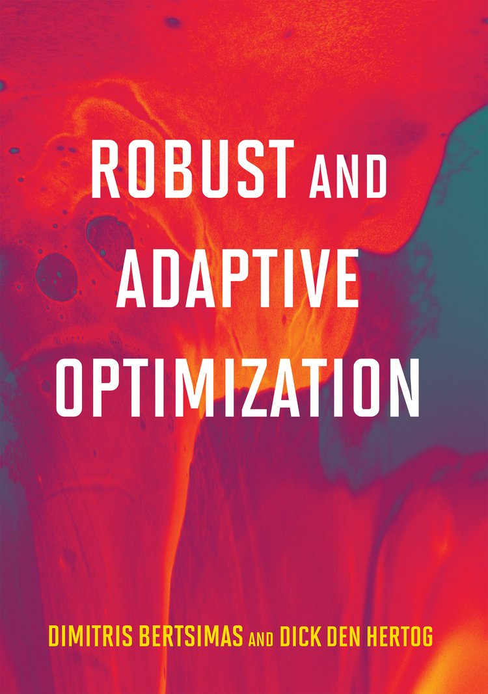
Robust and adaptive optimization (2022)

Slide 24
What do we do now? Modelling exercises
Start easy – let’s model three problems „without uncertainty” and discuss how to rest the robustness

