Slide 1
AIMMS Campus Robust optimization
Part 3: Adjustable robust optimization

Slide 2
Plan
Multi-stage optimization – ideas and difficulty
Four basic approaches
Case study: Unit commitment in energy planning
Exercises

Slide 3
Ideas

Slide 4





Single vs multi-stage

Slide 5

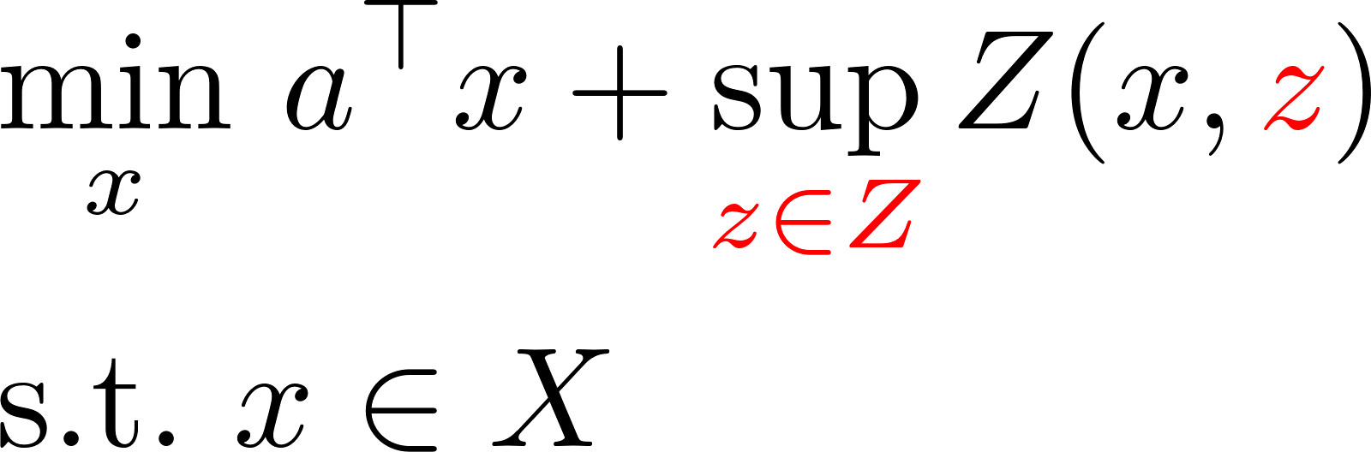

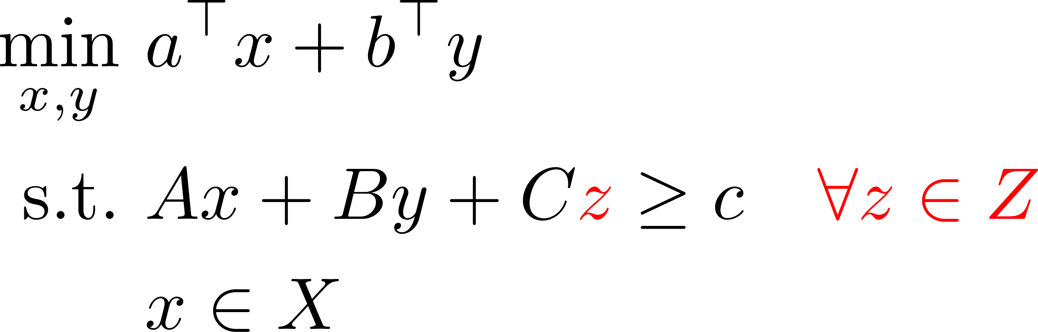
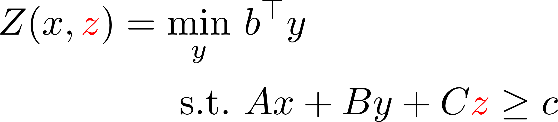
Two-stage optimization
The real thing
Naive formulation
where

Slide 6
Pros and cons of adaptivity
Less conservatism than static model
More feasibility
Here-and-now decisions that leave more slack for the future
Optimization problem straight from hell™
Black box?

Slide 7
Solution approaches

Slide 8
Inner and outer approaches
Inner: create „imperfect adaptivity” but maintain feasibility of the first decision
Outer: aim for „perfect adaptivity” but the first decision need not fully feasible

Slide 9
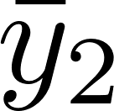
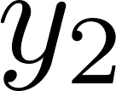


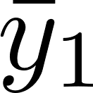
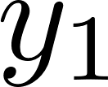

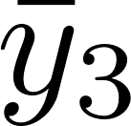
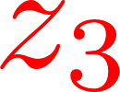
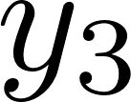
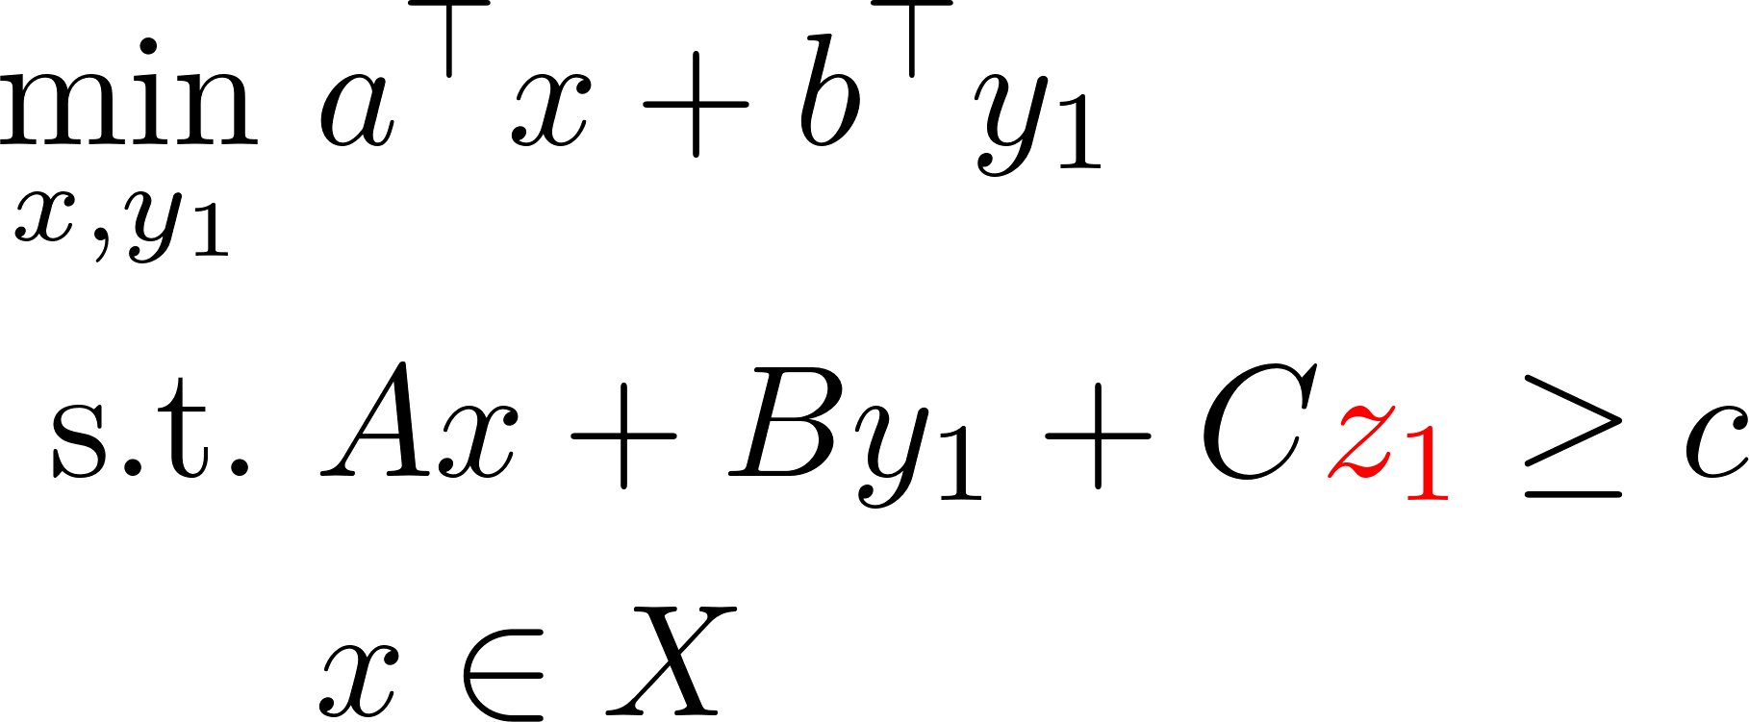
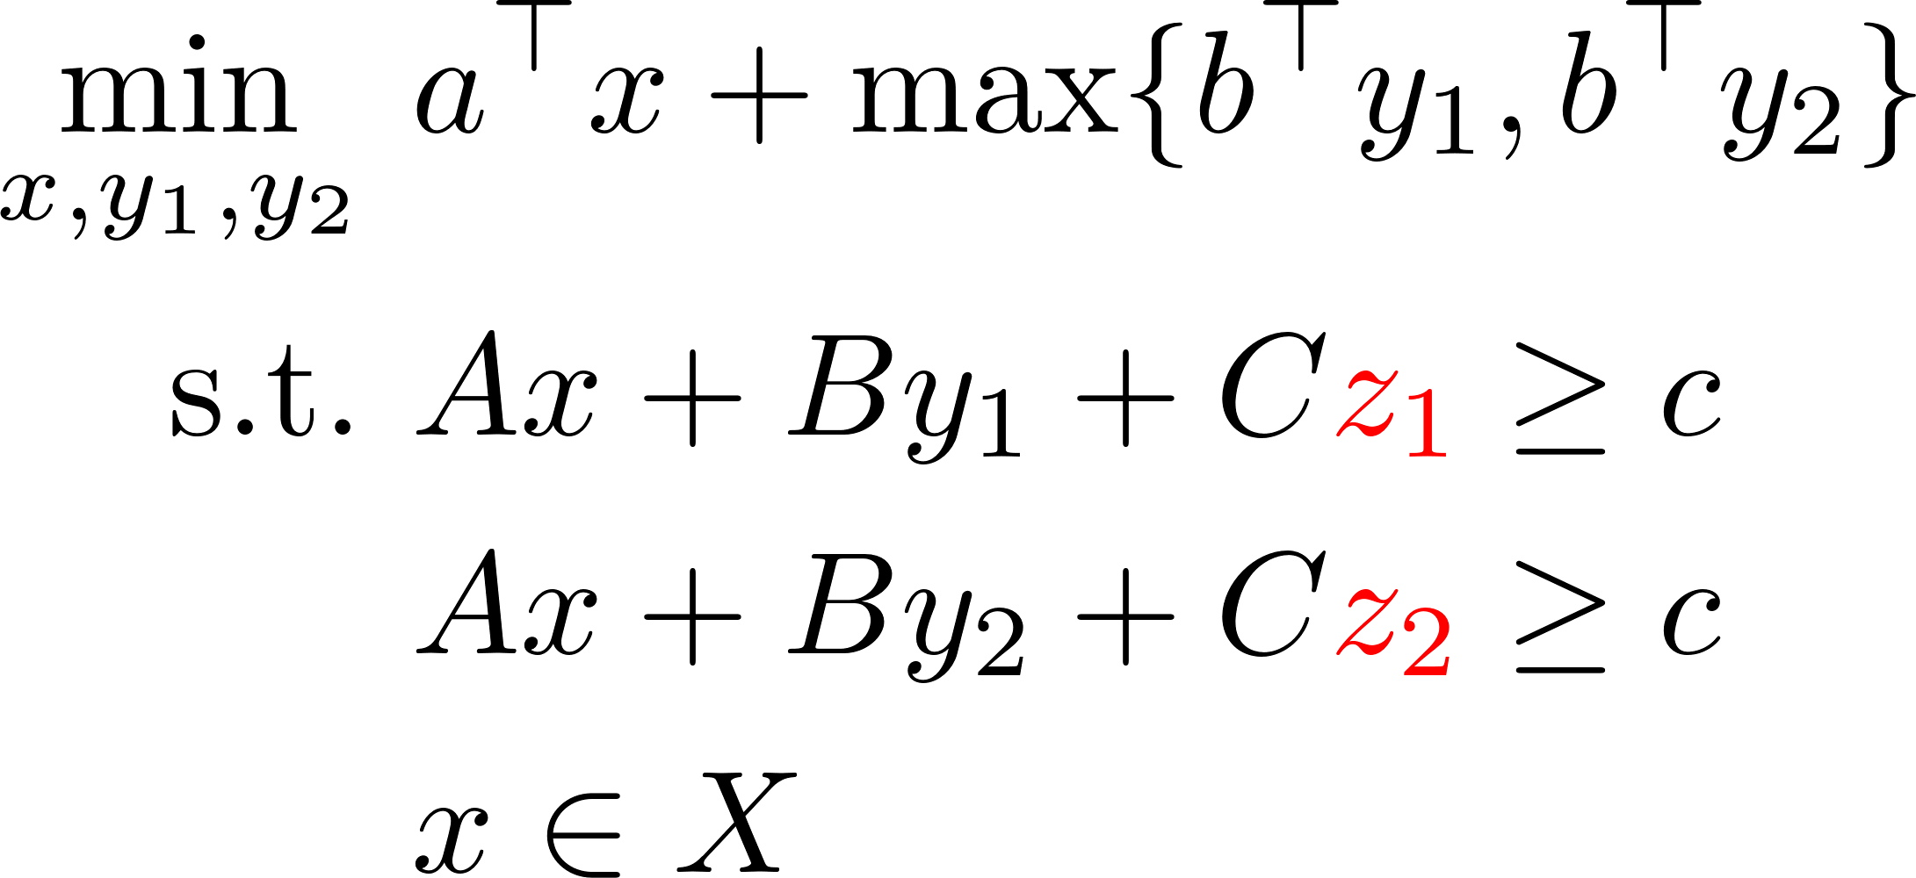
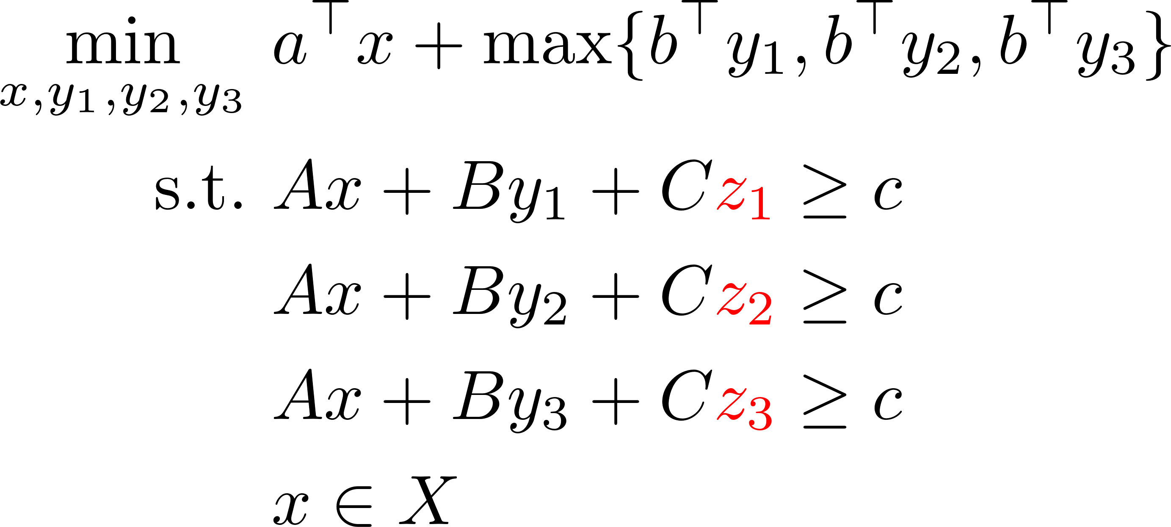
Outer solution approach 1: CCG

Slide 10

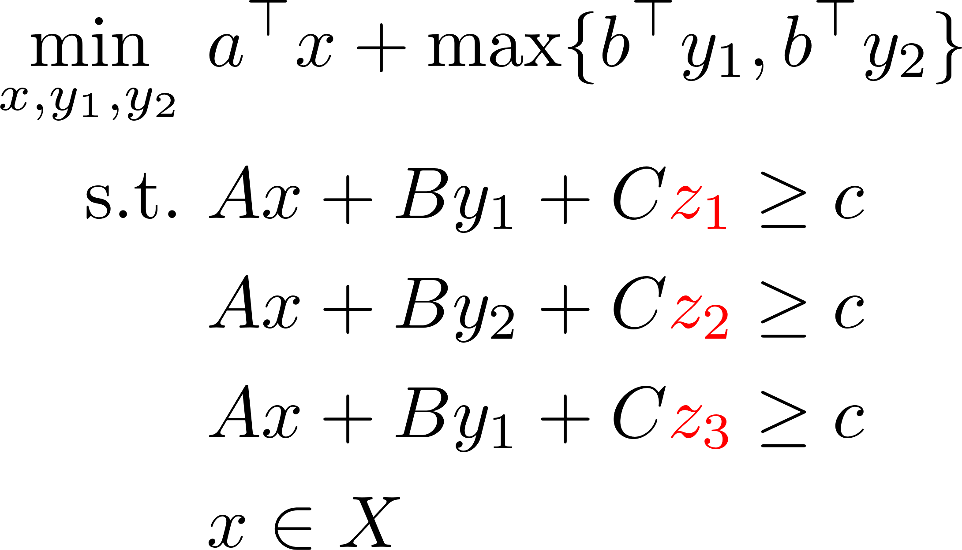

Outer solution approach 2: K-adaptability

Slide 11
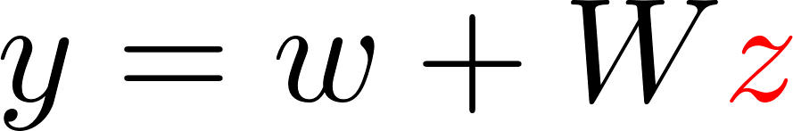
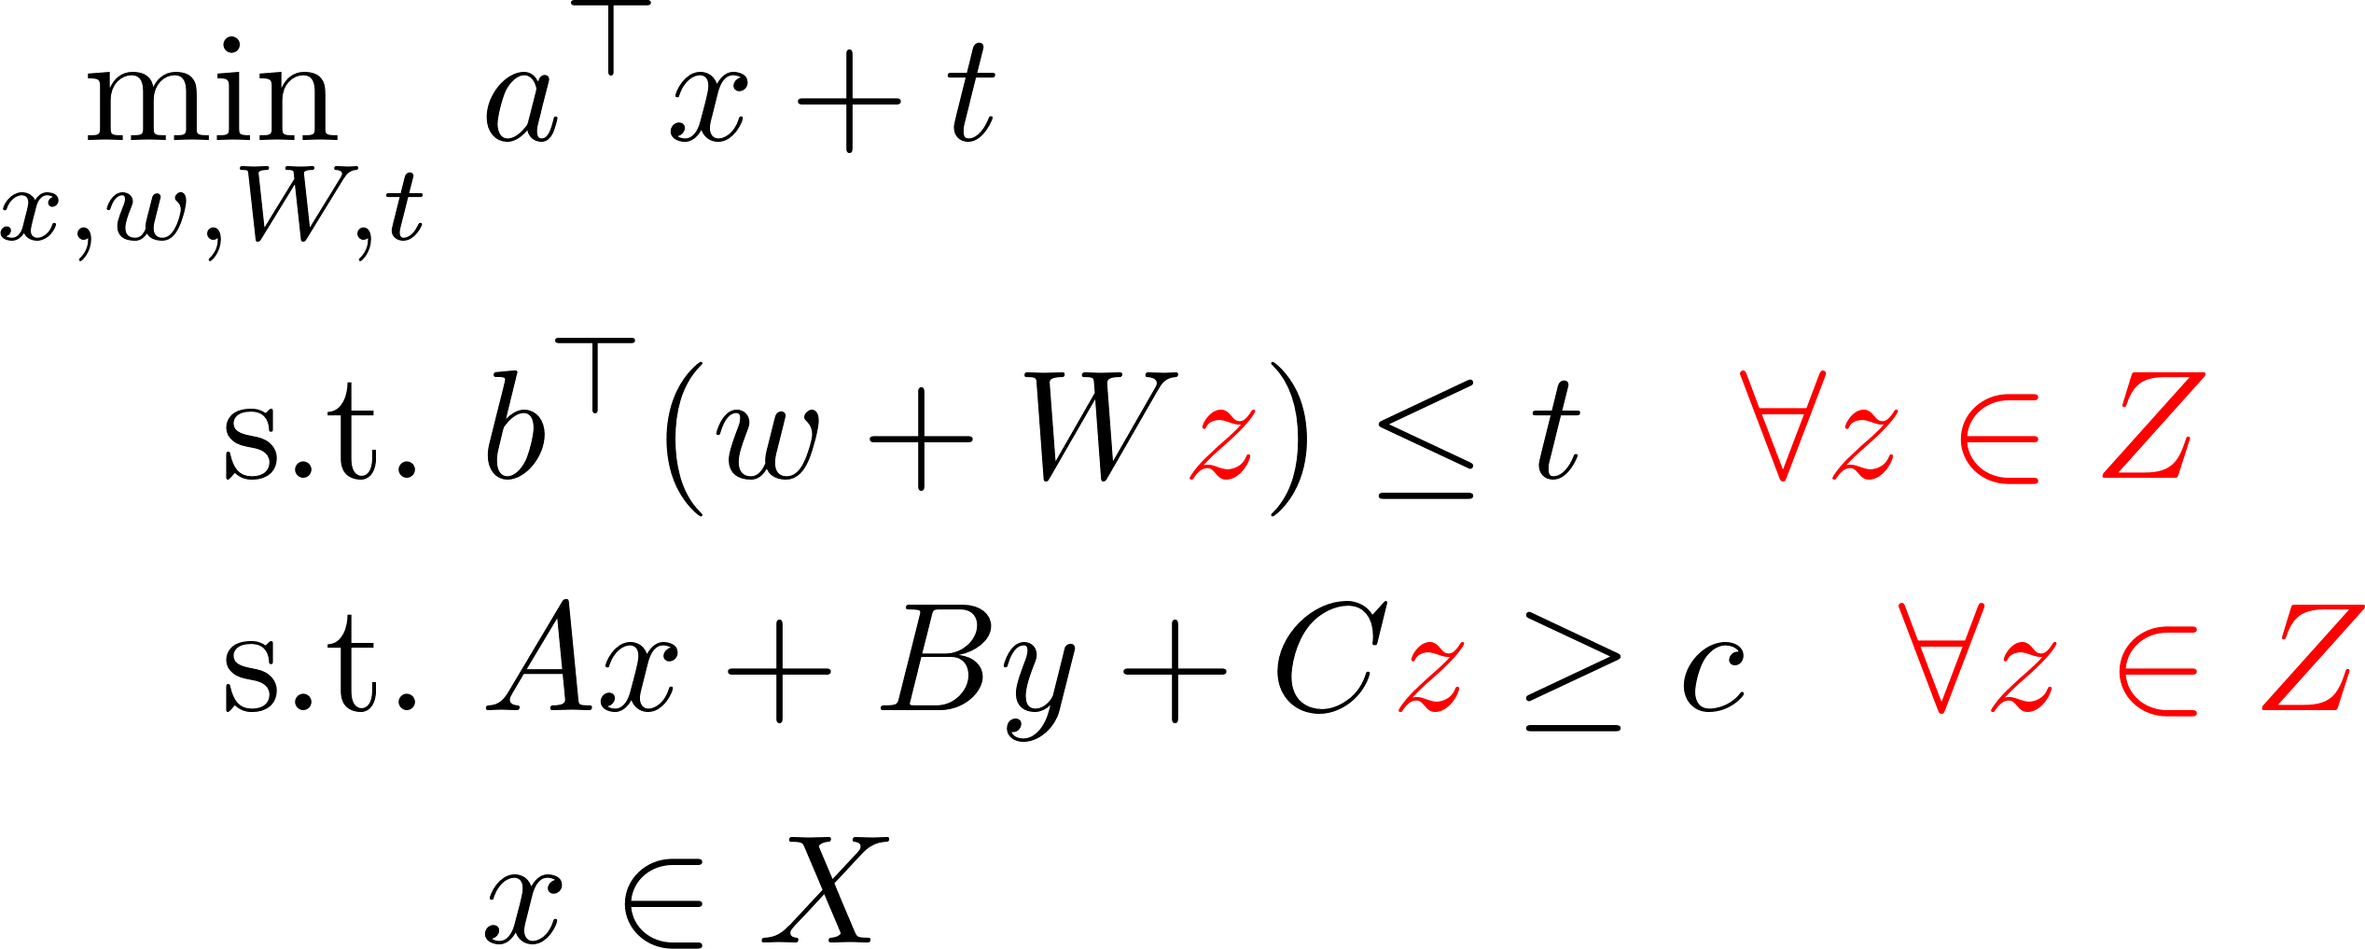
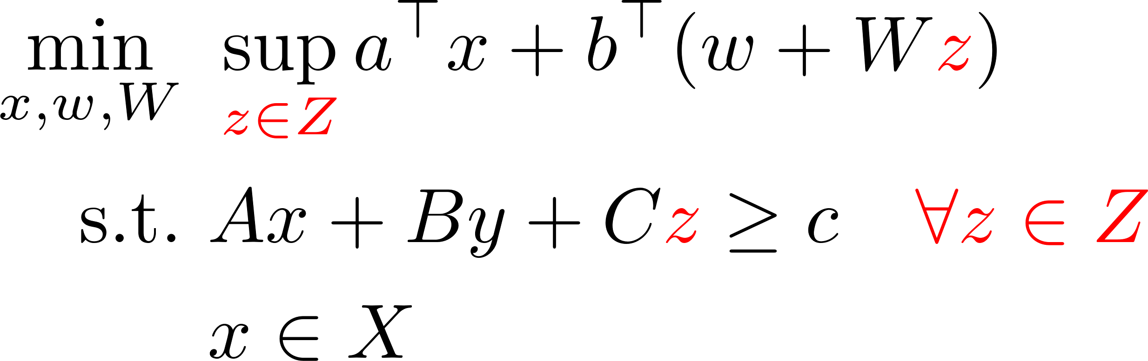
Inner approach 1: Linear Decision Rules

Slide 12

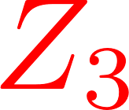



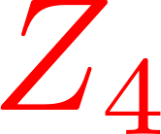
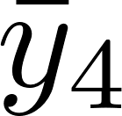
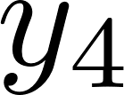
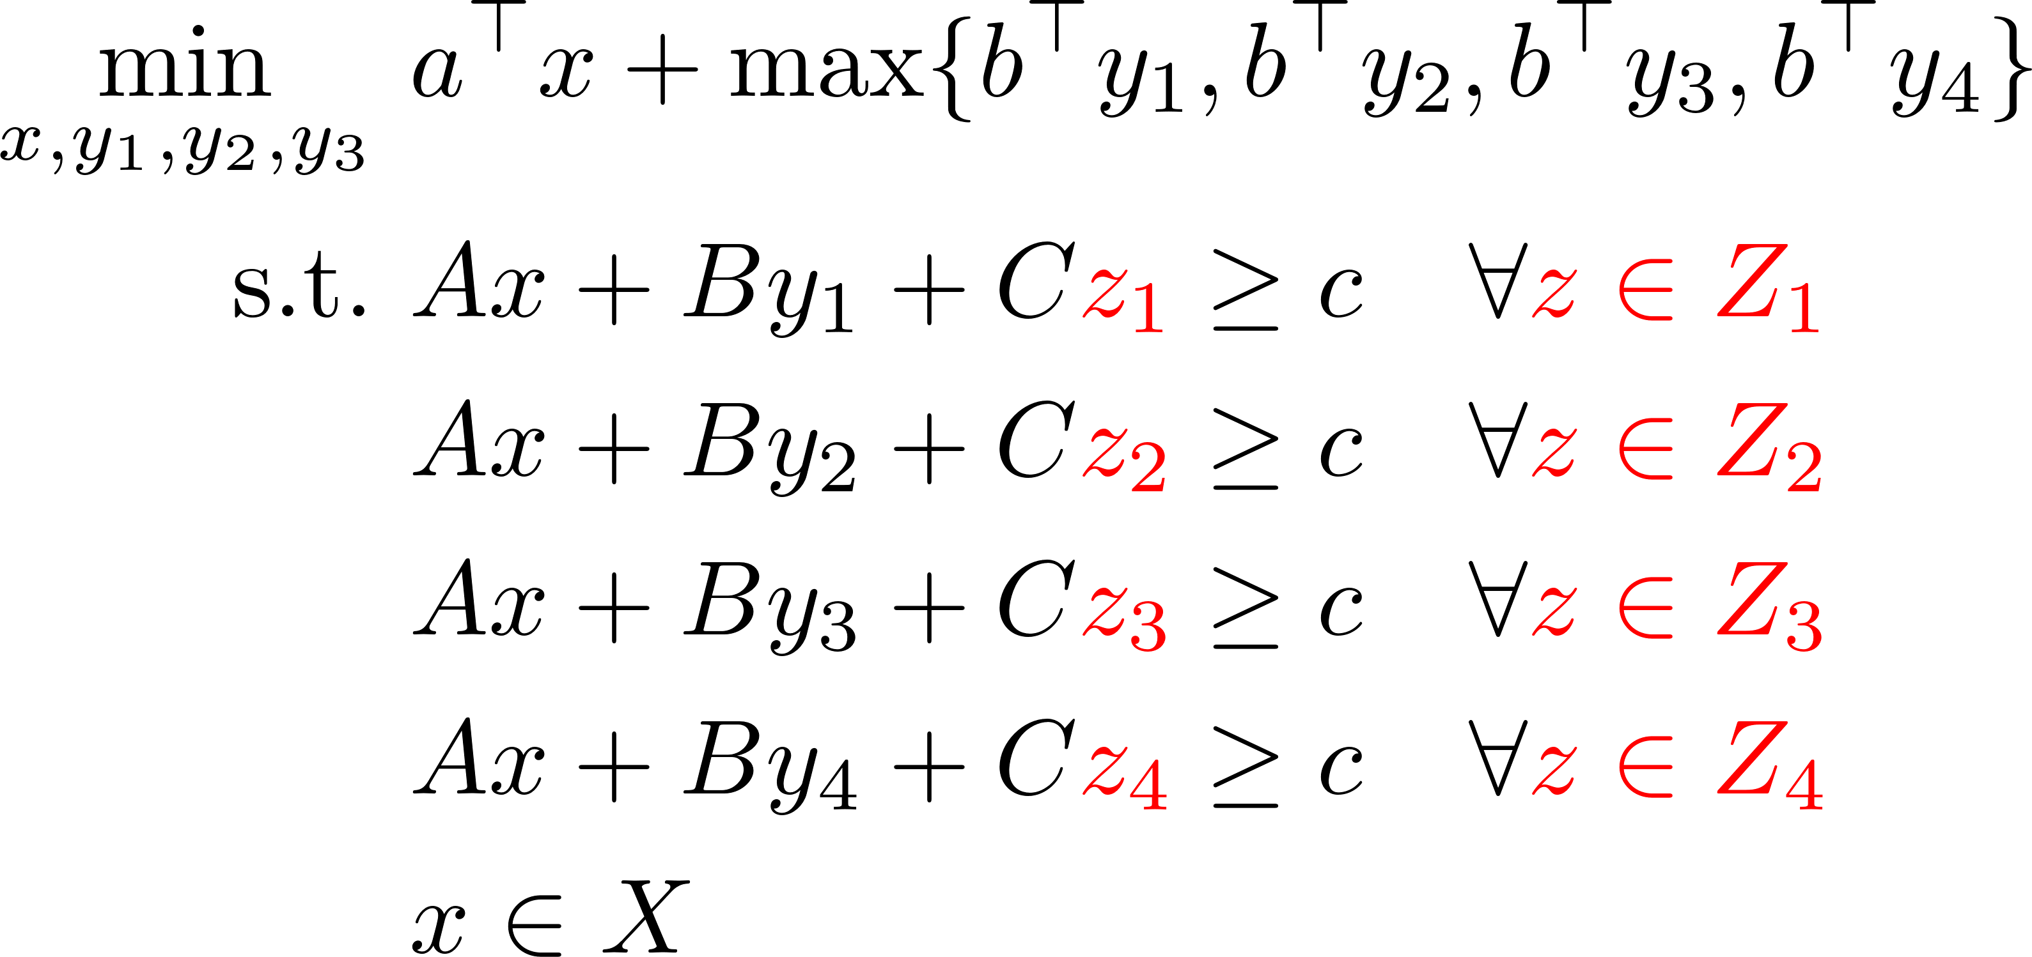
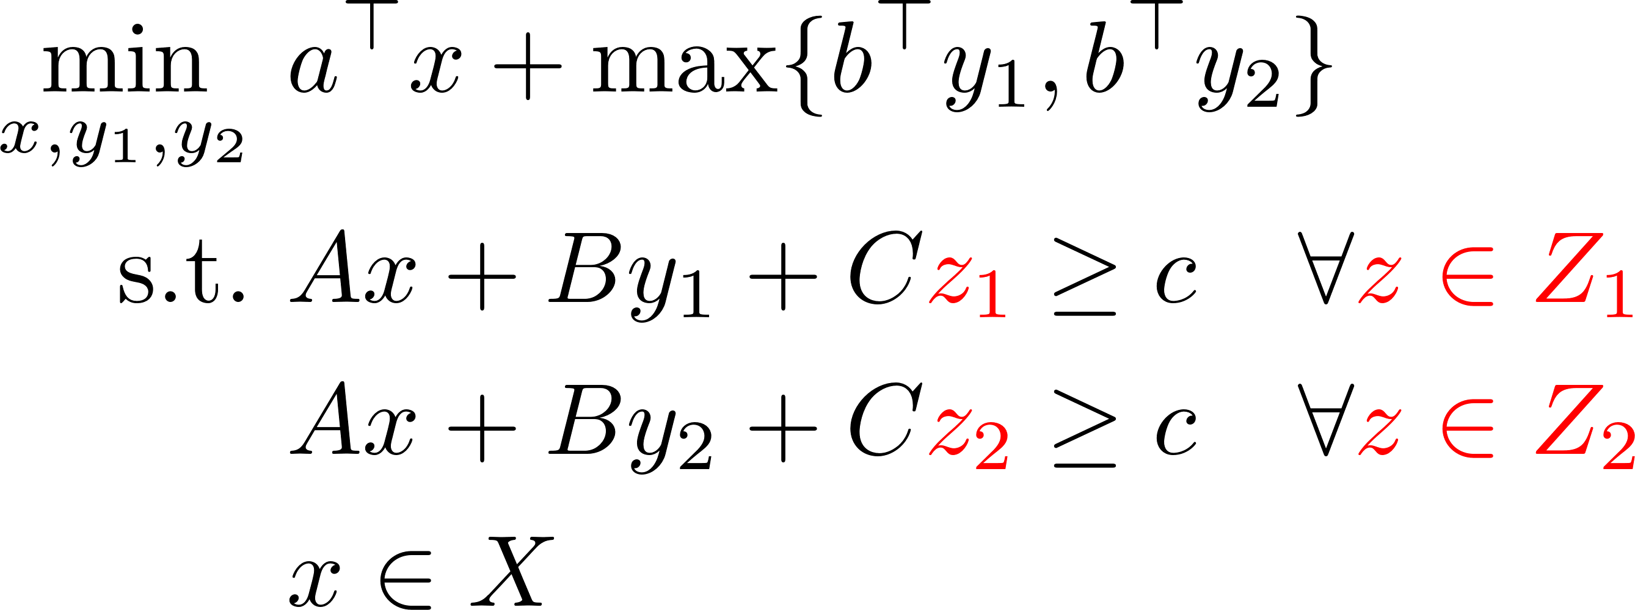
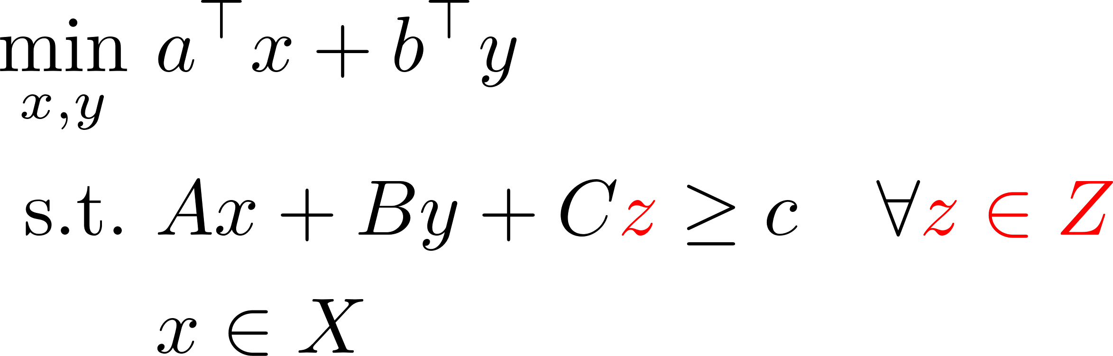
Inner solution approach 2: Adaptive Partitioning

Slide 13
Approaches – summary
 | Scalability | Guaranteed robust solution?
CCG | Up to a certain point | No
K-adaptability | No | No
Linear Decision rules | Yes | Yes
Adaptive Partitioning | Up to a certain point | Yes

Slide 14
Extension to multiple time stages

Slide 15
Case study: Unit commitment in energy planning
Courtesy of Dimitris Bertsimas (MIT)

Slide 16
Electric Power System Operations
Day-Ahead Decision Making: Unit Commitment
Generators must be committed before real-time operation (long startup time)
Info: Supply costs, load forecast
Decision: which units to commit
Goal: meet demand w. min cost
Constraints: physical, security
Info: Unit commit, realized load
Decision: generation level
Goal: min costs meet demand
Constraints: physical, security
Hour
-12
0
Day-ahead UC
Real-time Dispatch

Slide 17
Current practice: Deterministic UC with Reserve
Unit commitment logics
Start-up, shut-down
Min-up/down
Power balance
Ramping constraints
Power flow constraints
Reserve constraints

Slide 18
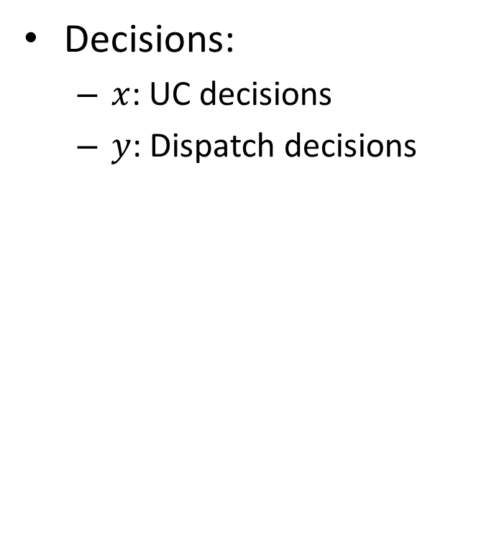
Current practice: MIO
Abstract formulation of UC:
Decisions:
$x$: UC decisions
$y$: Dispatch decisions
UC constraints
Dispatch constraints
Coupling constraints
Forecast demand

Slide 19
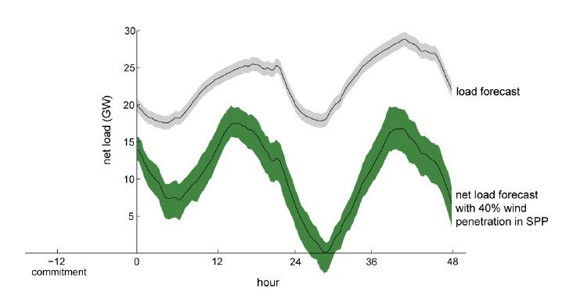
Challenges: Growing Uncertainty
Supply uncertainty (Renewables like wind and solar are growing fast)
Demand uncertainty

Slide 20
Current Practice: Reserve Adjustment
Deterministic Reserve adjustment approach
Incorporating extra resources called reserve
Drawbacks:
1. Uncertainty not explicitly modeled
2. Both system and locational requirement are preset,
heuristic, ad hoc

Slide 21
Stochastic Optimization
Stochastic optimization approach
Uncertainty modeled by distributions and scenarios
Weakness:
Hard to select “right” scenarios in large systems
The huge number of scenarios needed make the problem intractable for large scale problems.

Slide 22
Adaptive Robust Optimization
Two-stage robust optimization framework
Key Decision:
unit commit x (binary)
Such that:
under x, we have a dispatch policy p(d) satisfies all possible load d given in an uncertainty set with minimum cost.
hour
-12
0
Load/supply realization net load variation
Key Questions:
1. How to model uncertainty?
2. What is policy p(d)?

Slide 23
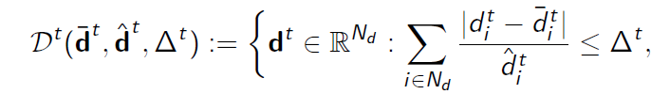

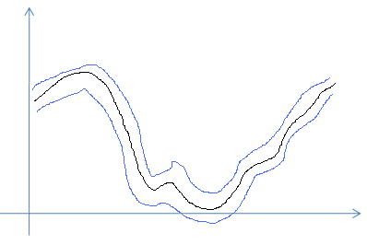
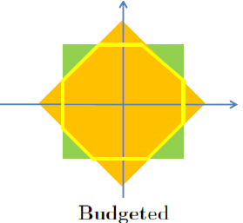

Model of Uncertainty
Uncertainty model of net load variation
t
hour

Slide 24

From Deterministic UC to Adaptive Robust UC
Deterministic UC
Adaptive robust UC
$\min_{x, y(⋅)}{c^{⊤}x+b^{⊤}y(d)}$
s.t. $Fx≤f$
$H\left(d\right)y≤h(d)$, $∀d∈D$
$Ax+By\left(d\right)≤g$, $∀d∈D$
$I_{u}y\left(d\right)=d$, $∀d∈D$
$x$ binary

Slide 25

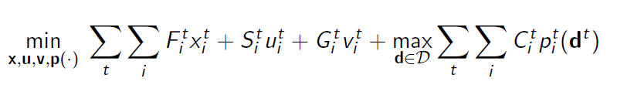
Decision Policy: Fully Adaptability
Dispatch solution fully adaptive to the uncertainty:
Subject to:
Commitment constraints: min-up/down times
Dispatch constraints:
Energy balance
Production bounds
Ramp up/down
Flow limits

Slide 26

Fully Adaptive Robust UC Problem
The fully adaptive policy:
Objective: Fixed-Cost + Worst case Dispatch Cost
Find worst
case d for
dispatch
For a fixed x, d minimize
dispatch cost
Constraints on commitment decision:
Startup/shutdown, Min-up/down…
Second-Stage Problem

Slide 27


Reformulation of the Second-Stage Problem
Dual of the dispatch problem $\min_{y∈Ω(x,d)}{b^{⊤}y}$
Equivalent reformulation of $\max_{d}{\min_{y}{b^{⊤}y}}$
$\min{b^{⊤}y}$
s.t. $Hy≤h$
$By≤g−Ax$
$I_{u}y=d$

Slide 28

Reformulation of the Second-Stage Problem
Second-Stage = Bilinear optimization
If optimal solution exists, then an extreme point is an optimal solution
Let $z_{1},…,z_{m}$ be all extreme points for $(φ,λ, η)$
Let $d_{1},…,d_{k}$ be all extreme points of $D$
Extreme point representation of Second-Stage:

Slide 29

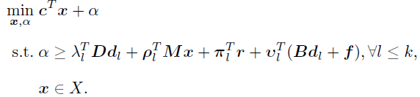

Overall Algorithm
Initialization: Get feasible , solve for dual var.
Iteration k:
Step 1:
Step 2: to generate cuts
If $U−L$ small enough, stop and return
otherwise k=k+1

Slide 30

Inner Level Algorithm: Outer Approximation (OA)
Initialization: Fix $x_{k}$ from outer level. Find initial $d_{1}∈D$
Iteration $j$:
Step 1: Solve OA subproblem $S(x_{k},d_{j})$
Let $(φ_{j},λ_{j},η_{j})$ be optimal solution
$L^{OA}=S\left(x_{k},d_{j}\right)$. Define linearization
Step 2: Solve OA master problem:

Slide 31
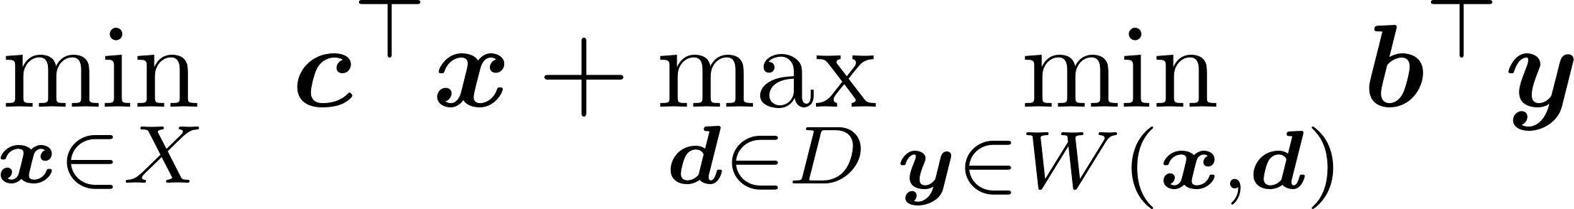
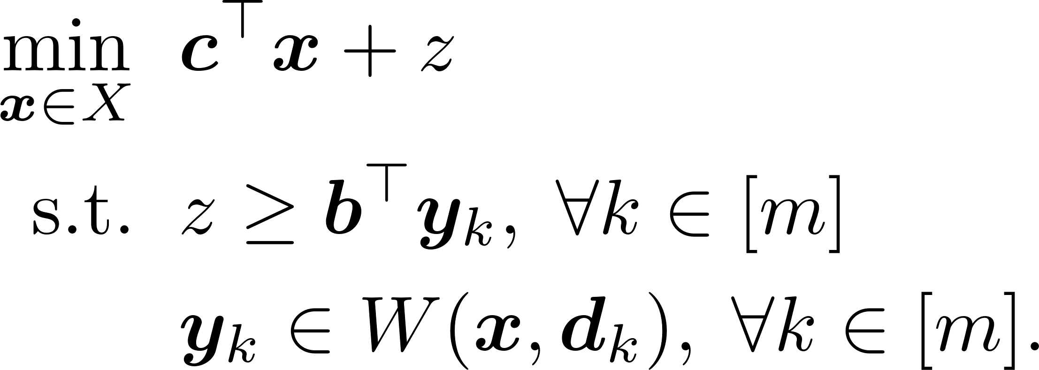

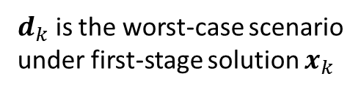
A Faster Algorithm
Also called Column-Constraint Generation (CCG)
Iteration $m$:
CCG is much more efficient than
Benders decomposition
$d_{k}$ is the worst-case scenario
under first-stage solution $x_{k}$
Independently proposed in Bertsimas, Litvinov, Sun, Zhao, Zheng (2013)
and Zeng Zhao (2013)

Slide 32
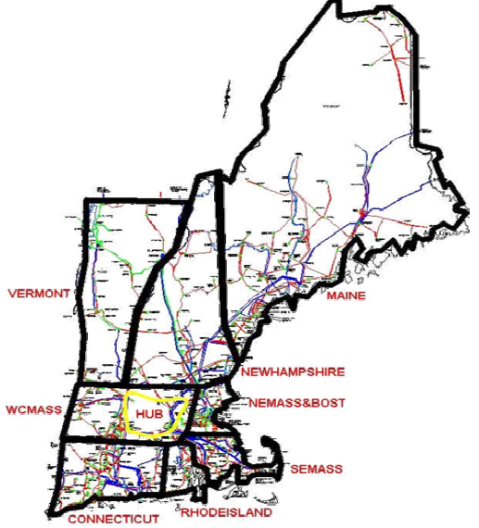
A Real-World Example: ISO-NE Power System
312 Generators
174 Loads
2816 Nodes
4 representative trans lines
24-hr data: gen/load/reserve
Total gen cap: 31.4GW
Total forecast load: 14.1GW

Slide 33


Computation Procedure and Measures
Solve AdptRob and ResAdj UC solutions for
= 0, 0.1Nd,…,Nd for all t.
Fix UC solutions, simulate dispatch over load samples
1000 load samples from
Compute average dispatch cost and std.
Avg dispatch cost: Economic efficiency
Standard deviation: Price and Operation Stability
Robustness to distributions

Slide 34
Computational Results (I-a): Average dispatch cost
2.7% relative saving or 472.9k$
Avg Dispatch Cost Relative Saving := (ResAdj – AdptRob)/ResAdj
0.65% - 2.7%

Slide 35


Design using Probability Law: Average dispatch cost
Design the uncertainty set
By probability law: CLT
Relative Saving: 1.86% to 6.96%
Absolute Saving: $321.2k to $1.27Million
vs

Slide 36
Computational Results (III): Robustness to Distribution
Relative difference: 0.0368% - 0.0920%
Absolute difference: $6.3k – $15.8k

Slide 37
Computational Results: Robustness to Distribution
Relative difference: 1.00% - 2.19%
Absolute difference: $174.4k – $382.2k

Slide 38
Concluding Remarks
Economic Efficiency
saves dispatch cost
( 6.92% $1.27M)
Reduces Price & System Operation Volatility
Significantly reduces
cost volatility
robust against
load distributions
Data Driven Approach
Demand Modeling
Reference: Adaptive Robust Optimization for Security Constrained Unit Commitment
Problems, D. Bertsimas, E. Litvinov, A. Sun, J. Zhao, T. Zheng,
IEEE Transactions on Power Systems 2012

Slide 39
Key takeaways
Solutions to optimization problems might be sensitive to data
Make the model include robustness, without making it too big
So that the average performance of the solution gets better
Realistic goal: add a minimum level of robustness needed to avoid disastrous scenarios
Analogy: regularization in ML for better out-of-sample performance

Slide 40
Exercises

